Slide 1


Project Quality
Management
Prepared by Dr. Ehab Mahmoud
PMG 354
Quality Auditing
Lecture 02

Slide 2



Project Quality
Management
Lecture 2
PMG354
Quality Auditing
Prepared by
Dr. Ehab Mahmoud

Slide 3

Lecture
Objectives
02
At the end of this lecture, we expect to acquire a knowledge about one of the most effective quality assurance tools by which all project phases can effectively implemented and gain the intended outcomes.

Slide 4

Lecture
Contents
02
What does AUDIT mean ?
Types of Audit
Auditing Principles
Auditor Attributes
Stages of Audit
Audit Planning
Audit Preparation
Conducting the Audit
Generate the Audit Finding
Reporting the Audit

Slide 5
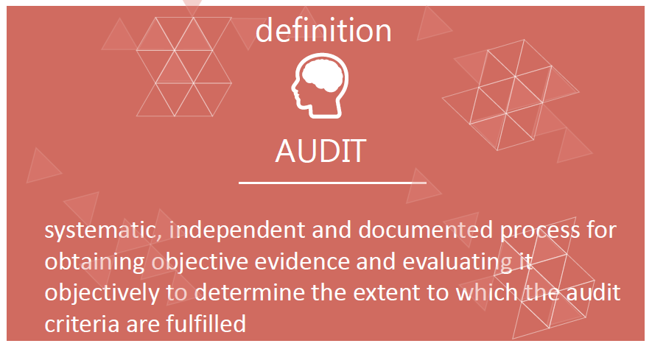
Lecture
What does AUDIT mean ?
02

Slide 6
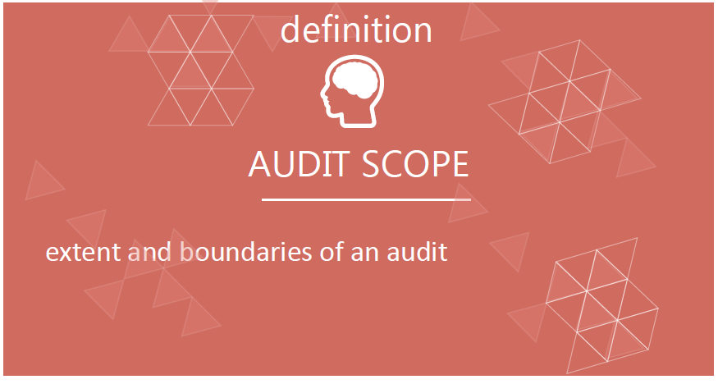
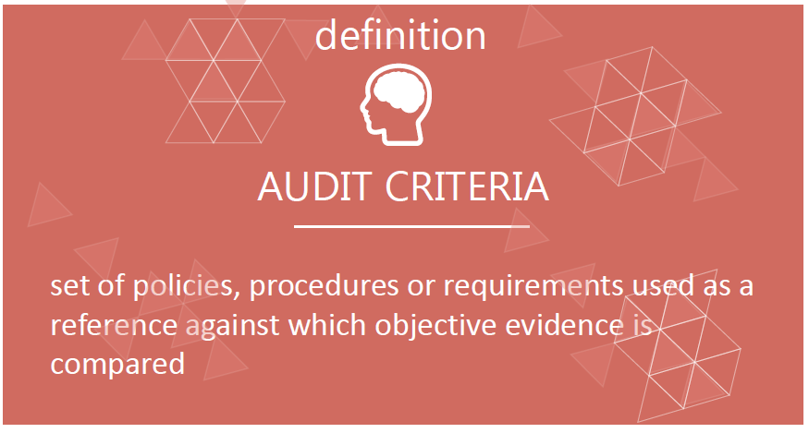
Lecture
What does AUDIT mean ?
02

Slide 7
Lecture
Types of Audit
02
Internal auditing | External auditing
 | Supplier auditing | Third party auditing
Sometimes called first party audit | Sometimes called second party | For legal, regulatory purposes

Slide 8
Lecture
Types of Audit
02
Customers
2nd Party
Customer audit on Your Organization
3rd Party
Independent audit Organization
Organization
Types of Audit
External
Internal
1st Party
Audit your own Organization
2nd Party
You audit Your Supplier
Supplier

Slide 9
Auditing Principles
Integrity
Impartiality
Fair Presentation
Due professional care
Confidentiality
Independence
Evidence-based approach

Slide 10
Lecture
Auditor Attributes
02
Professional Attributes of Auditors
Education
Professional Attributes
Training
Work and Auditing experience

Slide 11
Lecture
Auditor Attributes
02
Personal Attributes of Auditors
- Ethical
-Open minded
-Diplomatic
Personal Attributes
-Observant
-Versatile
-Self-reliant
-Decisive

Slide 12
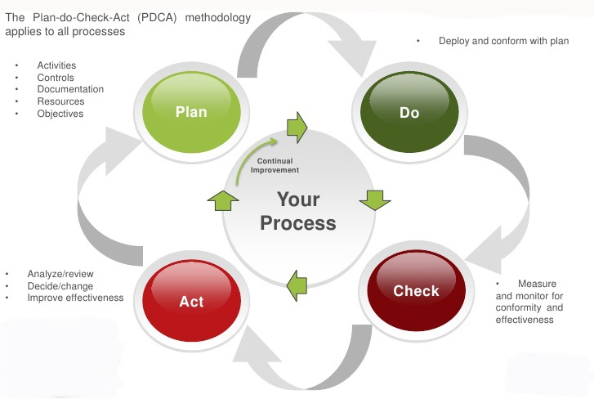
Lecture
Stages of Audit
02

Slide 13
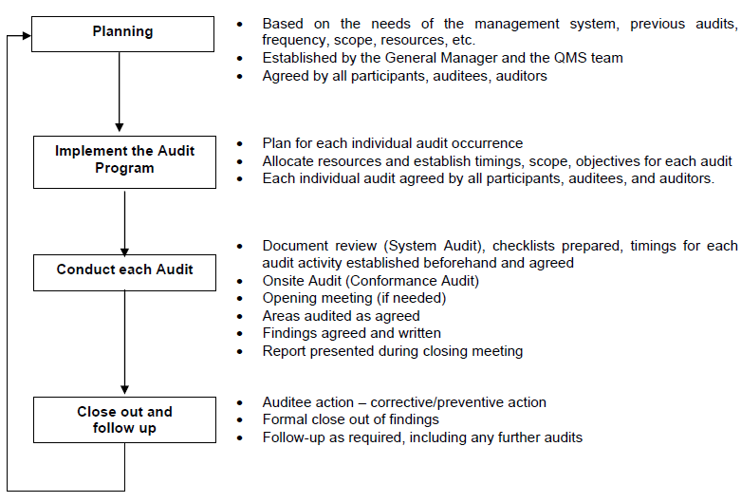
Lecture
Stages of Audit
02

Slide 14

Audit Planning
Lecture
02

Slide 15
Planning for the Audit
Lecture
02
 | Audit Program | Audit plan
Definition | An approved document that shows one or more audits that will be conducted at a certain period | An approved document that shows the detailed audit activities
Objectives | It shows the overall planning for upcoming audit activities along the project period | It shows the activities of each audit process and related tasks
Major elements | Processes being audited Audit frequency | Audit Objectives Audit Scope Audit Criteria Description of tasks Duration of each task Responsibilities

Slide 16

Audit Frequency depends on…..
Lecture
02
Significant change in management, organization, policy, techniques, or technology
Requests by the customer or regulatory body
Status and importance - internal audit results
Results of recent audits
Changes to the system

Slide 17
Audit Preparation
Lecture
02

Slide 18

Audit Preparation
Lecture
02
Establishing a Checklist
It is a memory aid

Slide 19
Audit Preparation
Lecture
02
Advantages
Disadvantages
Defines a formal audit process
Helps maintain the pace of audit
Keeps audit objectives clear
Serves as an audit record
Reduces workload on auditor during audit
Assures auditee of auditor professionalism.
Provide space for audit notes
Can become a tick list
May be full of yes-no questions
If not on checklist, will not look at area
May stifle initiative and process analysis
Audit
Checklist

Slide 20
Conducting the audit
Lecture
02

Slide 21
Conducting on site Audit Activity
Lecture
02
1
Conducting the opening meeting
2
Defining roles &responsibilities of audit participants
5
Communicating during the audit
3
6
Generating audit findings
Collecting and verifying information
4
7
Conducting the closing
Meeting
Preparing audit conclusions

Slide 22



Conducting on site Audit Activity
Lecture
02
1
2
3
Auditor Communication Skills
The Audit Interview
Questioning Techniques

Slide 23
Conducting on site Audit Activity
Lecture
02
Auditor Communication Skills
Reflect right attitude
Turn your own problems
Put auditee at ease
Ask and listen
Ask short questions
Show interest in what people want say
Be tactful and polite
Watch body language
Show patience
Smile and show eye contact
Avoid interruptions and contradictions
Remember to say please
Ask the right person
Give praise when appropriate

Slide 24

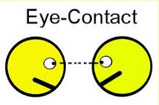

Conducting on site Audit Activity
Lecture
02
The Audit Interview
The best are those who say the least and have an ability to listen or hear what is being said
right kind of attitude and tone,
eye contact, along with small verbal acknowledgements,
thank auditee for their help and time, regardless whether it was beneficial or otherwise.

Slide 25
Conducting on site Audit Activity
Lecture
02
Questioning Techniques
Open question
Questioning Techniques
Non-verbal questions
Repetitive questions
Hypothetical questions
Closed questions

Slide 26

Conducting on site Audit Activity
Lecture
02
Now time has come for
Collecting and verifying information
How???

Slide 27
Conducting on site Audit Activity
Lecture
02
Sources of information
Collect by appropriate
sampling and verifying
Audit evidence
Evaluate against audit criteria
Audit findings
Reviewing
Audit conclusions

Slide 28
Conducting on site Audit Activity
Lecture
02
Sources of Objective Evidence
Investigating a document
Investigating a Record
Observation
Interview

Slide 29
Generate the audit findings
Lecture
02

Slide 30
Audit Finding
Lecture
02
Nonconformity
• A condition adverse to Quality
• The non-fulfillment of a requirement
Opportunity for Improvement

Slide 31
Audit Finding
Lecture
02
1. The procedure or defined process does not conform to requirements
THREE REASONS
2. The procedure or process has not been put into practice in the described way
3. The practice, what is actually done, is not effective (planned results not achieved).

Slide 32
Lecture
Rules for the recording of nonconformities
02
Exact observation of the facts
Where was it found?
What was found?
Why it is a nonconformity?
What is the objective evidence of the nonconformity?
Who was involved?
Use local terminology.
Make it retrievable
Make it helpful

Slide 33
Lecture
Rules for the recording of nonconformities
02
A well-documented nonconformity will have three parts:
QMS Documentation
Requirement
Standard of Specification
Given by
What shall be done
Code of Practice
Verbal Statement
Nature
Description Showing it was not done
Based on what the auditor finds
Time and place
Evidence
Identification
Such as
Name or job or title
Relevant Facts
Sample size
Verbal Statement

Slide 34
Lecture
Auditee review of actions in response to a Nonconformity
02
The audited organization should respond be to the nonconformity in three parts :
React to the non-conformity by
Correction
Investigating the root cause
Corrective Action

Slide 35
Lecture
Auditee review of actions in response to a Nonconformity
02
Correction
Action to eliminate a detected nonconformity
Corrective action
Action to eliminate the cause of a detected nonconformity or other undesirable situation
Preventive action
May arise from analysis of data and from lessons learned from corrective actions that may be applied to potential similar situations.

Slide 36
Lecture
Corrective Action Cycle
02
1
Identify Non-Conformity
2
Identify Correction
3
Identify root cause
4
Identify the Corrective Action
5
Assess the effect of Action
6
Implement the Corrective action
7
Follow-up the implementation
8
Detect the effectiveness of action

Slide 37
Reporting the Audit
Lecture
02

Slide 38
Lecture
Reporting On The Audit and Close-out
02
Audit Details and participants
Project Details
Audit objectives
1
2
3
Audit Scope
Audit Criteria
Summary on audit activities
4
5
6
Summary on Audit Findings
7
Any Related Actions
8
Audit Conclusion
9

Slide 39



Thank You

