Slide 1


Human Resources Management
Robert L. Mathis ⏐ John H. Jackson
Prepared by Dr. Samah Abdelfatah
MGM 243
Lecture 09

Slide 2



Part 4:Compensating Human Resources
Total Rewards & Compensation
Chapter
12
Lecture 9
MGM 243
Prepared by
Dr. Samah Abdelfatah

Slide 3

Chapter
Learning Outcomes
12
After you have read this chapter, you should be able to:
Identify the three general components of total rewards and examples of each.
Discuss four compensation system design issues.
Outline the process of building a base pay system.
Describe the two means of valuing jobs.
Explain two ways individual pay increases are determined

Slide 4

Nature of Compensation
Total rewards: Monetary and non-monetary rewards provided to employees in order to attract, motivate, and retain them
Types of Rewards
  Intrinsic
    Intangible, psychological and social effects of compensation
  Extrinsic
    Tangible, monetary and nonmonetary effects of compensation
Notes:
رئيسي او اصلي
عرضي

Slide 5
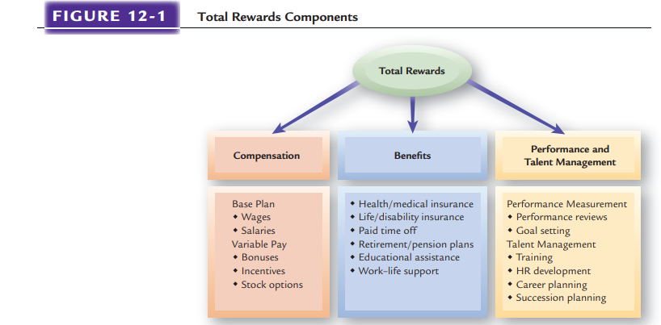
FIGURE 12-1

Slide 6

COMPENSATION
Includes fixed (base) pay and variable pay (pay at risk).
Also includes several forms of variable pay, such as short- and long-term incentives.
The most traditional element in total rewards and a key to business success
Chapter
12

Slide 7

Chapter
COMPENSATION
12
Base pay Basic compensation that an employee receives, usually as a wage or a salary.
Wages Payments directly calculated on the amount of time worked.
Salaries Consistent payments made each period regardless of the number of hours worked.
Variable pay Compensation linked directly to individual, team, or organizational performance (e.g. bonuses )
Benefits Include traditional programs such as medical, dental, and retirement, as well as newer, nontraditional programs such as identity theft and pet insurance.

Slide 8
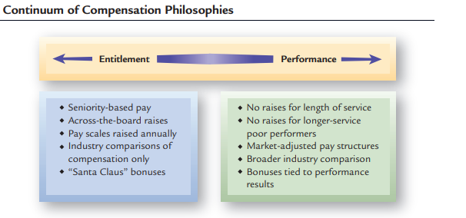
Compensation Philosophies
Chapter
12

Slide 9
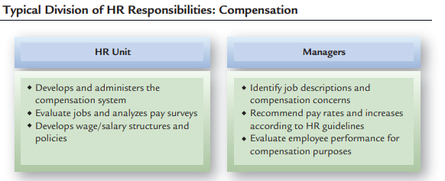

Slide 10
COMPENSATION SYSTEM DESIGN ISSUES
Compensation Fairness and Equity

Slide 11
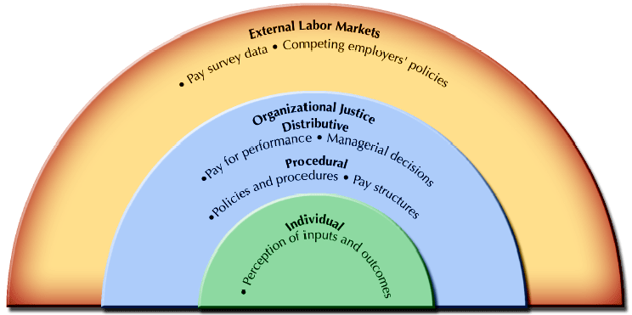
EQUITY CONSIDERATIONS IN COMPENSATION
FIGURE 12-2

Slide 12
Chapter
COMPENSATION SYSTEM DESIGN ISSUES CONT.
12
Market Competitiveness and Compensation

Slide 13
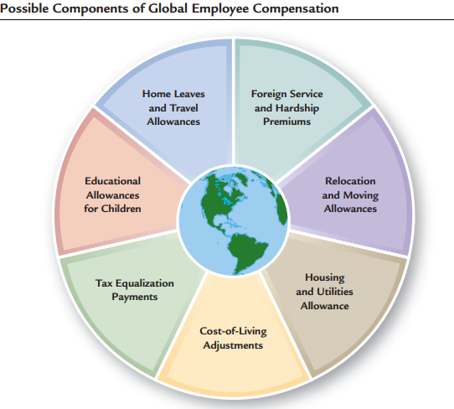
Chapter
COMPENSATION SYSTEM DESIGN ISSUES CONT.
12
Competency-based pay: Rewards individuals for the capabilities they demonstrate and acquire.
Individual vs. Team Rewards: Many organizations use team incentive rewards on top of base pay.
Global Compensation Issues
FIGURE 12-3

Slide 14

Chapter
LEGAL CONSTRAINTS ON PAY SYSTEMS
12
Exempt employees Employees to whom employers are not required to pay overtime. Non-exempt employees Employees who must be paid overtime
Fair Labor Standards
Exempt employees to whom employers are not required to pay overtime.
Non-exempt employees who must be paid overtime

Slide 15
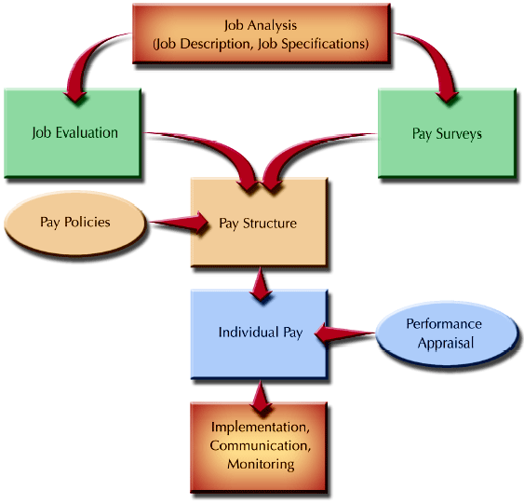
COMPENSATION ADMINISTRATION PROCESS
FIGURE 12-4

Slide 16
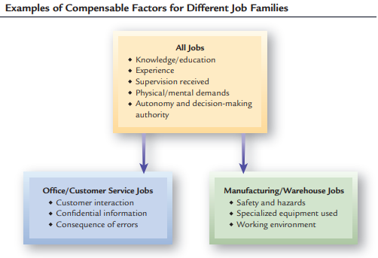
Chapter
Valuing Jobs with Job Evaluation Methods
12
Job evaluation: Formal, systematic means to identify the relative worth of jobs within an organization
Point Method :Is the most used method.
It breaks jobs down into various compensable factors and places weights, or points, on them.
A compensable factor identifies a job value commonly present throughout a group of jobs. Compensable factors are derived from the job analysis and reflect the nature of different types of jobs.

Slide 17
Valuing Jobs with Job Evaluation Methods
Other Job Evaluation Methods
The ranking method
Is a simple system that places jobs in order, from highest to lowest, by their value to the organization.
The classification method
Descriptions of each class of jobs are written, and then each job in the organization is put into a grade according to the class description it best matches.
The factor-comparison method
a quantitative complex combination of the ranking and point methods. Each organization must develop its own key jobs and its own factors.
Market pricing
Use of market pay data to identify the relative value of jobs based on what other employers pay for similar jobs

Slide 18
Developing Pay Surveys
Pay Surveys :Collection of data on compensation rates for workers performing similar jobs in other organizations. It is important to Benchmark jobs.
Select Employers with Comparable Jobs
Determine Jobs to be Surveyed
Decide What Information Is Needed
Conduct Survey

Slide 19
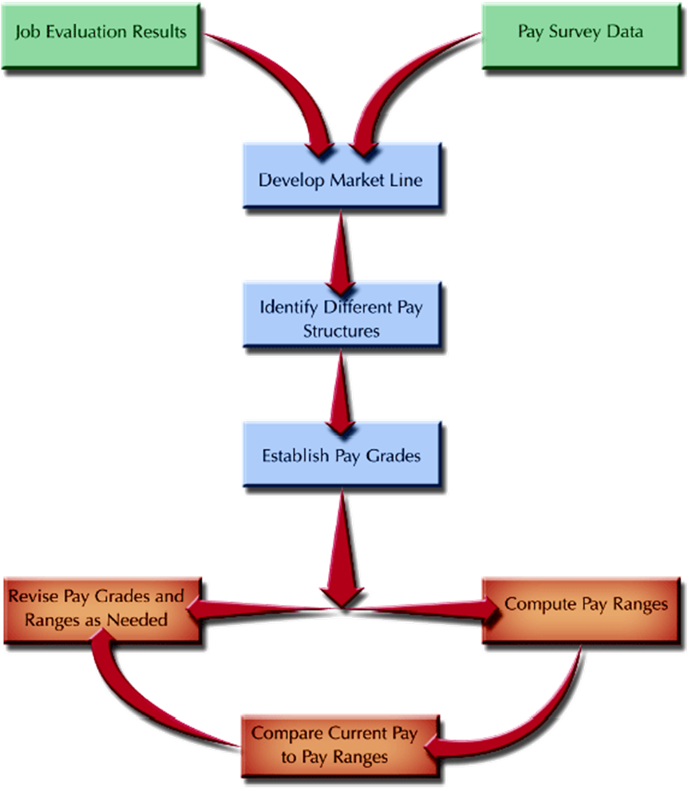
Establishing Pay Structures
FIGURE 12-5

Slide 20
Chapter
PAY STRUCTURES
12
Market Line
  The line on a graph showing the relationship between the job value, as determined by job evaluation points, and pay survey rates.
Common Pay Structures
  Hourly and salaried
  Office, plant, technical, professional, managerial
  Clerical, information technology, professional, supervisory, management, and executive

Slide 21
Chapter
PAY STRUCTURES CONT.
12
Pay Grades
  A grouping of individual jobs having approximately the same job worth.
Broad banding
  The practice of using fewer pay grades having broader pay ranges that in traditional systems.
  Benefits
    Encourages horizontal movement of employees
    Is consistent with trend towards flatter organizations
    Creates a more flexible organization
    Encourages competency development
    Emphasizes career development

Slide 22
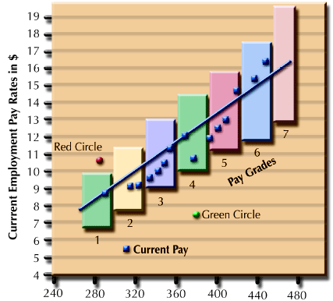
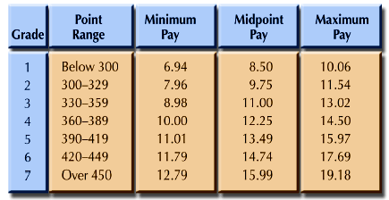
Example of Pay Grades and Pay Ranges
Job Evaluation Points
FIGURE 12-6

Slide 23
Chapter
Pay Rate Issues
12
Rates Out of Range
  Red-Circled Employees
    An incumbent (current job holder) who is paid above the range set for the job.
  Green-Circled Employees
    An incumbent who is paid below the range set for the job.
Pay Compression
  A situation in which pay differences among individuals with different levels of experience and performance in the organization becomes small.

Slide 24
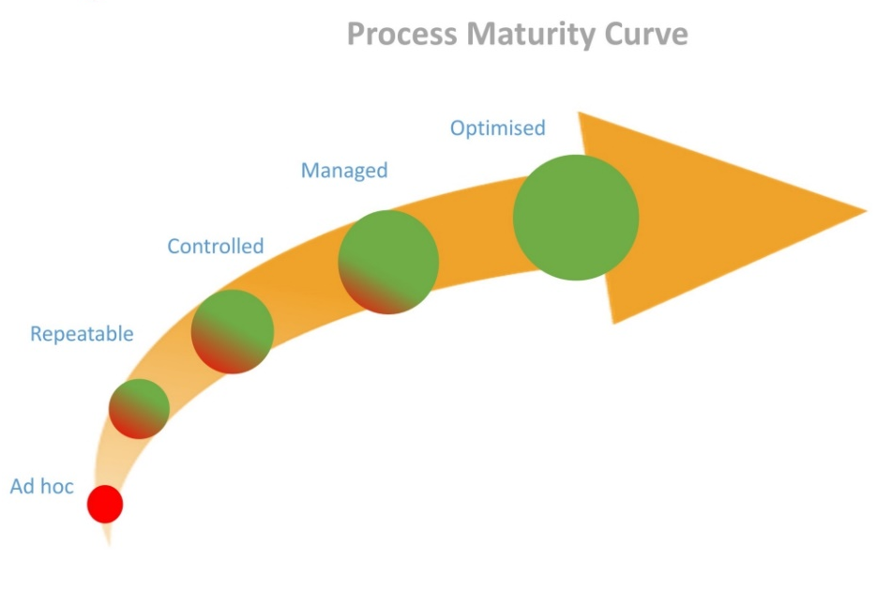
Chapter
Issues Involving Pay Increases
12
Seniority
  Time spent in an organization or on a particular job.
  Used to determine eligibility for organizational rewards and benefits.
Maturity Curve
  A curve that depicts the relationship between experience and pay rates.
  Assumption is that as experience increases, proficiency and performance increase.

Slide 25
Issues Involving Pay Increases Cont.
Cost-of-Living Adjustments (COLA)
  A percentage increase in wages that allows employees to maintain the same real wages in a period of economic inflation.
  Adjustments are tied to changes in an economic measure (e.g., the Consumer Price Index).
Lump-Sum Increases (LSI)
  A one-time payment of all or part of a yearly pay increase.
  Lump-sum payments do not increase base wages

Slide 26
Part 4:Compensating Human Resources
Variable Pay and Executive
Compensation
Chapter
13
Lecture 9
MGM 243
Prepared by
Dr. Samah Abdelfatah

Slide 27
Chapter
Learning Outcomes
13
After you have read this chapter, you should be able to:
Define variable pay and identify three elements of successful pay-for-performance plans.
Discuss three types of individual incentives.
Discuss why profit sharing and employee stock ownership are common organizational incentive plans.
Explain three ways that sales employees are typically compensated.
Identify the components of executive compensation.

Slide 28
Chapter
VARIABLE PAY: INCENTIVES FOR PERFORMANCE
13
Variable pay Compensation linked to individual, group/team, and/or organizational performance.
The foundation of variable pay rests on several basic assumptions:
  Some people perform better and are more productive than others.
  Employees who perform better should receive more compensation.
  Some of employees’ total compensation should be tied directly to performance and results.
  Some jobs contribute more to organizational success than others.

Slide 29
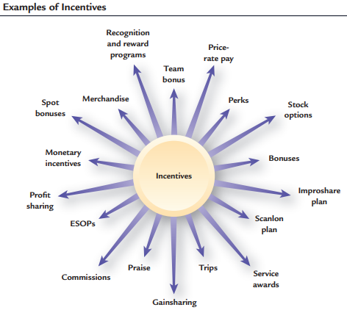
Chapter
Developing Successful Pay-for-Performance Plans
13
Employers adopt variable pay or incentive plans for a number of reasons.
Link strategic business goals and employee performance.
Enhance organizational results and reward employees financially for their contributions.
Reward employees and recognize different levels of employee performance.
Achieve HR objectives, such as increasing retention, reducing turnover, recognizing training, or rewarding safety.
FIGURE 13-1

Slide 30
Factors Affecting Variable Pay Plans
Does the plan fit
the organization?
In the case of pay-for-performance plans, one size does not fit all. For a plan to work, it must be linked to the objectives of the organization.
Variable Pay Plan Success
Are the right behaviors
encouraged by the plan?
Variable pay systems should be tied to desired performance. Employees must
see a direct relationship between their efforts and their financial rewards.
Is the plan being
administered properly?
A variable pay plan may be complex or simple, but it will be successful only if employees understand what they have to do to be rewarded.

Slide 31
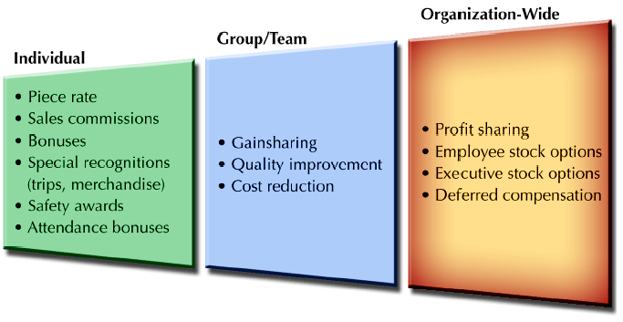
Types of Variable Pay Plans
FIGURE 13-2

Slide 32
INDIVIDUAL INCENTIVES
Piece-Rate Systems
Straight Piece-Rate Systems
  Wages are determined by multiplying the number of pieces produced by the piece rate for one unit.
Differential Piece-Rate Systems
  Employees are paid one piece-rate for units produced up to a standard output and a higher piece-rate wage for units produced over the standard.

Slide 33
INDIVIDUAL INCENTIVES CONT.
Bonuses and Special Incentive Programs
Bonus
  A one-time payment that does not become part of the employee’s base pay.
Awards
  Cash or merchandise used as an incentive reward.
Recognition Awards
  Recognition of individuals for their performance or service to customers in areas targeted by the firm.
Service Awards
  Rewards to employees for lengthy service with an organization.

Slide 34
INDIVIDUAL INCENTIVES CONT.
Types of Sales Compensation Plans
Salary Only
  All compensation is paid as a base salary with no incentives.
  Straight Commission
    Compensation is computed as a percentage of sales in units or dollars.
    To offset this insecurity, some employers use a draw system
    Draw system make advance payments against future commissions to salesperson.
  Salary Plus Commission or Bonus
    Compensation is part salary for income stability and part commission for incentive.

Slide 35
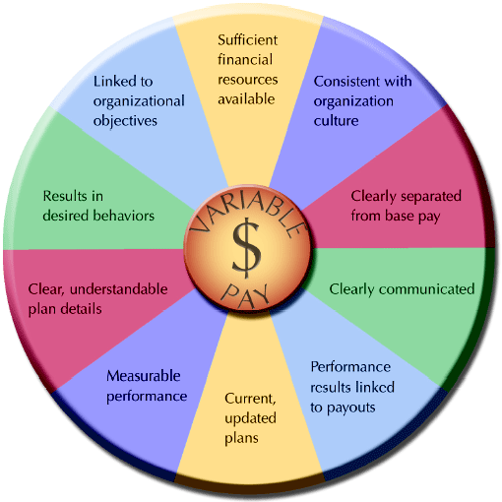
Factors for Successful Variable Pay Plans
FIGURE 13-3

Slide 36

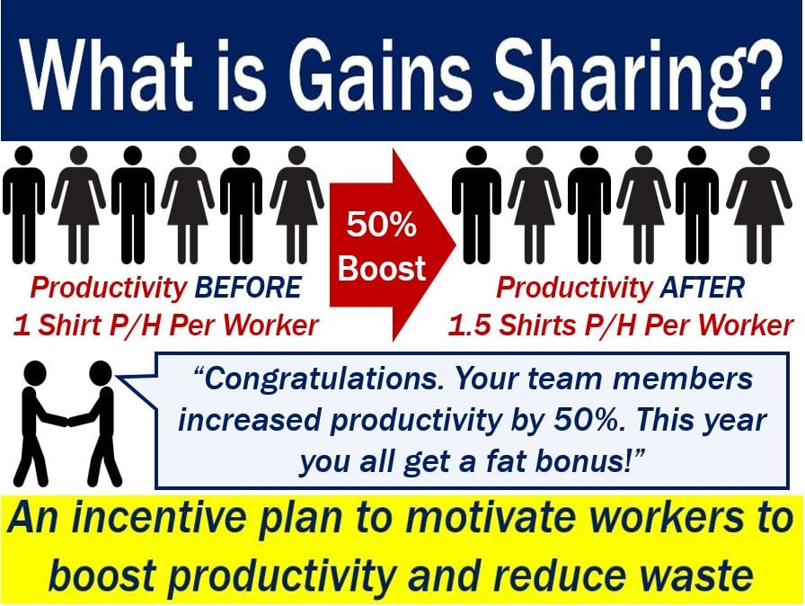
Types of Group/Team Incentives
Group/Team Results :Pay plans for groups/teams may reward all members equally on the basis of group output, cost savings, or quality improvement.
Gainsharing: System of sharing with employees greater-than-expected gains in profits and/or productivity. Also called team sharing or goal sharing.

Slide 37
ORGANIZATIONAL INCENTIVES
Profit Sharing
Profit Sharing
A system to distribute a portion of the profits of the organization to employees.
  Primary objectives
    Improve productivity
    Recruit or retain employees
    Improve product/service quality
    Improve employee morale
  Drawbacks
    Disclosure of financial information
    Variability of profits from year to year
    Profit results not strongly tied to employee efforts

Slide 38
ELEMENTS OF EXECUTIVE COMPENSATION
Executive Salaries: vary by the type of job, size of organization, industry, and other factors. In some organizations, particularly non-profits, salaries often make up 90% or more of total compensation.
Executive Benefits :Many executives are covered by regular benefits plans that are also available to non-executive employees, including traditional retirement, health insurance, and vacation plans
Executive Perquisites (Perks): In addition to the regular benefits received by all employees, executives often receive benefits called perquisites. Perquisites (perks) are special benefits— usually non-cash items— for executives.
Annual Executive Incentives and Bonuses :for executives can be determined in several ways. One way is to use a discretionary system whereby the CEO and the Board of Directors decide.
Performance Incentives: Long Term vs. Short Term Use of executive performance-based incentives tries to tie executive compensation to the long-term growth and success of the organization.

Slide 39
Chapter
SUMMARY
13
Chapter 13:Variable Pay and Executive
Compensation
Variable pay: incentives for performance
Developing Successful Pay-for-Performance Plans
Factors Affecting Variable Pay Plans
Types of Variable Pay Plans
Individual Incentives
Organizational Incentives
Types of Group/Team Incentives
Elements Of Executive Compensation
Chapter 12:Total Rewards & Compensation
Nature of Compensation
Total rewards components
Compensation Philosophies
Compensation System Design Issues
Compensation Administration Process

Slide 40


Thank You

