Slide 1


Storage Technologies
IT403
Prepared by
Dr. Ahmed El-Douh
Lecture 3

Slide 2



Storage Technologies
Lecture 3
IT403
Architecture of Storage Systems
Prepared by
Dr. Ahmed El-Douh

Slide 3
Objectives
Upon completion of this module, you will be able to:
  Introduces the common system architecture of storage systems, the components of storage systems
  Understand the common storage system architectures.
  Grasp the concepts of common storage components.
www.midocean.ae

Slide 4
Chapter
Outlines
03
Architecture of Storage Systems
Supported Hard Disk Types
Mechanical Hard Disk Drive (HDD)
HDD Port Technology
Solid State Drives (SSD)
www.midocean.ae

Slide 5


Chapter
03
Architecture of Storage Systems
www.midocean.ae

Slide 6
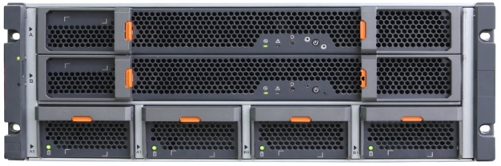
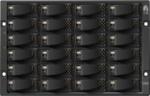

Common Forms of Storage Array Components
Controller and Disk Chassis Separation
+
=
Independent Controller Chassis
External Disk Enclosures for Expansion
Storage Array System
Controller and Disk Chassis Integration
+
=
Controller Module
Integrated Controller and Disk Enclosure
www.midocean.ae

Slide 7
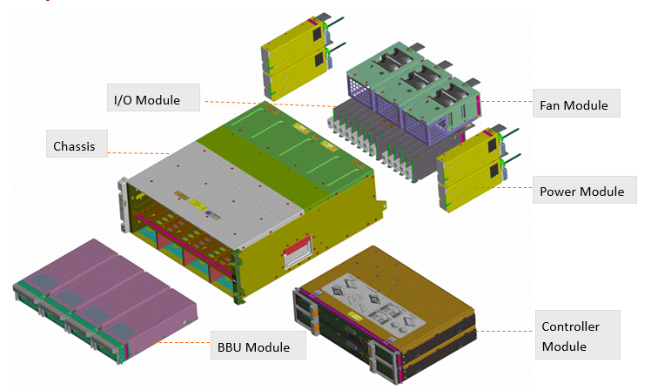
Chassis with Controller and Disk Separation
The diagram above shows the different components that makes up the controller and disk separated chassis.
The main components consist of the chassis, IO module, fan and power module and the controller and BBU (Backup Battery Unit) module.
This chassis is connected to the external high density disk enclosures via the I/O module.
BBU unit is the backup battery that provides power to the storage controller to save all the I/O cache into the coffer disks in the event of a power failure.
www.midocean.ae

Slide 8
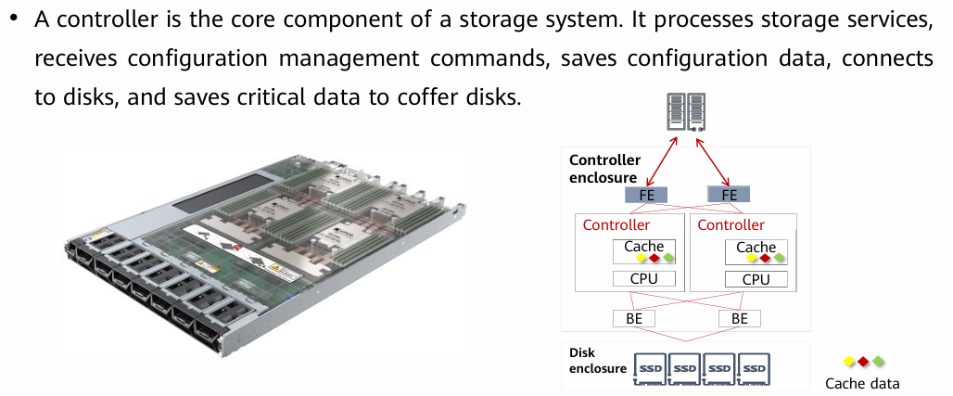
Controller
www.midocean.ae

Slide 9
Controller
The controller is a core module that processes services in a storage system.
  ▫ The CPU and cache on the controller work together to process I/O requests from the host and manage RAID of the storage system.
  ▫ Each controller has multiple built-in disks to store system data. If a power failure occurs, these disks also store cache data. Disks on different controllers are redundant of each other.
• Front-end (FE) ports are used for service communication between application servers and the storage system, that is, for processing host I/Os.
• Back-end (BE) ports connect a controller enclosure to a disk enclosure and provide channels for reading/writing data from/to disks.
• A cache is a memory chip on a disk controller. It provides fast data access speed and functions as a buffer between the internal storage and external interfaces.
• An engine is a core component of a development program or system on an electronic platform. It is usually the support part of a program or a set of systems.
www.midocean.ae

Slide 10
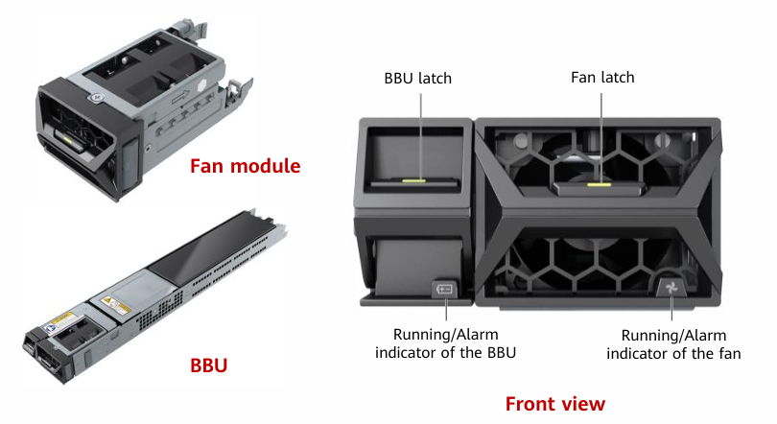
BBU and Fan Module
Fan modules dissipate heat from the system, allowing the controller enclosure to operate normally at maximum power.
BBUs supply power to the storage system in the event of an external power supply failure to protect data in the storage system.
www.midocean.ae

Slide 11
BBU (Backup Battery Unit)
When the external power supplies are normal, the BBUs are standing by. Faulty BBUs can be isolated without affecting normal running of the storage system.
The BBUs allow the system to write cache data to the built-in disks of the controllers upon a power failure to prevent data loss.
When the external power supply recovers, storage software recovers data from the built-in disks of the controllers into the cache.
Battery capacity is regularly tested through charging and discharging to detect issues early and ensure reliable data backup during power failures.
www.midocean.ae

Slide 12
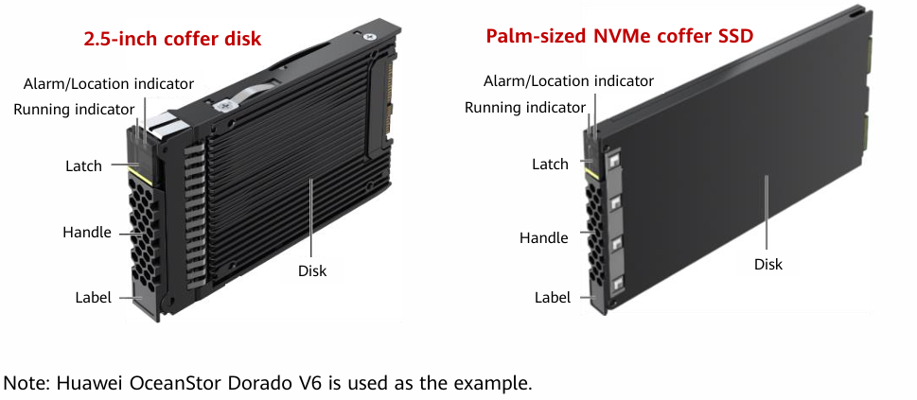
Coffer Disk
• Coffer disks are used to store user data, system configurations, logs, and dirty data in the cache in the event of an unexpected power outage.
• There are built-in coffer disks and external coffer disks.
www.midocean.ae

Slide 13
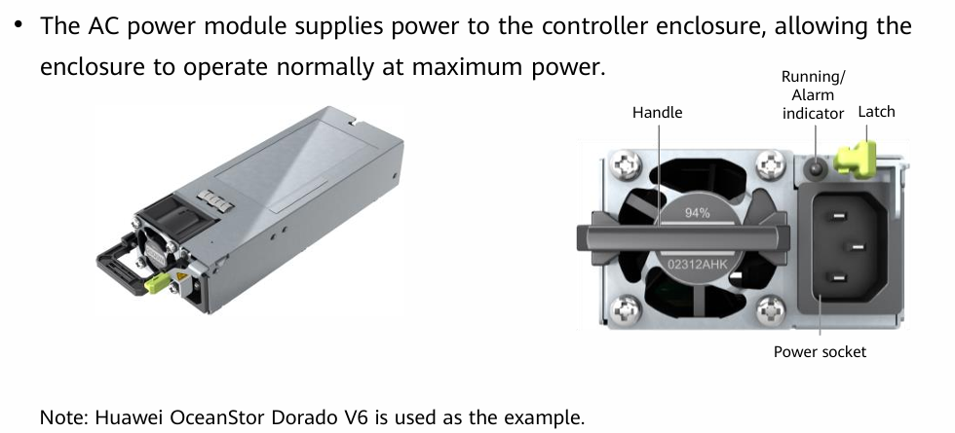
Power Module
www.midocean.ae

Slide 14
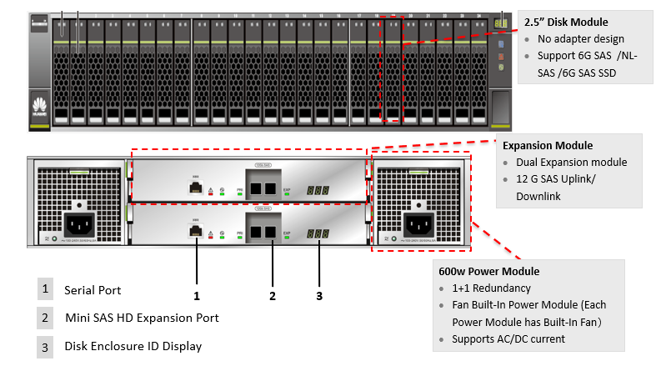
2U 2.5” Disk Enclosure
www.midocean.ae

Slide 15
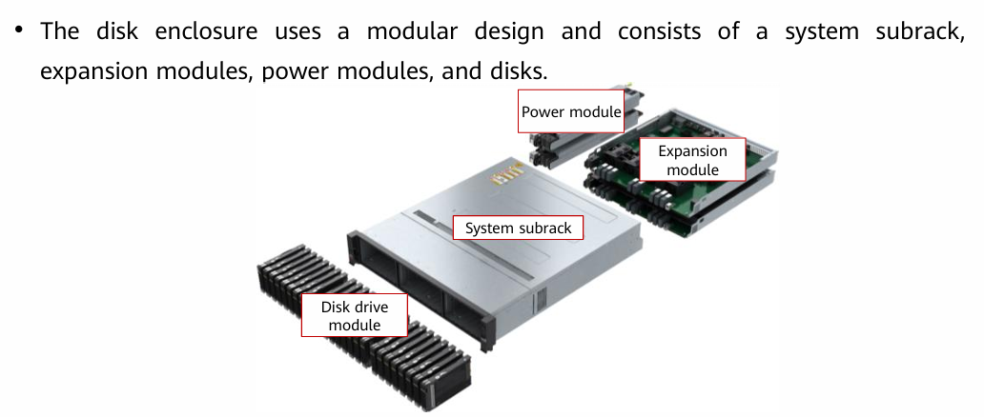
Disk Enclosure
• The system subrack integrates a backplane to provide signal and power connectivity among modules.
• The expansion module provides expansion ports to connect to a controller enclosure or another disk enclosure for data transmission.
• The power module supplies power to the disk enclosure, allowing the enclosure to operate normally at maximum power.
• Disks provide storage space for the storage system to save service data, system data, and cache data.
www.midocean.ae

Slide 16
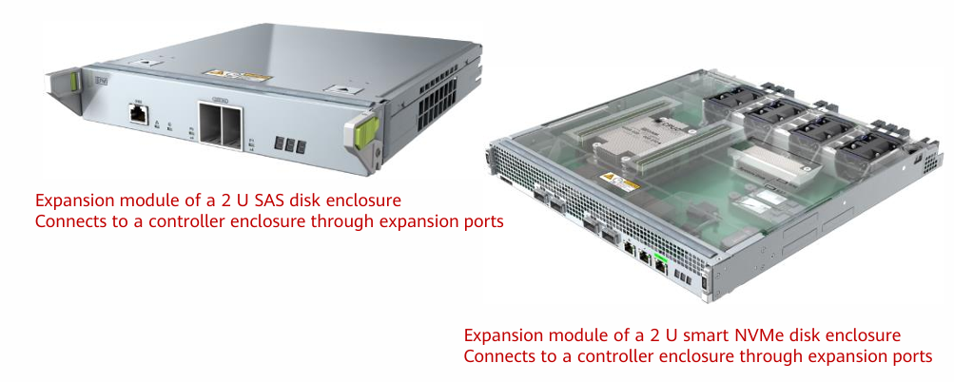
Expansion Module
The expansion module provides expansion ports to connect to a controller enclosure or another disk enclosure for data transmission.
www.midocean.ae

Slide 17
Chapter
03
Supported Hard Disk Types
www.midocean.ae

Slide 18
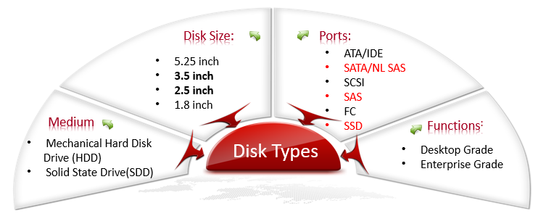
Disk Types
Desktop grade hard disks are mainly for personal and home use and mostly used in desktop PC and laptops.
Enterprise grade hard disks are mainly for enterprise level usage and mostly used in servers, storage arrays, and workstations.
www.midocean.ae

Slide 19
Chapter
03
Mechanical Hard Disk Drive (HDD)
www.midocean.ae

Slide 20
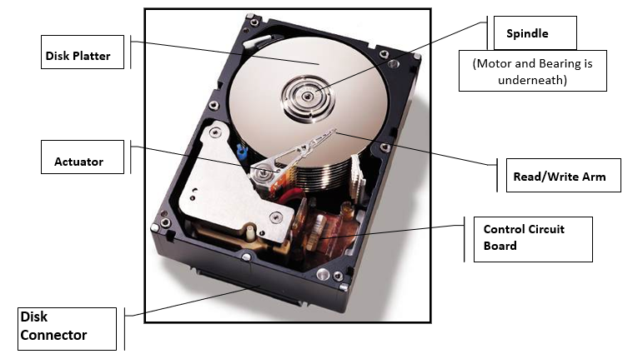
Components of a Hard Disk
The Read/Write Arm : Handles the data reading and writing
Platter: Preserves or saves the written data.
Actuator: Moves the Read/Write arm to the specified locations on the platter.
Spindle: Rotates the disk platter and moves the disc’s specified location to under the Read/Write arm.
Control Circuit Board: Controls the disk speed, movement of the actuator and send commands to the disk head.
Disk Connector: The interface that connects the hard disk to the rest of the system.
www.midocean.ae

Slide 21
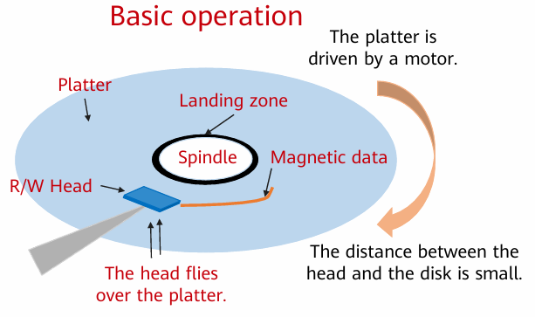
HDD Working Principles
Working principles:
▫ At the beginning, the read/write head is in the landing zone near the spindle of the platters.
▫ The spindle connects to all platters and a motor. The spindle motor rotates at a constant speed to drive the platters.
▫ When the spindle rotates, there is a small gap between the head and the platter, which is called the flying height of the head.
▫ The head is attached to the end of the actuator arm, which drives the head to the specified position above the platter where data needs to be written or read.
▫ The head reads and writes data in binary format on the platter surface. The read data is stored in the flash chip of the disk and then transmitted to the program.
www.midocean.ae

Slide 22
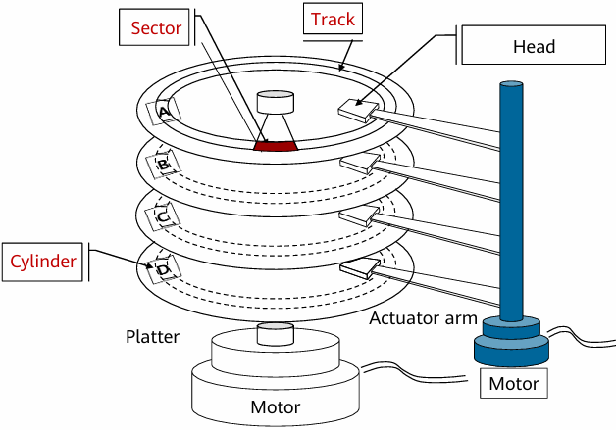
Data Organization on a Disk
Platter Surface:
Each disk platter has two usable surfaces for data storage. Surfaces are numbered starting from 0, and each one corresponds to a read/write head.
Track:
Tracks are concentric circles on a platter where data is stored. They are numbered from the outer edge inward. Each surface typically contains 300 to 1024 tracks, or more in modern disks.
Cylinder:
A cylinder consists of tracks with the same number on all platter surfaces. Data is read/written sequentially from head 0 downwards. The switching between cylinders is called seek.
Sector:
Each track is divided into sectors, which are the smallest addressable units of storage. Most sectors store 512 bytes, though some disks use larger 4 KB sectors.
www.midocean.ae

Slide 23
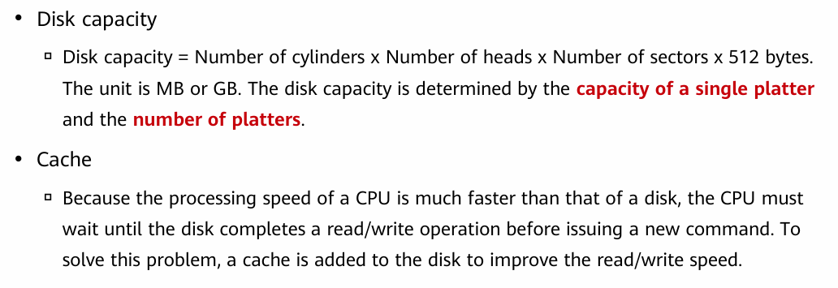
Disk Capacity and Cache
www.midocean.ae

Slide 24
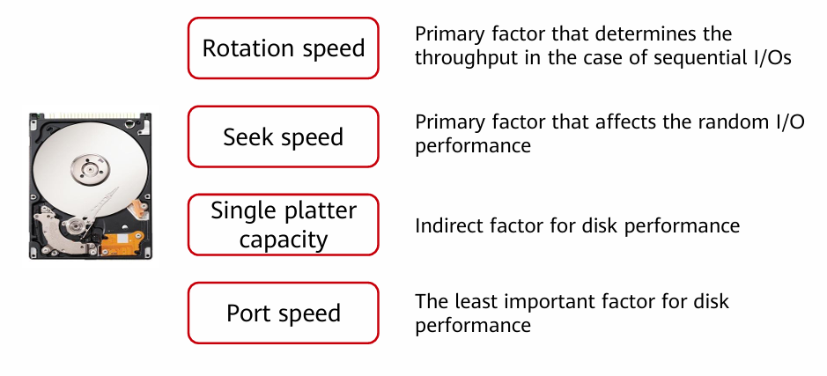
Factors Relevant to Disk Performance
www.midocean.ae

Slide 25
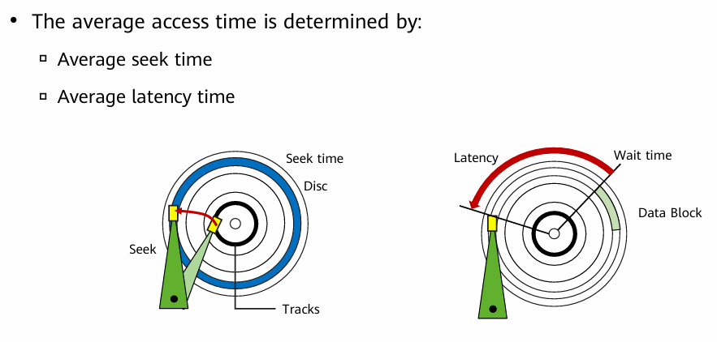
Average Access Time
Average Seek Time:
The time it takes for the read/write head to move from its current position to a target track.
  It's a key factor in the disk's internal data transfer rate—the shorter, the better.
Average Latency Time:
The waiting time for the desired sector to rotate under the head after reaching the correct track.
  Typically, it's half the time of a full disk rotation. So, higher rotation speed means lower latency.
www.midocean.ae

Slide 26
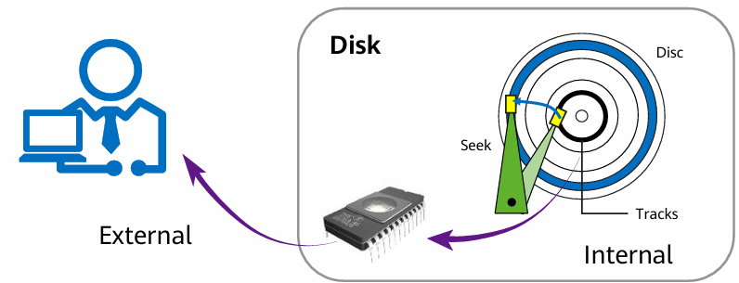
Data Transfer Rate
Data Transfer Rate
It refers to how fast data is transferred to and from the hard disk, whether during reading or writing.
  The unit is usually megabytes per second (MB/s), and it is divided into two types:
  Internal Transfer Rate → Reflects the hard disk's actual performance in reading/writing data from the disk itself.
  External Transfer Rate → Indicates the speed at which data is delivered from the hard disk to the computer.
www.midocean.ae

Slide 27
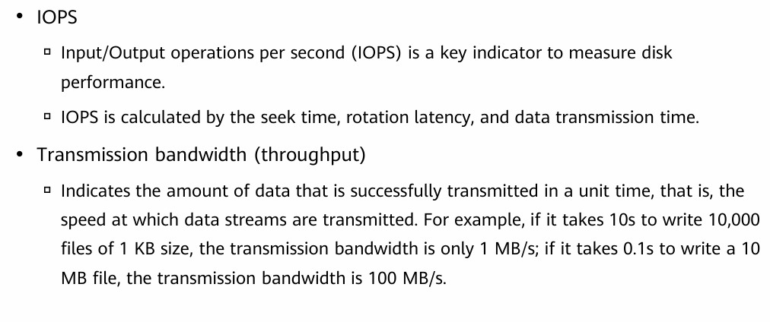
Disk IOPS and Transmission Bandwidth
www.midocean.ae

Slide 28
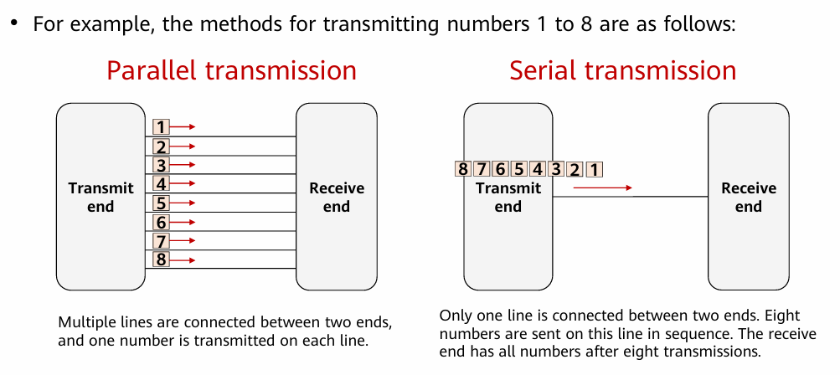
Parallel and Serial Transmission
www.midocean.ae

Slide 29
Chapter
03
HDD Port Technology
www.midocean.ae

Slide 30
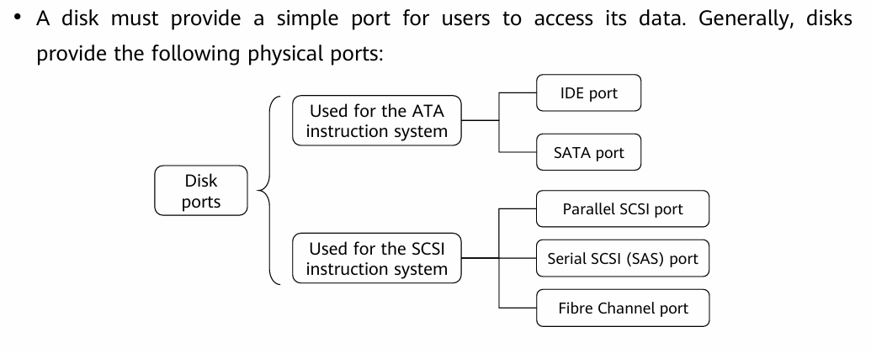
HDD Port Technology
www.midocean.ae

Slide 31
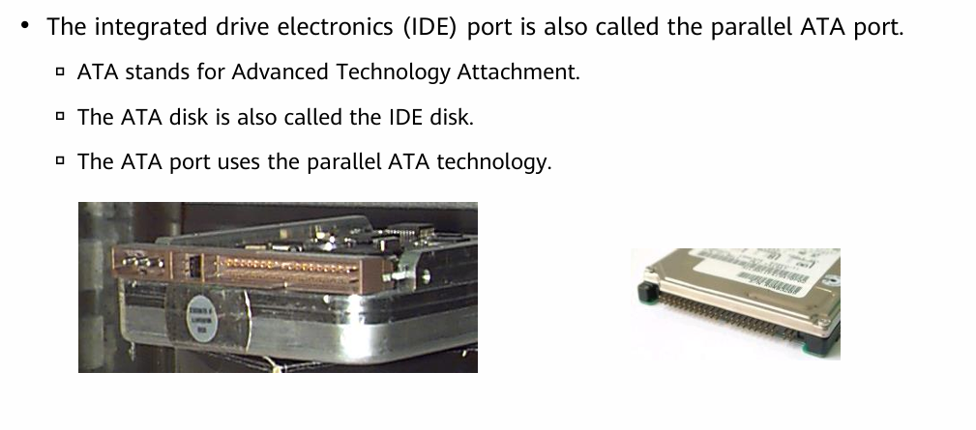
IDE Disk Port
www.midocean.ae

Slide 32
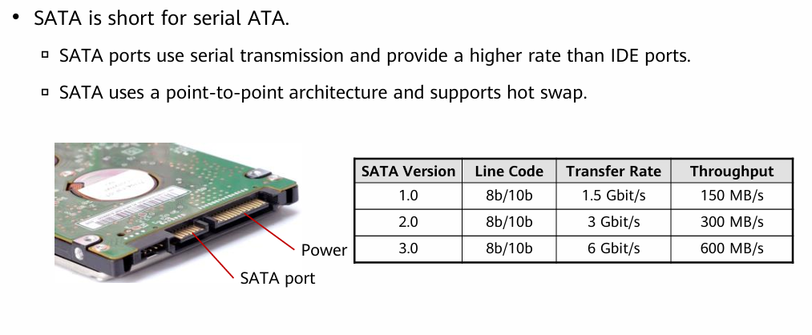
SATA Port
www.midocean.ae

Slide 33
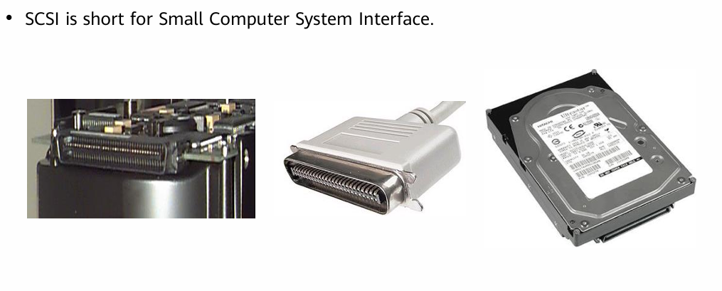
SCSI Port
www.midocean.ae

Slide 34
SCSI Port
SCSI disks were developed to replace IDE disks to provide higher rotation speed and transmission rate.
SCSI is originally a bus-type interface and works independently of the system bus.
• Advantages:
▫ Applicable to a wide range of devices. One SCSI controller card can connect to 15 devices simultaneously.
▫ High performance (multi-task processing, low CPU usage, fast rotation speed, and high transmission rate)
▫ SCSI disks can be external or built-in ones and are hot-swappable.
• Disadvantages:
▫ High cost and complex installation and configuration.
www.midocean.ae

Slide 35
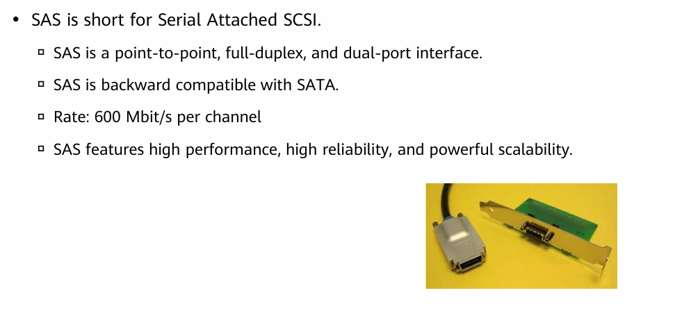
SAS Port
www.midocean.ae

Slide 36
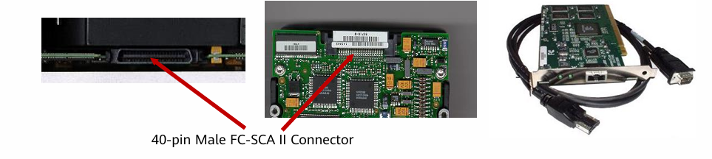
Fiber Channel Port
Fiber Channel disks use the Fiber Channel arbitrated loop (FC-AL).
FC-AL is a dual-port serial storage interface based on the SCSI protocol.
FC-AL supports full-duplex mode.
Fiber Channel provides a universal hardware transmission platform for upper-layer protocols (SCSI and IP). It is a serial data transmission interface that features high speed, high reliability, low latency, and high throughput.
www.midocean.ae

Slide 37
Chapter
03
Solid State Drives (SSD)
www.midocean.ae

Slide 38
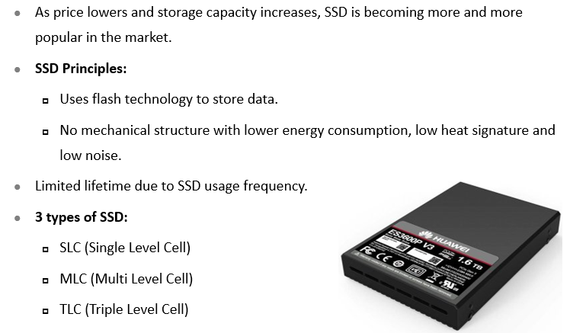
SSD Overview
www.midocean.ae

Slide 39
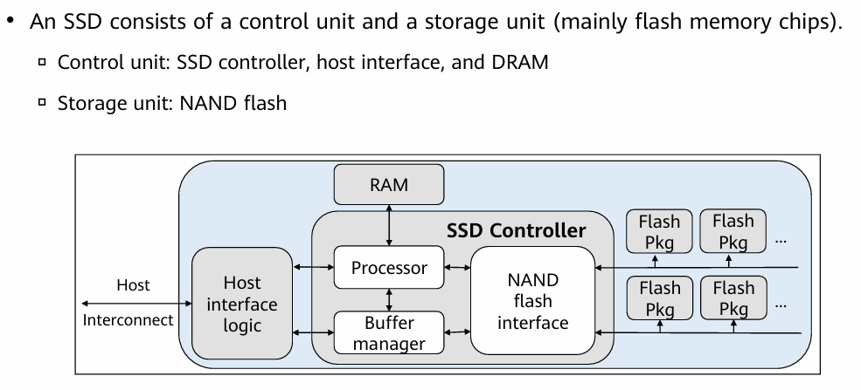
SSD Architecture
www.midocean.ae

Slide 40
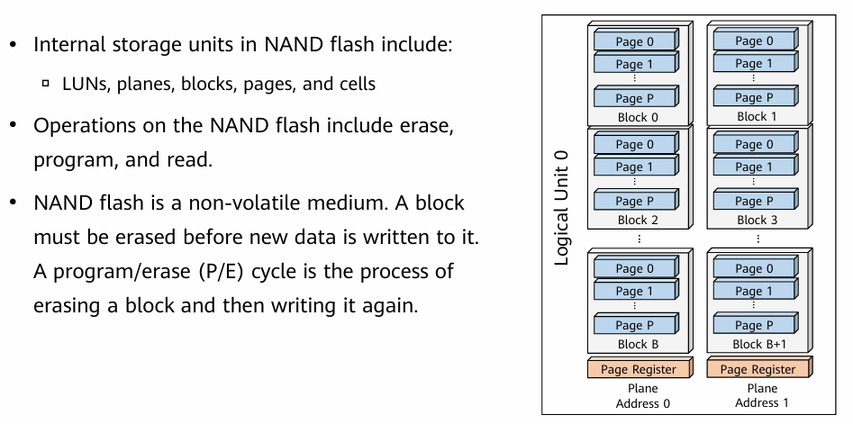
NAND Flash
www.midocean.ae

Slide 41
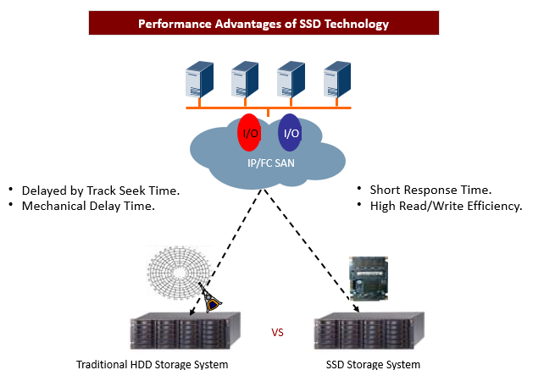
Advantages of SSD Performance
www.midocean.ae

Slide 42
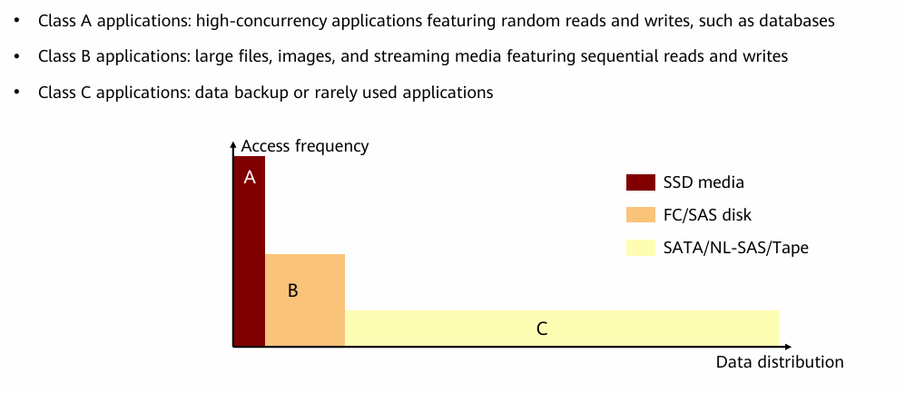
Use of SSDs in Storage Systems
www.midocean.ae

Slide 43
Summary
  Architecture of Storage Systems → general design and main components of storage.
  Supported Hard Disk Types → different types of disks used in storage systems.
  Mechanical Hard Disk Drive (HDD) → description of traditional hard disks and how they work.
  HDD Port Technology → the interfaces used to connect HDDs with the system.
  Solid State Drives (SSD) → modern drives that are faster, more efficient, and consume less power compared to HDDs.
www.midocean.ae

Slide 44



Thank You

