Slide 1

Writing in Organizations
Prepared by Dr. Adam Yagoub
Lecture 10
MGM 202
Writing Careful Long Reports

Slide 2
Lecture 1
Lecture 10
Key Learning Points
Course Outline
Lecture 1: Getting Started: Writing and Your Career.
Lecture 2: The Writing Process and Collaboration at Work.
Lecture 3: Writing Routine Business Correspondence.
Lecture 4: Writing Letters: Some Basics for Communicating with Audiences Worldwide.
Lecture 5: How to Get a Job: Searches, Dossiers, Portfolios, Résumés, Letters, and Interviews.
Lecture 6: Designing Successful Documents, Visuals, and Websites.
Lecture 7: Writing Instructions and Procedures.
Lecture 8: Writing Effective Short Reports.
Lecture 9: Writing Proposals.
Lecture 10: Writing Careful Long Reports.

Slide 3
Lecture 1
Lecture 10
Key Learning Points
Lecture Outline
1- Characteristics of a Long Report.
2- The Process of Writing a Long Report
3- Parts of a Long Report
4-Documenting Sources.
5- A Model Long Report
6- Final Words of Advice About Long Reports

Slide 4
Lecture 10
Writing Careful Long Reports
1- Characteristics of a Long Report:
The following sections explain some of the key elements in a long report.
A - Scope
A long report is a major study that provides an in-depth view of a key problem or idea. For example, a long report written for a course assignment may be 8 to 20 pages long; a report for a business or industry may be that long or, more likely, much longer, depending on the scope of the subject. The implications of a long report are wide ranging for a business—relocating a facility, retraining employees, adding a new line of products or services, or upgrading its technology.

Slide 5
Lecture 10
Writing Careful Long Reports
B - Research
A long, comprehensive report requires much more extensive research than a short report does. Information can be gathered over time from primary and secondary research—Internet searches, listservs, books, articles, government documents, laboratory experiments, on-site visits and tests, conferences with your boss and coworkers, interviews, and the writer’s own observations. For a course report, you will have to do a great deal of research and possibly interviewing to track down relevant background information and to discover what experts have said about the subject and what they propose should be suggested or have even done.

Slide 6
Lecture 10
Writing Careful Long Reports
C - Format
A long report is too detailed and complex to be adequately organized in a memo or letter format. The product of thorough research and analysis, the long report gives readers detailed discussions and interpretations of large quantities of data. To present the information in a logical and orderly fashion, the long report contains various parts, sections, headings, subheadings, documentation, and supplements (appendices) that would never be included in a short report. also gives readers a variety of visuals, including charts, a graph, and even a multicultural calendar.

Slide 7
Lecture 10
Writing Careful Long Reports
D - Timetable
A long report is generally commissioned by a company or an agency to explore with extensive documentation a subject involving personnel, locations, technology, costs, safety, or the environment. Many times a long report is required by law— for example, investigating the feasibility of a project that will affect the ecosystem. When you prepare a long report for a class project, select a topic that really interests you and/or the collaborative group you are a part of, because you will spend a good portion of the term working on it.

Slide 8
Lecture 10
Writing Careful Long Reports
E - Audience
The audience for a long report usually consists of individuals in the top levels of management—presidents, vice presidents, superintendents, directors, heads of departments—who make executive, financial, and organizational decisions. These individuals are responsible for long-range planning, or seeing the big picture, so to speak.

Slide 9
Lecture 10
Writing Careful Long Reports
F - Collaborative Effort
The long report in the world of business may not be the work of one employee. Rather, it may be a collaborative effort—the product of a committee or a group. Your instructor may ask you to work in a group (or alone) in preparing your long report. The group should estimate a realistic time necessary to complete the various stages of the work—when drafts are due or when editing must be concluded, for example. A project schedule based on that estimate should then be prepared.

Slide 10
Lecture 10
Writing Careful Long Reports
2- The Process of Writing a Long Report:
Because your work will be spread over many weeks, you need to see your report not as a series of static or isolated tasks but as an evolving project. The following guidelines will also help you plan and write a long report.
1. Identify a significant topic.
2. Conduct research.
3. Expect to confer regularly with your supervisor(s) and/or team members.
4. Revise your work often.
5. Keep the order flexible at first.
6. Prepare both a day-to-day calendar and a checklist.

Slide 11
Lecture 10
Writing Careful Long Reports
3- Parts of a Long Report:
A long report may include some or all of the following 12 parts, which form three categories: front matter (letter of transmittal, title page, abstract, table of contents, list of illustrations), report text (introduction, body, conclusion, recommendations), and back matter (glossary, references cited, any appendices).

Slide 12
Lecture 10
Writing Careful Long Reports
A- Front Matter
As the name implies, the front matter of a long report consists of everything that precedes the actual text of the report. Such elements introduce, explain, and summarize to help the reader locate various parts of the report. Use lowercase Roman numerals for front matter page numbers, not Arabic numbers.
1- Letter of Transmittal
This three- or four-paragraph (usually only one-page) letter states the purpose, scope, and major recommendation of the report. It highlights the main points of the report that will most interest your readers.

Slide 13
Lecture 10
Writing Careful Long Reports
2- Title Page
Find out what your boss or instructor prefers. Basically, your title page should contain the full title of your report and how you have restricted it in time, space, or method. Avoid titles that are vague, too short, or too long.

Slide 14
Lecture 10
Writing Careful Long Reports
3- Abstract
An abstract summarizes your report. It is usually only one paragraph long and can be included in different parts of your report—on the title page, on a separate page, or even on the first page of the report. But the abstract should always be in the front of the report so readers can find it easily. The abstract may be the most important part of your report. Not every member of your audience will read your entire report, but almost every one of them will study the abstract.

Slide 15
Lecture 10
Writing Careful Long Reports
4- Table of Contents
The table of contents lists the major headings and subheadings of your report and tells readers on which pages they can be found. Essentially, a table of contents shows how you organized your report and emerges from many outlines and drafts. The items on those outlines frequently expand, shrink, combine, and can be moved around until you decide on the formal divisions and subdivisions of your report.
5- List of Illustrations
This list contains the titles for all of the visuals and indicates where they can be found in your long report.

Slide 16
Lecture 10
Writing Careful Long Reports
B- Text of the Report
The text of a long report is made up of an introduction, the body, conclusions, and sometimes recommendations.
1- Introduction
The introduction may constitute as much as 10 or 15 percent of your report, but it should not be any longer. The introduction is essential because it tells readers why your report was written and thus helps them understand and interpret everything that follows. Avoid putting your findings, conclusions, or recommendations in your introduction.

Slide 17
Lecture 10
Writing Careful Long Reports
Do not regard the introduction as one undivided block of information. It includes related parts, which should be labeled with subheadings. Here are the types of information to include in your introduction.
1. Background.
2. Problem.
3. Purpose statement.
4. Scope.

Slide 18
Lecture 10
Writing Careful Long Reports
2- Body
This section, also called the discussion, is the longest, possibly making up as much as 70 percent of your report. The body contains statistical information, details about the environment, and physical descriptions, as well as the various interpretations and comments of authorities whose work you consulted as part of your research.
The body of your report
■ be carefully organized to reveal a coherent and well-defined plan
■ separate material into meaningful parts to identify the major issues
■ clearly relate the parts to each other
■ use headings to help your reader(s) identify major sections more quickly

Slide 19
Lecture 10
Writing Careful Long Reports
3- Conclusion(s)
The conclusion should tie everything together for readers by presenting the findings of your report. For a research report based on a study of sources located through various reference searches, the conclusion should summarize the main viewpoints of the authorities whose works you have cited. For a marketing report done for a business or organization, you must spell out the implications of your research for readers in terms of costs, personnel, products, location, and so forth.

Slide 20
Lecture 10
Writing Careful Long Reports
Regardless of the type of research you do, your conclusions should do the
following:
■ be based on the information and documentation in the body of the report
■ corroborate the evidence/information you gave in the body of your report
■ grow out of the work you describe in the body of the report
■ keep to the areas that your report covers, and not stay into areas it did not

Slide 21
Lecture 10
Writing Careful Long Reports
4- Recommendations
The recommendation(s) section tells readers what should be done about the findings recorded in the conclusion. Your recommendation tells readers how you want them to solve the problem your report has focused on. Readers will expect you to advise them on a specific course of action—what new technology to purchase, when and where to expand a market, how to improve and safeguard a web presence, or who to recruit, hire, train, and retain for your company.

Slide 22
Lecture 10
Writing Careful Long Reports
C- Back Matter
Included in the back matter of the report are all of the supporting data that, if included in the text of the report, would bog the reader down in details and cloud the main points the report makes.
1- Glossary
The glossary is an alphabetical list of the specialized vocabulary used in a long report and the definitions. A glossary might be unnecessary if your report does not use a highly technical vocabulary.

Slide 23
Lecture 10
Writing Careful Long Reports
2- References Cited
Any sources cited in your report—websites, books, articles, television programs, interviews, reviews, blogs, audiovisuals—are usually listed in this section.
3- Appendix
An appendix contains supporting materials for the report—tables and charts too long to include in the discussion, sample questionnaires, budgets and cost estimates, correspondence about the preparation of the report, case histories, transcripts of telephone conversations, copies of relevant letters and documents upon which the report is based, etc.

Slide 24
Lecture 10
Writing Careful Long Reports
4-Documenting Sources:
Documentation is at the heart of all the research you will do on the job. To document means to furnish readers with information about the print and electronic sources, as well as interviews, you have used for the factual support of your statements, including books, journals, newspapers, manuals, government and corporate reports, websites, and other resources such as blogs, site visits, or surveys. Documentation is an important component of any long report for at least three reasons.

Slide 25
Lecture 10
Writing Careful Long Reports
1. It demonstrates that you have done your homework by consulting experts on the subject and are relying on the most current and authoritative sources to build your case persuasively.
2. It gives proper credit to those sources.
3. It informs readers about specific books, articles, or websites you used so they can find your source and verify your facts or quotations.

Slide 26
Lecture 10
Writing Careful Long Reports
- The Ethics of Documentation: What Must Be Cited
To ensure that your report avoids any type of plagiarism and maintains high ethical standards, follow these guidelines:
■ If you use a source and take something from it, document it.
■ Stay away from patch working—using bits and pieces of information and passing them off as your own—which is also an act of plagiarism.
■ If any opinions, interpretations, and conclusions expressed verbally or in writing are not your own you must document them.
■ Even if you do not use an author’s exact words but still get an idea, concept, or point of view from a source, still document that work in your report.

Slide 27
Lecture 10
Writing Careful Long Reports
■ Never alter any original material to have it suit your argument.
■ If you use statistical data you have not compiled yourself, document them.
■ Always document any visuals—photographs, graphs, tables, charts, images downloaded from the Internet.
■ Never submit the same research paper for one course that you wrote for another course without first obtaining permission from the second instructor.
■ Do not delete an author’s name when you are citing or forwarding an Internet document. You are obligated to give the Internet author full credit.

Slide 28
Lecture 10
Writing Careful Long Reports
- What Does Not Need to Be Cited
Be careful not to distract readers with unnecessary citations. That only demonstrates your lack of understanding of the documentation process and can undercut the professionalism of your report. There is no need to cite the following:
■ Common-knowledge scientific facts and formulas.
■ Readily available geographical data.
■ Well-known dates.

Slide 29
Lecture 10
Writing Careful Long Reports
■ Factual historical information,
■ Proverbs from folklore,
■ Well-known quotations,
■ The Bible, Koran,
■ Classic literary works,

Slide 30
Lecture 10
Writing Careful Long Reports
- Parenthetical Documentation
Two frequently used systems of parenthetical documentation are found in the MLA Handbook for Writers of Research Papers and the Publication Manual of the American Psychological Association. The Modern Language Association (MLA) system is used primarily in the humanities and other related disciplines; the APA system is used in psychology, nursing and allied health disciplines, the social sciences, and in some business and technological fields. Both MLA and APA use parenthetical, or in-text, documentation. That is, the writer tells readers directly in the text of the paper, at the moment the acknowledgment is necessary, what reference is being cited.

Slide 31
Lecture 10
Writing Careful Long Reports
- Works Cited or Reference Pages
Whether you follow MLA or APA, you will need to list your sources at the end of your report, on a new page, under the title of “Works Cited” or “References” at the top and then arrange the list alphabetically by authors’ last names (except when no author is listed). But, as Table 9.1 points out, there are major differences between MLA and APA guidelines on the placement of information, punctuation, the use of italics and quotation marks, and capitalization.

Slide 32
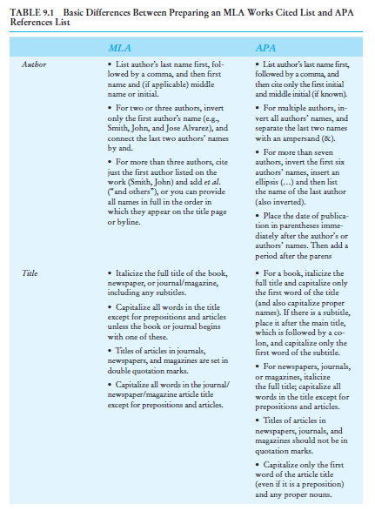
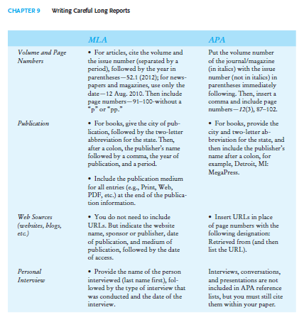
Lecture 10
Writing Careful Long Reports

Slide 33
Lecture 10
Writing Careful Long Reports
5- A Model Long Report:
The following long report in Figure 9.2 was written by a senior training specialist, Terri Smith Ruckel, and her staff for the vice president of human resources, who had commissioned it. As often happens in the world of work, only Ruckel’s name as the senior member or head of a department appears on the report. The main task facing Ruckel and her collaborative team was to demonstrate what RPM Technologies should do recruit and retain multinational workers and thus promote diversity in the workplace.

Slide 34
Lecture 10
Writing Careful Long Reports
She gathered relevant data from both primary research (interviews, direct observations, site visits, and tests) and secondary research (consulting and commenting at times on sources already available, such as books, websites, journal articles, reference works, government documents, and even in-house publications from newspapers and company reports on the RPM intranet).

Slide 35
Lecture 10
Writing Careful Long Reports
Figure 9.2 contains all the parts of a long report discussed in this chapter except a glossary and an appendix. Intended for a decision maker interested in learning more about the problems multinational workers face, the report does not contain the technical terms and data that would require a glossary or an appendix.

Slide 36
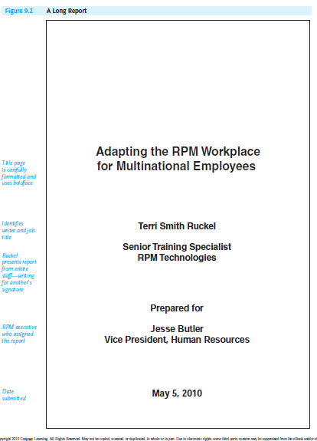
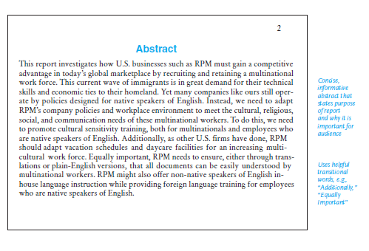
Lecture 10
Writing Careful Long Reports

Slide 37
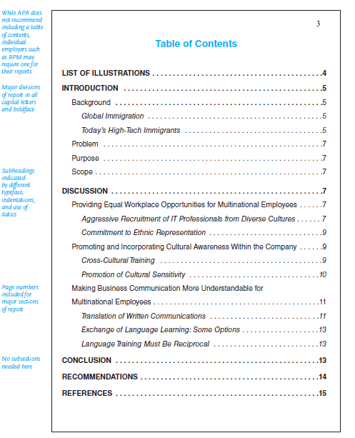
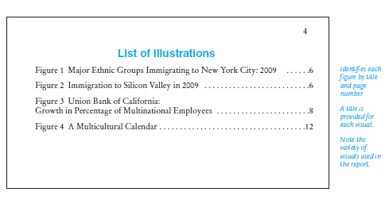
Lecture 10
Writing Careful Long Reports

Slide 38
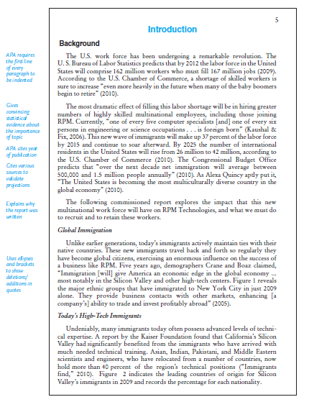
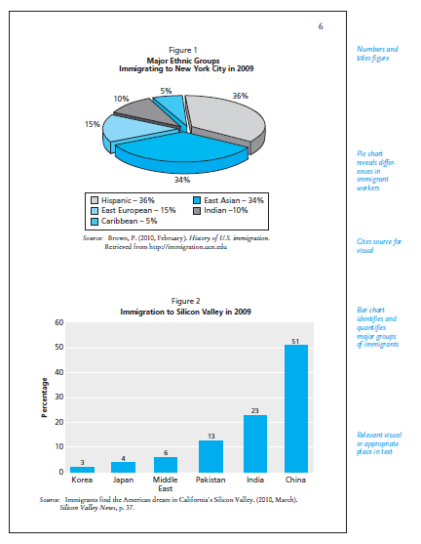
Lecture 10
Writing Careful Long Reports

Slide 39
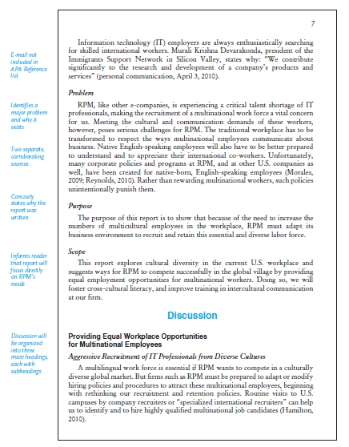
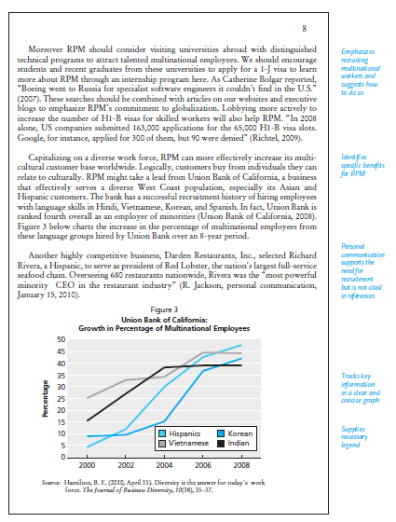
Lecture 10
Writing Careful Long Reports

Slide 40
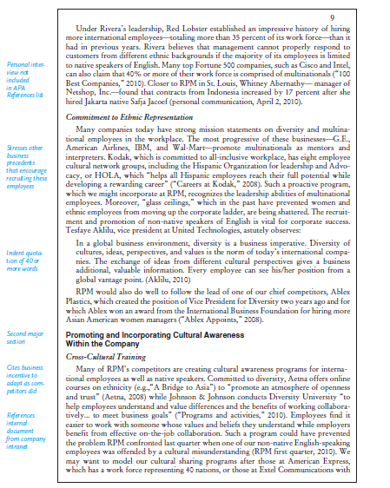
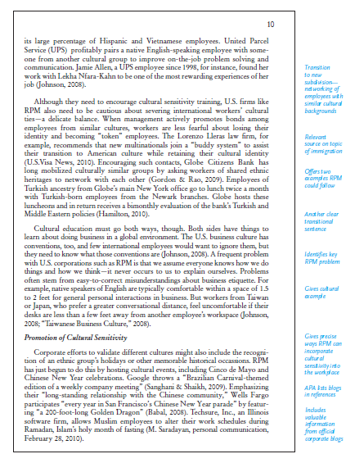
Lecture 10
Writing Careful Long Reports

Slide 41
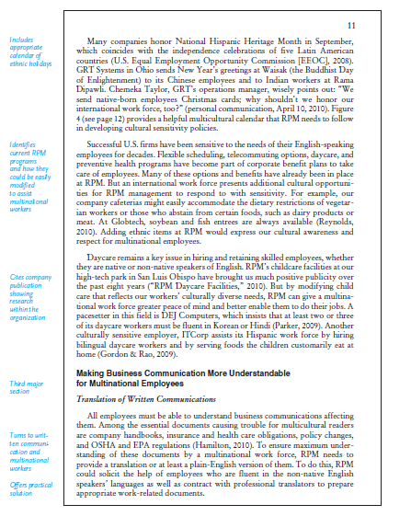
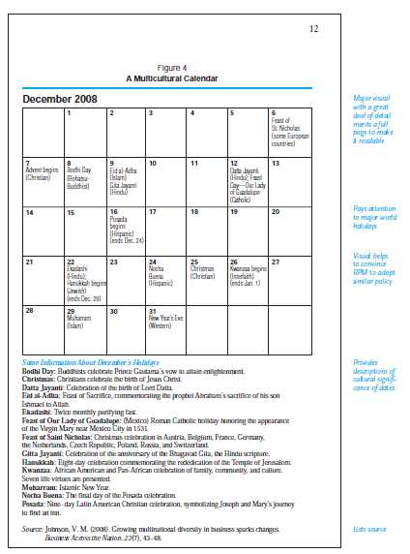
Lecture 10
Writing Careful Long Reports

Slide 42
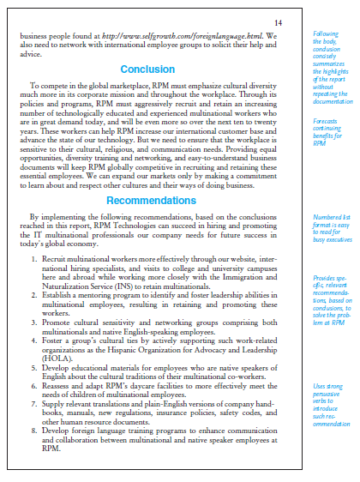
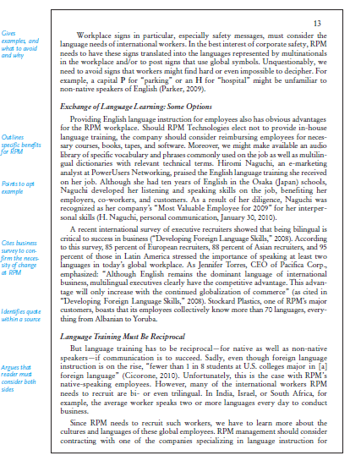
Lecture 10
Writing Careful Long Reports

Slide 43
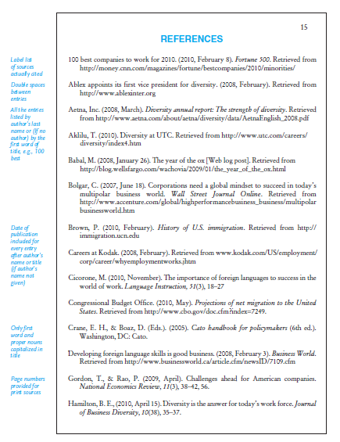
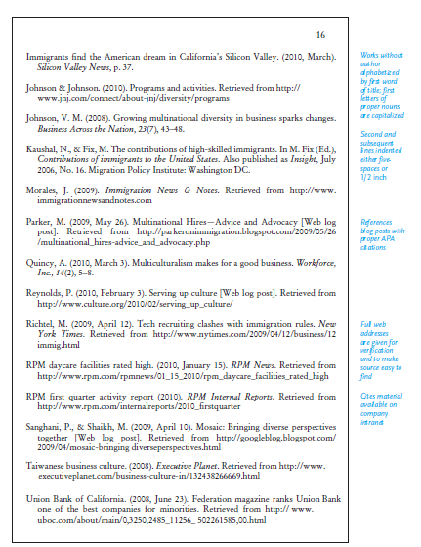
Lecture 10
Writing Careful Long Reports

Slide 44
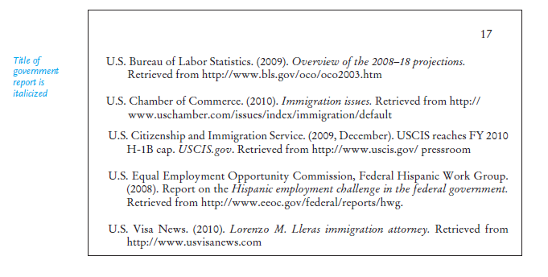
Lecture 10
Writing Careful Long Reports

Slide 45
Lecture 10
Writing Careful Long Reports
6- Final Words of Advice About Long Reports:
Perhaps no piece of writing you do on the job carries more weight than the long report. You can simplify your job and increase your chances for success by following these guidelines for scheduling, researching, and collaborating:

Slide 46
Lecture 10
Writing Careful Long Reports
1. Plan and work early—do not postpone work until a deadline draws near.
2. Do a thorough search among Internet, print, and other resources.
3. Divide your workload into meaningful units—reassure yourself that you do not have to write the report or even an entire section of a report in a day or two.
4. Set up mini-deadlines for each phase of your work and then meet them.
5. Confer often and carefully with others in your group office.

Slide 47

Lecture 10
Writing Careful Long Reports
References:
Successful Writing at Work, Concise Third Edition,
By: Philip C. Kolin
University of Southern Mississippi
Chapter 9

