Slide 1

Enhancing aspect Based sentiment Analysis of Saudi E-Commerce Reviews Using BERT Models
Prepared by
Areej Haddaj Alqarni
Submitted in fulfillment of the requirements for the degree Master of Science in Artificial Intelligence
Supervised
Dr. Yasser Abdul Hamid
College of Informatics Department of Artificial Intelligence

Slide 2
Outline
Introduction
Sentiment Analysis Overview
Sentiment Analysis for Arabic Language
Problem Definition
Research Objective
Previous work
Proposed Approach
Evaluation Results
Conclusion
Future Work

Slide 3
Introduction
-E-commerce has experienced significant growth in recent years, leading to a substantial increase in the number of customers and the volume of reviews written about products and services.
-With this massive amount of data, manually analyzing customer opinions has become difficult and impractical, which reduces the ability of companies to effectively utilize this information to improve their services.
-Therefore, there is a need to develop a model capable of understanding the Saudi dialect and accurately classifying customer satisfaction levels, which supports businesses in making better decisions and enhancing the customer experience.

Slide 4
Sentiment Analysis Overview
Sentiment Analysis is one of the Natural Language Processing (NLP) techniques that aims to understand the user's opinion through written texts, The system determines whether the sentiment in the text is positive, negative, or neutral.
Sentiment analysis is divided into three main types:
Document-Level Sentiment Analysis: which evaluates sentiment at the level of the entire text and provides a single overall judgment.
Sentence-Level Sentiment Analysis: which analyzes each sentence separately to determine its specific sentiment.
Aspect-Based Sentiment Analysis (ABSA): as it focuses on analyzing sentiments associated with each specific aspect or feature within the text, allowing for the extraction of multiple and varied opinions from the same sentence.

Slide 5
Sentiment Analysis for Arabic Language
Arabic is one of the most widely used languages on the internet, as it is spoken in 22 countries ,With the daily increase in e-commerce and social media activity, sentiment analysis of Arabic and its dialects has become essential for understanding customers in e-commerce. However, sentiment analysis faces certain challenges in Arabic, including:
The diversity of Arabic dialects and their differences.
The complexity of morphology and syntax.
The lack of resources and linguistic lexicons for the Arabic language.
The use of loanwords from other languages and their Arabization .

Slide 6
Problem Definition
With the rapid growth of e-commerce in the Arab world, sentiment analysis in Arabic continues to face numerous challenges, including:
A scarcity of datasets, which has led some models to rely on datasets of limited size.
Most models rely on machine learning techniques that hinder the understanding of complex linguistic contexts.
The limited use of multi-dimensional sentiment analysis in analyzing customer reviews.
Reviews being written in local dialects rather than Modern Standard Arabic.

Slide 7
Research Objective
To collect and prepare a dataset of customer reviews written in the Saudi dialect from e-commerce platforms.
To apply Natural Language Processing techniques to preprocess, clean, and analyze informal text written in Saudi dialect.
To develop a sentiment analysis model, including Aspect-Based Sentiment Analysis (ABSA), capable of classifying customer satisfaction levels (positive, negative, and neutral).
Evaluating the Performance of BERT Models in aspect-based Sentiment Analysis on Saudi Dialect.

Slide 8
Previous work
Study | Algorithm | Dataset | Key Findings
(Alrefae, et al., 2024) | SVM, Random Forest (RF), Naïve Bayes (NB), KNN | Amazon, Jarir, Shein, Noon, and X (Twitter) | For the electronics dataset, the RF algorithm worked well with TF-IDF, POS tagging, and trigrams, achieving an average accuracy of 86.26% per aspect. For the clothing dataset, using TF-IDF along with POS tagging and bigrams, an average accuracy of 86.51% per aspect was achieved.
(Alomari, et al.,2017) | SVM , Naïve Bayes | collected from the X (Twitter) | The best results SVM –TF-IDF-stemmerBigrams88.72%,Naïve Bayes-TF-light stemmer-Trigrams 83.61%.
(Dahbi,et al.,2019) | Naive Bayes, SVM,KNN, Decision Tree | using a Python script from X (Twitter) and Facebook | SVM algorithm achieved the highest performance after converting the texts from the Moroccan dialect to Modern Standard Arabic (MSA) with accuracy 94%.

Slide 9
Previous work (cont.)
(Louati, et al., 2023) | SVM | real student opinions from the Department of Computer Science and Information Systems at Prince Sattam University. | The SVM-SAA-SCR model achieved strong performance with an accuracy of 84.7% ,Precision of 86% and Recall 85%.
(Musleh, et al.,2023) | NB, SVM,KNN, DT,RF. | Collect data from YouTube comments | Achieved an accuracy of 94.62%, precision of 94.64%, recall of 94.64%, and F1-score of 94.62%, making it the best-performing classifier among the six evaluated classifiers.
(Abo,et al. ,2024) | SVM , NB. | Collect data in X( Twitter). | SVM achieved 85% accuracy and 88% Precision . NB achieved 94% accuracy and 78% Precision .
(Sridhar, et al., 2025) | HCABSA | Food Amazon reviews from Kaggle | HCABSA achieved 98% accuracy , 97% Precision and 97% Recall and 97% F1-score.

Slide 10
The Proposed Approach
Data Collection
Data augmentation
Dataset Refinement
preprocessing
Fine tuning Bert
Evaluation Metrics

Slide 11
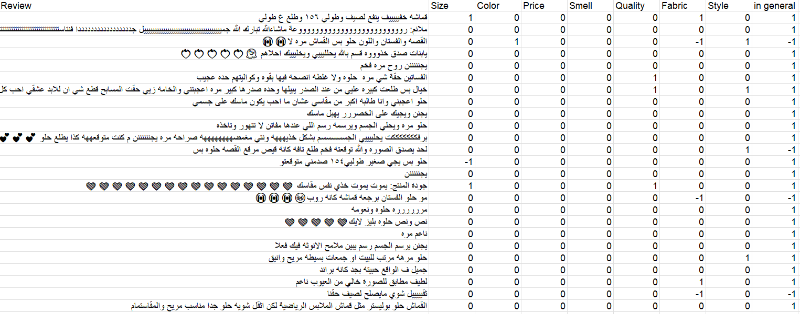
Proposed Approach (cont.)
Data Collection
Dataset obtained from the website IEEE Dataport specializing in clothing reviews in the Saudi dialect .
The dataset contains 2,142 rows and 10 columns.

Slide 12
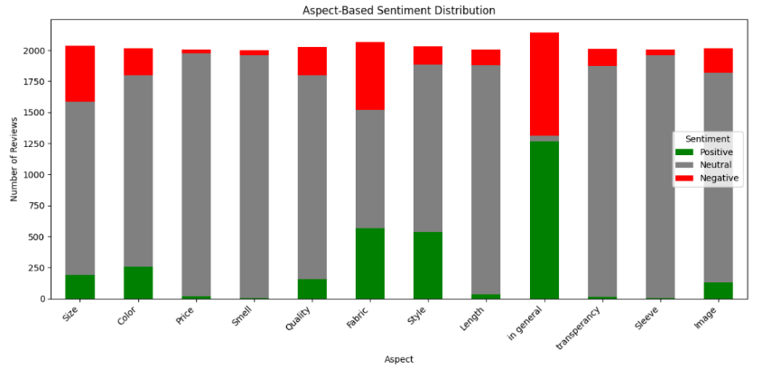
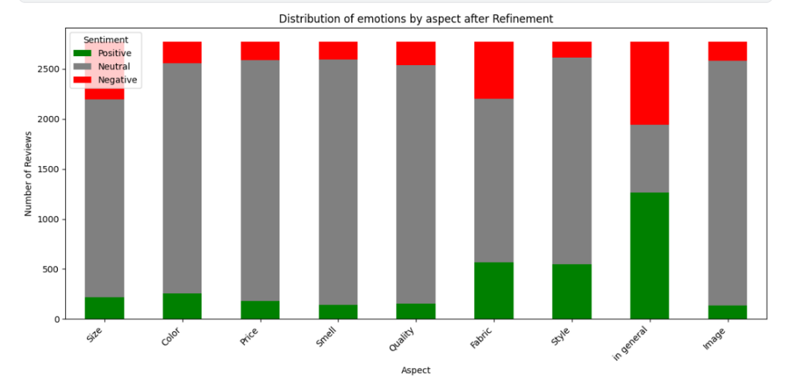
Proposed Approach (cont.)
Dataset Refinement

Slide 13
Proposed Approach (cont.)
Preprocessing :
Handling missing values.
Data cleaning.
Arabic text normalization.
Data Splitting:
Training 70%
Validation 15%:
Testing15%
Data Augmentation:
Oversampling was applied exclusively to the training set.

Slide 14
Proposed Approach (cont.)
Training Configuration
Base Model: Use of pre-trained transformer models (SaudiBERT and CamelBERT-AD).
Task: Aspect-Based Sentiment Analysis (ABSA) for eight different aspects.
libraries: Use of the PyTorch framework with the Hugging Face Transformers library.

Slide 15
Evaluation Results
Model | Accuracy | Precision | F1-Score | Recall
SaudiBERT | 92% | 85% | 79% | 77%
CAMeLBERT | 91% | 79% | 75% | 73%

Slide 16
Conclusion
Model Success: The study demonstrated the success of the proposed model in accurately classifying consumer reviews across eight different dimensions.
SaudiBERT’s Superiority: The model specialized in the Saudi dialect achieved the highest performance with 92% accuracy, outperforming general models.
Practical Value: An effective AI tool was developed to help e-commerce companies understand the Saudi dialect and improve product quality based on accurate data.

Slide 17
Future Work
Inclusion of local dialects.
Developing an API.
Sentiment analysis using Emojis.
Expanding the Dataset.

Slide 18


