Slide 1


Project Time Management
مقرر: إداره وقت المشروع
Prepared by Dr. Amira Elfekky
PMG 212
Lecture 06

Slide 2
Agenda
Analyzing and Reporting Variances in Schedule and Cost
Analyzing and Reporting Variances
Understanding Project Analyses
S-Curve Overview
Tracking Gantt Chart
Control Charts
SPI and CPI Charts
Causes of Variances
Variance Thresholds
Root Cause Analysis (RCA)
Reporting Project Status
Projects Life Cycle
The Stage-Gate Process
Gatekeepers
The Stage-Gate Most Common Decisions
The Major Benefits of the Stage-Gate
Pitfalls That May Disrupt the Process
The Stage-Gate Vs life-cycle

Slide 3
Agenda
Analyzing and Reporting Variances in Schedule and Cost
Analyzing and Reporting Variances
Understanding Project Analyses
S-Curve Overview
Tracking Gantt Chart
Control Charts
SPI and CPI Charts
Causes of Variances
Variance Thresholds
Root Cause Analysis (RCA)
Reporting Project Status
Projects Life Cycle
The Stage-Gate Process
Gatekeepers
The Stage-Gate Most Common Decisions
The Major Benefits of the Stage-Gate
Pitfalls That May Disrupt the Process
The Stage-Gate Vs life-cycle

Slide 4
Chapter
Analyzing and Reporting Variances
06
Project manager reviews data if schedule or cost deviates from plan
Determine whether variance requires corrective action or is normal
Use earned value and efficiency ratios for analysis
Assess impact of variances on overall project
Identify potential causes and root causes of variances

Slide 5
Agenda
Analyzing and Reporting Variances in Schedule and Cost
Analyzing and Reporting Variances
Understanding Project Analyses
S-Curve Overview
Tracking Gantt Chart
Control Charts
SPI and CPI Charts
Causes of Variances
Variance Thresholds
Root Cause Analysis (RCA)
Reporting Project Status
Projects Life Cycle
The Stage-Gate Process
Gatekeepers
The Stage-Gate Most Common Decisions
The Major Benefits of the Stage-Gate
Pitfalls That May Disrupt the Process
The Stage-Gate Vs life-cycle

Slide 6
Chapter
Understanding Project Analyses
06
Project data comes from multiple sources and must be compiled
Graphical representation helps in understanding trends
Common graphical tools: S-Curves, Gantt charts, Control charts, SPI/CPI charts
Visual analysis aids in quick decision-making and problem detection

Slide 7
Agenda
Analyzing and Reporting Variances in Schedule and Cost
Analyzing and Reporting Variances
Understanding Project Analyses
S-Curve Overview
Tracking Gantt Chart
Control Charts
SPI and CPI Charts
Causes of Variances
Variance Thresholds
Root Cause Analysis (RCA)
Reporting Project Status
Projects Life Cycle
The Stage-Gate Process
Gatekeepers
The Stage-Gate Most Common Decisions
The Major Benefits of the Stage-Gate
Pitfalls That May Disrupt the Process
The Stage-Gate Vs life-cycle

Slide 8
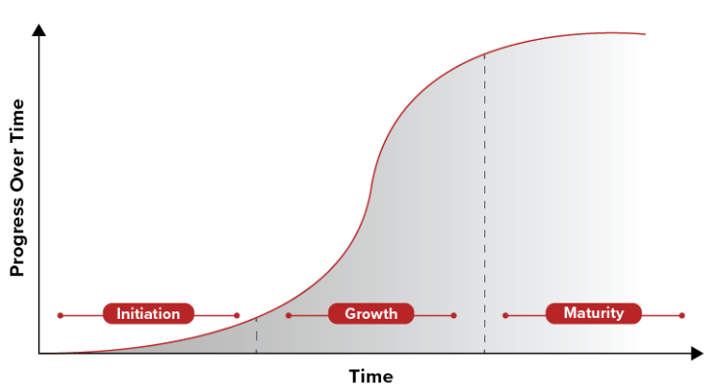
Chapter
S-Curve Overview
06
A graph that shows how the project is progressing over time
S-shape: starts slow → speeds up → slows down at the end
Planned line = what we expected to finish
Actual line = what we really did
Earned line = value of work completed
Helps the manager see delays or extra costs quickly

Slide 9
Agenda
Analyzing and Reporting Variances in Schedule and Cost
Analyzing and Reporting Variances
Understanding Project Analyses
S-Curve Overview
Tracking Gantt Chart
Control Charts
SPI and CPI Charts
Causes of Variances
Variance Thresholds
Root Cause Analysis (RCA)
Reporting Project Status
Projects Life Cycle
The Stage-Gate Process
Gatekeepers
The Stage-Gate Most Common Decisions
The Major Benefits of the Stage-Gate
Pitfalls That May Disrupt the Process
The Stage-Gate Vs life-cycle

Slide 10
Tracking Gantt Chart
Chapter
06
Compares actual vs baseline start/finish times for tasks
Visual format shows critical path impact
Updates reveal trends and causes of delays
Useful for cost monitoring alongside schedule
Immediate visual impact aids in corrective action

Slide 11
Agenda
Analyzing and Reporting Variances in Schedule and Cost
Analyzing and Reporting Variances
Understanding Project Analyses
S-Curve Overview
Tracking Gantt Chart
Control Charts
SPI and CPI Charts
Causes of Variances
Variance Thresholds
Root Cause Analysis (RCA)
Reporting Project Status
Projects Life Cycle
The Stage-Gate Process
Gatekeepers
The Stage-Gate Most Common Decisions
The Major Benefits of the Stage-Gate
Pitfalls That May Disrupt the Process
The Stage-Gate Vs life-cycle

Slide 12
Chapter
Control Charts
06
Used to track schedule performance over time
Shows if the project is ahead or behind schedule
Middle line = planned schedule (baseline)
Points above the line = ahead of schedule
Points below the line = behind schedule
Helps managers see performance trends quickly

Slide 13
Agenda
Analyzing and Reporting Variances in Schedule and Cost
Analyzing and Reporting Variances
Understanding Project Analyses
S-Curve Overview
Tracking Gantt Chart
Control Charts
SPI and CPI Charts
Causes of Variances
Variance Thresholds
Root Cause Analysis (RCA)
Reporting Project Status
Projects Life Cycle
The Stage-Gate Process
Gatekeepers
The Stage-Gate Most Common Decisions
The Major Benefits of the Stage-Gate
Pitfalls That May Disrupt the Process
The Stage-Gate Vs life-cycle

Slide 14
Chapter
SPI and CPI Charts
06
Used to measure project efficiency
SPI (Schedule Performance Index) → shows schedule performance
  SPI = 1.00 → on schedule
  SPI < 1.00 → behind schedule
  SPI > 1.00 → ahead of schedule
Charts help track performance trends over reporting periods

Slide 15
Chapter
SPI and CPI Charts
06
Used to measure project efficiency
CPI (Cost Performance Index) → shows cost performance
  CPI = 1.00 → on budget
  CPI < 1.00 → over budget
  CPI > 1.00 → under budget
Charts help track performance trends over reporting periods

Slide 16
Agenda
Analyzing and Reporting Variances in Schedule and Cost
Analyzing and Reporting Variances
Understanding Project Analyses
S-Curve Overview
Tracking Gantt Chart
Control Charts
SPI and CPI Charts
Causes of Variances
Variance Thresholds
Root Cause Analysis (RCA)
Reporting Project Status
Projects Life Cycle
The Stage-Gate Process
Gatekeepers
The Stage-Gate Most Common Decisions
The Major Benefits of the Stage-Gate
Pitfalls That May Disrupt the Process
The Stage-Gate Vs life-cycle

Slide 17
Chapter
Causes of Variances
06
Cost Variances:
Poorly defined scope, incorrect budgeting, excessive front-loading
Performing work out of sequence, scope creep
Premium wages, inefficient crew sizes, material delays
Schedule Variances:
Interruptions, inadequate supervision, rework
Late starts, incorrect task linkage, equipment breakdown
Crew issues, scope changes, insufficient resources

Slide 18
Agenda
Analyzing and Reporting Variances in Schedule and Cost
Analyzing and Reporting Variances
Understanding Project Analyses
S-Curve Overview
Tracking Gantt Chart
Control Charts
SPI and CPI Charts
Causes of Variances
Variance Thresholds
Root Cause Analysis (RCA)
Reporting Project Status
Projects Life Cycle
The Stage-Gate Process
Gatekeepers
The Stage-Gate Most Common Decisions
The Major Benefits of the Stage-Gate
Pitfalls That May Disrupt the Process
The Stage-Gate Vs life-cycle

Slide 19
Chapter
Variance Thresholds
06
Variances may not always require immediate action
Thresholds set based on risk tolerance and project size
Example: SPI ±5%, CPI ±8% → triggers investigation if exceeded
Helps distinguish normal fluctuations from serious issues
Thresholds may vary over project life cycle

Slide 20
Agenda
Analyzing and Reporting Variances in Schedule and Cost
Analyzing and Reporting Variances
Understanding Project Analyses
S-Curve Overview
Tracking Gantt Chart
Control Charts
SPI and CPI Charts
Causes of Variances
Variance Thresholds
Root Cause Analysis (RCA)
Reporting Project Status
Projects Life Cycle
The Stage-Gate Process
Gatekeepers
The Stage-Gate Most Common Decisions
The Major Benefits of the Stage-Gate
Pitfalls That May Disrupt the Process
The Stage-Gate Vs life-cycle

Slide 21
Chapter
Root Cause Analysis (RCA)
06
Systematic approach to identify causes of variances
Steps:
  Collect data
  Organize contributing factors
  Identify root causes
  Recommend solutions and track implementation
Focuses on correcting underlying issues, not symptoms

Slide 22
Agenda
Analyzing and Reporting Variances in Schedule and Cost
Analyzing and Reporting Variances
Understanding Project Analyses
S-Curve Overview
Tracking Gantt Chart
Control Charts
SPI and CPI Charts
Causes of Variances
Variance Thresholds
Root Cause Analysis (RCA)
Reporting Project Status
Projects Life Cycle
The Stage-Gate Process
Gatekeepers
The Stage-Gate Most Common Decisions
The Major Benefits of the Stage-Gate
Pitfalls That May Disrupt the Process
The Stage-Gate Vs life-cycle

Slide 23
Chapter
Reporting Project Status
06
Consolidate data from reports, schedules, and cost tracking
Status reports summarize project progress, not opinions
Include: completed tasks, delayed tasks, milestones, issues
Use concise, third-person, bullet format
Regular distribution ensures team alignment and proactive action

Slide 24
Agenda
Analyzing and Reporting Variances in Schedule and Cost
Analyzing and Reporting Variances
Understanding Project Analyses
S-Curve Overview
Tracking Gantt Chart
Control Charts
SPI and CPI Charts
Causes of Variances
Variance Thresholds
Root Cause Analysis (RCA)
Reporting Project Status
Projects Life Cycle
The Stage-Gate Process
Gatekeepers
The Stage-Gate Most Common Decisions
The Major Benefits of the Stage-Gate
Pitfalls That May Disrupt the Process
The Stage-Gate Vs life-cycle

Slide 25
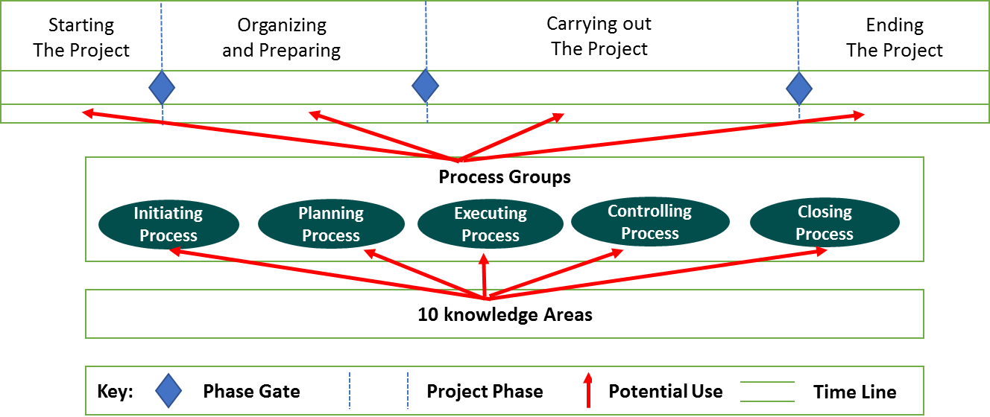
Chapter
Projects Life Cycle
06

Slide 26
Chapter
Projects Life Cycle
06
🔹 Phase Gates (Decision Points)
Represent checkpoints between phases (e.g., “Start → Plan → Execute → Close”).
Purpose: Decide whether the project should Continue, Stop, or Be Adjusted.
They ensure resources are not wasted on projects that are no longer viable.
Example: Before moving from “Organizing & Preparing” to “Carrying out the project,” management reviews cost, risks, and scope.

Slide 27
Chapter
Projects Life Cycle
06
🔹 Process Groups
The work performed inside each phase.
They are ongoing management activities that happen across all phases.
5 groups: Initiating, Planning, Executing, Controlling, Closing.
Example: While carrying out the project, the team is executing work, controlling progress, and sometimes re-planning.

Slide 28
Chapter
Projects Life Cycle
06
🔹 Relationship Between Them
Phase gates are “WHERE” decisions happen (end of a phase).
Process groups are “WHAT” you do inside phases to manage the work.
At each gate, outputs from the process groups are reviewed:
  Initiating → provides project charter for approval at Gate 1.
  Planning → provides detailed project plan for review at Gate 2.
  Executing + Controlling → progress reports & performance data reviewed at Gate 3.
  Closing → final deliverables reviewed at the last gate.

Slide 29
Chapter
Projects Life Cycle
06
✅ In short:
Gates = Decision checkpoints between phases.
Process Groups = Management actions within the phases.
The process groups produce deliverables and reports → which are then evaluated at gates to decide whether the project should move forward.

Slide 30
Chapter
Projects Life Cycle
06
Project Management Phases & Process Groups
The Four Project Phases:
Starting the Project
Organizing and Preparing
Carrying Out the Project
Ending the Project

Slide 31
Chapter
Projects Life Cycle
06
Phase Gates
Represent decision points before moving to next stage
Key checks: Feasibility, Resources, Risks, Approval
Diamond symbols in diagram = “Go / Kill / Hold / Recycle” decisions

Slide 32
Chapter
Projects Life Cycle
06
Process Groups Overview
Initiating
Define objectives & scope
Identify stakeholders
Secure approvals & resources

Slide 33
Chapter
Projects Life Cycle
06
Process Groups Overview
Planning
Develop project plan (schedule, cost, resources)
Risk management planning
Communication planning

Slide 34
Chapter
Projects Life Cycle
06
Process Groups Overview
Executing
Assign and manage teams
Coordinate resources
Deliver project outputs

Slide 35
Chapter
Projects Life Cycle
06
Process Groups Overview
Controlling
Track progress vs. plan
Manage changes
Monitor risks and quality

Slide 36
Chapter
Projects Life Cycle
06
Process Groups Overview
Closing
Formal project closure
Deliverables handover
Lessons learned & documentation

Slide 37
Chapter
Projects Life Cycle
06
Process Groups Overview
Key Pitfalls to Avoid
(Based on the list we built earlier)
Weak gatekeeping
Unrealistic deadlines
Poor communication
Lack of risk management
Misaligned objectives

Slide 38
Agenda
Analyzing and Reporting Variances in Schedule and Cost
Analyzing and Reporting Variances
Understanding Project Analyses
S-Curve Overview
Tracking Gantt Chart
Control Charts
SPI and CPI Charts
Causes of Variances
Variance Thresholds
Root Cause Analysis (RCA)
Reporting Project Status
Projects Life Cycle
The Stage-Gate Process
Gatekeepers
The Stage-Gate Most Common Decisions
The Major Benefits of the Stage-Gate
Pitfalls That May Disrupt the Process
The Stage-Gate Vs life-cycle

Slide 39
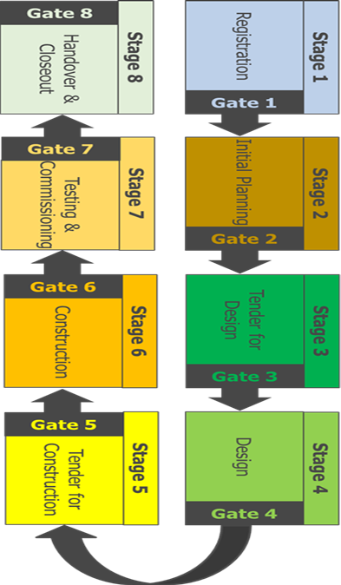
Chapter
The Stage-Gate Process
06
Provides a project delivery systematic process
1
Contains a list of critical deliverables for each of the 8 stages over the life cycle of the project
2
Contains a list of critical deliverables for each of the 8 stages over the life cycle of the project
3

Slide 40
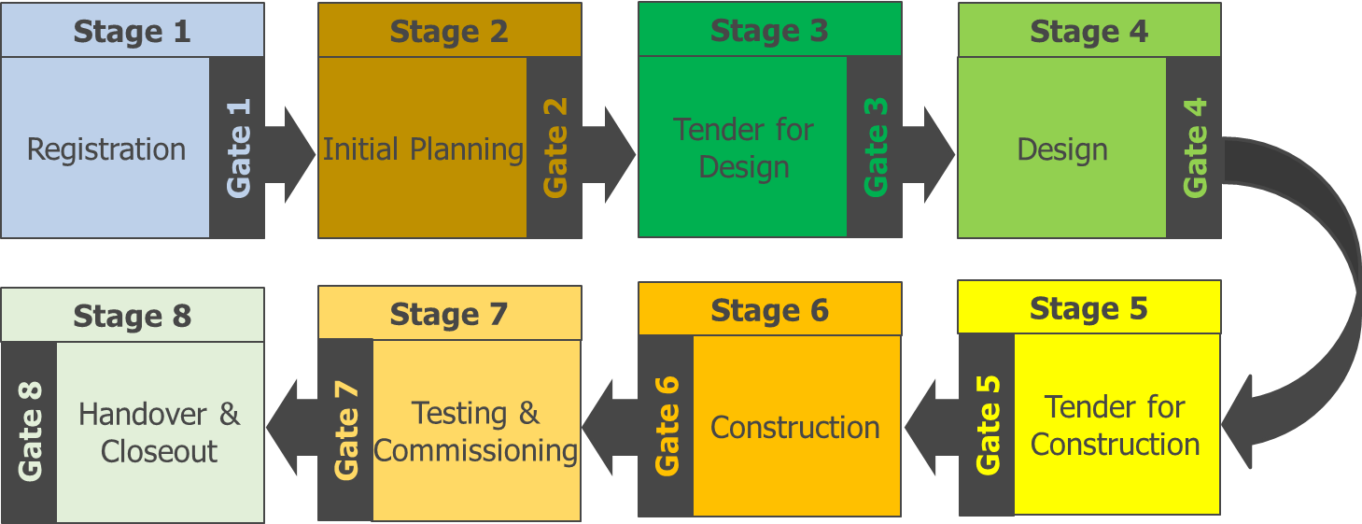
Chapter
The Stage-Gate Main Roles
06
Align Kick-off meeting and Gate Review Meeting to the project schedule
Participate in the kick-off meeting
Approve the stage deliverables.
Decide on “Go / No-go” to the next stage.
Assign the Gate Coordinator.
Gate Keeper

Slide 41
Chapter
The Stage-Gate Main Roles
06
Establish the Gate Committee.
Issue the Stage Gate Checklist.
Chair the Stage Kick-off Meeting.
Finalize the Stage Deliverable Checklist
Gate Coordinator

Slide 42
Chapter
The Stage-Gate Main Roles
06
Schedule the Gate Review Meeting
Chair the Gate Review Meeting
Prepare the Gate Review Summary sheet
Coordinate resolution of any deliverable deficiencies with Functional Departments
Gate Coordinator

Slide 43
Chapter
The Stage-Gate Main Roles
06
Participate in the Stage Kick-off Meeting.
Agree on the Stage Deliverable Checklist.
Confirm all Gate deliverables are complete.
Typical make-up: Project level Functional Department representatives from Engineering, Construction, Safety, Contracts, Quality, etc.
Gate Committee

Slide 44
Chapter
The Stage-Gate Main Roles
06
Functional Departments
Agree on the key stage deliverables.
Complete the assigned stage deliverables.
Support the Gate Committee by resolving any deliverable deficiencies.

Slide 45
Chapter
The Stage-Gate Process
06
The stage-gate process was created because the traditional organizational structure was designed primarily for top-down, centralized management, control, and communications, all of which were no longer practical for organizations that use project management and horizontal work flow.

Slide 46
Chapter
The Stage-Gate Process
06
Project management is used to manage the stages between the gates, and can shorten the time between the gates.
This is a critical success factor if the stage-gate process is to be used for the development and launch of new products.
A good corporate methodology for project management will provide checklists, forms, and guidelines to make sure that critical steps are not omitted.

Slide 47
Chapter
The Stage-Gate Checklists
06
Checklists for gate reviews are critical. Without these checklists, project managers can waste hours preparing gate review reports. Good checklists focus on answering these questions:
● Where are we today (i.e., time and cost)?
● Where will we end up (i.e., time and cost)?
● What are the present and future risks?
● What assistance is needed from management?

Slide 48
Agenda
Analyzing and Reporting Variances in Schedule and Cost
Analyzing and Reporting Variances
Understanding Project Analyses
S-Curve Overview
Tracking Gantt Chart
Control Charts
SPI and CPI Charts
Causes of Variances
Variance Thresholds
Root Cause Analysis (RCA)
Reporting Project Status
Projects Life Cycle
The Stage-Gate Process
Gatekeepers
The Stage-Gate Most Common Decisions
The Major Benefits of the Stage-Gate
Pitfalls That May Disrupt the Process
The Stage-Gate Vs life-cycle

Slide 49
Chapter
Gatekeepers
06
Project managers are never allowed to function as their own gatekeepers.
The gatekeepers are either individuals (i.e., sponsors) or groups of individuals designated by senior management and empowered to enforce the structured decision-making process.

Slide 50
Chapter
Gatekeepers
06
The gatekeepers are authorized to evaluate the performance to date against predetermined criteria and to provide the project team with additional business and technical information.
Gatekeepers must be willing to make decisions

Slide 51
Agenda
Analyzing and Reporting Variances in Schedule and Cost
Analyzing and Reporting Variances
Understanding Project Analyses
S-Curve Overview
Tracking Gantt Chart
Control Charts
SPI and CPI Charts
Causes of Variances
Variance Thresholds
Root Cause Analysis (RCA)
Reporting Project Status
Projects Life Cycle
The Stage-Gate Process
Gatekeepers
The Stage-Gate Most Common Decisions
The Major Benefits of the Stage-Gate
Pitfalls That May Disrupt the Process
The Stage-Gate Vs life-cycle

Slide 52
Chapter
The Stage-Gate Most Common Decisions
06
The four most common decisions are:
● Proceed to the next gate based upon the original objectives
● Proceed to the next gate based upon revised objectives
● Delay making a gate decision until further information is obtained
● Cancel the project

Slide 53
Chapter
The Stage-Gate Most Common Decisions
06
Sponsors must also have the courage to terminate a project. The purpose of the gates is not only to obtain authorization to proceed, but to identify failure early enough so that resources will not be wasted but will be assigned to more promising activities.

Slide 54
Agenda
Analyzing and Reporting Variances in Schedule and Cost
Analyzing and Reporting Variances
Understanding Project Analyses
S-Curve Overview
Tracking Gantt Chart
Control Charts
SPI and CPI Charts
Causes of Variances
Variance Thresholds
Root Cause Analysis (RCA)
Reporting Project Status
Projects Life Cycle
The Stage-Gate Process
Gatekeepers
The Stage-Gate Most Common Decisions
The Major Benefits of the Stage-Gate
Pitfalls That May Disrupt the Process
The Stage-Gate Vs life-cycle

Slide 55
Chapter
The Major Benefits of the Stage-Gate:
06
● Providing structure to project management
● Providing possible standardization in planning, scheduling, and control (i.e., forms, checklists, and guidelines)
● Allowing for a structured decision-making process

Slide 56
Agenda
Analyzing and Reporting Variances in Schedule and Cost
Analyzing and Reporting Variances
Understanding Project Analyses
S-Curve Overview
Tracking Gantt Chart
Control Charts
SPI and CPI Charts
Causes of Variances
Variance Thresholds
Root Cause Analysis (RCA)
Reporting Project Status
Projects Life Cycle
The Stage-Gate Process
Gatekeepers
The Stage-Gate Most Common Decisions
The Major Benefits of the Stage-Gate
Pitfalls That May Disrupt the Process
The Stage-Gate Vs life-cycle

Slide 57
Chapter
Pitfalls That May Disrupt the Process:
06
● Assigning gatekeepers and not empowering them to make decisions
● Assigning gatekeepers who are afraid to terminate a project
● Denying the project team access to critical information
● Allowing the project team to focus more on the gates than on the stages
● Treating the Stage-Gate process as a formality rather than a decision-making tool

Slide 58
Agenda
Analyzing and Reporting Variances in Schedule and Cost
Analyzing and Reporting Variances
Understanding Project Analyses
S-Curve Overview
Tracking Gantt Chart
Control Charts
SPI and CPI Charts
Causes of Variances
Variance Thresholds
Root Cause Analysis (RCA)
Reporting Project Status
Projects Life Cycle
The Stage-Gate Process
Gatekeepers
The Stage-Gate Most Common Decisions
The Major Benefits of the Stage-Gate
Pitfalls That May Disrupt the Process
The Stage-Gate Vs life-cycle

Slide 59
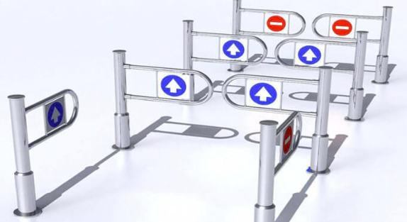
Chapter
The Stage-Gate Vs life-cycle
06
The stage-gate process appears to have been replaced by life-cycle phases. Although there is some truth in this, the stage-gate process is making a comeback.

Slide 60
Chapter
The Stage-Gate Vs life-cycle
06
Since the stage-gate process focuses on decision-making more than life-cycle phases, the stage gate process is being used as an internal, decision-making tool within each of the lifecycle phases.

Slide 61
Chapter
The Stage-Gate Vs life-cycle
06
The stage-gate process appears to have been replaced by life-cycle phases. Although there is some truth in this, the stage-gate process is making a comeback.

Slide 62
Chapter
The Stage-Gate Vs life-cycle
06
The advantage is that, while life-cycle phases are the same for every project, the stage-gate process can be custom-designed for each project to facilitate decision making and risk management.

Slide 63
Chapter
The Stage-Gate Vs life-cycle
06
Every program, project, or product has certain phases of development known as life-cycle phases.
A clear understanding of these phases permits managers and executives to better control resources to achieve goals.

Slide 64


Thank You

