Slide 1


Project Feasibility Study
PMG201
Prepared by Dr. Manal El-Sayed
PLANNING THE PROJECT
Lecture 6

Slide 2

Lecture 6
1. The Contents of a Project Plan—The “Project Charter”.
2. The Planning Process—Overview.
3. The Planning Process—Nuts and Bolts.
4. More on the Work Breakdown Structure and Other Aids .
5. Multidisciplinary Teams—Balancing Pleasure and Pain.

Slide 3

Lecture 6
Introduction
If problems arise during the life of a project, our first hunch would be that the project was not properly planned. Most of the time our hunch would be correct. Inadequate planning is more the case than the exception.

Slide 4

Lecture 6
Project Planning
Basic objective:
  To create a plan to meet the commitments of the project.
  Create a path that, if followed, will lead to a successful project.
Planning involves
  Defining the LC process to be followed, estimates, detailed schedule, plan for quality, etc.
Main output
  A project management plan, and
  project schedule.

Slide 5
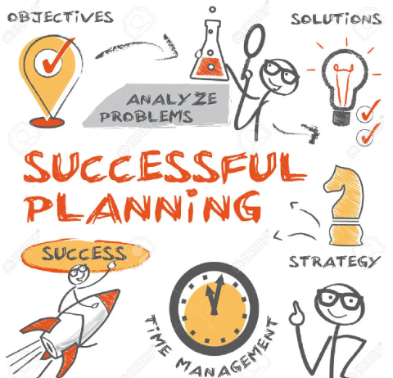
Lecture 6
Key Planning Tasks
Define suitable processes for executing the project.
Estimate effort.
Define project milestones and create a schedule.
Define quality objectives and a quality plan.
Identify risks and make plans to mitigate them.
Define measurement plan, project-tracking procedures, training plan, team organization, etc.

Slide 6

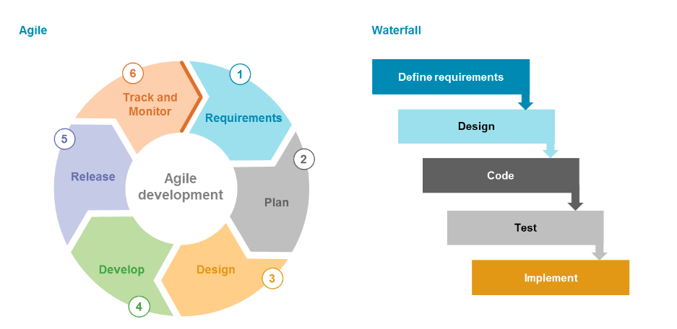
Life Cycle Process
Various LC models - waterfall, iterative, prototyping; diff models suit different projects
During planning can select the model that is best for the project.
This gives the overall process which has to be fine-tuned to suit the project needs
Usually done by process tailoring - changing the process to suit the project
Tailoring finally results in adding, deleting, modifying some process steps

Slide 7
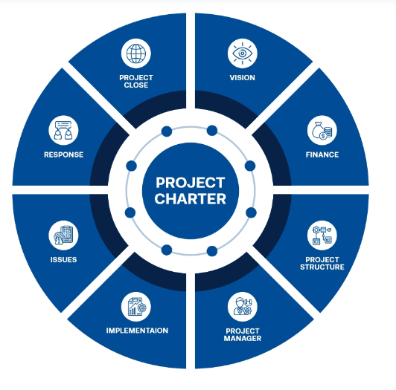
Lecture 6
The Contents of a Project Plan
The Project Charter
It is a document that serves to formally announce the selection and approval of the project, as well as grant the project manager the authority to meet project objectives using organizational resources. It also includes the main goals of the project, and the designation of roles and responsibilities.

Slide 8
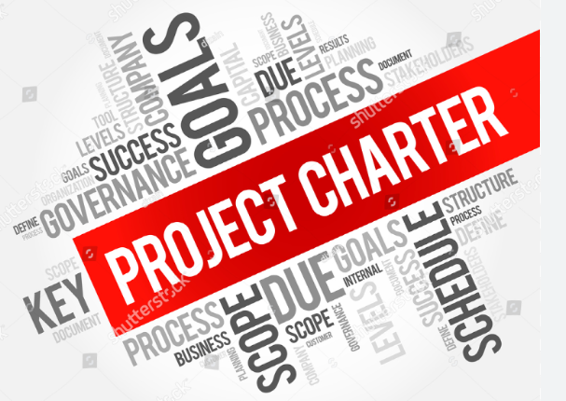
The Project Charter
The purpose of the project charter is to provide support for the project managers involved, as well as helping the stakeholders to understand what the given project is hoping to accomplish. It defines the project's success, offers deadlines, provides information on identified risks, and outlines the budget. The project charter serves as the basis for the project planning, and it maps out each step of the way so that any changes can be implemented easily and smoothly.

Slide 9

Lecture 6
The project plan fall into one of the following nine categories:
Overview.
Objectives.
General approach.
Contractual aspects.
Schedules.
Resource requirements .
Personnel.
Risk management.
Evaluation methods.

Slide 10

Lecture 6
1- Overview
This section contains a brief description of the project and its deliverables This section should include the Business Case for the project.
The Business Case includes the strategic reasons for the project, its expected profitability and competitive effects as well as the desired scope and any other technical results. The main goal of the Business Case is to communicate to project team members (and others) the reasons why the organization is undertaking the project.
.

Slide 11

Lecture 6
2. Objectives.
This is a more detailed description of the project ’ s scope, its deliverables and outcomes. Another approach to describing a project ’ s objectives is the project mission statement. While somewhat similar to the Business Case, the focus of the mission statement is to communicate to project team members (and others) what will be done to achieve the project ’ s overall objectives. To foster team understanding of the project as a whole.

Slide 12

Lecture 6
3. General approach.
In this section, the technological and managerial approaches to the work are described. Also noted are plans that go beyond the organization ’ s standard management practices. For example, some firms do not allow the use of consultants or subcontractors without special approval.

Slide 13

Lecture 6
4. Contractual aspects
This section contains a complete description of all agreements made with the client or any third party. This list would include all reporting requirements; the technical specifications of all deliverables; agreements on delivery dates.
If relevant, it may contain agreements to comply with legal, environmental, and other constraints on the project work and outputs.

Slide 14

Lecture 6
5. Schedules
An outline of all schedules and milestones. Each task in the project is listed in a project WBS. Listed with each task is the time required to perform it. The project schedule is constructed from these data and is included in this section.

Slide 15

Lecture 6
6. Resource requirements
Estimates of project expenses, both capital and operating, are included here. The costs associated with each task are shown, and overhead and fixed charges are listed. In addition, cost monitoring and cost control procedures are described here. The details of materiel acquisition are also detailed in this section.

Slide 16

7. Personnel.
This section covers the details of the project work force. It notes any special skill requirements, necessary training. Combined with the schedule, it notes the time - phasing of all personnel requirements.

Slide 17

Lecture 6
8. Risk management
Planners should list the major and minor disasters that may strike projects. The argument is made that crises cannot be predicted.
The only uncertainty, however, is which of the crises will occur and when. In any case, dealing with crises does not require a which - and - when prediction. Contingency plans to deal with such potential crises should be a standard part of the project plan.

Slide 18

Lecture 6
9. Evaluation methods.
Descriptions of all project evaluation procedures and quality standards are found in this section. Also included are procedures to ensure compliance with all corporate requirements for monitoring, collecting, and storing data on project performance.

Slide 19

Lecture 6
2. The Planning Process—Overview
A great deal has been written about planning. Some of the literature focuses on the strategic aspect of planning — choosing and planning projects that contribute to the organization ’ s goals.
Another body of writing is directed at the techniques of how to plan rather than what to plan.
As far as we can determine, the way that planning techniques vary in these different cases has more to do with nomenclature than substance.

Slide 20

Lecture 6
The following planning process that has been divided into EIGHT distinct steps.
Develop and evaluate the concept of the project. Describe what it is you wish to develop, including its basic performance characteristics, and decide if getting such a deliverable is worthwhile.
Carefully identify the actual capabilities that the project ’ s deliverable must have to be successful.
Create a system (product or service), which is to say, build a prototype deliverable.
Test the prototype to see if it does, in fact, have the desired capabilities. If necessary, cycle back to step 3 to modify the prototype and retest it. Continue until the deliverable meets the preset requirements.

Slide 21
Lecture 6
5. Integrate the deliverable into the system for which it was designed.
6. Validate the deliverable — which answers the question, “does it still work properly? ”
7. If the deliverable has been validated, let the client test it. Can the client operate the system? If not, instruct the client.
8. If the client can operate (and accepts) the deliverable, make sure that the client understands all standard operating and maintenance requirements. Then shake the client ’ s hand, present the client with a written copy of maintenance and operating instructions, give the client the bill, and leave.

Slide 22

Lecture 6
3. The Planning Process—Nuts and Bolts
This section deals with the problem of determining and listing the various tasks that must be accomplished in order to complete a project. The important matters of generating a project budget and developing a precise project schedule are left to coming chapters, though much of the raw material for doing those important things will come from the planning process described here.

Slide 23
Lecture 6
The Planning Process—Nuts and Bolts cont. …
The project launch meeting sets the project scope, demonstrates managerial commitment to the project, and initiates the project plan. The result is a WBS that lists all the tasks required to carry out the plan together with task resource requirements, durations, predecessors, and identification of the people responsible for each task.

Slide 24
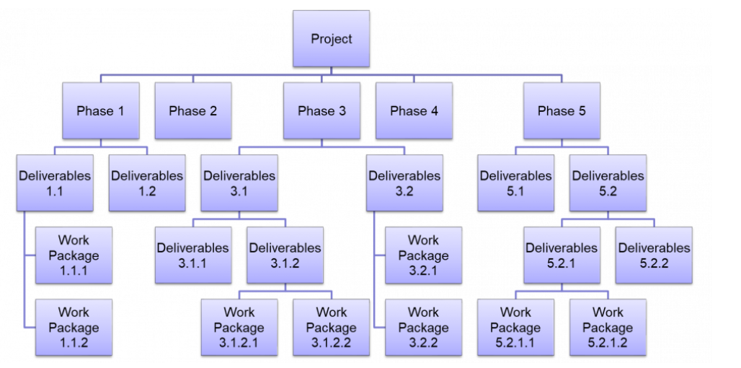
Lecture 6
4. More on the Work Breakdown Structure and Other Aids
The process of building a WBS is meaningful. The PM and individual team members may differ on the technical approach to working on the task, the type and quantity of resources needed, or the duration for each subtask. If so, negotiation is apt to accompany the planning process. As usual, participatory management and negotiation often lead to improved project performance and better ways of meeting the project ’ s goals.

Slide 25
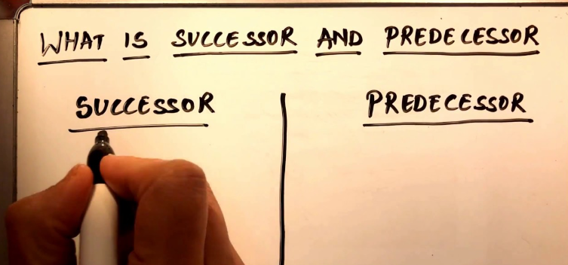
Lecture 6
More on the Work Breakdown Structure and Other Aids cont.
1. All project activities will be identified and arranged in successively finer detail, that is, by levels.
2. For each activity, the type and quantity of each required resource (including personnel) are identified.
3. For each activity, predecessors and task duration are estimated.
4. All project milestones are identified and located on the project schedule following their predecessor activities.
5. For each activity, the individual or group assigned to perform the work is identified.

Slide 26

Lecture 6
More on the Work Breakdown Structure and Other Aids cont.
6. If project milestones, task durations, and predecessors are combined, the result is the project master schedule.
7. The master schedule allows the PM to compare actual and planned task durations and resource usage at any level of activity.
The need for such comparisons provide the information about project performance should be monitored. This gives the PM the ability to control the project and take corrective action if the project is not proceeding according to plan.

Slide 27
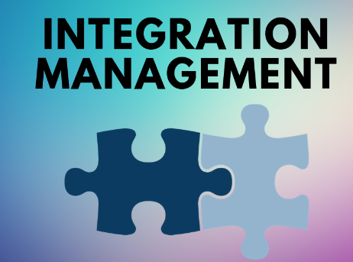
Lecture 6
5. Multidisciplinary Teams, Balancing Pleasure and Pain
Integration Management
Integration management is an organized approach that ensures all processes within a project are synchronized and executed efficiently, and resources remain on track to achieve the project goals. It helps project managers to balance stakeholder expectations and customer needs while optimizing tasks and resources, steering the project toward success.
what can be achieved through integration management:
Processes and tasks can be organized and listed out.
Team members can be allocated responsibilities.
Shared resources and their overlapping schedules are managed.
Work efficiency within teams is enhanced.

Slide 28
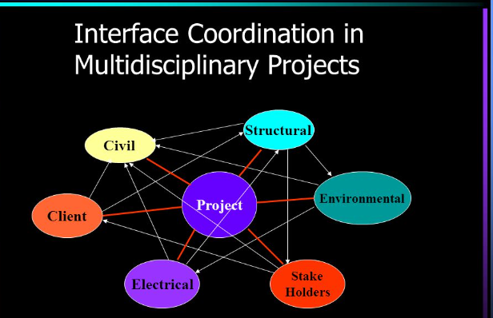
Lecture 6
Interface Coordination , Interface Management
One of the PM ’ s more difficult problems is coordinating the work of different functional groups interacting as team members. The team members come from different functional areas and often are not used to dealing with one another directly.
For the most part, they have no established dependencies on each other and being co - members of a team is not sufficient to cause them to associate — unless the team has a mission that makes it important for the members to develop relationships.

Slide 29
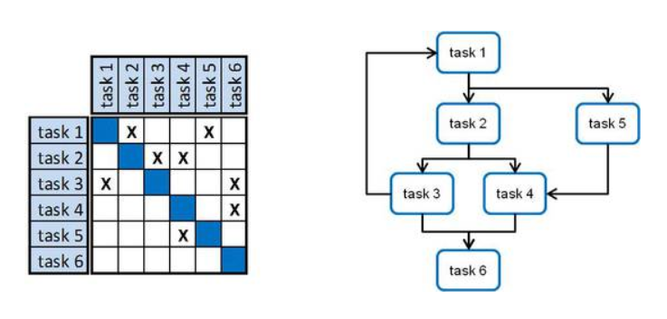
Lecture 6
The Design Structure Matrix
The Design Structure Matrix (DSM) is a general method for representing and analyzing system models in a variety of application areas. A DSM is a square matrix that shows relationships between elements in a system.
DSM has two main advantages:
It provides a simple and concise way to represent a complex system.
It is amenable to powerful analyses, such as clustering and sequencing.

Slide 30

Lecture 6
Comments on Empowerment and Work Teams
Some of the more important advantages of empowerment are:
1. Teams generate high - quality solutions to appropriate problems.
2. Micromanagement is avoided.
3. The team is given accountability for some part of the project deliverable.
4. Synergistic solutions are frequent.
5. The PM has a tool for timely team evaluation and feedback.

Slide 31

Lecture 6

