Slide 1


Project Management Technologies
PMG 312
Prepared by Dr. Majid Saad
PMP, PMI-ACP, PMI –ACP
PMG 312- L10
AI in Project Management
Key Updates in the 8th Edition of the (PMBOK®)
Enterprise project management Office - EPMO

Slide 2



Project Management Technologies PMG 312
PMG 312- L10
AI in Project Management
Key Updates in the 8th Edition of the (PMBOK®)
Enterprise project management Office - EPMO

Slide 3
PMG 312
Outline
AI in Project Management
Key Updates in the 8th Edition of the (PMBOK®)
Enterprise project management Office - EPMO

Slide 4
PMG 312
AI in Project Management
Artificial Intelligence (AI) refers to the technology that enables computer systems to perform human-like cognition, learning, reasoning, problem solving and other tasks by simulating human intelligence processes.

Slide 5
PMG 312
Impact of Artificial Intelligence on Project Management
Artificial intelligence technology has brought far-reaching impacts on project management.
Firstly, AI technology can provide more accurate and faster data analysis and prediction capabilities, providing more reliable support for project decision-making.
Secondly, AI technology can automate and intelligentsia various aspects of project management, such as task allocation, progress monitoring, risk identification, etc., improving the efficiency and precision of project management.

Slide 6
PMG 312
Impact of Artificial Intelligence on Project Management
Thirdly , AI technology can facilitate communication and collaboration between teams through intelligent collaboration tools and platforms, enabling cross-regional and cross-cultural project teams to work together.
The application of AI technology can help project managers better cope with uncertainty and change, improve project adaptability and flexibility, and thus enhance project success and competitiveness
In summary, the impact of AI on project management lies in the improvement of management efficiency, optimization of the decision-making process, and enhancement of teamwork, which provides a more reliable guarantee for project success.

Slide 7
PMG 312
AI in Project Management
80%
of project management tasks will be run by AI by 2030 (PMI, 2025)

Slide 8
PMG 312
AI in Project Management
86%
Of enterprises rank AI and big data as top-priority skills for their workforce (PMI, 2025)

Slide 9
PMG 312
AI in Project Management
Only 1%
of organizations believe they’ve reached GenAI maturity, according to PMI research (PMI, 2025)

Slide 10
PMG 312
AI in Project Management
Generative artificial intelligence (GenAI) has rapidly become a top priority for executive leaders.
GenAI is now the most frequently deployed AI solution in organizations, and 89% of executives rank it among their top three technology priorities, according to McKinsey.
Yet only 1% of organizations believe they have reached GenAI maturity, revealing a stark mismatch between ambition and readiness.

Slide 11
PMG 312
AI in Project Management
The rapid evolution of GenAI is redefining how organizations approach project management, moving from traditional methods toward more adaptive, intelligent and data-informed practices.
As project professionals begin to explore the possibilities Gen AI offers, the challenge is no longer just about understanding the technology, but about building the right environment to support its effective and sustainable use.
Successful transformation isn’t just about the tools but about creating a culture where innovation is encouraged, outcomes are measurable and collaboration is embedded into the process.”.

Slide 12
PMG 312
AI in Project Management
AI tools are highly useful to the project manager in terms of controlling and monitoring the project. The trend of merging different AI tools continues to hold sway, wherein the strengths of one tool can compensate for the weaknesses of another.
AI will make all the decisions and will manage the resources in an optimal and timely manner, while the project manager will take the role of data scientist, working as part of a team with the AI to interpret the data and the decision making. Overall, then, project managers will continue to play a crucial role when the AI is fully developed.

Slide 13
PMG 312
AI in Project Management
AI is a support tool for managers, but it does not completely replace them. To make the most of the benefits of AI, managers need to develop complementary skills. They need to redefine their role as leaders within the organization and focus on the social and relational dimension of their work.
Managers must find new ways to exercise leadership and manage teams. In addition to technical skills, emotional intelligence and communication and listening skills are becoming essential for managers

Slide 14
PMG 312
How Organizations Can Enable Project Professionals to Move From Individual Experimentation to Systematic Transformation
When organizations commit to supporting GenAI adoption, the initiative goes beyond doing the same with less.
More than simply enabling project professionals to do existing tasks more efficiently, well-supported GenAI implementation enhances the fundamental capabilities of project professionals.
As Matt Segelman, president of the Burning Glass Institute and senior advisor at Harvard University’s Project on Workforce (USA) argues, this “makes project professionals more valuable by increasing the numerator in the productivity equation, not just reducing the denominator.”

Slide 15
PMG 312
Organizational Preparedness and Initiative
The rapid advancement of Generative AI necessitates that project professionals take ownership of their learning.
Self-directed development is critical to remaining competitive. Leading organizations facilitate this by providing AI upskilling opportunities and leveraging modern learning and development tools, such as workshops, webinars and innovation cohorts.
Access to learning and growth opportunities has become a key factor when onboarding or transitioning roles. Consequently, a handshake of continuous learning mindset with commitment to growth is essential for success in this dynamic landscape.”

Slide 16
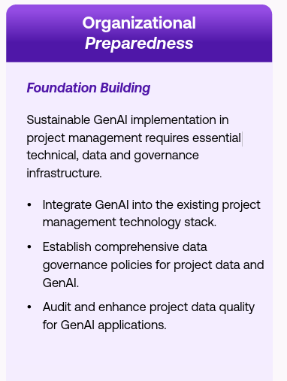
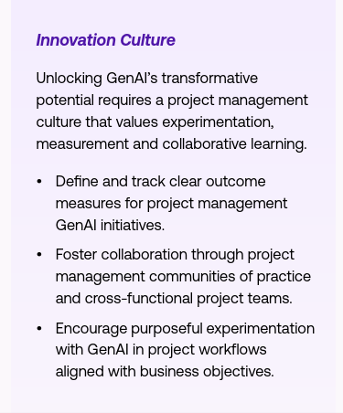
PMG 312
Organizational Preparedness and Initiative

Slide 17
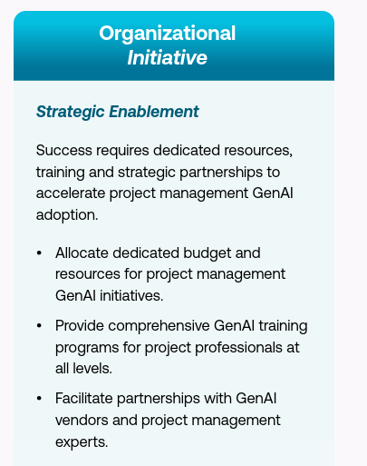
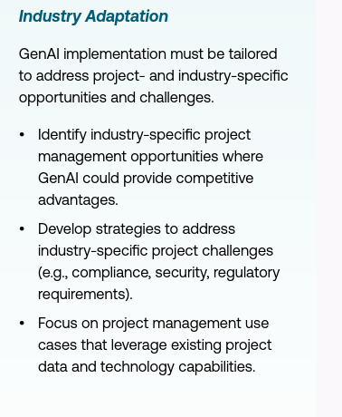
PMG 312
Organizational Preparedness and Initiative

Slide 18
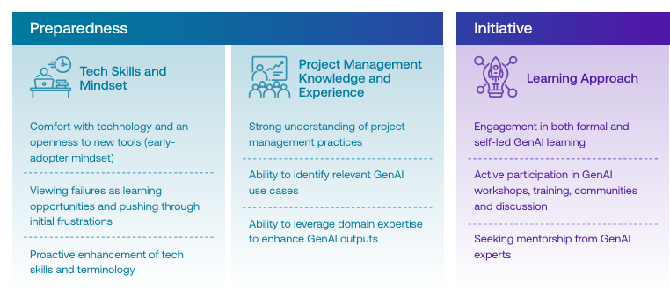
PMG 312
Organizational Preparedness and Initiative

Slide 19
PMG 312
GenAI Adoption and Productivity Gains
Adoption:
The frequency and extent of GenAI usage in project management. Increase in adoption is frequency of use compared to six months prior. For example, an initial 2x to 3x (100 to 200%) increase in adoption means using GenAI twice to thrice as much as before, whether through using it for more projects, more tasks within projects or both.
Productivity:
The reported work efficiency achieved using GenAI in project management. Increase in productivity is the efficiency achieved by using GenAI compared to not using it. For example, an initial 2x to 3x (100 to 200%) increase in productivity means completing the same work in half the time or less when using GenAI versus not using it.

Slide 20
PMG 312
Taking the Lead: Start Your GenAI Journey Now
27% of project professionals report GenAI already impacts more than half their work, and 46% expect this level of impact to increase in the next five years. Those who embrace this technology now will set themselves apart, not only in their current roles but in the future of project management itself.
We encourage project professionals to take charge of their own GenAI journey , exploring available tools, experimenting with use cases and building foundational skills independently. By doing so, they position themselves as forward-thinking leaders who can advocate for and drive GenAI adoption within their organizations, ultimately benefiting both their organization and their personal careers

Slide 21
PMG 312
Taking the Lead: proactive steps to lead your own GenAI journey
1- Own Your Learning Path
Your GenAI journey is personal. Begin by exploring tools that align with your daily tasks, even if they’re as simple as data summarization or initial report generation. Dive into online resources, workshops or even peer discussions to deepen your understanding. A growth mindset toward this technology will enable you to stay adaptable and skilled as GenAI continues to evolve.

Slide 22
PMG 312
Taking the Lead: proactive steps to lead your own GenAI journey
2- Experiment and Iterate
Experimentation is essential for mastering GenAI tools. Try new applications, discover what works for your unique needs and don’t be deterred by initial setbacks. Treat each learning curve as part of your path forward.
The resilience to push through obstacles will enable you to tackle more sophisticated tasks with GenAI, which are bound to yield significant improvements in productivity and project outcomes.

Slide 23
PMG 312
Taking the Lead: proactive steps to lead your own GenAI journey
3- Seek Out Resources and Ask for Support
While individual initiative is all that’s in your control, organizational support can significantly accelerate your GenAI journey. If your organization doesn’t yet offer the resources or structured learning paths you need, leverage the tools available to you and communicate your needs to leadership.
Taking charge by advocating for necessary resources and fostering discussions around GenAI’s potential benefits may encourage broader organizational support for this transformative technology.

Slide 24
PMG 312
Taking the Lead: proactive steps to lead your own GenAI journey
4- Lead by Example
As you develop your proficiency, share your learning and experiences with peers. Mentor others who are less familiar with GenAI and build a community of practice within your organization. .
If your superiors are hesitant about GenAI, demonstrate how it can be utilized safely and ethically in your organization. Leading by example can foster a culture of continuous learning and adaptation, which is critical in a landscape that’s continuously being reshaped by technological advancements..

Slide 25
PMG 312
Taking the Lead: proactive steps to lead your own GenAI journey
5- Elevate Your Role With GenAI
Consider how GenAI can enhance your strategic value. Use it to drive data-backed insights, improve decision-making and introduce innovative project practices.
Discover case studies uniquely applicable to your organization or industry.
Set a goal for how you want your GenAI expertise to burnish your profile as a project professional and map out a clear roadmap for getting there.
By applying GenAI thoughtfully, you position yourself as a forward-thinking project professional capable of navigating complex challenges and adding measurable value If your superiors are hesitant about GenAI, demonstrate how it can be utilized safely and ethically in your organization

Slide 26
PMG 312
Key actions for organizations
Conduct a comprehensive infrastructure audit of your current technology stacks and governance practices specifically for project management GenAI readiness, benchmarking against industry leaders where possible.
Establish comprehensive GenAI usage policies for project contexts that balance individual initiative with organizational support, including clear guidelines for appropriate project use cases, project data-handling protocols and risk management procedures.
Enhance project data quality systematically by identifying inconsistencies in project information, cleaning and standardizing both structured and unstructured project data and ensuring optimization for project management GenAI applications.

Slide 27

PMG 312
Key actions for organizations
“ Organizations must invest in resources and support experimentation. Provide employees with training, tools and incentives to help them develop their GenAI skills”

Slide 28
PMG 312
Key actions for organizations
Allocate dedicated budgets for project management GenAI initiatives and comprehensive training programs, treating these as strategic investments in project delivery capabilities rather than operational expenses.
Democratize training access by ensuring GenAI education for project management reaches all organizational levels, from project team members to PMO leaders, to prevent skill gaps that constrain project delivery improvements.
Establish strategic partnerships with GenAI vendors and industry experts specializing in project management applications to provide hands-on learning opportunities and accelerate project capability development.

Slide 29
PMG 312
Key actions for organizations
Create specialized roles such as dedicated project management GenAI teams or GenAI champions within PMOs to drive adoption and provide internal expertise and support for project teams.
Foster systematic knowledge sharing through communities of practice where project professionals can exchange good practices and learn from each other’s GenAI experiences in project planning, execution and delivery

Slide 30
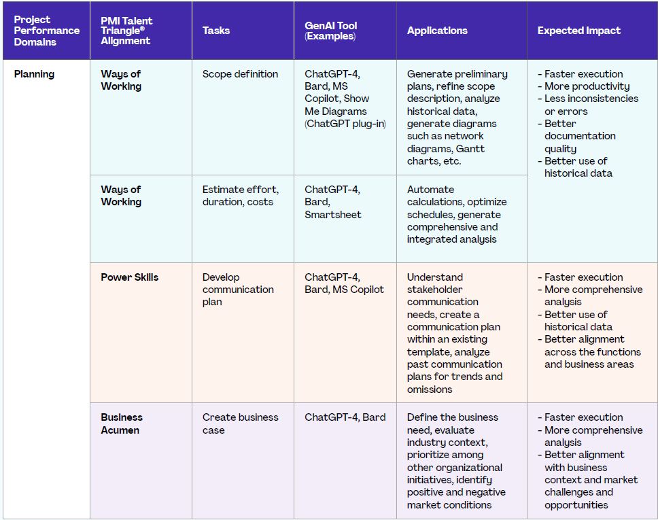
PMG 312
Putting GenAI to Work

Slide 31
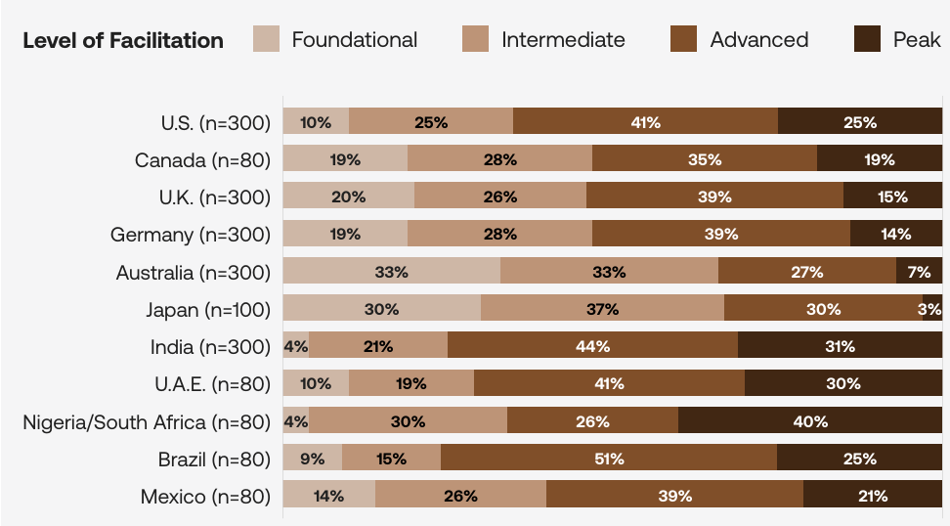
PMG 312
Organizational GenAI Facilitation and Adoption Level by Country

Slide 32
PMG 312
AI Project Management Applications
Table 1: Task & Workflow Automation AI
AI Application | Main Use in Project Management | Examples of How It Helps
Monday.com AI | Workflow automation, delay prediction | Automatically assigns tasks based on workload, flags bottlenecks before they affect deadlines
Asana AI | Priority setting, task automation | Suggests task priorities, recommends the best person for tasks, predicts tasks that may be overdue
Trello AI (Butler) | Task automation, rule-based workflows | Sends automatic reminders, moves cards to next stage when tasks are completed
Microsoft Copilot for Project | Automated planning, scheduling, risk analysis | Generates project timelines, creates Gantt charts, summarizes project status

Slide 33
PMG 312
AI Project Management Applications
Table 2: Analytics, Reporting & Knowledge AI
AI Application | Main Use in Project Management | Examples of How It Helps
ClickUp AI | Documentation, reporting, performance analysis | Writes meeting notes, generates reports automatically, tracks project KPIs
Jira Intelligence | Agile sprint planning, workload prediction | Auto-classifies issues, predicts sprint capacity, suggests workload balance
Notion AI | Knowledge management, meeting summaries | Creates project briefs, extracts action items from notes
Power BI with AI | Predictive analytics, dashboards | Forecasts costs, predicts schedule slippage, visualizes risk trends
Wrike AI | Risk prediction, delay alerts | Highlights high-risk tasks early, sends alerts on potential delays

Slide 34
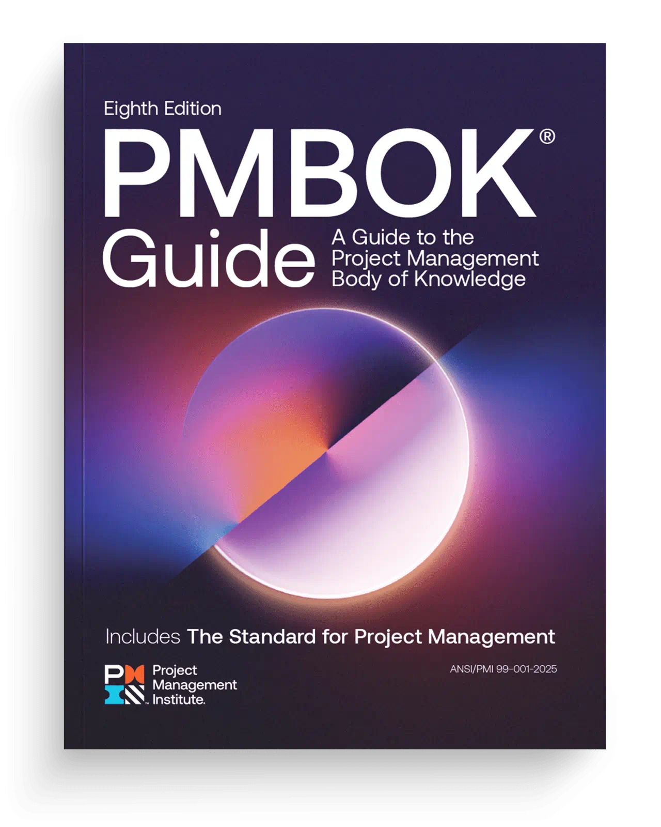
Key Updates in the 8th Edition of the Project Management Body of Knowledge (PMBOK®)

Slide 35
PMBOK 8: Critical change
The Project Management Body of Knowledge (PMBOK) is a globally recognized standard that provides guidelines, best practices, and principles for effective project management. With the release of PMBOK 8, the framework has evolved to reflect the dynamic nature of modern projects, emphasizing adaptability, value delivery, and stakeholder engagement.
PMBOK 8 introduces several critical updates compared to previous editions, focusing on: Modernizing key terms and concepts, Refining guiding principles.

Slide 36
PMBOK 8: Critical change
Reintroducing process groups as flexible focus areas, and Updating project management performance domains to align with current practices.
These changes aim to provide project managers with a more holistic, flexible, and practical approach to managing projects in diverse industries and complex environments. Understanding these updates is essential for practitioners seeking to improve project outcomes and maintain alignment with global standards.

Slide 37
PMBOK 8: Critical change
PMBOK 8 introduces several critical updates compared to previous editions, focusing on four main categories:
Key term and concept updates,
Principle refinement,
Reintroduction of Process Groups as Focus Areas, and
Project management performance domain updates..

Slide 38
Key Changes from PMBOK 7 to PMBOK 8: An Overview
Aspect | PMBOK 7th Edition | PMBOK 8th Edition
Framework | Flexible, based on principles, driven by value | Expanded principles, digital transformation, complex
Principles | 12 guiding principles | Six fundamentals (streamlined and refined)
Performance Domains | 8 core domains (Team, Stakeholders, Development, etc.) | 7 domains driven by processes, with particular attention to outcomes
Process Groups & Details | Processes de-emphasized, more abstract | Process groups are reintroduced (like PMBOK 6), can be implemented
Digital/Tech Emphasis | Reference to agile/hybrid/tech tools | Focus on AI, machine learning, automation, and digital technologies
Sustainability/Ethics | Coverage is limited | Principles of sustainability are firmly anchored in ethics
Value Focus | Value delivery, systems-thinking | Value creation as the main concept
Methodology Flexibility | Waterfall Flexible, hybrid-encouraged | Hybrid digital-first, agile, high-adaptability

Slide 39
Key Features: The Evolution Continues
Greater Emphasis on Value: PMBOK 8 elevates the concept of value creation as the central theme, ensuring projects align with organizational strategy and deliver measurable benefits.
Expanded Focus on Sustainability: Integrates environmental, social, and governance (ESG) considerations into project management practices.
Enhanced Digital Tools: Addresses the integration of AI, data analytics, and other emerging technologies in project management.
Global Relevance: Broader application across cultures and industries, reflecting global project management trends.

Slide 40
Key Features: The Evolution Continues
The PMBOK 8th Edition preview of the Table of Contents lists six actionable principles as the foundation of the new guide:
Adopt a Holistic View
Focus on Value
Embed Quality Into Processes and Deliverables
Be an Accountable Leader
Integrate Sustainability
Build an Empowered Culture

Slide 41
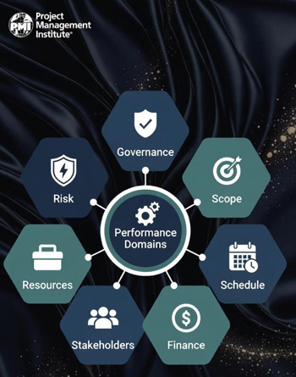
Key Features: The Evolution Continues
According to the PMBOK® 8th Edition preview of the Table of Contents, seven performance domains are identified:
Governance
Scope
Schedule
Finance
Stakeholders
Resources
Risk

Slide 42
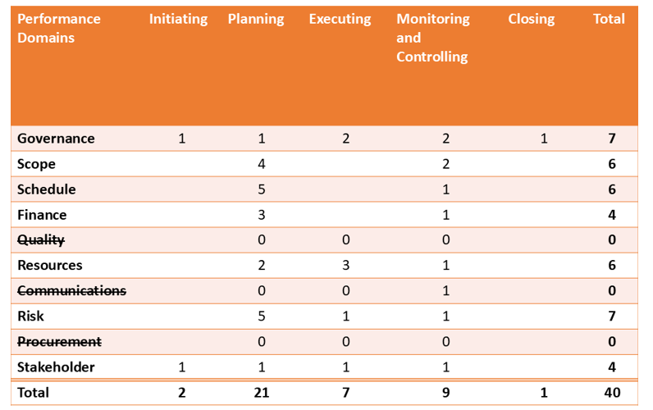
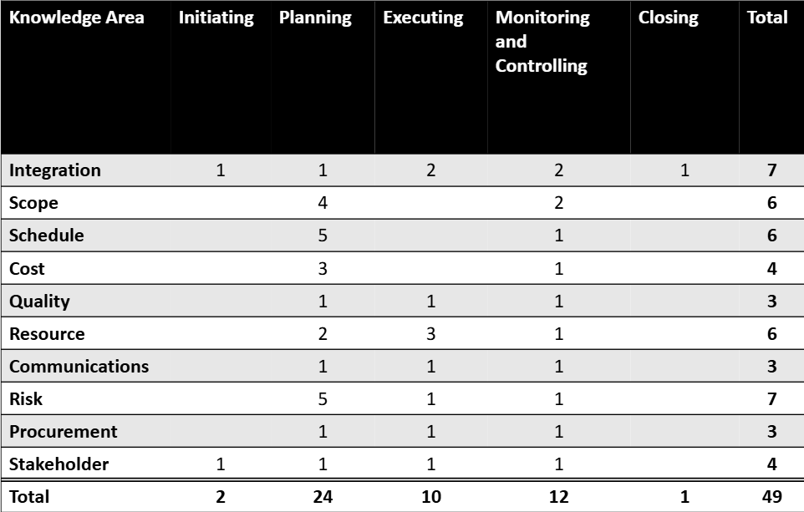
PMBOK 8th Edition & PMBOK 6/7th Edition Processes

Slide 43
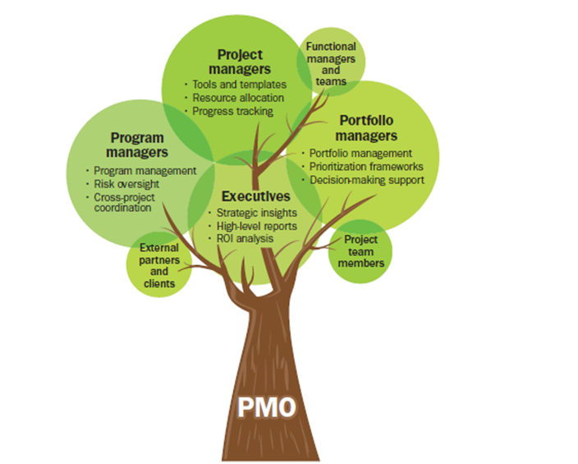
Enterprise project management Office - EPMO

Slide 44
PMG 312
Introduction
Enterprise project management office
Introduction
Project, program, and portfolio management
Prioritize projects to align with strategic plans. Moving to the enterprise project management office What is the organization maturity baseline? Steering committee Summary

Slide 45
Enterprise project management office-EPMO - Introduction
The EPMO is created to assist in decisions related to making sure the right organizational projects are done at the right time, with the right tools and templates, and that they contribute to the organization’s strategic plans.
The following list summarizes 16 common reasons why this organizational initiative may suffer from mediocre success:

Slide 46
EPMO - Introduction
The following list summarizes 16 common reasons why this organizational initiative may suffer from mediocre success:
1 | Authority | Many PMO managers report to a functional manager who in turn reports to some higher-level executive. This multi-layer reporting situation increases the challenge of proving the worth of the organization. This can be enhanced if the PMO reports directly to the higher-level executive. PMOs vary in size, responsibilities, and structure, but if they are embedded in a functional unit such as IT, the odds are that it is not a real EPMO because its focus is more limited to that organizational subgroup. Also, the EPMO organization will be perceived as “just some IT thing” and as a result, it will not be respected as having a more global role.
2 | Organizational alignment | This problem occurs when the location or formal authority of the PMO function does not align or link with its design goals. For example, this can include the project scope, planning time frame, or overall business objectives. In addition to this, the PMO needs to align its key status measurements to the business objectives that executives value the most.
3 | Process Involvement | It is imperative that the PMO function be actively involved in the project selection process. This will help to ensure that the correct projects are being pursued—in short, portfolio assets optimization.
4 | Stovepipe view | This management syndrome relates to the focus of the PMO organization. In essence, it means that the PMO function should spend most of its time on creating strategic organizational synergy around the overall project portfolio that will add maximum business value.

Slide 47
EPMO - Introduction
5 | Comparing projects | To evaluate both proposed and in-work projects, it is necessary to develop a common evaluation measurement system. Failure to accomplish this goal will limit the ability to compare current projects against each other and also to compare current projects against new project requests and strategic goals.
6 | Leadership turnover | Organizations are dynamic entities and key leadership roles often change. Therefore, having a high personnel turnover in various organizational or PMO roles can negatively impact the value and stability of the PMO. The importance of good and consistent leadership cannot be overstated. The elements of quality and stability are the key considerations linked to PMO success.
7 | It takes time to mature | Starting up a PMO is not an overnight event. This process requires total commitment by the entire organization. It must be recognized that it takes multiple years for a PMO to mature, have repeatable processes, and fully add value to the overall organization. If management is expecting quick results, they are often disappointed.
8 | No methodology | The value of a standard development process has been mentioned previously. Organizations that have ad hoc processes or static ones generally do not profit from standardization and reusability. A methodology should always be viewed as a living organism that constantly needs to be reviewed and updated. If this is done, it has the result of producing valuable lessons learned and harvesting best practices from the industry.
9 | Not all projects are equal | In many cases, a PMO will develop a standard methodology and then require that all projects are executed in the same way. This creates the image of excessive bureaucracy and reflects negatively on the perceived value of the PMO. Small projects should have fewer required steps to reflect their smaller scope and lower complexity. The decisions, regarding how to customize the management of various projects, are a key success element for the PMO. If it is viewed as creating excessive overhead for no value, the organization will be shut down as a failure.
10 | Keep projects under a year | Projects that last longer than one year suffer a host of change dynamics that can negatively impact success. Scope control is often lost as a result of these dynamics, as well as organizational interest in the goal. If possible, projects scheduled for longer than a year in duration should be broken down into phases. This minimizes the change dynamics and reduces the risk of failure.

Slide 48
EPMO - Introduction
11 | Training is important | The quality movement of the 1940s highlighted the productivity value of training and that lesson is still valid. If the organization does not invest sufficient resources in training to support formal project management or PMO initiatives, the overall operational maturity value gained will be lost. Also, having an effective training program can help reduce employee turnover and employee satisfaction and loyalty. Another HR enhancement strategy is to support various certification initiatives for employees for increased professionalism. Supporting membership in professional organizations such as PMI should be considered. In all of these examples, the idea is to make the employee more aware of the underlying theory that improves technical success.
12 | Using contractors | The practice of using contractors on project teams is controversial. In some cases, an outside contractor can bring increased maturity to the management or technical process. On the negative side, once they leave, that knowledge goes with them. So, if supplemental contractors are used, the goal should be to transfer as much of that knowledge to the permanent workforce as possible.
13 | Sponsorship is important | Many projects have no active sponsorship or have weak sponsorship (i.e., lack of participation). There is a high correlation between poor project sponsorship and project failure. If the sponsor is not actively involved in the project, the project will often drift away from current goals and result in lower success, or even outright failure.
14 | Canceling projects | Project managers and stakeholders often get so locked into a project objective that they do not see that its value has eroded because of the changing environment. In this situation, they often resist canceling a failing or redundant project. One of the key roles of the PMO is to bring a more rational evaluation approach to the ongoing value analysis for the selected portfolio.
15 | Resource management | The process of helping in managing the overall project resource pool is one of the most valuable aspects of the PMO role. Resource management is one of the most complex challenges for both the PM and PMO. Many would consider failures in this area as the Achilles’ heel of project management. Failure to successfully link appropriate constrained resources to project needs is a core PMO objective.
16 | Risk identification | The Gartner Group estimates that poor risk management will result in the future cancelation of about 20% of all projects and that number may be conservative. Since individual projects may not have access to this skill base, the PMO organization can provide this across the total portfolio and add increased value.

Slide 49
Project, program, and portfolio management
What is the difference between project program and portfolio management?
A program is a group of projects that are similar or related to one another, and which are often managed and coordinated as a group instead of independently.
A portfolio is a group of different programs and/or projects within the same organization, which may be related or unrelated to one another.
Generally, a project represents a single, focused effort.
Programs are collections of projects together that constitute a complete package of work. The program's overall objectives are achieved through the complementarity of the various projects.
https://www.simplilearn.com/difference-between-projects-and-programs-article

Slide 50
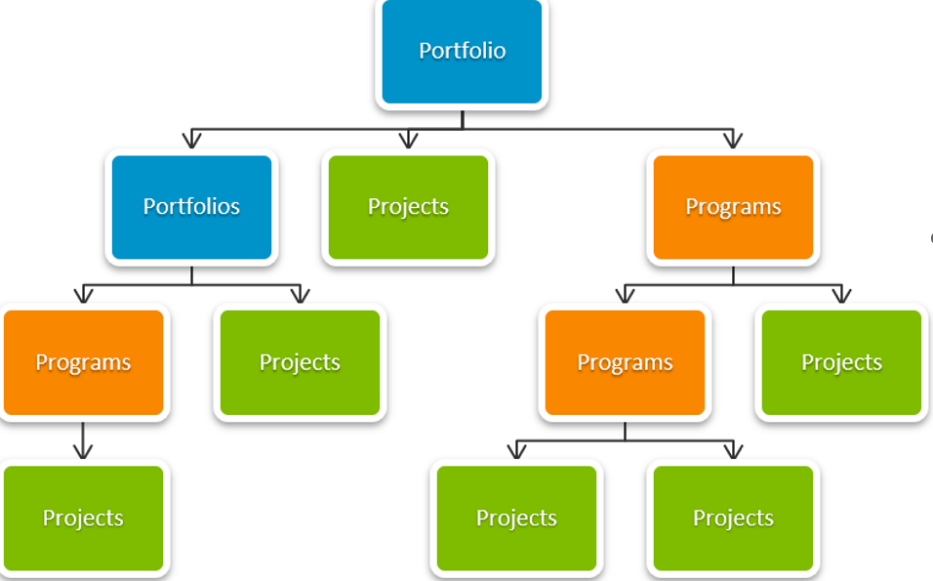
Project, program, and portfolio management
What is the difference between project program and portfolio management?
A portfolio organizes programs, projects, sub-portfolios, sub-programs, and operations to facilitate business benefits
https://www.simplilearn.com/difference-between-projects-and-programs-article

Slide 51
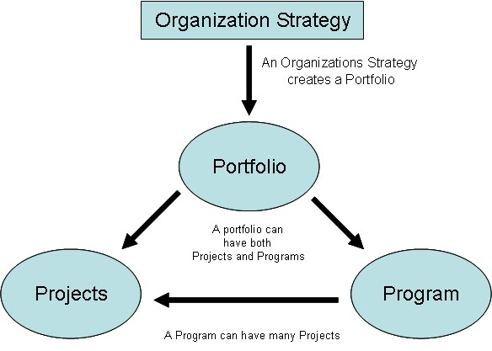
Project, program, and portfolio management
What is the difference between project program and portfolio management?
A portfolio organizes programs, projects, sub-portfolios, sub-programs, and operations to facilitate business benefits
https://www.simplilearn.com/difference-between-projects-and-programs-article
http://getpmpcertified.blogspot.com/2011/05/chapter-13-relationship-between-project.html

Slide 52
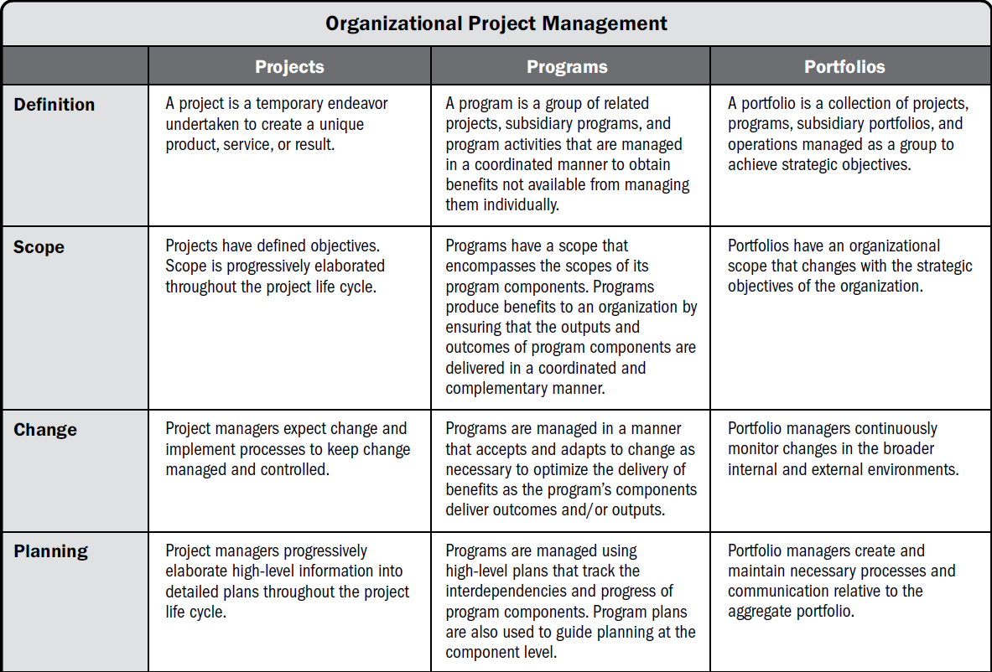
Project, program, and portfolio management

Slide 53
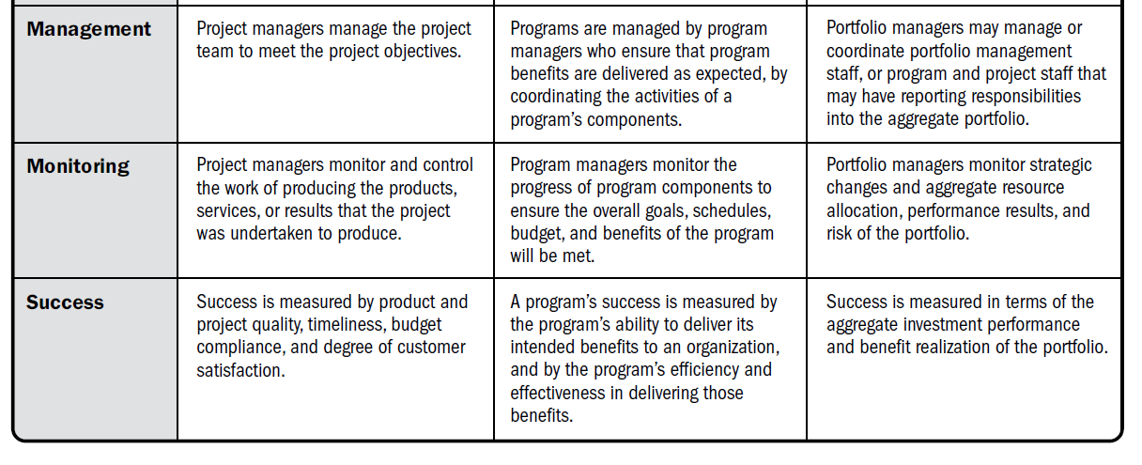
Project, program, and portfolio management
Project, program, and portfolio management
Source: Adapted from PMI. 2017. PMBOK® Guide, 7th, Project Management Institute, Inc.

Slide 54
Project, program, and portfolio management
References :
Project Management Institute. (2025). Guide to the project management body of knowledge (PMBOK® guide) (8th ed.).
Project Management Institute. (2025). Gen AI: The need for organizational support.
Project Management Institute. (2025). Shaping the future of project management with AI.
Diao, Z. (2024). Project management in the age of artificial intelligence. Highlights in Business, Economics and Management, 39.‏
Nenni, M. E., De Felice, F., De Luca, C., & Forcina, A. (2025). How artificial intelligence will transform project management in the age of digitization: a systematic literature review. Management Review Quarterly, 75(2), 1669-1716.‏
Duică, M. C., Vasciuc Săndulescu, C. G., & Panagoreț, D. (2024). The use of artificial intelligence in project management. Valahian Journal of Economic Studies, 15(1), 105-118.‏

Slide 55



Thank You

