Slide 1


Procurement and
Supply Chain Management
Prepared by Dr. Tarek Mohamed
MGM 431
Lecture 5

Slide 2


Life cycle, processes and supply-chain integration
Lecture 5
MGM 431
Prepared by
Dr. Tarek Mohamed
www.midocean.ae

Slide 3

Course Agenda
Chapter
Define the meaning of integrated supply chain management.
Identify the main characteristics of integrated supply chain management.
Understanding the SCOR model processes.
Identify both external and internal supply chain linkages.
Explain how to use Levers for improved supply chain performance.
www.midocean.ae

Slide 4
Supply Chain Management
Supply Chain Management
All facilities, functions, activities, associated with flow and transformation of goods and services from raw materials to customer, as well as the associated information flows.
An integrated group of processes to “source,” “make,” and “deliver” products.
Supply chain management tries to match the flow of materials, services and information with demand.
The purpose of supply chain design is to shape a firm's supply chain to meet the competitive priorities of its operations strategies.
www.midocean.ae

Slide 5
Supply Chain Management (cont.)
Suppliers
Procurement
  Purchase of goods and services from suppliers
  On-demand (direct response) delivery
  Requires supplier to deliver goods when demanded by customer
Continuous replenishment
  Supplying orders in a short period of time according to a predetermined schedule
Cross-enterprise teams coordinate processes between company and supplier
www.midocean.ae

Slide 6
Supply Chain Management (cont.)
Outsourcing
Sourcing
  Selection of suppliers
Outsourcing
  Purchasing of goods and services from an outside supplier
Core competencies
  What a company does best?
Single sourcing
  A company purchases goods and services from only a few (or one) suppliers
www.midocean.ae

Slide 7
Supply Chain Management (cont.)
Distribution
  Encompasses all channels, processes, and functions, including warehousing and transportation, that a product passes on its way to final customer
  Often called logistics
Logistics
  Transportation and distribution of goods and services
  Driving force today is speed particularly important for Internet dot-coms
www.midocean.ae

Slide 8
Supply Chain Management
Managing flow of information through supply chain in order to attain the level of synchronization that will make it more responsive to customer needs while lowering costs
Keys to effective SCM
Information
Communication
Cooperation
Trust
www.midocean.ae

Slide 9
Distribution Centers (DC) and Warehousing
DCs
Are some of the largest business facilities in the United States
Trend
Is for more frequent orders in smaller quantities
Flow-through facilities and automated material handling
Postponement
Final assembly and product configuration may be done at the DC
www.midocean.ae

Slide 10
Warehouse Management Systems
Highly automated system that runs day-to-day operations of a DC
Controls item put away, picking, packing, and shipping.
Features
  Transportation management
  Order management
  Yard management
  Labor management
  Warehouse optimization
www.midocean.ae

Slide 11
Vendor-Managed Inventory
Collaborative planning, forecasting, and replenishment create greater economies of scale
Internet-based exchange of data and information
Significant decrease in inventory levels and more efficient logistics
Companies focus on core competencies
www.midocean.ae

Slide 12
Collaborative Logistics and Distribution Outsourcing
Manufacturers generate orders, not distributors or retailers
Stocking information is accessed using EDI
A first step towards supply chain collaboration
Increased speed, reduced errors, and improved service
www.midocean.ae

Slide 13
Integrating the Supply Chain
Supply Chain Integration
The effective coordination of supply chain processes though the seamless flow of information up and down the supply chain.
The purpose of supply chain management is to synchronize a firm's processes with those of its suppliers and customers.
www.midocean.ae

Slide 14
Integrating the Supply Chain
Information sharing among supply chain members
  Reduced bullwhip effect
  Early problem detection
  Faster response
  Builds trust and confidence
Collaborative planning, forecasting, replenishment, and design
  Reduced bullwhip effect
  Lower Costs (material, logistics, operating, etc.)
  Higher capacity utilization
  Improved customer service levels
Information sharing among supply chain members
  Reduced bullwhip effect
  Early problem detection
  Faster response
  Builds trust and confidence
Collaborative planning, forecasting, replenishment, and design
  Reduced bullwhip effect
  Lower Costs (material, logistics, operating, etc.)
  Higher capacity utilization
  Improved customer service levels
www.midocean.ae

Slide 15
Supply Chain Integration (cont.)
Coordinated workflow, production and operations, procurement
  Production efficiencies
  Fast response
  Improved service
  Quicker to market
Adopt new business models and technologies
  Penetration of new markets
  Creation of new products
  Improved efficiency
  Mass customization
www.midocean.ae

Slide 16
Collaborative Planning, Forecasting, and Replenishment
Process for two or more companies in a supply chain to synchronize their demand forecasts into a single plan to meet customer demand
Parties electronically exchange
  Past sales trends
  Point-of-sale data
  On-hand inventory
  Scheduled promotions
  Forecasts
www.midocean.ae

Slide 17
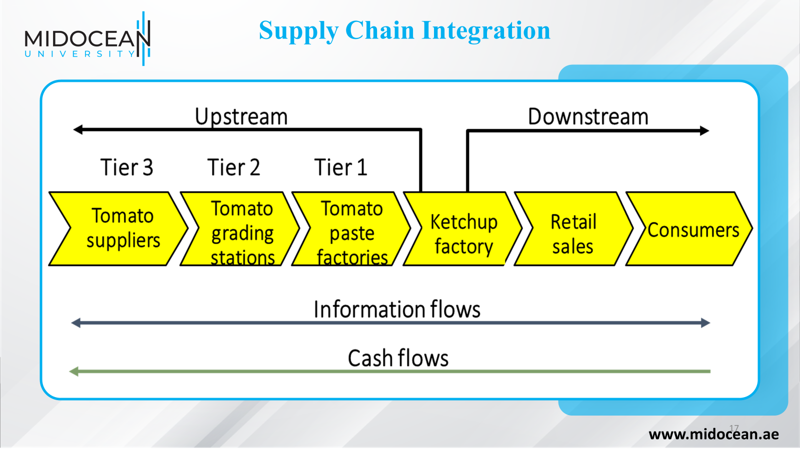

Slide 18
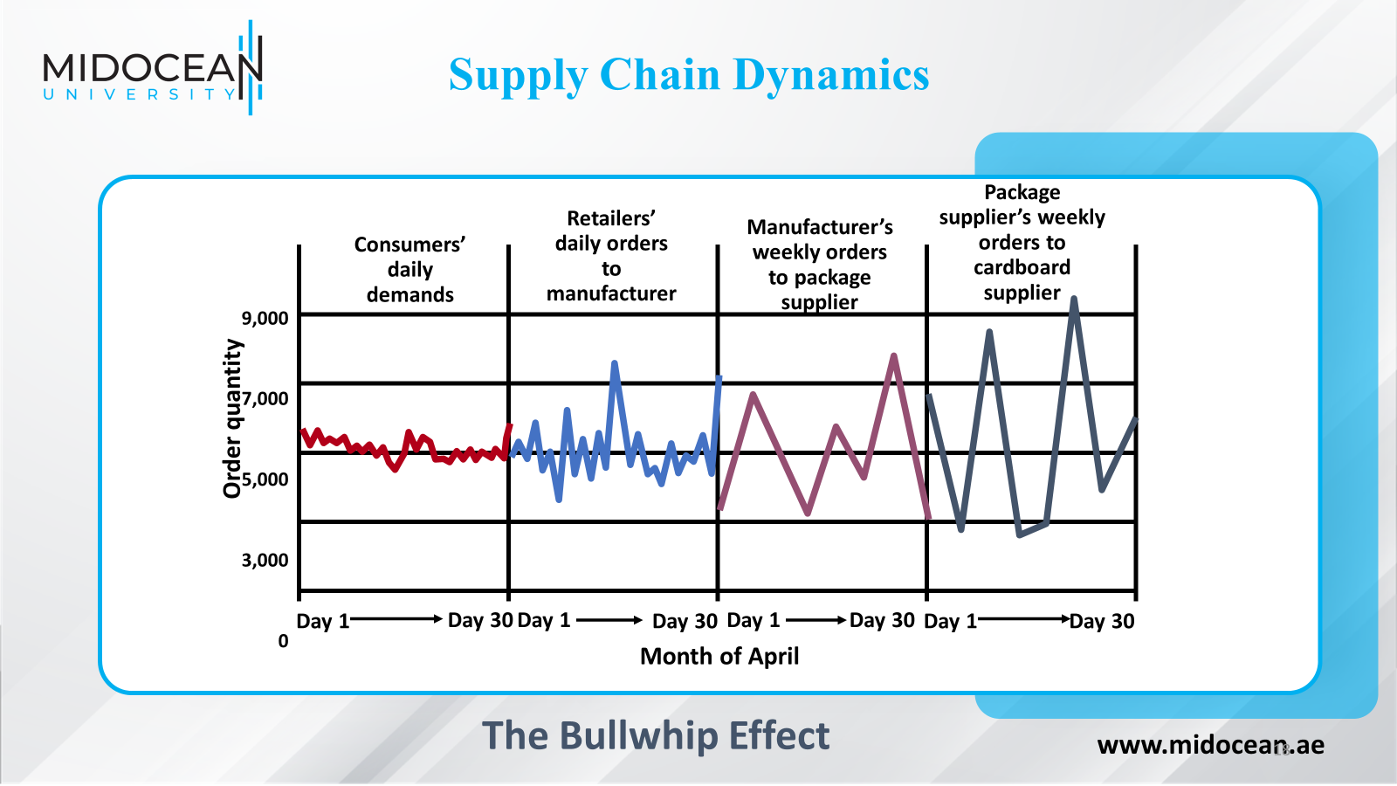

Slide 19
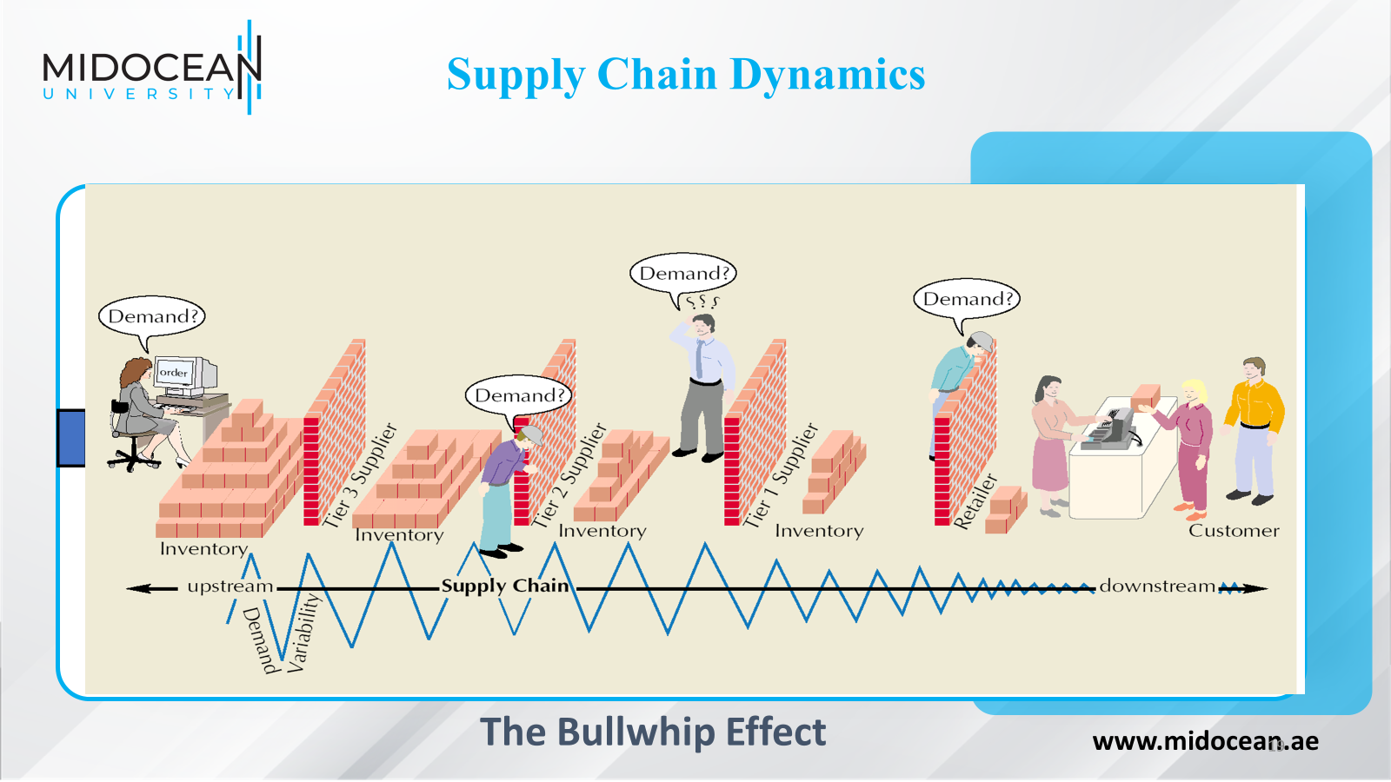

Slide 20
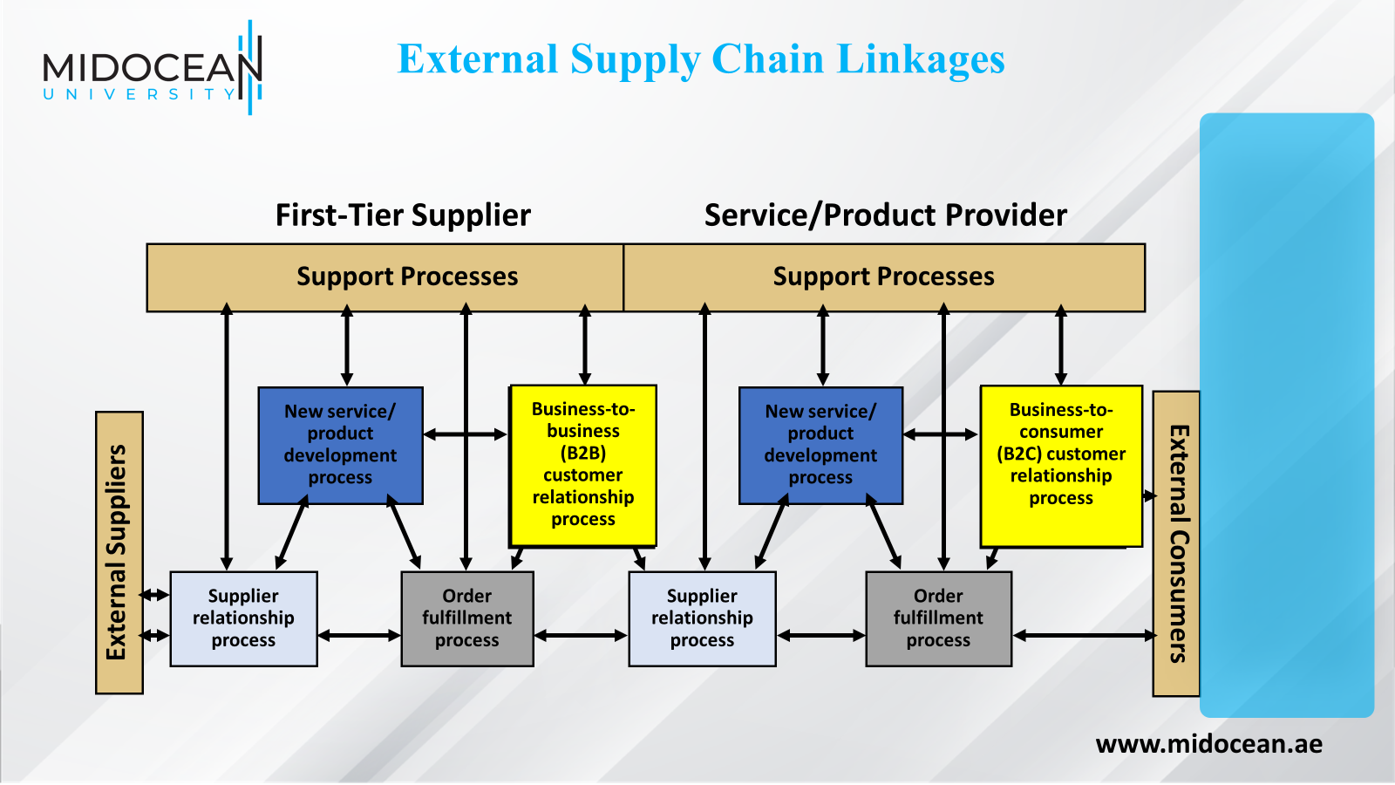

Slide 21
Integrated Supply Chains
SCOR Model
  Plan
  Source
  Make
  Delivery
  Return
www.midocean.ae

Slide 22
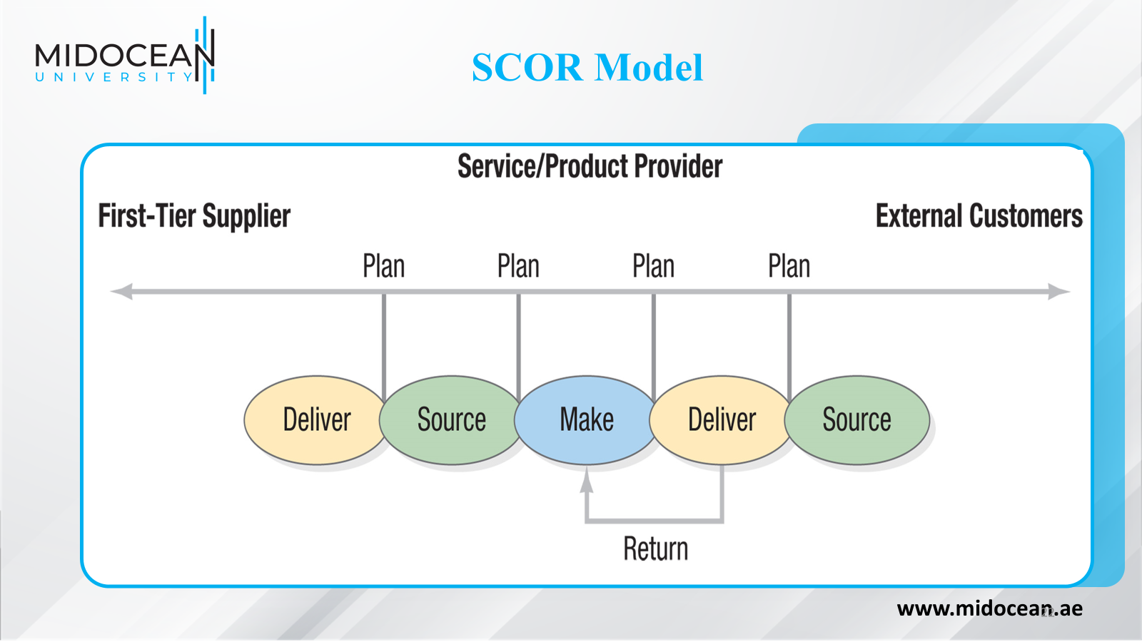

Slide 23
SCOR Model Processes
Deliver
Provide products
to meet demand,
including order
management,
transportation
and distribution
Plan
Develop a course of action that best meets sourcing, production and delivery requirements
Source
Procure goods
and services to
meet planned
or actual
demand
Make
Transform
product to a
finished state to
meet planned
or actual
demand
Return
Return
products,
post-delivery
customer
support
www.midocean.ae

Slide 24
SCOR: Customer Facing
Performance Attribute
Performance Metric
Definition
Supply Chain Delivery Reliability
Delivery performance
Percentage of orders delivered on time and in full to the customer
Fill rate
Percentage of orders shipped within24 hours of order receipt
Perfect order fulfillment
Percentage of orders delivered on time and in full, perfectly matched with order with no errors
Supply Chain Responsiveness
Order fulfillment lead time
Number of days from order receipt to customer delivery
Supply Chain Flexibility
Supply chain response time
Number of days for supply chain to respond to an unplanned significant change in demand without a cost penalty
Production flexibility
Number of days to achieve an unplanned 20% change in orders without a cost penalty
www.midocean.ae

Slide 25
SCOR: Internal Facing
Performance Attribute
Performance Metric
Definition
Supply Chain Cost
Supply chain management cost
Direct and indirect cost to plan, source and deliver products and services
Cost of goods sold
Direct cost of material and labor to produce a product or service
Value-added productivity
Direct material cost subtracted from revenue and divided by the number of employees, similar to sales per employee
Warranty/returns processing cost
Direct and indirect costs associated with returns including defective, planned maintenance and excess inventory
Supply Chain Asset Management Efficiency
Cash-to-cash cycle time
Number of days that cash is tied up as working capital
Inventory days of supply
Number of days that cash is tied up as inventory
Asset turns
Revenue divided by total assets including working capital and fixed assets
www.midocean.ae

Slide 26
Performance Measures
Customer Relationship | Order Fulfillment | Supplier Relationship
Percent of orders taken accurately Time to complete the order placement process Customer satisfaction with the order placement process Customer’s evaluation of firm’s environmental stewardship | Percent of incomplete orders shipped Percent of orders shipped on-time Time to fulfill the order Percent of botched services or returned items Cost to produce the service or item Customer satisfaction with the order fulfillment process Inventory levels of work-in-process and finished goods Amount of greenhouse gasses emitted into the air | Percent of suppliers’ deliveries on-time Suppliers’ lead times Percent defects in services and purchased materials Cost of services and purchased materials Inventory levels of supplies and purchased components Evaluation of suppliers’ collaboration on streamlining and waste conversion Amount of transfer of environmental technologies to suppliers
www.midocean.ae

Slide 27
Levers for Improved Supply Chain Performance
The levers
  Sharing data
  Collaborative activities
  Reduce replenishment lead times
  Reduce order lot sizes
  Ration short supplies
  Use everyday low pricing (EDLP)
  Be cooperative and trustworthy
www.midocean.ae

Slide 28
Levers for Improved Supply Chain Performance
Performance measures
  Costs
  Time
  Quality
  Environmental impact
www.midocean.ae

Slide 29
Supply Chain Integration
The effective coordination of supply chain processes through the seamless flow of information up and down the supply chain
A river that flows from raw material suppliers to consumers
  Upstream
  Downstream
Mitigating the effects of supply chain disruptions
www.midocean.ae

Slide 30
Supplier Relationship Process
Design collaboration
  Early supplier involvement
  Pre-sourcing
  Value analysis
Negotiation
  Obtain an effective contract that meets the price, quality, and delivery requirements
  Competitive orientation
  Cooperative orientation
www.midocean.ae

Slide 31
Supplier Relationship Process
Buying
  Procurement of the service or material from the supplier
  e-purchasing
  Loss of control
Information exchange
  Radio frequency identification (RFID)
  Vendor managed inventories (VMI)
www.midocean.ae

Slide 32
Order Fulfillment Process
Customer demand planning
  Facilitates collaboration
  Demand forecasts
Supply planning
  Inventory management
  Operations planning and scheduling
  Resource planning
Production
Logistics
  Ownership
  Facility location
  Mode selection
  Capacity
  Cross-docking
www.midocean.ae

Slide 33
Order Fulfillment Process
1 (a)
Web site
2
JIT Inventory
3
Traveler Sheet
1 (b)
Voice-to-voice
1 (d) Direct
relationship sales
4
Kitting
1 (c)
Face-to-face
5 Assemble
to order
6 Testing and
system integration
7 Boxing
and shipping
8
Delivery
Dell’s Order Fulfillment Process
www.midocean.ae

Slide 34
The Customer Relationship Process
Customer relationship management (CRM) programs identify, attract, and build relationships with customers
Marketing
  Electronic commerce (e-commerce)
  Business-to-Consumer (B2C) systems
  Business-to-Business (B2B) systems
www.midocean.ae

Slide 35
The Customer Relationship Process
Order placement
  Execute a sale, register the specifics, confirm acceptance, and track progress
  Internet provides advantage
Customer service
  Helps customers with answers to questions, resolves problems, and provides general information
  Call centers
www.midocean.ae

Slide 36
Supply Chains and the Environment
Sustainability
  Environmental stewardship
  Environmental protection
  Productivity improvement
  Risk minimization
  Innovation
Reverse logistics
  Planning, implementing, and controlling flows from consumption back to origin
  Closed-loop supply chain
www.midocean.ae

Slide 37
Closed Loop Supply Chain
Production process
Distribution/Retailers
Customers
New service/product
development process
Direct reuse
Returns
processor
Repair
Remanufacture
Recycle parts
and materials
Product information
Waste
disposal
Forward logistics flow
Reverse logistics flow
Flows in a Closed-Loop Supply Chain
www.midocean.ae

Slide 38
Summary of Learning Objectives
Define the meaning of integrated supply chain management.
Identify the main characteristics of integrated supply chain management.
Understanding the SCOR model processes.
Identify both external and internal supply chain linkages.
Explain how to use levers for improved supply chain performance.
www.midocean.ae

Slide 39
Essential Reference
Lysons, K., & Farrington, B. (2020). Procurement and supply chain management. Pearson UK.
Chopra, S., & Meindl, P. (2016). Global Edition. Pearson Education Limited
Morris, P. W., & Pinto, J. K. (Eds.). (2007). The Wiley guide to project technology, supply chain, and procurement management (Vol. 4). John Wiley & Sons.
Schwalbe, K. (2015). Information technology project management. Cengage Learning.
Supply Chain Council
www.midocean.ae

Slide 40


Thank You

