Slide 1


Computer Organization and Architecture
Prepared by Dr. Eng. Gamal Selim
Lecture 07

Slide 2
Revision

Slide 3
Adders

Slide 4
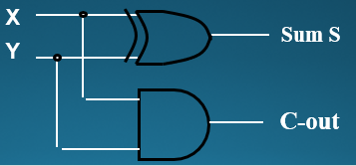
Half Adder
Adding two single-bit binary values, X, Y produces a sum S bit and a carry out C-out bit.
This operation is called half addition and the circuit to realize it is called a half adder.
Half Adder Truth Table
  S(X,Y) = Σ (1,2)
  S = X’Y + XY’
  S = X ⊕ Y
  C-out(x, y, C-in) = Σ (3)
  C-out = XY
Inputs
Outputs
X
0
0
1
1
Y
0
1
0
1
S
0
1
1
0
C-out
0
0
0
1
X
Half
Adder
S
Y
C-OUT

Slide 5
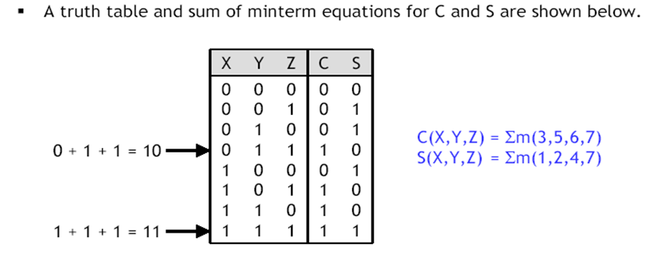
Full Adder
A combinational circuit that adds 3 input bits to generate a Sum bit and a Carry bit

Slide 6
Full Adder Circuit Using XOR
X
Y
Sum S
X
Y
C-in
Full
Adder
X
XY
C-out
C-in
Y
X
XC-in
C-out
S
C-in
Y
C-in
YC-in

Slide 7
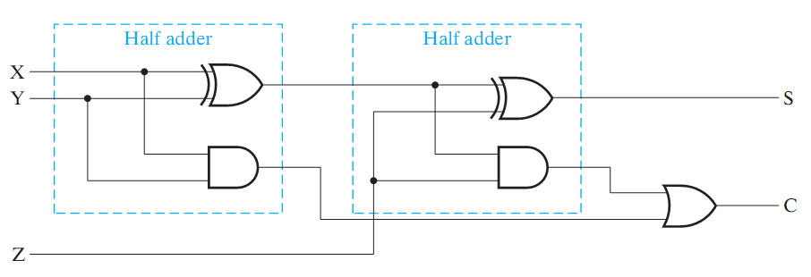
Full Adder = 2 Half Adders
Manipulating the Equations:
S = ( X ⊕ Y ) ⊕ Z
C = XY + XZ + YZ = XY + Z(X ⊕ Y )
Think of Z as a carry in
Src: Mano’s Book

Slide 8
4-bit Carry Ripple Adder
Inputs to be added
X3X2X1X0
Y3Y2Y1Y0
Adds two 4-bit numbers:
X = X3 X2 X1 X0
Y = Y3 Y2 Y1 Y0
producing the sum S = S3 S2 S1 S0 ,
C-out = C4 from the most significant
position j=3
4-bit
Adder
C4
C-out
C-in
C0 =0
S3 S2 S1 S0
Data inputs to be added
Sum Output
X3
Y3
X2
Y2
X1
Y1
X0
Y0
Full
Adder
C3
Full
Adder
C2
Full
Adder
C1
Full
Adder
C4
C-out
C-in
C-out
C-in
C-out
C-in
C-out
C-in
C0 =0
S3
S2
S1
S0
Sum output

Slide 9
Subtractors

Slide 10
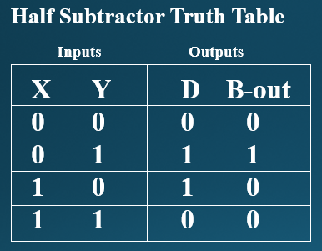
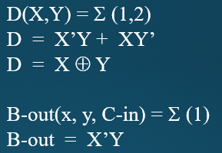
Half Subtractor
Subtracting a single-bit binary value Y from anther X (I.e. X -Y ) produces a difference bit D and a borrow out bit B-out.
This operation is called half subtraction and the circuit to realize it is called a half subtractor.
X
Y
Difference D
X
Half
Subtractor
D
Y
B-OUT
B-out

Slide 11
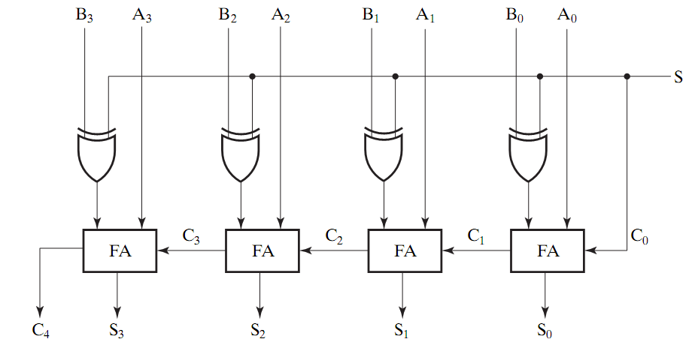
Adder/Subtractor
0 : Add
1: subtract
Src: Mano’s Book
Using full adders and XOR we can build an Adder/Subtractor!

Slide 12
Digital Circuits

Slide 13
Digital Circuits
Decoders
Encoders

Slide 14
Decoders

Slide 15
Decoder
  Accepts a value and decodes it
    Output corresponds to value of n inputs
  Consists of:
    Inputs (n)
    Outputs (2^{n} , numbered from 0 → 2^{n} - 1)
    Selectors / Enable (active high or active low)

Slide 16
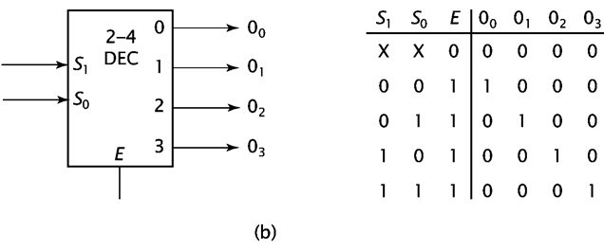
2-to-4 Decoder

Slide 17
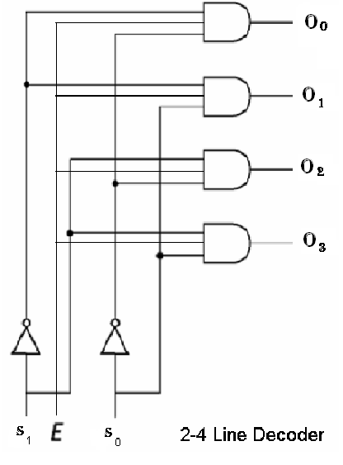
2-to-4 Decoder

Slide 18
The truth table of 3-to-8 Decoder
A2 | A1 | A0 | D0 | D1 | D2 | D3 | D4 | D5 | D6 | D7
0 | 0 | 0 | 1 | 0 | 0 | 0 | 0 | 0 | 0 | 0
0 | 0 | 1 | 0 | 1 | 0 | 0 | 0 | 0 | 0 | 0
0 | 1 | 0 | 0 | 0 | 1 | 0 | 0 | 0 | 0 | 0
0 | 1 | 1 | 0 | 0 | 0 | 1 | 0 | 0 | 0 | 0
1 | 0 | 0 | 0 | 0 | 0 | 0 | 1 | 0 | 0 | 0
1 | 0 | 1 | 0 | 0 | 0 | 0 | 0 | 1 | 0 | 0
1 | 1 | 0 | 0 | 0 | 0 | 0 | 0 | 0 | 1 | 0
1 | 1 | 1 | 0 | 0 | 0 | 0 | 0 | 0 | 0 | 1

Slide 19
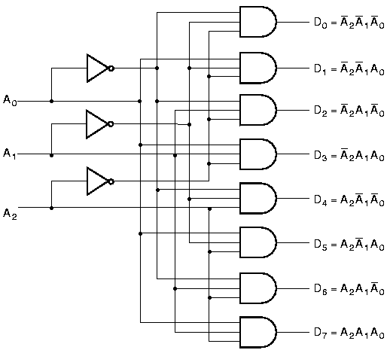
3-to-8 Decoder

Slide 20
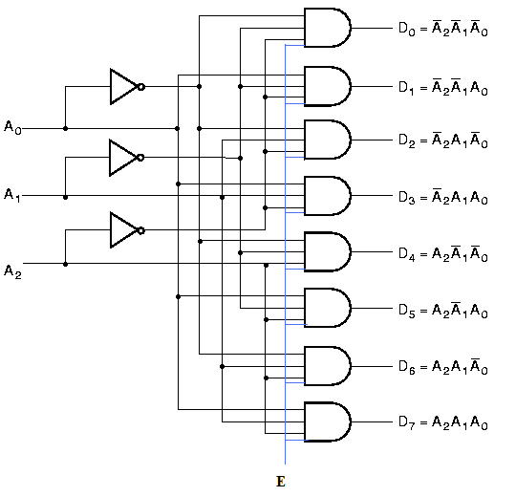
3-to-8 Decoder with Enable

Slide 21
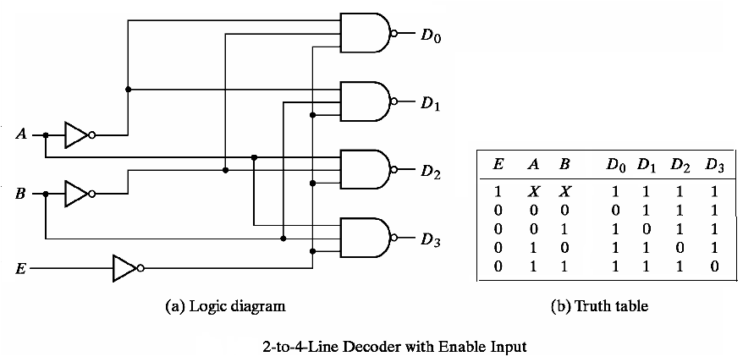
2-to-4 Decoder: NAND implementation
Decoder is enabled when E=0 and an output is active if it is 0

Slide 22
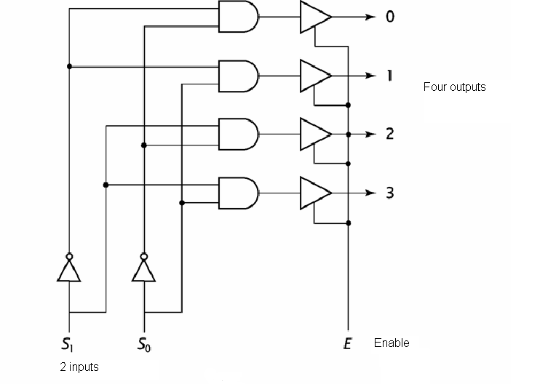
2-4 Decoder with 2-input and Enable

Slide 23
Decoder Expansion
Decoder expansion
  Combine two or more small decoders with enable inputs to form a larger decoder
  3-to-8-line decoder constructed from two 2-to-4-line decoders
    The MSB is connected to the enable inputs
    if A₂=0, upper is enabled; if A₂=1, lower is enabled.

Slide 24
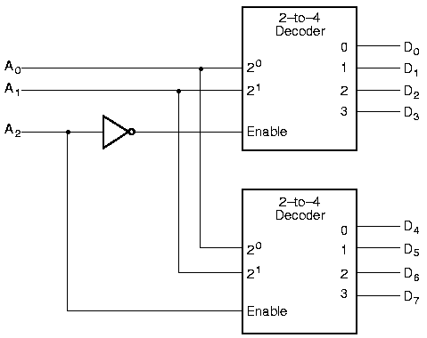
Decoder Expansion

Slide 25
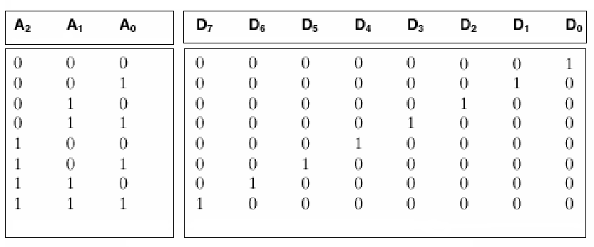
2-4 decoders to form one 3-8 decoder
Combining two 2-4 decoders to form one 3-8 decoder using enable switch

Slide 26
Encoders

Slide 27
Encoders
Perform the inverse operation of a decoder
  2^{n} (or less) input lines and n output lines

Slide 28
Encoders
The combinational circuits that change the binary information into N output lines are known as Encoders. The binary information is passed in the form of 2^{N} input lines. The output lines define the N-bit code for the binary information. In simple words, the Encoder performs the reverse operation of the Decoder. At a time, only one input line is activated for simplicity. The produced N-bit output code is equivalent to the binary information.

Slide 29
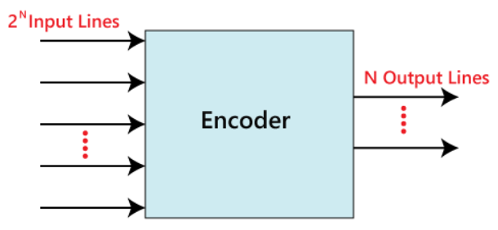
Encoders

Slide 30
4-to-2 line Encoder

Slide 31
4 to 2 line Encoder
In 4 to 2 line encoder, there are total of four inputs, i.e., Y₀, Y₁, Y₂, and Y₃, and two outputs, i.e., A₀ and A₁. In 4-input lines, one input-line is set to true at a time to get the respective binary code in the output side. Below are the block diagram and the truth table of the 4 to 2 line encoder.

Slide 32
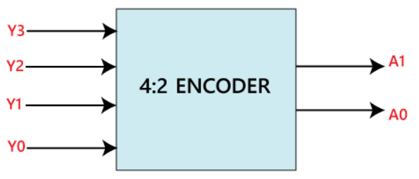
4 to 2 line Encoder

Slide 33
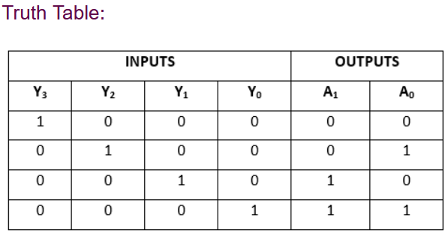
4 to 2 line Encoder

Slide 34
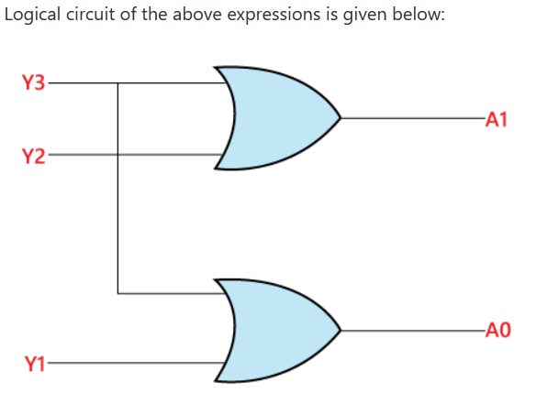
4 to 2 line Encoder
The logical expression of the term A0 and A1 is as follows:
A₁=Y₃+Y₂
A₀=Y₃+Y₁

Slide 35
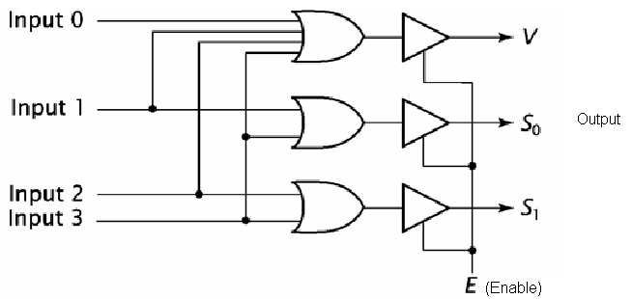
Encoders with OR gates

Slide 36
8-to-3 line Encoder

Slide 37
8-to-3 Encoder
The 8 to 3 line Encoder is also known as Octal to Binary Encoder. In 8 to 3 line encoder, there is a total of eight inputs, i.e., Y₀, Y₁, Y₂, Y₃, Y₄, Y₅, Y₆, and Y₇ and three outputs, i.e., A₀, A1, and A₂. In 8-input lines, one input-line is set to true at a time to get the respective binary code in the output side. Below are the block diagram and the truth table of the 8 to 3 line encoder.

Slide 38
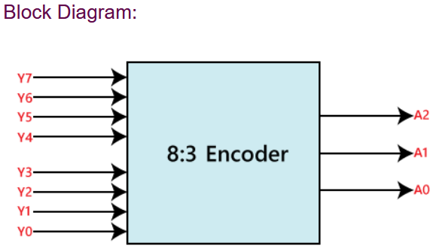
8 x 3 Encoder

Slide 39
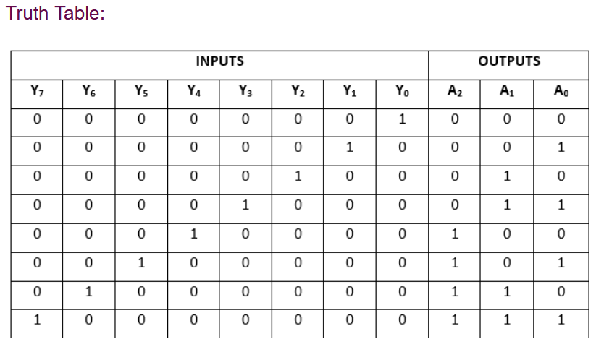
8 x 3 Encoder

Slide 40
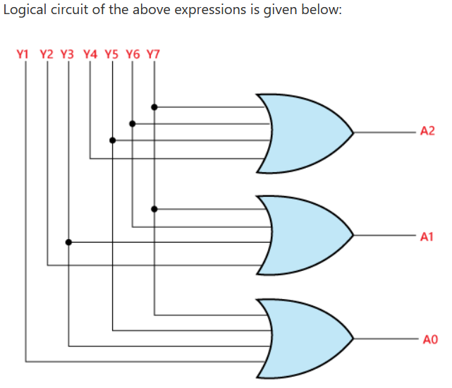
8 x 3 Encoder
The logical expression of the term A0, A1, and A2 are as follows:
A₂=Y₄+Y₅+Y₆+Y₇
A₁=Y₂+Y₃+Y₆+Y₇
A₀=Y₇+Y₅+Y₃+Y₁

Slide 41




  Thank You

