Slide 1

Lecture 7
Team Building

Slide 2

Last Lecture, we leaned about
  Digital Leaders
  8 components of digital leadership
    1. Media competence, 2. Agility, 3. Personal responsibility and autonomy, 4. Interconnected thinking and acting, 5. Innovation and vision, 6. Clear communication, 7. People in focus, 8. Transparency
  8 key leadership strengths
    1. Self-awareness, 2. communication, 3. Presentation Skills, 4. negotiation 5. Critical Thinking, 6. Conflict resolution skills, 7. creative problem-solving,
    8. Decision Making
Lec.7

Slide 3
Lecture outline
Today’s Lecture we will Know about
Lec.7
  Action-Centered Leadership
    The Task
    Individuals
    Team
    The Task Oriented Profile
    The Individual Oriented Profile
    The Team Oriented Profile
  Team Building
    What is a team?
    The advantages of teams
    The disadvantages of teams
    When should you build teams?
    What makes a good team?
    How do you build a team?
  Virtual Teams
    What is a virtual team?
    Factors impact virtual
    teams’ performance
    Challenges of virtual teams
    Adaptability of virtual teams
    Trust in virtual teams

Slide 4
Introduction & Learning Outcomes
Successful virtual teams require leadership and high-level communication skills. The capacity to communicate and share data through online platforms (ICTs) has redefined organizations by giving the team members distant from each other the ability to participate and engage by working virtually.
Learn about Action-Centered Leadership three aspects which are task, individual and team
Learn about Team Building, Virtual Teams and the Effective Communication in virtual organizations
Lec.7

Slide 5

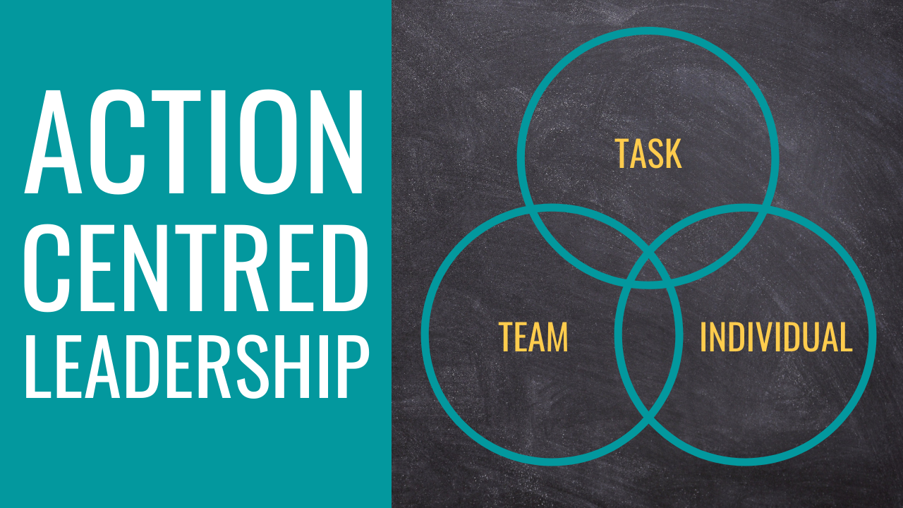
Lec.7

Slide 6
Action-Centered Leadership
Task Needs
Team Maintenance Needs
Individual Needs
Lec.7
Action Centered Leadership is a simple leadership and management model, which makes it easy to remember, apply and adapt to your own situation.
John Adair's Action-Centered Leadership model is commonly represented by three overlapping circles, that explain how to be able to use each of the elements according to the situation.

Slide 7
Action-Centered Leadership
Task Needs
Team Maintenance Needs
Individual Needs
Lec.7
Being able to do all of these things, and keep the right balance, gets results, builds morale, improves quality, develops teams and productivity and is the mark of a successful manager and leader.
The 'three circles' diagram illustrates three core responsibilities:
    Achieving the task
    Managing the team or group
    Managing individuals

Slide 8
Lec.7
Action-Centered Leadership: The Task
Identify aims and vision for the group, purpose, and direction - define the activity (the task)
Identify resources, people, processes, systems and tools (inc. financials, communications, IT)
Create the plan to achieve the task - deliverables, measures, timescales, strategy and tactics
Establish responsibilities, objectives, accountabilities and measures, by agreement and delegation
Set standards, quality, time and reporting parameters
Control and maintain activities against parameters
Monitor and maintain overall performance against the plan
Report on progress towards the group's aim
Review, re-assess, and adjust plan, methods and targets as necessary

Slide 9
Lec.7
Action-Centered Leadership: Individuals
Understand the team members as individuals - personality, skills, strengths, needs, aims and fears
Assist and support individuals - plans, problems, challenges, highs and lows
Identify and agree on appropriate individual responsibilities and objectives
Give recognition and praise to individuals - acknowledge effort and good work
Where appropriate reward individuals with extra responsibility, advancement and status
Identify, develop and utilize each individual's capabilities and strengths
Train and develop individual team members
Develop individual freedom and authority

Slide 10
Lec.7
Action-Centered Leadership: Team
Establish, agree and communicate standards of performance and behavior
Establish a style, culture and approach of the group - soft skill elements
Monitor and maintain discipline, ethics, integrity and focus on objectives
Anticipate and resolve group conflict, struggles or disagreements
Assess and change as necessary the balance and composition of the group
Develop team-working, cooperation, morale and team spirit
Develop the collective maturity and capability of the group - progressively increase group freedom and authority
Encourage the team towards objectives and aims - motivate the group and provide a collective sense of purpose
Identify, develop and agree on the team- and project-leadership roles within the group
Enable, facilitate and ensure effective internal and external group communications
Identify and meet group training needs
Give feedback to the group on overall progress; consult with, and seek feedback and input from the group

Slide 11
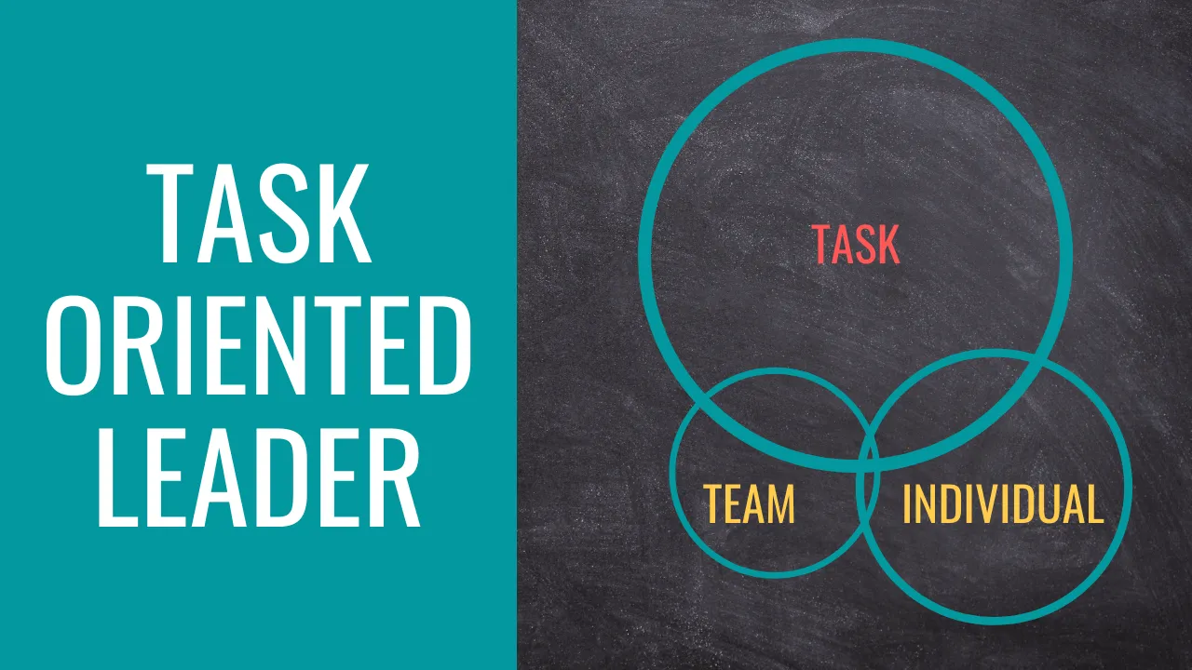
Action-Centered Leadership:
The Task Oriented Profile
Lec.7
If your diagram presents a large circle for the task element, then you are more oriented towards a task-focused leadership style.
This means that you tend to focus more on task completion and less on the needs of the team or the individuals within the team.

Slide 12
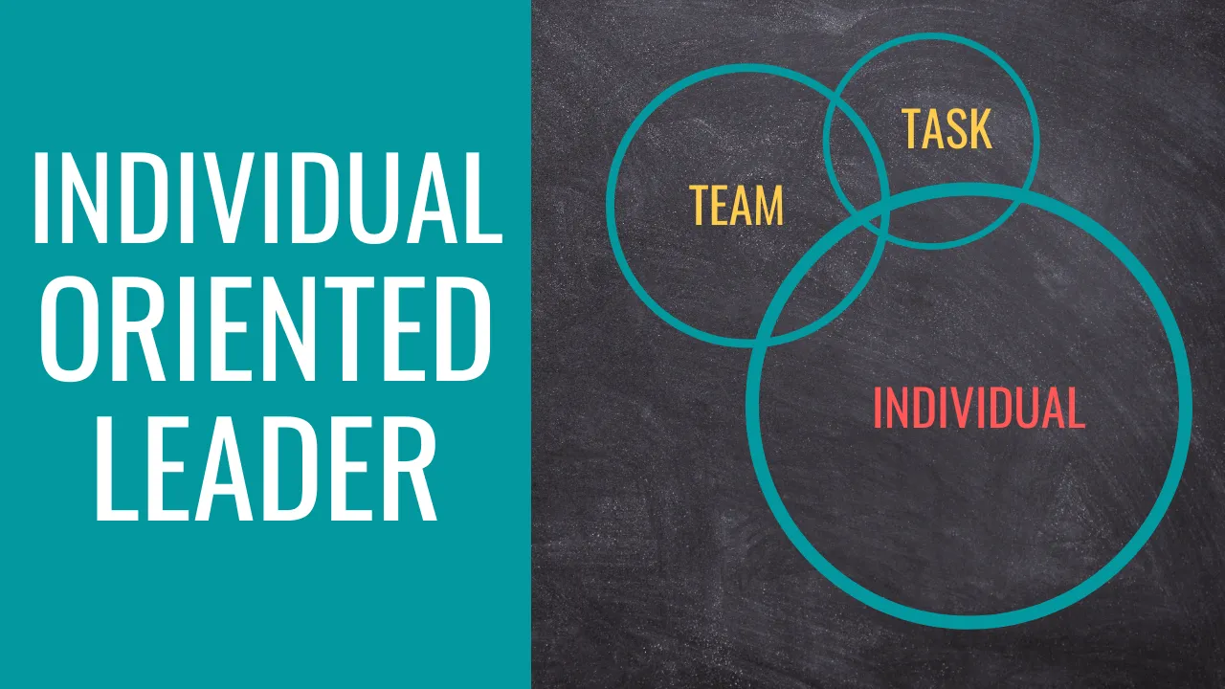
Action-Centered Leadership:
The Individual Oriented Profile
Lec.7
If your diagram presents a large circle for the individual element, then you are more oriented towards an individual-focused leadership style.
This means that you tend to focus more on the needs of individuals and less on task completion and team cohesion.

Slide 13
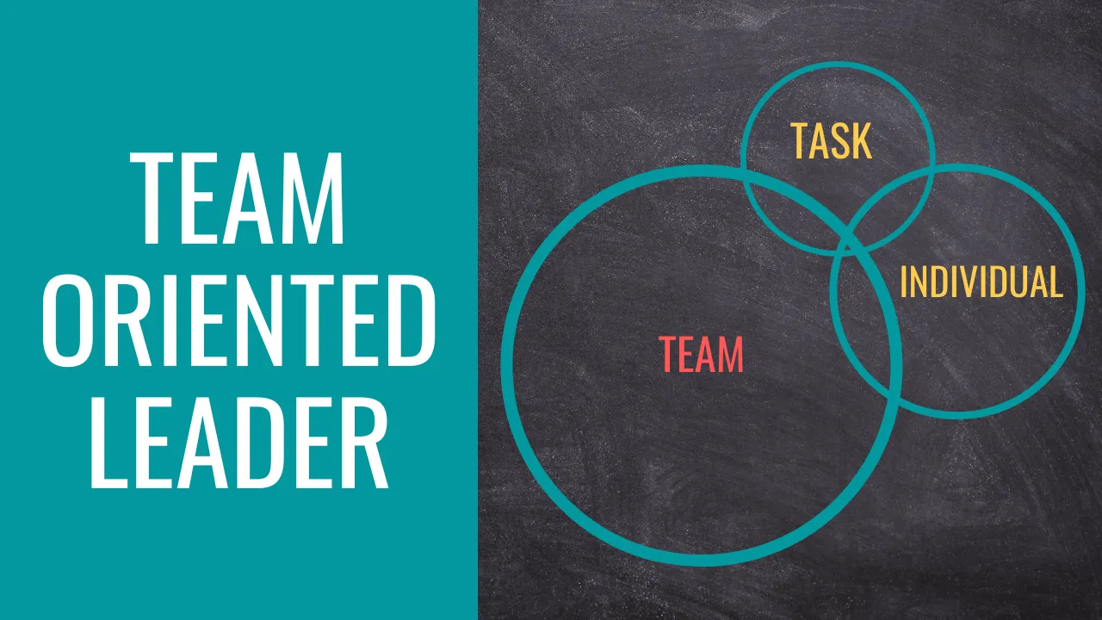
Action-Centered Leadership:
The Team Oriented Profile
Lec.7
If your diagram presents a large circle for the team element, then you are more oriented towards a team-focused leadership style.
This means that you tend to focus more on team cohesion and less on task completion and the individuals within the team.

Slide 14
Lec.7
Action-Centered Leadership
John Adair's 50:50 Rule
  Adair also promotes a '50:50 rule' which he applies to various situations involving two possible influencers, e.g the view that 50% of motivation lies with the individual and 50% comes from external factors, among them leadership from another.
  This contradicts most of the motivation mentors who assert that most motivation is from within the individual.
  He also suggests that 50% of team building success comes from the team and 50% from the leader.

Slide 15
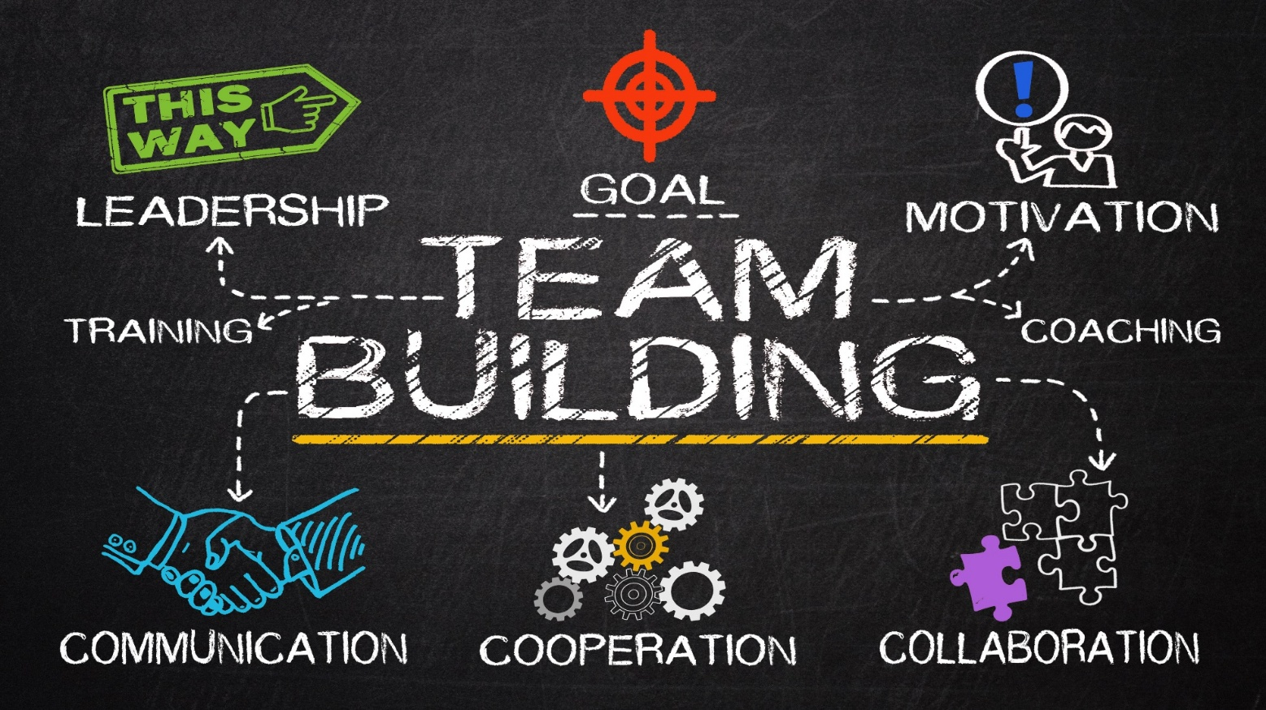
Lec.7

Slide 16
Lec.7
Team Building
        What is a team?
A team is a group of people with a commitment to one another, to the team, to a high level of achievement, to a common goal, and to a common vision.
The advantages of teams:
  A team broadens what individuals can do.
  Several heads mean a wider range of ideas.
  Teams have a great array of talents and skills.
  Team members learn new skills from their colleagues.
  Teamwork is more efficient than a number of individuals working singly.
  Teamwork provides relief when someone's having a problem.
  Team workers are more effective.
  A team member has more ownership of what he/she's doing.
  Good teams can build leaders.
  A shared vision keeps everyone moving forward.

Slide 17
Lec.7
Team Building
The disadvantages of teams:
  Team decision-making takes longer.
  Team effort can be wasted effort.
  The team's success may hang on the work of the least effective team member.
  A team might gain momentum in the wrong direction.
  The work of team can bog down in interpersonal issues, resentments, and blame.
  Team members may be reluctant to tell other about their unsatisfactory work.
  Lost motivation for lack of individual recognition.

Slide 18
Lec.7
Team Building
        When should you build teams?
  Creating a strategic plan for addressing community issues.
  Starting up a new organization or initiative.
  Starting a new program or intervention.
  Starting a coalition.
  Planning and carrying out a community assessment.
  Evaluating an organization, initiative, or intervention.
  Spearheading an advocacy campaign with a specific goal.
  Running a fundraising event or campaign.
  Staffing and running an organization or initiative.
  Engaging in ongoing advocacy.
  Performing a particular function within a community program or initiative.
  Changing the community over the long term.

Slide 19
Lec.7
Team Building
What makes a good team?
    Some lessons about Great Groups:
    Greatness starts with superb people.
    Great Groups and great leaders create each other.
    Every Great Group has a strong leader
    Leaders of Great Groups love talent and know where to find it.
    Great Groups are full of talented people who can work together.
    Great Groups think they are on a mission from a leader.
    Every Great Group is an island -- but an island with a bridge to the mainland.
    Great Group see themselves as winning underdogs.
    Great Groups always have an enemy.
    People in Great Groups have blinders on.
    Great Groups are optimistic, not realistic.
    In Great Groups the right person has the right job.
    The leaders of Great Groups give them what they need and free them from the rest.
    Great Groups ship (produce results).
    Great work is its own reward.

Slide 20
Lec.7
Team Building
How do you build a team?
  Start with the best people you can find.
  Choose team members so they'll have a good fit.
  Look for members with a diversity of backgrounds and perspectives
  Look for members with a commitment to the concept of working as a team
  Look for team members committed to the team's guiding vision
  Find people with a sense of humor.

Slide 21
Lec.7
Team Building
  Tips for Building the Team:
  Start with the vision.
  Build team bonds.
  Make sure that the concept of a team is absolutely clear.
  Involve the team in jointly planning functionality and individual responsibilities.
  Address personal issues.
  Establish team norms.
  Hash out the logistics of working as a team.
  Start the team with a doable task that requires teamwork
  Go back over both successes and failures to learn for the future.
  Provide both individual and team support.
  Give people something extra for working as a team.
  Reward accomplishments like crazy.

Slide 22

Lec.7
Virtual Teams

Slide 23
Lec.7
Virtual Teams
What is a virtual team? A virtual team is “a group of people who work interdependently with a shared purpose across space, time, and organization boundaries using technology.”
A virtual team consists of a group of employees or individuals who use digital tools to communicate.
Virtual team members can be based in the same psychical location, or working from different locations e.g., city or country.
There are many terms for virtual teams, such as ‘’geographically dispersed teams’’ or ‘’remote teams’’.

Slide 24
Virtual Teams
Lec.7
Factors that impact virtual teams’ performance

Slide 25
Lec.7
Virtual Teams
Factors affecting Virtual teams:
1) A key factor is technology, along with management, information distribution and human resources.
  Technology is the cornerstone in virtual communication; therefore, it has the most influence in the efficiency and effectiveness of a virtual team’s performance.
2) Teamwork is one of the core elements of an organization and it determines how well an organization performs.
  Teamwork is not only about how individuals work together, but also about how individuals correspond with the organization’s goals and strategies. It is necessary to examine the different levels of individuality in a work team - commitment, identification and attachment - to understand how team members affect team results and organizational goals.

Slide 26
Lec.7
Virtual Teams
        3) Operations
Knowledge, skills, and abilities are essential to teams and to successful organizations.
Virtual employees benefit corporations, by making it possible to cut down on office space and travel costs, all while making lower labor costs more appealing.
Virtual working enables around the clock operations and without time boundaries employers are more engaged in teamwork due to temporal flexibility.
Virtual teams can offer several benefits, such as cultural diversity, flexible time usage, and lower costs.

Slide 27
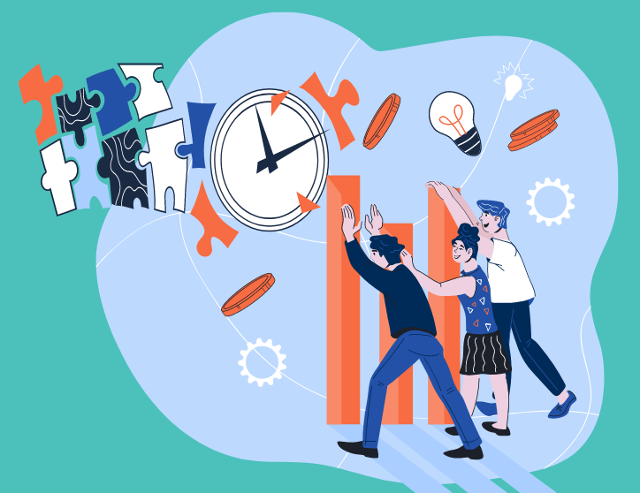
Lec.7
Challenges of virtual team

Slide 28
Lec.7
Challenges of virtual teams
The same aspects apply for challenges of virtual teams:
  Time, as a benefit, can be seen as synchronous, due to different time zones are limited by the ability to communicate synchronously and the solution appears as asynchronous communication media (e.g., e-mail).
  Virtual teams may not accomplish tasks as quickly as face-to-face teams. Accomplishing tasks and reaching decisions takes more time for virtual teams than for face-to-face teams. Reasons for this may be that typing is slower than talking in person, and synchronicity makes communication challenging.

Slide 29
Lec.7
Challenges of virtual teams
The same aspects apply for challenges of virtual teams:
  Relational boundaries regarding virtual teams: “individuals are more likely to look within their relational networks rather than across networks for team members”. This can be seen as both an opportunity and as a challenge.
  “Members have to work across differences in assumptions, motivations, knowledge bases … ”. It is possible that these aspects weaken the trust in other team members, which highly affect the efficiency of a virtual team.

Slide 30

Lec.7
Adaptability of virtual teams

Slide 31
Lec.7
Adaptability of virtual teams
Development and change are continuous in the current era of the knowledge culture. Successful changes in organizations and teams, require adaptability.
Adaptability can be described as a capacity to understand and comprehend changes and as a willingness to being flexible and open-minded.
The importance of adaptability of team members in virtual teams, states that adaptive team members form an adaptive virtual time, which in turn contributes to the organization’s goals and outcomes.

Slide 32
Lec.7
Adaptability of virtual teams
Team members, who show flexibility, calmness and an interest in learning are contributing to an adaptive team performance.
This shows that individual actions affect team outcomes, and vice versa. Technological, work, and social adaptation are considered as key factors for virtual teams.
Technological adaptation consists of different technological tools, that organizations provide and must be flexible and used for problem solving, because technological tools are meant to reduce technological limitations and increase effortless communication.
The behavior emerged from work adaptation is then furthermore implemented in social adaptation, by creating patterns of interaction.

Slide 33

Lec.7
Trust in virtual teams

Slide 34
Lec.7
Trust in virtual teams
Trust is seen as a statement of confidence and mirrors as a cooperative behavior. Trust is an action where people are in good faith to each other and where honesty replaces the act of taking advantage of others. Trust in virtual teams, must be examined separately from trust in face-to-face interactions, due to lack of in-person interaction.
The lack of face-to-face interaction in virtual teams, interferes with building trust in other team members.

Slide 35
Lec.7
Trust in virtual teams
Studies showed that trust is highly associated with leadership, which makes leadership in virtual teams a higher factor for successful outcomes. The study showed that a strong connection between leadership skills and trust. The study examined how lack of in-person interactions affect trust in teams. Results showed that in order for a virtual team to be efficient and effective, lack of in-person interaction must be replaced by a leader’s effectiveness and proper use of correct communication tools and techniques.

Slide 36
Lec.7
Trust in virtual teams
Performance level and behavioral controls affect trust in virtual teams. Studies showed that team members, who are required to use behavioral controls, for instance weekly reports, are more likely to lack faith in the virtual team. Furthermore, studies showed that highly performing virtual teams are more successful in maintaining high levels of trust. Team performance is also affected by the effectiveness of communication in virtual teams and studies showed that a higher level in trust improves a team’s performance.

Slide 37
Conclusion
Lec.7
Working on a successful team is an important learning experience for future leaders.
It demonstrates that not everything can be done by one person and shows them what it takes to create a team.
A leader who's been part of a good team will be able to build good teams because she knows what they look and feel like.

Slide 38
Conclusion
Lec.7
We learned about
  Action-Centered Leadership
    The Task
    Individuals
    Team
    The Task Oriented Profile
    The Individual Oriented Profile
    The Team Oriented Profile
  Team Building
    What is a team?
    The advantages of teams
    The disadvantages of teams
    When should you build teams?
    What makes a good team?
    How do you build a team?
  Virtual Teams
    What is a virtual team?
    Factors impact virtual teams’ performance
    Challenges of virtual teams
    Adaptability of virtual teams
    Trust in virtual teams

Slide 39


References
Lec.7
Rabinowitz, P. (n.d.). Leadership and Management chapter 13:16. Community Tool Box. Retrieved January 4, 2023, from https://ctb.ku.edu/en/table-of-contents
Bli-Group-Wp. (2011). Leadership Course material. Amideast Egypt. Business Intelligence, Training & Consulting, http://bli-group.com/
Hyvönen, M., & Utoslahti, E. (2021, May 25). Leadership and communication in virtual teams. theseus.fi. Retrieved March 12, 2023, from https://www.theseus.fi/bitstream/handle/10024/500605/Leadership_and_Communication_in_Virtual_Teams.pdf?sequence=2

Slide 40



Thank You

