Slide 1



PMG663
Managing Reputational Risks in Supply Chains
Lecture 2
Prepared by
Dr. Badur elgasim
www.midocean.ae

Slide 2
Chapter
02
Learning Objectives
The nature of reputation and the risks involved in a supply chain setting.
Understanding, identifying, and mitigating reputational risks becomes a key management task.
Our four-lenses CSR perspective enables companies to improve upon the risk identification process
www.midocean.ae

Slide 3
Chapter
02
In the face of ever expanding global markets, supply chain risks have become increasingly important.
Most professionals are fully aware of the risks that have the potential to disrupt supplies such as minor design problems or even natural disasters.
However, there is one kind of risk that has been often overlooked in supply chain management but is now becoming a threat: reputational risk
www.midocean.ae

Slide 4
Chapter
02
Corporate Reputation definition
Reputation is a dynamic and valuable asset that has been shown to mitigate the negative outcomes stemming from a crisis and serves as a fundamental source of competitive advantage .
The significance for managing the organization’s reputation cannot be over stated – particularly in the supply chain context
www.midocean.ae

Slide 5
Chapter
02
Foundation elements of Reputation
There are three foundational elements in the development of a reputation:
First, it is based upon perceptions.
Second, it is the aggregated perceptions of all stakeholder groups;
and third, it is comparative.
Individuals form an impression of who and what an organization represents by their individual experiences with the firm and by the way the firm manages its asset
www.midocean.ae

Slide 6
Chapter
02
Reputational triggers
In the former,
The actions, the impression is shaped by the consumer’s experience with the firm regarding its actions (including how the firm interacts with the local community),
the offering (including products and services),
and lastly the firm’s communications (including official standards and third-party certifications).
These three triggers convey an impression, and when considered collectively with other stakeholders, result in a reputation
www.midocean.ae

Slide 7
Chapter
02
Examples
These are thus considered ‘reputational triggers’.
Take for instance McWane Inc., a U.S. manufacturer of pipe used in municipal utilities. Its reputation for being a dangerous company is due in large part by its actions associated to the health and safety of its employees. Over the years, a significant number of employees have been injured or killed while working at the facilities.
www.midocean.ae

Slide 8
Chapter
02
Examples
the American culture has traditionally placed higher values on democratic than on authoritarian leadership, certain biases can be detected in the research on the effects of these leadership styles. A great deal of research is designed to prove that democracy is superior to autocracy, rather than to test that proportion.
Apple Inc. (the U.S. technology company) has the reputation of being an innovator. This is a result of their product offerings, sporting state of the art design, and cutting edge technology.
Lastly, whether we read it on social media platforms, on the firm’s own website, or hear it from other stakeholders, we may decide that the BMW may not be the vehicle of our choice. It is a decision based upon a series of communications that influenced our perception. Others may have a completely different opinion. We, as consumers, pay attention to information that we deem relevant, which in turn impacts our views and resulting reputation
www.midocean.ae

Slide 9
Chapter
02
The three general triggers, actions, offering and communications are made up of individual dimensions that form the basis of a reputation.
Before proceeding to look at these more closely, it is important to recognize that we often associate a firm’s reputation with the end-consumer market.
But if we were to broaden our focus beyond the consumer, even past the retailer, multiple stakeholder groups would come under consideration. In this larger context, we then see that reputation is relevant in both the business-to-consumer (B2C) and the business-to-business (B2B) setting. In order to capture the various impressions,
www.midocean.ae

Slide 10
Chapter
Dimensions of the Triggers
02
Each trigger has specific dimensions that are relevant for all stakeholder groups.
The end-consumers’ perceptions play a dominant role for today’s market-oriented companies, With respect to the first trigger, the firm’s actions, this entails the quality of management, how management treats its employees, how the firm’s resources are being utilized, what long-term investments are made, their corporate social responsibility efforts, the image that is casted and lastly
www.midocean.ae

Slide 11
Chapter
02
These triggers serve as a set of variables for the formation and development of a reputation, which reflects a multi-stakeholder acuity whether it is in a B2C or B2B setting.
Within each of the three triggers, we can see how corporate reputation can be developed or in particular easily damaged ,especially when it is not developed, managed, and protected in a timely and appropriate fashion .
www.midocean.ae

Slide 12
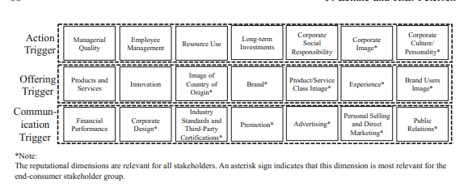
Chapter
02
www.midocean.ae

Slide 13
Chapter
02
Reputational Risks
Reputational risks are defined as the cumulative likelihood that events resulting from exogenous or endogenous sources can occur and negatively impact the stakeholder’s perception of the firm’s behavior and performance .
They may be based upon:
an economic,
societal,
or environmental event that involves the firm directly or they may arise indirectly via the activities of another organization in the supply chain
www.midocean.ae

Slide 14
Chapter
02
Reputation Risk Signals
Wasting resources .
taking a short-term horizon in investments may signal negligence.
Employee complaints of mistreatment
superior financial performance may signal that an organization is greedy.
That may be reinforced by insufficient activities in CSR and the destruction of the natural environment. In short, the reputation of any corporation is at risk and needs to be closely and regularly monitored
www.midocean.ae

Slide 15
Chapter
02
Assessing the Reputation Cost
An organization’s reputation may be placed at risk if a member organization conducts itself in such a manner that the behavioral outcomes spread beyond its organizational boundaries.
It is not surprising that this type of risk, if not realized, goes unnoticed. On the one hand, reputational risks rarely result in the disruption of resources and they hardly impact the quality and quantity of a supply—two major risks that tend to receive the most attention. On the other, it is generally problematic to assess their associated costs, if realized, making mitigation difficult to justify. Lastly, estimating the probability of an event occurring and the impact the event will have on a reputation, (and to what extent) is very difficult.
www.midocean.ae

Slide 16
Chapter
02
This means that assessing the costs and benefits of managing such risks are highly unpredictable.
In order to mitigate the potential risks that threaten a firm’s reputation, we must first understand its function in the supply chain context. Lets look at the theoretical underpinnings before proceeding with some of the practical steps
www.midocean.ae

Slide 17
Chapter
Reputation, Spillover and the Ripple Effect in the Supply Chain
02
Supply Chain Reputation: The reputational triggers and dimensions discussed thus far are particularly suitable for capturing the perspectives of all stakeholders associated with the processes and outcomes of a supply chain.. Yet, the underlying principle applies just the same: along the chain, each firm forms their own reputation based upon the perceptions of stakeholders with respect to the firm’s behaviors and competences for each of the three triggers. The reputation derived from any one or more dimensions (i.e., within the respective trigger) has the probability of being transferred from one party to another
www.midocean.ae

Slide 18
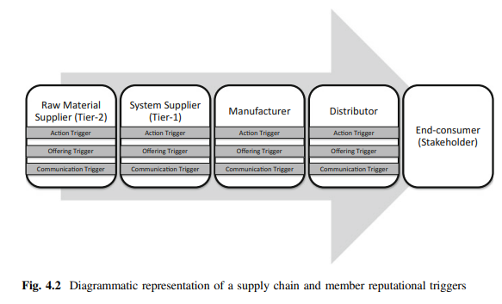
Chapter
02
Figure 4.2
represents a simplified view of such a chain. We only consider one raw material producer (tier-2 supplier), system supplier (tier-1), manufacturer, and a distributor for practical purposes but in reality, there may be many more with multiple tiers
1-18
www.midocean.ae

Slide 19
Chapter
02
The Mechanics of Reputational Spillover and the Ripple Effect Even though a corporation will develop a reputation along the chain , this is not in isolation.
In fact, there is an associated chain where ‘reputational owners’ and ‘reputational borrowers’ co-exist .
Knowing which dimensions remain with the party that essentially earned it and which dimensions have a probability of spillover is the key to understanding when or where risks should be mitigated.
www.midocean.ae

Slide 20
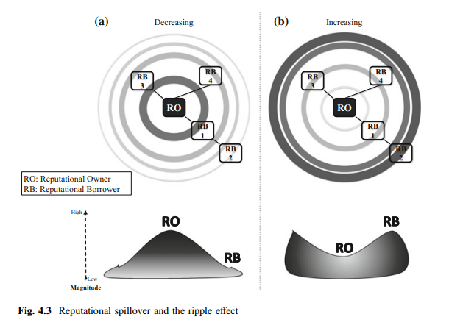
Chapter
02
Figure 4.3 provides a snapshot of the underlying mechanics
The reputational owner (RO in the figure) forms a reputation through the varying triggers associated with its market offering, communications, and actions.
The reputational borrower (RB) will passively or indirectly be impacted by the reputation from the owner merely by association
www.midocean.ae

Slide 21
Chapter
02
This association could be embedded in a:
contractual frame (e.g., business partnership),
industry setting (e.g., electronics),
geographical region (e.g., South America), and others.
Transferring reputation from the owner to the borrower is what we consider the spillover effect. The spillover could be direct (RO to RB1, RB3, and RB4) or indirect (RO to RB2) via multiple partners
www.midocean.ae

Slide 22
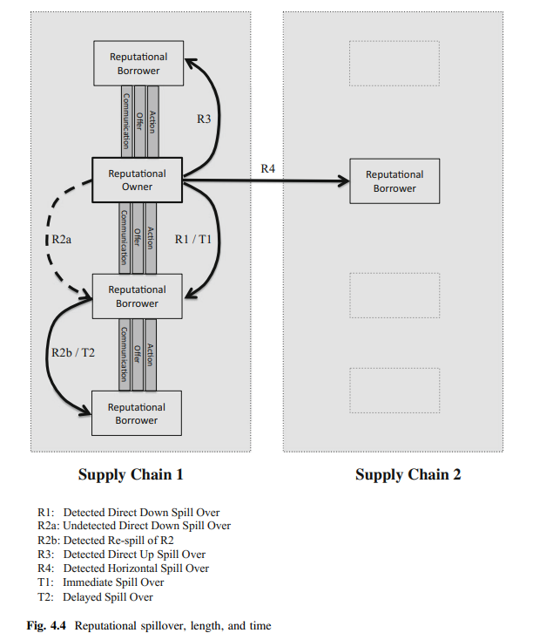
Chapter
02
www.midocean.ae

Slide 23
Chapter
02
We draw attention to four different reputational spillover states (R1 to R4 in Fig. 4.4) to explain variations in the supply chain context:
• Stemming from the reputational borrower, R1 is a direct downstream spillover. Note that ‘down’ refers to the supply chain, meaning that the reputation transfers from one supply chain actor to another that is positioned closer to the target market. For instance, a manufacturing firm that has a significant reputation for being fashionable, like Super dry (the UK clothing company), may have a spillover effect and thereby enhances the reputation for being fashionable to a partnering firm. Put another way, the retailer borrows the reputation for being fashionable from the manufacturer.
www.midocean.ae

Slide 24
Chapter
02
• R2 describes an interesting spillover that first directly transfers undetected to a downstream partnering firm (R2a) and re-spills detected to the next downstream organization
This is an indirect down spill from the reputational owner to a reputational borrower without any direct relationship (R2b).
For example, the reputation of a manufacturer for following fair trade principles may not be important for a global distributor of food. Given that this is neither relevant for the distributor nor for its stakeholders, there is a hidden fair trade reputational effect. The distributor could borrow the reputation, but does not look for it, does not detect it, and does not publicize it. Stakeholders also do not deem this important and are, thus, not concerned with this. Next, the retailer buys a range of products from the distributor and will then offer these to the end-consumer
www.midocean.ae

Slide 25
Chapter
02
market. If end-consumers, as a stakeholder group, are looking for fair trade products, the manufacturer’s fair trade reputation becomes relevant and re-spills, via the distributor, to the retailer who will borrow it for attracting end-consumers. In this scenario, we see that spillovers can vary in length, sometimes transferring reputation to both upstream and downstream companies that are more than one tier away. It is all about sequencing, which is another way of saying that the reputational ripple effect underlines the supply chain system
If end-consumers, as a stakeholder group, are looking for fair trade products, the manufacturer’s fair trade reputation becomes relevant and re-spills, via the distributor, to the retailer who will borrow it for attracting end-consumers. In this scenario, we see that spillovers can vary in length, sometimes transferring reputation to both upstream and downstream companies that are more than one tier away.
www.midocean.ae

Slide 26
Chapter
02
It is all about sequencing, which is another way of saying that the reputational ripple effect underlines the supply chain system and extends beyond it. A re-spill creates the next wave that, in this particular case, increases in magnitude Following this thought, R1 could be further transferred, providing that the reputation (for being fashionable, to stay with the example above) becomes relevant for organizations and stakeholders further downstream the supply chain.
• R3 describes an upstream spill of reputation. A supplier that works with Apple Inc. could borrow Apple’s reputation for being innovative and could “use the high-tech reputation to present itself as a highly capable and innovative supplier to new potential customers”. In this example, we see that reputational spillovers can be multi-directional.
www.midocean.ae

Slide 27
Chapter
02
R4 is an example that goes beyond the realm of a single supply chain.
Thus far, R1 to R3 described vertical spillovers that stay within a given chain. R4 demonstrates that an organization outside that chain can borrow the reputation from the owner.
For instance, the reputation of Volkswagen (the German automotive manufacturer) for being environmentally responsible was tarnished with the diesel emissions scandal ..
www.midocean.ae

Slide 28
Chapter
02
As soon as it became public that the French police raided some of the manufacturing sites of Renault (the French automotive manufacturer), stock prices fell by 20% because investors were worried that Renault would be pulled into the Volkswagen emissions scandal as well .
Even the reassurances of the French government that Renault is not involved in any fraud, did not help to recover the losses. In this example, we see that the reputation of one company can spill horizontally to another organization, even though these are embedded in two different supply chains
www.midocean.ae

Slide 29
Chapter
02
The figure also draws attention to two time lapses (T1 and T2):
• T1 shows that reputation could spill over with an immediate effect. For instance, the reputation of a company manufacturing real fur coats spills over to partner organizations (e.g., retailers) as soon as ‘wearing real fur products’ becomes unfashionable, unethical, unsustainable, etc.
The negative or positive reputation of the manufacturer has the potential to spillover directly and immediately to others.
www.midocean.ae

Slide 30
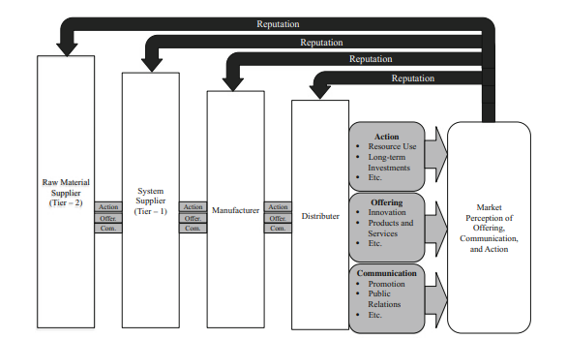
Chapter
02
www.midocean.ae

Slide 31
Chapter
02
T2 highlights that reputation could remain latent and stay with the owner for some time and may spill over later to another party as soon as the reputational trigger becomes relevant and active in a given situation. For example, a clothing company sourcing products from countries where child labour is the norm has no reputational damage, as long as ‘child labour’ is not perceived as being wrong. Retailers will not experience any spillover, given that its immediate stakeholders do not deem this important.
www.midocean.ae

Slide 32
Chapter
02
As soon as child labor becomes a topic of debate and stakeholders (such as end-consumers) perceive this as being negative, the reputation of the clothing company will spill over to the retailer, regardless of whether the retailer offers products from the clothing company at present.
Given that the manufacturer-retailer association has already been established, activities and market offerings of the past could result in a latent reputational spillover at a later point in time
www.midocean.ae

Slide 33

Chapter
The Tool to Detect and Capture Reputational Spillover
02
Regardless of time and the reach of a reputational spillover within the ripple zone, it is important to understand what reputational dimensions typically stay with the reputational owner and what dimensions have the propensity to transfer to borrowers. When seen from a distant, reputation in a supply chain becomes an unknown entity making it difficult to tease out the processes that lie behind it. The conceptual model presented next captures this by arranging the dimensions in the supply chain context
www.midocean.ae

Slide 34
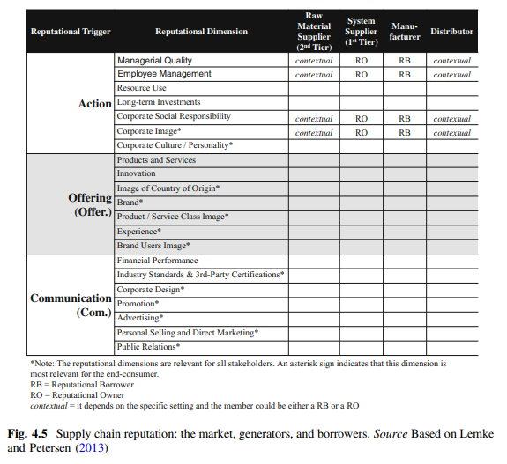
Chapter
02
www.midocean.ae

Slide 35
Chapter
02
Reputational Risk Management
Integrating CSR into the supply chain serves to guide members with incentives and tools to enhance performance, a strategy that builds on the notion of ‘greening’ the supply chain. There are the relevant management steps:
Assessing and managing for reputational risks entails a coordinated effort to assess all supply chain members’ commitment, actions, and surrounding policies. The emphasis is to target the governance of partnering firms .the seven-step management process that the environment initiates—one has to take these in stated order:
www.midocean.ae

Slide 36
Chapter
02
Member Orientation—the process begins with the gathering of information from supply chain members. This entails their responsibility and sustainability statements, an analysis of their policies and procedures, corresponding performance, the quality of their metrics, and their connections to other business parties. This procedure would make the supply chain transparent and creates a platform where knowledge-sharing, learning, developing a sense of shared meaning and values, etc. is encouraged.
www.midocean.ae

Slide 37
Chapter
02
Other efforts, such as conducting a lifecycle analyses on the products, would assist in identifying opportunities to mitigating environmental issues, human rights problems or disruptions to supplies. Scanning the environment for issues associated to the specific activities an organization engages in (i.e., regulatory matters, public policy issues, and societal trends) helps to identify and navigate through potential risks. This also includes regulatory non-compliance and/or awards. Ensuring that interested and affected parties are taken into consideration, identifying risks early on will assist in addressing and mitigating stakeholder issues at a later date.
www.midocean.ae

Slide 38
Chapter
02
2. Risk Analysis—Assessment begins with the characterization of the risks. Probability, impacts, social burden and cost to the organization are conducted here. Prioritization should occur to determine which risks should receive immediate attention as per stakeholder preferences and their input. Nevertheless, capturing and detailing the risks, based on accurate and relevant information, will lead to better decision-making.
For instance, the lifecycle analysis will identify whether any supply chain member uses conflict materials in the production process or perhaps detail the carbon footprint of their product or service. It will also indicate the risk type perceived by each stakeholder group.
www.midocean.ae

Slide 39
Chapter
02
3. Risk Ranking—Risks should be prioritized and then categorically assessed for how the organization should manage them. This step could be based on the costs, resources, capabilities, impact, etc. involved in addressing the risk or on the consequences resulting from it
4. CSR Mitigating Strategies—CSR is shaped by the activities of the firm, the environmental situation, and the perceptions of respective stakeholders. The result of the previous step, risk ranking, provides a process of prioritization that is captured within a CSR framework, and would then provide options for mitigation. Given the complexity, CSR allows the formulation of counter-strategies specifically in light of governance, ethical, environmental, and social aspects of the business, which shall be discussed later.
www.midocean.ae

Slide 40
Chapter
02
5. Decision—Selection of the best option should lead to reducing or eliminating the risk in the most cost effective manner. Management’s approach must be collaborative. Reducing or eliminating the risk is in the best interests of all supply chain members, but more so with those that have more to lose.
By developing the managerial competencies of all parties in the analysis, recognition and decision-making process, the chain becomes stronger and has the probability of providing a competitive advantage. Selection of the mitigating options are contingent upon ensuring that there is a collaborative approach that considers the resources required by the decision, the intensity of the effort, and the parties that are affected
www.midocean.ae

Slide 41
Chapter
02
6. Implementation—Collecting and assessing the performance data for effectiveness ensures that management practices are measured. This then will allow for continuous improvement. Implementation involves the development of the appropriate policy, establishing goals and metrics, identifying roles and responsibilities, acquiring the needed resources, and starting the implementation programme
7. Feedback—After the data is collected, procedures implemented, and performance evaluated, the loop must be closed. Performance evaluation data is fed back in at the front of the loop and the risk analysis process begins once again
www.midocean.ae

Slide 42
Chapter
02
Corporate Social Responsibility in the Supply Chain
From a traditional stakeholder vantage point, one of the primary roles or responsibilities of business is wealth generation which guides them on their duties as for-profit entities . This is an extreme view, and one held by very few business people today. Included in the building up of monetary wealth, business now must also strive to assume CSR, which entails responsibilities surrounding economic, societal and environmental issues . Although it is a topical business practice with a pedigree of academic writing, the CSR concept is still somewhat ill-defined . This is due, in part, to varying stakeholder expectations and what one would consider to be a CSR-related action
www.midocean.ae

Slide 43
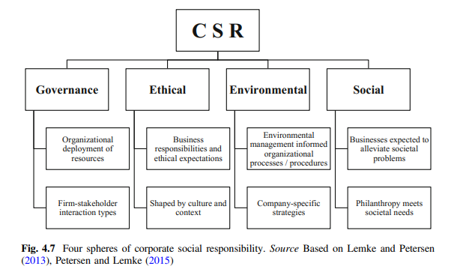
Chapter
02
www.midocean.ae

Slide 44
Chapter
02
The first CSR sphere, governance:
views a corporation as being embedded in existing social structures and international business networks. This sphere encapsulates how organizational resources are being deployed and the type of interaction the organization has with its .Responsible firms have better organizational performance, good risk management practices, support from institutional investors, satisfied employees, and loyal Compliance and organizational responsiveness among chain members should be observed at the level of governance.
www.midocean.ae

Slide 45
Chapter
02
The second sphere is ethics:
which captures the expectations of stakeholders and also the corporation’s willingness to assume its ethical responsibility .In general, ethical behavior has a direct impact on shareholder value and in the supply chain, organizations are serving a more diverse and global market and thus, have to cooperate with multiple and sometimes international suppliers and buyers. Ethics covers the materials and working processes employed at each link of the supply chain that may start in one country, and cross national boundaries, cultural zones, legal systems, and individual viewpoints. On this journey, the interpretation of ethics can and does change and what appeared to be ethical at one stage – even with the best intentions at any given time – may look neutral or unethical in the next . in the end, the consumer that fuels the production process and, therefore, the final ethical verdict would come from the end-consumer. This highlights the necessity that the ethical interpretation of all supply chain members becomes united and reflects one and the same ethical approach
www.midocean.ae

Slide 46
Chapter
02
The environment represents the third sphere:
and it captures the responsibilities and actions pertaining to the management of the natural environment. This sphere includes business processes so that the organization and the environment form a symbiotic relationship in which both entities flourish. In this instance, a future-oriented and pro-active environmental strategy could reap financial rewards for the business.
The last CSR sphere is social and it involves the public’s expectations on business leaders that surpass their fiduciary duties. Just as we would expect of a good citizen to participate in alleviating social ills, businesses are expected to contribute in the same way. Human rights atrocities, racial disparity, the prevention of child labor, creating awareness of alcohol abuse, anti-smoking campaigns
www.midocean.ae

Slide 47
Chapter
05
Reference
Supply Chain Risk Management Advanced Tools, Models, and Developments
By: Yacob Khojasteh
-ISBN 978-981-10-4106-8 (eBook)
Chapter 2
www.midocean.ae

Slide 48




Thank You

