Slide 1





Introductory lecture
Prepared by Dr. Walaa Mohamed
PMG633
Financial Risk Management

Slide 2
Core Bank Services
Deposit collection—the process of accepting cash or money (deposits) from individuals and businesses (depositors) for safekeeping in a bank account, available for future use.
Payment services—the process of accepting and making payments on behalf of the customers using their bank accounts.
Loan underwriting—the process of evaluating and deciding whether a customer (borrower) is eligible to receive credit and then extending a loan or credit to the customer.

Slide 3
Types of banks
Some types of banks
Retail Banks
Wholesale Banks
Bank Holding Companies
Cooperative Banks
Credit Unions
Micro-finance Institutions
Central Banks

Slide 4
Some types of risks
Some types of risks
1. Credit Risk
Credit risks the risk that a bank borrower, also known as a counterparty, may fail to meet its obligations—pay interest on the loan and repay the amount borrowed—in accordance with agreed terms.

Slide 5
2. Market Risk
Market risks the risk of losses to the bank arising from movements in market prices as a result of changes in interest rates, foreign exchange rates, and equity and commodity prices.
Operational risk is the risk of loss resulting from inadequate or failed internal processes, people, and systems or from external events.

Slide 6
4. Liquidity Risk
Liquidity risk is the risk that a bank may not be able to meet its obligations to repay deposits and other funding, or to continue financing its assets.
5. Business risk
Business risk is the potential loss due to a decrease in the competitive position of the bank and the prospect of the bank prospering in changing markets.

Slide 7
6. Reputational risk
Reputational risk is the potential loss resulting from a decrease in a bank’s standing in public opinion.
7. Compliance risk
Compliance risk is the risk that a bank may suffer losses as a result of its failure to comply with laws and regulations or with internal policies and procedures that govern the way it operates.

Slide 8
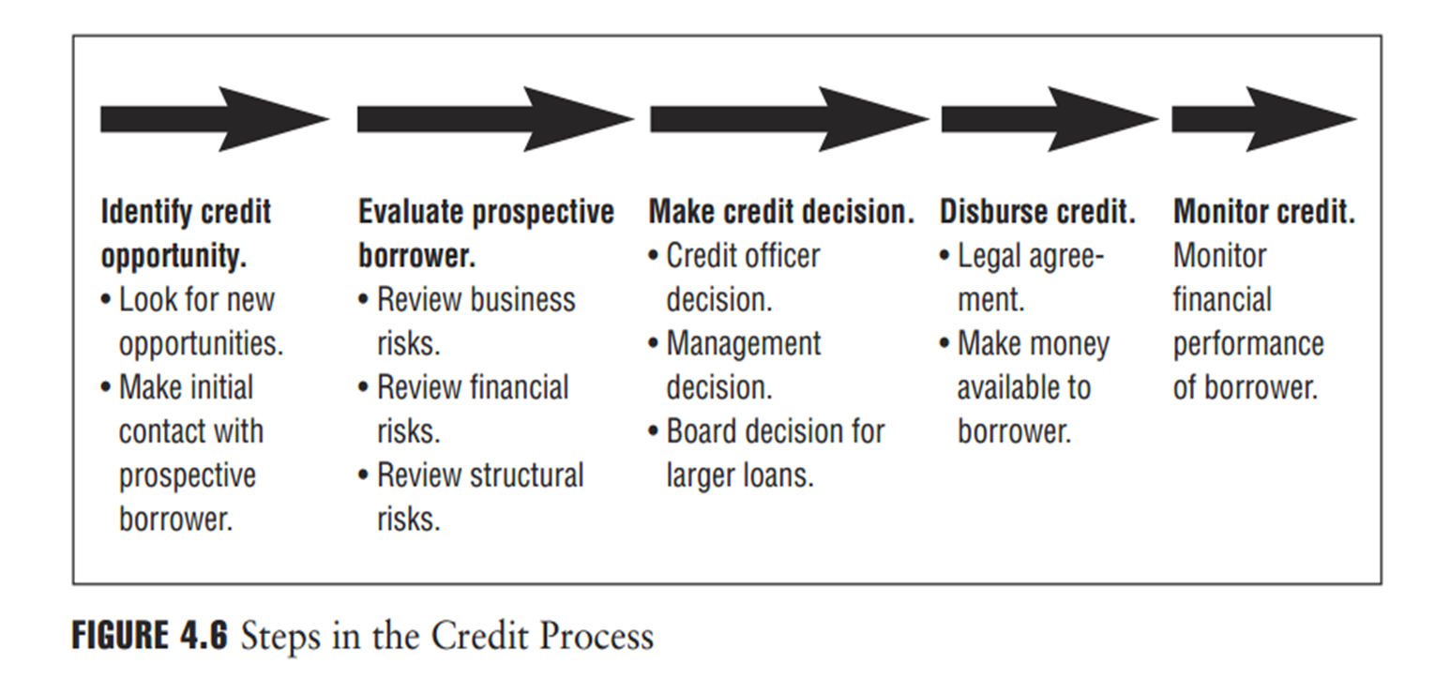

Slide 9
Portfolio Diversification
In addition to finding the best combination of investments that delivers the optimal return for the allowable risk profile of the portfolio, the portfolio manager must also seek to minimize specific portfolio risks, namely concentration and default correlation risks.
    Concentration Risk
An inherent risk in lending is that a bank can become skilled in lending to, for example, one geographical area or to one industry (e.g., shipping) and will then tend to focus the majority of its underwriting efforts on that area or sector. This can lead to a highly concentrated, or not suitably diversified, credit portfolio, which will increase the bank’s exposure to potential losses in the event of deterioration in that particular area or industry.

Slide 10
A diversified loan portfolio will be diversified by geography, industry type, demographic profile, or other indicators and should reduce the impact to the bank of a severe market disruption. Although development of a core competency in lending to a specific market or industry might lead to concentration risks, its effects might be mitigated somewhat by the possibility that the bank’s expertise in that specific sector helps it avoid the weakest credits.
Reducing concentration risk may require active management of a bank’s loan portfolio. For example, a bank might sell some of its loans to third parties, thereby removing those risks from its banking book. Or it might introduce diversification into its portfolio by buying nonsimilar loans from other banks.

Slide 11
    Contagion Risk
Contagion risk refers to a ripple effect of defaults that may occur in a particular industry or country or between countries where the default of one borrower—or counterparty—has a negative impact on other borrowers.

Slide 12

صيغ التمويل في المصارف الإسلامية
تقوم المصارف التجارية بعمليات القروض والسلفيات لعملائها مقابل فائدة ربوية محددة مقدماً. أما في المصارف الإسلامية فيتم استخدام الأموال عن طريق صيغ التمويل المتعددة والمشروعة والتي تناسب كافة الأنشطة سواء أكانت تجارية، صناعية، زراعية، عقارية، مهنية، حرفية. ويعد نشاط التمويل من أهم الأنشطة بالمصارف الإسلامية حيث تمثل عوائده أهم مصدر للأرباح.
وهناك العديد من صيغ التمويل الإسلامية، منها: التمويل بالمرابحة، والتمويل بالمشاركة، والتمويل بالمضاربة، والتمويل بالاستصناع، والتمويل بالسَلَم، والتمويل بالإجارة والتمويل بالبيع الآجل.

Slide 13
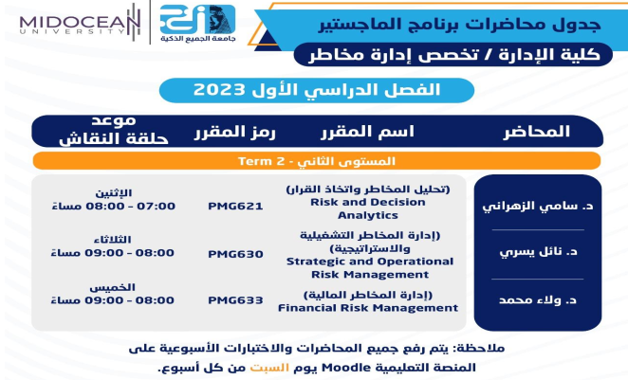


حساب اللينك ان الخاص بي
https://www.linkedin.com/in/walaa-mohamed-95a402122/

