Slide 1



Machine Learning
Prepared by Dr. Yasser Abdelhamid
DS 620
Machine Learning
Lecture 2

Slide 2

Outline
Machine learning preliminaries.
  Knowledge
  Inference
    Inductive inference
    Deductive inference
  Domain
  Instance
  Attributes
  Dataset
  Training set
  Model
Example

Slide 3
Knowledge
Whenever discussing any form of learning, the term “Knowledge” is frequently used to refer to the expected result of the learning process.
It is difficult to provide a satisfactory definition of knowledge, however we can describe how it is being used.
The purpose of knowledge is inference.

Slide 4
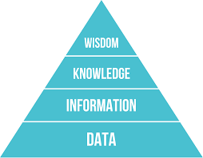
Hierarchy of knowledge
Data: Is the raw material from which information is created.
Information: is the first processing step towards extracting something useful from data ( aggregation, validation, …) it is the answer to all questions like who?, What?, When, Where? but not How.
Knowledge: Is the process of applying extracted information to fulfill our goals, and it is usually the answer for How?
Wisdom: Is using the knowledge and insights gained from the information to take proactive decisions or simply the right decision.

Slide 5
Inference
Inference can be considered as the process of using some available knowledge and information to derive some new knowledge.
Different types of inference are employed when using training information to derive knowledge and when using this derived knowledge.
These are :
  Inductive inference, and
  Deductive inference.

Slide 6
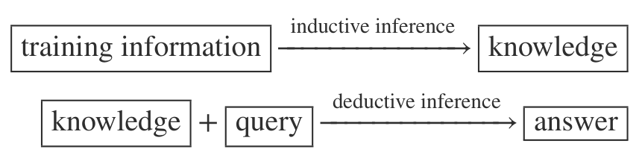
How we use inference?

Slide 7
Inductive inference
inductive inference is a “specific-to-general” reasoning process.
Inductive inference takes a number of individual observations (instances) to generate rules that match these known observations.
These rules can be used to predict unknown future observations.
Inductive inference is fallible and there is no guarantee that it would yield true conclusions when applied to true premises.

Slide 8
Deductive inference
Performing deductive inference based on knowledge derived via inductive learning conform to the popular “general-to-specific” pattern.
Deductive inference is infallible and its conclusions are guaranteed to be satisfied whenever its premises are true.
The infallibility of deductive inference guarantees receiving correct answers to all queries, only if the knowledge on which the deduction is based were perfectly correct, which cannot be expected in practice.

Slide 9
Domain
The domain, designated by X, is the set of all entities that are considered in a given inductive learning task.
Examples:
  Customers,
  Transactions,
  Devices
  …

Slide 10
Instances
Any single element of the domain, x ∈ X, is an instance.
Instances constitute both training information for model creation and queries for model application.

Slide 11
Attributes
Instances are observed by their attributes.
An attribute is a function
a ∶ X → A
It assigns an attribute value to each instance from the domain.
Generally, we assume that there are n attributes defined on the domain X,
a1 ∶ X → A1, a2 ∶ X → A2, … , an ∶ X → An.
When speaking of an instance x, we will usually mean the vector of values a1(x), a2(x), … , an(x).

Slide 12
Types of attributes
Nominal.
  Having a finite number of discrete values with no order relation.
Ordinal.
  Having a finite number of discrete values with an order relation.
Continuous
  Having numerical values.

Slide 13
Target attribute
A distinguished attribute that represents the property of instances that the created model should be able to predict, based on the values of other attributes.

Slide 14
Input attributes (features)
Some or all of non-target attributes are considered input attributes.
The values of which are assumed to be available for the whole domain.
There is a possibility of having missing values, which is one of the common practical data quality issues.

Slide 15
Training set
A training set is a subset of the domain.
the training set T ⊆ D is the set of instances actually used for model creation, where D ⊂ X denotes the set of all available instances.
Why we use only a subset of the whole available set of instances D for model creation?
  Computational savings,
  Model evaluation.

Slide 16
Model
Inductive learning task generates a model h based on the provided training set.
The generated model h represents knowledge that can be applied to all instances x ∈ X in an automated way.
This is a function that takes an instance as its argument (query) and returns a prediction as its value (answer).
It can be therefore considered a new attribute (column), inductively derived from the training data, but defined (computed) for the whole domain.
The predicted value is an approximation of an existing attribute that is only provided for a limited dataset, but remains unknown for the rest of the domain.

Slide 17
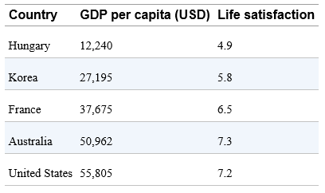
Example
Does money make people happier?

Slide 18
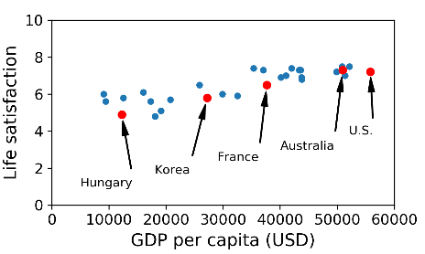
Exploring data

Slide 19
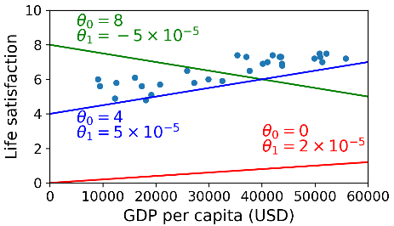
Selecting the model
You decided to model life satisfaction as a linear function of GDP per capita.
you selected a linear model of life satisfaction with just one attribute, GDP per capita.
life_satisfaction =
  θ0 + θ1 × GDP_per_capita

Slide 20
specify a performance measure
A fitness function that measures how good your model is.
A cost function that measures how bad it is.

Slide 21
Linear regression
Using Linear Regression algorithm, you feed it your training examples, and it finds the parameters that make the linear model fit best to your data.(Training)
In our case, the algorithm finds that the optimal parameter values are θ0 = 4.85 and θ1 = 4.91 × 10–5

Slide 22
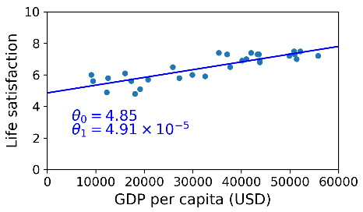
Solution model

Slide 23
Making predictions
Cyprus’s GDP per capita is $22,587
Life satisfaction for Cypriots.
4.85 + 22,587 × 4.91 × 10-5 = 5.96.
What about KSA?

Slide 24
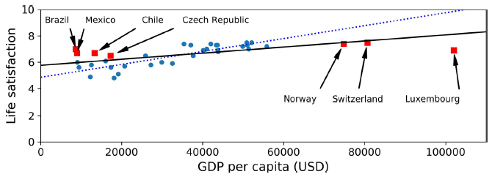
Main Challenges of Machine Learning
Insufficient Quantity of Training Data
  Data matters more than algorithms in complex problems.
Non-representative Training Data (Sampling Bias)

Slide 25
Main Challenges of Machine Learning
Poor-Quality Data
  Mistakes
  Outliers
  Missing
  …

Slide 26
Main Challenges of Machine Learning
Irrelevant Features (feature engineering)
  Feature selection
  Feature extraction
  Creating new features (from new data)

Slide 27
Main Challenges of Machine Learning
Overfitting the Training Data
  The model performs well on the training data, but it does not generalize well.
  Regularization.(reduce the risk of overfitting)
  Hyper-parameters: a parameter of a learning algorithm.
Underfitting the Training Data
  The model is too simple to learn the underlying structure of the data.

Slide 28
Testing and Validation
generalization error: error rate on new cases.

Slide 29


Thank You

