Slide 1


Computer Organization and Architecture
Prepared by Dr. Eng. Gamal Selim
Lecture 02 - Instructions: Language of the Computer

Slide 2
Instruction Set
The collection of instructions of a computer
Different computers have different instruction sets
But with many aspects in common
Early computers had very simple instruction sets
Simplified implementation
Many modern computers also have simple instruction sets

Slide 3
Instruction Set Architecture
Anything programmers need to know to make a binary machine language program work correctly, including:
Registers
Organization of programmable storage
Data types and data structures: encoding and representations
Instruction set
Instruction formats
Modes of addressing: accessing data items and instructions
Exceptional conditions

Slide 4
The MIPS Instruction Set
Used as the example throughout the book
Stanford MIPS commercialized by MIPS Technologies
www.mips.com
Founded in 1984 by a group of researchers from Stanford University that included John L. Hennessy
Little share of embedded core market
Applications in consumer electronics, network/storage equipment, cameras, printers, …
Typical modern ISAs
ARM: ARMv7
HP: PA-RISC 2.0
Intel: x86 - IA-32, x86-64 (Intel 64); IA-64
MIPS: MIPS32, MIPS64
SUN: SPARC-V9

Slide 5
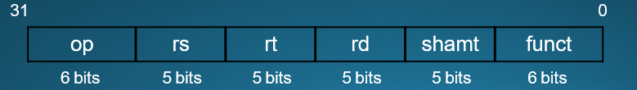
Arithmetic Operations
Add and subtract, three operands
Two sources and one destination
add a, b, c # a gets b + c
Operation, operator, operand
All arithmetic operations have this form
Design Principle 1: Simplicity favors regularity
Regularity makes implementation simpler
Simplicity enables higher performance at lower cost

Slide 6
Arithmetic Example
C code:
f = (g + h) - (i + j);
Compiled MIPS code:
add t0, g, h # temp t0 = g + h
add t1, i, j # temp t1 = i + j
sub f, t0, t1 # f = t0 - t1

Slide 7
Register Operands
Arithmetic instructions use operands from registers
The size of a register in MIPS architecture is 32 bits, which is a word
The word is the natural unit of access in a computer, usually a group of 32 bits; corresponds to the size of a register

Slide 8
Register Operands
MIPS has a 32 × 32-bit register file
Use for frequently accessed data
Cache of cache?
Numbered 0 to 31
Assembler names
$t0, $t1, …, $t9 for temporary values
$s0, $s1, …, $s7 for saved variables
$zero
Design Principle 2: Smaller is faster Cf. main memory: millions of locations

Slide 9
Register Operand Example
C code:
f = (g + h) - (i + j);
f, …, j in $s0, …, $s4
Compiled MIPS code:
add | $t0, | $s1, | $s2
add | $t1, | $s3, | $s4
sub | $s0, | $t0, | $t1

Slide 10
Memory Operands
Data transfer instruction: before arithmetic operations can be done
Load values from memory into registers
Store result from register to memory
RISC (Reduced instruction set computing) vs. CISC
Only load and store instructions access memory
Memory is byte addressed
Each address identifies an 8-bit byte
Alignment restriction: words are aligned in memory
For lw/sw, the address must be a multiple of 4
If either of the two least-significant bits of the address are non-zero, an Address Error exception occurs

Slide 11
Addressing Alignment Constraints
MIPS uses byte addressing for halfword, word, and doubleword accesses with the following alignment constraints:
Halfword accesses must be aligned on an even byte boundary (0, 2, 4...).
Word accesses must be aligned on a byte boundary divisible by four (0, 4, 8...).
Doubleword accesses must be aligned on a byte boundary divisible by eight (0, 8, 16...).

Slide 12
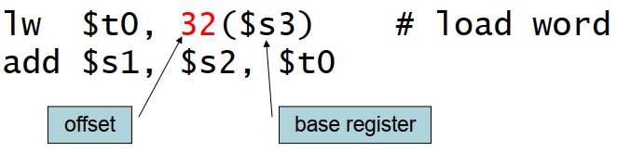
Memory Operand Example 1
C code:
g = h + A[8];
g in $s1, h in $s2, base address of A in $s3
Compiled MIPS code:
Index 8 requires offset of 32
4 bytes per word

Slide 13
Memory Operand Example 2
C code:
A[12] = h + A[8];
h in $s2, base address of A in $s3
Compiled MIPS code:
Index 8 requires offset of 32
lw | $t0, | 32($s3) | # | load | word
add sw | $t0, $t0, | $s2, $t0 48($s3) | # | store | word

Slide 14
Registers vs Memory
Registers are faster than memory
Smaller is faster
Operating on memory data requires loads and stores
More instructions to be executed
Compiler must use registers for variables as much as possible
Only spill to memory for less frequently used variables by store
Register optimization is important!

Slide 15

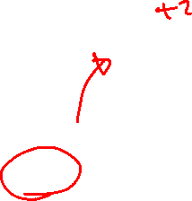
Immediate Operands
Constant data specified in an instruction
addi $s3, $s3, 4
No subtract immediate instruction
Just use a negative constant
addi $s2, $s1, -1
Design Principle 3: Make the common case fast
Small constants are common
Immediate operand avoids a load instruction

Slide 16
The Constant Zero
MIPS register 0 ($zero) is the constant 0
Cannot be overwritten
Hardwired to ground
Useful for common operations
E.g., move between registers
add $t2, $s1, $zero

Slide 17

Unsigned Binary Integers
Given an n-bit number
Range: 0 to +2^{n} – 1
Example
0000 0000 0000 0000 0000 0000 0000 1011₂
= 0 + … + 1×2³ + 0×2² +1×2¹ +1×2⁰
= 0 + … + 8 + 0 + 2 + 1 = 11₁₀
Using 32 bits
0 to +4,294,967,295

Slide 18

2s-Complement Signed Integers
Given an n-bit number
Range: –2^{n – 1} to +2^{n – 1} – 1
Example
1111 1111 1111 1111 1111 1111 1111 1100₂
= –1×2³¹ + 1×2³⁰ + … + 1×2² +0×2¹ +0×2⁰
= –2,147,483,648 + 2,147,483,644 = –4₁₀
Using 32 bits
–2,147,483,648 to +2,147,483,647

Slide 19
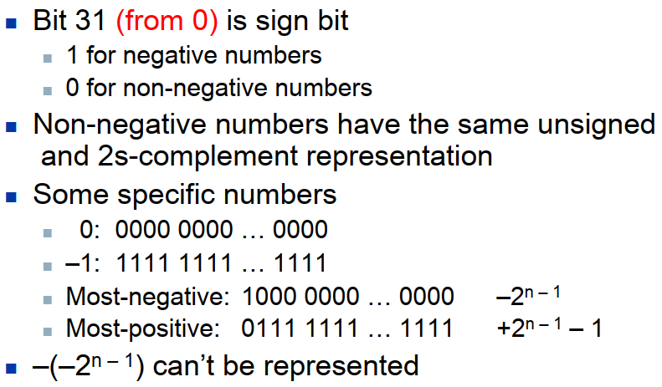
2s-Complement Signed Integers

Slide 20
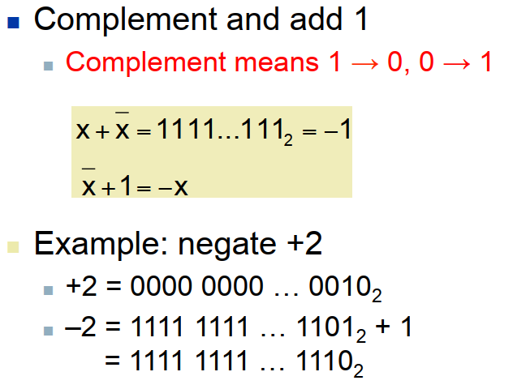
Signed Negation

Slide 21
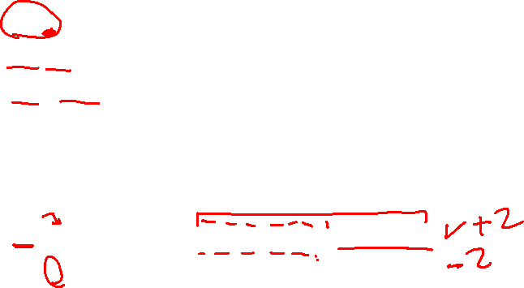
Sign Extension
Representing a number using more bits
Preserve the numeric value
In MIPS instruction set
addi: extend immediate value
lb, lh: extend loaded byte/halfword
beq, bne: extend the displacement
Sign Extension: replicate the sign bit to the left
Cf. unsigned values: extend with 0s
Examples: 8-bit to 16-bit
+2: 0000 0010 => 0000 0000 0000 0010
–2: 1111 1110 => 1111 1111 1111 1110

Slide 22
Representing Instructions
Machine language
Instructions are encoded in binary, called machine code
Used for communication within a computer
Very hard to make out which instruction is which
Assembly language
Symbolic representation of machine instructions： mnemonic symbol

Slide 23
MIPS Instruction Set
MIPS instructions
Encoded as 32-bit instruction words
Small number of formats encoding operation code (opcode), register numbers, …
Similar instructions have the same format
Simplicity favors regularity!
Register numbers
$t0 – $t7 are reg’s 8 – 15
$t8 – $t9 are reg’s 24 – 25
$s0 – $s7 are reg’s 16 – 23

Slide 24
MIPS R-format Instructions
op | rs | rt | rd | shamt | funct
6 bits 5 bits 5 bits 5 bits 5 bits 6 bits
Instruction format
The layout of the instruction
Instruction fields
op: operation code (opcode)
rs: first source register number
rt: second source register number
rd: destination register number
shamt: shift amount (00000, useless for R-format)
funct: function code (extends opcode)

Slide 25
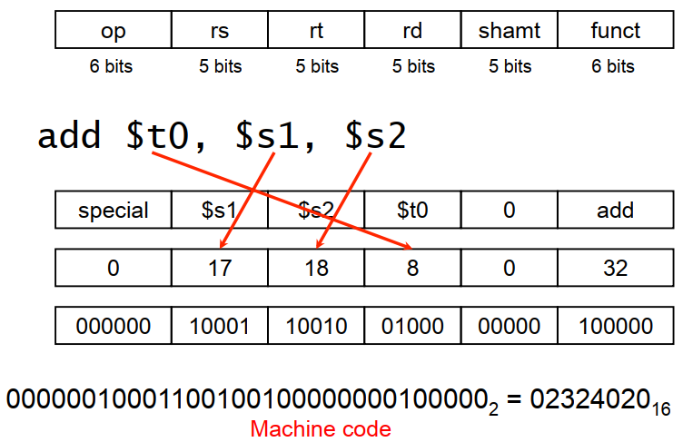
R-format Example

Slide 26
Hexadecimal
Base 16
Compact representation of bit strings
4 bits per hex digit
0 | 0000 | 4 | 0100 | 8 | 1000 | c | 1100
1 | 0001 | 5 | 0101 | 9 | 1001 | d | 1101
2 | 0010 | 6 | 0110 | a | 1010 | e | 1110
3 | 0011 | 7 | 0111 | b | 1011 | f | 1111
Example: eca8 6420
1110 1100 1010 1000 0110 0100 0010 0000

Slide 27
MIPS I-format Instructions
6 bits 5 bits 5 bits 16 bits
Immediate arithmetic and load/store instructions
rt: destination (addi, lw) or source (sw) register number
Constant: –2¹⁵ to +2¹⁵ – 1 (signed)
Address: offset added to base address in rs
Design Principle 4: Good design demands good compromises
Different formats complicate decoding, but allow 32-bit instructions uniformly
Keep formats as similar as possible
op | rs | rt | constant or address

Slide 28
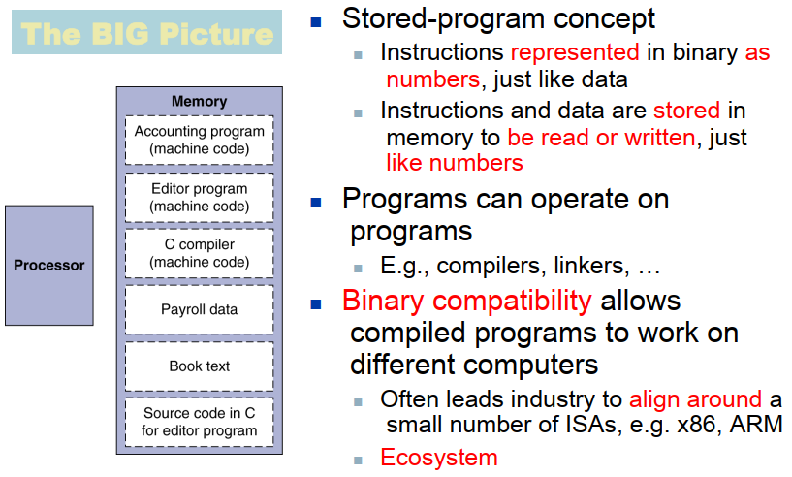
Stored Program Computers

Slide 29
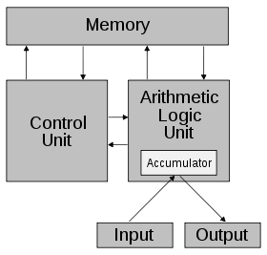
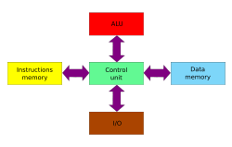
Von Neumann architecture
Von Neumann architecture
“Stored-program computer“ and "Von Neumann architecture" are interchangeably
Named after the mathematician and early computer scientist John von Neumann
Arose from Von Neumann's paper "First Draft of a Report on the EDVAC"
Von Neumann bottleneck
The limited throughput between the CPU and memory (memory wall)
Cf. Harvard architecture

Slide 30


Logical Operations
Instructions for bitwise manipulation
Operation | C | Java | MIPS
Bitwise AND | & | & | and, andi
Bitwise OR | | | | | or, ori
Bitwise NOT | ~ | ~ | nor

Slide 31
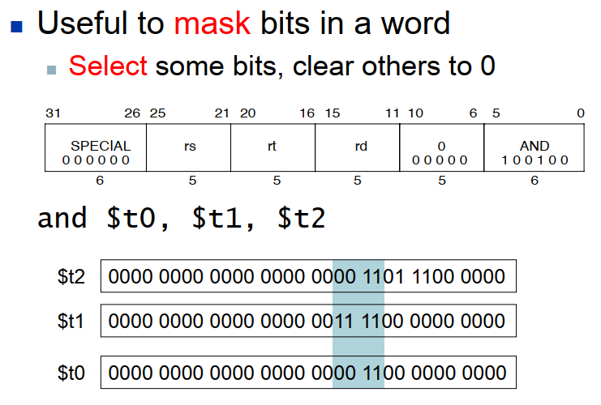
AND Operations

Slide 32
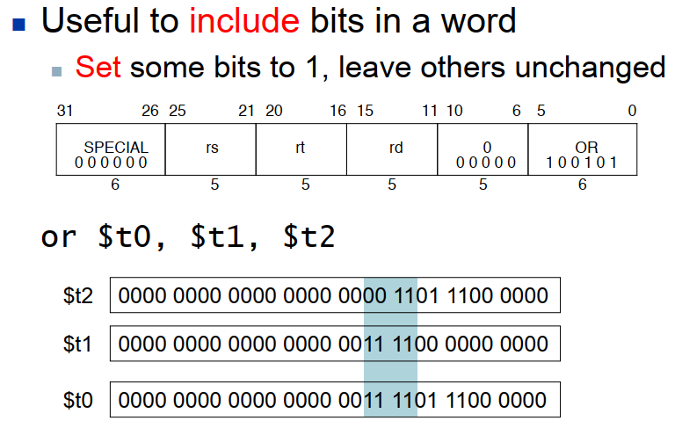
OR Operations

Slide 33
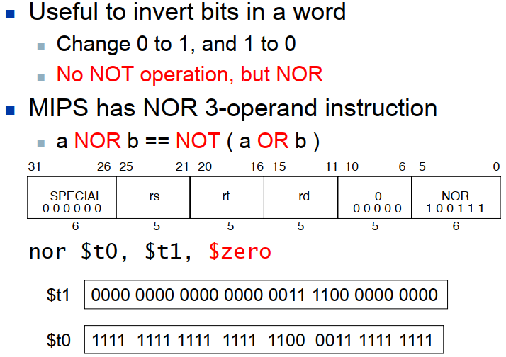
NOT Operations

Slide 34
Conditional Operations
The difference between a computer and a calculator is the ability to make decisions
In high level language
if statement
go to statement
Branch to a labeled instruction if a condition is true; Otherwise, continue sequentially
Conditional and unconditional branches
PC-relative and absolute/register indirect branch

Slide 35
Conditional Operations
MIPS defines the following instructions
PC-relative conditional branch: bne,beq, ± 128 KB
PC-region unconditional jump: j, jal, 256MB region
Absolute/register indirect unconditional jump: jr
How to “decide”? Program counter (PC)
The register containing the address of the instruction in the program being executed
PC is affected only indirectly by certain instructions - it is NOT an architecturally-visible register

Slide 36
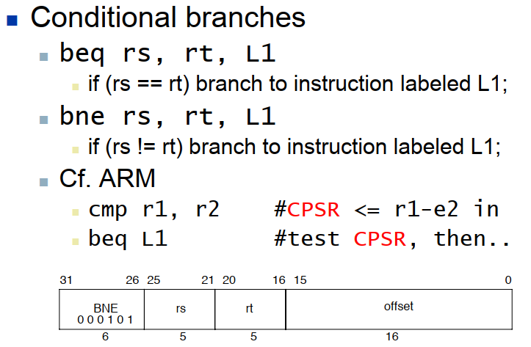
Conditional Operations

Slide 37
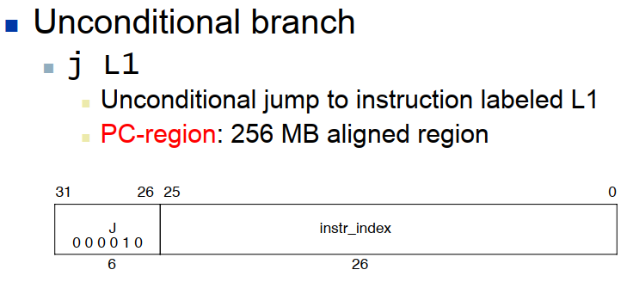
Conditional Operations

Slide 38
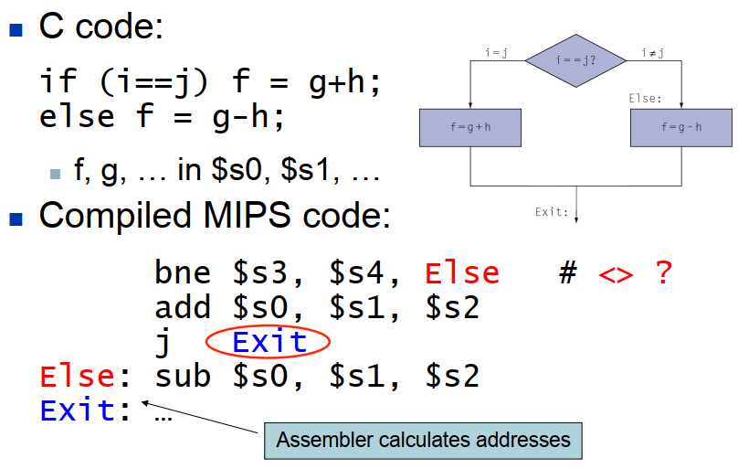
Compiling If Statements

Slide 39
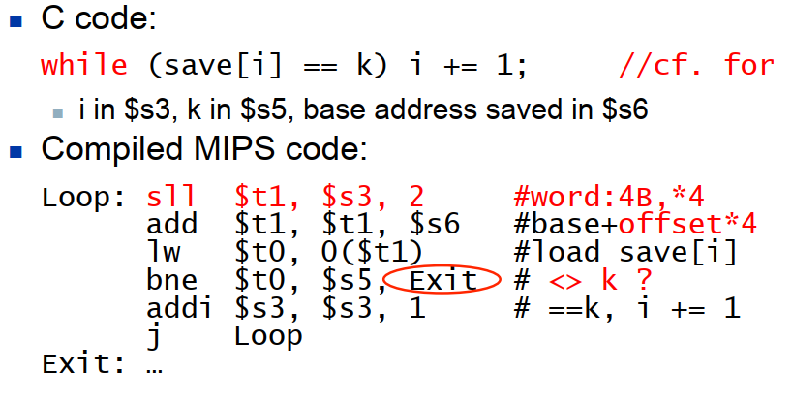
Compiling Loop Statements

Slide 40
Procedure
A stored subroutine that performs a specific task based on the parameters
Advantages: code reuse, easy understanding
Caller: the calling procedure, providing parameters to callee
Callee: the called program, executes stored instructions based on the parameters provided by the caller

Slide 41
Procedure Calling
To execute a procedure, steps required
Place parameters in registers accessible to procedure (callee)
Transfer control to procedure
Acquire storage for procedure
Perform procedure’s operations
Place result in register accessible to caller
Return to place of call

Slide 42
Register Usage
$a0 – $a3: reg’s 4 – 7
4 arguments register to pass parameters
$v0, $v1: reg’s 2 – 3
2 result registers to return values
$ra: reg 31
return address register to return to the point of call
$t0 – $t9: reg’s 8 – 15, reg’s 24 – 25
Temporaries. Can be overwritten by callee
$s0 – $s7: reg’s 16 – 23
Saved. Must be saved/restored by callee
$gp: global pointer for static data (reg 28)
$sp: stack pointer (reg 29)
$fp: frame pointer (reg 30)
$at: assembler temporary (reg 1)

Slide 43
Procedure Call
Caller
The calling program puts the parameter values in $a0 - $a3 (4 registers)
Transfers control to jump to procedure x using
jal x
Callee
The procedure x then performs the calculations
Places the results in $v0 and $v1 (2 registers)
Returns control to caller using jr $ra

Slide 44
Character Data
Byte-encoded character sets
ASCII: 128 characters
American Standard Code for Information Interchange
95 graphic, 33 control
Latin-1: 256 characters
ASCII, +96 more graphic characters
Unicode: 16/32-bit character set
Universal encoding of the alphabets of most human language
Used in Java (16 bit by default), C++ wide characters
Most of the world’s alphabets, plus symbols

Slide 45




  Thank You

