Slide 1



Network Security
Fundamentals
Lecture 9
CCNA – Introduction to Networks V7.0 (ITN)
Prepared by
Dr. Abdelrhman Ahmed

Slide 2
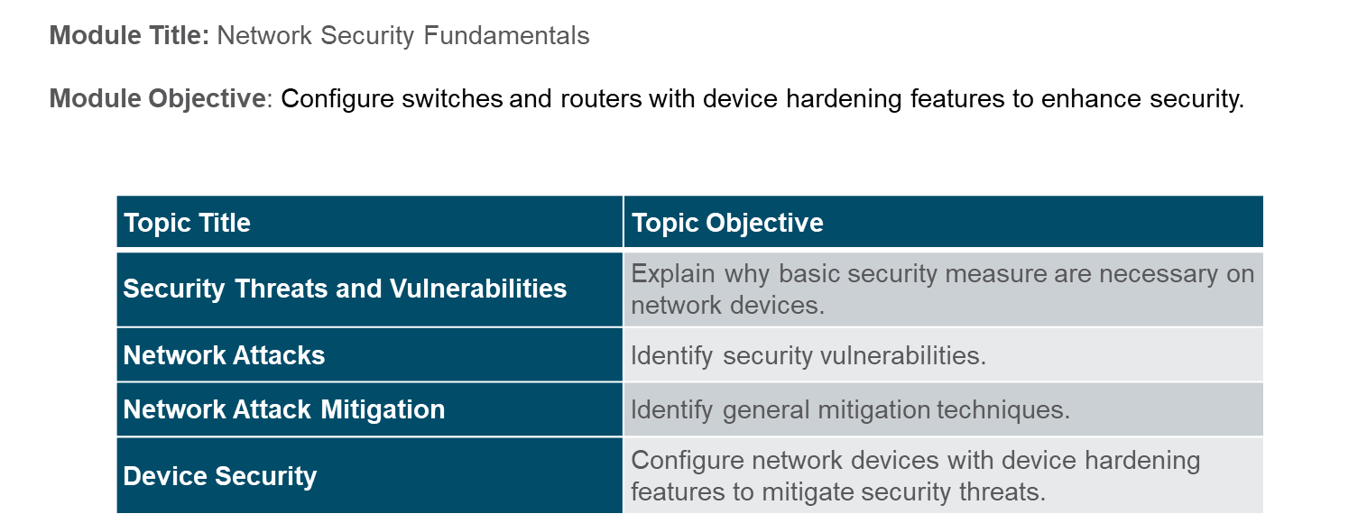
Chapter
Module Objectives
09

Slide 3
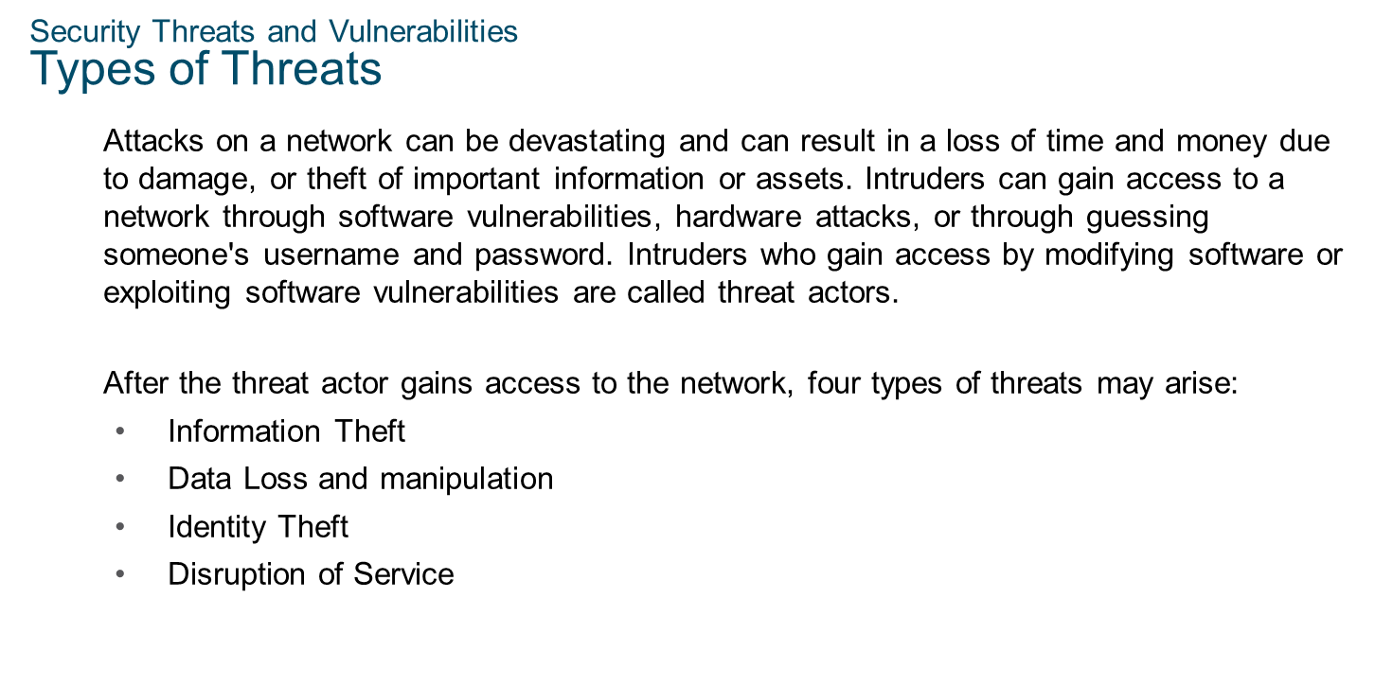
Chapter
Security Threats and Vulnerabilities
09

Slide 4
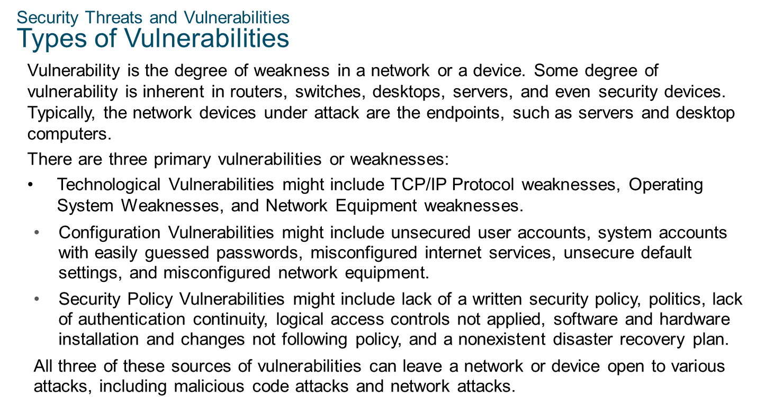
Chapter
Security Threats and Vulnerabilities
09

Slide 5
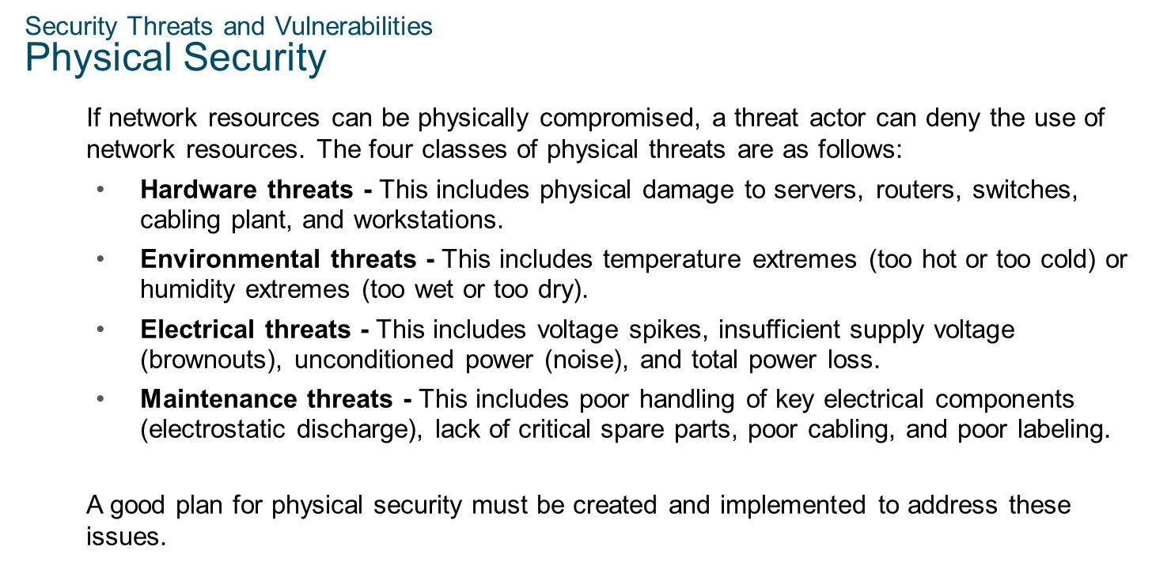
Chapter
Security Threats and Vulnerabilities
09

Slide 6
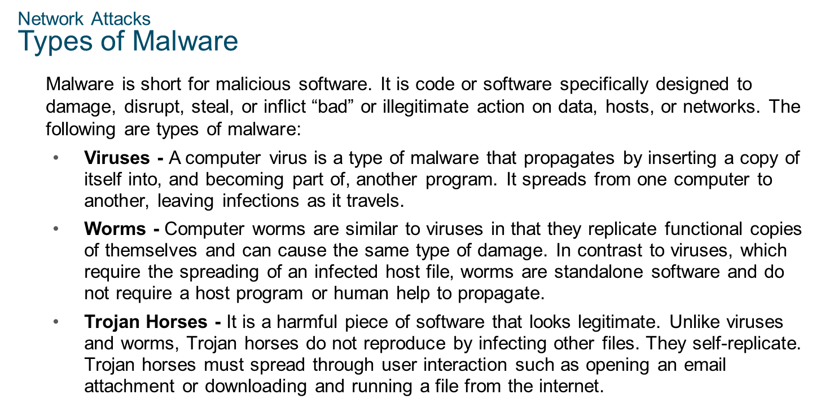
Chapter
Network Attacks
09

Slide 7
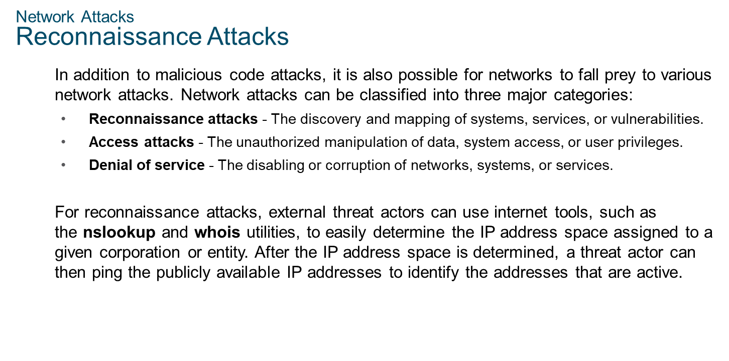
Chapter
Network Attacks
09

Slide 8
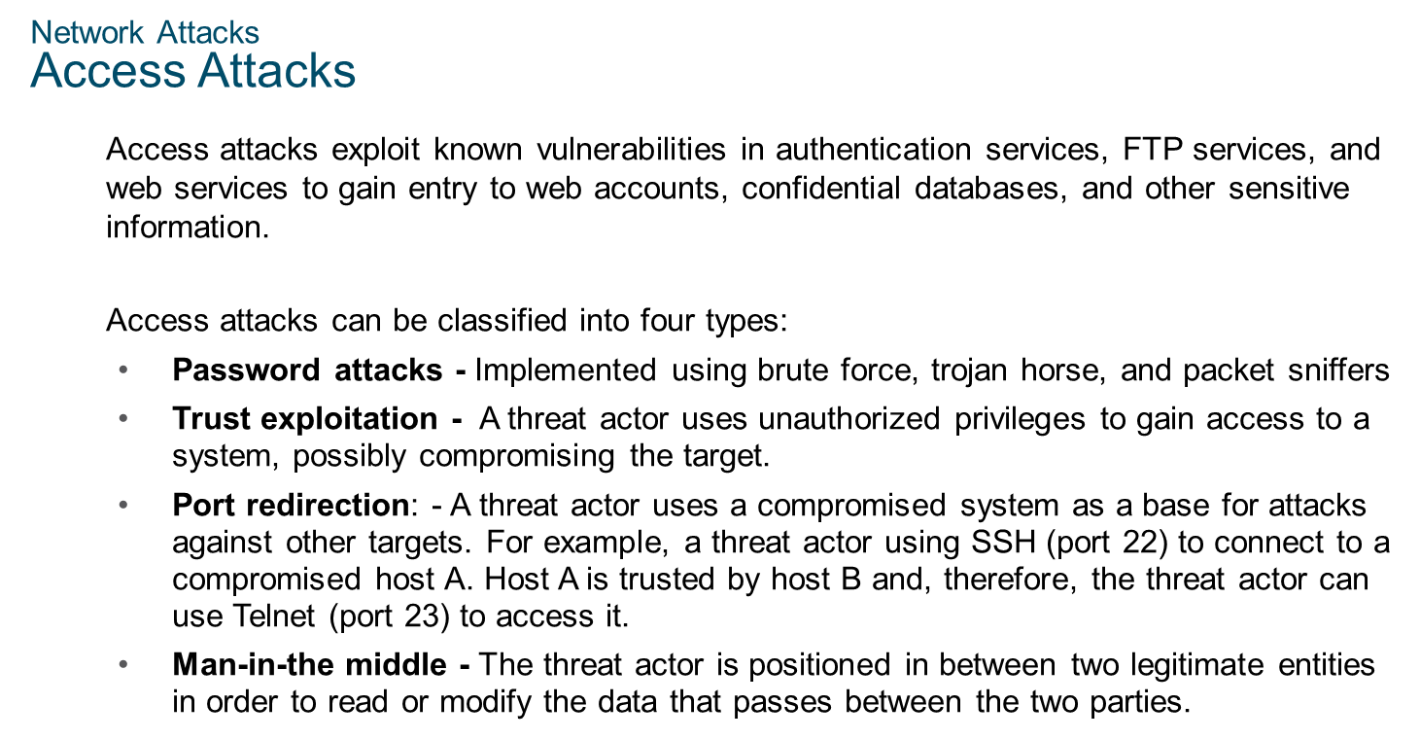
Chapter
Network Attacks
09

Slide 9
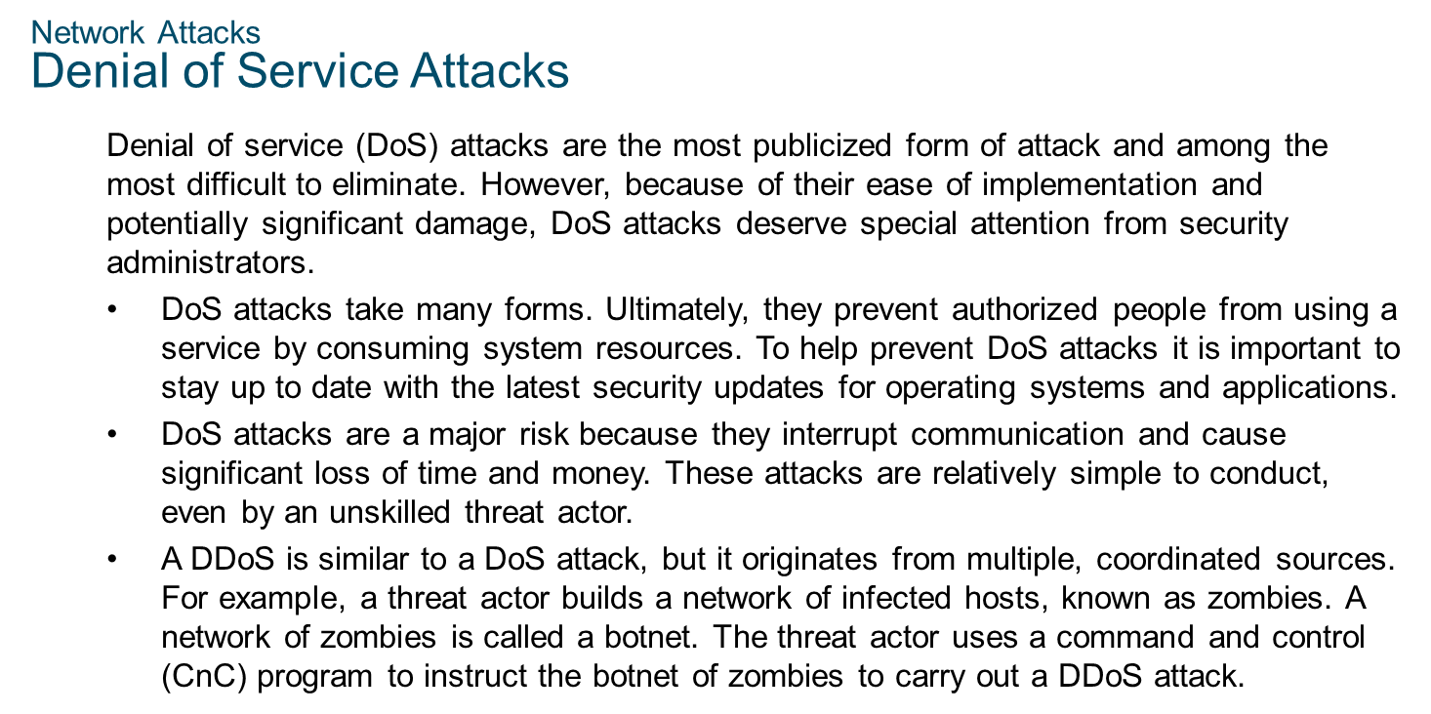
Chapter
Network Attacks
09

Slide 10
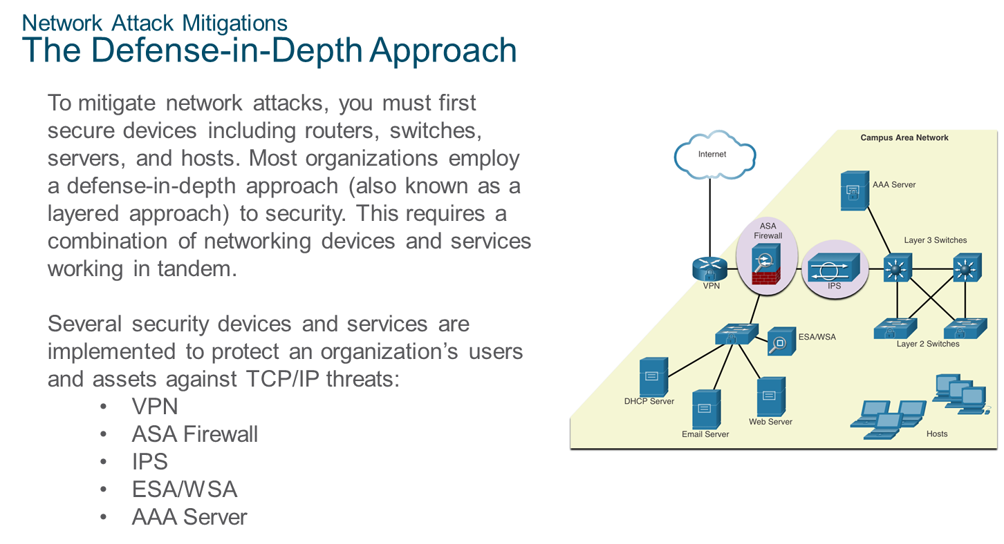
Chapter
Network Attack Mitigations
09

Slide 11
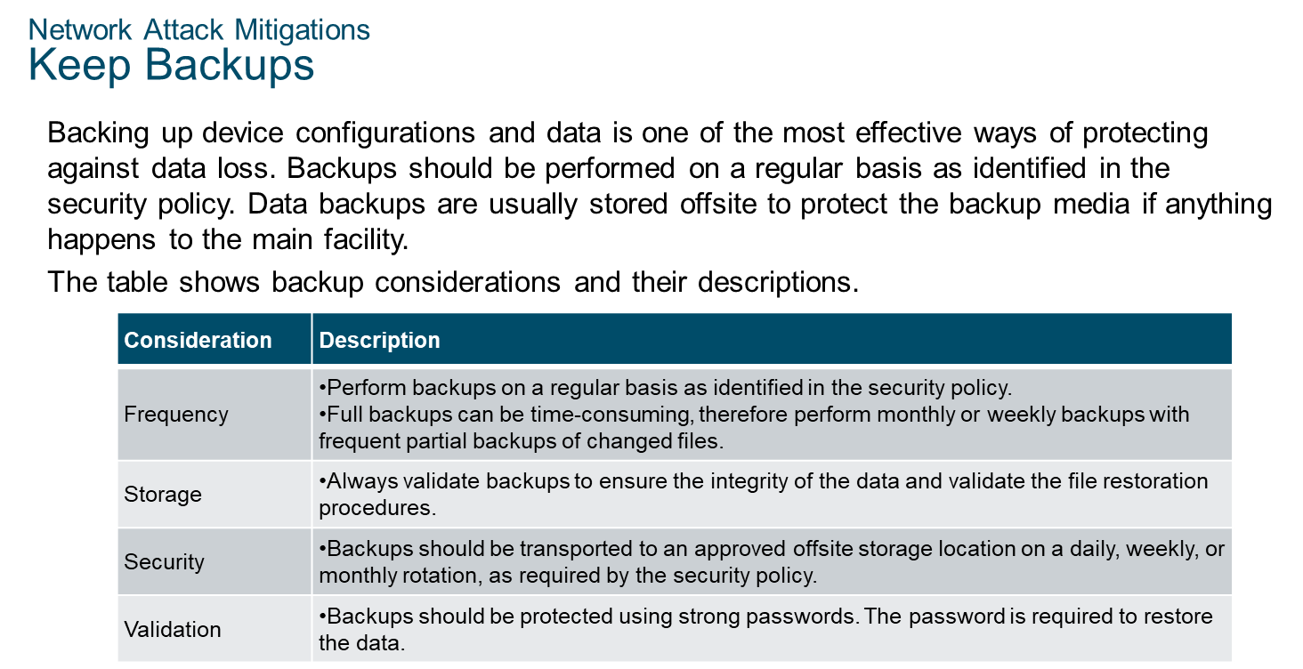
Chapter
Network Attack Mitigations
09

Slide 12
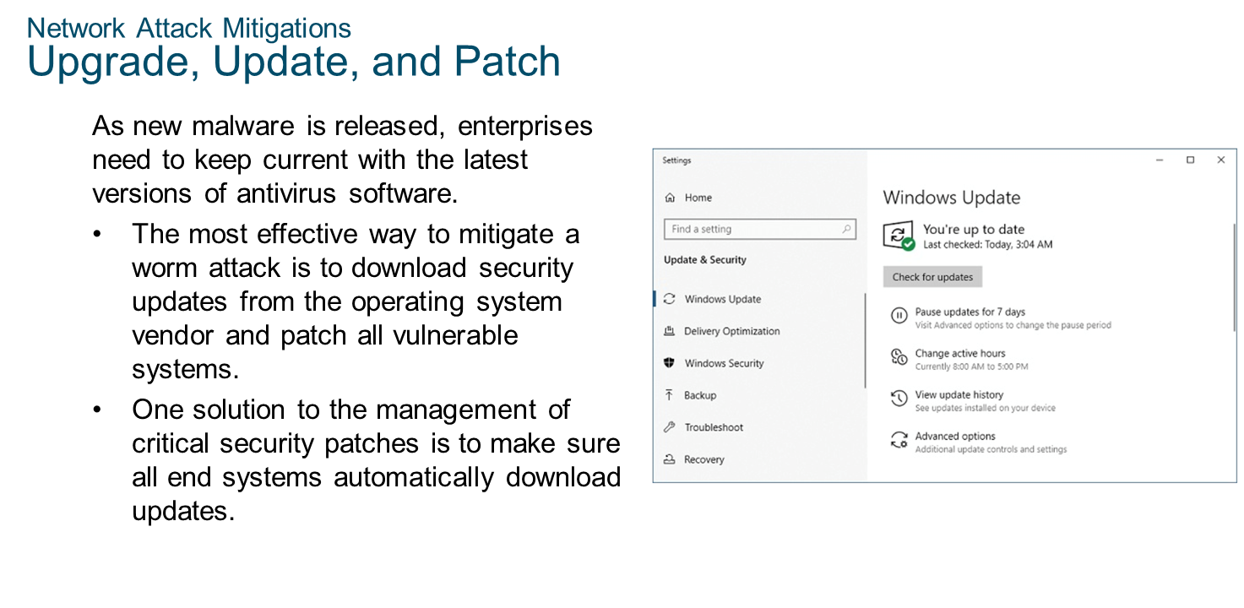
Chapter
Network Attack Mitigations
09

Slide 13
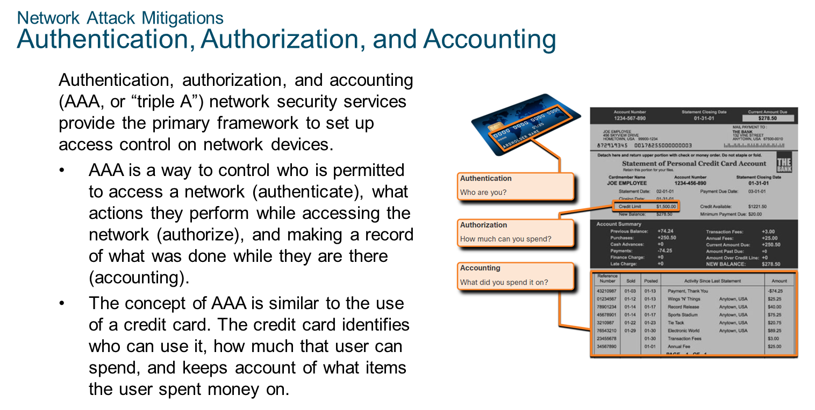
Chapter
09
Network Attack Mitigations

Slide 14
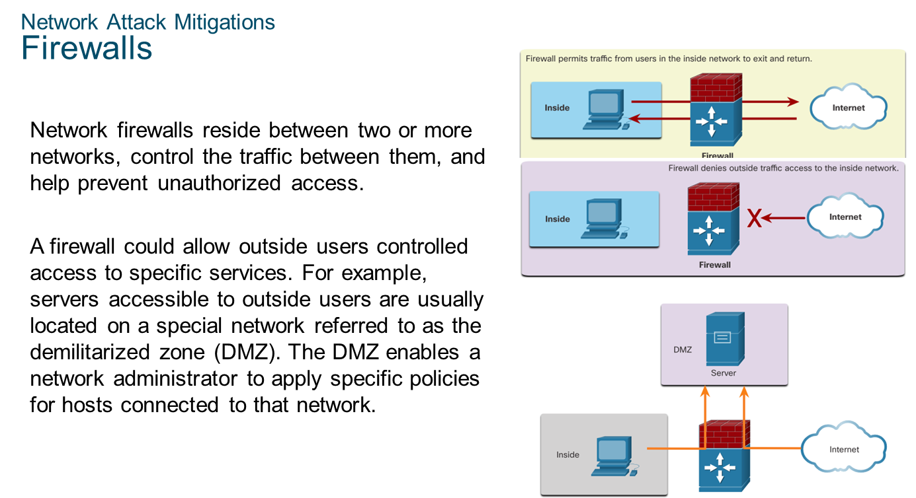
Chapter
09
Network Attack Mitigations

Slide 15
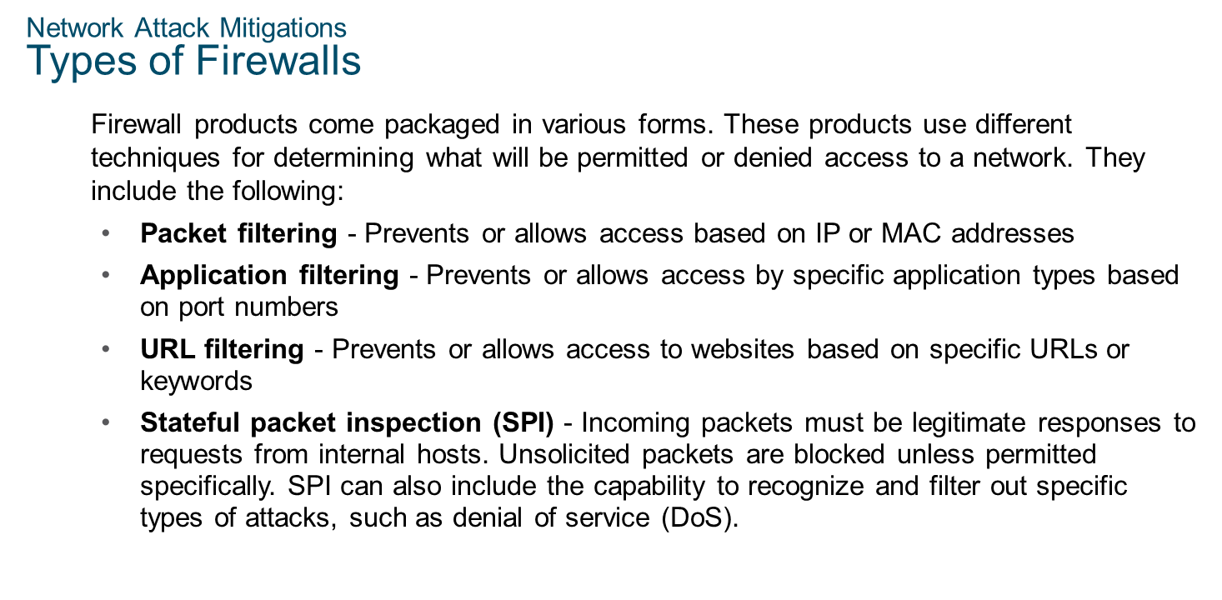
Chapter
09
Network Attack Mitigations

Slide 16
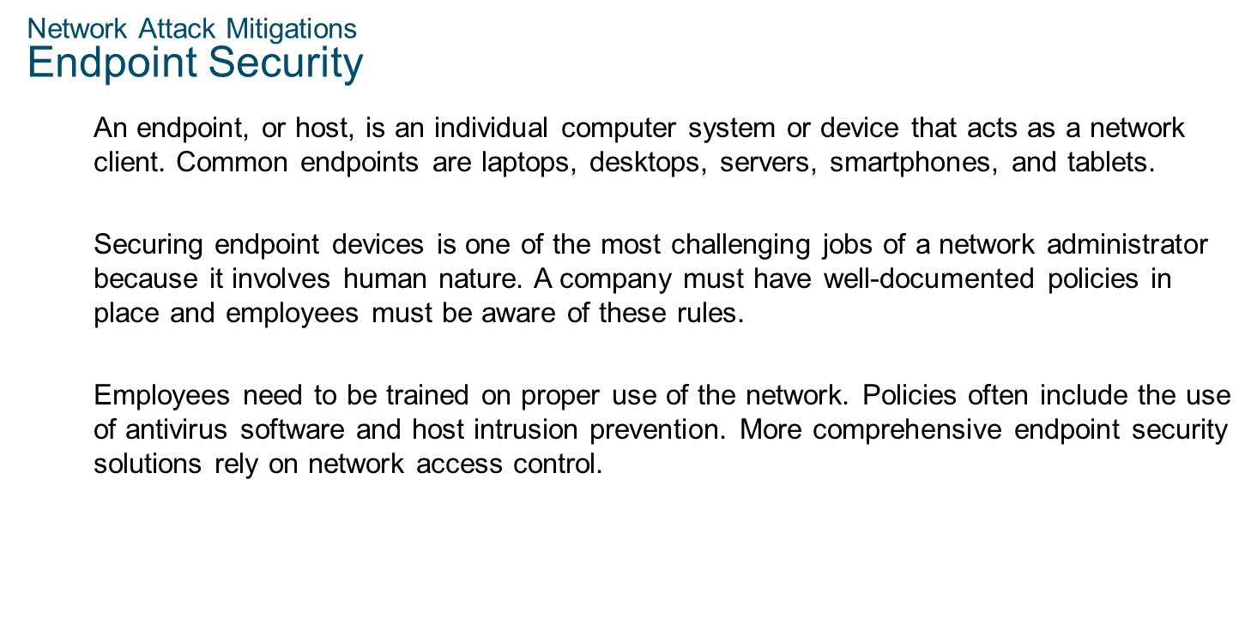
Chapter
09
Network Attack Mitigations

Slide 17
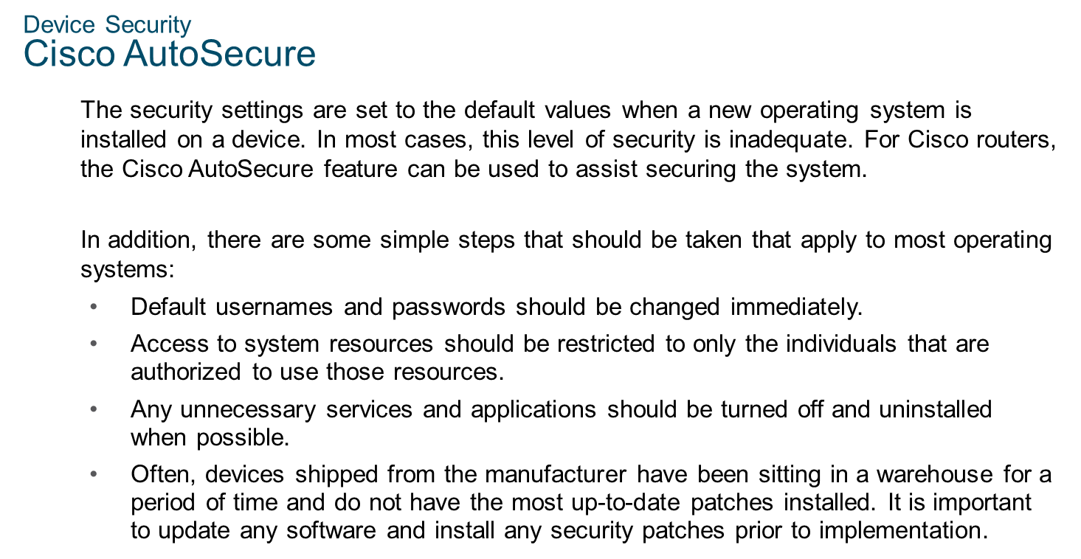
Chapter
09
Device Security

Slide 18
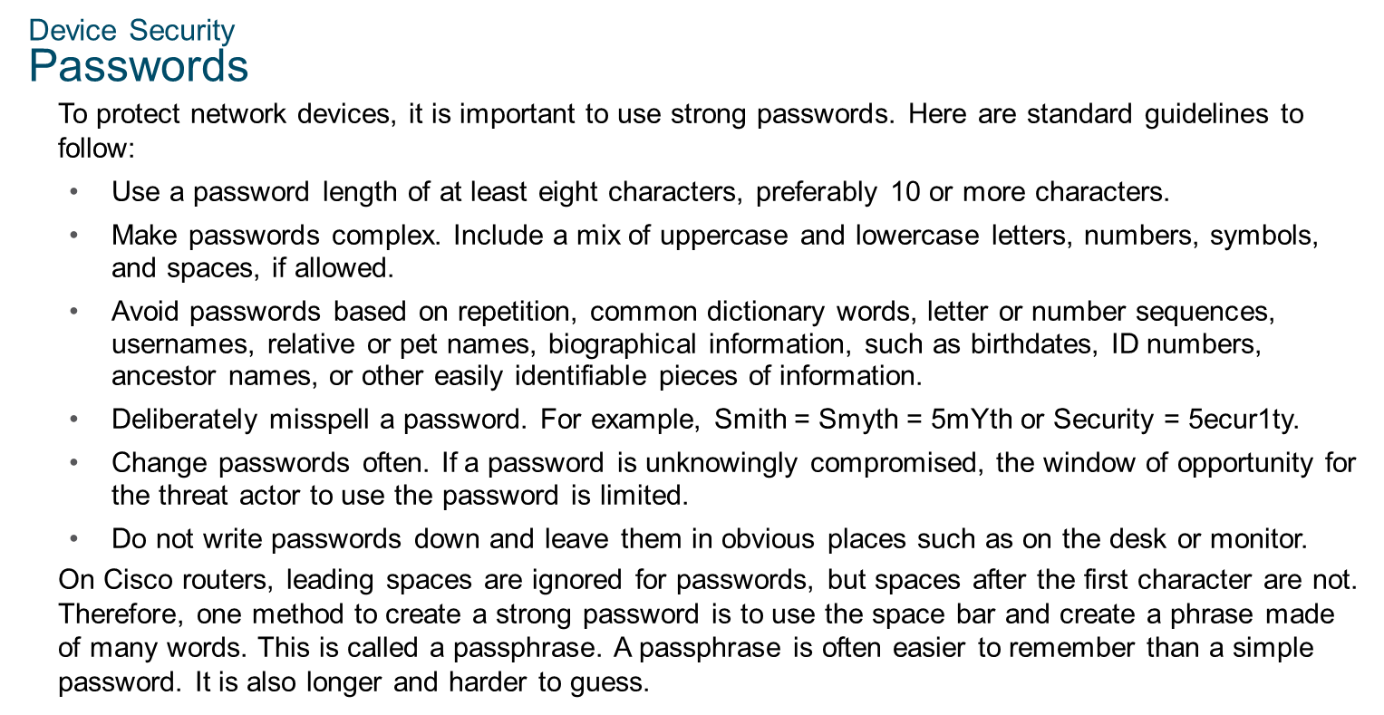
Chapter
09
Device Security

Slide 19
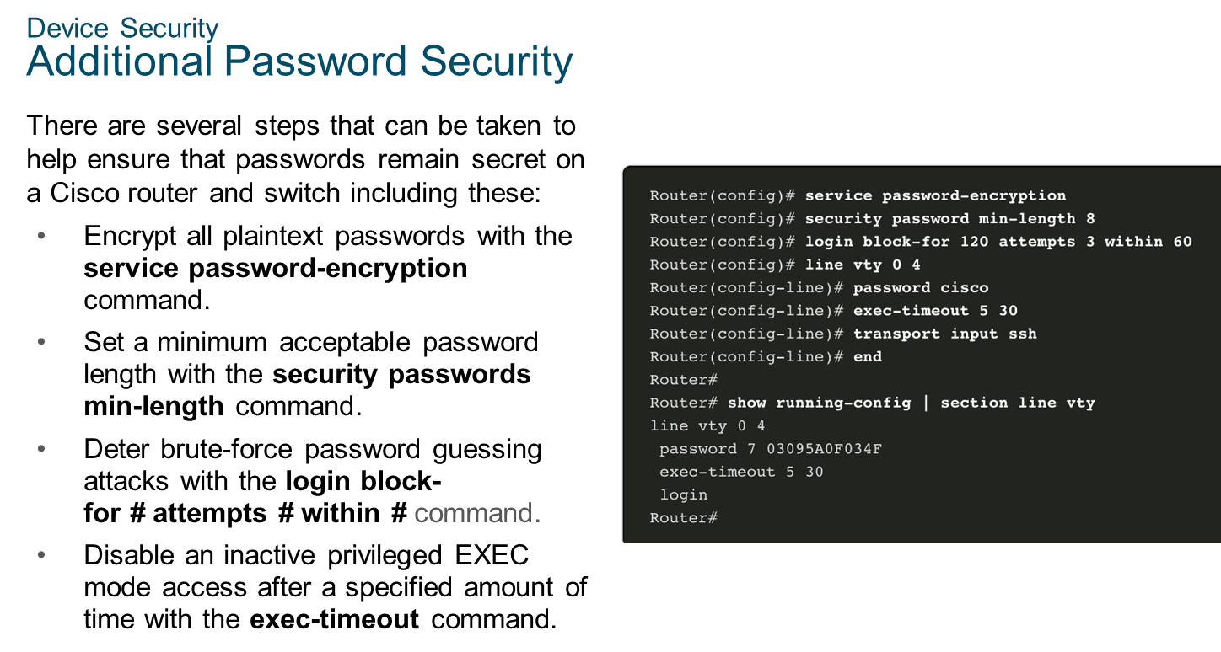
Chapter
09
Device Security

Slide 20
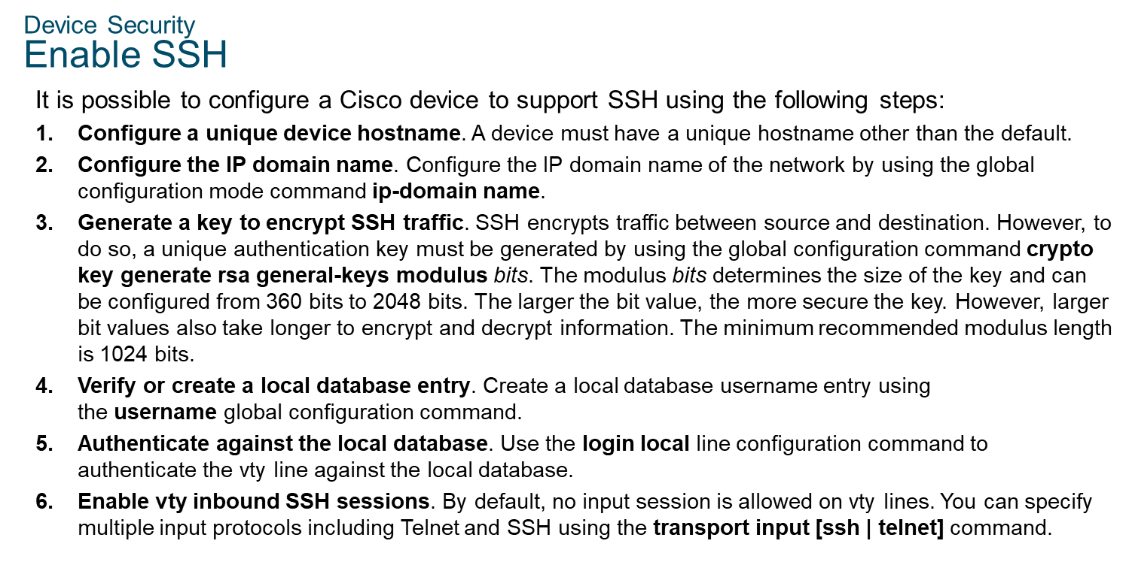
Chapter
09
Device Security

Slide 21
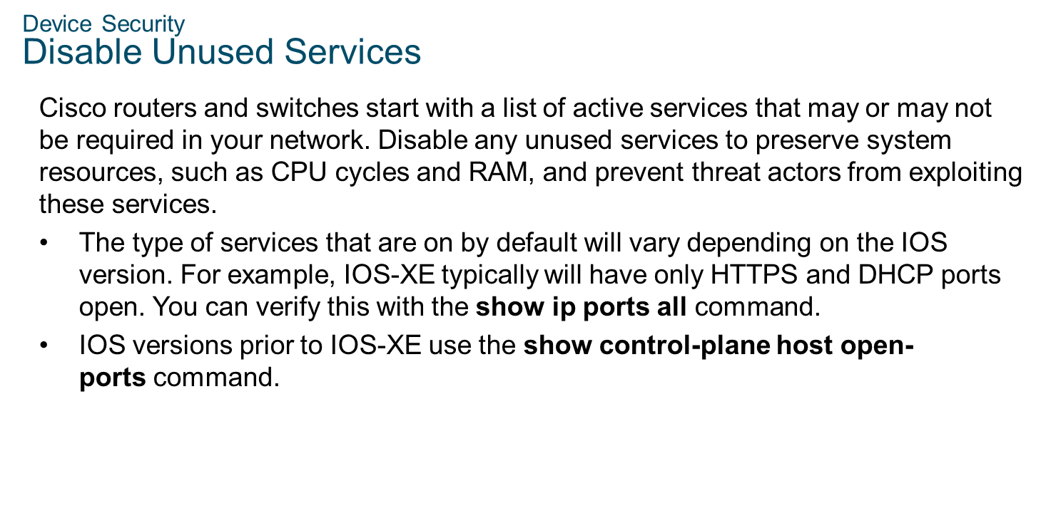
Chapter
09
Device Security

Slide 22



Thank You

