Slide 1



A Lean Framework
For Starting
a New Venture
Prepared by Dr. Mohamed Soliman
ENT624
Entrepreneurial Strategy
Lecture 8

Slide 2



Learning Objectives
1. Discuss the Lean Startup Framework: Its Origins, and Core Ideas and Building Blocks of the Lean Startup Framework.
2. How to conduct a Business Model Canvas.
3. Explore an Overarching Perspective on the Lean Startup Framework.

Slide 3
The Lean Startup Framework: Its Origins, and Core Ideas
Steve Blank started the notion of the lean startup framework.
Blank was a successful serial entrepreneur and investor who focused on reducing the risk associated with the new venture–startup process. Blank was highly critical of the many startups that begin the startup process with an already well-established product idea. He was also critical of entrepreneurs’ inward-looking approach, in which they focus their time, effort, and other resources on perfecting a product idea without knowing whether customers need the product or would be willing to pay for it or whether the newly created venture could make sufficient revenues.
Therefore, he proposed that entrepreneurs should adopt an outward looking mindset to learn and adapt. He argued that entrepreneurs should develop opportunity conjectures about their startups’ key elements with an outward-looking learning mindset, move out of their offices, test these conjectures, and then adapt their potential opportunities until the process yielded a viable business model.
Blank offered the first set of tools (customer development, agile engineering, and minimum viable product) to help entrepreneurs accomplish their search, learning, and validation activities.

Slide 4
Osterwalder and Pigneur (2010) also contributed to the lean startup framework. Specifically, they positioned the startup process in a design science framework based on the scientific method. This approach led to the “Business Model Canvas.” This tool aims to help entrepreneurs design a business model and formulate and test hypotheses about that business model. The Business Model Canvas assumes that every business model can be broken down into nine different building blocks that founders must define for their ventures. These building blocks capture:
the venture’s value proposition,
(2) the customer segments the venture aims to target,
(3) the customers relationships the venture has to build with its customers,
(4) the channels through which the venture reaches its customers,
(5) the revenue streams the venture expects from customers,
(6) the key activities the venture has to perform,
(7) the key resources the venture needs to perform these activities,
(8) the key partnerships required for performing the activities, and
(9) the cost structure arising from the venture’s activities.

Slide 5
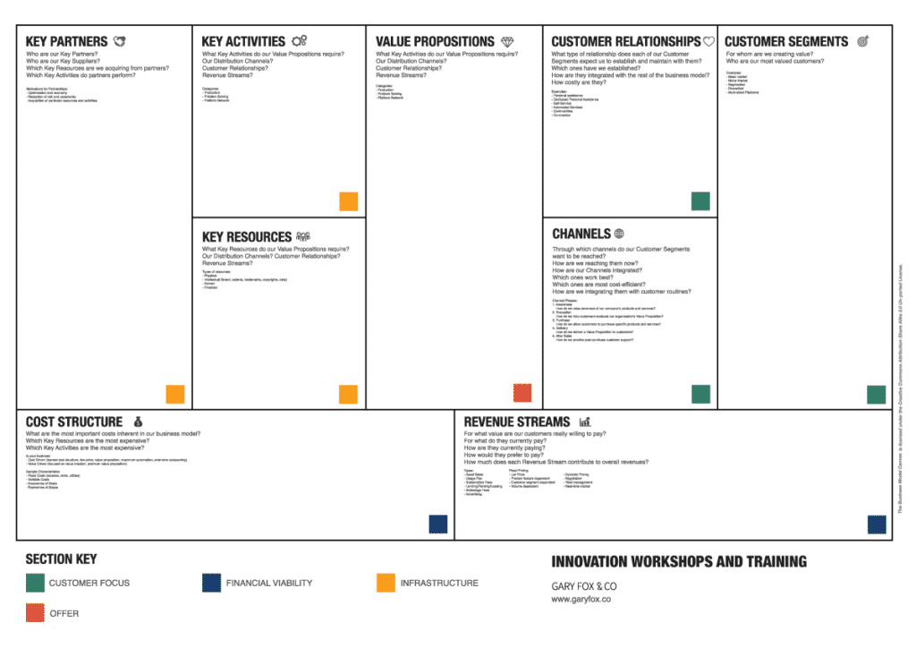

Slide 6
Business Model Canvas arranges these building blocks in a graphical illustration, in the form of a tool that founders can use to:
a) gain a comprehensive overview of their ventures’ business models and
b) adapt these building blocks based on feedback from (potential) customers, investors, or other stakeholders.
Eric Ries made the next significant contribution to the lean startup framework. Ries was an entrepreneur and student of Steve Blank. He identified critical similarities between the startup process’s goals (as proposed by Blank and Osterwalder and Pigneur) and the lean manufacturing approach. Ries dubbed the combination of customer development and the iterative agile techniques as the “Lean Startup.” Specifically, he argued that:
Lean Startup method [allows for] continuous adjustments with a steering wheel called the Build-Measure-Learn feedback loop.
Through this process of steering, we can learn when and if it’s time to make a sharp turn called a pivot or whether we should persevere along our current path.
Once we have an engine that’s revved up, the Lean Startup offers methods to scale and grow the business with maximum acceleration.

Slide 7
Finally, the most recent addition to the lean startup framework is the “Market Opportunity Navigator” developed by Marc Gruber and Sharon Tal (2017).
Market Opportunity Navigator tells you how to rapidly find product/market fit inside a market, and how to pivot when your hypotheses are incorrect. However, they don’t help you figure out where to start the search for your new business.
It provides a wide-lens perspective to find different potential market domains for your innovation, before you zoom in and design the business model or test your minimal viable products.
This tool enables entrepreneurs to identify and choose the most promising starting position for the startup process (Shepherd & Gruber, 2020).

Slide 8
Building Blocks of the Lean Startup Framework
The lean startup framework has five primary building blocks:
identifying and evaluating market opportunities in startups,
designing business models,
engaging in validated learning (including customer development),
building minimum viable products (MVPs), and
learning whether to persevere with or pivot from the current course of action.
In Fig. 2, we illustrate the connection between the various building blocks and how they work together as a framework to help entrepreneurs reduce some of the uncertainty and risks associated with the startup process.

Slide 9
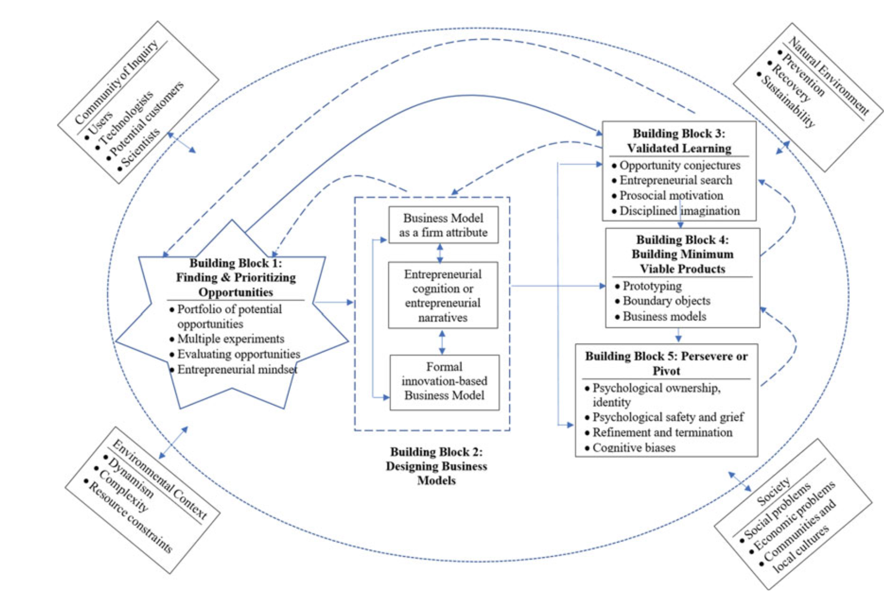
Fig. 2 Building a startup model by combining practitioner knowledge with current and future academic research (Shepherd & Gruber, 2020)

Slide 10
Building Block 1: Identifying and Evaluating Market Opportunities
Entrepreneurs are often too optimistic and confident about the attractiveness of the potential opportunity at the center of the startup process. This overoptimism and overconfidence often lead entrepreneurs to make mistakes that require a challenging “restart” in an alternative market domain.
Indeed, one estimation is that 70% of all new ventures have to perform such a pivot. This emphasis on the importance of finding and prioritizing opportunities reflects how many startups explore multiple market opportunities before deciding on their target market. Those startups that identify many potential opportunities before choosing to exploit one tend to perform better than those that identify fewer potential opportunities.
The Market Opportunity Navigator provides an important contribution to the initial stage of the lean startup process by enabling an entrepreneur to generate a portfolio of potential opportunities. The entrepreneur then chooses the most promising potential opportunity upon which he or she designs a business mode.
Furthermore, identifying a portfolio of opportunities allows entrepreneurs to engage in multiple experiments simultaneously. Indeed, in highly uncertain contexts, entrepreneurs need to generate multiple opportunities to probe the future.

Slide 11
An essential step in the Market Opportunity Navigator is to evaluate the focal consideration set’s potential opportunities and choose the most promising one. This choice depends on entrepreneurs’ assessments of opportunity attractiveness, and entrepreneurs’ assessments of opportunity attractiveness depend on their experience. Therefore, entrepreneurs with different backgrounds are likely to conduct different types of experiments to test their portfolios of potential opportunities.
In particular, after identifying multiple opportunities, entrepreneurs may seek to understand the relative attractiveness of these opportunities and consider the different levels of uncertainty associated with each opportunity. When entrepreneurs exploit multiple market opportunities, their early decisions can enhance their ventures’ agility later. The early decisions that can enhance agility include picking a brand name that could fit several markets, hiring employees with more flexible human capital, and so on.
Therefore, by understanding how startups use the Market Opportunity Navigator to engage in lean learning cycles, we gain a deeper understanding of the entrepreneurial mindset and strategic entrepreneurship and how entrepreneurs can develop their cognitive flexibility to adapt their startups to external environmental changes.

Slide 12
Building Block 2: Designing Business Models
While the Market Opportunity Navigator helps entrepreneurs determine where to play, to develop viable new ventures, entrepreneurs also need to understand how to play in their current context.
Designing a business model is a crucial steppingstone in the startup process. A business model makes explicit assumptions about the respective startup in the form of a framework. This framework provides the basis for entrepreneurs to form venture-creation hypotheses that they can then test.
Indeed, the design of a business model presents a “leap of faith,” a leap of faith that the respective startup can solve the focal customer problem by offering a product or service that delivers value to customers and other stakeholders, including the startup’s owners.
From this leap of faith, entrepreneurs employ the lean startup framework’s validated-learning process to rapidly and cheaply test hypotheses and use the information from these tests to refine or substantially change their business models.

Slide 13
Business-model innovation refers to innovating “a company’s system of interconnected and interdependent activities that determines the way the company ‘does business’ with its customers, partners and vendors”.
From a cognitive perspective, analogical reasoning and conceptual combinations can lead to business-model innovation.
Analogical reasoning involves applying existing knowledge structures from a familiar domain to a new domain, which can enhance business-model innovation by reconceptualizing the familiar so that new relationships and interdependencies between the elements of a business model emerge.
Entrepreneurs can also use combinations of existing business-model concepts to alter the focal concept’s attributes, which can lead to business model innovation through “incorporating attributes or structures from a wide range of concepts to modify a target concept, so that fundamentally new attributes, unavailable in either preexisting concept, can emerge”.

Slide 14
Therefore, business models are an integral aspect of the startup process for a number of reasons.
First, from the perspective that business models represent an attribute of the firm, such as Osterwalder and Pigneur’s (2010) Business Model Canvas, business models can help to explain to audiences (and self) how and why the startups’ activities create value. The business model likely impacts the schema entrepreneurs use when attending to, interpreting, and narrating business models and vice versa, to which we now turn.
Second, from a cognitive perspective, business models involve the “cognitive structures that consist of concepts and relations among them that organize managerial understanding about the design of activities and exchanges that reflect the critical inter-dependencies and value-creation relations in their [entrepreneurs’] firms’ exchange networks”. These cognitive imprints of the initial business model of the startup explain how business-model innovation emerges and persists over time. Of course, a cognitive perspective of business models is not restricted to a single entrepreneur’s mind but can involve founding teams, early employees, and other stakeholders. This collective cognition can have a major impact on the development of opportunities and the startup of a new venture.

Slide 15
Third, it is important to consider a narrative perspective of business models. Narratives are stories that offer “temporally sequenced accounts of interrelated events or actions undertaken by characters”. Narratives help entrepreneurs acquire resources, make sense of failure, and influence potential customers’ narratives. Understanding business models’ narratives provides insights into the sensemaking process, the identification of potential stakeholders, and the development of potential opportunities tied to business-model co-construction by entrepreneurs and potential stakeholders.

Slide 16
Building Block 3: Engaging in Validated Learning
A startup’s initial business model represents a series of hypotheses that the focal entrepreneur needs to test and validate. Entrepreneurs can apply the validated-learning approach to nine key elements of startups. The validated-learning approach is “the process of demonstrating empirically that a team has discovered valuable truths about a startup’s present and future prospects”. Therefore, entrepreneurs need to follow the scientific method by explicitly stating their hypotheses about their business models and then use experiments to test these hypotheses as part of the validated-learning process. The scientific method requires that entrepreneurs to be open to the possibility that their experiments will disconfirm their hypotheses. Entrepreneurs can then use the information from disconfirmed hypotheses to develop new hypotheses for subsequent testing. Building on the importance of an opportunity’s market attractiveness, learning involves testing the assumptions about a new venture’s value proposition, customer segments, and channels to reach customers.
Specifically, entrepreneurs engage in testing to primarily address the following four questions: “(1) Do customers recognize that they have a problem you are trying to solve? (2) If there was a solution, would they buy it? (3) Would they buy it [the solution] from us? (4) Can we build a solution for that problem”.
The validated-learning approach ensures that entrepreneurs do not skip Questions 1–3 to focus solely on building a solution (Question 4).

Slide 17
These notions of experimenting for validated learning require us to think more deeply about several issues:
First, entrepreneurs can form hypotheses and test them, but they must be able to interpret the results. However, they face several challenges with interpreting test results. Specifically, while entrepreneurs form hypotheses about their potential opportunities, they (as all people) tend to engage in confirmatory search. The problem with entrepreneurs engaging in confirmatory search is that it often leads to poor decision making. Indeed, adherence to the scientific method helps entrepreneurs counter confirmation bias. To overcome confirmation bias, entrepreneurs need a mindset toward skepticism (i.e., to hold doubt) about their hypotheses’ veracity until empirical testing either erodes sufficient doubt such that a hypothesis can be accepted or provides information sufficient to reject it. However, we note that avoiding confirmation bias is easier said than done.

Slide 18
There could be (a few) circumstances in which a belief model of hypothesis testing may have advantages over the scientific method’s skepticism. For example, individuals may only be able to pursue radical opportunities by having faith in their conjectures. This confirmation approach to hypothesis testing is more a process of sensemaking than the scientific method.
Sensemaking involves “the ongoing retrospective development of plausible images that rationalize what people are doing”. Unlike the scientific method, which focuses on revealing the truth, the belief model of hypothesis testing (for startups) is about enabling entrepreneurs to build an account of their experiences in a way that informs subsequent actions.
Therefore, through this belief model of hypothesis testing, a startup (i.e., its business model) becomes more plausible as the focal entrepreneur takes actions and makes sense of those actions.
Indeed, startups become more plausible when “they tap into an ongoing sense of the current climate, are consistent with other data, facilitate ongoing projects, reduce equivocally, provide an aura of accuracy and offer a potentially exciting future”.
Indeed, we already know that narratives impact sensemaking (and vice versa).

Slide 19
Second, entrepreneurs’ empathic judgment can inform more instructive hypotheses about their startups and test these hypotheses more effectively. Indeed, entrepreneurs form hypotheses to test potential stakeholders’ responses to the current problems and solutions that underlie their startups’ business models. Entrepreneurs with greater empathic accuracy are likely more effective at noticing social problems and generating possible solutions to those problems by formulating and testing hypotheses than entrepreneurs lower in empathic accuracy (McMullen, 2015). Empathetic accuracy refers to entrepreneurs’ capability to estimate others’ preferences to form accurate expectations of how various stakeholders will respond to their business models. In this way, entrepreneurs with high empathetic accuracy (vis-à-vis those with low empathic accuracy) likely differ in their generation of hypotheses, search for information, approach to hypothesis testing (belief or skepticism), and interpretation of the results from their hypothesis tests. Similarly, detecting human suffering or environmental degradation can stimulate entrepreneurs’ prosocial motivation—the desire to help others—and impact their startups’ business models. Differences in entrepreneurs’ prosocial motivation likely impact the validated-learning process by directing attention and resources to those issues that have the greatest potential to help others.

Slide 20
Third, as described above, there is likely heterogeneity in how entrepreneurs form hypotheses about the veracity of their startups’ business models and how they test those hypotheses. Indeed, entrepreneurs likely vary in their engagement of disciplined imagination to form and test hypotheses about their startups. The discipline aspect of disciplined imagination involves the consistent application of selection criteria to test a hypothesis. The imagination aspect introduces diversity to problem statements, thought experiments, and selection criteria for learning about the veracity of a startup’s business model. Recognizing the use of disciplined imagination in forming and testing business-model hypotheses, we challenge the notion that entrepreneurs’ hypothesis testing is only possible through interactions with the external world. Abstract hypothetical scenarios that serve as imaginary experiments can be a cheap and rapid means of testing entrepreneurs’ hypotheses to improve their startups’ business models.

Slide 21
Building Block 4: Building Minimum Viable Products
As detailed above, experiments are central to the lean startup framework. An experiment is “more than just a theoretical inquiry; it is also a first product”. That is, for hypothesis testing, an entrepreneur may need to develop and present his or her startup’s first product. An important question for entrepreneurs is how between an emerging startup and its stakeholder groups (e.g., potential customers).
A boundary object is an artifact that provides a bridge connecting facilitating the flow of information to enhance learning. Boundary objects can take many different forms but include software programs, strategy tools, and narratives.
Boundary objects likely facilitate validated learning when they :
provide a shared language for two parties to exchange information with each other,
(2) help both parties learn about their differences, and
(3) provide a means for the parties to work together to transform knowledge.
-- That is, entrepreneurs can use boundary objects across the borders between startups and their various community of inquiry members (e.g., potential stakeholders).

Slide 22
Specifically, entrepreneurs need to build minimum viable products (MVPs).
An MVP is a “version of the product that enables a full turn of the build-measure-learn loop with a minimum amount of effort and the least amount of development time”.
Therefore, an entrepreneur should build and present a first product that has only what he or she hypothesizes to be the critical features of the envisioned product and is sufficient to test that hypothesis quickly. This minimalist approach to experimenting is appropriate because under conditions of high uncertainty, “no amount of design can anticipate the many complexities of bringing a product to life in the real world”.
With an MVP, an entrepreneur aims to learn and use that learning to improve his or her startup’s business model.
Therefore, adding features to an MVP (that do not facilitate learning) is a waste of resources.
Although there are some challenges with building an MVP—for example, legal issues, fears about competitors, branding risks, and impact on morale—MVPs are critical to reducing the risks associated with starting a new venture.

Slide 23
The notion of prototyping can provide insights into the minimum element of MVPs.
Prototyping refers to “designers’ visualization and materialization skills, which they use to make intangible insights, ideas, and concepts tangible, sharable and understandable”.
A prototype is below the minimum of an MVP when it fails to make intangible insights, ideas, and concepts tangible, sharable, and understandable to hypothesized stakeholders.
In contrast, when a prototype makes a potential opportunity tangible, sharable, and understandable to stakeholders, then the prototype is an MVP and has served its purpose as a vehicle for learning.
Although we often think of MVPs as three-dimensional objects, they can include sketches, simulations, and thought experiments. However, entrepreneurs need to recognize that what is sharable and understandable to one stakeholder group may not be so for a different stakeholder group. Therefore, entrepreneurs may need to create different versions of their MVPs for different target audiences.
MVPs are boundary objects. Recognizing MVPs’ role as boundary objects can help entrepreneurs formulate and make the most of their MVPs. This role as a boundary object is important because it can be difficult to transfer knowledge across boundaries, such as the boundary between an emerging startup and its stakeholder groups (e.g., potential customers).

Slide 24
Finally, while entrepreneurs can use their MVPs as boundary objects, they can also use their business models as boundary objects. Entrepreneurs can use their business models as boundary objects to facilitate communication and learning from outsiders. For example, a business model can act as a market device—“the material and discursive assemblage that intervenes in the construction of markets”. In doing so, the business model can provide a flexible mix of narratives to communicate with different stakeholders but is sufficiently robust to represent a common source of information and knowledge across boundaries. Indeed, formal statements about a startup’s plans provide a boundary object to establish a common language across potential stakeholders to learn what the different stakeholder groups understand. This representation of stakeholder knowledge enables entrepreneurs to learn about differences between potential stakeholder groups. This information also allows potential stakeholders to transform their knowledge (consistent with a boundary object). Therefore, entrepreneurs can use MVPs as boundary objects to learn and thereby advance their startups.

Slide 25
Building Block 5: Learning Whether to Persevere with or Pivot from the Current Course of Action
While an entrepreneur can persevere with his or her startup’s current business model by making incremental changes to improve it, the entrepreneur may learn (or come to suspect) that these incremental changes are not sufficient to advance the startup.
When incremental changes do not seem to be providing adequate progress, the entrepreneur may decide to pivot.
A successful pivot allows a startup to head in a new direction to reach a sustainable, repeatable business model that will enable the new venture to grow.
To determine whether to persevere or pivot, an entrepreneur can set learning milestones as triggers for accumulating information to inform this decision.
These milestones test the assumptions the entrepreneur made explicit at the beginning of the startup process (e.g., feedback on a first prototype).
The persevere-or-pivot decision is not easy because the greater the entrepreneur’s investment of creative energy and other resources into a particular business model for his or her startup, the greater the entrepreneur’s sunk costs.
Sunk costs make perseverance more likely and make deciding to pivot more difficult.
Indeed, the lean startup framework emphasizes that entrepreneurs need courage to decide to pivot.

Slide 26
Some entrepreneurs may be reluctant to pivot because they focus on vanity metrics (i.e., metrics that make them look good but do not reflect startup progress). Therefore, these entrepreneurs may not be aware of the need to pivot or are reluctant to do so because they are afraid they will fail and lower employee morale and stakeholder support.
Indeed, Ries (2011) argued that the decision to pivot is so difficult that many entrepreneurs fail to do it to the detriment of their startups.
To overcome some of these challenges, entrepreneurs can set up persevere-or-pivot meetings in advance, i.e., help entrepreneurs overcome biases associated with sunk costs and the status quo.
To the extent that entrepreneurs are willing and able to pivot, they provide their startups greater resilience to mistakes, environmental uncertainty, and substantial changes in the external environment.
There are several additional challenges to making the persevere-or pivot decision. First, information indicating the need for a pivot may simultaneously trigger resistance to a pivot.

Slide 27
For example, entrepreneurs likely develop psychological ownership over their startups’ business models. With feelings of high psychological ownership over their startups’ creative ideas, these entrepreneurs are likely highly reluctant to accept information indicating the need to pivot. Indeed, one estimation claims that less than 40% of new ventures change their business models over 10 years (Denoo et al., 2018). Overcoming this reluctance to pivot appears to require reappraising one’s psychological ownership—only by detaching themselves from their current business-model formulations can entrepreneurs create the necessary space to consider and enact a pivot to a new business model.
Second, we offer caution in our discussion of the decision between persevering and pivoting. It seems that the lean startup framework’s emphasis on one or the other represents a potential anti-failure bias. For example, in addition to preserving or pivoting, there is the option to terminate a venture project (some new ventures detailed in Chapter 2 chose this option).

Slide 28
Indeed, “fail fast, fail cheaply” is part of the entrepreneurial mindset’s underlying logic for managing uncertainty.
Perhaps if entrepreneurs pivot enough using MVPs to test hypotheses with well-designed experiments, they will eventually “come across” a winning business model. However, to do so, they need a sufficient runway. Here, runway refers to “the amount of time remaining in which a startup must either achieve lift off or fail”.
In this way, entrepreneurs do not necessarily decide to terminate; this decision is made for them by the length of their startups’ runways. Therefore, the longer the runway, the greater the stakes—that is, the greater the likelihood that a pivot will lead to a viable business model. If it does not, then the costs of failure will likely be greater (consistent with the consequences of an anti-failure bias). We need more research that considers the termination of a particular startup as a decision alternative to pivoting or persevering.
Third, scheduling persevere-or-pivot meetings informed by relevant information does not mean entrepreneurs will decide to pivot when appropriate. Indeed, entrepreneurs often persevere with a losing course of action even when confronted with information that highlights the costs of this losing course of action.

Slide 29
Effective persevere-or-pivot meetings can provide a mechanism for entrepreneurs to reappraise their psychological ownership of their startups’ creative ideas, work through needed changes to their identities, and involve a broad and diverse array of stakeholders in the pivot decision (see Chapter 2). The cultures of emerging ventures and their entrepreneurial teams likely impact the effectiveness of these persevere-or-pivot meetings. For example, when there is a feeling of psychological safety in a venture or within an entrepreneurial team— namely, “a shared belief held by members of the team that the team is safe for inter-personal risk taking” ()—meeting participants are less likely to have biased decision making (e.g., less need to justify past decisions to avoid blame). Therefore, they are more likely to decide to pivot the focal new venture.
Finally, startups have different runways, and these differences can have important implications for starting up a new venture. As detailed above, Ries (2011) defined a runway as both “the number of pivots it [a startup] can still make” (p. 160) and “the amount of time remaining in which a startup must either achieve lift off or fail” (p. 160), and the runway can be extended by gaining the “same amount of validated learning at a lower cost or in a shorter time”.

Slide 30
When runway refers to the number of pivots that a startup can still make, then the number of pivots remaining is likely influenced by:
(1) the extent of refinement in each pivot;
(2) the type of pivot;
(3) the quality and results of hypothesis testing;
(4) the cost of a pivot (including the startup’s agility and past decisions that may make pivoting more costly);
(5) the capacity of stakeholders to absorb pivots;
(6) the number of pivots already performed;
(7) the focal entrepreneur’s capacity, skills, and ability to conduct and absorb pivots; and
(8) the startup’s on-hand resources and recommitments by stakeholders.
While a longer runway increases the likelihood of lift off, it also increases the losses from that startup attempt if failure occurs.

Slide 31
An Overarching Perspective on the Lean Startup Framework
From an overarching perspective, there is more for us to understand about the lean startup framework, such as the performance implications of using the lean startup framework and the contingencies (including external context) that may condition the lean startup framework’s applicability and performance.
However, there is some evidence on the performance benefits of the lean startup framework and its contingencies.
Specifically, one study found that a scientific approach to venture startup—consistent with the lean startup framework—leads to more successful ventures than an approach that relies on unguided activities and entrepreneurs’ intuition.
The lean startup framework’s effectiveness appears to come from its ability to decrease the likelihood that entrepreneurs will pursue unviable business models.
Indeed, a study of web-based startups found that a learning-focused, agile approach to startup creation —consistent with the lean startup framework— leads to relatively more successful ventures.

Slide 32
Furthermore, it is important to understand when applying the lean startup framework may lead to worse outcomes. Several internal and external contingency factors seem relevant.
An ample funding for a startup may decrease the need for the lean startup framework. Specifically, “when capital for startups is readily available at scale, it makes more sense to go big, fast and make mistakes than it does to search for product/market fit”.
If the availability of financial resources dampens the relationship between the lean startup approach and performance, perhaps entrepreneurs can better apply the “traditional” innovation approach” to their startups.
The major point is that the lean startup approach may not be highly effective for startups with high resource slack.
Still, given that most startups of independent ventures (vis-à-vis corporate ventures) occur in the face of resource scarcity (and even adversity), the lean startup approach is likely to be appropriate for a large number of independent ventures.

Slide 33
Beyond these internal contingency factors, we propose some conditions external to ventures:
1) A community of inquiry is an informal group of stakeholders that can help an entrepreneur evaluate and develop a potential opportunity. For example, one study showed how communities of inquiry help entrepreneurs develop and refine their emerging ventures through interactions involved in prototype testing.
2) The lean startup approach relies heavily on “external” participants for testing (and reformulating) hypotheses using MVPs. These community members may include potential customers, technologists, scientists, and so on.
Given the importance of a community of inquiry for the emergence of a startup, differences in the groups that make up a community of inquiry likely substantially impact the startup process.

Slide 34
Moreover, the lean startup framework offers a way for entrepreneurs to learn under conditions of uncertainty.
Although startups are typically embedded in dynamic or high-velocity environments, these environmental conditions vary on a continuum (vis-à-vis a dichotomy).
Therefore, rather than assuming all startups face the same environmental conditions (because they involve entrepreneurial action), entrepreneurs need to be aware of how different environmental dimensions—more or less dynamism, more or less complexity, more or less hostility, more or less velocity—influence the lean startup process.
For example, the lean startup framework is likely less effective for starting up a new venture in an environment with low uncertainty (e.g., a potential opportunity in a stable, munificent environment).
Indeed, in less dynamic environments, entrepreneurs appear to be “better off pursuing a munificent approach to planning”.

Slide 35
Recap
The Lean Startup Framework: Its Origins, and Core Ideas
Business Model Canvas
Building Blocks of the Lean Startup Framework
Market Opportunity Navigator
An Overarching Perspective on the Lean Startup Framework

Slide 36
Summary
This chapter discussed the building blocks of the lean startup framework. In particular, we focused on open questions regarding its application and the potential boundary conditions for making each building block more or less effective in developing a startup. In summary, our discussion suggests that our understanding of when and how the lean startup framework is best applied can be enhanced by academic research addressing the following broad topics.
2) Future studies can investigate how startups’ communities of inquiry, specifically users, technologists, potential customers, and scientists, influence the five building blocks of the lean startup framework and the outcomes of applying these building blocks for startups.
3) Future studies can investigate how the environmental/industry context, the state of the natural environment, and societal developments influence the five building blocks of the lean startup framework and the application of these building blocks for startups.

Slide 37
Summary
4) Future studies can investigate how important behavioral (e.g., entrepreneurial search, use of boundary objects, use of narratives) and cognitive (e.g., entrepreneurial mindset, empathy, prosocial motivation, psychological ownership, biases) characteristics of entrepreneurs influence the five building blocks of the lean startup framework and the outcomes of applying these building blocks for startups.
5) Future studies can investigate the interrelationships between the five building blocks of the lean startup framework and the outcomes of the interdependencies between these building blocks for startups (e.g., when entrepreneurship should move from one building block forward to the next or back to the previous).

Slide 38



Thank You

