Slide 1



Machine Learning
Prepared by Dr. Yasser Abdelhamid
DS 620
Machine Learning
Lecture 6

Slide 2

Outline
Classification
Naïve Bayes Algorithm
Measuring accuracy

Slide 3
classification

Slide 4
classification
Classification is the process of dividing up objects so that each is assigned to one of a number of mutually exclusive and exhaustive categories known as classes.
Examples:
  Buying a product.
  Having a disease.
  Stock price.
  …

Slide 5
Mutually exclusive classes
Mutually exclusive classes, in the context of classification, refer to classes or categories that do not overlap or have any elements in common.
If two classes are mutually exclusive, it means that an instance can only belong to one class and cannot belong to multiple classes simultaneously.

Slide 6
Exhaustive classes
Exhaustive classes refer to a situation where all possible categories or classes are considered and included in the classification scheme.
It means that every instance or observation must be assigned to one of the predefined categories without any instance being left unclassified.

Slide 7
naïve Bayes Classifiers

Slide 8
Naïve bayes classification
Naive Bayes is a classification algorithm that is based on Bayes' theorem.
It is a simple yet effective probabilistic algorithm widely used for text classification, spam filtering, sentiment analysis, and other machine learning tasks.

Slide 9
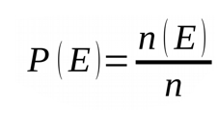
Basics of Probability theory
Given a dataset that consists of n instances.
P(E) is the probability of an event E that has occurred n(E) times, is calculated as follows:

Slide 10
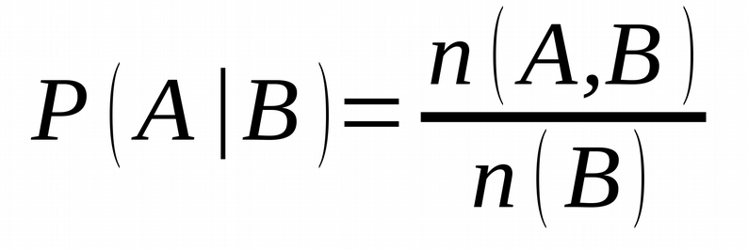
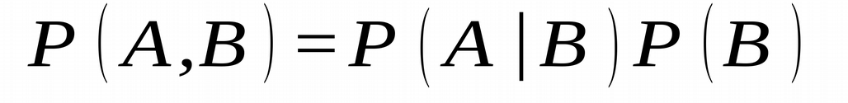
Conditional and joint probability
Conditional probability =
Joint probability =

Slide 11
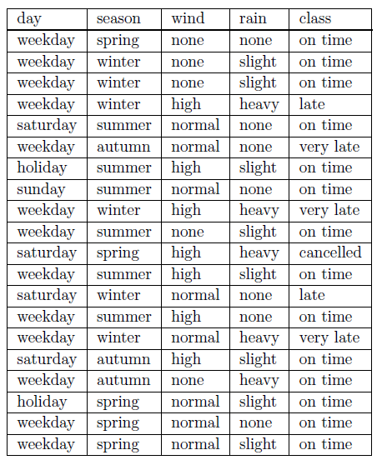
Example
Let’s have the shown dataset of Alexandria train arrival time.
Possible events (classes) are:
  E1 = cancelled = 0.05
  E2 = very late = 0.10
  E3 = late = 0.15
  E4 = on-time = 0.70

Slide 12
Example
How should we use probabilities to find the most likely classification for an unseen instance such as the one below?

Slide 13
The easy way
Using only the frequency of classes, we can expect that the train will arrive on time.
Is that satisfying?

Slide 14
conditional probability
What is the probability of the train being on time if we know that the season is winter?

Slide 15
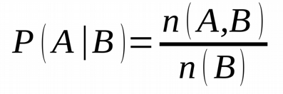
conditional probability
We can calculate this as the number of times class = on time (A) and season = winter (in the same instance),
Divide it by the number of times the season is winter(B), which is 2/6 = 0.33.
P(class = on time | season = winter).

Slide 16
prior probability
Probability that is estimated before any other information is available is called prior probability.

Slide 17
Posterior probability
The probability that we can calculate for the classification after we have obtained an information is called posterior probability.

Slide 18
Most Likely classification
(single attribute)
What is the most likely classification of an instance given that rain = heavy?
We calculate the posterior probability for each class and select the highest probability.

Slide 19
Most Likely classification
(single attribute)
P(class = on time | rain = heavy) = 1/5 = 0.2
P(class = late | rain = heavy) = 1/5 = 0.2
P(class = very late | rain = heavy) = 2/5 = 0.4
P(class = cancelled | rain = heavy) = 1/5 = 0.2
So we can conclude that the most likely class is “very late”.

Slide 20
Naïve Bayes theorem
The Naïve Bayes algorithm gives us a way of combining the prior probability and conditional probabilities in a single formula, which we can use to calculate the probability of each of the possible classifications in turn.

Slide 21
Naïve Bayes theorem
Having done this we choose the classification with the largest value.
The meaning of the word |”Naïve” is that the effect of the value of one attribute on the probability of a given classification is independent of the values of the other attributes.

Slide 22

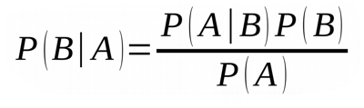
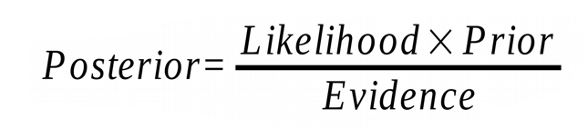
Naïve Bayes theorem
Given that
Using symmetry rule P (A, B ) = P (B, A)
Then
We can conclude with Bayes theorem which is:
i.e.

Slide 23
Naïve Bayes Classification
Given a set of k mutually exclusive and exhaustive classifications c₁, c₂, . . . ,c_{k},
Each class c_{i} has prior probability P(c_{i}), and
Given n attributes a₁, a₂, . . . , a_{n} which for a given instance have values v₁, v₂,. . . , v_{n} respectively.

Slide 24
Naïve Bayes Classification
The posterior probability of class c_{i} occurring for the specified instance can be shown to be proportional to:

Slide 25

Naïve Bayes Classification
Making the assumption that the attributes are independent, the value of this expression can be calculated using the product:
Which is
We calculate this product for each value of i from 1 to k and choose the classification that has the largest value.

Slide 26
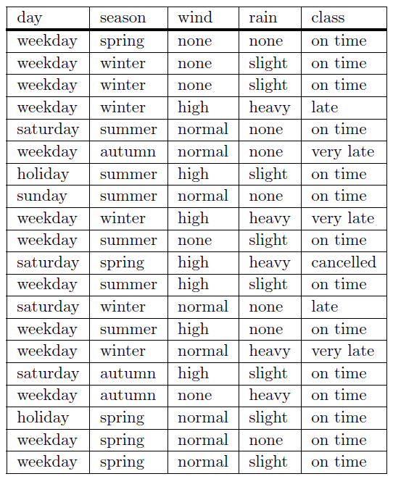

Slide 27
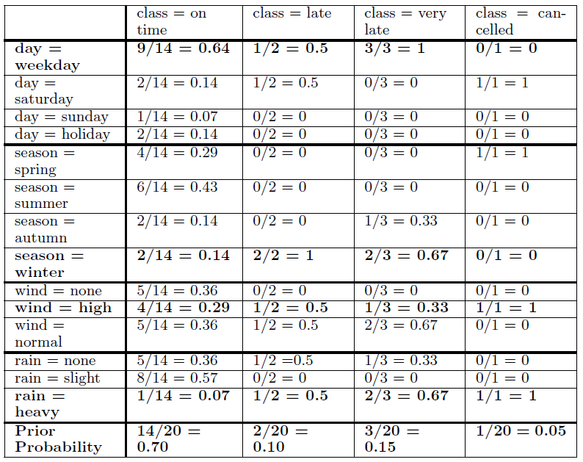
Classes
Day
Season
Wind
Rain

Slide 28

predicted class
What is the predicted class of the following instance?

Slide 29
predicted class
class = on time
  0.70 × 0.64 × 0.14 × 0.29 × 0.07 = 0.0013
class = late
  0.10 × 0.50 × 1.00 × 0.50 × 0.50 = 0.0125
class = very late
  0.15 × 1.00 × 0.67 × 0.33 × 0.67 = 0.0222
class = cancelled
  0.05 × 0.00 × 0.00 × 1.00 × 1.00 = 0.0000
The largest value is for class = very late.

Slide 30
Measuring accuracy

Slide 31
Separate Training and Test Sets
Data is split into two parts called a training set and a test set .
Training set is used to construct a classifier.
The classifier is then used to predict the classification for the instances in the test set.
Predictive accuracy of the classifier for the test set is p = C/N. where C is the correctly classified cases and N is the total number of test cases.
This can be used as an estimate of classifier’s performance on any unseen dataset.

Slide 32
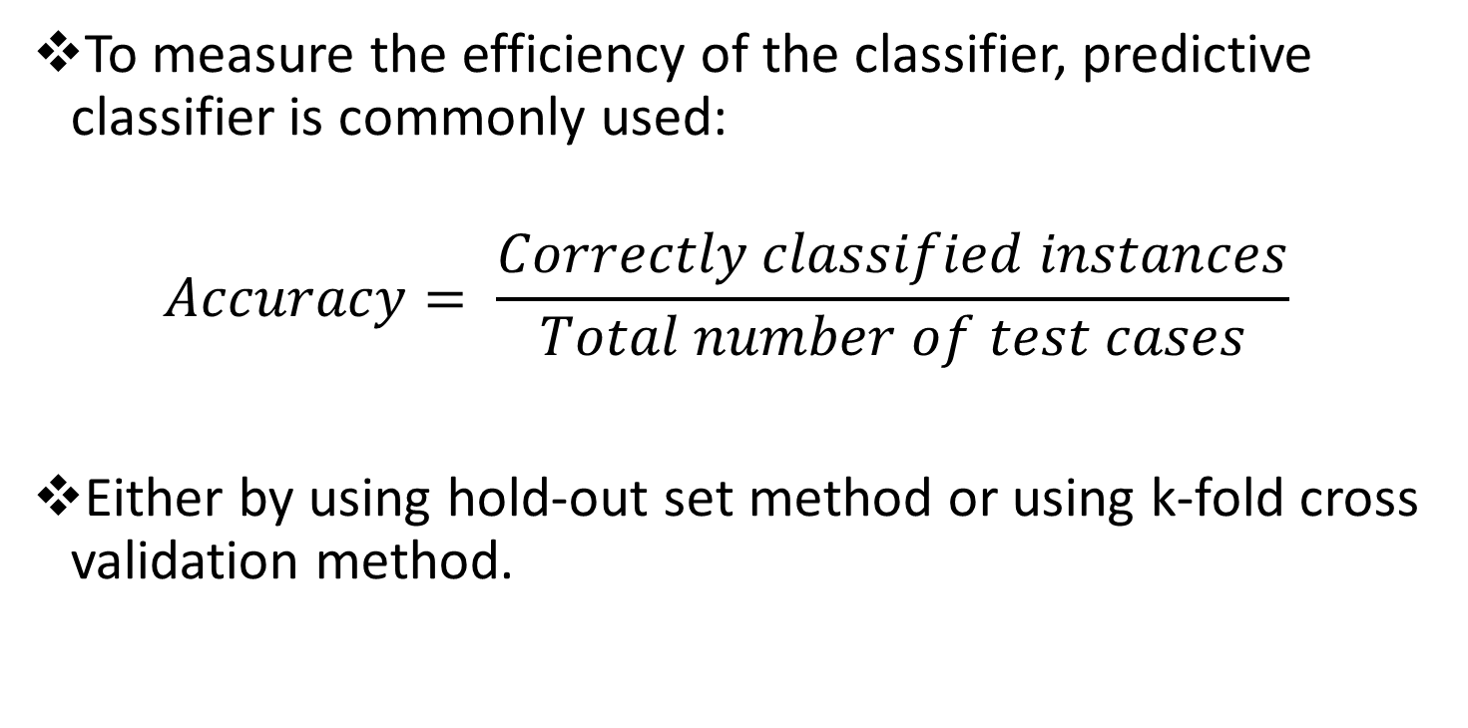
Predictive Accuracy
To measure the efficiency of the classifier, predictive classifier is commonly used:
$$Accuracy= \frac{Correctly classified instances}{Total number of test cases}$$
Either by using hold-out set method or using k-fold cross validation method.

Slide 33
Predictive Accuracy
Accuracy measure may not be efficient in some applications where classes are imbalanced.
Example:
  In Credit card fraud detection, 99% of the instances are classified as non-fraudulent, and only 1% are classified as fraudulent.

Slide 34
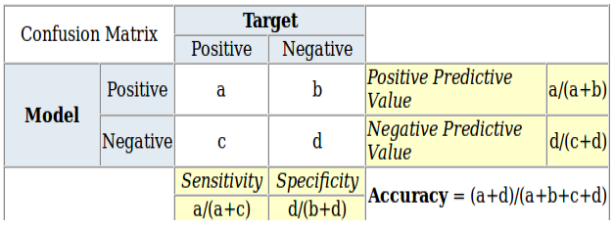
Confusion matrix
A confusion matrix is an N x N matrix that describes the classification errors in detail, compared to the actual classes.
N is the number of classes in the target attribute.
The following table displays a 2x2 confusion matrix for two classes (Positive and Negative)

Slide 35
Confusion matrix
Accuracy : The proportion of correct classifications from the overall number of cases.
Positive Predictive Value or Precision : the proportion of positive cases that were correctly identified.
Negative Predictive Value : the proportion of negative cases that were correctly identified.
Sensitivity or Recall : the proportion of actual positive cases which are correctly identified.
Specificity : the proportion of actual negative cases which are correctly identified.

Slide 36
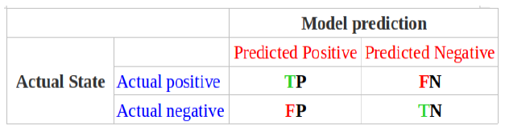
precision and recall measures
TP ( True Positive): The number of correct classifications of the positive examples
FN (False Negative): The number of incorrect classifications of the positive examples.
FP(False Positive):The number of incorrect classifications of the negative examples.
TN(True Negative): The number of correct classifications of the negative examples.

Slide 37
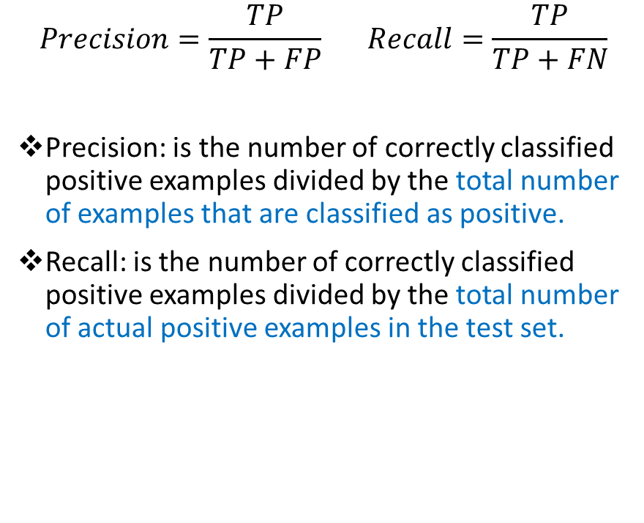
precision and recall measures
$$Precision=\frac{TP}{TP+FP} Recall=\frac{TP}{TP+FN}$$
Precision: is the number of correctly classified positive examples divided by the total number of examples that are classified as positive.
Recall: is the number of correctly classified positive examples divided by the total number of actual positive examples in the test set.

Slide 38
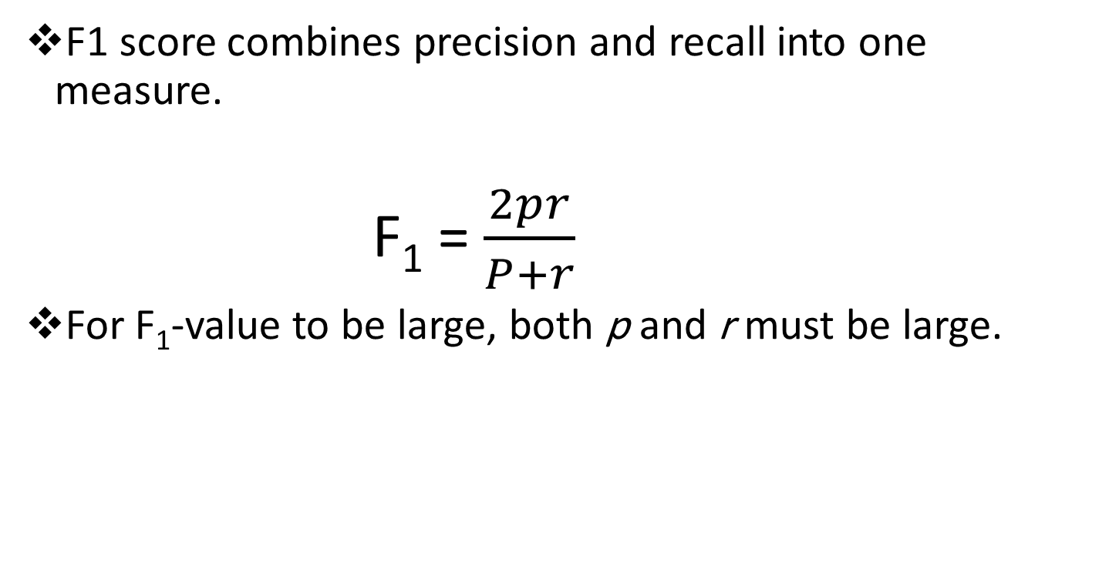
F1-Score
F1 score combines precision and recall into one measure.
  F₁ = $\frac{2pr}{P+r}$
For F₁-value to be large, both p and r must be large.

Slide 39
SUmmary
Classification
Naïve Bayes Algorithm
Measuring accuracy
  Predictive accuracy
  Confusion matrix
  Precision and recall
  F1 score

Slide 40


Thank You

