Slide 1


Data Structures and Algorithms
Prepared by Prof. Shereen Taie
IT251
Information Technology Department
Lecture 2

Slide 2




Data Structures and
Algorithms
Lecture 2
IT251
Information Technology Department
Prepared by
Prof. Shereen Taie
www.midocean.ae

Slide 3
Algorithm
Chapter
01
www.midocean.ae

Slide 4

Chapter
01
Algorithm Design
www.midocean.ae

Slide 5
Algorithm can be described in three ways:
  Natural language like English
  Graphic representation called flowchart
  Pseudo-code Method
Chapter
01
www.midocean.ae

Slide 6
Algorithm Design:
Natural language like English:
When this way is chosen care should be taken, we should ensure that each & every statement is definite.
Starting with the first item in S,
compare x with each item in S in sequence until x is found or until S is exhausted.
If x is found, answer yes; if x is not found, answer no.
Chapter
01
www.midocean.ae

Slide 7
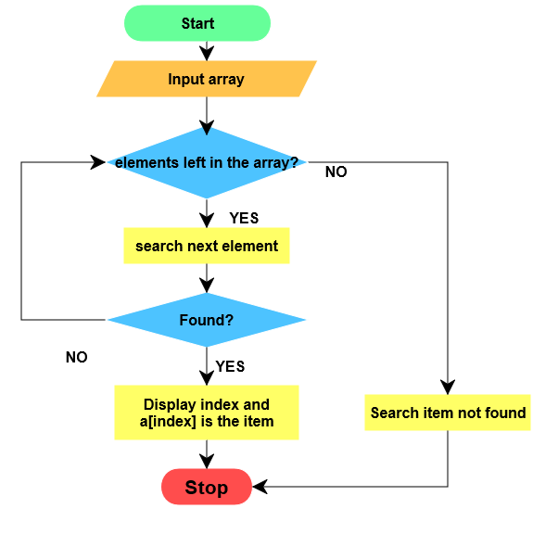
Algorithm Design:
2. Graphic representation called flowchart:
This method will work well when the algorithm is small& simple.
Chapter
01
www.midocean.ae

Slide 8


Algorithm Design:
3. Pseudo-code Method:
In this method, we should typically describe algorithms as program.
  The pseudocode is similar, but not identical, to C++.
  Not discuss the implementation of algorithms in any particular programming language.
  It aims to present algorithms clearly so they can be readily understood and analyzed.
Chapter
01
www.midocean.ae

Slide 9
PSEUDO-CODE RULES:
1. Comments begin with // and continue until the end of line.
2. Blocks are indicated with matching braces {and} or Indentation المسافة الفارغة 3. An identifier begins with a letter.
  The data types of variables are not explicitly declared.
4. Compound data types can be formed with records.
Chapter
01
www.midocean.ae

Slide 10
PSEUDO-CODE RULES:
Here is an example:
Here link is a pointer to the record type node. Individual data items of a record can be accessed with ->and period.
Node. Record
{
data type – 1 data-1;
data type – n data – n;
node * link;
}
Chapter
01
www.midocean.ae

Slide 11
PSEUDO-CODE RULES:
5. Assignment of values to variables is done using the assignment statement.
<Variable>:= <expression>; Or <Variable> ← <expression>;
6. There are two Boolean values TRUE and FALSE.
Logical Operators AND, OR, NOT
Relational Operators <, <=,>,>=, =, !=
Chapter
01
www.midocean.ae

Slide 12
PSEUDO-CODE RULES:
The following looping statements are employed.
For, while and repeat-until
While Loop:
While < condition > do
{
<statement-1>
<statement-n>
}
Chapter
01
www.midocean.ae

Slide 13
PSEUDO-CODE RULES:
For Loop:
For variable: = value-1 to value-2 do
{
<statement-1>
<statement-n>
}
Chapter
01
www.midocean.ae

Slide 14
PSEUDO-CODE RULES:
repeat-until:
repeat
<statement-1>
<statement-n>
until<condition>
Chapter
01
www.midocean.ae

Slide 15
PSEUDO-CODE RULES:
8. A conditional statement has the following forms.
If <condition> then <statement>
OR
If <condition> then <statement-1>
Else <statement-2>
Chapter
01
www.midocean.ae

Slide 16
PSEUDO-CODE RULES:
Case statement:
select case(expression)
{
case 1 : <statement-1>
case n : <statement-n>
default : <statement-n+1>
}
Chapter
01
www.midocean.ae

Slide 17
PSEUDO-CODE RULES:
9- Input and output are done using the instructions read & write.
10- There is only one type of procedure:
Algorithm, the heading takes the form,
Algorithm Name (Parameter lists)
Chapter
01
www.midocean.ae

Slide 18
PSEUDO-CODE RULES:
As an example, the following algorithm fields & returns the
maximum of ‘n’ given numbers:
1. algorithm Max(A,n)
2. // A is an array of size n
3. {
4. Result := A[1];
5. for K ← 2 to n do
6. if A[K] > Result then
7. Result ← A[K];
8. return Result;
9. }
Chapter
01
www.midocean.ae

Slide 19
Chapter
01
How to implement?
www.midocean.ae

Slide 20
Examples for how to implement:
Given 1000 integers, find how many 3 numbers with sum 400?
  We can do 3 loops and try every 3 numbers!
  Hmm..1000000000 operations! Too much Computations!
Given 1000 integers, sort them?
  Hmm...nothing direct in mind...I need to think more!
Input: Given airport locations and cost of every direct flight,
Output: find flight from Cairo to New York with the minimum cost?
  Hmm...how to represent airports relations!
Chapter
01
www.midocean.ae

Slide 21
Examples for how to implement:
Input: Facebook site has 1.4 Billion users,
Output: please suggest to Mostafa all new friends from them,
Restrictions: where there is exactly 2 friends between Mostafa and each of a new friend?
  For every user in the system
  Count intersection of Mostafa users and this user
  If count == 2, we suggest this friend
  Hmm...too many billion operations
  Hmm...system memory can’t hold even all of that!
  Our solution performance is too bad!
Chapter
01
www.midocean.ae

Slide 22
Performance:
In real life applications, we care with many factors
  E.g. Usability, Security, Maintainability, Reliability...etc
One of the major factors is the performance
A memory and time efficient applications are desirable features.
  Imagine if facebook is a slow application!
This is where algorithms field arises!
  Computational solution that is efficient time and memory
Chapter
01
www.midocean.ae

Slide 23


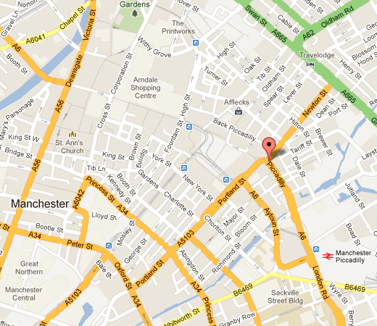




High performance real life apps:
Chapter
01
www.midocean.ae

Slide 24
Multiplication!
What’s the best way to multiply two numbers?
Chapter
01
www.midocean.ae

Slide 25
Grade-school Multiplication:
Input: 2 non-negative numbers, x and y (n digits each)
Output: the product x · y
5678
x 1234
7006652
Chapter
01
www.midocean.ae

Slide 26
Grade-school Multiplication:
45
x 63
135
2700
2835
Chapter
01
www.midocean.ae

Slide 27
Grade-school Multiplication:
Algorithm description (informal):
compute partial products (using multiplication
& “carries” for digit overflows),
and add all (properly shifted) partial products together
45
x 63
135
2700
2835
Chapter
01
www.midocean.ae

Slide 28
Grade-school Multiplication:
45123456678093420581217332421
x 63782384198347750652091236423
☹
Chapter
01
www.midocean.ae

Slide 29
Grade-school Multiplication
n digits
45123456678093420581217332421
x 63782384198347750652091236423
☹
How efficient is this algorithm?
(How many single-digit operations are required?)
Chapter
01
www.midocean.ae

Slide 30
Grade-school Multiplication
n digits
45123456678093420581217332421
x 63782384198347750652091236423
☹
n partial products: ~2n² ops (at most n multiplications & n additions per partial product)
adding n partial products: ~2n² ops
(a bunch of additions & “carries”)
How efficient is this algorithm?
(How many single-digit operations
in the worst case?)
Chapter
01
www.midocean.ae

Slide 31
Grade-school Multiplication
n digits
45123456678093420581217332421
x 63782384198347750652091236423
☹
n partial products: ~2n² ops (at most n multiplications & n additions per partial product)
adding n partial products: ~2n² ops
(a bunch of additions & “carries”)
How efficient is this algorithm?
(How many single-digit operations
in the worst case?)
~ 4n² operations in the worst case
Chapter
01
www.midocean.ae

Slide 32
Grade-school Multiplication
n digits
THE QUESTION IS...
CAN WE DO BETTER?
45123456678093420581217332421
x 63782384198347750652091236423
☹
n partial products: ~2n² ops (at most n multiplications & n additions per partial product)
adding n partial products: ~2n² ops
(a bunch of additions & “carries”)
How efficient is this algorithm?
(How many single-digit operations
in the worst case?)
~ 4n² operations in the worst case
Chapter
01
www.midocean.ae

Slide 33
Chapter
01
Algorithms Analysis
www.midocean.ae

Slide 34
Algorithms Analysis:
Given an algorithm, we need to
  1) Prove its Correctness
  2) Measure time efficiency
  3) Measure memory efficiency
Steps 2 and 3 allow us to compare algorithms
  Fall in complementary area: Computational Complexity
Chapter
01
www.midocean.ae

Slide 35
Algorithms Analysis:
An example of sorting algorithms
  Selection sort, orders N numbers using N*N operations
  Quicksort, orders N numbers using N*log₂N operations
  Then Quicksort is faster...and better algorithm
Chapter
01
www.midocean.ae

Slide 36
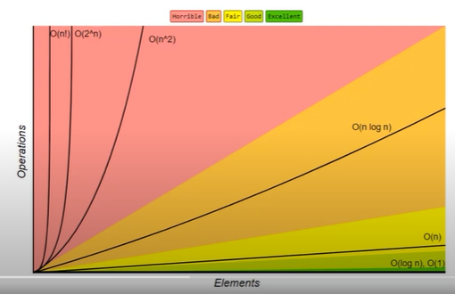
Growth Rates of Common Functions:
Chapter
01
www.midocean.ae

Slide 37
Analysis of Algorithm:
The main goal is to determine the cost of running an algorithm and how to reduce that cost.
Cost is expressed as Complexity:
  Time Complexity: how much time an algorithm needs.
  Space Complexity: how much memory an algorithm needs.
Chapter
01
www.midocean.ae

Slide 38
Time Complexity
Time Complexity Depends on:
Machine Speed
Size of Data and
Number of Operations needed (n)
Chapter
01
www.midocean.ae

Slide 39
Space Complexity
Space Complexity Depends on:
Size of Data
Size of Program
Chapter
01
www.midocean.ae

Slide 40
Time Complexity
How to measure absolute time ?
  A new computer will be faster than an old computer.
  Super computers vs. Smartphones/ Personal computers.
Solution:
It is generic and Machine independent.
Considering: Number of steps
Chapter
01
www.midocean.ae

Slide 41
Time Complexity
Expressed as T(n) = number of basic operations required.
(n) is the Problem Size: n could be the number of specific operations, or the size of data (e.g. an array) or both.
Not only depends on the input size n, but also depends on the arrangement of the input items.
Chapter
01
www.midocean.ae

Slide 42
Time Complexity
Each "simple" operation (+, -, =, <, >=) is one operation.
Loops and function calls are not simple operations, but depend upon the size of the data and the contents of a function.
Each memory access is one operation.
Chapter
01
www.midocean.ae

Slide 43




Thank You

