Slide 1


Prepared by Dr. Rana Maya
REA 621
Real Estate market analysis
Lecture 9

Slide 2



MIXED-USE DEVELOPMENT
Market analysis
Lecture 9
REA621
Real Estate market analysis
Prepared by
Dr. Rana Maya

Slide 3

lecture
Abstract
09
This lecture introduces conducting a market analysis for mixed-use projects to determine the appropriate mix of uses, understand demand and supply dynamics, evaluate financial feasibility, and minimize development risks.

Slide 4

lecture
09
Contents
1. Introduction
2. Mixed-Use Development Challenges
3. . Characteristics of Mixed-Use Development
4. Analyzing the Market Potential of Mixed-Use Projects
5. Understanding Synergy
6. Using Consumer Research and Social Media
7. Overall marketability
8. Case Study: Market Analysis for a Mixed-Use Development Project

Slide 5
lecture
09
  Learning outcomes
By the end of the lecture, you will be able to:
Understand the concept and characteristics of mixed-use developments.
• Explain the importance of market analysis in mixed-use real estate projects.
• Identify key demand and supply factors affecting mixed-use development markets.
• Analyze demographic, economic, and location factors influencing project feasibility.
• Evaluate the appropriate mix of residential, commercial, and other land uses in a development project.
• Interpret market indicators such as absorption rates, vacancy levels, and price trends.
• Apply market analysis techniques to assess the viability of mixed-use development projects.

Slide 6
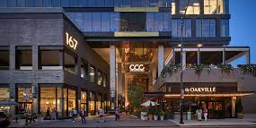
Mixed-use development has become a central strategy in contemporary urban planning and real estate development. By integrating residential, commercial, office, hospitality, and recreational functions within a single project or district, mixed-use developments create vibrant environments that support economic activity, efficient land use, and sustainable urban growth.
Why?
A comprehensive market analysis helps developers and investors identify target markets, forecast absorption rates, and align project components with the economic and demographic characteristics of the surrounding area.

Slide 7
1. Introduction
A mixed-use project can cover a dozen acres or much more; it might have a few buildings with only one use (for example, freestanding restaurants, a hotel, or townhouses), and multiple taller buildings, each with two or more uses.
The development will have pedestrian connections between buildings, open space (plazas, parks, walking/ biking trails, water features), shared signage, and (to some extent) shared parking.

Slide 8
1. Introduction
Three or More Significant Revenue-Producing Uses
A mixed-use project as “a development, in one building or several buildings, that combines at least three significant revenue-producing uses that are physically and functionally integrated and developed in conformance with a coherent plan.
A mixed-use development might include, for example, retail space on the ground floor, offices on the middle floors, and condominiums on the top floors, with a garage on the lower levels.”

Slide 9
1. Introduction
Mixed-use developments are not the same as the MPCs The latter, encompassing hundreds or even thousands of acres, usually will contain a variety of housing types and price points, as well as multiple commercial uses. MPCs may have pedestrian connectors and bike paths. But the primary focus—and profit generator—is housing. The community shopping centers, professional offices, health clubs, and other recreational facilities in an MPC are included primarily to enhance the marketability of homes and apartments.

Slide 10
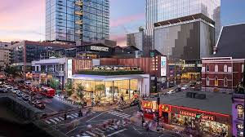
1. Introduction
Local conditions may not precisely mirror national trends. Not every metropolitan area benefits from a national economic boom, and some communities will survive a national recession relatively unscathed. As a result, real estate market studies usually give greater weight to metropolitan area economic indicators than to nationwide statistics.
Mixed-use developers must strategize the proper sizing, placement, connections, and timing of components.
Site planners and architects must deal with myriad building code standards, density limits, parking requirements, and design issues that can differ for each proposed use.
Market analysts must evaluate each property type individually and understand the synergies—both positive and negative— that can be created.
Financing is complex as the developer, investors, and lenders conduct their due diligence on the individual uses, as well as the composite project.

Slide 11
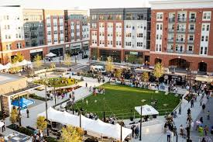
1. Introduction
Today, mixed-use development is accepted and often encouraged by government agencies because of its vitality.
In densely developed neighborhoods, combining apartments or condominiums with retail, hotels, and entertainment has created 24-hour locations that are safer for residents and more inviting for tourists and business visitors.

Slide 12
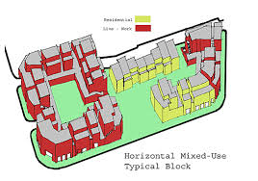
2. Mixed-Use Development Challenges
Those involved must have managerial mastery and staff experience for each different property type involved and be able to monitor and adjust to very different market cycles for each.
An eye for properties that make good candidates for such projects and the financial wherewithal to acquire the land in premium locations are also important. .
“You are dealing simultaneously with multiple different product types with different cycles, different demand generators and different fundamentals in the market for each form that are rarely in sync.
There is a ton of complexity.

Slide 13
2. Mixed-Use Development Challenges
Having at least three significant uses together in one development usually implies a project of considerable scale and impact. Typically, each major component will exceed 100,000 square feet, and total project size is usually more than 300,000 square feet. The largest developments can involve a million square feet or more.
“A mixed-use project can also improve the chances of success for a socially desirable but economically risky activity because the more profitable uses can carry the less profitable. For example, higher prices charged for market rate rental apartments provide funds to help subsidize less profitable units that are set aside for low-income households.

Slide 14
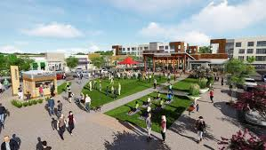
3. Characteristics of Mixed-Use Development
Physical and Functional Integration
The second descriptive characteristic of mixed-use developments is a :
significant physical and functional integration of the project’s components.
All buildings and outdoor spaces should be interconnected by pedestrian links, although such integration can take many physical forms:
■ Vertical mixing of project components into a single megastructure.
■ Careful positioning of key project components around central public spaces (parks, fountains, plazas, amphitheaters) or open-air shopping areas.
■ Combining single-purpose and multiuse buildings.
■ Linking project components with sidewalks, interior walkways or trails, enclosed corridors, underground concourses, common lobbies, escalators and elevators, or even aerial bridges between buildings.
■ Shared parking, which improves land use efficiency and reduces costs.

Slide 15
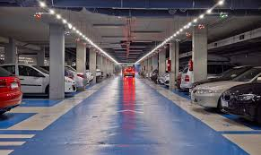
3. Characteristics of Mixed-Use Development
Parking, Circulation, and Transit
An integrated mix of on- and off-street parking is the most desirable goal for mixed-use centers.
The convenience of short-term, on-street spaces in front of stores or outdoor play areas is a marketing plus, whereas off-street spaces (either in garages or surface lots—or both) are needed to accommodate residents, workers, and customers who will be staying for more than an hour or two.
If land values and planned densities are high, parking decks, either above or below ground, can be justified—and are certainly more desirable than endless rows of open parking.

Slide 16
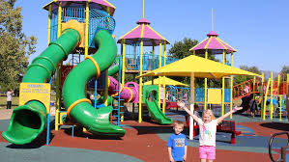
3. Characteristics of Mixed-Use Development
“places thrive when users have a range of reasons to be there”
The reasons might include a place to sit, playgrounds to enjoy, art to touch, music to hear, food to eat, history to experience, and people to meet. Ideally, some of these activities will be unique to that particular place, reflecting the culture and history of the surrounding community.
Busy plazas and pedestrian-friendly streets contribute directly to retail customer satisfaction.
It’s not enough to have just one great place in a neighborhood—you need a number of them to create a truly lively community.”
Those features can push building rents upward and reduce vacancy rates..

Slide 17
3. Characteristics of Mixed-Use Development
Mixed-Use Projects Enhance Long-Term Investment Stability
The primary case for investing in mixed-use assets is that the combining of uses generates revenue and value premiums that exceed the incremental cost of delivery or acquisition.
In other words, mixed-use assets get better rents.
Also if the office component of a mixed-use building suffers because that local market became soft, the residential and retail components of the same building may continue to produce revenue growth.

Slide 18
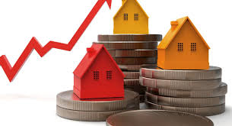
4. Analyzing the Market Potential of Mixed-Use Projects
Mixed-use developments present challenges for the market analyst.
If conditions are optimal, the project’s developer and investors can capitalize on the synergy among complementary uses and create an overall cumulative market attraction that exceeds what the individual project components would generate independently.

Slide 19



4. Analyzing the Market Potential of Mixed-Use Projects
In a project with multiple buildings, proper phasing of project components is crucial, as is the need for flexibility in planning and design. Elements of the original plan may need to be revised in response to changing market conditions.
Buildings in the initial phase must function independently of future activity, because a considerable lag in construction completion could occur. The project should begin with the uses that have the strongest current market potential, thereby creating cash flow that can be funneled into later phases of the project.

Slide 20
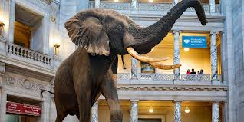
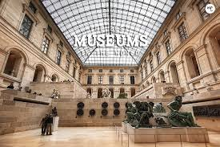
4. Analyzing the Market Potential of Mixed-Use Projects
FV = PV(1+r)^n
Different project elements may appeal to distinct socioeconomic groups. Prospective buyers of luxury condominiums might not like to see ground-floor retail space that caters to a less affluent demographic.
Museums and cultural center patrons could be more affluent than office workers.
Restaurants and coffee shops will need to cater to both groups.

Slide 21
4. Analyzing the Market Potential of Mixed-Use Projects
The market analyst must start with the basics described previously:
The analysis of demand demographics
(b) An assessment of the subject site’s attractiveness and accessibility
(c) Evaluation of the strengths and weaknesses of competitive properties
(d) A review of market supply conditions,
(e) Identification of “what’s missing” in the area.
These key steps are performed for each separate use as if each were to be independently located and built. The recommendations can then be refined to reflect the attraction among co-located uses and to estimate any cumulative attraction that might generate greater market penetration.

Slide 22
4. Analyzing the Market Potential of Mixed-Use Projects
An attractive mixed-use development with good road and transit access and an appealing location (for example, near a beach, an amusement park, a harbor, or an area with mountain views) will likely draw more out-of-town travelers and metropolitan area residents who live beyond the local trade area.

Slide 23
5. Understanding Synergy
| Month | Predicted Price ($/m²) |
| -------- | ---------------------- |
| Jan 2025 | 3,520 |
| Feb 2025 | 3,560 |
| Mar 2025 | 3,630 |
| Apr 2025 | 3,720 |
| May 2025 | 3,800 |
Housing
Clearly, a powerful relationship can exist between residential development and retail space.
Residents need a place to shop for basic necessities, creating demand for convenience stores and services such as dry cleaners or hair salons.
Mixed-use projects that include housing are attractive to both young adults and empty nesters, creating support for restaurants, coffee shops, specialty food purveyors.
It is unrealistic to expect that on-site housing alone will generate sufficient demand for shops and services to be successful. Most stores and restaurants will need to generate a majority of their market support from patrons living outside the mixed-use development .

Slide 24
5. Understanding Synergy
IRR: ≈ 9.4%
Housing
Consider a project with 500 housing units and 150,000 square feet of store space.
Assuming that the retail space would need sales of at least $400 per square foot per year, each residential unit would have to spend $120,000 annually at the development’s retailers to make it successful.
Clearly, the shops and eateries in a mixed-use project would not survive if they failed to attract residents of other neighborhoods, nearby workers, and visitors

Slide 25
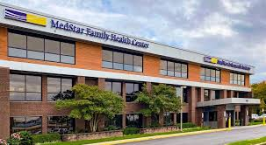
5. Understanding Synergy
Office Space
Office development has clear market synergy with hotels, and restaurants.
Retail stores that are open in the evening can draw workers as they leave their offices
The market analyst should explore the frequency with which businesses bring visitors for meetings and conferences, and the types of accommodations those visitors prefer.
Medical practices, dentists, physical therapists, imaging centers, testing laboratories, can be attracted to multitenant office space, but they may prefer separate buildings.

Slide 26
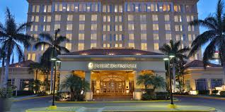
5. Understanding Synergy
Hotels
Hotels can be vital components of mixed-use developments for several reasons.
A quality hotel can enhance the project’s image and provide immediate name recognition.
Secondary uses such as health clubs can be shared by hotel guests, office tenants, and residents, saving the hotel the cost of providing its own facilities.
Hotel guests help support a mixed-use project’s retail activity, especially unique specialty shops, bars and restaurants, sports arenas, and entertainment venues.

Slide 27
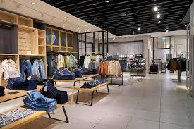
5. Understanding Synergy
Retail Space
Depending on the size of the residential component and nearby competition beyond the project’s boundaries, a supermarket could be included (a full-size, natural foods, or smaller specialty operator).
Specialty retail uses (upscale apparel and shoe stores, children’s items, unique craft and gift shops, local memorabilia and foods) are also included in downtown mixed-use projects.
In downtown locations, retail space needs to be paired with entertainment and dining so that the development attracts patrons who live outside the central business district.

Slide 28
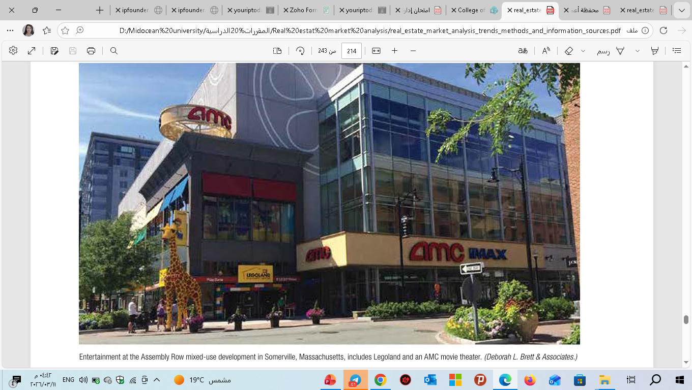
5. Understanding Synergy
A complete market study report should include a map that shows where the property sits within the metropolitan area or a major city. At a smaller scale, a map should show the boundaries of the primary and secondary market areas, location of the site, nearby interstate highways, and key
Retail Space key questions to ask:
■ What are the key sources of patronage?
■ What are the likely demographic and income characteristics of households that will live in the mixed-use development?
■ From how far away can other metro-area residents be drawn and what would bring them to the stores? (The mix needs to differ from what is seen in typical suburban community centers.)
■ Will the development as currently envisioned generate demand from tourists and other nonlocal visitors?

Slide 29
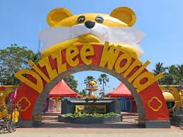
5. Understanding Synergy
Entertainment, Culture, and Identity Creation
Often the key factors affecting the success of a mixed-use development are related to the sense of place that the project can create and its ability to attract patrons on both weekdays and weekends, at lunchtime and in the evening, and through all four seasons.
Entertainment, cultural facilities, Bowling alleys and golf simulators, and casinos serve this objective well and have
become key ingredients in many mixed-use developments.
Plazas, sculpture, green spaces, water features, unique lighting, and colorful signage are also important in creating a sense of place and an identity for the “brand.”

Slide 30
5. Understanding Synergy
To attract visitors, mixed-use properties use outdoor concerts (targeting adults, teens, or children) and special events (fundraisers for local schools or charities, sidewalk sales, antique car or other hobby shows, five-kilometer races). Some offer skating rinks during the winter months

Slide 31

5. Understanding Synergy
Case Study 1: Mid-Rise Residential Development
Project Summary:
60 units
3-year development
Total cost: $8 million
Expected sales: $10.5 million
IRR = 16%
Required return = 15%
However, sensitivity analysis shows:
8% price drop → IRR falls to 11%
Conclusion:
Project is feasible but highly sensitive to price fluctuations.
Sports Facilities, Health Clubs, Spas, Marinas
Health clubs and specialty exercise studios are often included in mixed-use developments because potential revenues from residents living in the project (and those residing nearby) can be augmented by marketing the facilities to office workers.
Smaller fitness spaces devoted to cycling, yoga, kickboxing, karate, climbing walls, and high-intensity training are capturing a growing share of demand, as are exercise and swim facilities that cater to families.
In waterfront locations, mixed-use projects might include commercial marinas

Slide 32
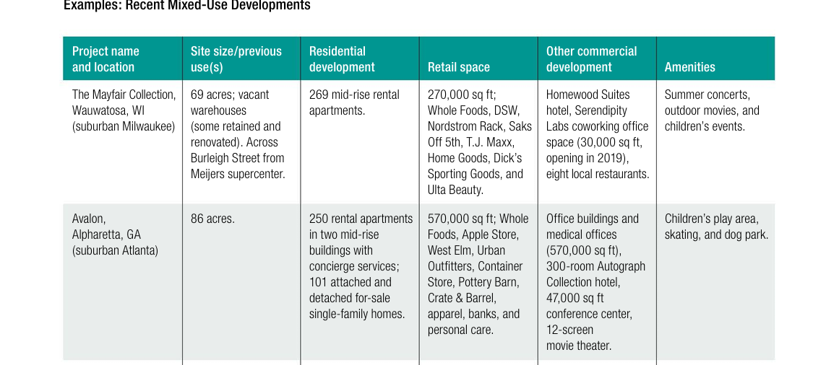
5. Understanding Synergy - Example

Slide 33
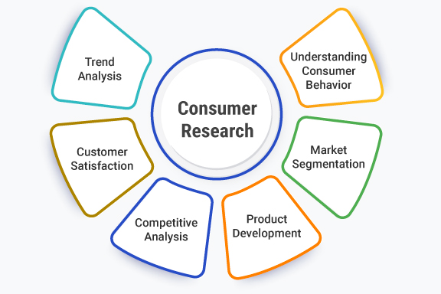
6. Using Consumer Research and Social Media
Given that all 8 billion people on the planet must live somewhere, how do we organize ourselves?
Insights into consumer preferences and cross-sales potential can best be derived from direct user research involving each of the key constituencies to be represented in the mixed-use development.
Focus groups are a good way to get consumer reaction to site plans, building designs, and materials.
Interviews with representatives of potential retail and office tenant types—as well as operators of health/fitness and restaurant concepts—would also be advantageous.

Slide 34

lecture
6. Using Consumer Research and Social Media
Numerous areas of contemporary economics are connected to urban economics. My early professional goal was to become a | Source | % of Sessions |
| --------------------- | ------------- |
| Organic Search | 41% |
| Paid Ads (Google Ads) | 27% |
| Social Media | 18% |
| Direct | 14% |
macroeconomist. Understanding the causes and effects of booms and recessions is the goal of macroeconomists. Additionally, they aim to comprehend the
Developers can use social media to post a description of the concept, highlight the various land uses and public spaces in the site plan, and show building renderings and streetscapes.
his is a good way to create “buzz,” but it can also generate useful input about materials, colors, and signage. Respondents can sign up for news about the project and be contacted as work progresses, thus creating a pool of marketing leads.
Consumer research meets two objectives:
getting user reaction to project plans and determining whether tenants or users of one project component will likely take advantage of other uses.
This information helps the analyst determine whether the array of uses will justify a rent premium

Slide 35
7. Overall marketability
| Competitor Project | Units | Price Range | Occupancy |
| -------------------- | ----- | ----------- | --------- |
| Sunrise Towers | 180 | $180k–$260k | 92% |
| Al Noor Residences | 250 | $160k–$240k | 95% |
| Palm View Apartments | 150 | $200k–$300k | 88% |
The final step in the market analysis for a mixed-use development is to estimate its overall marketability on the basis of consumer demographics, the supply of key competitive properties, and the mix of tenant types at competitive locations.
Large-scale mixed-use projects usually have few, if any, directly comparable projects in the same market area with a similar combination of uses.
If such analogues exist, the performance of their key components should be analyzed in detail.
Comparable properties in other markets can also help direct the developer toward choosing the right land uses and tenant types and avoid pitfalls

Slide 36
7. Overall marketability
Investment decision
After examining the market potential, the team of analysts will recommend refinements to the plan. These refinements could include changes in the size or location of project components, phasing, design, or marketing. Some elements might be dropped if synergy is insufficient.

Slide 37
7. Overall marketability
| Priority Factor | % Selecting as “Very Important” |
| ----------------------- | ------------------------------- |
| Proximity to work | 72% |
| Parking availability | 65% |
| Public transport access | 58% |
| Security | 76% |
| Retail/services nearby | 49% |
Mixed-use developments are risk intensive and complicated to implement. But they can be highly desirable and worthwhile for developers, residents, and the community as a whole. Although the premiums are difficult to quantify, and will not be the same for all property types, experience indicates that developers may see rent or sales price premiums as high as 15 to 20 percent in a well-conceived mixed-use development compared with those for a single-use project.
The challenge is to carefully determine early in the development process the proper balance between higher costs and higher payback.

Slide 38
8. Case Study: Market Analysis for a Mixed-Use Development Project
1. Project Overview :Project Name: Riverside Integrated Development
Location: Central Business District
Project Type: Mixed-Use Development (Residential, Office, Retail, Hospitality)
Site Area: 120,000 m²
Total Built-up Area: 350,000 m²
Proposed Components
Residential apartments: 1,200 units
Office space: 80,000 m²
Retail mall: 45,000 m²
Hotel: 250 rooms
Parking: 2,500 spaces
Development Objective: Create a vibrant urban destination combining residential living, commercial activities, and leisure facilities.

Slide 39
8. Case Study: Market Analysis for a Mixed-Use Development Project
Using Qualitative Research
2. Market Area Definition
The primary market area includes the central districts, including:
Project A
Project B
Project C
These areas represent the main mixed-use and residential growth corridors in the city.

Slide 40
8. Case Study: Market Analysis for a Mixed-Use Development Project
| Year | Net Absorption (m²) |
| ---- | ------------------- |
| 2020 | 60,000 |
| 2021 | 75,000 |
| 2022 | 90,000 |
| 2023 | 105,000 |
3. Macroeconomic Analysis
Population Growth
Population growth increases demand for housing, retail services, and offices.
Indicator | Value
Population (Abu Dhabi) | 1.7 million
Annual Growth Rate | 3-4 %
Expat Population | 80 %

Slide 41
8. Case Study: Market Analysis for a Mixed-Use Development Project
| Indicator | Value |
| ------------------------- | ------------------------ |
| GDP Growth | 3.5% |
| Major sectors | Energy, tourism, finance |
| Infrastructure investment | High |
Economic Indicators
Indicator | Value
GDP Growth | 3.5 %
Major sectors | Energy, tourism, finance
Infrastructure investment | High

Slide 42
8. Case Study: Market Analysis for a Mixed-Use Development Project
4. Demand Analysis
Residential Demand
Key drivers:
Population growth
Expats moving to urban centers
Rising demand for lifestyle communities
Market Demand Estimate
Segment | Annual Demand
Apartments | 6,000 units
Villas | 1,500 units
Estimated annual apartment absorption in the study area:3,000–4,000 units

Slide 43
8. Case Study: Market Analysis for a Mixed-Use Development Project
| Year | Net Absorption (m²) |
| ---- | ------------------- |
| 2020 | 60,000 |
| 2021 | 75,000 |
| 2022 | 90,000 |
| 2023 | 105,000 |
Office Demand
Office demand is driven by:
Government entities
International companies
Financial and consulting firms
Office Market Indicators
Indicator | Value
Vacancy Rate | 12 %
Average Rent | 1,300 AED/m²/year
Demand Growth | 3% annually
Mixed-use projects attract companies seeking integrated environments.

Slide 44
8. Case Study: Market Analysis for a Mixed-Use Development Project
| Year | Net Absorption (m²) |
| ---- | ------------------- |
| 2020 | 60,000 |
| 2021 | 75,000 |
| 2022 | 90,000 |
| 2023 | 105,000 |
Retail Demand
Retail demand is supported by:
Tourism growth
High household income
Expanding population
Retail Market Indicators
Indicator | Value
Retail Space Supply | 2.7 million m²
Average Rent | 2,500 AED/m²
Vacancy Rate | 10 %
Lifestyle retail integrated with residential areas performs strongly.

Slide 45
8. Case Study: Market Analysis for a Mixed-Use Development Project
| Year | Net Absorption (m²) |
| ---- | ------------------- |
| 2020 | 60,000 |
| 2021 | 75,000 |
| 2022 | 90,000 |
| 2023 | 105,000 |
Hospitality Demand
Tourism drives hotel demand.
Indicator | Value
Hotel Occupancy | 70 %
Average Daily Rate | $170
Annual Visitors | 24 million
tourism attractions support hotel demand.

Slide 46
8. Case Study: Market Analysis for a Mixed-Use Development Project
| Year | Net Absorption (m²) |
| ---- | ------------------- |
| 2020 | 60,000 |
| 2021 | 75,000 |
| 2022 | 90,000 |
| 2023 | 105,000 |
5. Supply Analysis
Major competing mixed-use developments include:
Project A
Entertainment and residential destination
Major retail and leisure facilities
Project B
Cultural district
Luxury residential projects
Project C
High-density residential towers
Commercial offices and retail
These projects demonstrate strong market demand for integrated developments.

Slide 47
8. Case Study: Market Analysis for a Mixed-Use Development Project
| Year | Net Absorption (m²) |
| ---- | ------------------- |
| 2020 | 60,000 |
| 2021 | 75,000 |
| 2022 | 90,000 |
| 2023 | 105,000 |
6. Competitive Analysis
Project | Residential Units | Retail Space | Office Space
A Projects | 150000 | 150,000 m² | 200,000 m²
B Developments | 8000 | 80,000 m² | Limited
C Developments | 6000 | 200,000 m² | 100,000 m²
The proposed project competes by offering balanced land use and central location.

Slide 48
8. Case Study: Market Analysis for a Mixed-Use Development Project
| Year | Net Absorption (m²) |
| ---- | ------------------- |
| 2020 | 60,000 |
| 2021 | 75,000 |
| 2022 | 90,000 |
| 2023 | 105,000 |
7. Absorption Analysis
Projected annual absorption:
Segment | Annual Absorption
Residential | 300 units
Office | 12,000 m²
Retail | 6,000 m²
Full stabilization expected in 6–7 years.

Slide 49
8. Case Study: Market Analysis for a Mixed-Use Development Project
| Year | Net Absorption (m²) |
| ---- | ------------------- |
| 2020 | 60,000 |
| 2021 | 75,000 |
| 2022 | 90,000 |
| 2023 | 105,000 |
8. Financial Indicators
Estimated development cost:
Component | Cost
Residential | $650 million
Retail | $220 million
Office | $300 million
Hotel | $180 million
Full stabilization expected in 6–7 years.
Indicator | Value
IRR | 14 %
Payback Period | 8 years
NPV | Positive

Slide 50
8. Case Study: Market Analysis for a Mixed-Use Development Project
| Year | Net Absorption (m²) |
| ---- | ------------------- |
| 2020 | 60,000 |
| 2021 | 75,000 |
| 2022 | 90,000 |
| 2023 | 105,000 |
9. Risk Analysis
Key risks include:
Market oversupply
Economic fluctuations
Construction cost escalation
Changes in tourism demand
Risk mitigation strategies:
Phased development
Mixed tenant mix
Flexible unit design

Slide 51
8. Case Study: Market Analysis for a Mixed-Use Development Project
| Year | Net Absorption (m²) |
| ---- | ------------------- |
| 2020 | 60,000 |
| 2021 | 75,000 |
| 2022 | 90,000 |
| 2023 | 105,000 |
10. Conclusion
The market analysis indicates that mixed-use developments remain highly attractive, driven by:
population growth
economic diversification
tourism expansion.
The proposed project demonstrates strong long-term investment potential, particularly if implemented in phases aligned with market demand.

Slide 52
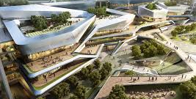
Conclusion
Mixed-use developments are risk intensive and complicated to implement. But they can be highly desirable and worthwhile for developers, residents, and the community as a whole.
In many ways, it consists of more than the sum of its parts: at best, it generates premium rents/prices because of cumulative attraction; at worst, it can fail because one or more uses were ill-conceived or failed to capture demand.
lecture
09
Exercise
Do Mixed-use developments Market analysis to decide about developing new project in your town?

Slide 53



Thank You

