Slide 1


Red Hat System Administration I
Dr. Eng. Gamal Selim
Lecture 10

Slide 2
Agenda
Chapter 15: Comprehensive Review
Red Hat Linux Administration I
Lecture 10
Dr. Eng. Gamal Selim

Slide 3
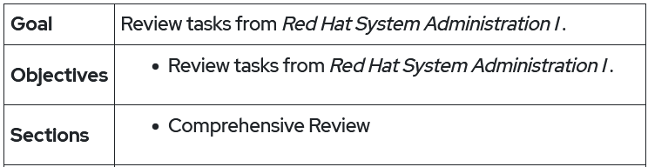
Red Hat Linux Administration I
Lecture 10
Dr. Eng. Gamal Selim

Slide 4
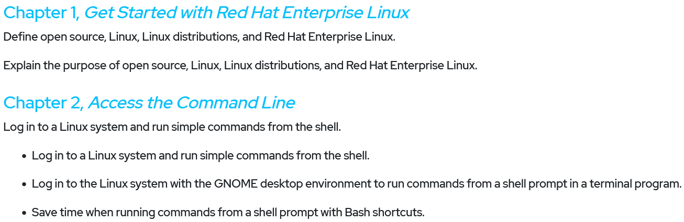
Red Hat Linux Administration I
Lecture 10
Dr. Eng. Gamal Selim

Slide 5
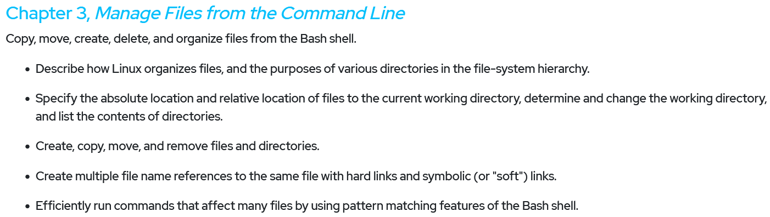
Red Hat Linux Administration I
Lecture 10
Dr. Eng. Gamal Selim

Slide 6
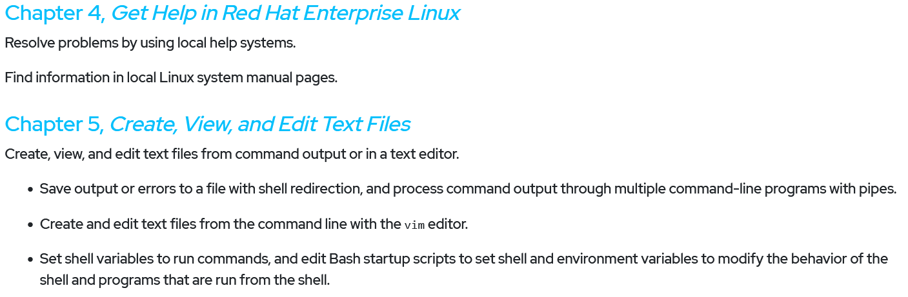
Red Hat Linux Administration I
Lecture 10
Dr. Eng. Gamal Selim

Slide 7
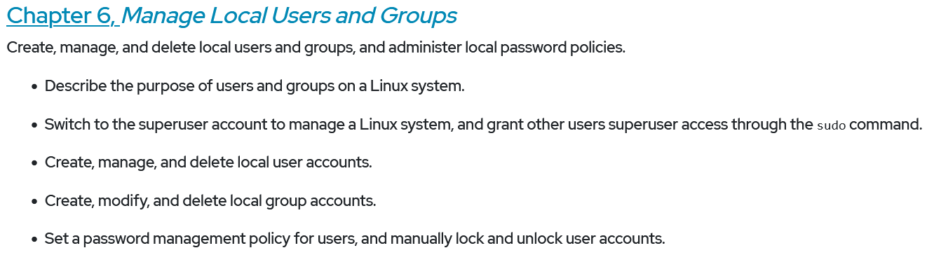
Red Hat Linux Administration I
Lecture 10
Dr. Eng. Gamal Selim

Slide 8
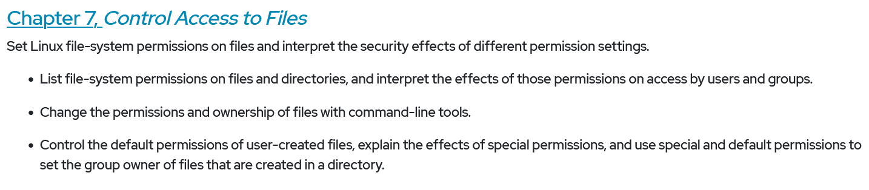
Red Hat Linux Administration I
Lecture 10
Dr. Eng. Gamal Selim

Slide 9
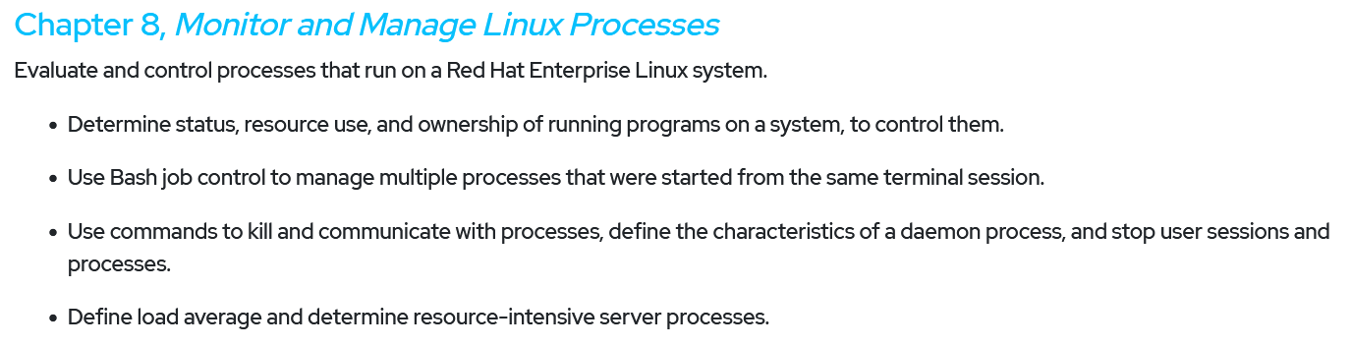
Red Hat Linux Administration I
Lecture 10
Dr. Eng. Gamal Selim

Slide 10
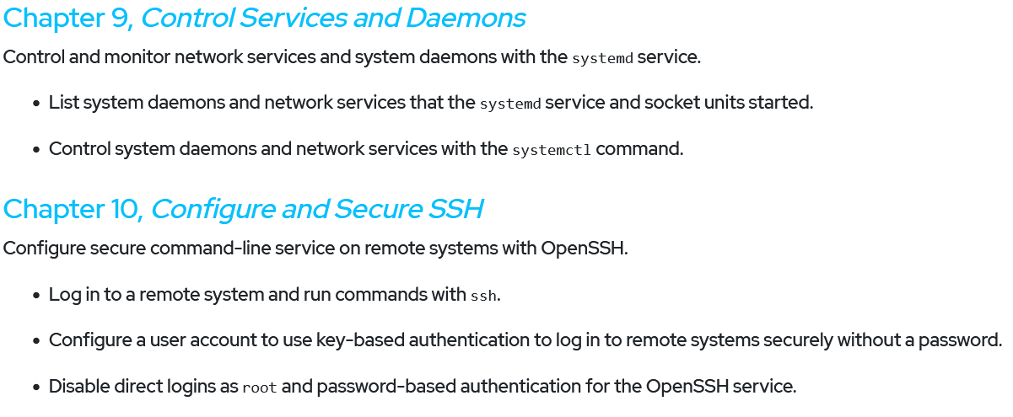
Red Hat Linux Administration I
Lecture 10
Dr. Eng. Gamal Selim

Slide 11
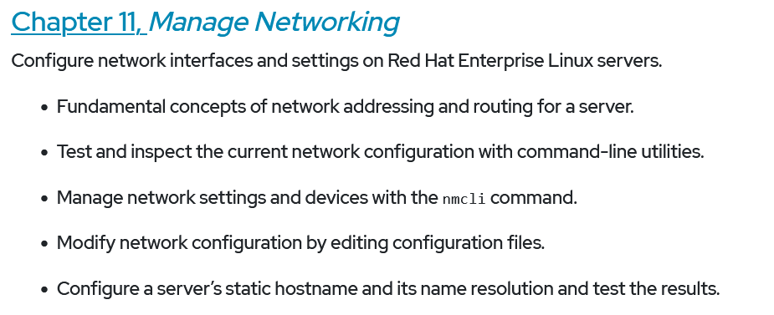
Red Hat Linux Administration I
Lecture 10
Dr. Eng. Gamal Selim

Slide 12
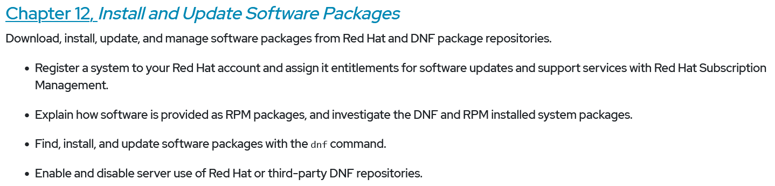
Red Hat Linux Administration I
Lecture 10
Dr. Eng. Gamal Selim

Slide 13
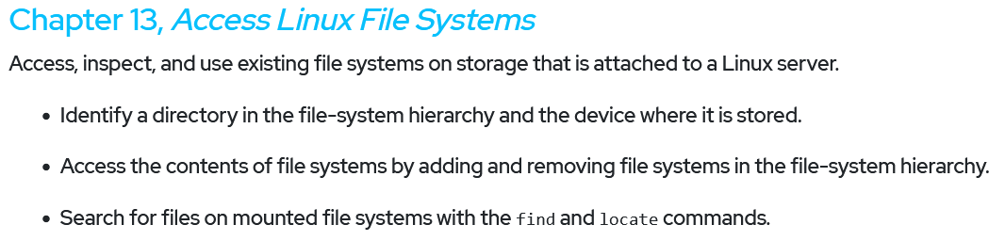
Red Hat Linux Administration I
Lecture 10
Dr. Eng. Gamal Selim

Slide 14
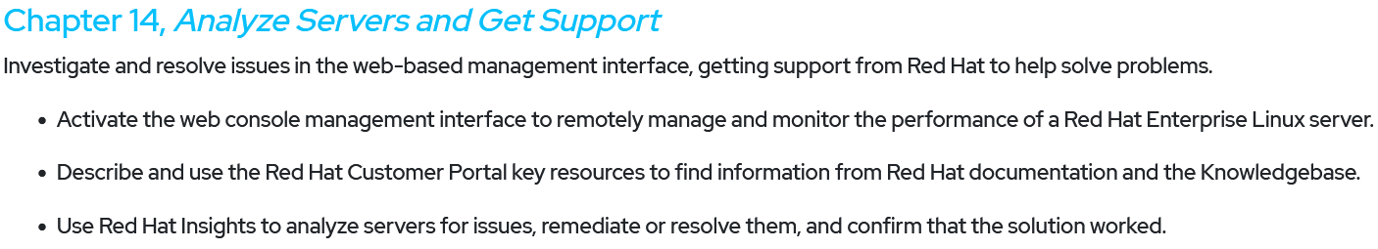
Red Hat Linux Administration I
Lecture 10
Dr. Eng. Gamal Selim

Slide 15
End of Chapter 15
Red Hat Linux Administration I
Lecture 10
Dr. Eng. Gamal Selim

Slide 16


