Slide 1


Information Security Operations Center
(Info SOC)
Lecture 7
The impacts of cryptography on network security monitoring
Prepared by
Dr. Ibrahim Gomaa

Slide 2

Lecture
Contents
7
Topic Title | Topic Objective
Integrity and Authenticity | Explain the role of cryptography in ensuring the integrity and authenticity of data.
Confidentiality | Explain how cryptographic approaches enhance data confidentiality.
Public Key Cryptography | Explain public key cryptography.
Authorities and the PKI Trust System | Explain how the public key infrastructure functions.
Applications and Impacts of Cryptography | Explain how the use of cryptography affects cybersecurity operations.
Information Security Operations Center
Lecture 7
Dr. Ibrahim Gomaa

Slide 3
Lecture
Securing Communications
7
Organizations must provide support to secure the data internally as well as externally.
The four elements of securing communications are:
  Data Integrity - Guarantees that the message was not altered.
  Origin Authentication - Guarantees that the message is not a forgery, and it actually comes from whom it states.
  Data Confidentiality - Guarantees that only authorized users can read the message.
  Data Non-Repudiation - Guarantees that the sender cannot repudiate, or refute, the validity of a message sent.
Information Security Operations Center
Lecture 7
Dr. Ibrahim Gomaa

Slide 4
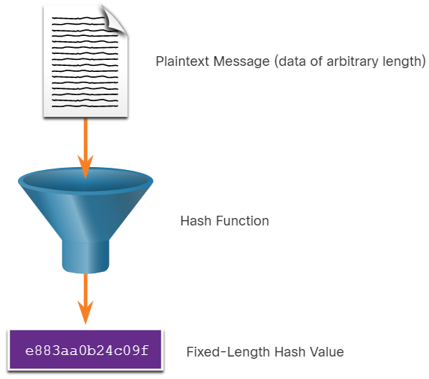
Lecture
Securing Communications
7
Cryptographic Hash Functions
Hashes are used to verify and ensure data integrity.
Hashing is based on a one-way mathematical function that is relatively easy to compute, but significantly harder to reverse.
A hash function takes a variable block of binary data, called the message, and produces a fixed-length, condensed representation, called the hash.
The resulting hash is also sometimes called the message digest, digest, or digital fingerprint.
With hash functions, it is computationally infeasible for two different sets of data to come up with the same hash output.
Every time the data is changed or altered; the hash value also changes.
Information Security Operations Center
Lecture 7
Dr. Ibrahim Gomaa

Slide 5
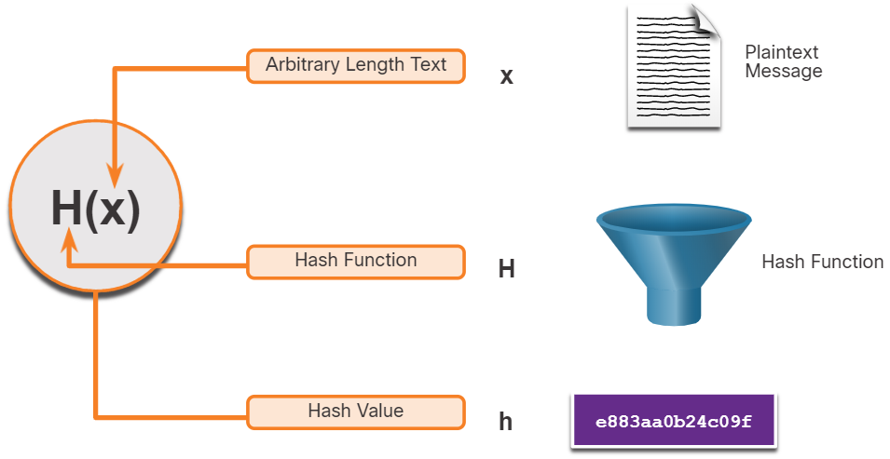
Lecture
Securing Communications
7
Cryptographic Hash Functions
Mathematically, the equation h= H(x) is used to explain how a hash algorithm operates.
As shown in the figure, a hash function H takes an input x and returns a fixed-size string hash value h.
A cryptographic hash function should have the following properties:
  The input can be any length.
  The output has a fixed length.
  H(x) is relatively easy to compute for given x.
  H(x) is one way and not reversible.
  H(x) is collision free, meaning that two different input values will result in different hash values.
Information Security Operations Center
Lecture 7
Dr. Ibrahim Gomaa

Slide 6
Lecture
Securing Communications
7
MD5 and SHA
While hashing can be used to detect accidental changes, it cannot be used to guard against deliberate changes that are made by a threat actor.
There is no unique identifying information from the sender in the hashing procedure.
This means that anyone can compute a hash for any data, as long as they have the correct hash function.
Therefore, hashing is vulnerable to man-in-the-middle attacks and does not provide security to transmitted data. To provide integrity and origin authentication, something more is required.
Note: Hashing algorithms only protect against accidental changes and does not protect the data from changes deliberately made by a threat actor.
Information Security Operations Center
Lecture 7
Dr. Ibrahim Gomaa

Slide 7
Lecture
Securing Communications
7
Origin Authentication
To add origin authentication and integrity assurance, use a keyed-hash message authentication code (HMAC).
HMAC uses an additional secret key as input to the hash function.
Note: Other Message Authentication Code (MAC) methods are also used. However, HMAC is used in many systems including SSL, IPsec, and SSH.
Information Security Operations Center
Lecture 7
Dr. Ibrahim Gomaa

Slide 8
Lecture
Securing Communications
7
Origin Authentication
To add origin authentication and integrity assurance, use a keyed-hash message authentication code (HMAC).
HMAC uses an additional secret key as input to the hash function.
Note: Other Message Authentication Code (MAC) methods are also used. However, HMAC is used in many systems including SSL, IPsec, and SSH.
Information Security Operations Center
Lecture 7
Dr. Ibrahim Gomaa

Slide 9
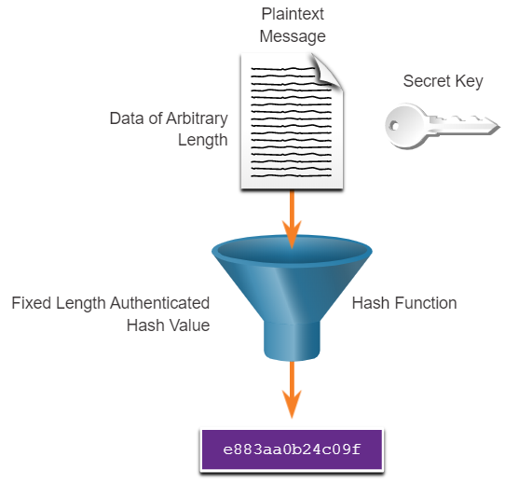
Lecture
Securing Communications
7
Origin Authentication
HMAC Hashing Algorithm
An HMAC is calculated using any cryptographic algorithm that combines a cryptographic hash function with a secret key.
Only the sender and the receiver know the secret key, and the output of the hash function depends on the input data and the secret key.
Only parties who have access to that secret key can compute the digest of an HMAC function.
If two parties share a secret key and use HMAC functions for authentication, a properly constructed HMAC digest of a message that a party has received indicates that the other party was the originator of the message.
Information Security Operations Center
Lecture 7
Dr. Ibrahim Gomaa

Slide 10
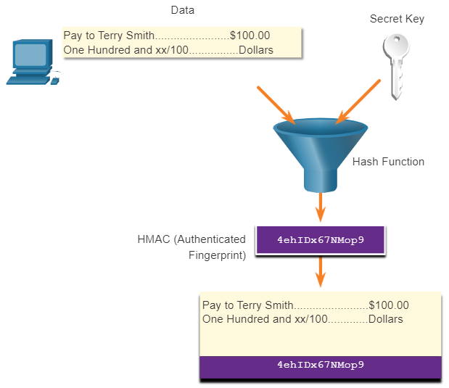
Lecture
Securing Communications
7
Origin Authentication
Creating the HMAC Value
As shown in the figure, the sending device inputs data into the hashing algorithm and calculates the fixed-length HMAC digest.
This authenticated digest is then attached to the message and sent to the receiver.
Information Security Operations Center
Lecture 7
Dr. Ibrahim Gomaa

Slide 11
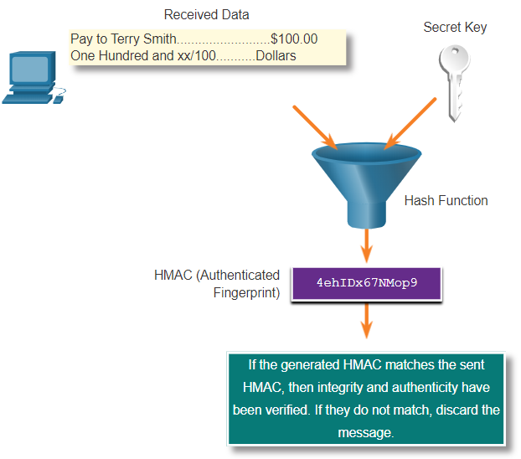
Lecture
Securing Communications
7
Origin Authentication
Verifying the HMAC Value
In the figure, the receiving device removes the digest from the message and uses the plaintext message with its secret key as input into the same hashing function.
If the digest that is calculated by the receiving device is equal to the digest that was sent, the message has not been altered.
Additionally, the origin of the message is authenticated because only the sender possesses a copy of the shared secret key. The HMAC function has ensured the authenticity of the message.
Information Security Operations Center
Lecture 7
Dr. Ibrahim Gomaa

Slide 12
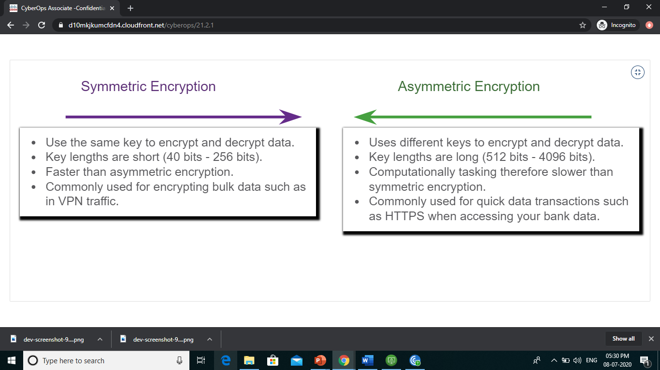
Lecture
Encryption
7
Data Confidentiality
There are two classes of encryption used to provide data confidentiality; asymmetric and symmetric. These two classes differ in how they use keys.
Symmetric encryption algorithms such as Data Encryption Standard (DES), 3DES, and Advanced Encryption Standard (AES) are based on the premise that each communicating party knows the pre-shared key.
Data confidentiality can also be ensured using asymmetric algorithms, including Rivest, Shamir, and Adleman (RSA) and the public key infrastructure (PKI).
The figure highlights some differences between symmetric and asymmetric encryption.
Information Security Operations Center
Lecture 7
Dr. Ibrahim Gomaa

Slide 13
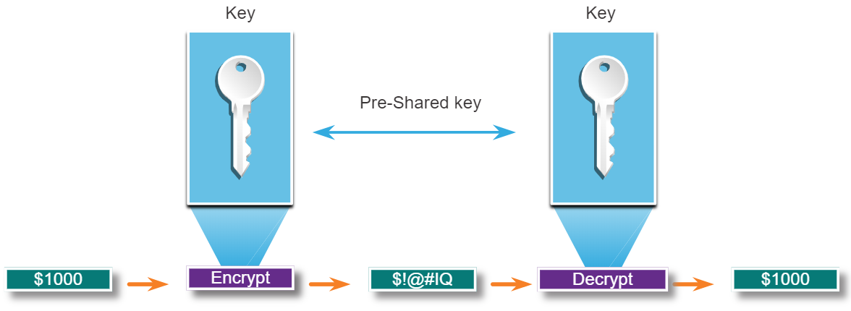
Lecture
Encryption
7
Symmetric Encryption
Symmetric algorithms use the same pre-shared key (secret key) to encrypt and decrypt data.
Symmetric encryption algorithms are commonly used with VPN traffic because they use less CPU resources than asymmetric encryption algorithms.
When using these algorithms, the longer the key, the longer it will take for someone to discover the key.
Most encryption keys are between 112 and 256 bits. Use a longer key for more secure communications.
Symmetric encryption algorithms are sometimes classified as a block cipher or a stream cipher.
Information Security Operations Center
Lecture 7
Dr. Ibrahim Gomaa

Slide 14
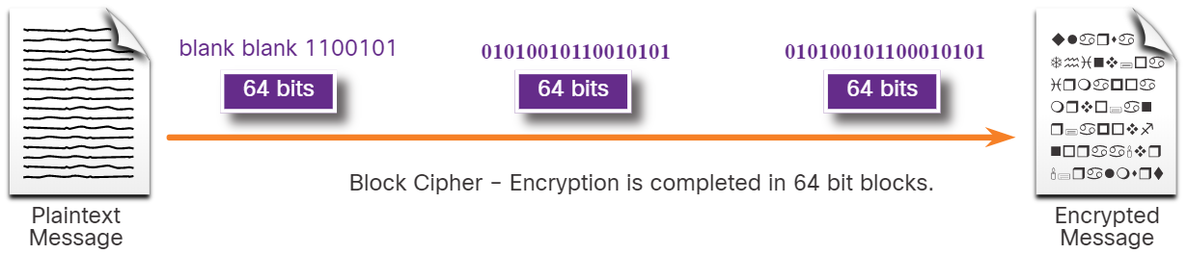
Lecture
Encryption
7
Symmetric Encryption
Block Ciphers
Block ciphers transform a fixed-length block of plaintext into a common block of ciphertext of 64 or 128 bits.
Common block ciphers include DES with a 64-bit block size and AES with a 128-bit block size.
Information Security Operations Center
Lecture 7
Dr. Ibrahim Gomaa

Slide 15
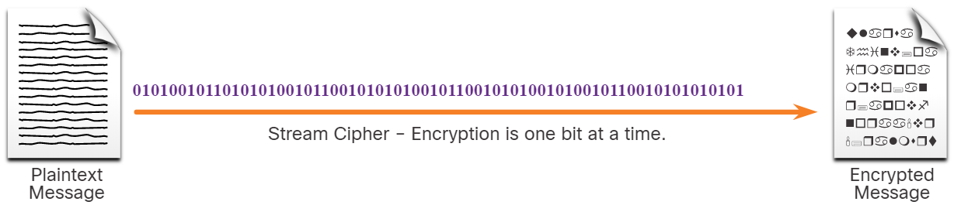
Lecture
Encryption
7
Symmetric Encryption
Stream Ciphers
Stream ciphers encrypt plaintext one byte or one bit at a time.
Stream ciphers are basically a block cipher with a block size of one byte or bit.
Stream ciphers are typically faster than block ciphers because data is continuously encrypted.
Examples include RC4 and A5 which is used to encrypt GSM cell phone communications.
Information Security Operations Center
Lecture 7
Dr. Ibrahim Gomaa

Slide 16
Lecture
Encryption
7
Symmetric Encryption
Well-known symmetric encryption algorithms are described in the table
Symmetric Encryption Algorithms | Description
Data Encryption Standard (DES) | This is a legacy algorithm. It uses a short key length that makes it insecure.
3DES (Triple DES) | This is the replacement for DES and repeats the DES algorithm three times. It should be avoided as it is scheduled to be retired in 2023. If implemented, use very short key lifetimes.
Advanced Encryption Standard (AES) | It offers combinations of 128-, 192-, or 256-bit keys to encrypt 128, 192, or 256 bit-long data blocks.
Software-Optimized Encryption Algorithm (SEAL) | It is a stream cipher that uses a 160-bit encryption key and has a lower impact on the CPU compared to other software-based algorithms.
Rivest ciphers (RC) series algorithms | RC4 is a stream cipher that was used to secure web traffic. It has been found to have multiple vulnerabilities which have made it insecure. RC4 should not be used.
Information Security Operations Center
Lecture 7
Dr. Ibrahim Gomaa

Slide 17
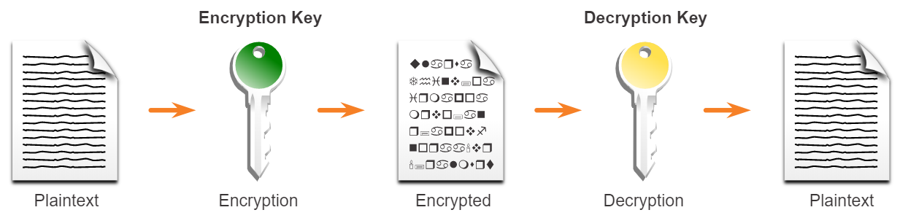
Lecture
Encryption
7
Asymmetric Encryption
Asymmetric algorithms, also called public-key algorithms, are designed in a way that the encryption and the decryption keys are different.
Asymmetric algorithms use a public key and a private key. Both keys are capable of the encryption process, but the complementary paired key is required for decryption.
The process is also reversible. Data that is encrypted with the public key requires the private key to decrypt.
Asymmetric algorithms achieve confidentiality and authenticity by using this process.
Asymmetric encryption can use key lengths between 512 to 4,096 bits.
Asymmetric algorithms are substantially slower than symmetric algorithms.
Information Security Operations Center
Lecture 7
Dr. Ibrahim Gomaa

Slide 18
Lecture
Encryption
7
Asymmetric Encryption
Common examples of asymmetric encryption algorithms are described in the table.
Asymmetric Encryption Algorithms | Key Length | Description
Diffie-Hellman (DH) | 512, 1024, 2048, 3072, 4096 | This algorithm allows two parties to agree on a key that they can use to encrypt messages they want to send to each other. The security depends on the assumption that it is easy to raise a number to a certain power, but difficult to compute which power was used, given the number and the outcome.
Digital Signature Standard (DSS) and Digital Signature Algorithm (DSA) | 512 – 1024 | It specifies DSA as the algorithm for digital signatures. DSA is a public key algorithm based on the ElGamal signature scheme. Signature creation speed is similar to RSA, but is 10 to 40 times slower for verification.
Elliptic curve techniques | 224 or higher | Elliptic curve cryptography can be used to adapt many cryptographic algorithms, such as Diffie-Hellman or ElGamal. The main advantage of elliptic curve cryptography is that the keys can be much smaller.
Information Security Operations Center
Lecture 7
Dr. Ibrahim Gomaa

Slide 19
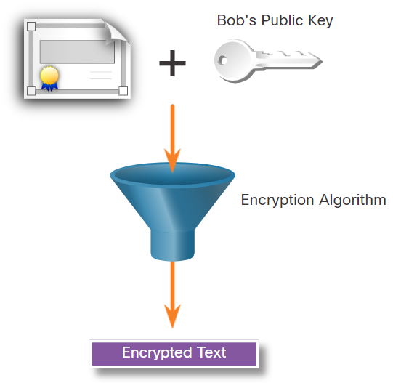
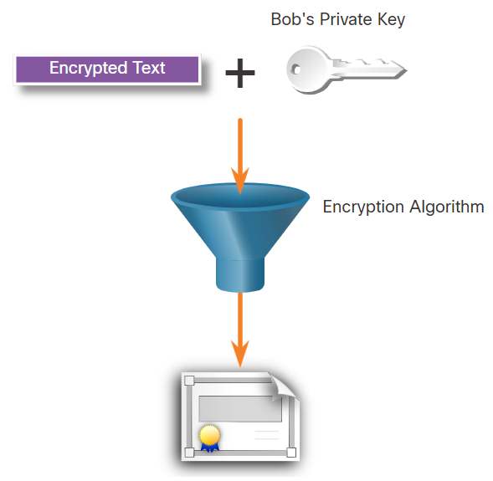
Lecture
Encryption
7
Asymmetric Encryption-Confidentiality
Asymmetric algorithms are used to provide confidentiality without pre-sharing a password.
The confidentiality objective of asymmetric algorithms is initiated when the encryption process is started with the public key.
The process can be summarized using the formula: Public Key (Encrypt) + Private Key (Decrypt) = Confidentiality
When the public key is used to encrypt data, the private key must be used to decrypt data.
Only one host has the private key; therefore, confidentiality is achieved.
Example: Data exchange between Bob and Alice
Alice acquires and uses Bob’s public key to encrypt a message and then send it to Bob.
Bob decrypts the message with the private key and as he is the only one with the private key, confidentiality is achieved.
Information Security Operations Center
Lecture 7
Dr. Ibrahim Gomaa

Slide 20
Lecture
Encryption
7
Asymmetric Encryption- Authentication
The authentication objective of asymmetric algorithms is initiated with the private key encryption process.
The process can be summarized using the formula: Private Key (Encrypt) + Public Key (Decrypt) = Authentication
When the private key is used to encrypt the data, the corresponding public key must be used to decrypt the data.
Because only one host has the private key, only that host could have encrypted the message, providing authentication of the sender.
When a host successfully decrypts a message using a public key, it is trusted that the private key encrypted the message, which verifies who the sender is. This is a form of authentication.
Information Security Operations Center
Lecture 7
Dr. Ibrahim Gomaa

Slide 21
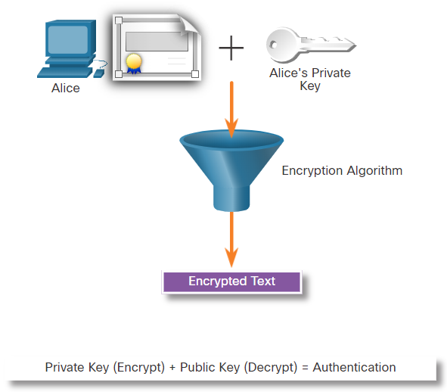
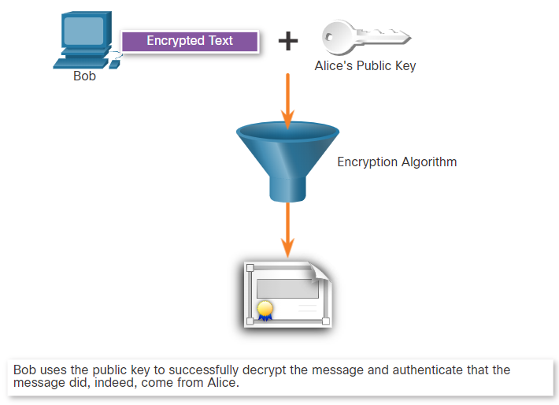
Lecture
Encryption
7
Asymmetric Encryption- Authentication
Let's see how the private and public keys can be used to provide authentication to the data exchange between Bob and Alice.
Alice uses her private key
Alice encrypts a message using her private key and sends it to Bob.
Bob decrypts using the public key
After Bob obtains Alice’s public key, he uses it to decrypt the message and to authenticate that the message has been received from Alice.
Information Security Operations Center
Lecture 7
Dr. Ibrahim Gomaa

Slide 22
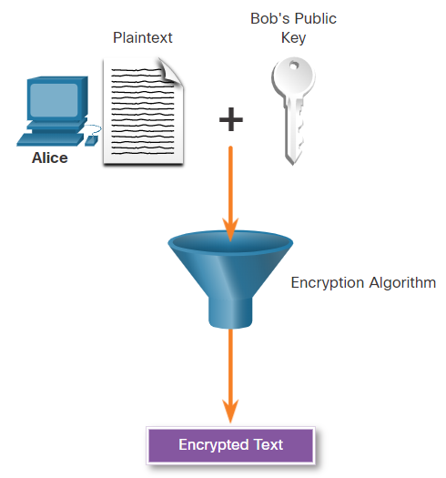
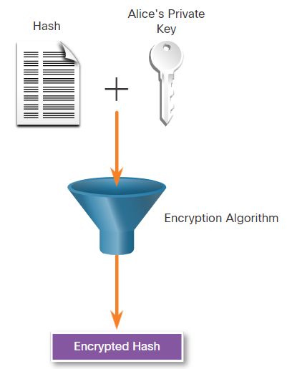
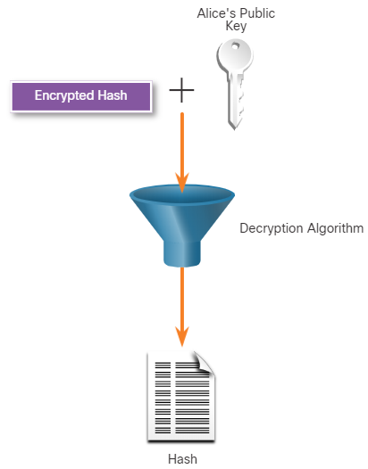
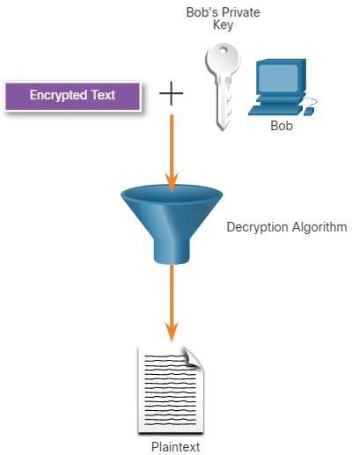
Lecture
Encryption
7
Asymmetric Encryption- Integrity
Combining the two asymmetric encryption processes provides message confidentiality, authentication, and integrity. In this example, a message will be ciphered using Bob’s public key and a ciphered hash will be encrypted using Alice’s private key.
Alice uses Bob’s Public Key
Alice encrypts a hash using her private key
Bob uses Alice’s public key to decrypt the hash
Bob uses his private key to decrypt the message
Information Security Operations Center
Lecture 7
Dr. Ibrahim Gomaa

Slide 23
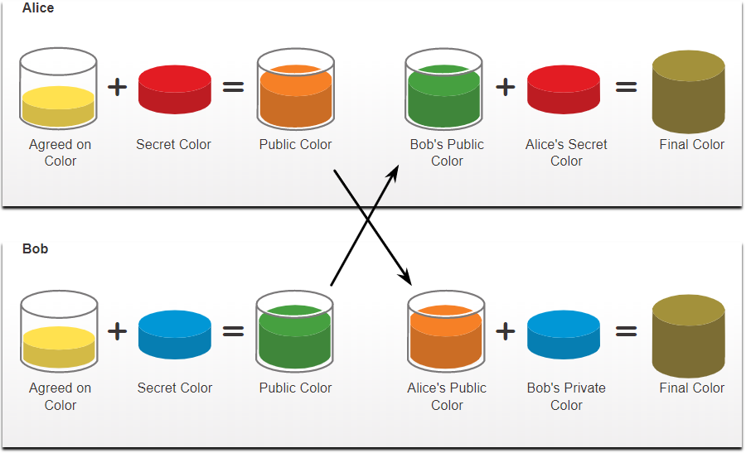
Lecture
Encryption
7
Diffie-Hellman
Diffie-Hellman (DH) is an asymmetric mathematical algorithm that allows two computers to generate an identical shared secret without having communicated before.
The new shared key is never actually exchanged between the sender and receiver.
The key can be used by an encryption algorithm to encrypt traffic between the two systems as both parties know it.
Following are two examples of instances when DH is commonly used:
  Data is exchanged using an IPsec VPN
  SSH data is exchanged
  The security of DH is based on the fact that it uses very large numbers in its calculations.
Information Security Operations Center
Lecture 7
Dr. Ibrahim Gomaa

Slide 24
Lecture
Encryption
7
Diffie-Hellman
Diffie-Hellman uses different DH groups to determine the strength of the key that is used in the key agreement process. The higher group numbers are more secure but require additional time to compute the key.
The following identifies the DH groups examples:
  DH Group 1: 768 bits
  DH Group 2: 1024 bits
  DH Group 5: 1536 bits
  DH Group 14: 2048 bits
  DH Group 15: 3072 bits
  DH Group 16: 4096 bits
Information Security Operations Center
Lecture 7
Dr. Ibrahim Gomaa

Slide 25
Lecture
Public Key Cryptography
7
Using Digital Signatures
Digital signatures are a mathematical technique used to provide authenticity, integrity, and nonrepudiation.
Digital signatures use asymmetric cryptography.
Digital signatures are commonly used in the following two situations:
  Code signing - Code signing is used to verify the integrity of executable files downloaded from a vendor website. It also uses signed digital certificates to authenticate and verify the identity of the site that is the source of the files.
  Digital certificates - These are used to authenticate the identity of a system with a vendor website and establish an encrypted connection to exchange confidential data.
The Digital Signature Standard (DSS) algorithms used for generating and verifying digital signatures are:
  Digital Signature Algorithm (DSA)
  Rivest-Shamir Adelman Algorithm (RSA)
  Elliptic Curve Digital Signature Algorithm (ECDSA)
Information Security Operations Center
Lecture 7
Dr. Ibrahim Gomaa

Slide 26
Lecture
Public Key Cryptography
7
Digital Signatures for Code Signing
Digital signatures are commonly used to provide assurance of the authenticity and integrity of software code.
Executable files are wrapped in a digitally signed envelope, which allows the end user to verify the signature before installing the software.
Digitally signing code provides several assurances about the code:
  The code is authentic and is actually sourced by the publisher.
  The code has not been modified since it left the software publisher.
  The publisher undeniably published the code. This provides nonrepudiation of the act of publishing.
The purpose of digitally signed software is to ensure that the software has not been tampered with, and that it originated from the trusted source as claimed.
Information Security Operations Center
Lecture 7
Dr. Ibrahim Gomaa

Slide 27
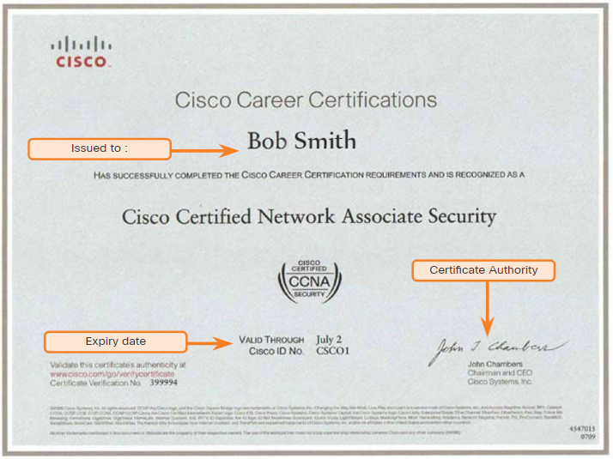
Lecture
Public Key Cryptography
7
Digital Signatures for Digital Certificates
A digital certificate enables users, hosts, and organizations to securely exchange information over the Internet.
It is used to authenticate and verify that a user who is sending a message is who they claim to be.
Digital certificates can also be used to provide confidentiality for the receiver with the means to encrypt a reply.
Digital certificates are similar to physical certificates.
Digital certificate independently verifies an identity.
In other words, a certificate verifies an identity, a signature verifies information coming from an identity.
Information Security Operations Center
Lecture 7
Dr. Ibrahim Gomaa

Slide 28
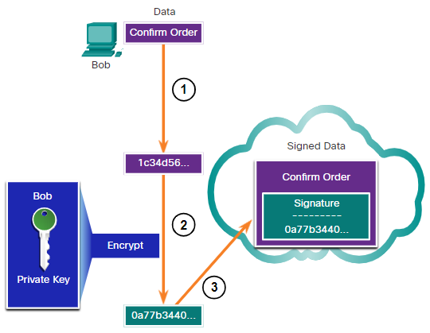
Lecture
Public Key Cryptography
7
Digital Signatures for Digital Certificates
This scenario will help you understand how a digital signature is used.
Bob is confirming an order with Alice, which she is ordering from Bob’s website.
Bob confirms the order, and his computer creates a hash of the confirmation.
The computer encrypts the hash with Bob's private key.
The encrypted hash, which is the digital signature, is added to the document.
The order confirmation is then sent to Alice over the internet.
Information Security Operations Center
Lecture 7
Dr. Ibrahim Gomaa

Slide 29
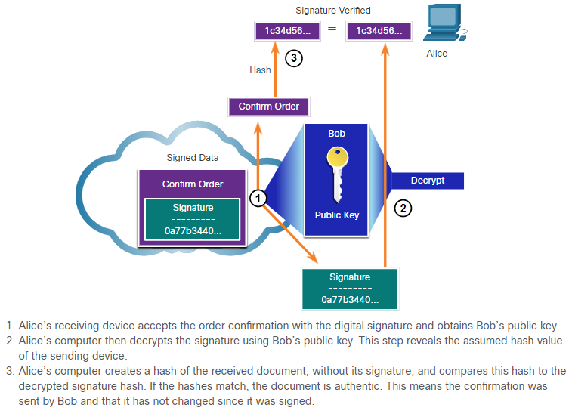
Lecture
Public Key Cryptography
7
Digital Signatures for Digital Certificates
When Alice receives the digital signature, the following process occurs:
Alice's receiver accepts the order confirmation with the digital signature and obtains Bob's public key.
Alice's computer then decrypts the signature using Bob's public key which reveals the assumed hash value of the sending device.
Alice's computer creates a hash of the received document, without its signature, and compares this hash to the decrypted hash.
If the hashes match, the document is authentic. This means the confirmation was sent by Bob and has not changed since signed.
Information Security Operations Center
Lecture 7
Dr. Ibrahim Gomaa

Slide 30
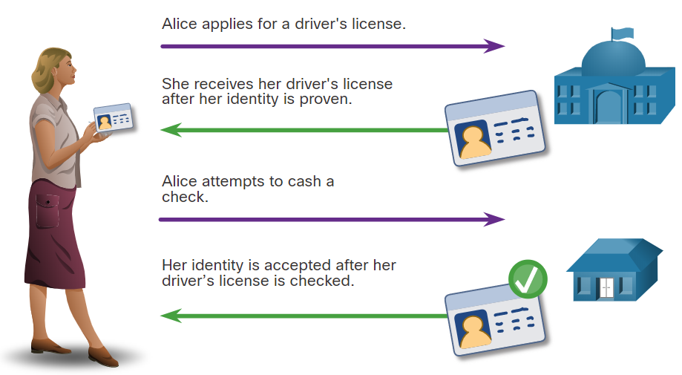
Lecture
Authorities and the PKI
Trust System
7
Public Key Management
When establishing an asymmetric connection between two hosts, the hosts will exchange their public key information.
Trusted third parties on the Internet validate the authenticity of these public keys using digital certificates. The third-party issues credentials that are difficult to forge.
From that point forward, all individuals who trust the third party simply accept the credentials that the third-party issues.
The Public Key Infrastructure (PKI) consists of specifications, systems, and tools that are used to create, manage, distribute, use, store, and revoke digital certificates.
Information Security Operations Center
Lecture 7
Dr. Ibrahim Gomaa

Slide 31
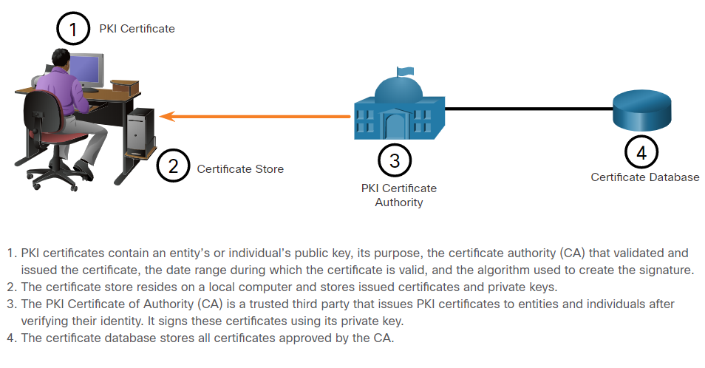
Lecture
Authorities and the PKI
Trust System
7
The Public Key Infrastructure
PKI is needed to support large-scale distribution and identification of public encryption keys.
The PKI framework facilitates a highly scalable trust relationship.
It consists of the hardware, software, people, policies, and procedures needed to create, manage, store, distribute, and revoke digital certificates.
The figure shows the main elements of the PKI.
Information Security Operations Center
Lecture 7
Dr. Ibrahim Gomaa

Slide 32
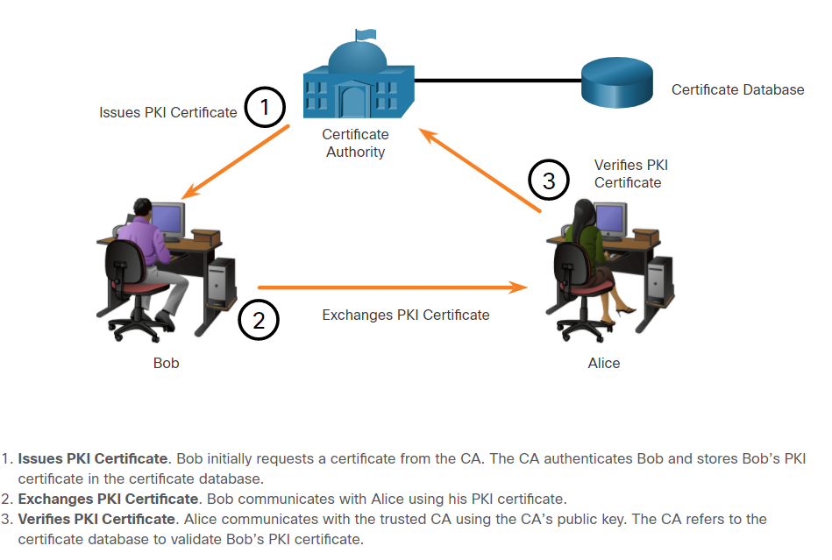
Lecture
Authorities and the PKI
Trust System
7
The Public Key Infrastructure
The below figure shows how
the elements of the PKI interoperate:
Information Security Operations Center
Lecture 7
Dr. Ibrahim Gomaa

Slide 33
Lecture
Authorities and the PKI
Trust System
7
PKI Applications
The following provides a short list of common uses of PKIs:
SSL/TLS certificate-based peer authentication
Secure network traffic using IPsec VPNs
HTTPS Web traffic
Control access to the network using 802.1x authentication
Secure email using the S/MIME protocol
Secure instant messaging
Approve and authorize applications with Code Signing
Protect user data with the Encryption File System (EFS)
Implement two-factor authentication with smart cards
Securing USB storage devices
Information Security Operations Center
Lecture 7
Dr. Ibrahim Gomaa

Slide 34
Lecture
Authorities and the PKI
Trust System
7
Encryption and Security Monitoring
Network monitoring becomes more challenging when packets are encrypted.
Security analysts must know how to circumvent and solve these issues. Here is a list of some of the things that a security analyst could do:
  Configure rules to distinguish between SSL and non-SSL traffic, HTTPS and non-HTTPS SSL traffic.
  Enhance security through server certificate validation using CRLs and OCSP (Online Certificate Status Protocol ).
  Implement antimalware protection and URL filtering of HTTPS content.
  Deploy SSL Appliance to decrypt SSL traffic and send it to intrusion prevention system (IPS) appliances to identify risks normally hidden by SSL.
Information Security Operations Center
Lecture 7
Dr. Ibrahim Gomaa

Slide 35
Lecture
7
Thanks
Information Security Operations Center
Lecture 7
Dr. Ibrahim Gomaa

