Slide 1



Business Data Analysis
MGM509
Lecture 2
Predictive Modeling Foundations: Correlation to Segmentation
Prepared by
Eng. Ahmed Hussein, MBA, PfMP©, PMP©, CMP APMG

Slide 2

Lecture
What we will cover
2
The purpose and power of predictive models
What makes an attribute “informative”
Measuring data uncertainty
How decision trees use data to create business insights
2 – 2

Slide 3
Lecture
What is Predictive Modeling?
2
Using Data to Predict Outcomes
Creating models to forecast unknown outcomes, based on historical data with known outcomes
Used in many business problems as:
  Churn prediction
  Fraud detection
  Credit scoring
  Demand forecasting
  It’s not about explaining the past — it’s about guiding future decisions.
2 – 3

Slide 4
Lecture
Predictive vs. Descriptive Modeling
2
Feature | Predictive Modeling | Descriptive Modeling
Purpose | Forecast outcomes | Understand Past Patterns
Uses Labeled Data | Yes | Not necessarily
Common in | Business decision support | Reporting & Analysis
Output | Predictions/scores | Insights/segments
Predictive modeling supports action, not just understanding.
2 – 4

Slide 5
Lecture
Models, Induction, and Prediction
2
Model: A simplified representation of reality
A Predictive Model: A formula for estimating the unknown value of interest (the Target). Formula could be Mathematical or Logical or a hybrid
Model Induction: Creation of models from data, or generalizing from specific cases to general rules).
Prediction: Using a model to estimate an unknown value
Example:
  Data: 1000 past customers
  Induction: Customers with < 1 year tenure are likely to churn
  Prediction: New customer with 8 months tenure is likely to churn
2 – 5

Slide 6
Lecture
Supervised Learning
2
Learning from Examples
Model creation where the model describes a relationship between a set of selected variables (attributes or features) and a predefined variable called the target variable
Train a model using data with known outcomes.
Components:
  Instance or Feature vector (example, data point, row)
  Attributes (Features)
  Target Variable (Label)
Example
Attribute | Target Variable (Churn?)
Monthly Charges: $100 | Yes
Contract Type: One-year | No
2 – 6

Slide 7
Lecture
The Target Variable
2
What are you trying to predict
Central to supervised learning
Must be clearly defined and measurable
Examples:
  Customer will churn (Yes/No)
  Loan will default (Yes/No)
  Expected monthly revenue (numeric)
  The model’s job is to learn how attributes relate to the target!
2 – 7

Slide 8
Predictive Modeling as
Supervised Segmentation
Lecture
2
Think of Predictive Modeling as Supervised Segmentation
How can we segment the population into groups that differ from each other with respect to some quantity of interest (or something that we would like to predict or estimate).
The target of interest is unknown at decision making time.
Finding or selecting important informative variables or “attributes” of the entities described by the data, or finding knowable attributes that correlate with the target of interest and reduce our uncertainty in it.
  Informative means something that reduces uncertainty
2 – 8

Slide 9
Lecture
What is Supervised Segmentation?
2
Dividing data to improve prediction
Split the population into segments where behavior is more consistent using attribute values to define segments
Breaks down data into predictable subgroups
  • Uses labeled data to guide the process
  • Sets the stage for:
      • Attribute selection
      • Decision tree construction
      • Rule generation
Goal: Identify areas where prediction is more certain
  Segmentation helps uncover meaningful patterns in messy data.
2 – 9

Slide 10
Lecture
Why Segment?
2
Increases prediction accuracy
Enables targeted actions
Simplifies complex problems
Examples:
Churn risk may depend heavily on tenure for low-data users, but not for heavy users
Loan default may depend on age, employment status, and loan amount, but not on location or marital status.
2 – 10

Slide 11
Lecture
Supervised Segmentation in Practice
2
Begins with a target variable and searches for attributes that best split the data by the target
Recursive: Splits again within each segment to refine predictions
Example (Telco Customers Dataset):
Contract Type
One Year
Monthly
Low churn
High churn
2 – 11

Slide 12

Lecture
How Segmentation Helps Prediction?
2
Key Question: Which attribute to split on?
We need a way to rank attributes by how useful they are
Look for attributes that reduce uncertainty about the target
Goal: Find the attribute (Informative Attribute) that gives the cleanest separation between churners and non-churners
2 – 12

Slide 13
Lecture
What Makes an Attribute Informative?
2
Strongly correlates with the target variable
Helps predict the target better than chance
Not all correlations are helpful — we care about predictive power
Examples:
  Useful: “Tenure” for churn prediction
  Useless: “Customer ID” (unique for each person)
2 – 13

Slide 14
Lecture
Goal of Attribute Selection
2
Choosing the Right Splitting Attribute
We want to reduce uncertainty about the target variable
Best attribute = the one that creates the purest subgroups
Evaluate based on how well an attribute separates classes
The more predictable the subgroup, the better the split.
2 – 14

Slide 15
Lecture
Measuring Uncertainty using Entropy
2
Entropy: A measure of disorder or unpredictability in data
“How uncertain we are before making a prediction”
High entropy = mixed outcomes (impure), Entropy is highest when split is 50/50 (pure uncertainty)
Low entropy = mostly one class (pure), Entropy is 0 when all examples are the same (pure certainty)
Examples:
  Dataset with 50% churners = high entropy
  Dataset with 95% churners = low entropy
2 – 15

Slide 16
Lecture
Measuring Entropy
2
Entropy(S) = - P₁ log (P₁)- P₂ log (P₂)- ⋯
Where: P_{i} is the probability (the relative percentage) of property (i) in the dataset
P_{i} = 1 when all members of the set have property (i),
and P_{i} = 0 when no members of the set have property (i).
2 – 16

Slide 17
Lecture
Information Gain
2
How Much Does an Attribute Reduce Uncertainty?
Information Gain (IG) = Reduction in entropy after the split
Chooses the attribute that gives the greatest information gain
Formula:
Information Gain (IG) = Entropy (before split) – Weighted Entropy (after split)
Or
Information Gain (parent, children) = entropy(parent) - P(c1) x entropy(c1) + P(c2) x entropy(c2) +⋯
2 – 17

Slide 18
Lecture
Example – Calculating Gain
2
Entropy Calculation:
Attribute: Contract Type | # Churn | # No Churn | Total
Month-to-Month | 80 | 20 | 100
One-Year | 10 | 90 | 100
TOTAL | 90 | 110 | 200
 | P (Churn) | P (No Churn) | Entropy
TOTAL (before split) | 90/200 = 0.45 | 110/200 = 0.55 | -0.45 log (0.45) - 0.55 log (0.55) = approx 0.991
Month-to-Month | 80/100 = 0.8 | 20/100 = 0.2 | -0.8 log (0.8)- 0.2 log (0.2) = approx. 0.722
One-Year | 10/100 = 0.1 | 90/100 = 0.9 | -0.1 log (0.1) – 0.9 log (0.9) = approx. 0.469
2 – 18

Slide 19
Lecture
Example – Calculating Gain
2
Entropy(after split) = 100/200 x 0.722 + 100/200 x 0.469 = 0.5955
IG= Entropy(total) – Entropy(after split) = 0.991 - 0.5955 = 0.3955
What does this mean?
Contract Type is a useful predictor of whether a customer will churn:
  Customers with Month-to-Month contracts are more likely to churn.
  Customers with One-Year contracts are more likely to stay.
The Information Gain of 0.396 means that Contract Type gives you a moderately strong signal that helps reduce uncertainty about churn behavior.
2 – 19

Slide 20
Lecture
Other Measures of Informativeness
2
Alternatives to information gain:
  Gini Index (used in CART)
  Chi-square statistic
  Variance reduction (for numeric targets)
All aim to select the attribute that leads to the most useful partitioning
2 – 20

Slide 21
Attribute Selection – Real-World Churn Example
Lecture
2
Dataset: Telecom customer data with known churn outcomes
Candidate attributes:
  Tenure
  Monthly charges
  Contract type
  Customer service calls
  Data usage
Which attributes best predict whether a customer will churn?
2 – 21

Slide 22
Lecture
Ranking Attribute Informativeness
2
Attribute | Information Gain
Contract Type | 0.25
Customer Service Call | 0.18
Tenure | 0.12
Monthly Charges | 0.05
Gender | 0.0
Contract Type is most informative
Gender has no predictive power
Not all available data is useful for prediction
2 – 22

Slide 23
Lecture
What Makes “Contract Type” SO Useful?
2
Clear behavioral patterns:
Month-to-month = higher churn
One-year or two-year = lower churn
Strong, non-random split
Easily actionable insight for retention strategies
2 – 23

Slide 24
Feature Importance – Interpret with Caution
Lecture
2
High information gain ≠ causal relationship
Beware of:
  Correlated attributes
  Leakage variables (e.g., refund requested after cancellation)
  Use domain knowledge to validate statistical findings
Good features are predictive, not necessarily explanatory
2 – 24

Slide 25
Lecture
What is a Decision Tree?
2
Tree-Structured Predictive Models: Recursive segmentation of data based on attribute values
Each node splits the data by the most informative attribute
Ends in leaves that assign a prediction or probability
Example:
Contract Type
One Year
Monthly
Low churn
High churn
2 – 25

Slide 26
Lecture
How Decision Trees are Constructed
2
Recursive Binary Splitting
Choose the attribute with highest information gain
Split the dataset based on that attribute
Repeat the process on each branch
Stop when:
- No more informative attributes, or
- Segment is pure enough, or
- Tree is too deep (risk of overfitting)
2 – 26

Slide 27
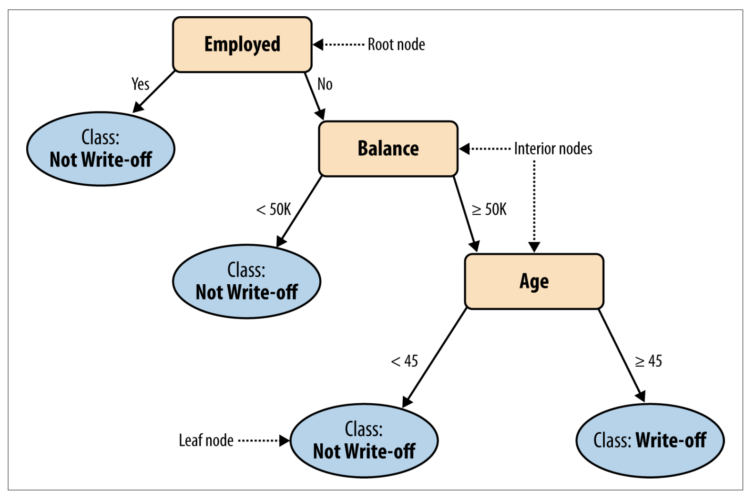
Lecture
Sample Decision Tree
2
2 – 27

Slide 28
Lecture
Overfitting – A Common Pitfall
2
Deep trees may fit the training data too well but Performs poorly on new, unseen data
Too specific to training data
Poor generalization
False sense of performance
Solution:
Use validation data
Prune trees
Apply complexity penalties
2 – 28

Slide 29
Lecture
When to Stop Splitting
2
Prevent Overfitting
Stop tree growth when:
  Nodes are too small
  Splits don’t improve prediction
  Maximum depth is reached
  Or use post-pruning to cut back a large tree
Simpler trees are often more robust
2 – 29

Slide 30
Lecture
Visualizing a Decision Tree
2
Example:
A Map of Predictive Segmentation
Tree diagrams show:
  Nodes = decision points
  Branches = attribute-based splits
  Leaves = predictions
Contract Type = Monthly?
Yes
No
High Churn
Customer Service Calls >3?
Yes
No
High Churn
Low Churn
2 – 30

Slide 31
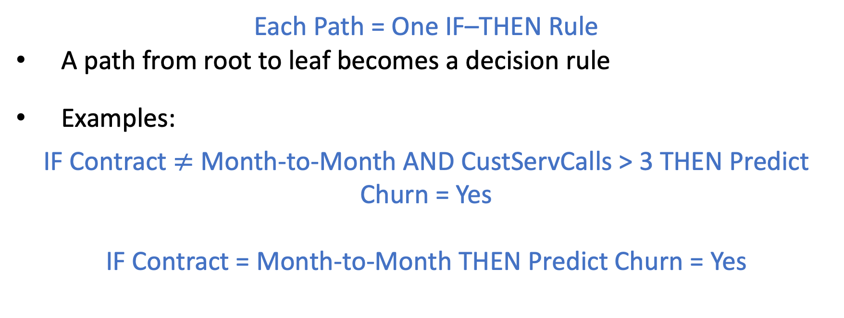
Lecture
Trees as Sets of Rules
2
Each Path = One IF–THEN Rule
A path from root to leaf becomes a decision rule
Examples:
IF Contract $≠$ Month-to-Month AND CustServCalls > 3 THEN Predict Churn = Yes
IF Contract = Month-to-Month THEN Predict Churn = Yes
2 – 31

Slide 32
Benefits and Limitations of
Rule-Based Interpretation
Lecture
2
Benefits
Limitations
Can become large and complex
Deep trees are:
Harder to interpret
More prone to overfitting
May miss interactions that ensemble models can capture
Human-readable
Easy to explain to stakeholders
Easy to convert into:
Business logic
SQL filters
Operational policies
Helps in:
Auditing model logic
Regulatory compliance
Building trust in the model
Balance interpretability with performance needs
2 – 32

Slide 33
Beyond Classification – Estimating Probability
Lecture
2
Trees Don’t Just Say “Yes” or “No”
Leaves can output probabilities, not just labels
Based on training data in each leaf:
Example: 75 out of 100 customers in a leaf churned → Churn probability = 75%
Probabilistic predictions support risk-based decision-making
2 – 33

Slide 34
Lecture
Why Use Probabilities?
2
Probabilities allow businesses to act based on confidence, not just classification
Enables graded responses:
  90% churn → Offer retention deal
  10% churn → No action needed
Useful for:
Prioritization
Cost-sensitive decisions
Marketing campaigns
2 – 34

Slide 35
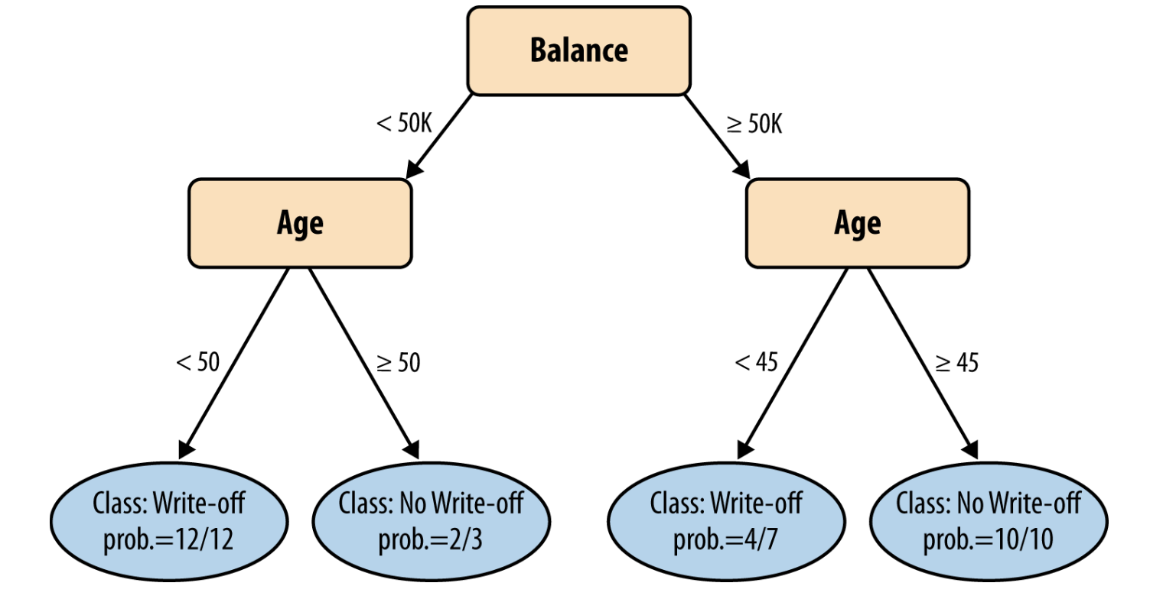
Example on Probabilities –
Which Loans to Write-off?
Lecture
2
New Customer, whose age is >45 and balance >50K
Based on model:
  What is the prediction?
  What is the probability?
2 – 35

Slide 36
Lecture
How Trees Estimate Probability
2
Probability estimates from trees are easy to interpret and use
Estimate = Proportion of class labels in the leaf
Can be improved with:
  Laplace correction (smoothing)
  Pruning to ensure stable estimates
Important: More training data in the leaf → More reliable probabilities
2 – 36

Slide 37
Case Study – Steps to Predict Customer Churn
Lecture
2
Applying a Decision Tree Model
Business Problem:
“Which customers are likely to cancel their service?”
Steps Followed:
Collected historical customer data
Labeled churn outcomes (Yes/No
Selected predictive attributes
Built a decision tree
Used tree to estimate churn risk
2 – 37

Slide 38
Understanding Results from the Tree Model
Lecture
2
Example prediction for New Customer:
“Customer A” has a 73% probability of churn
Segment defined by:
  Month-to-month contract
  3 customer service calls
  High monthly charge
Interpretation:
  This customer is at high risk → trigger retention strategy
  Good starting point, but evaluate business impact too
2 – 38

Slide 39
Lecture
Business Implications
2
Decision trees help bridge analytics and operational action
Turning Predictions Into Action:
  Prioritize outreach to high-risk segments
  Customize retention offers (e.g., loyalty incentives)
  Track model performance over time
2 – 39

Slide 40
Lecture
Key Points
2
Predictive modeling supports forward-looking business decisions
Supervised segmentation divides data into meaningful subgroups
Informative attributes reduce uncertainty about outcomes
Decision trees are:
Interpretable
Easy to deploy
Powerful for classification and probability estimation
2 – 40

Slide 41

For Discussion Panel and Next Lecture:
Use the open-source Telco Customer Churn dataset available on Kaggle.
Calculate Information Gain for each attribute and identify the most informative attribute(s)
Visualize the Decision Tree Model
Lecture
2
For Discussion Panel and Next Lecture
2 – 41

Slide 42



Thank You

