Slide 1


Developing KPIs to Measure
Healthcare Systems
Prepared by Dr. Abdulaziz Alsaedi
MHA611
Healthcare Systems
Lecture 06

Slide 2

Outlines:
Overview of information in healthcare.
Definitions and concepts of the key performance indicators (KPIs).
Benefits of KPIs.
Characteristics of KPIs.
Forms of KPIs.
Types of KPIs.
Six Steps of developing KPIs.

Slide 3

Chapter
Learning Objectives
06
Understanding the importance of information in the healthcare industry.
Understanding the role of KPIs in measuring healthcare performance.
Understanding many concepts of KPIs.
Understanding how KPIs are developed, measured, and reported.

Slide 4

Chapter
Overview
06
Health is information-intensive, generating huge volumes of data every day.
It is estimated that up to 30% of the total health budget may be spent one way or another on handling information, collecting it, looking for it, and storing it.
It is therefore imperative that information is managed in the most effective way possible in order to ensure a high-quality, safe service.
Safe, reliable, healthcare depends on access to, and the use of, information that is accurate, valid, reliable, timely, relevant, legible and complete.
Health information has a key role to play in healthcare planning.

Slide 5
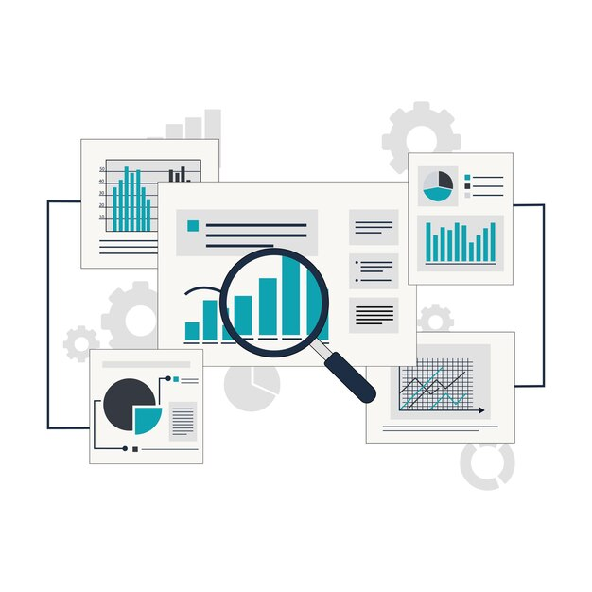
Chapter
Overview
06
Performance measurement promotes accountability to all stakeholders including the public, service users, clinicians and the Government by facilitating informed decision-making and safe, high quality and reliable care through monitoring, analyzing and communicating the degree to which healthcare organizations meet key Goals.
Accurate performance measurement is dependent on information that is of good quality and comparable and can be shared within the health sector.
KPIs play an important role in the performance measurement process by helping to identify and appropriately measure levels of service performance.

Slide 6

Chapter
06
Developing KPIs to Measure Healthcare Systems
What is a Key Performance Indicator?

Slide 7

Chapter
06
Developing KPIs to Measure Healthcare Systems
What is a KPI?
Key performance indicators, or KPIs, are the elements of your organization’s plan that express the quantitative outcomes you seek and how you will measure success.
Key Performance Indicator (KPI) is a quantifiable metric used to track progress towards a specific business objective.
KPIs help organizations measure and evaluate their success in achieving strategic goals.
While all KPIs are metrics, not all metrics are KPIs. KPIs are strategic metrics tied to specific goals, while metrics can measure any aspect of business performance without necessarily being critical to strategic objectives.

Slide 8
Chapter
06
Developing KPIs to Measure Healthcare Systems
KPIs vs Metrics:
Although they are both designed to measure performance, KPIs and metrics have different characteristics and are used by businesses in different ways.
Metrics are measures used to track progress and evaluate success, while KPIs are metrics tied to specific goals during a certain period of time.
KPIs are designed to align with business goals and targets, while metrics evaluate the performance of particular processes.
Metrics are usually specific to a particular person or team and frequently align with industry standards or best practices.

Slide 9
Chapter
06
Developing KPIs to Measure Healthcare Systems
KPIs vs Metrics:
 | Metrics | Key Performance Indicators
Linkage to Objectives | No link with any objective | Directly linked with objectives
Purpose | Rarely provide any significant notification | Feedback on reaching targets
Number of KPIs | Unlimited | limited

Slide 10
Chapter
06
Developing KPIs to Measure Healthcare Systems
Benefits of KPIs:
Realize the direction and common goal.
Optimal use of time, energy and resources.
Make the right strategic decisions at all levels proactively and not reactively.
Reduce variation in the system.
Enhance reputation and trust among stakeholders.
Improvement.
Planning and forecasting.
Competitiveness.
Rewards.
Compliance with regulations and standards.

Slide 11
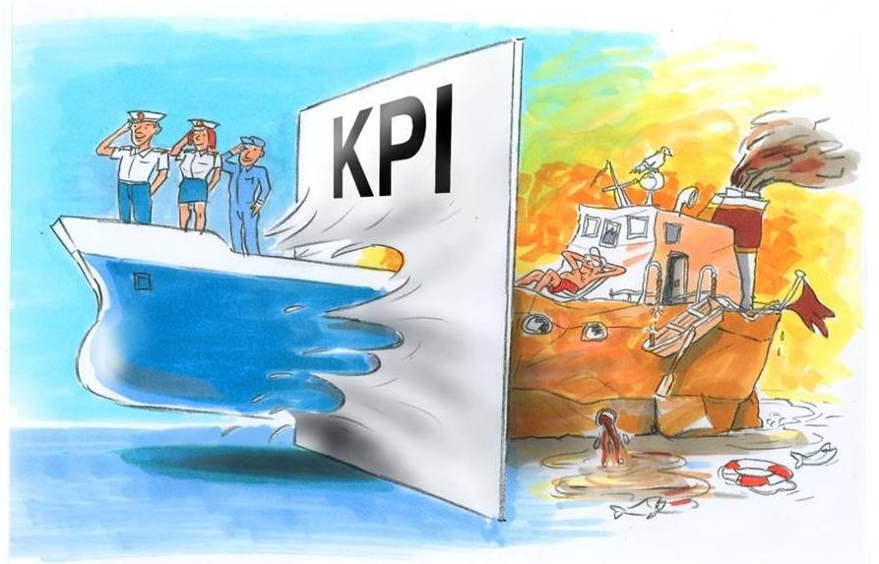
Chapter
06
Developing KPIs to Measure Healthcare Systems
Benefits of KPIs

Slide 12
Chapter
06
Developing KPIs to Measure Healthcare Systems
Main Functions of KPIs

Slide 13

Chapter
06
Developing KPIs to Measure Healthcare Systems
Main Functions of KPIs:
1. Monitoring
KPIs (Key Performance Indicators) are widely used for monitoring organizational performance.
They serve as quantifiable metrics that help businesses track progress toward specific goals and objectives.
Monitoring is done through data collection, data visualization, and regular review.

Slide 14

Chapter
06
Developing KPIs to Measure Healthcare Systems
Main Functions of KPIs:
2. Improvement
KPIs (Key Performance Indicators) are widely used for improvement in organizations.
They serve as essential tools for measuring, monitoring, and driving improvements in various aspects of business operations.
Improvement is done by identifying areas for improvement, setting improvement targets, and driving continuous improvement.

Slide 15

Chapter
06
Developing KPIs to Measure Healthcare Systems
Main Functions of KPIs:
3. Communication
Communicating or disseminating KPIs can be done through the following:
Top-down communication.
Bottom-up communication.
Horizontal communication.
Cross-departmental sharing.

Slide 16
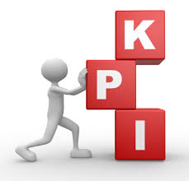
Chapter
06
Developing KPIs to Measure Healthcare Systems
Characteristics of KPIs:
Measurable
Quantitative
Directly linked to the goals

Slide 17
Chapter
06
Developing KPIs to Measure Healthcare Systems
Characteristics of KPIs:
Measurable:
Measurable KPIs are quantifiable metrics that can be objectively tracked and evaluated.
Quantitative:
KPIs should be represented quantitatively not qualitatively.
Directly linked to the goals:
KPIs should be developed to measure the progress toward achieving certain goals.

Slide 18
Chapter
06
Developing KPIs to Measure Healthcare Systems
Forms of KPIs:
Number
KPIs come in various forms, including numbers, ratios, percentages, ordinal values, or even classification.
Therefore, choosing the appropriate format is crucial to track the progress towards strategic and operational objectives.
An objective can be measured with more than one form, if necessary.
Ratio
Percentage
Ordinal
Classification

Slide 19

Chapter
06
Developing KPIs to Measure Healthcare Systems
Types of KPIs:
KPIs can be categorized into various types based on their characteristics and applications.
Each category has been defined from a different perspective/view.
Each category has its own characteristics, time frame, and level of business that is likely to use it.
Different KPIs may also be used by different departments within the same business.

Slide 20
Chapter
06
Developing KPIs to Measure Healthcare Systems
Types of KPIs:
Strategic
Operational
Classification 1
Projects
Employees
Risks

Slide 21
Chapter
06
Developing KPIs to Measure Healthcare Systems
Types of KPIs:
Exercise:
Give an example for each of the previously mentioned classifications.

Slide 22
Chapter
06
Developing KPIs to Measure Healthcare Systems
Types of KPIs:
Key Results Indicators
Results Indicators
Classification 2
Performance Indicators
Key Performance Indicators

Slide 23
Chapter
06
Developing KPIs to Measure Healthcare Systems
Types of KPIs:
Exercise:
Give an example for each of the previously mentioned classifications.

Slide 24
Chapter
06
Developing KPIs to Measure Healthcare Systems
Types of KPIs:
Lagging
Classification 3
Leading

Slide 25
Chapter
06
Developing KPIs to Measure Healthcare Systems
Types of KPIs:
Leading vs Lagging Indicators
A Leading indicator (or leading KPI) is a measure that signals future changes. It is predictive in nature and offers a glimpse of the company's future performance. For example, the number of new leads obtained by a sales team is a leading indicator, as it predicts future sales.
A Lagging indicator (or lagging KPI), on the other hand, is a measure of past performance. It reflects the results obtained by the company following the actions taken. For example, last quarter's sales are a lagging indicator, because they measure the results of efforts made in the past.

Slide 26
Chapter
06
Developing KPIs to Measure Healthcare Systems
Types of KPIs:
Exercise:
Give an example for each of the previously mentioned classifications.

Slide 27
Chapter
06
Developing KPIs to Measure Healthcare Systems
Types of KPIs:
Constant
Classification 4
Changeable

Slide 28
Chapter
06
Developing KPIs to Measure Healthcare Systems
Types of KPIs:
Exercise:
Give an example for each of the previously mentioned classifications

Slide 29
Chapter
06
Developing KPIs to Measure Healthcare Systems
Developing KPIs

Slide 30
Chapter
06
Developing KPIs to Measure Healthcare Systems
Description of desired results
Identify alternative KPIs
Choose the right KPI
KPIs development steps
Determine the composite KPI
Setting targets and Thresholds
Documenting KPIs

Slide 31

Chapter
06
Developing KPIs to Measure Healthcare Systems
Step One: Description of desired results
Clearly identify the final results you aim to achieve.
Results are the determinant of success.
KPI should be directly linked to the desired results.
At least one KPI for each desired result.
At least one result for each objective.
More results mean more KPIs.

Slide 32

Chapter
06
Developing KPIs to Measure Healthcare Systems
Step Two: Identify alternative KPIs
Having more KPIs for the same objective is helpful.
There are many tools to identify alternative KPIs.
Using tools is essential to come up with alternative KPIs.
Selecting KPIs out of these alternatives is based on certain criteria.
Using more tools means identifying more alternative KPIs.

Slide 33
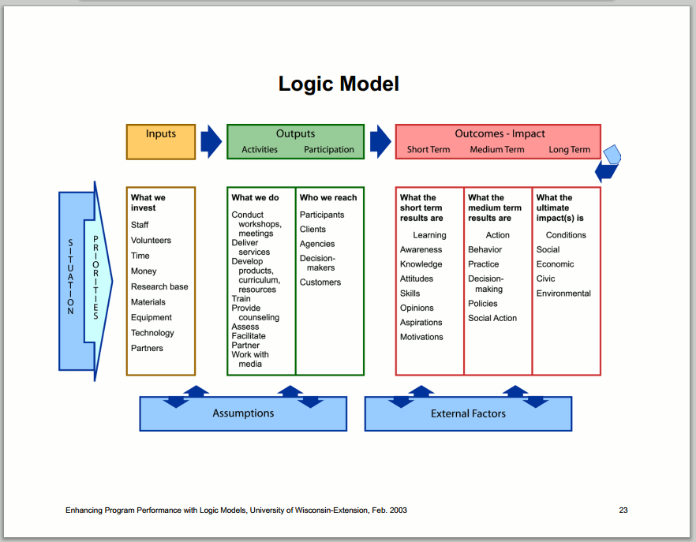
Chapter
06
Developing KPIs to Measure Healthcare Systems
Step Two: Identify alternative KPIs
Flow Process Analysis
Logic Model
Fishbone Diagram

Slide 34

Chapter
06
Developing KPIs to Measure Healthcare Systems
Step Three: Choose the right KPI:
Relevant
Alternative KPIs need to be compared to select the most suitable KPIs.
There are sets of criteria to fairly assess alternative KPIs.
The aim of this step is to minimize the number of KPIs as much as possible.
Fewer KPIs are best.
Clear
Economic
Measurable
Adequate

Slide 35
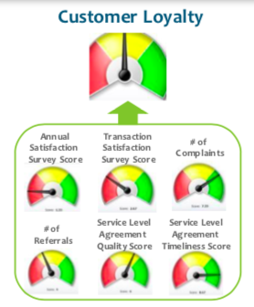
Chapter
06
Developing KPIs to Measure Healthcare Systems
Step Four: Determine the composite KPI
A composite indicator combines two or more data sources into a single measure.
A composite indicator is often used for measuring results that are multidimensional in nature.

Slide 36
Chapter
06
Developing KPIs to Measure Healthcare Systems
Step Five: Setting Targets and Thresholds
Targets are the desired level of performance for a specific reporting period.
Thresholds are the upper and lower limits of desired performance around a target value.

Slide 37
Chapter
06
Developing KPIs to Measure Healthcare Systems
Step Five: Setting Targets and Thresholds
There are many ways to set targets, such as:
Requirements
Benchmarking
Baseline
Targets should be reviewed periodically against actual performance and adjusted when needed.

Slide 38
Chapter
06
Developing KPIs to Measure Healthcare Systems
Step Six: Documenting KPIs
Documenting KPIs helps clearly define what success looks like for the organization.
It ensures everyone understands the specific objectives and how performance will be measured.
Documented KPIs provide concrete metrics that can be consistently measured over time.
This allows organizations to track progress and identify trends.
It enables comparison against targets and benchmarks.
It helps hold individuals and teams accountable for their performance.
Proper documentation ensures KPIs are measured consistently over time.
It defines how data should be collected and analyzed.

Slide 39

Chapter
06
Developing KPIs to Measure Healthcare Systems
Step Six: Documenting KPIs
KPI Profile should include:
Related objective and its Owner.
KPI title and its description.
KPI owner.
Where KPI data will be collected.
When KPI data will be collected.
How KPI data will be analyzed and reported.
To whom KPI analyzed data will be reported.

Slide 40
Chapter
Summary
06
KPIs are measurable, quantitative, and linked to goals.
KPIs can be numbers, ratios, percentages, ordinal, and classification.
KPIs can be classified into Leading and Lagging indicators.
KPIs are used for monitoring, improvement, and communication.
There are six steps for developing KPIs.
There are many tools to develop alternative KPIs.
Selecting the right KPIs should based on certain criteria.
KPIs should be documented.

Slide 41



Thank You

Slide 42
Chapter
References:
06
Wang, H. (2016). Comparative Health Systems: A Global Perspective. In International Encyclopedia of Public Health. Jones & Bartlett Learning. https://doi.org/10.1016/B978-0-12-803678-5.00085-0
Rivki, M., Bachtiar, A. M., Informatika, T., Teknik, F., & Indonesia, U. K. (2013). healthcare Systems Around The World (Issue 112).
Will, K. K., Mutyala, J., & Essary, A. C. (2023). Health Systems Science. Jaapa, 36(6), 45–46. https://doi.org/10.1097/01.jaa.0000931464.13332.f1
https://www.mdclarity.com/glossary/social-insurance-bismarck-model
https://www.ahaap.org/out-of-pocket-model

