Slide 1
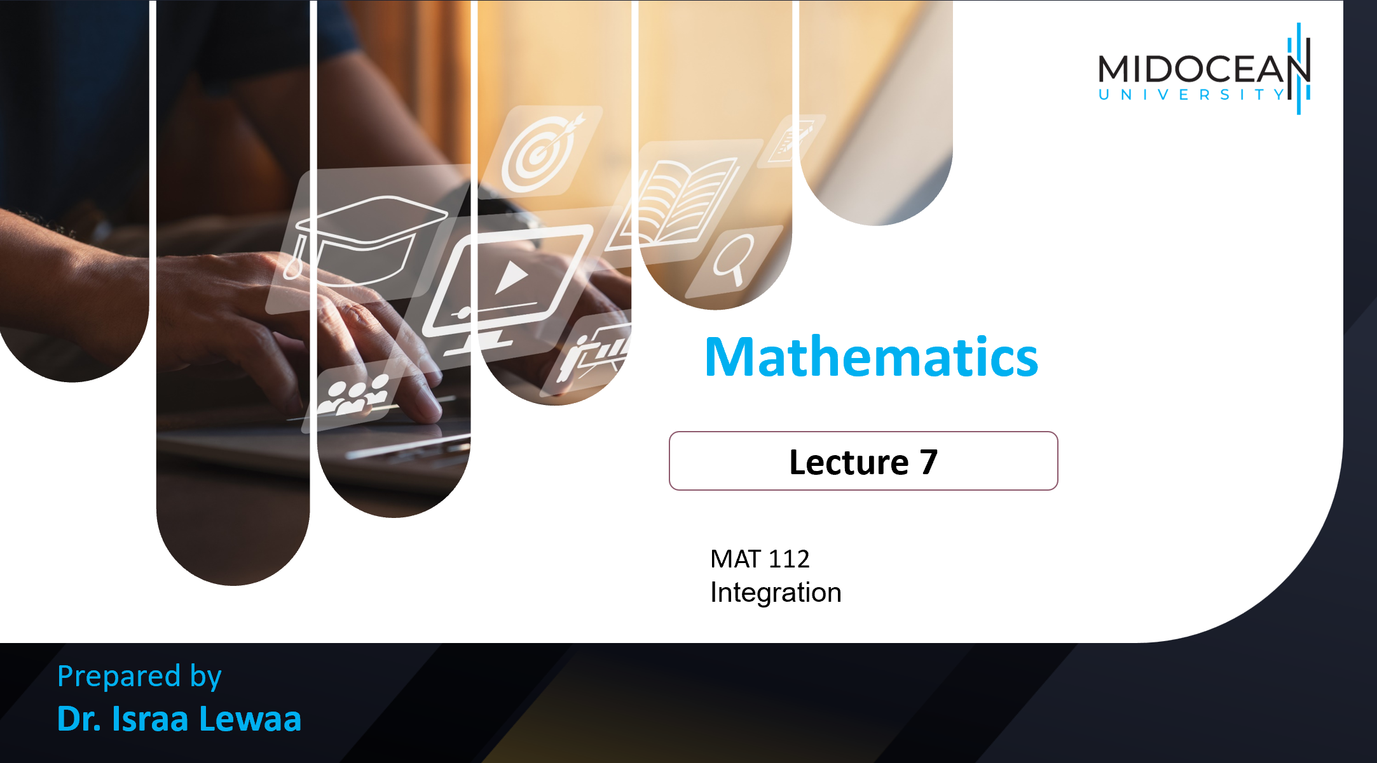
MAT 112
Integration

Slide 2

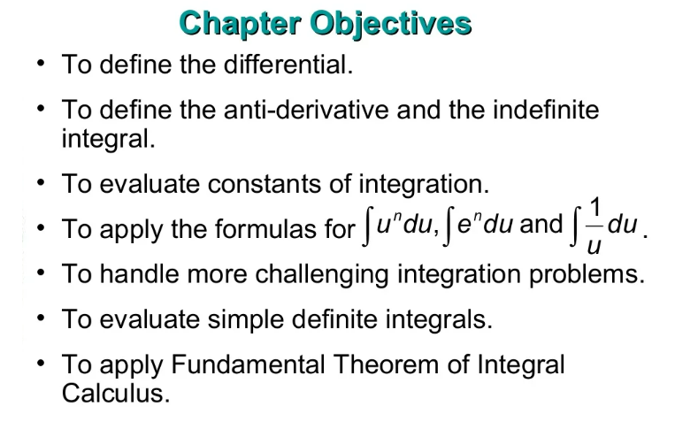
Lecture
07
Lecture Objectives

Slide 3
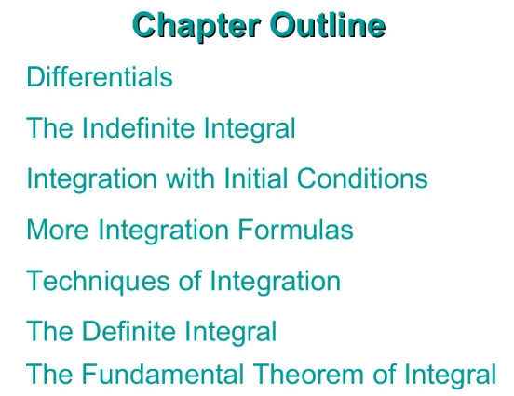
Lecture
07
Lecture Outline

Slide 4
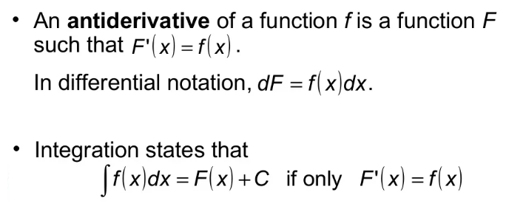
Lecture
07
1- The Infinite Integral

Slide 5
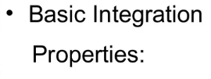
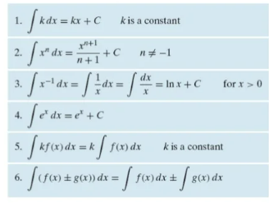
Lecture
07
2- Rules of Integration

Slide 6
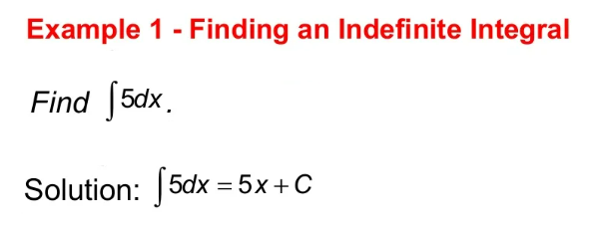
Lecture
04
Example

Slide 7
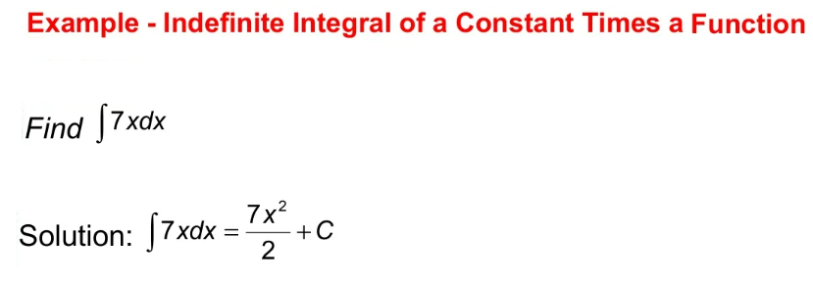
Lecture
07
Example

Slide 8
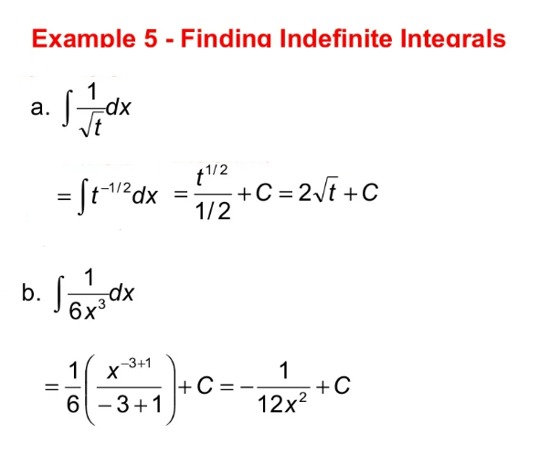
Lecture
07
Example

Slide 9
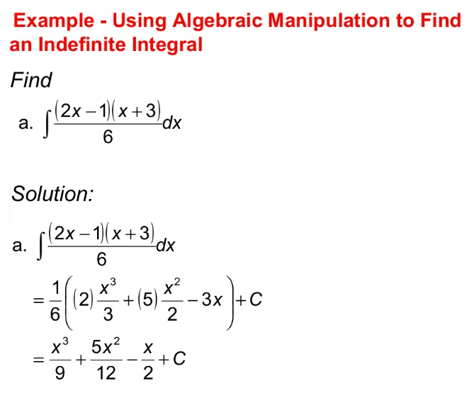
Lecture
07
Example

Slide 10
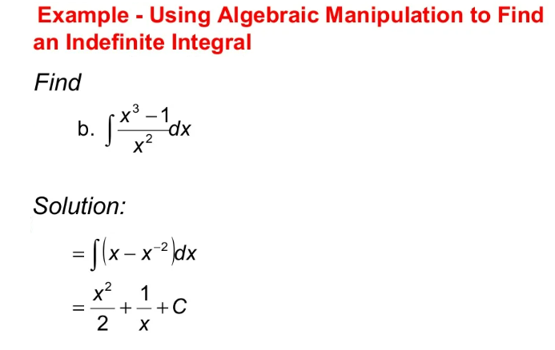
Lecture
07
Example

Slide 11
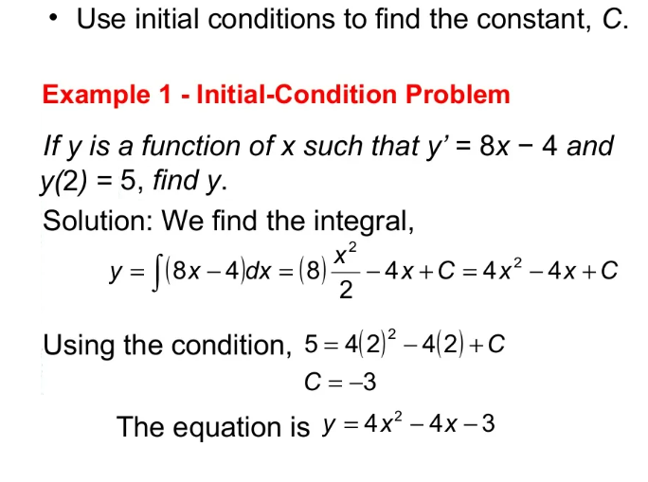
Lecture
07
3- Integration with initial Conditions

Slide 12
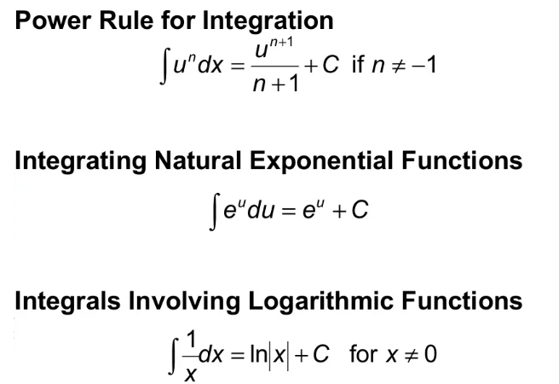
Lecture
07
4- More Integration Formulas

Slide 13
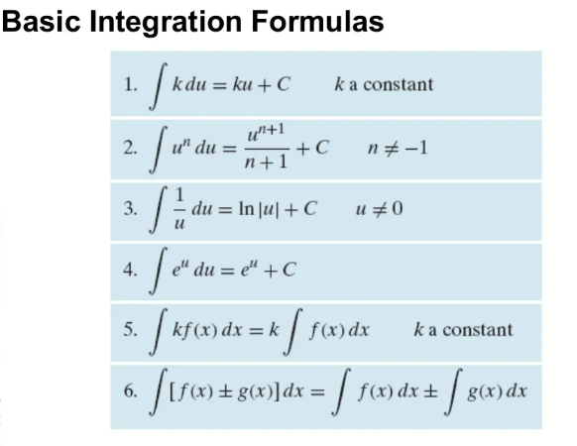
Lecture
07
Basic Integration Formulas

Slide 14
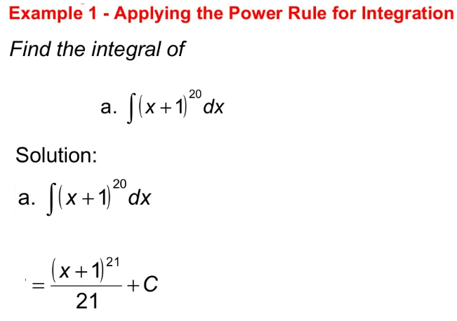
Lecture
07
Example

Slide 15
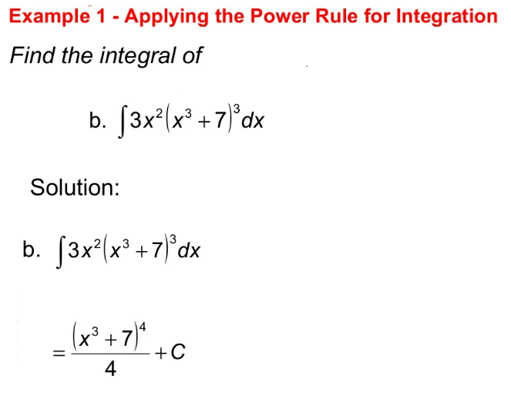
Lecture
07
Example

Slide 16
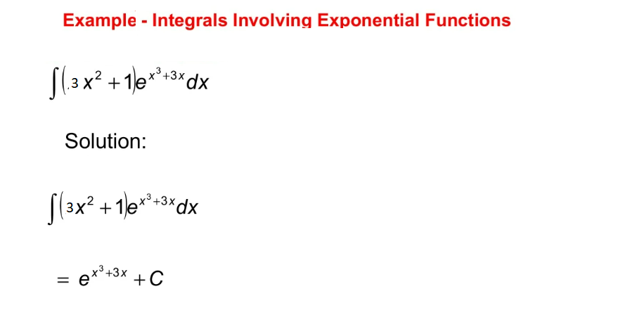
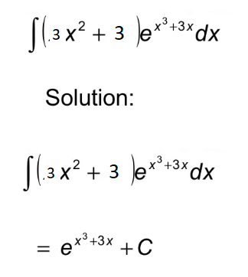
Lecture
07
Example

Slide 17
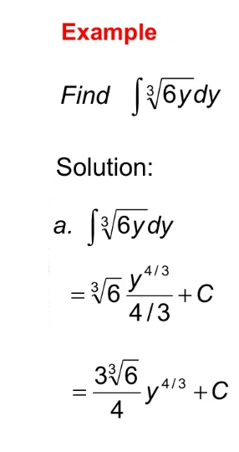
Lecture
07
Example

Slide 18
Lecture
07
5- Techniques on Integration

Slide 19
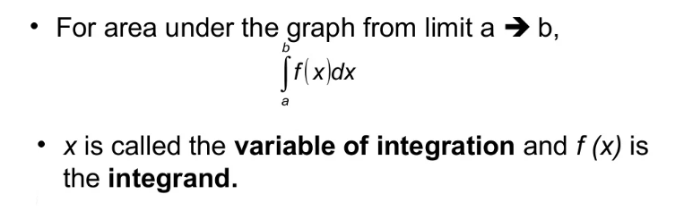
Lecture
07
6- The Definite Integral

Slide 20
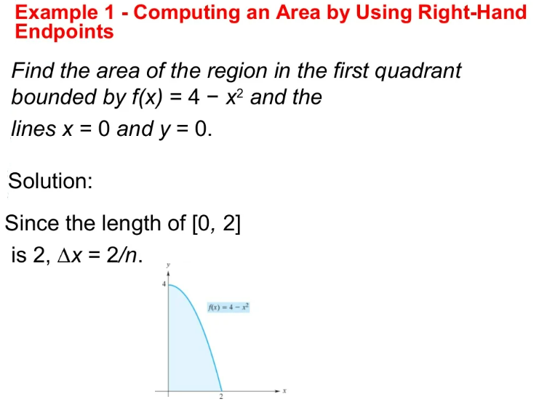
Lecture
07
Example

Slide 21
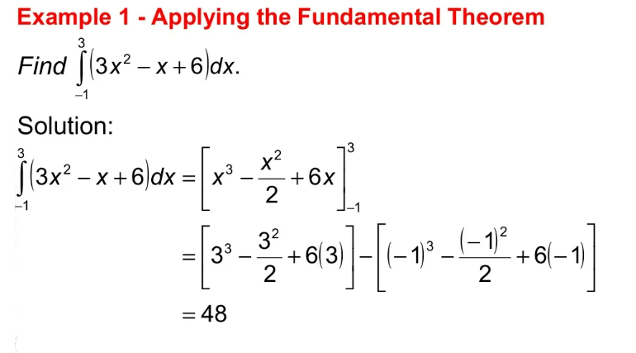
Lecture
07
Example

Slide 22
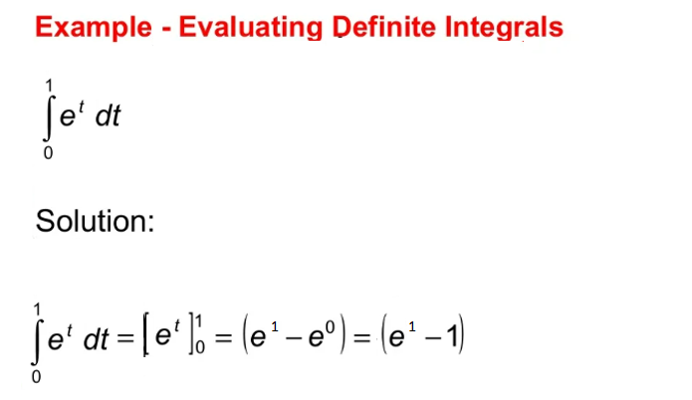
Lecture
07
** EXTRA PRACTISE

Slide 23
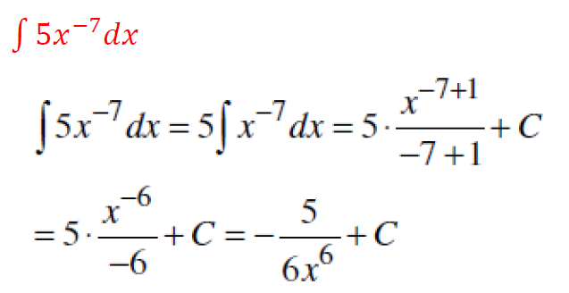
Lecture
07
** EXTRA PRACTISE

Slide 24
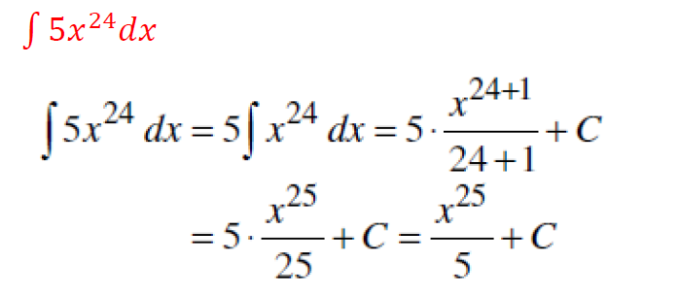
Lecture
07
** EXTRA PRACTISE

Slide 25
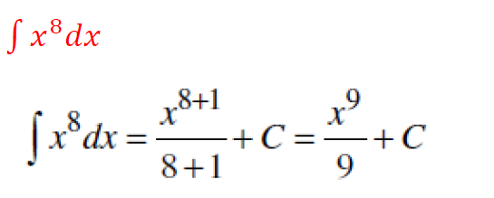
Lecture
07
** EXTRA PRACTISE

Slide 26
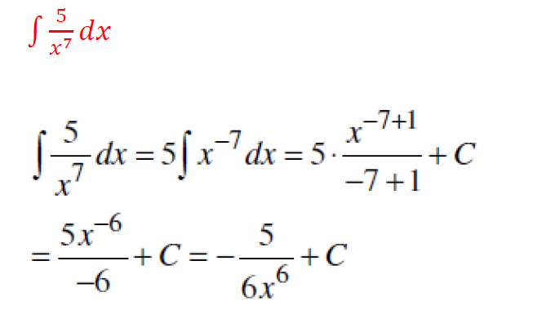
Lecture
07
** EXTRA PRACTISE

Slide 27
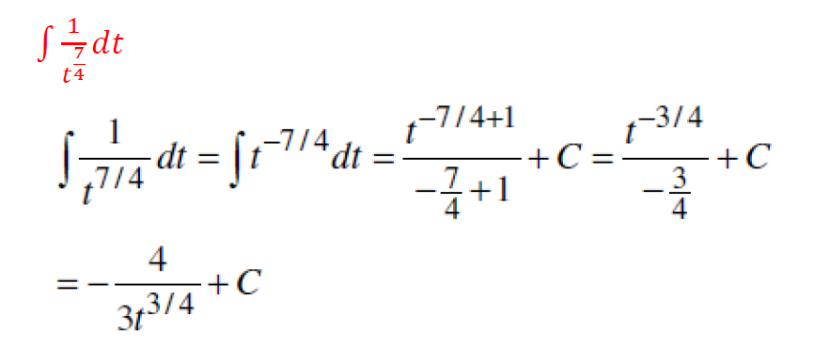
Lecture
07
** EXTRA PRACTISE

Slide 28
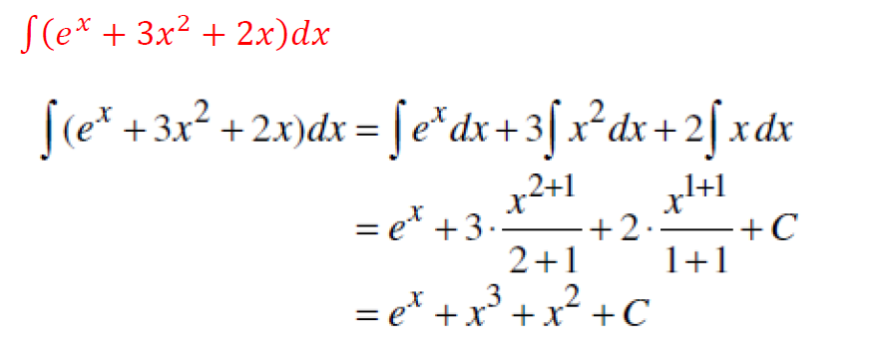
Lecture
07
** EXTRA PRACTISE

Slide 29
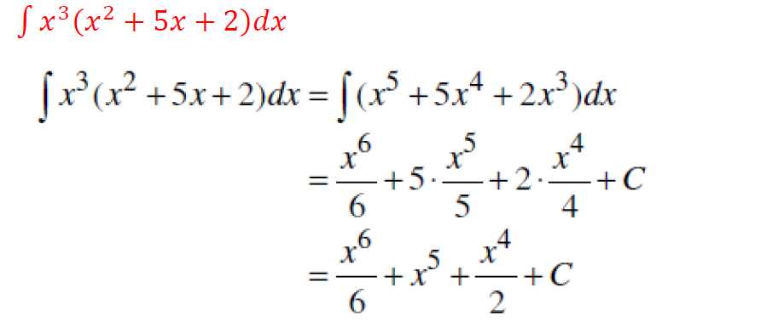
Lecture
07
** EXTRA PRACTISE

Slide 30
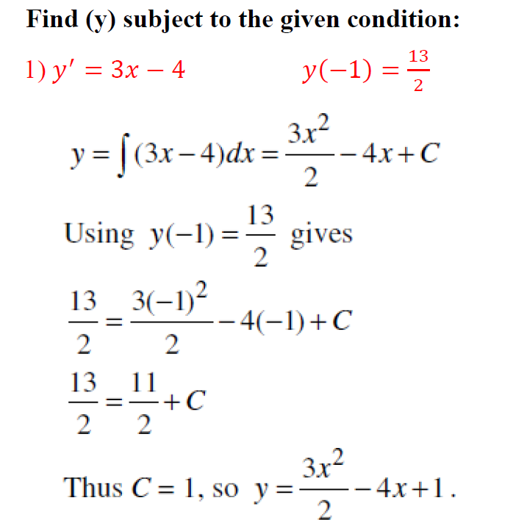
Lecture
07
** EXTRA PRACTISE

Slide 31
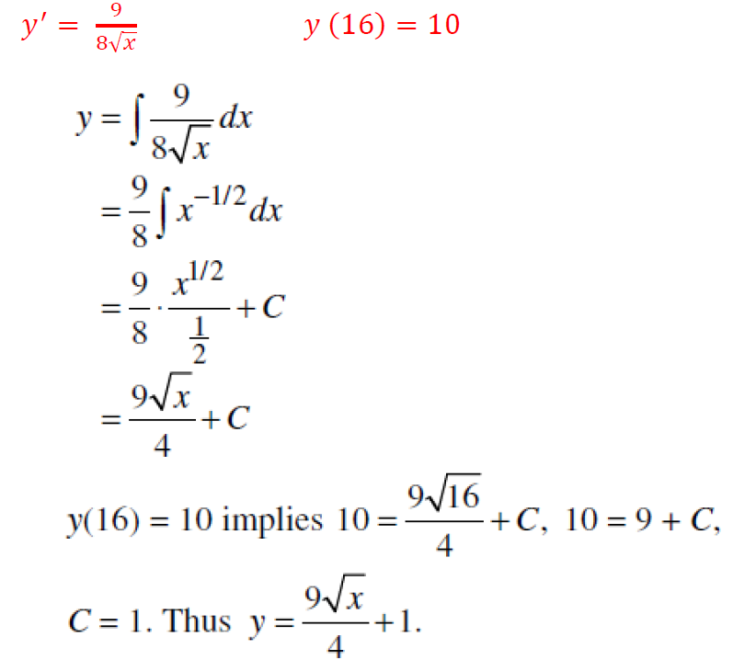
Lecture
07
** EXTRA PRACTISE

Slide 32
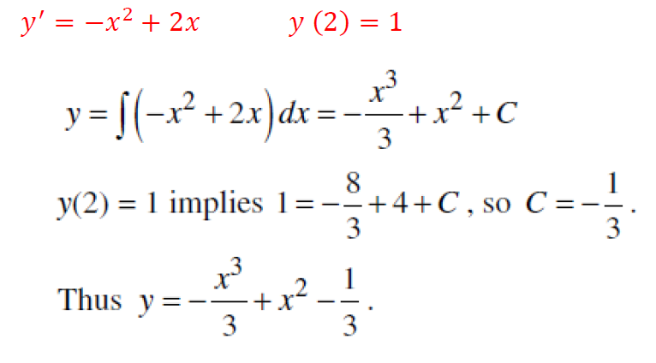
Lecture
07
** EXTRA PRACTISE

Slide 33
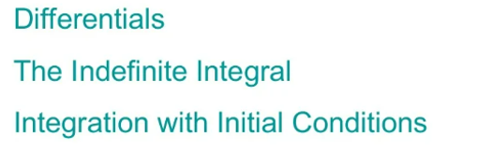
Lecture
07
Lecture Summary

Slide 34

Lecture
07
Lecture Summary

