Slide 1



Module 1: Networking
Today
Lecture 1
CCNA – Introduction to Networks V7.0 (ITN)
Prepared by
Dr. Abdelrhman Ahmed

Slide 2
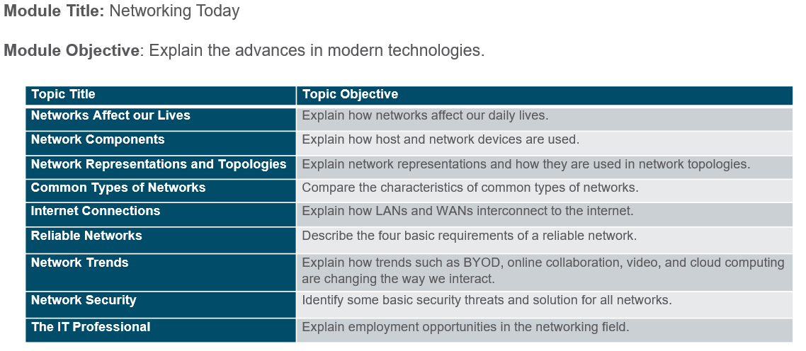
Chapter
Module Objectives
01

Slide 3

Chapter
Networking Today: Networks Connect Us
01
Communication is almost as important to us as our reliance on air, water, food, and shelter. In today’s world, using networks, we are connected like never before.
World without boundaries
Global communities
Human network

Slide 4
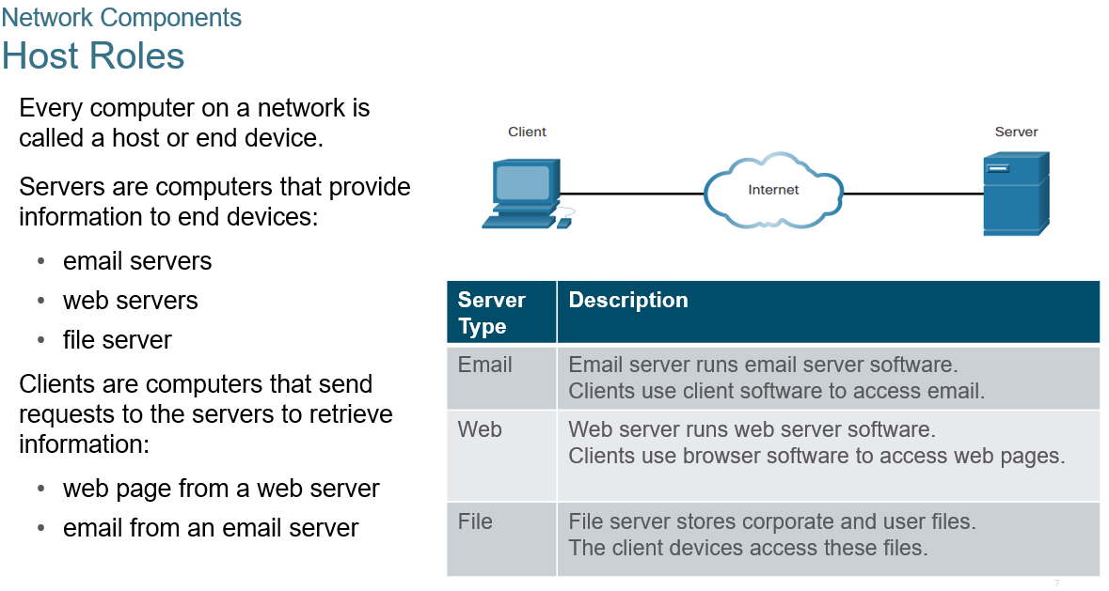
Chapter
Network Components
01

Slide 5
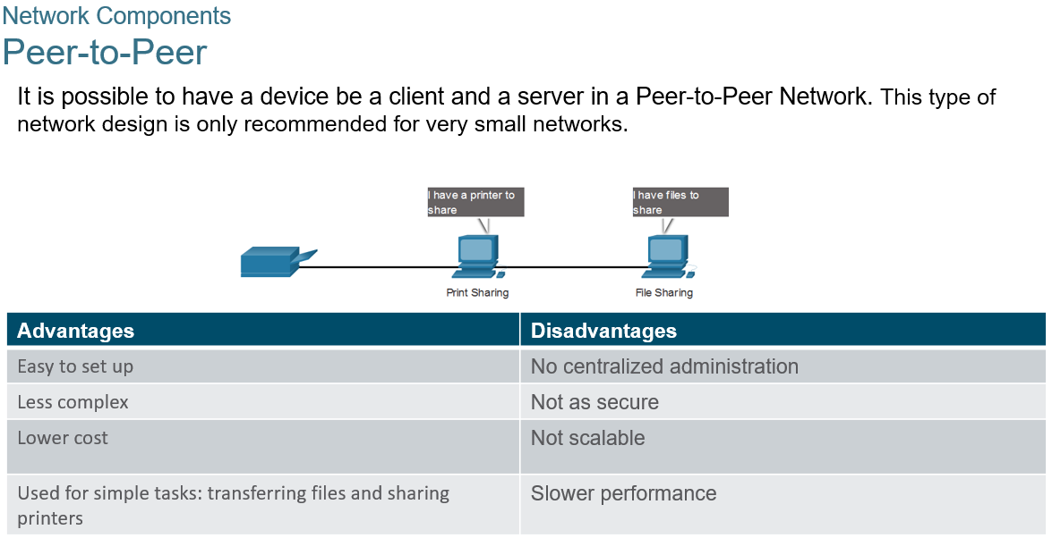
Chapter
Network Components
01

Slide 6
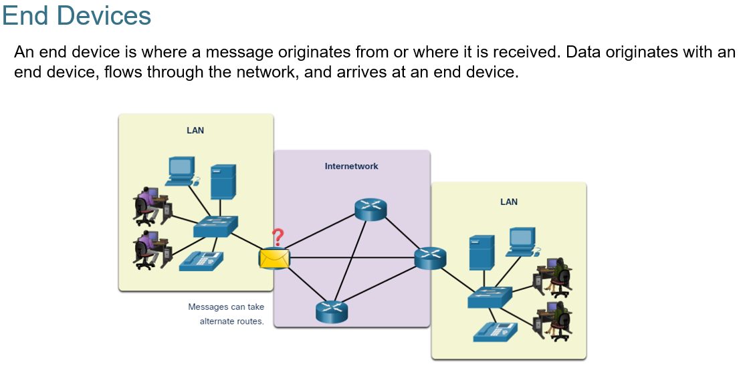
Chapter
Network Components
01

Slide 7
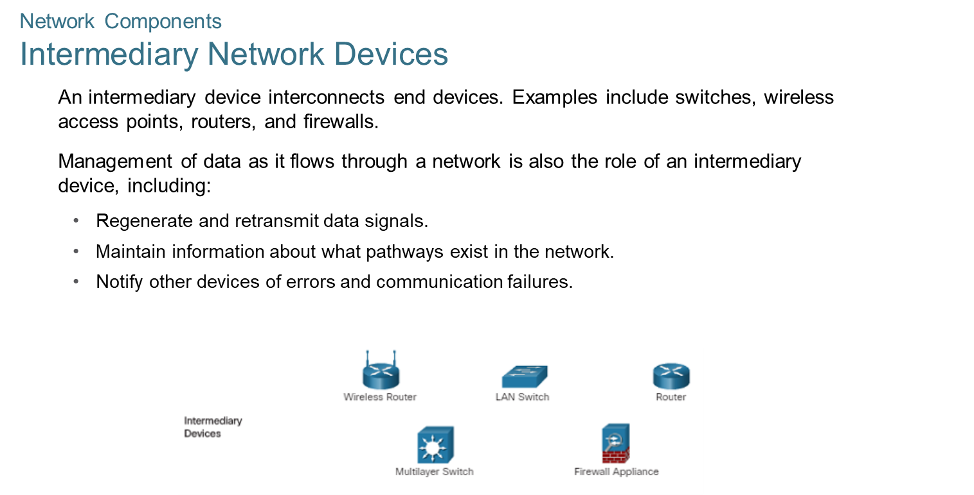
Chapter
Network Components
01

Slide 8
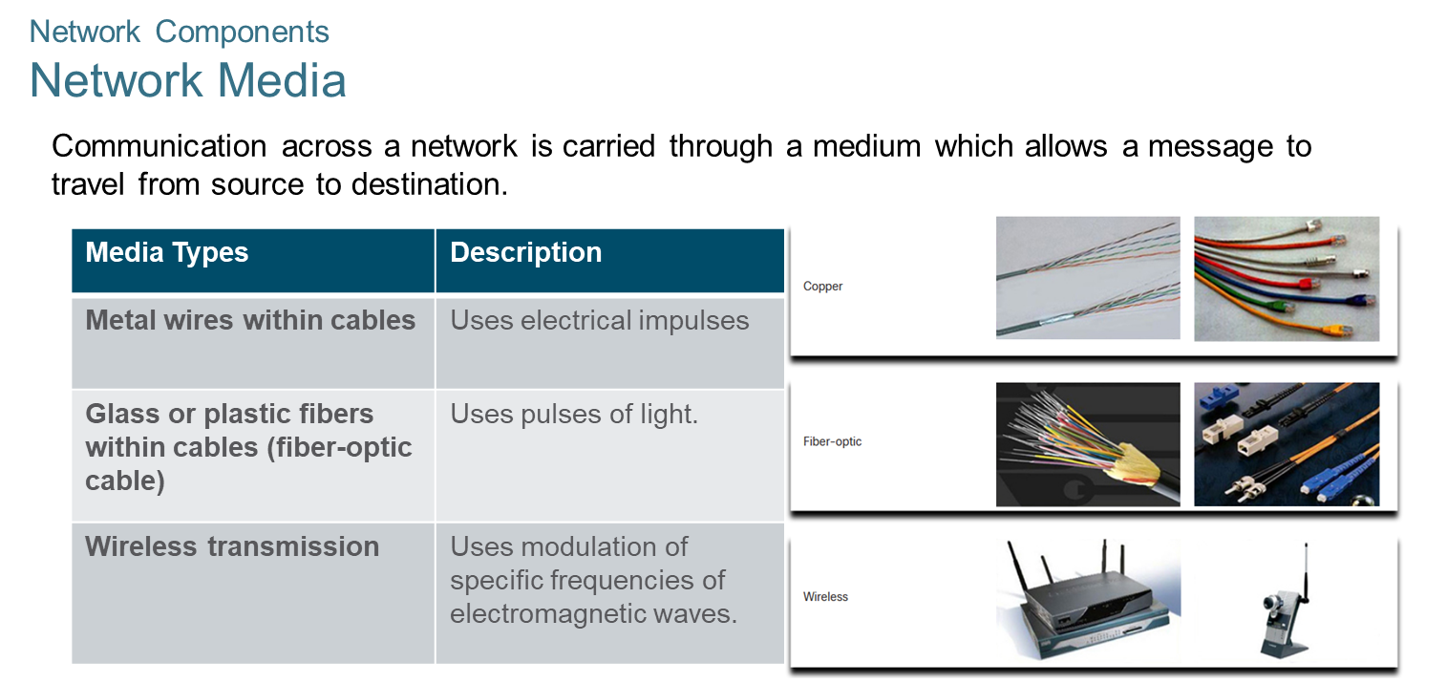
Chapter
Network Components
01

Slide 9
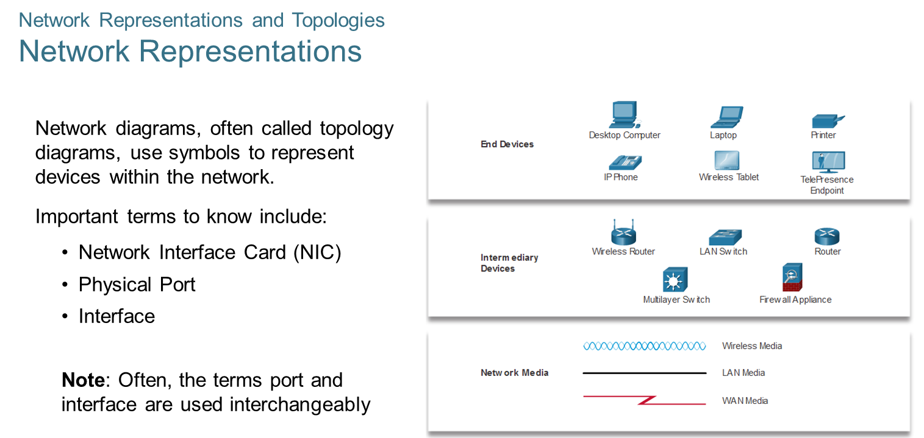
Chapter
Network Representations and Topologies
01

Slide 10
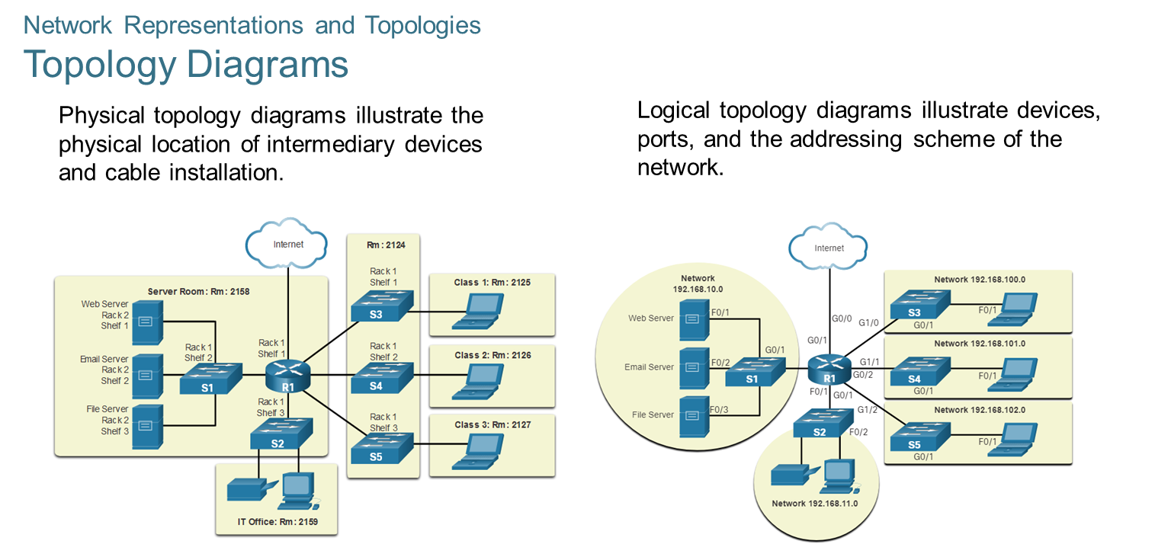
Chapter
Network Representations and Topologies
01

Slide 11
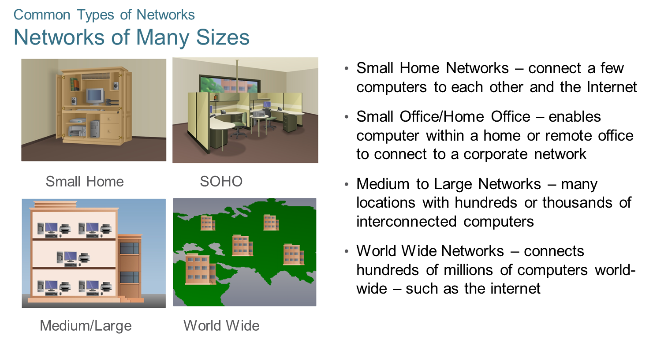
Chapter
Common Types of Networks
01

Slide 12
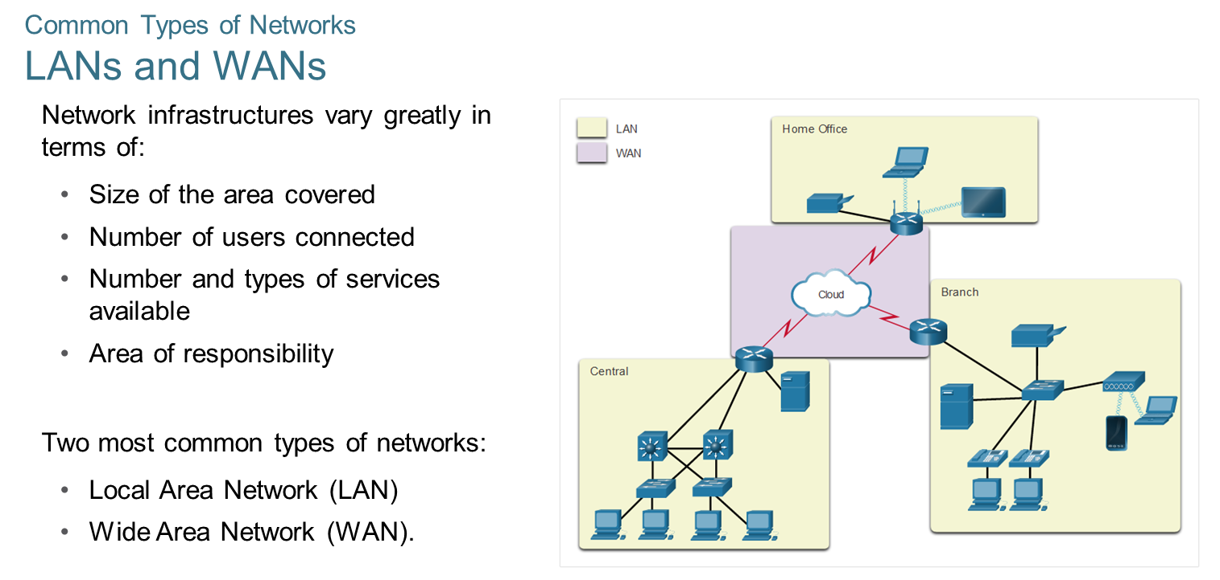
Chapter
01
Common Types of Networks

Slide 13
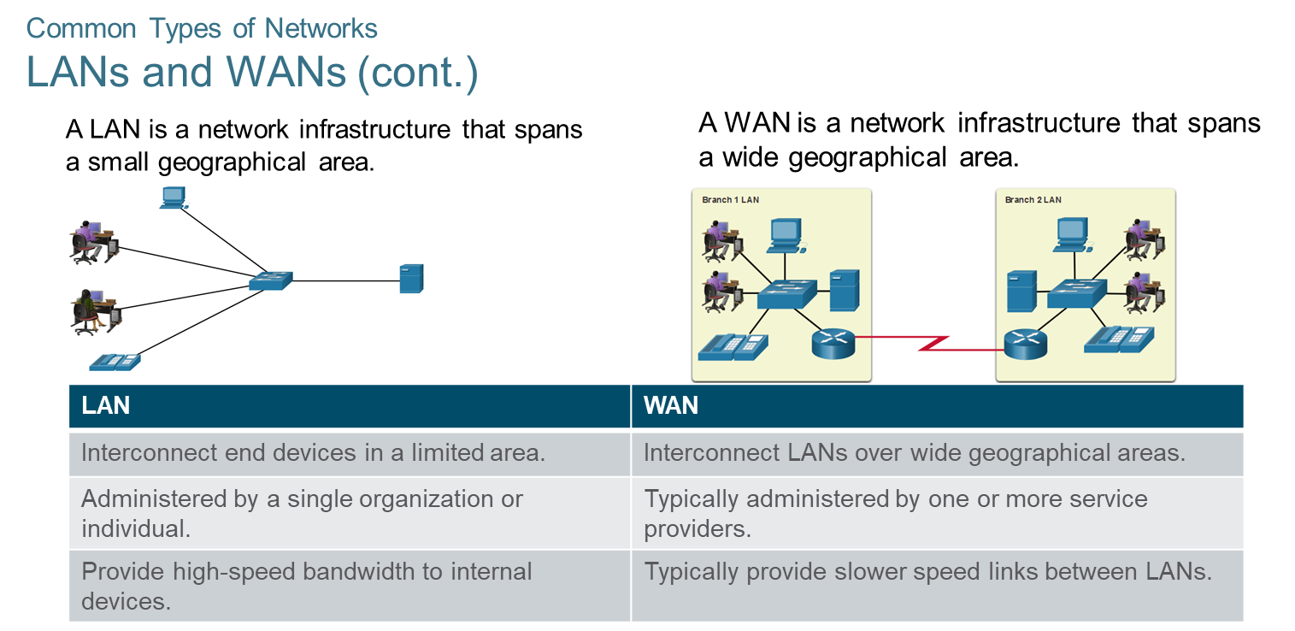
Chapter
Common Types of Networks
01

Slide 14
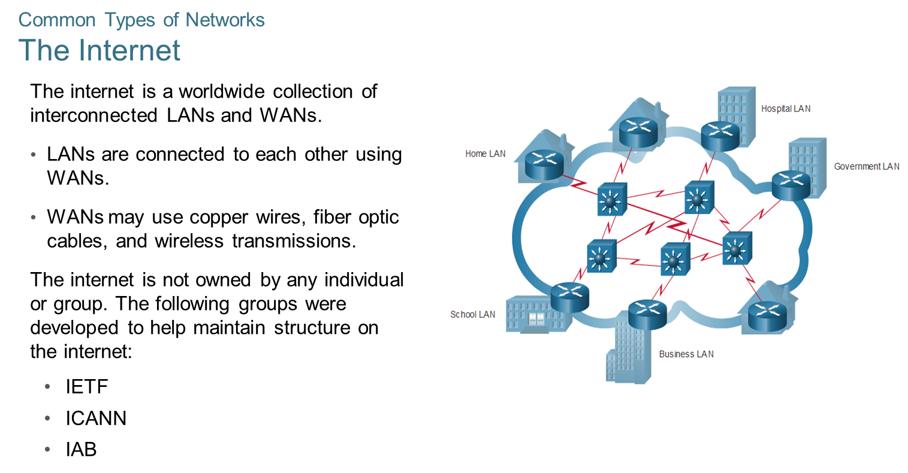
Chapter
Common Types of Networks
01

Slide 15
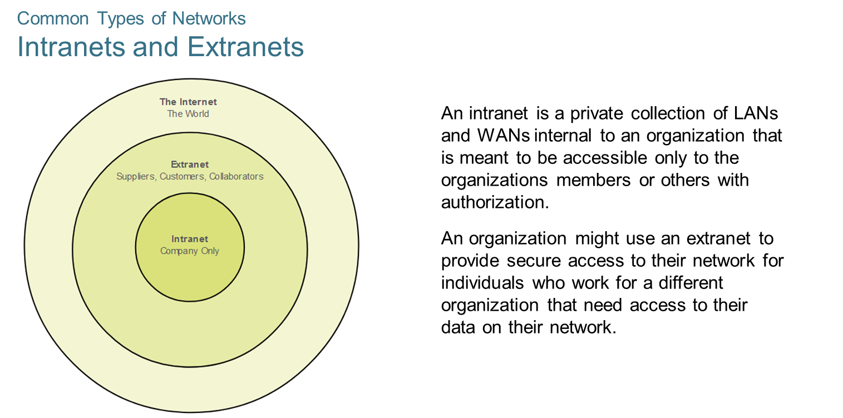
Chapter
Common Types of Networks
01

Slide 16
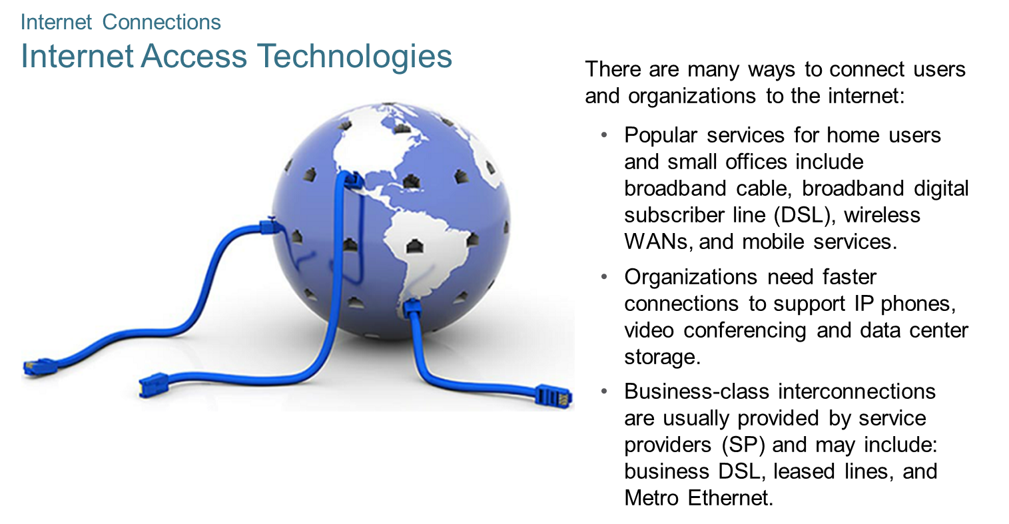
Chapter
Internet Connections
01

Slide 17
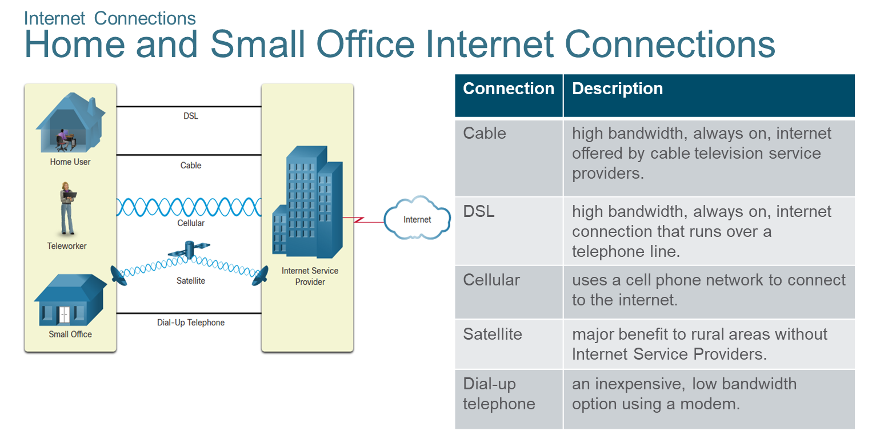
Chapter
Internet Connections
01

Slide 18
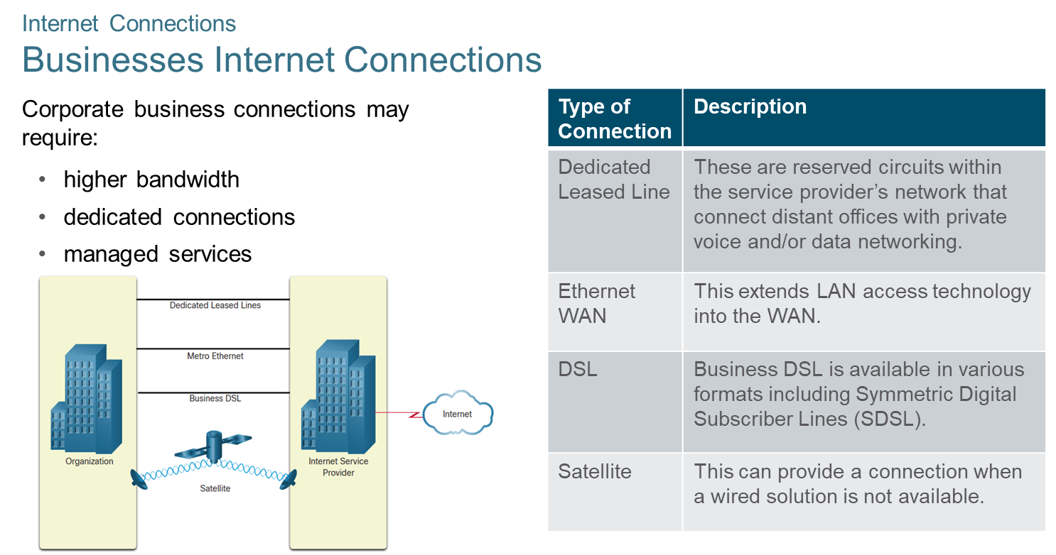
Chapter
Internet Connections
01

Slide 19
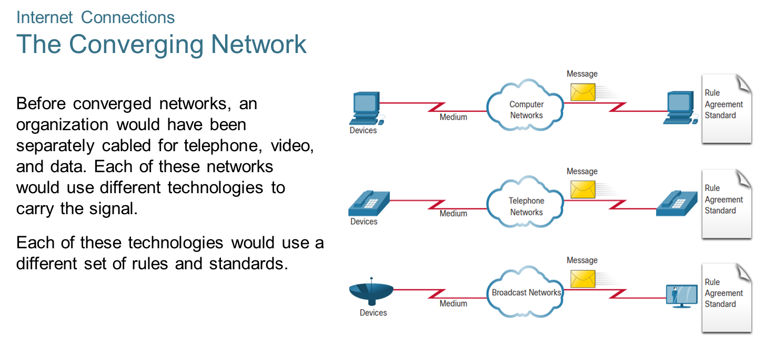
Chapter
Internet Connections
01

Slide 20
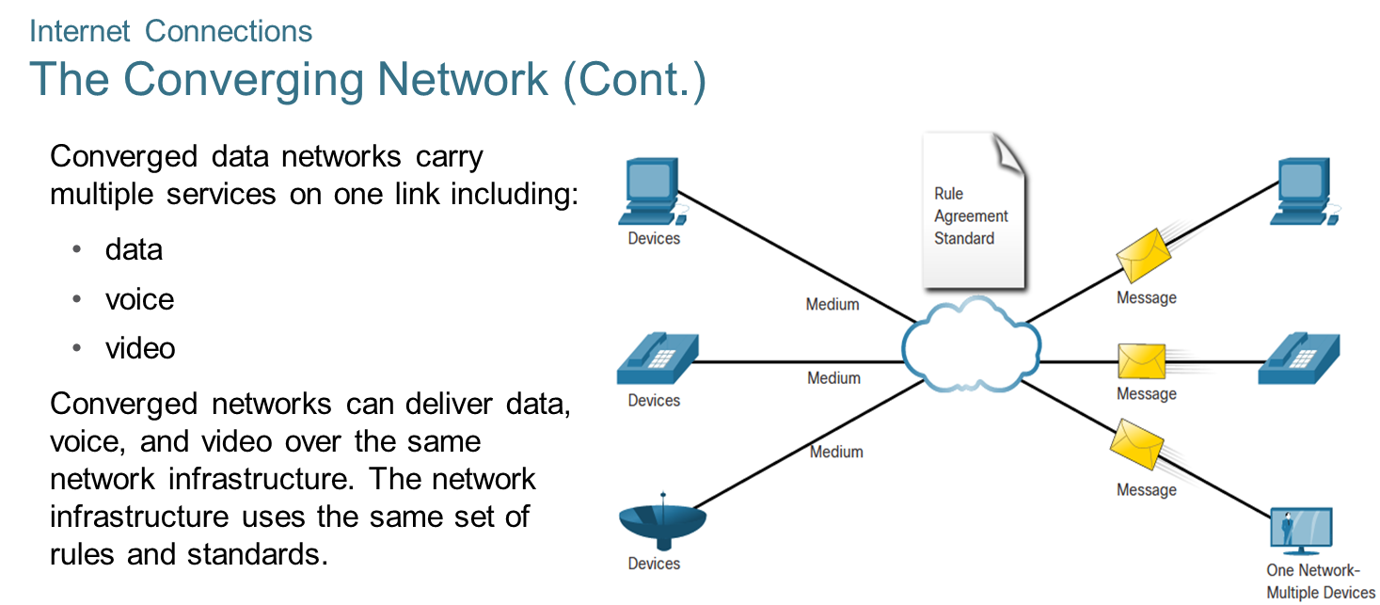
Chapter
Internet Connections
01

Slide 21
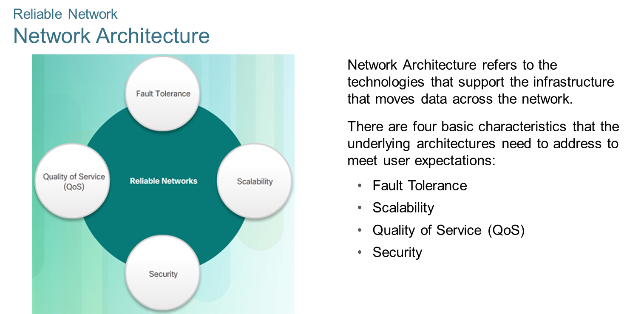
Chapter
Reliable Networks
01

Slide 22
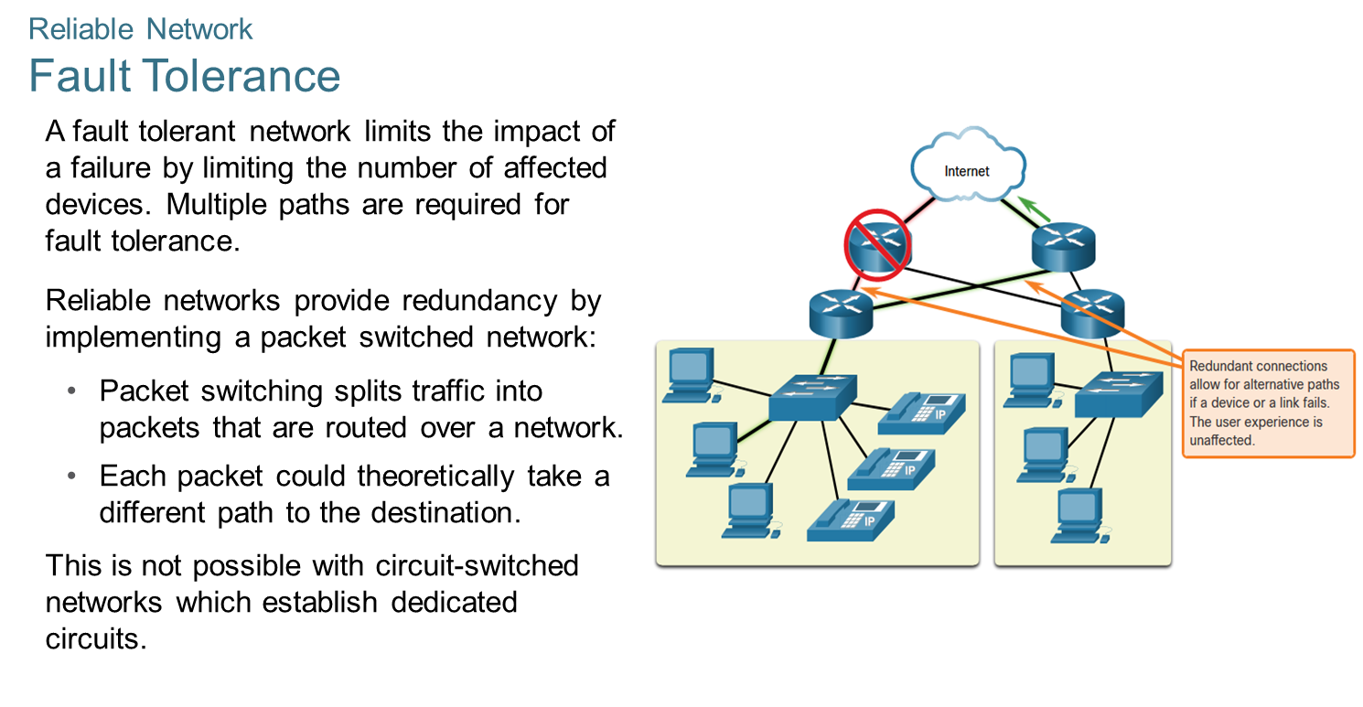
Chapter
Reliable Networks
01

Slide 23
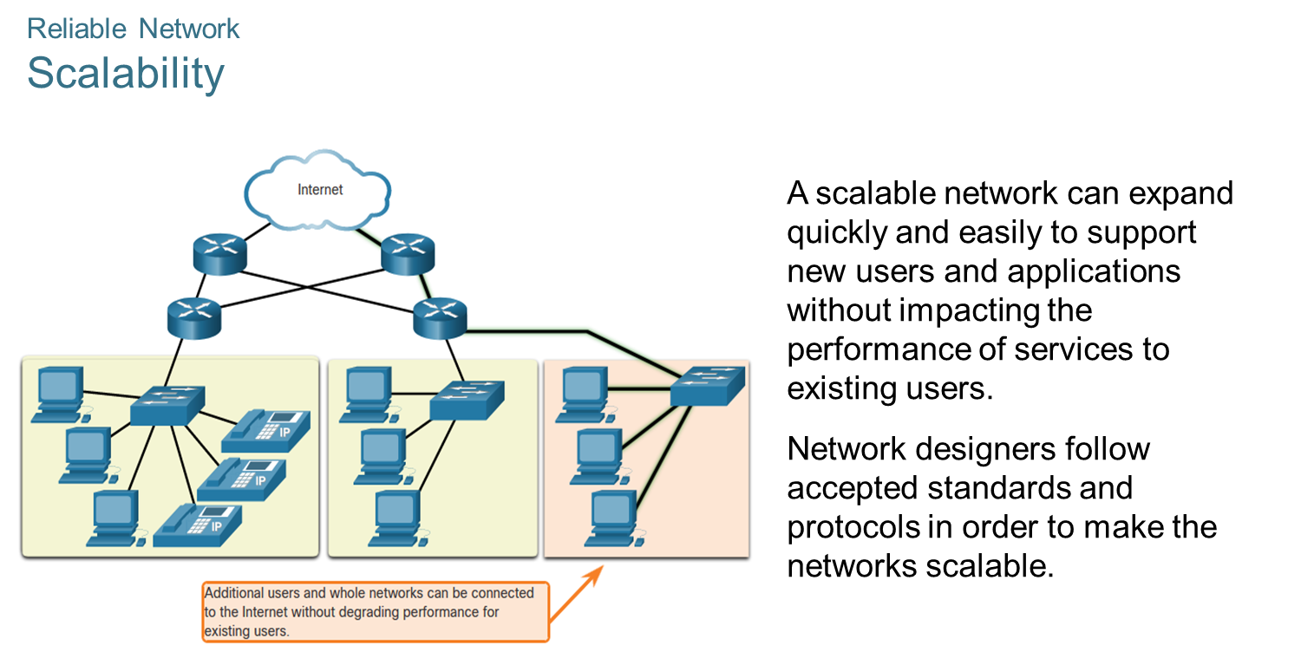
Chapter
Reliable Networks
01

Slide 24
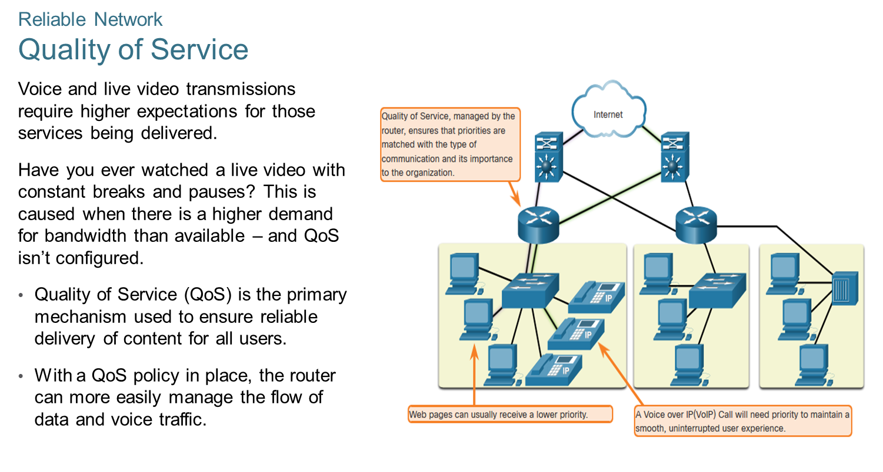
Chapter
Reliable Networks
01

Slide 25
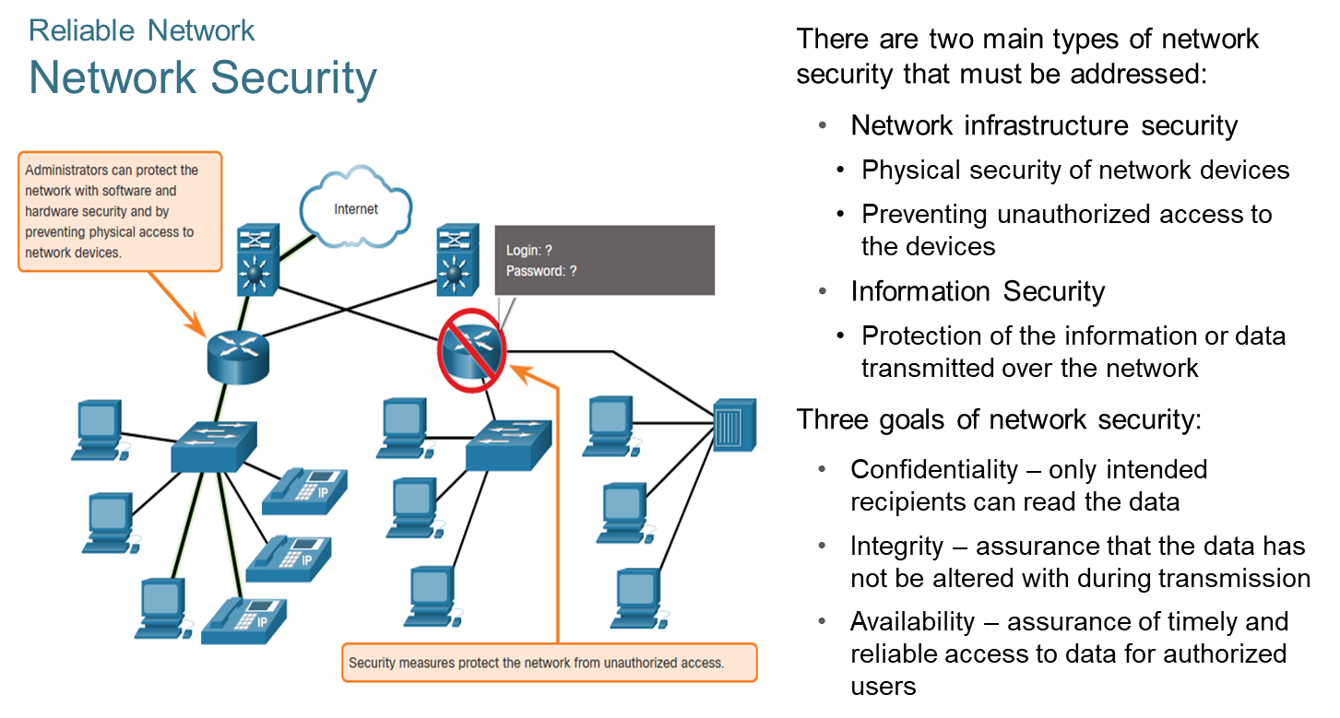
Chapter
Reliable Networks
01

Slide 26
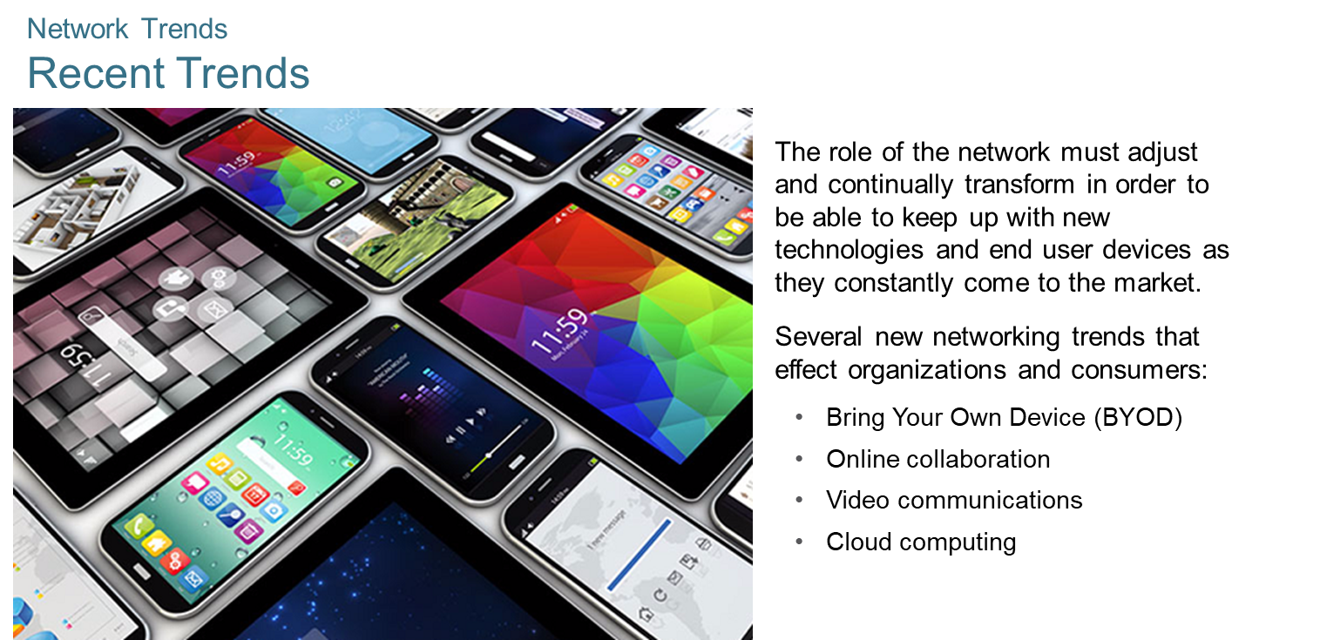
Chapter
Network Trends
01

Slide 27
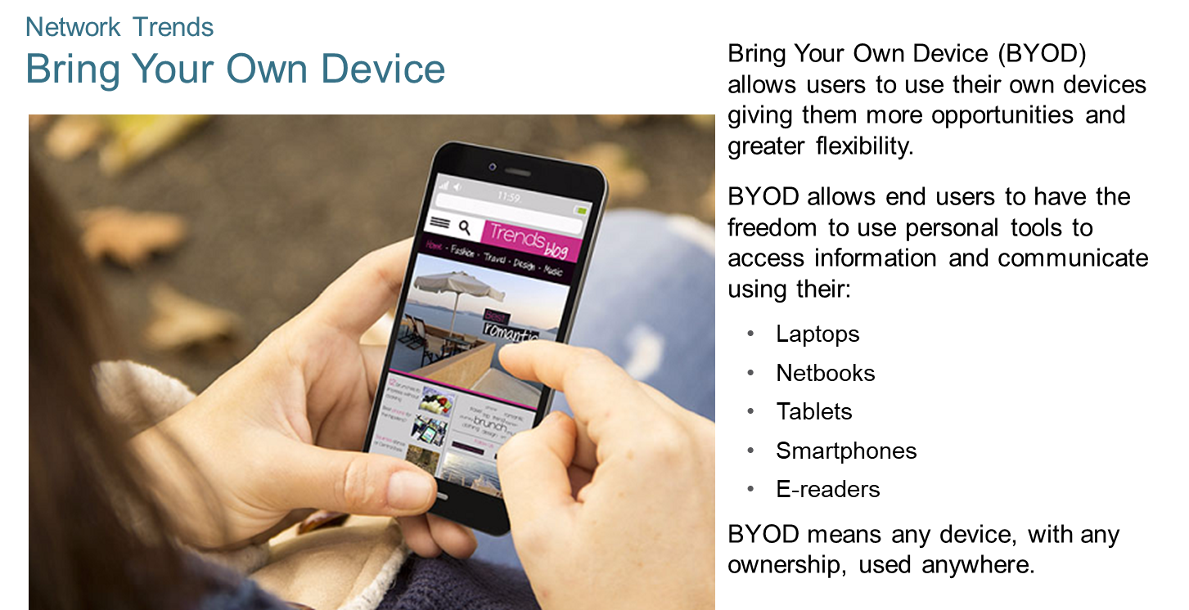
Chapter
Network Trends
01

Slide 28
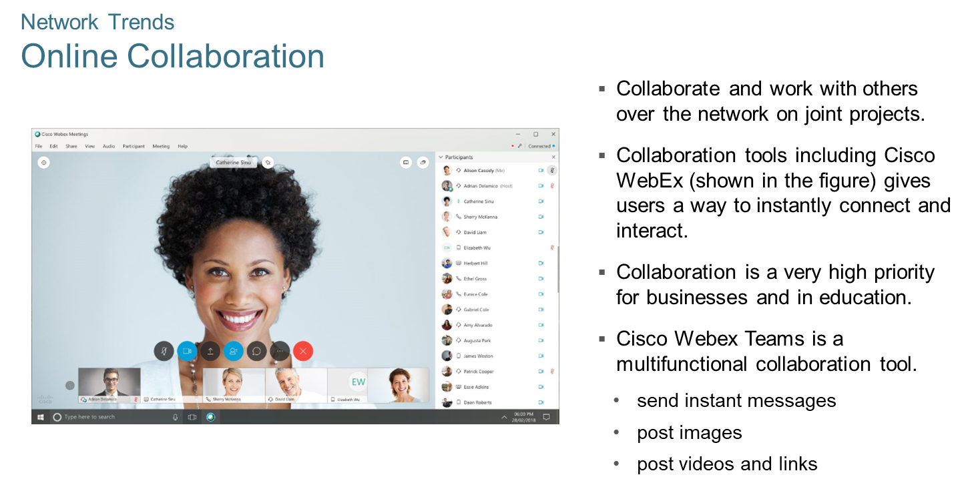
Chapter
Network Trends
01

Slide 29
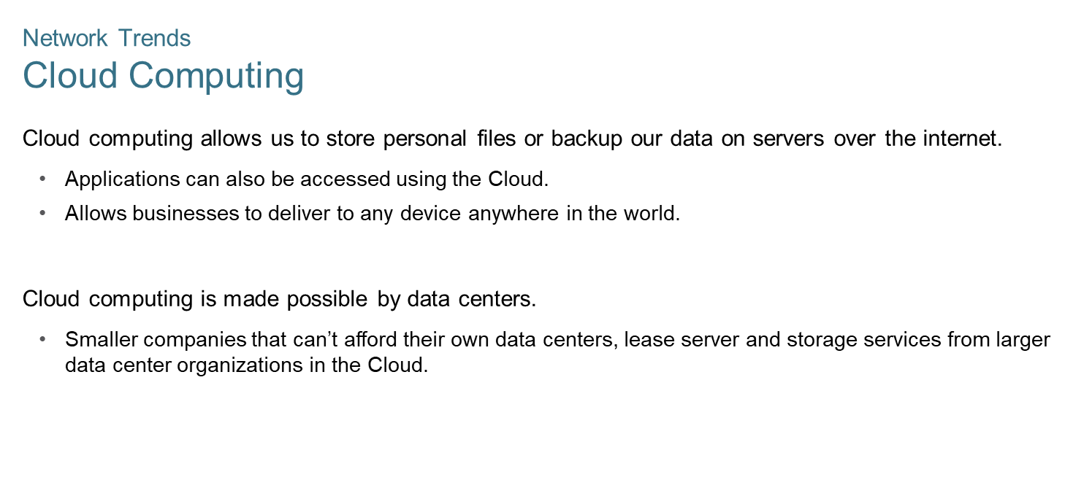
Chapter
Network Trends
01

Slide 30
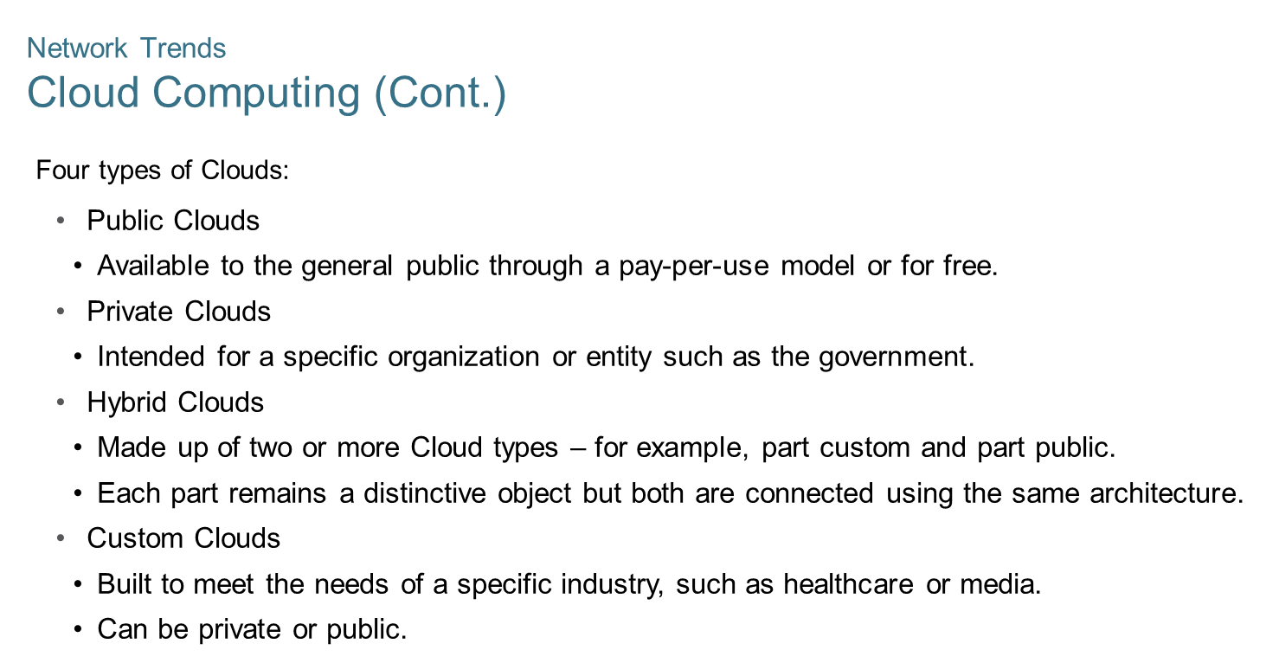
Chapter
Network Trends
01

Slide 31
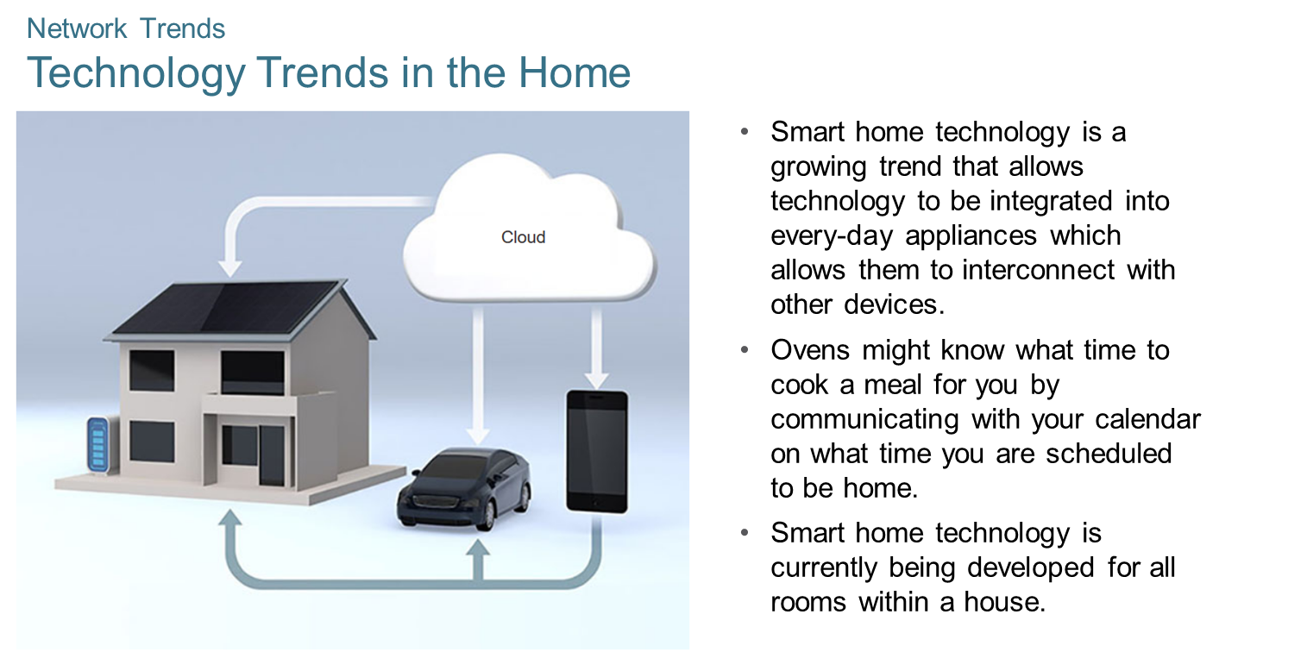
Chapter
Network Trends
01

Slide 32
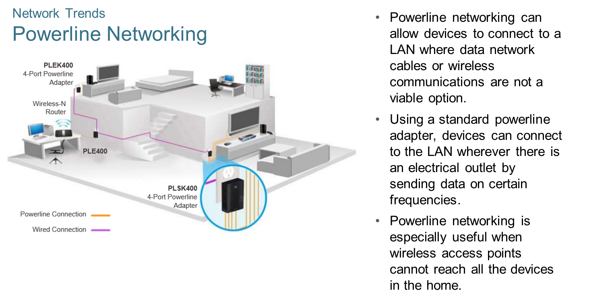
Chapter
Network Trends
01

Slide 33
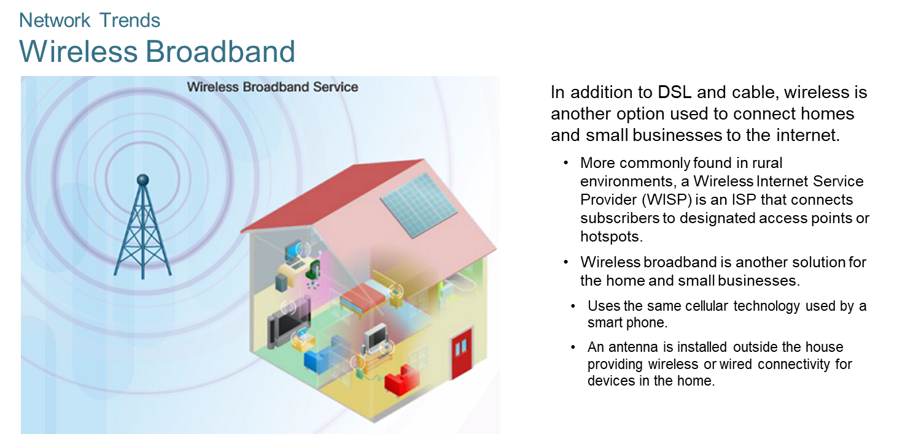
Chapter
Network Trends
01

Slide 34
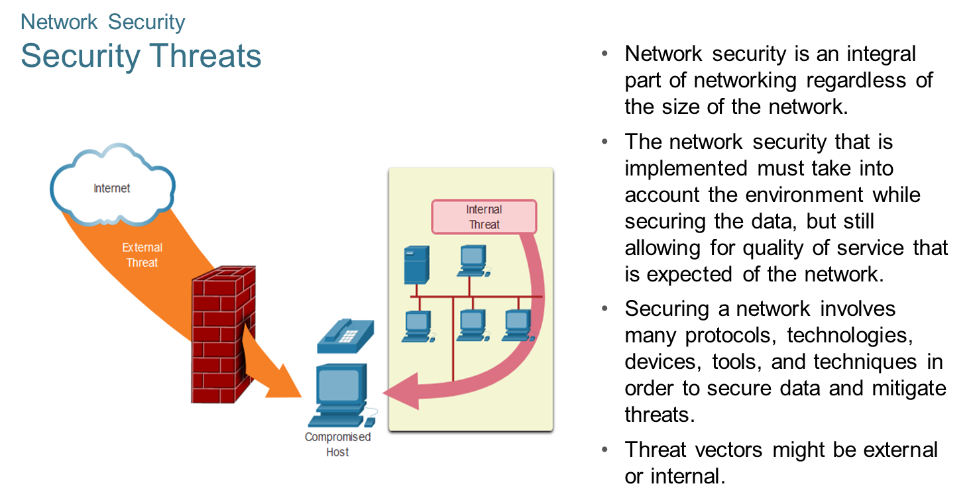
Chapter
Network Security
01

Slide 35
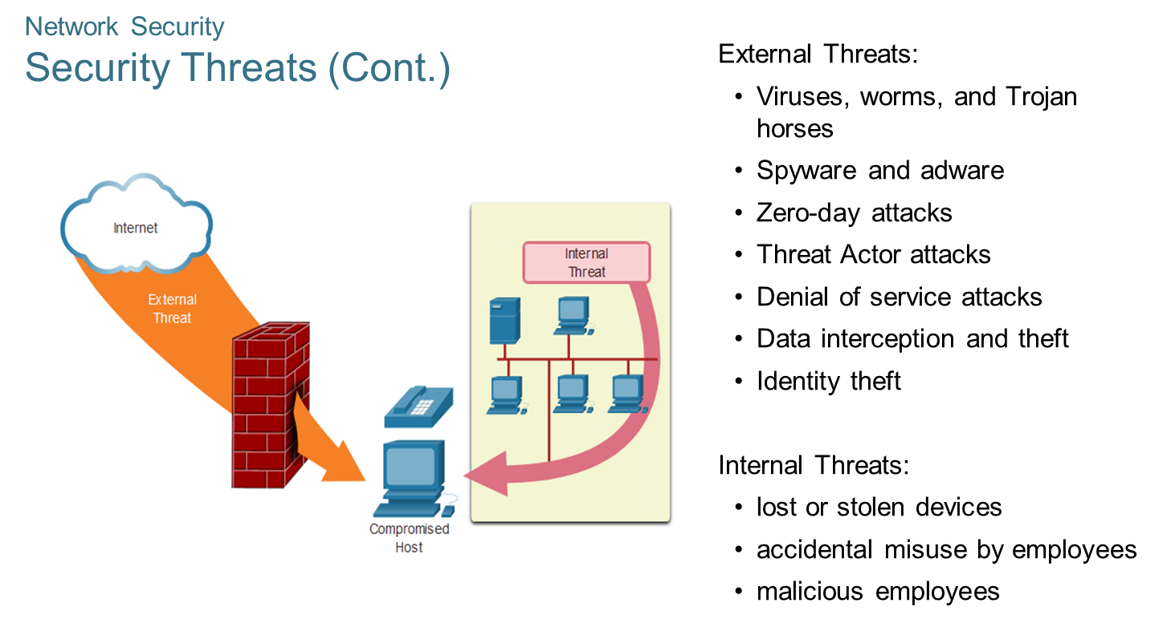
Chapter
Network Security
01

Slide 36
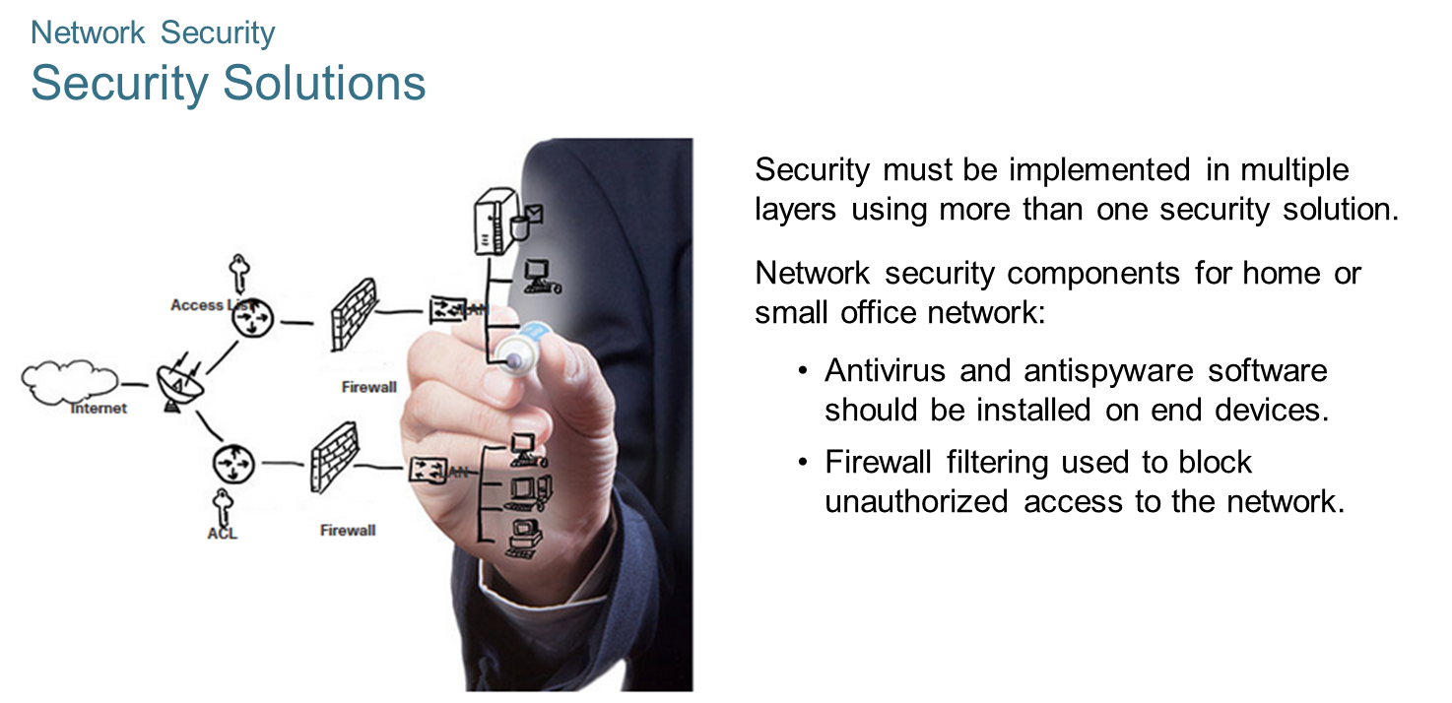
Chapter
Network Security
01

Slide 37
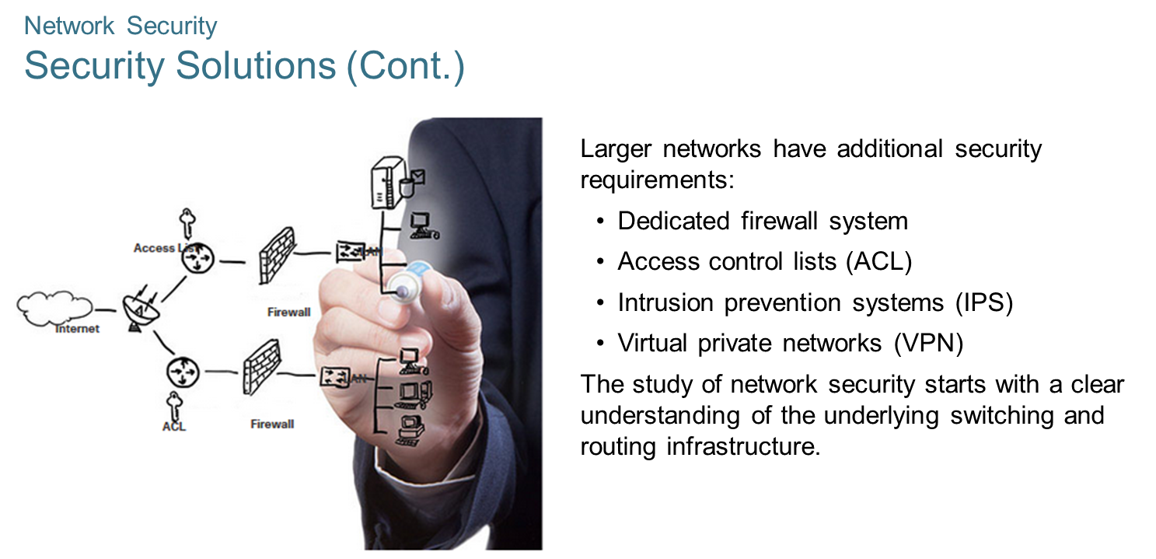
Chapter
Network Security
01

Slide 38
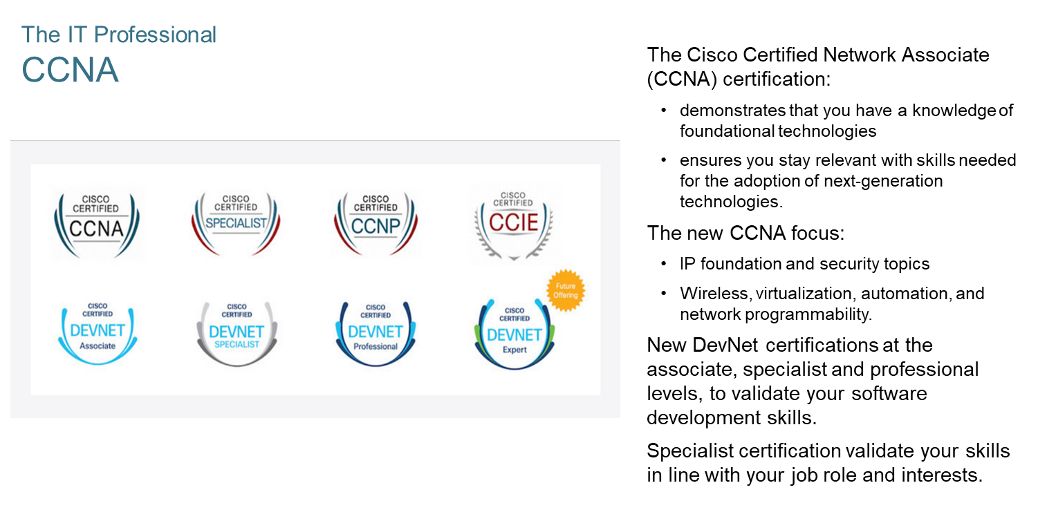
Chapter
The IT Professional
01

Slide 39



Thank You

