Slide 1


College of Management
Business Ethics
Lecturer: Dr. Raef Baraka
PMG 750
Lecture 07

Slide 2

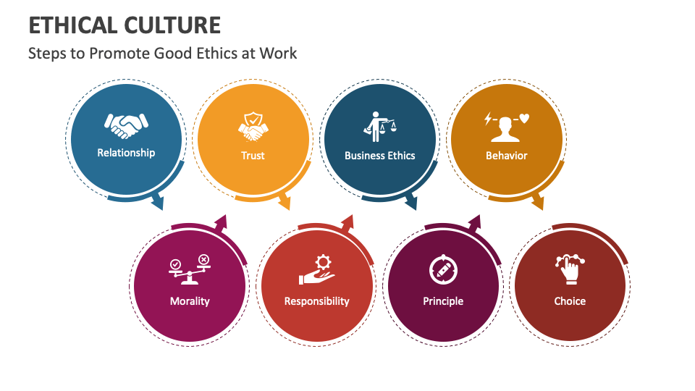
Chapter 7: ORGANIZATIONAL FACTORS: THE ROLE OF ETHICAL CULTURE AND RELATIONSHIPS
CHAPTER OBJECTIVES:
Understand the concept of corporate culture.
Examine the influence of corporate culture on business ethics.
Determine how leadership, power, and motivation relate to ethical decision making in organizations.

Slide 3
Chapter 7: ORGANIZATIONAL FACTORS: THE ROLE OF ETHICAL CULTURE AND RELATIONSHIPS
CHAPTER OBJECTIVES:
Assess organizational structure and its relationship to business ethics.
Explore how the work group influences ethical decisions.
Discuss the relationship between individual and group ethical decision making.

Slide 4
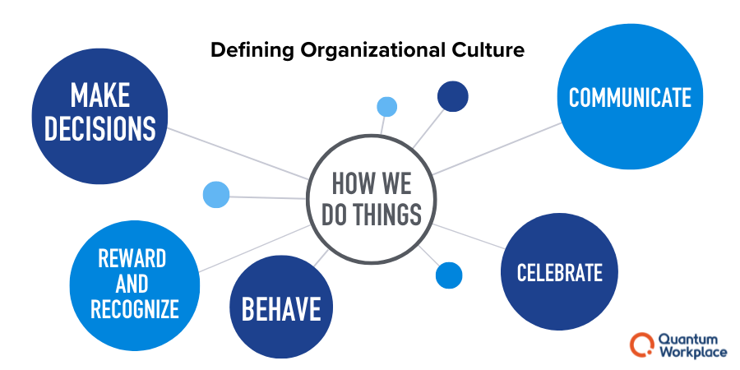
ORGANIZATIONAL FACTORS: THE ROLE OF ETHICAL CULTURE AND RELATIONSHIPS
DEFINING CORPORATE CULTURE

Slide 5
ORGANIZATIONAL FACTORS: THE ROLE OF ETHICAL CULTURE AND RELATIONSHIPS
Defining Corporate Culture
Organizational culture includes shared values, norms, and artifacts that influence employees and determine behavior, including ways of solving problems that members (employees) of an organization share.
Corporate culture is “the shared beliefs top managers in a company have about how they should manage themselves and other employees, and how they should conduct their business(es).
How to resolve ethical issues is part of corporate culture.
Values, beliefs, customs, rules, and ceremonies that are accepted, shared, and circulated throughout an organization represent its culture.
Leaders are responsible for the actions of their subordinates, and corporations should have ethical corporate cultures.

Slide 6
ORGANIZATIONAL FACTORS: THE ROLE OF ETHICAL CULTURE AND RELATIONSHIPS
Defining Corporate Culture
In many firms, an ethical corporate culture is measured in the following ways:
Management and the board demonstrate their commitment to integrity, core values, and ethics codes through their communications and actions.
Every employee is encouraged and required to have hands-on involvement in compliance, especially internal control systems and reporting systems.
Ethical leadership should start with the tone at the top.
Employees are expected to receive communication through resolutions and corrective actions related to ethical issues.
Employees can report policy exceptions anonymously to any member of the organization, including the CEO, other members of management, and the board of directors.

Slide 7
ORGANIZATIONAL FACTORS: THE ROLE OF ETHICAL CULTURE AND RELATIONSHIPS
Defining Corporate Culture
The problem with these measurement standards is that they focus more on risk, compliance, and reporting.
They are not a complete measure of the aspects of a company that make up its ethical culture.
Yet many assume the five aforementioned items define an ethical corporate culture.
Since values, norms, and artifacts are the three major components of culture that impact behavior, all of these elements are important in measuring an ethical culture.

Slide 8
ORGANIZATIONAL FACTORS: THE ROLE OF ETHICAL CULTURE AND RELATIONSHIPS
Defining Corporate Culture
In the past 50 years, scholars developed and attempted to measure at least 164 distinct definitions of culture, with recent reviews indicating that the number of definitions has been increasing.
While these definitions of culture vary greatly, they share three common elements:
(1) “Culture is shared among individuals belonging to a group or society.”
(2) “culture is formed over a relatively long period of time,” and
(3) “Culture is relatively stable.”
Different models of culture, and consequently different instruments for measuring it, focus on various levels (national, organizational, individual) and aspects (values, practices, observable artifacts and rituals, underlying implicit assumptions).

Slide 9
ORGANIZATIONAL FACTORS: THE ROLE OF ETHICAL CULTURE AND RELATIONSHIPS
Defining Corporate Culture
The problem with these measurement standards is that they focus more on risk, compliance, and reporting.
They are not a complete measure of the aspects of a company that make up its ethical culture.
Yet many assume the five aforementioned items define an ethical corporate culture.
Since values, norms, and artifacts are the three major components of culture that impact behavior, all of these elements are important in measuring an ethical culture.

Slide 10
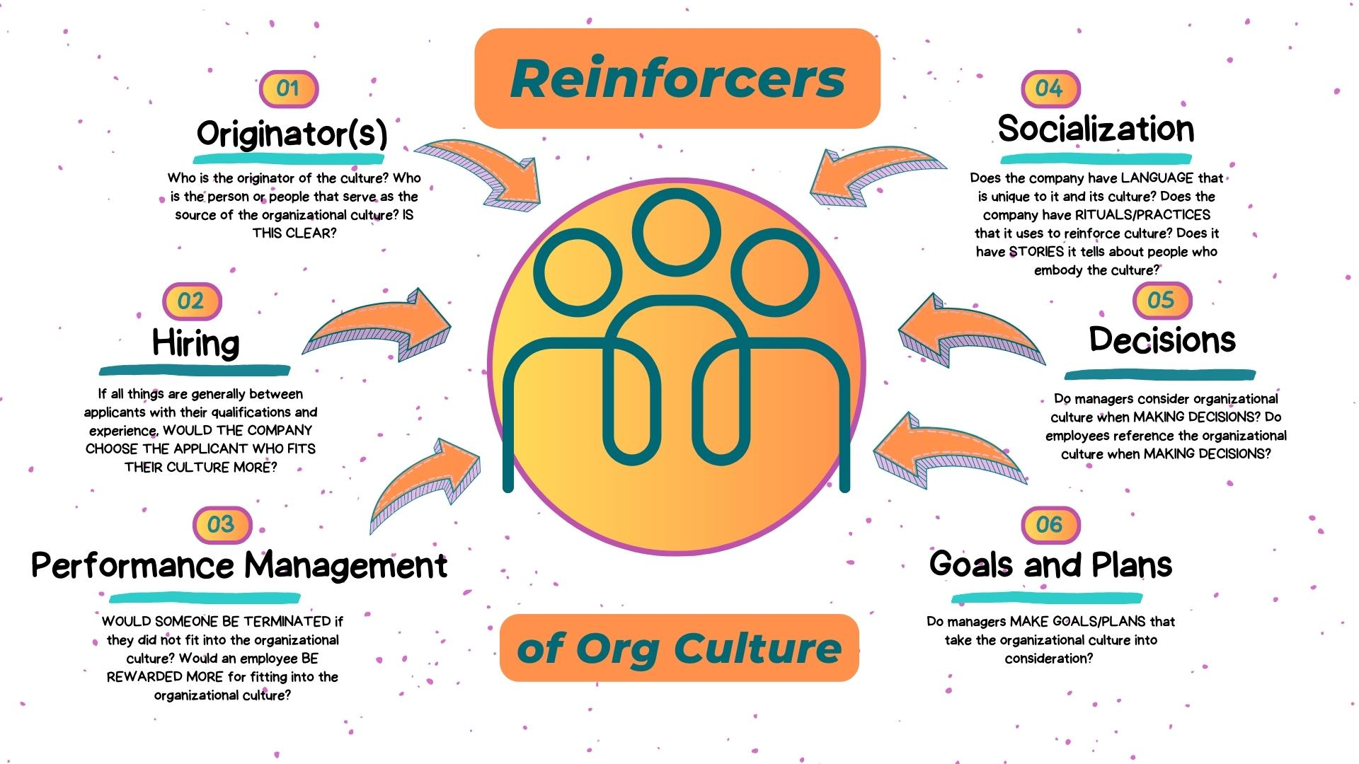
ORGANIZATIONAL FACTORS: THE ROLE OF ETHICAL CULTURE AND RELATIONSHIPS
THE ROLE OF CORPORATE CULTURE IN ETHICAL DECISION MAKING

Slide 11
ORGANIZATIONAL FACTORS: THE ROLE OF ETHICAL CULTURE AND RELATIONSHIPS
The Role Of Corporate Culture In Ethical Decision Making
Corporate culture has been associated with a company’s success or failure.
Some cultures are so strong that to outsiders they come to represent the character of the entire organization.
For example, Levi Strauss, Ben & Jerry’s Homemade Ice Cream, and Hershey Foods are widely perceived as casual organizations with strong ethical cultures, whereas Lockheed Martin, Procter & Gamble, and Texas Instruments are seen as having more formal ethical cultures.
The culture of an organization may be explicitly articulated or left unspoken.

Slide 12
ORGANIZATIONAL FACTORS: THE ROLE OF ETHICAL CULTURE AND RELATIONSHIPS
The Role Of Corporate Culture In Ethical Decision Making
Explicit statements of values, beliefs, customs, and expected behavior usually come from upper management.
Memos, written codes of conduct, handbooks, manuals, forms, and ceremonies are formal expressions of an organization’s culture.
Many of these statements can be found on company websites, like those of Bristol-Myers Squibb (Table 7–1).
The company specifically addresses integrating compliance and their principles to impact their culture.

Slide 13
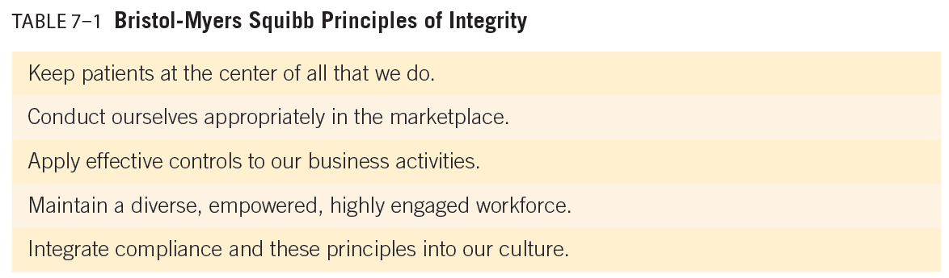
ORGANIZATIONAL FACTORS: THE ROLE OF ETHICAL CULTURE AND RELATIONSHIPS
The Role Of Corporate Culture In Ethical Decision Making

Slide 14
ORGANIZATIONAL FACTORS: THE ROLE OF ETHICAL CULTURE AND RELATIONSHIPS
The Role Of Corporate Culture In Ethical Decision Making
Corporate culture is often expressed informally through statements, both direct and indirect, that communicate the wishes of management.
In some companies, shared values are expressed by instituting informal dress codes, working late, and participating in extracurricular activities.
Corporate culture can be expressed through gestures, looks, labels, promotions, programs, and legends (or the lack thereof).
Many catastrophic events stem from ethical deficiencies resulting in a lack of human value judgments and actions influenced by different corporate cultures.
When organizational leaders involve lower-level employees in a meaningful role in shaping and maintaining an ethical culture, they are more likely to perceive the culture as strong and view it similarly to the way leaders view it.

Slide 15
ORGANIZATIONAL FACTORS: THE ROLE OF ETHICAL CULTURE AND RELATIONSHIPS
The Role Of Corporate Culture In Ethical Decision Making
The “tone at the top” is a determining factor in the creation of a high-integrity organization.
When leaders are perceived as trustworthy, employee trust increases; leaders are seen as ethical and as honoring a higher level of duties.
In a survey of global consumers (Figure 7–1), more than 6,000 employees from 13 markets were asked what traits they believe are the most important among leaders.
The most popular answer was leading by example, followed closely by open communication.
A culture that emphasizes the importance of ethics and social responsibility can reduce misconduct such as earnings manipulation in the finance area.

Slide 16
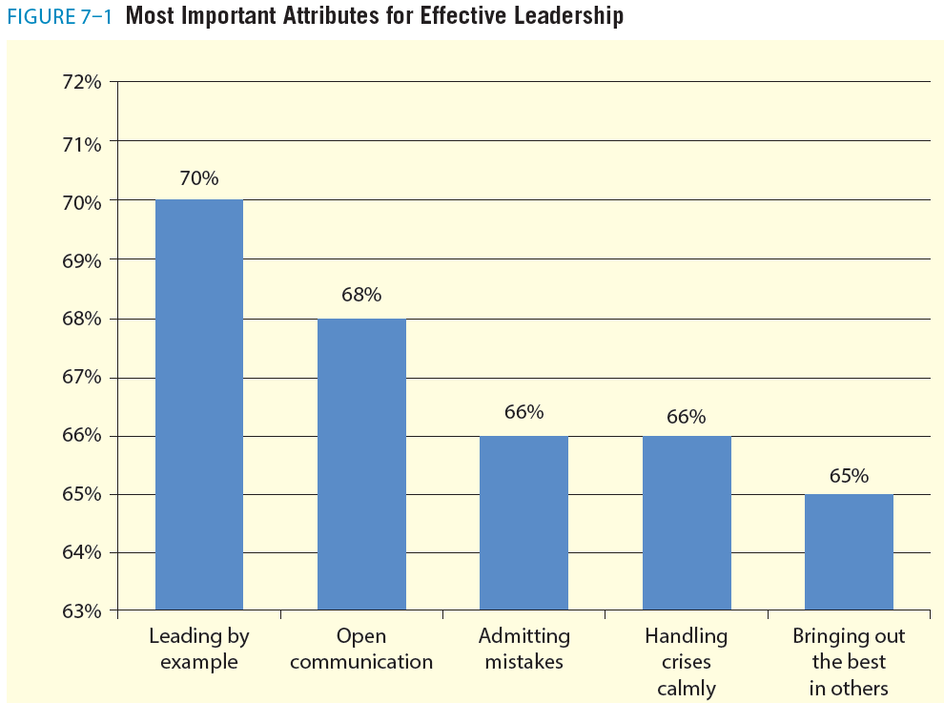
ORGANIZATIONAL FACTORS: THE ROLE OF ETHICAL CULTURE AND RELATIONSHIPS
The Role Of Corporate Culture In Ethical Decision Making

Slide 17
ORGANIZATIONAL FACTORS: THE ROLE OF ETHICAL CULTURE AND RELATIONSHIPS
Ethical Frameworks and Evaluations of Corporate Culture
Corporate culture has been conceptualized in many ways. For example, N. K. Sethia and Mary Ann Von Glinow proposed two basic dimensions to describe an organization’s culture:
(1) concern for people—the organization’s efforts to care for its employees’ well-being
(2) concern for performance—the organization’s efforts to focus on output and
employee productivity.
Figure 7–2 provides examples of companies that display elements of these four organizational cultures.
The four organizational cultures can be classified as apathetic, caring, exacting, and integrative.

Slide 18
ORGANIZATIONAL FACTORS: THE ROLE OF ETHICAL CULTURE AND RELATIONSHIPS
Ethical Frameworks and Evaluations of Corporate Culture
An apathetic culture shows minimal concern for either people or performance.
In this culture, individuals focus on their own self-interest. Apathetic tendencies can occur in almost any organization.
A caring culture exhibits high concern for people but minimal concern for performance issues.
From an ethical standpoint, the caring culture seems appealing. However, it is difficult to find nationally recognizable companies that maintain little or no concern for performance
An exacting culture shows little concern for people but a high concern for performance; it focuses on the interests of the organization.

Slide 19
ORGANIZATIONAL FACTORS: THE ROLE OF ETHICAL CULTURE AND RELATIONSHIPS
Ethical Frameworks and Evaluations of Corporate Culture
An integrative culture combines a high concern for people and performance.
An organization becomes integrative when superiors recognize employees are more than interchangeable parts—employees have an ineffable quality that helps the firm meet its performance criteria.
In this culture, individuals focus on their own self-interest. Apathetic tendencies can occur in almost any organization.
Figure 7–2 shows, the four organizational cultures can be classified as apathetic, caring, exacting, and integrative.

Slide 20
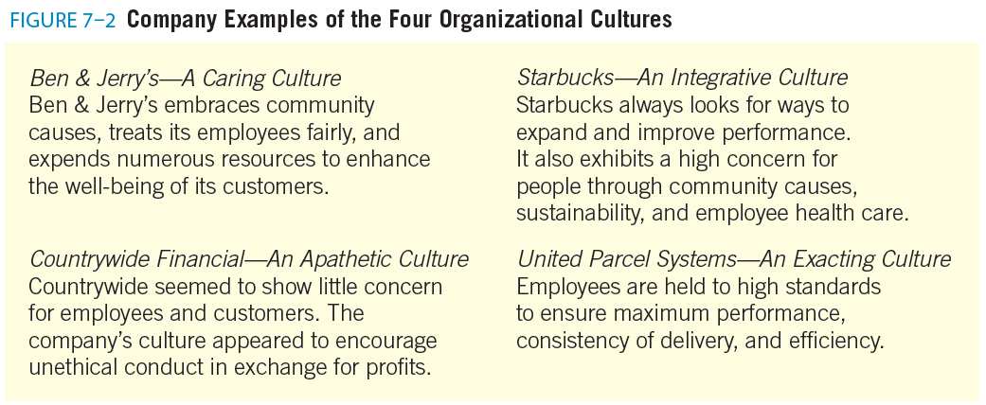
ORGANIZATIONAL FACTORS: THE ROLE OF ETHICAL CULTURE AND RELATIONSHIPS
Ethical Frameworks and Evaluations of Corporate Culture

Slide 21
ORGANIZATIONAL FACTORS: THE ROLE OF ETHICAL CULTURE AND RELATIONSHIPS
Ethical Frameworks and Evaluations of Corporate Culture
Companies can classify their corporate culture and identify their specific values, norms, beliefs, and customs by conducting a cultural audit.
A cultural audit is an assessment of an organization’s values.
The audit is usually conducted by outside consultants but may be performed internally as well.
Communication about ethical expectations and support from top management helps to identify a corporate culture that encourages ethical conduct or leads to ethical conflict.

Slide 22

ORGANIZATIONAL FACTORS: THE ROLE OF ETHICAL CULTURE AND RELATIONSHIPS
ETHICS AS A COMPONENT OF CORPORATE CULTURE

Slide 23
ORGANIZATIONAL FACTORS: THE ROLE OF ETHICAL CULTURE AND RELATIONSHIPS
Ethics As A Component Of Corporate Culture
If a firm’s culture encourages or rewards unethical behavior, the employees may act unethically.
If the culture dictates hiring people with specific, similar values and if those values are perceived as unethical by society, society will view the organization and its members as unethical.
On the other hand, if an organization values ethical behaviors, it rewards them.
It is important to handle recognition and awards for appropriate behavior in a consistent and balanced manner.

Slide 24
ORGANIZATIONAL FACTORS: THE ROLE OF ETHICAL CULTURE AND RELATIONSHIPS
Ethics As A Component Of Corporate Culture
Management’s sense of an organization’s culture may not be in line with the values and ethical beliefs that actually guide a firm’s employees.
Table 7–2 provides an example of a corporate culture ethics audit.
Companies interested in assessing their culture can use this tool and benchmark against previous years’ results to measure organizational improvements.

Slide 25
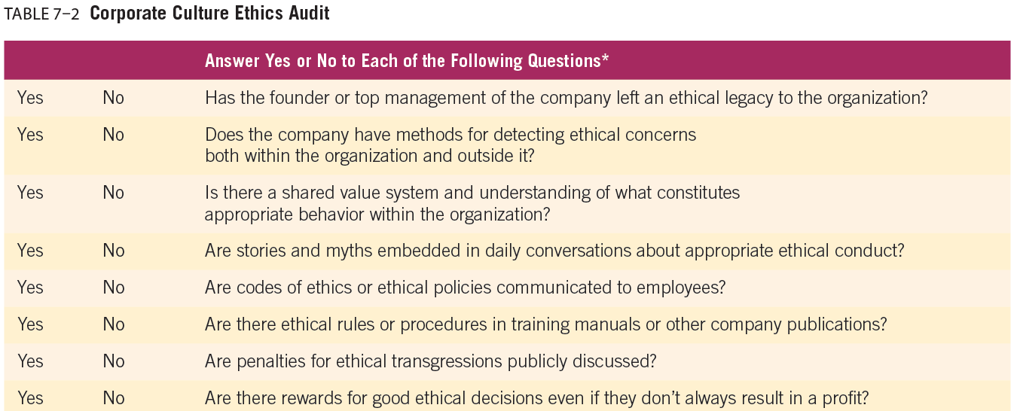
ORGANIZATIONAL FACTORS: THE ROLE OF ETHICAL CULTURE AND RELATIONSHIPS

Slide 26
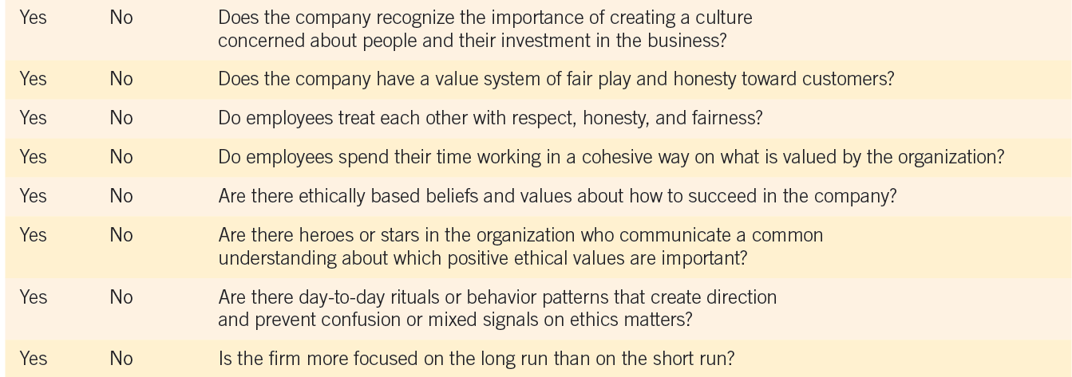
ORGANIZATIONAL FACTORS: THE ROLE OF ETHICAL CULTURE AND RELATIONSHIPS

Slide 27
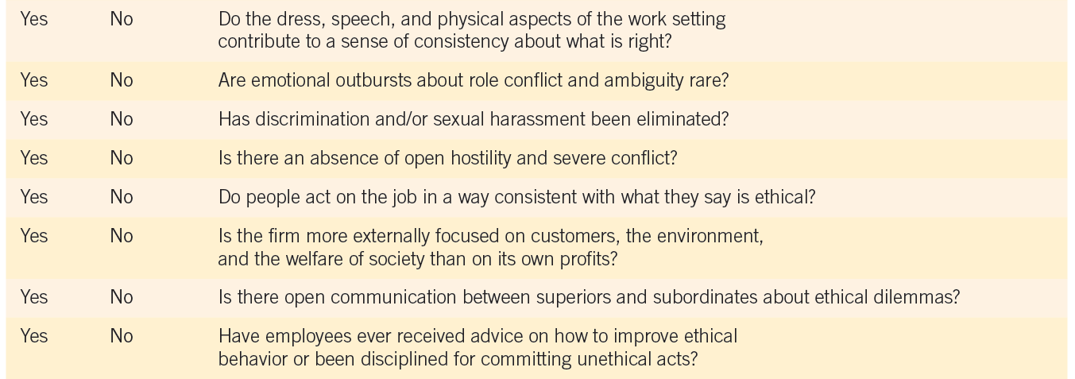
ORGANIZATIONAL FACTORS: THE ROLE OF ETHICAL CULTURE AND RELATIONSHIPS

Slide 28
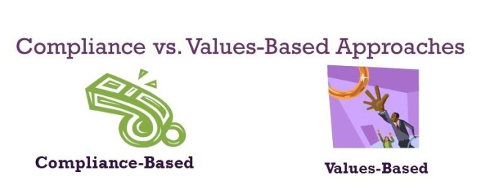
ORGANIZATIONAL FACTORS: THE ROLE OF ETHICAL CULTURE AND RELATIONSHIPS
COMPLIANCE VERSUS VALUES-BASED ETHICAL CULTURES

Slide 29
ORGANIZATIONAL FACTORS: THE ROLE OF ETHICAL CULTURE AND RELATIONSHIPS
Compliance Versus Values-based Ethical Cultures
Compliance-based cultures use a legalistic approach to ethics.
They use laws and regulatory rules to create codes and requirements.
Codes of conduct are established with compliance as their focus, with rules and policies enforced by management.
Instead of revolving around an ethical culture, the company revolves around risk management.
The compliance approach is good in the short term because it helps management, stakeholders, and legal agencies ensure laws, rules, and the intent of compliance are fulfilled.
A problem with the compliance approach is its lack of long-term focus on values and integrity. In addition, it does not teach employees to navigate ethical gray areas.

Slide 30
ORGANIZATIONAL FACTORS: THE ROLE OF ETHICAL CULTURE AND RELATIONSHIPS
Compliance Versus Values-based Ethical Cultures
A values-based ethics culture approach to ethical corporate cultures relies upon an explicit mission statement that defines the core values of the firm and how customers and employees should be treated.
The board of directors, as well as upper management, might add to the general value statements by formulating specific value statements for its strategic business units (SBU), which can be organized by product, geography, or function within the firm’s management structure.
Certain areas may have rules associated with stated values, enabling employees to understand the relationship between the two.
The focus of this type of corporate culture is on values such as trust, transparency, and respect to help employees identify and deal with ethical issues

Slide 31
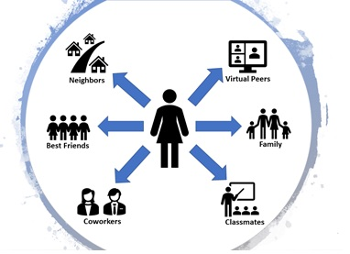
ORGANIZATIONAL FACTORS: THE ROLE OF ETHICAL CULTURE AND RELATIONSHIPS
DIFFERENTIAL ASSOCIATION

Slide 32
ORGANIZATIONAL FACTORS: THE ROLE OF ETHICAL CULTURE AND RELATIONSHIPS
Differential Association
Differential association is the idea that people learn ethical or unethical behavior while interacting with others who are part of their role-sets or belong to other intimate personal groups.
The learning process is more likely to result in unethical behavior if the individual associates primarily with persons who behave unethically.
Associating with others who are unethical, combined with the opportunity to act unethically, is a major influence on ethical decision making, as described in the decision-making framework in Chapter 5.

Slide 33
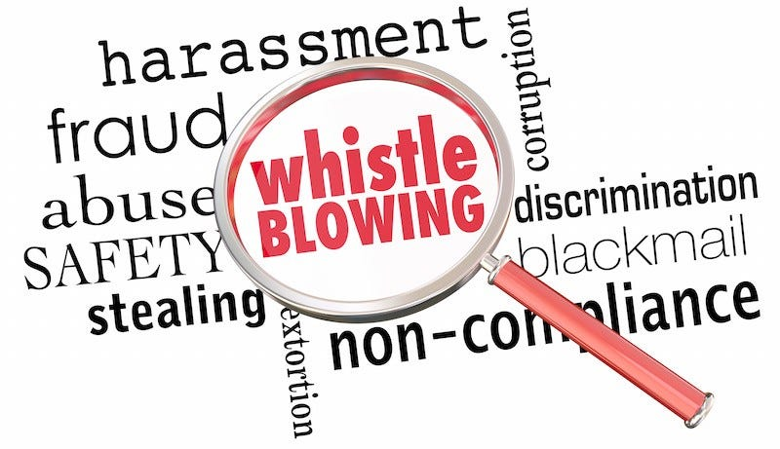
ORGANIZATIONAL FACTORS: THE ROLE OF ETHICAL CULTURE AND RELATIONSHIPS
WHISTLE-BLOWING

Slide 34
ORGANIZATIONAL FACTORS: THE ROLE OF ETHICAL CULTURE AND RELATIONSHIPS
Whistle-Blowing
Interpersonal conflict occurs when employees think they know the right course of action in a situation, yet their work group or company promotes or requires a different, unethical decision.
In such cases, employees may choose to follow their own values and refuse to participate in unethical or illegal conduct.
If they conclude that they cannot discuss what they are doing or what should be done with coworkers or immediate supervisors, and if there is no method of protection for anonymous reporting, these employees may go outside the organization to publicize and correct the unethical situation.
A number of laws exist to protect whistle-blowers.

Slide 35
ORGANIZATIONAL FACTORS: THE ROLE OF ETHICAL CULTURE AND RELATIONSHIPS
Whistle-Blowing
Whistle-blowing means exposing an employer’s wrongdoing to outsiders such as the media or government regulatory agencies.
The term whistle-blowing is sometimes used to refer to internal reporting of misconduct to management, especially through anonymous reporting mechanisms often called hotlines.
Legal protection for whistle-blowers exists to encourage reporting of misconduct.
Whistle-blower laws have provisions against retaliation and are enforced by a number of government agencies.

Slide 36
ORGANIZATIONAL FACTORS: THE ROLE OF ETHICAL CULTURE AND RELATIONSHIPS
Whistle-Blowing
To be truly effective, whistle-blowing requires that the individual have adequate knowledge of wrongdoing that could damage society.
It is important to minimize risk to the whistle-blower while dealing with ethical issues.
Table 7–3 provides a checklist of questions an employee should ask before going to external sources.
Table 7–4 reveals the ways employees can report potential misconduct within an organization.
Most public companies are creating computer systems that encourage reporting misconduct internally, also called internal whistle-blowing.

Slide 37
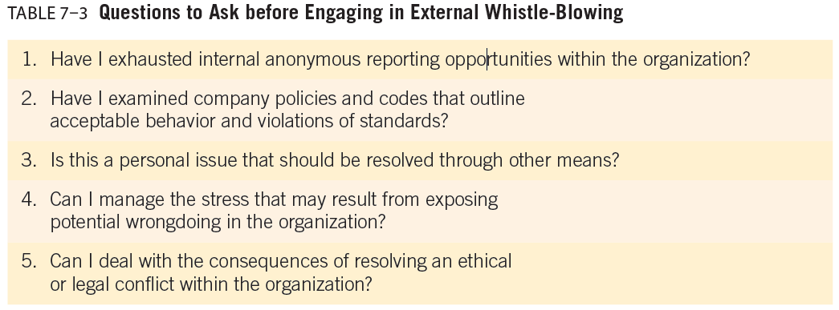
ORGANIZATIONAL FACTORS: THE ROLE OF ETHICAL CULTURE AND RELATIONSHIPS

Slide 38
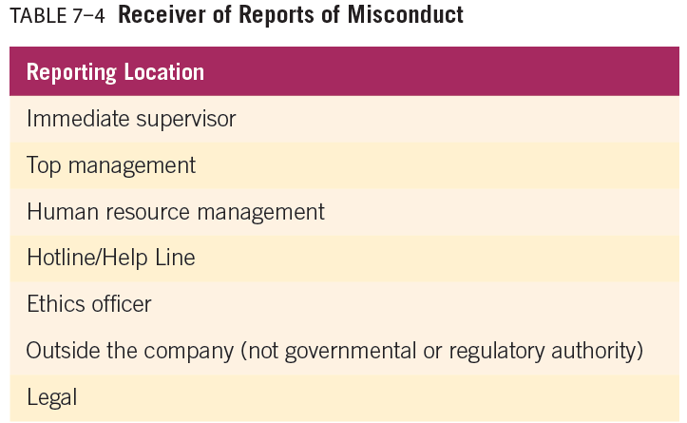
ORGANIZATIONAL FACTORS: THE ROLE OF ETHICAL CULTURE AND RELATIONSHIPS

Slide 39
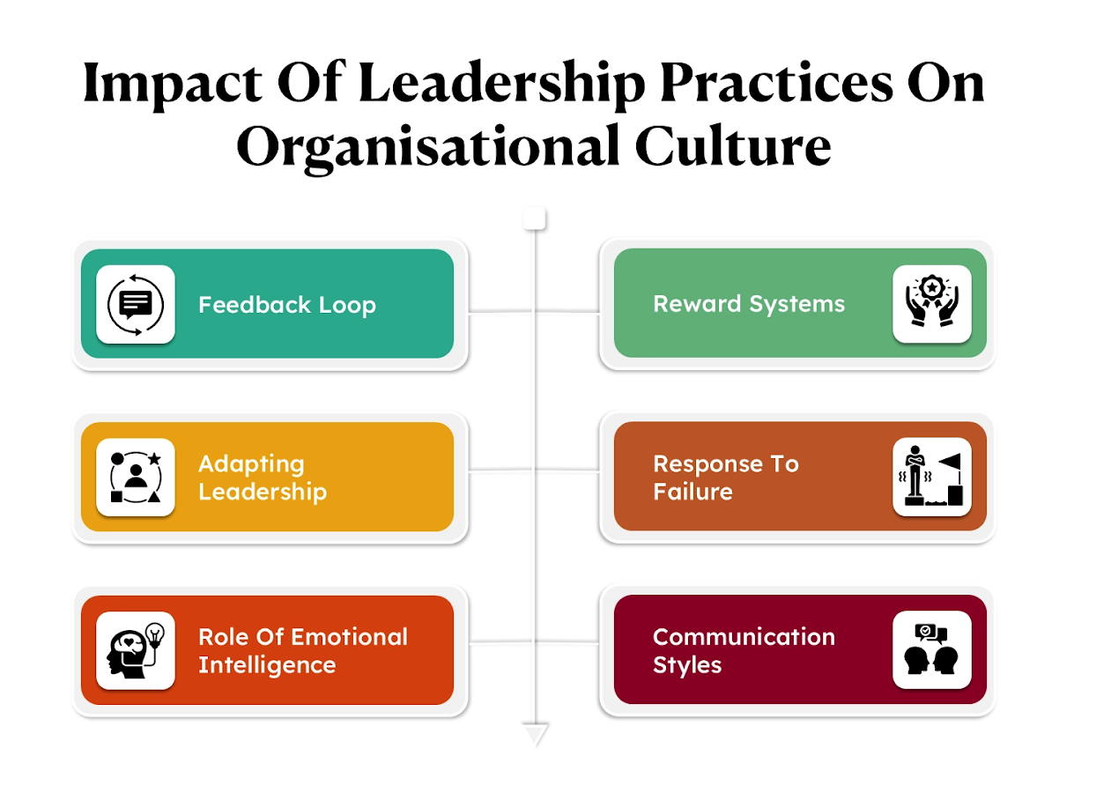
ORGANIZATIONAL FACTORS: THE ROLE OF ETHICAL CULTURE AND RELATIONSHIPS
LEADERS INFLUENCE CORPORATE CULTURE

Slide 40
ORGANIZATIONAL FACTORS: THE ROLE OF ETHICAL CULTURE AND RELATIONSHIPS
Leaders Influence Corporate Culture
Power refers to the influence leaders and managers have over the behavior and decisions of subordinates.
Organizational leaders can shape and influence corporate culture, resulting in ethical or unethical leadership.
Leaders need to be effective and ethical.
An effective leader is one who does well for the stakeholders of the corporation.
Effective leaders get followers to their common goals or objectives in the most effective and efficient way.
There are five power bases from which one person may influence another:
(1) reward power, (2) coercive power, (3) legitimate power, (4) expert power, and (5) referent power.
These five bases of power can be used to motivate individuals either ethically or unethically.

Slide 41
ORGANIZATIONAL FACTORS: THE ROLE OF ETHICAL CULTURE AND RELATIONSHIPS
Leaders Influence Corporate Culture
A leader’s ability to motivate subordinates plays a key role in maintaining an ethical organization.
Motivation is a force within the individual that focuses his or her behavior toward achieving a goal
An organization’s structure is important to the study of business ethics because the various roles and job descriptions that comprise that structure can create opportunities for unethical behavior.
The structure of organizations can be described in many ways. For simplicity’s sake, we discuss two broad categories of organizational structures—centralized and decentralized.

Slide 42
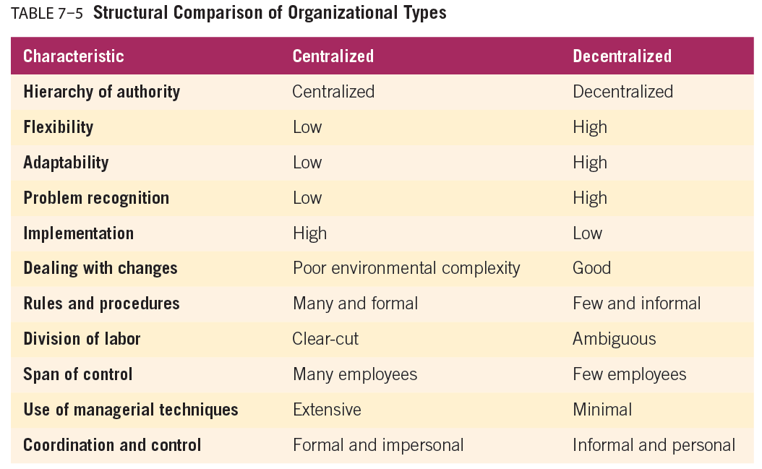
ORGANIZATIONAL FACTORS: THE ROLE OF ETHICAL CULTURE AND RELATIONSHIPS

Slide 43



Thank You

