Slide 1

Risk Management
Prepared by Dr. Dalia Hosni
Introduction
MGM 510
Risk Management

Slide 2



Introduction
Cyber Security Risk Specialist

Slide 3

Introduction
Risk Management
Identifies And Evaluates Risk
Risk management identifies and analysis various risk associated with business. It identifies risk at early stages and takes all necessary steps to avoid their harmful effects. Information from past is analyzed to recognize all possible future unfortunate events. Risk management properly evaluates risk originated in business and develops a proper understanding regarding its real causes. This all help in taking all measures in mitigating the effects of these risks.

Slide 4
Introduction
Risk Management
Reduce And Eliminate Harmful Threats
Harmful risks and threat are part of every business organization. They have negative effect on productivity and profitability of business. Risk management techniques helps in avoiding and reducing the effect of these threats to business. Risk manager formulates strategic plans for each department and monitors their performance from time to time.

Slide 5
Introduction
Risk Management
Supports Efficient Use Of Resources
Risk management aims at efficient utilization of all resources. Fuller utilization leads to better productivity and increased profits. Risk management techniques support strategic planning for better results. It sets plans for functioning of business and ensures that all activities are going on their planned track. Certain targets are set for each division within organizations and perform routine check-ups from time to time. If any deviations arise, it takes all possible steps.

Slide 6
Introduction
Risk Management
Better Communication Of Risk Within Organization
Risk management develops better communication network between directors, managers and employees. It helps in spreading all information regarding risk easily around the organization timely. All people are able to interact with each other effectively and discuss about core solution about these risk. This helps in better understanding of several threats and taking timely action against them.

Slide 7
Introduction
Risk Management
Reassures Stakeholders
Stakeholders are an important part of every business organization. Business must aim at serving the interest of its stakeholders for their support.
Risk management helps in increasing the confidence of stakeholders in business and assures them of non-occurrence of any unfortunate incident.

Slide 8

Introduction
Risk Management
To understand the concept of risk, uncertainty & risk parameters in the context of commercial
management.
Analyze risk assessment and mitigation strategies in specific situations

Slide 9

Introduction
Risk Management
Management
Risk
Risk Management

Slide 10
Introduction
Risk Management
Section Topics:
Plan Risk Management
Identify Risks
Perform Qualitative Risk Analysis
Perform Quantitative Risk Analysis
Plan Risk Responses
Monitor and Control Risks

Slide 11
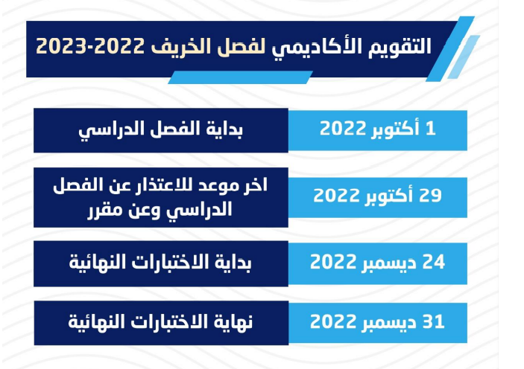
Introduction
Risk Management

Slide 12
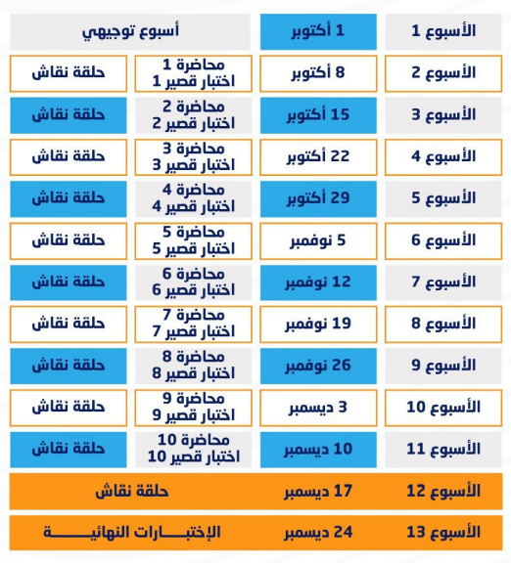
Introduction
Risk Management

Slide 13
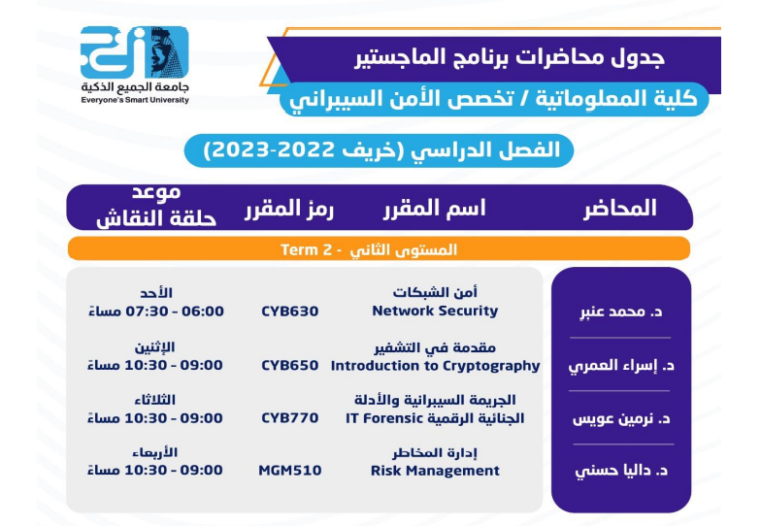
Introduction
Risk Management

Slide 14

Introduction

