Slide 1

Product Analysis and Development
Prepared by Dr. Aya Mohamed
Lecture 2
ENT 614
Product Analysis

Slide 2
Module 1
Product Analysis: Types, Methods,
and Examples
Lecture 2
Dr. Aya Mohamed

Slide 3

Module 1
Product Analysis: Types, Methods, and Examples
Lecture 2
Why Is Product Analysis Necessary?
Examining the Difference Between Product Screening and Product Analysis
What Is the Difference Between Customer Analysis and Product Analysis?
Difference Between Ladle Analysis and Product Analysis

Slide 4

Importance of Product Analysis
1- Understand the Target Market for Your Product.
You can’t create a product that people will want to buy if you don’t know what they want. Product analysis helps you figure out the needs and wants of your target market.
A target market is the segment of consumers most likely to want or need a business's products or services.

Slide 5

Importance of Product Analysis
1- Understand the Target Market for Your Product.
Demographics
like their age, gender, employment status, life stage, family structure, religion and income EXAMPLE
College students with a part-time job
Women ages 40–50 who are employed full time with a yearly income of at least $60,000
Factors to consider when defining your target market

Slide 6

Importance of Product Analysis
1- Understand the Target Market for Your Product.
Geographics
Whether they live in a rural, suburban or urban environment
Which area of the country they live in
Their local language and time zone EXAMPLE
Women live in villages in certain country, work with their husbands
Sail men live by the red sea in country…
Factors to consider when defining your target market

Slide 7

Importance of Product Analysis
1- Understand the Target Market for Your Product.
Psychographics
Psychographics describe the intrinsic personal qualities of people in your target market. This includes things like their hobbies and leisure activities, entertainment interests and preferred sources of information.
Example:
Working persons having their morning coffee at 8:00 o’clock
Factors to consider when defining your target market

Slide 8

Importance of Product Analysis
1- Understand the Target Market for Your Product.
Behavioral patterns
Behavioral patterns are those that define your customers' purchasing habits.
purchasing behavior, occasion-based behavior, the usage rate of your products, purchase reasoning, customer loyalty, and how they interact with your brand
Example:
- Moms having very small kids and using diapers
Factors to consider when defining your target market

Slide 9
Importance of Product Analysis
2- Understand Your Competition.
Business competition is the contest between organizations that provide similar products or services or that target the same audience of consumers. Businesses compete to convert and retain customers, increase revenue and gain more market share.

Slide 10

Types of competition in business
Direct competition
Direct competitors are brands or businesses that sell the same products or services to the same target audience.
Characters:
They operate within the same industry
They provide the same or similar products or services
They target the same audience of consumers
They satisfy the same customer need
They use the same channel of distribution

Slide 11
Types of competition in business
Indirect competition
Indirect competitors provide products or services that are not the same but that satisfy the same consumer needs. A great example of indirect competitors would be two different styles of restaurants. For example, a fast-food restaurant and a buffet restaurant do not provide the same type of product, but they satisfy the same customer need of hunger.
Characters:
They operate in the same industry
They satisfy the same need
They target the same audience

Slide 12

Types of competition in business
Replacement competition
Replacement competitors are brands and businesses that can completely replace existing organizations by producing new products or services that better satisfy the needs of their target audience.
Example: mobile phone manufactures eventually replaced manufacturers of landline phones because they fulfilled the same need in an improved, more convenient way.
You can tell if an organization is a replacement competition if it offers an existing product or service in a new, innovative way the more successfully satisfies the needs of consumers

Slide 13
Importance of Product Analysis
3- Understand the Costs Associated With Making and Selling Your Product.
Pricing and Profitability
Price: that which is given in return for a product in a commercial exchange.
Profit is the amount of revenue that remains after accounting for all expenses, debts, and other costs.
Product profitability, is how much money a product makes minus what it costs to build, sell, and support it.

Slide 14
Commercial Exchange
Seller
Something in Exchange
Product
Buyer
• Product: good or service
• Buyer: consumer or business customer
• Something in exchange: price

Slide 15
Importance of Product Analysis
4- Understand the Risks Associated With Making and Selling Your Product.
Definition of Risks
All the uncertainties and risks that can cause a product development effort to be unsuccessful.

Slide 16

Risks during new product development
Technology Risks
Performance Risks
Market Risks
Organizations Risks
Supply chain Risks
Financial Risks

Slide 17

Risks during new product development
Technology risks – When incorporating new technology in a product, there’s a chance your team may have blind spots or lack specific capabilities that could cause roadblocks during development.
Solution: Bringing in outside experts, such as an advanced manufacturing partner, can fill in knowledge gaps and add capabilities to your project team.

Slide 18
Risks during new product development
5 Critical Risks Facing the Technology Industry
1) Cyber Security Awareness of cyber risk increases every day as more and more businesses are threatened with some form of cyber attack. Yet companies still neglect to prepare for such threats
2) Robots and Artificial Intelligence If a robot malfunctions, who is at fault? The user or the manufacturer?
3) Steep Pressure to Innovate
4) Workforce Shortage
5) Lacking in Diversity

Slide 19
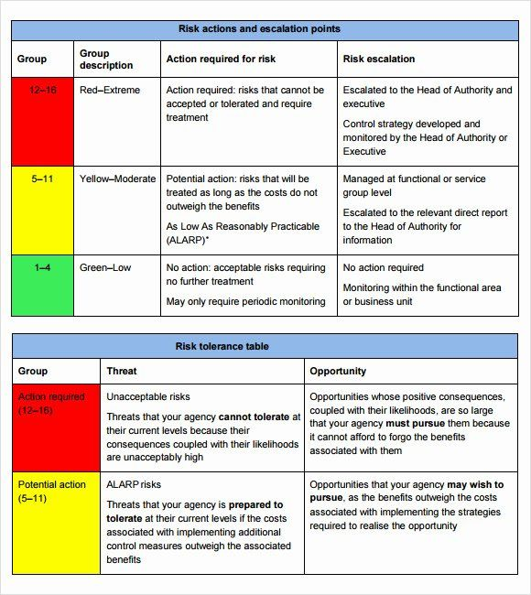
Risks during new product development
Technology Risk Template
A template is used to perform security risk and vulnerability assessments in your business.
IT Professionals can use this as a guide for the following:
Identify the source of threat and describe existing controls

Slide 20
Risks during new product development
Technology Risk Template
A template is used to perform security risk and vulnerability assessments in your business.
IT Professionals can use this as a guide for the following:
Identify the source of threat and describe existing controls

Slide 21

Risks during new product development
Performance risks – The function and reliability of the product in real-world conditions.
Solution: During the Develop and Validate steps, functional prototyping and testing are conducted to confirm the product works as intended.
The infamous Phone that Caught Fire

Slide 22
Risks during new product development
Performance risks –
A product is considered to be a failure when its occupancy in the market leads to the following:
Sudden withdrawal of the product from the market.
The inability of the product to achieve profits.
The inability to complete its life cycle.
The inability of the product to retain market share to continue with its place in the market

Slide 23
Risks during new product development
Market risks – customer sentiment, economic conditions, and unforeseen circumstances (a certain pandemic comes to mind). Timing is critical into the market (Too early and customers may not fully understand or appreciate the technology; too late and your competitors will already be established as market leaders).
Solution: Market research is critical to understand the customer’s needs and wants.

Slide 24
Risks during new product development
Organization risks – Internal conflict. Often, human resources are one of the biggest capability question marks on a project.
Solution: The Define and Feasibility steps can identify any capacity issues and ensure everyone is pulling in the same direction.

Slide 25
Risks during new product development
Supply chain risks – Sourcing materials or components from vendors can reduce costs and internal workloads, but it also makes your product vulnerable to supply chain disruptions. There’s always the possibility that a supplier can’t meet its contractual obligations.
Solution: During material selection, you can vet suppliers for not just price but also reliability. Also, since the plan encourages cross-department communication, your entire team will stay updated on supply chain issues and make quicker decisions.

Slide 26
Risks during new product development
Financial risk – Certain stakeholders will be keeping an eye on the finances to make sure the project is a good investment. Restricted access to capital or arising issues that put the project over budget can prevent a new product from crossing the development finish line.
Solution: The right plan can lower overall development costs, accelerate speed to market, and enhance manufacturability – all things that can benefit the bottom line.

Slide 27
Importance of Product Analysis
Understand the Target Market for Your Product.
Understand Your Competition
Understand the Costs Associated With Making and Selling Your Product
Understand the Risks Associated With Making and Selling Your Product.

Slide 28
Comparison
Difference Between Product Screening and Product Analysis
Product Screening | Product Analysis
Product screening is identifying products that meet a particular set of criteria. This could include products that have a specific feature, are in a certain price range, or meet some other requirement. Screening helps you narrow down your options and focus on the products that are most likely to be successful. | product analysis is the process of studying a product to understand its strengths and weaknesses. Analysis helps you understand how well a product will meet your customers’ needs and what improvements can be made.

Slide 29
Comparison
Difference Between Customer Analysis and Product Analysis?
Customer Analysis | Product Analysis
Customer analysis is studying your target market to understand their needs and wants. The information is then used to decide what features to include in your product and how to market it. | On the other hand, product analysis is the process of studying a product to understand its strengths and weaknesses. Analysis helps you understand how well a product will meet your customers’ needs and what improvements can be made. As you can see, product analysis is just one piece of the puzzle for developing a successful product.

Slide 30
Comparison
Difference Between Customer Analysis and Product Analysis?
“Customer Analysis and Product Analysis are interlocked”
If you want to create a product that meets your customers’ needs, you need to analyze what they want as well as how to deliver it.

Slide 31
Comparison
Difference Between Ladle Analysis and Product Analysis?
Ladle Analysis | Product Analysis
Ladle analysis is studying the metal content of a sample to understand its composition. This information is then used to decide how to best use the metal. | On the other hand, product analysis is the process of studying a product to understand its strengths and weaknesses. Analysis helps you understand how well a product will meet your customers’ needs and what improvements can be made. As you can see, product analysis is just one piece of the puzzle for developing a successful product.

Slide 32
Topic
Product Analysis Methods
The most popular product analysis methods:
KJ method
SWOT analysis
Value chain analysis
PESTLE analysis
Business model canvas
Competitive product analysis

Slide 33
Topic One
Product Analysis Methods
KJ Method
invented in the 1960s by Japanese anthropologist Jiro Kawakita
The KJ method is a popular technique used to help understand a product.
It’s also known as the Affinity Diagram, and it’s often used in product design and development.
The KJ method is a way of organizing information by grouping it into categories.
This can be done by brainstorming with a group and then sorting the information into groups.
The advantage of using the KJ method is that it helps you see patterns and relationships between ideas

Slide 34
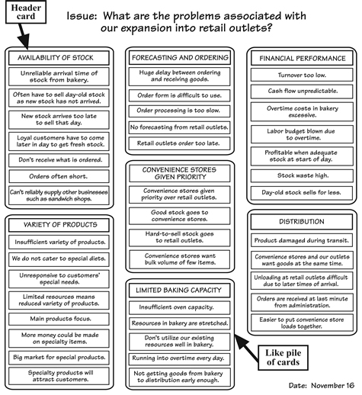
How it looks like
KJ Method or Affinity Diagram
Is the most effective when
1- the issue is complex
2- the issue is unorganized
3- the issue requires the involvement and support of a group

Slide 35
One
Affinity Diagram or KJ Method
Choose a facilitator.
The facilitator is responsible for leading the group through the steps to make the affinity diagram.
State the issue or problem.
Before beginning, the group should state the issue or problem to be addressed. It is often useful to state the problem in the form of a question. In the example, the question is, “What are the problems associated with our expansion into retail outlets?” It is essential that the group understands the aim of the session.

Slide 36
One
Affinity Diagram or KJ Method
Brainstorm and record ideas.
Next, brainstorm ideas concerning the issue statement. Brainstorming for ideas to make an affinity diagram uses a mixture of traditional brainstorming and the Crawford slip method. In traditional brainstorming, individuals generate ideas, which they voice in turn. Ideas are given by each person in the group until no one has anything else to add. In the Crawford slip method, ideas are recorded on index cards, slips of paper, or sticky notes, in silence. There is no verbal exchange. Brainstorming for the affinity diagram uses a mixture of these two approaches.

Slide 37
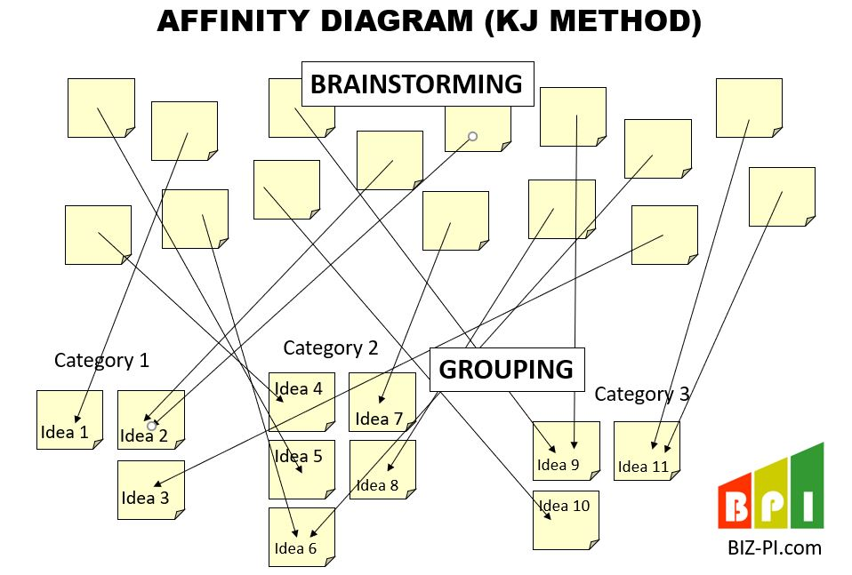
One
Affinity Diagram or KJ Method

Slide 38
One
Affinity Diagram or KJ Method
Importance of affinity Diagram
Find creative solutions to difficult problems by involving people from diverse fields
Sort through large volumes of confusing data and quickly organize them in a logical, easy-to-understand manner
Encourage the participation of everyone involved, which leads to uncovering new patterns of thinking and unique solutions
Generate useful discussions that will lead to innovation/ effective solutions
Present your analysis to others in the company in an easy-to-understand manner

Slide 39
Conclusion
Product analysis
Many different types of analyses can be done on a product.
There is a difference between product screening, ladle analysis and product analysis
But customer analysis and product analysis are interlocked
“ Without product analysis, you would be flying blind and making decisions based on guesswork.”

Slide 40
Wrap Up
Product analysis
The Importance of Product Analysis
Examining the Difference Between Product Screening and Product Analysis
What Is the Difference Between Customer Analysis and Product Analysis?
Difference Between Ladle Analysis and Product Analysis
KJ Method of product analysis

Slide 41
Product Analysis and Development
Prepared by Dr. Aya Mohamed
Lecture 1
Thank You

