Slide 1


Accreditation in Healthcare
(Part II)
Prepared by Dr. Hesham Mousli
MHA623
Healthcare Quality
Lecture 10

Slide 2

Our Roadmap
Quality improvement methodologies Overview
Common planning tools
Six-Sigma methodology
1
3
5
2
4
6
Planning phase orientation
PDCA cycle
Accreditation overview

Slide 3

Intended Objectives
Chapter
10
Define the purpose and structure of JCI accreditation.
List key benefits of JCI for healthcare facilities.
Recognize main components of JCI standards.
Relate standards to patient care and safety.
Understand leadership and ethics in accreditation.

Slide 4
Overview
Chapter
10
JCI: Joint Commission International – a global leader in healthcare accreditation.
Aim: Improve patient safety and quality of care worldwide.
Manual: Structured into chapters covering care functions, eligibility, and accreditation processes.

Slide 5

Value of JCI Accreditation
Chapter
10
Recognized Gold Seal of Approval®.
Boosts hospital’s competitive edge and credibility.
Required by many insurers and agencies.
Drives performance improvement and high reliability.
Enhances staff education and leadership in safety.
Provides expert support and continuous learning.

Slide 6
Standards Development Process
Chapter
10
Involves focus groups, literature reviews, expert input.
Guided by global trends and evidence-based practices.
Reviewed by Technical Advisory Panel.
Public feedback via online field review.
Revisions based on feedback, legal/regulatory needs, and evolving practices.

Slide 7
Organization of the Hospital Accreditation Manual
Chapter
10
Section I: Accreditation Participation Requirements (APRs).
Section II: Patient-Centered Standards.
Section III: Health Care Organization Management Standards.
Section IV: Global Health Impact Standards.
Section V: Academic Medical Center Standards.
Appendices include: Patient Safety Systems, Sentinel Event Policy, etc.

Slide 8
Key Elements in Each Standards Chapter
Chapter
10
Overview: purpose of the chapter.
Standards List: detailed structure.
Intent: explains rationale behind the standard.
Measurable Elements (MEs): scoring criteria for compliance.
Examples & Notes: help clarify expectations

Slide 9
Documentation Requirements
Chapter
10
Marked with icon D when required.
Focus on implementation, not just paperwork.
Documents may include policies, reports, licenses, etc.
Can be electronic or paper-based.

Slide 10

Chapter
Section I
Accreditation Participation Requirements (APRs)

Slide 11
Accreditation Participation Requirements (APR)
Chapter
10
Submit accurate information to JCI and report changes (e.g., services, leadership).
Grant JCI surveys and access to external evaluation reports.
Use quality measures for continuous improvement.
Only accredited hospitals can display the Gold Seal.
Protect staff reporting safety concerns from retaliation and notify the public on how to report concerns.
Ensure no "Immediate Threat to Health or Safety" exists.

Slide 12
Chapter
Section II
Patient-Centered Standards

Slide 13
Access to Care and Continuity of Care (ACC)
Chapter
10
Overview :
  Focuses on matching patient needs with services and ensuring smooth transitions.
Key Standards :
  Admission: Prioritize urgent cases; inform patients of delays.
  Patient Flow: Educate patients/families on care plans and costs at admission.
  Discharge/Transfer: Plan for continuing care; provide summaries for transfers.
  Transportation: Ensure safe, compliant transport services.

Slide 14
Assessment of Patients (AOP)
Chapter
10
Overview :
  Identifies patient needs through history, physical, and ongoing reassessment.
Key Standards :
  Initial Assessment: Includes physical, psychological, social, and pain screening.
  Falls Prevention: Implement processes to reduce fall risks.
  Lab/Imaging Services: Ensure quality, timely results, and equipment safety.
  Blood Transfusion: Follow guidelines for safe handling and administration.

Slide 15
Anesthesia and Surgical Care (ASC)
Chapter
10
Overview :
  Covers sedation, anesthesia, and surgical care with a focus on safety.
Key Standards :
  Sedation: Standardize practices; qualify practitioners; document risks/benefits.
  Anesthesia: Conduct pre-anesthesia assessments; monitor physiological status.
  Surgery: Plan care pre/post-op; discuss risks/alternatives; document procedures.

Slide 16
Care of Patients (COP)
Chapter
10
Overview :
  Ensures individualized, coordinated care for all patients, including high-risk groups.
Key Standards :
  Care Plans: Develop and modify based on patient needs.
  High-Risk Services: Follow guidelines for resuscitation, suicide prevention, and pain management.
  Transplant Programs: Oversee donor/recipient processes; ensure informed consent.
  End-of-Life Care: Address comfort, dignity, and family needs.

Slide 17
International Patient Safety Goals (IPSG)
Chapter
10
Overview :
  Mandatory goals to address critical safety areas.
Key Goals :
  Correct Identification: Prevent errors with standardized patient ID processes.
  Communication: Report critical test results; standardize handovers.
  Medication Safety: Manage high-alert and look-alike/sound-alike medications.
  Safe Surgery: Verify procedures with time-outs and site marking.
  Infection Prevention: Implement hand hygiene guidelines.

Slide 18
Medication Management and Use (MMU)
Chapter
10
Overview :
  Medications are vital for diagnosis, treatment, and prevention.
  Medication errors are a leading cause of preventable harm globally.
  Errors can occur at all stages: prescribing, dispensing, administration, and monitoring. we must do our best to prevent them.

Slide 19
Medication Management and Use (MMU)
Chapter
10
Key Standards :
  Organization: Manage medication processes, antimicrobial stewardship, and recall systems.
  Storage: Ensure safe storage, especially for emergency medications.
  Prescribing: Define qualified prescribers and safe practices (e.g., reconciliation).
  Dispensing/Administering: Ensure right dose, patient, and time.
  Monitoring: Track adverse drug events and errors.

Slide 20
Patient-Centered Care (PCC)
Chapter
10
Overview :
  Care must respect patient/family needs, values, and cultural beliefs.
  Education and informed consent are critical for decision-making.
Key Standards :
  Rights: Protect privacy, confidentiality, and access to information.
  Engagement: Involve patients/families in care decisions (e.g., treatment refusal).
  Education: Assess and document patient learning needs.
  Complaints: Provide a process for reporting concerns/errors.

Slide 21
Chapter
Section III
Health Care Organization Management Standards

Slide 22
Facility Management and Safety (FMS)
Chapter
10
Overview :
  Ensure safe, functional facilities by managing risks (e.g., fire, utilities, hazards).
Key Standards :
  Safety/Security: Comply with laws; inspect facilities regularly.
  Hazardous Materials: Proper handling and disposal.
  Emergency Preparedness: Plan for disasters/epidemics.
  Medical Equipment: Maintain and monitor for recalls.
  Utilities: Ensure water/energy availability and quality.

Slide 23
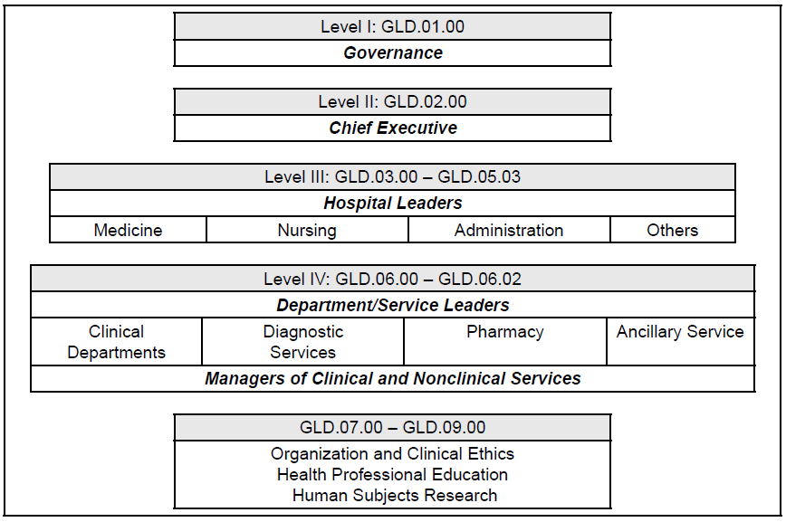
Governance, Leadership, and Direction (GLD)
Chapter

Slide 24
Governance, Leadership, and Direction (GLD)
Chapter
10
Overview :
  Effective leadership is essential for quality/safety culture.
Key Standards :
  Structure: Define roles of governance, executives, and departments.
  Quality/Safety: Prioritize improvement initiatives and measure outcomes.
  Ethics: Promote ethical decision-making and patient rights.
  Contracts: Ensure qualified staff and safe supply chains.

Slide 25
Health Care Technology (HCT)
Chapter
10
Overview :
  Technology (EHRs, AI, telehealth) enhances care but requires oversight.
Key Standards :
  IT Management: Protect data privacy and cybersecurity.
  Telehealth/AI: Ensure guidelines for safe use.
  Downtime Plans: Prepare for system failures.

Slide 26
Management of Information (MOI)
Chapter
10
Overview :
  Effective information management prevents communication errors.
Key Standards :
  Confidentiality: Secure patient data against breaches.
  Standardization: Use uniform codes/abbreviations.
  Medical Records: Maintain accurate, accessible records.

Slide 27
Prevention and Control of Infections (PCI)
Chapter
10
Overview :
  Healthcare Associated Infections (HAIs) are a major risk; prevention requires hospital-wide efforts.
Key Standards :
  Program Oversight: Assign qualified leaders for infection control.
  Equipment/Sterilization: Proper cleaning and disposal.
  Transmission Prevention: Protect staff/patients from outbreaks.
  Education: Train staff on hygiene and protocols.

Slide 28
Quality and Patient Safety (QPS)
Chapter
10
Overview :
  Data-driven improvements enhance care outcomes.
Key Standards :
  Measurement: Collect/analyze data to identify trends.
  Improvement: Prioritize and sustain changes.
  Risk Management: Proactively reduce adverse events.

Slide 29
Staff Qualifications and Education (SQE)
Chapter
10
Overview :
  Qualified staff are critical for safe care.
Key Standards :
  Credentials: Verify licenses and competencies.
  Training: Provide orientation and ongoing education.
  Health/Safety: Vaccinate staff and prevent workplace violence.

Slide 30
Chapter
Section IV
Global Health Impact Standards

Slide 31
Global Health Impact (GHI)
Chapter
10
Overview :
  Hospitals must address climate risks and sustainability.
Key Standards :
  Governance: Integrate environmental strategies.
  Resource Use: Reduce energy/water waste.
  Supply Chain: Minimize environmental impact.

Slide 32
Chapter
Section V
Academic Medical Center Standards

Slide 33
Human Subjects Research (HRP)
Chapter
10
Overview :
  Protect participants in clinical research.
Key Standards :
  Ethics Review: Institutional Review Board (IRB) oversight for all studies.
  Safety: Manage conflicts of interest and adverse events.

Slide 34
Medical Professional Education (MPE)
Chapter
10
Overview :
  Ensure quality/safety in teaching settings.
Key Standards :
  Supervision: Trainees must be overseen by qualified staff.
  Compliance: Align education with hospital policies.

Slide 35
Wrap Up
Chapter
10
JCI promotes global patient safety and quality.
Manual covers clinical and management standards.
Standards include intent, measures, and docs.
Patient-centered care is a core focus.

Slide 36
Wrap Up
Chapter
10
  Safe medication use is essential.
  Infection control requires system-wide effort.
  Leadership ensures safety culture and improvement.
  IRB ensures ethical research practices.

Slide 37



Thank You

