Slide 1


Slide 2
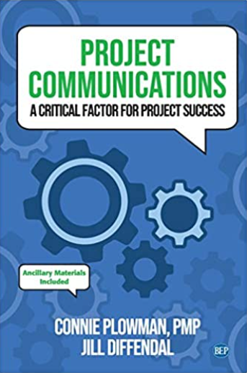
Project communications

Slide 3
Project communications
Miscommunication is the biggest culprit in project failures. When changes and updates are not communicated correctly and on time, it creates confusion among coworkers and different departments. This confusion further leads to errors, missed steps in process, conflicts, and more. All these scenarios will ultimately result in delays or budget over.
Because project teams often comprise of professionals with a diverse range of backgrounds and skills, communication is crucial in order to keep each professional informed and on-task. Project managers spend much of their time as leaders communicating to their team to ensure the success of the project.

Slide 4
The book aims to:
This book presents a new way to look at communication within projects. It combines real-world examples and practical tips with theory, research, and professional standards you can apply to any size and type of project.
Gain actionable insights into identifying your audience, choosing the right tools, managing change, and handling conflict. Expand your professional toolkit with templates, activities, and resources. Develop your project communications expertise with reflective questions and recommendations.

Slide 5

After completing this course you will be able to:
Understand why people communicate by looking at two different communication theories that focus on communication as a way people handle uncertainty
Understand why project communication is so important
Trace the evolution of project communications

Slide 6
After completing this course you will be able to:
See the connection between effective communication and stakeholder trust
Evaluate the impact of the quality as well as the quantity of communication in a project
Put a Project communication plan between the different parties of the project

Slide 7
Outline of the Book
The book is organized into five distinct parts.
Overview on communication theory and Audience
Planning Project communication
Managing and Monitoring project communications
Communication tools and change
Managing conflicts through communication

Slide 8

Communication skills
Chapter 1
Introduction to Project communication
Improvement of project communication stages
Exploring Communication Theories
Uncertainty and Effective communication

Slide 9
Communication skills
Chapter 2
Defining Audience
Prioritizing Stakeholders
Stakeholder engagement

Slide 10
Communication skills
Chapter 3
Project Kick-Off meeting
The project Plan

Slide 11
Communication skills
Chapter 4
Managing communications
Monitoring communications
Putting it into Practice

Slide 12
Communication skills
Chapter 5
Managing communications
Monitoring communications
Putting it into practice

Slide 13
Communication skills
Chapter 6
Choosing the right tools
Communication tools
Putting it into practice

Slide 14
Communication skills
Chapter 7
Communication tools- part 2
Putting it into practice
Change management
ACMP’s Standard Change Management

Slide 15
Communication skills
Chapter 8
Team Personal pitfalls
Team Process pitfalls
Managing Conflict with Stakeholders

Slide 16
Communication skills
Chapter 9
Team Structure
Team development

Slide 17
Communication skills
Chapter 10
Various Approaches to Virtual Communication
Leadership styles to communicate to distributed teams

Slide 18

What I expect from you?

Slide 19

What I expect from you?

Slide 20



What I expect from you?

Slide 21

What I expect from you?

Slide 22

What I expect from you?
merna@esu.ac.ae

Slide 23


