Slide 1




Project Leadership
Lecture 9
PMG 511
Ch9 – Decision-making: An Essential Leadership Skill
Prepared by
Dr Hakem Sharari
www.midocean.ae

Slide 2
Chapter
Learning Outcomes
09
What is decision-making ?
decision-making and leadership
Importance of Decision-Making
Types of decision-making
decision-making style
Stages of decision-making process/ models
decision-making from leaders perspective
Decision-making skills.
Summary and Conclusions.
www.midocean.ae

Slide 3

Chapter
09
www.midocean.ae

Slide 4
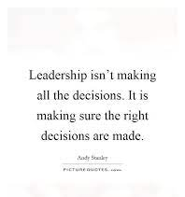
Chapter
09
www.midocean.ae

Slide 5
Chapter
What is Decision-making?
09
www.midocean.ae

Slide 6
Chapter
What is Decision-making?
09
Please write a One Sentence Definition of
Decision-making
www.midocean.ae

Slide 7
Chapter
What is Decision-making?
09
“Decision-making involves the selection of a course of action from among two or more possible alternatives in order to arrive at a solution for a given problem”.
George R Terry
www.midocean.ae

Slide 8
Chapter
What is Decision-making?
09
It is a cognitive function concerned with the process of reflecting on the consequences of a certain choice (Senik at al., 2012).
Decision-making is vital to all management activities.
Throughout the business cycle, decisions are usually made to attain the objectives of the business.
Decisions must be made. Every aspect of management functions, such as planning, organizing, and control is determined by decisions, the result of which is the performance in the organization.
www.midocean.ae

Slide 9
Chapter
Decision-making Process
09
Decision-making process: the process by which managers/leaders respond to opportunities and threats by analyzing options, and making decisions about goals and courses of action.
Decisions in response to opportunities: managers/leaders respond to ways to improve organizational performance.
Decisions in response to threats: occurs when managers/leaders are impacted by adverse events to the organization.
www.midocean.ae

Slide 10
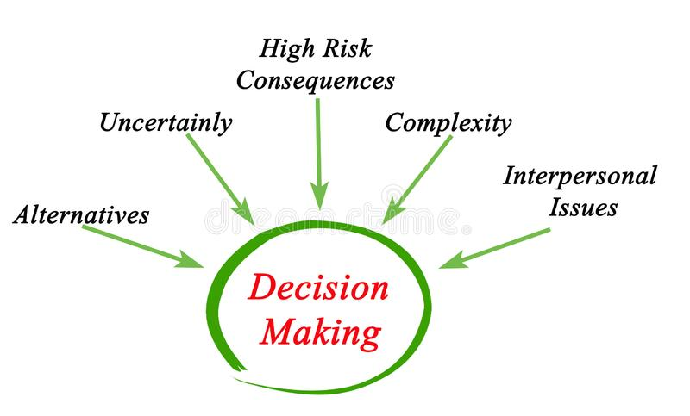
Chapter
Making Effective Decisions
09
Factors:
 Perception.  Goals.
 Priority.  Values.
 Acceptability.  Demands.
 Risk.
 Resources.
 Style.
 Judgement
www.midocean.ae

Slide 11
Chapter
Decision-making and Leadership
09
www.midocean.ae

Slide 12
Chapter
Great Leaders are Great Decision-makers
09
Decision-making is the key skill in the workplace and very important for leaders.
Great leaders understand how to balance emotion with reason and make decisions that positively impact themselves, their employees, their customers and stakeholders, and their organizations.
The decision-making process is a crucial leadership function that is increasingly becoming convoluted due to technological and politico-socio-economic factors.
www.midocean.ae

Slide 13
Chapter
Great Leaders are Great Decision-makers
09
- A leader's decisions can be characterized by routine, but they can also be acute or strategic.
Being able to effectively make individual and group decisions is the primary action that defines who a leader is, what a leader does, and what a leader can accomplish for his or her organization.
www.midocean.ae

Slide 14
Chapter
Importance of Decision-making
09
www.midocean.ae

Slide 15
Chapter
Importance of Decision-making
09
Leaders perform all their skills through decision-making.
Making right decision in right times values much to the project.
Helps the management to procure necessary data and information.
Helps to initiate and complete the action of all the activities of the management in the right time.
Helps in the formation of strategies and implement them.
www.midocean.ae

Slide 16

Chapter
Essentials for Effective Decision-making
09
Accuracy.
Environment for decision.
Timely decision .
Communication of decision.
Participative decision-making.
Implementation of decision.
www.midocean.ae

Slide 17

Chapter
Difficulties in Decision-making
09
Incomplete Information.
Un-supporting environment.
Non-acceptance by subordinates.
Ineffective Communication.
Incorrect timing.
www.midocean.ae

Slide 18
Chapter
Types of Decision-making
09
www.midocean.ae

Slide 19
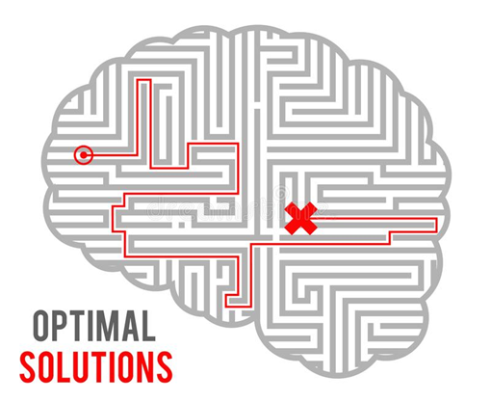
Chapter
Types of Decision-making
09
1. Basic Decision or Strategic Decisions
All basic decision is strategic decisions involving large range commitments and large investments.
Slight or small mistakes in these decisions would seriously injure the entire organizations.
www.midocean.ae

Slide 20
Chapter
Types of Decision-making
09
2. Administrative Decisions
Non-programmed Decisions:
Unusual situations that have not been often addressed.
No rules to follow since the decision is new.
These decisions are made based on information, and a leader’s intuition, and judgment.
Example: Should the firm invest in a new technology?
Programmed Decisions:
Routine, almost automatic process.
Leaders have made decision many times before.
There are rules or guidelines to follow.
Example: Deciding to reorder office supplies.
www.midocean.ae

Slide 21
Chapter
Types of Decision-making
09
3. Major and Minor Decisions.
4. Policy and operative Decisions.
5. Organizational and Personal Decisions.
The highest level of Organizational decisions is referred to as strategic decisions. These decisions affect an organization's general direction, long-term objectives, philosophy and values. Uncertainty is generally high. The middle level is referred to as tactical decisions. These support the strategic decisions, and tend to be of moderate importance and to have moderate impact. The lowest level is known as operational decisions.
6. Individual and Group Decisions.
7. Long-term and short-term Decisions.
8. Departmental Decisions.
www.midocean.ae

Slide 22
Chapter
Types of Decision-making
09
9. Non-economic decisions: relate to values, moral behavior, etc.
10. Crisis and research Decisions: Crisis decisions are those which are made to meet unanticipated situations. Mostly made immediately under pressure of the circumstances.
Research Decisions are made after thorough analysis without any pressure.
11. Initiative and forced Decisions
12. Problem and opportunity Decisions:
Problem decisions= resolving Problem situations which have arisen as anticipated or not...,
opportunity decisions= pertain to taking advantage of an opportunity...sometimes involves risk
Decisions in response to opportunities: managers/leaders respond to ways to improve organizational performance.
Decisions in response to threats: occurs when managers/leaders are impacted by adverse events to the organization.
www.midocean.ae

Slide 23
Chapter
Decision-making Styles
09
www.midocean.ae

Slide 24
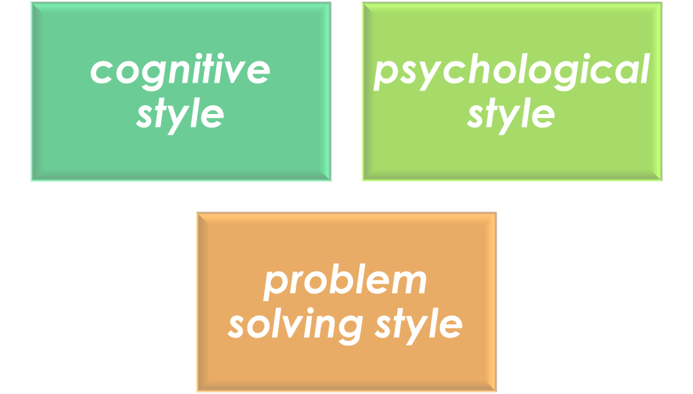
Chapter
Decision-making Styles
09
Decision style has been referred to as:
www.midocean.ae

Slide 25
Chapter
Decision-making Styles
09
Cognitive style is the information processing habits of an individual.
Myers and Briggs (1995) explain that psychology type is a theory to explain the normal differences between healthy people.
The Center for Creative Learning (2013) defines problem solving style as the “consistent individual differences in the ways people prefer to deal with new ideas, manage change, and respond effectively to complex, open-ended opportunities and challenges.”
www.midocean.ae

Slide 26
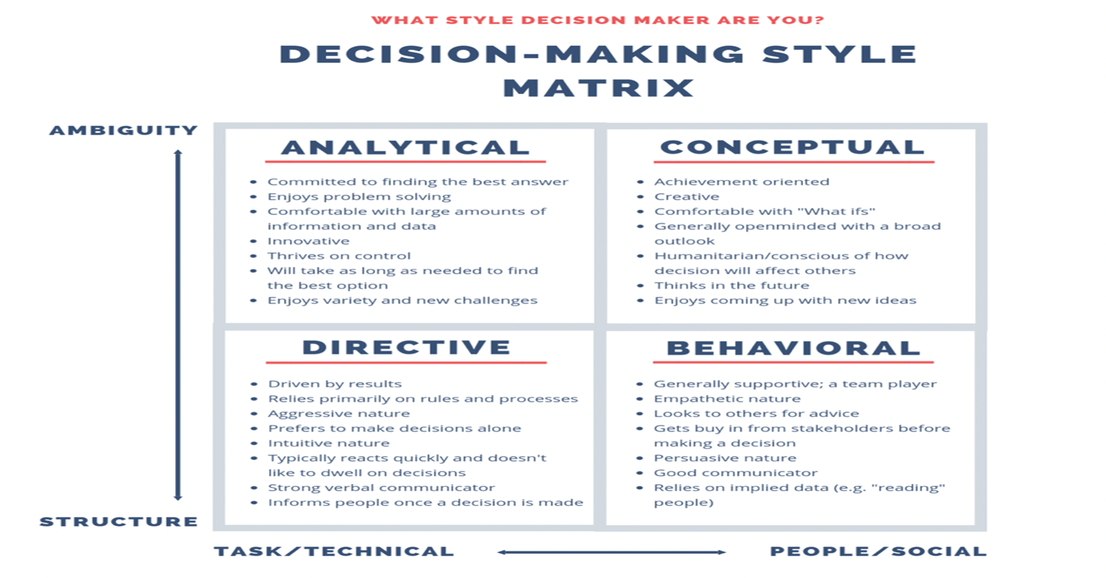
Chapter
Decision-making Styles
09
www.midocean.ae

Slide 27
Chapter
Stages of Decision-making Process/Models
09
www.midocean.ae

Slide 28
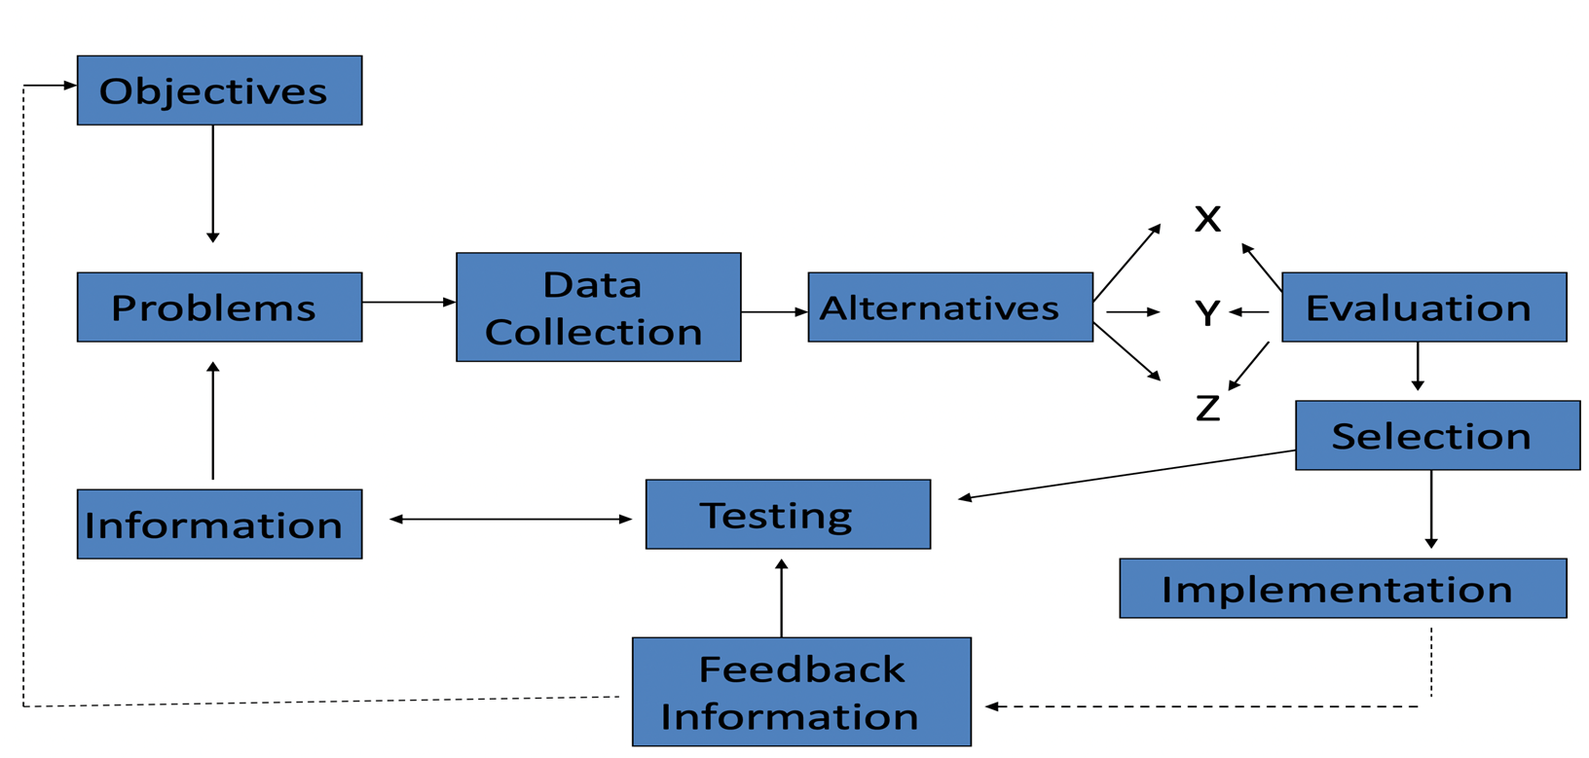
Chapter
Stages of Decision-making Process
09
www.midocean.ae

Slide 29
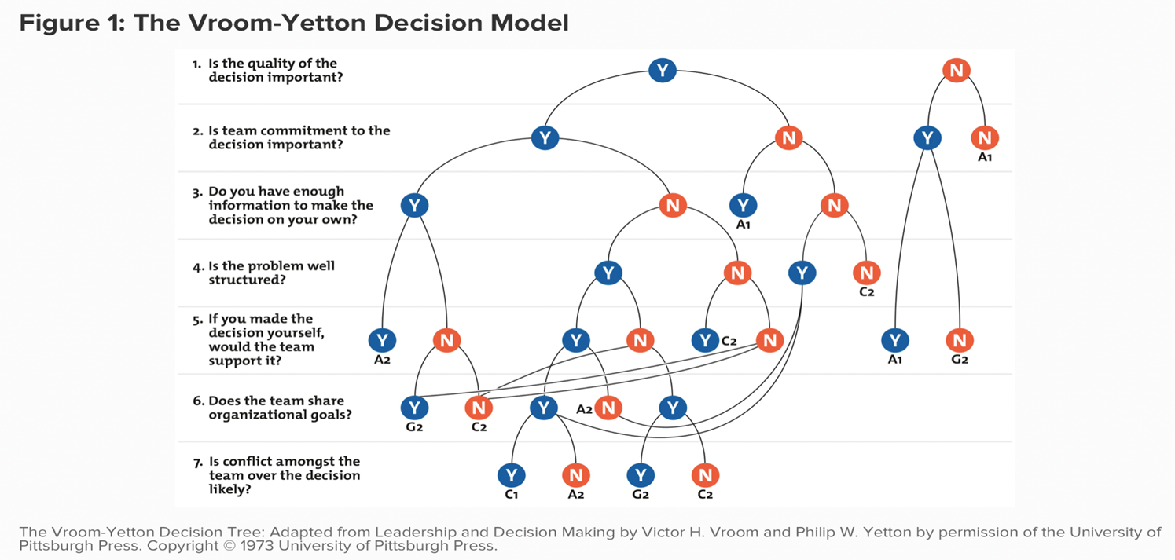
Chapter
Decision-making Models
09
1. Normative Model
• Seven steps are identified in the analytical precise model.
www.midocean.ae

Slide 30
Chapter
Normative Model
09
The following codes represent the five decision-making processes that are described by the model:
Autocratic (A1): You use the information that you already have to make the decision, without requiring any further input from your team.
Autocratic (A2): You consult your team to obtain specific information that you need, and then you make the final decision.
Consultative (C1): You inform your team of the situation and ask for members' opinions individually, but you don't bring the group together for a discussion. You make the final decision.
Consultative (C2): You get your team together for a group discussion about the issue and to seek their suggestions, but you still make the final decision by yourself.
Collaborative (G2): You work with your team to reach a group consensus . Your role is mostly facilitative, and you help team members to reach a decision that they all agree on.
Shows the Vroom-Yetton model. The framework poses seven "yes/no" questions, which you need to answer to find the best decision-making process for your situation.
As you answer each of the questions, you work your way through a decision tree until you arrive at a code (A1, A2, C1, C2, or G2). This code identifies the best decision-making process for you and your team. (Note that, in some scenarios, you won't need to answer all of the questions.)
www.midocean.ae

Slide 31
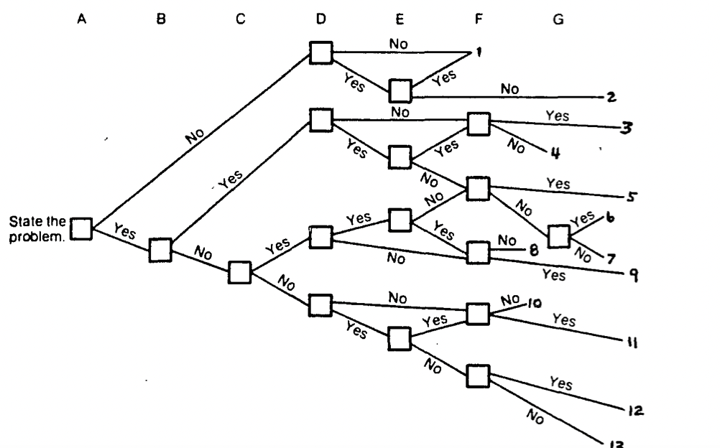
Chapter
Decision Tree Model
09
- Every path through the tree corresponds to a possible sequence of actions and events, each with its own distinct consequences.
- Probabilities of both positive and negative consequences of each action and event are estimated and recorded on the appropriate branch.
www.midocean.ae

Slide 32
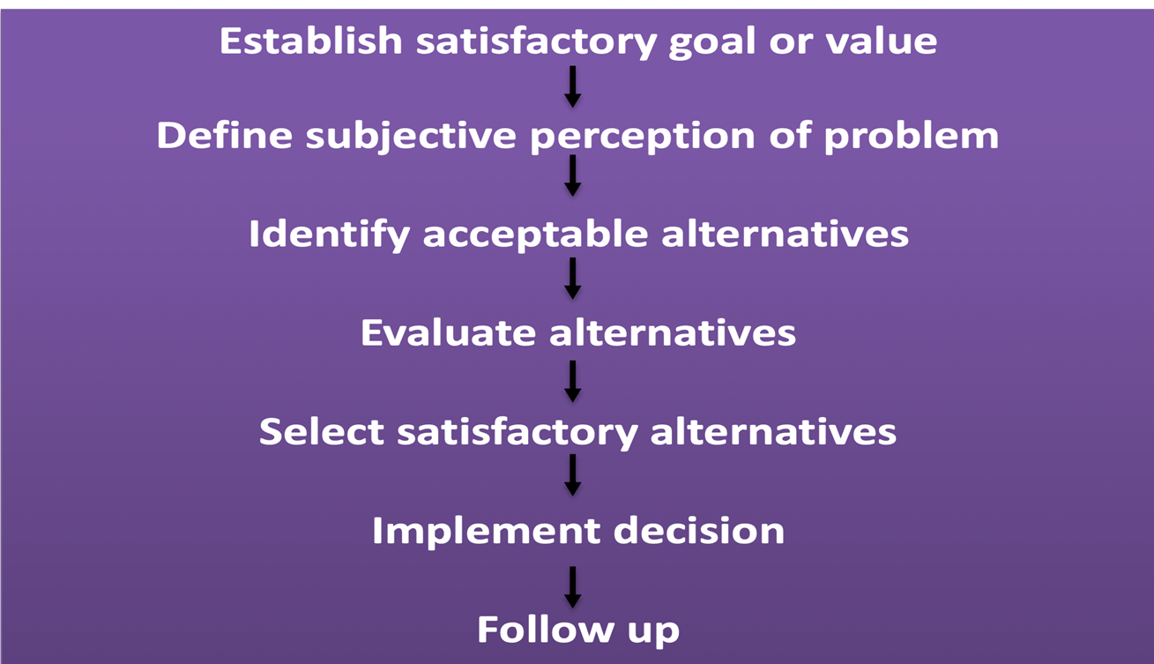
Chapter
Descriptive Model of Decision-making
09
www.midocean.ae

Slide 33
Chapter
Types of Decision-making Environments
09
Under certain environments:
- Exist when information is insufficient to predict the results of each alternative in advance of implementation.
Decision-making under uncertainty:
• In making decision under uncertainty, the decision maker knows with certainty what conditions will subsequently occur and affect the decision outcomes.
Decision-making under risk:
• In making decision under risk, the probabilities are used to obtain expected values of outcomes for each decision alternative.
www.midocean.ae

Slide 34
Chapter
Types of Decision-making Environments
09
Under uncertain environments:
In some cases a decision maker cannot assess the probability of occurrence for the various states of nature. so little information that they cannot even assign probabilities to various alternatives and possible outcomes.
Uncertainty forces decision makers to rely individual and group creativity to succeed in problem solving.
When no probabilities are available, the situation is referred to as making decision under uncertainty.
www.midocean.ae

Slide 35
Chapter
Types of Decision-making Environments
09
Under risky environments:
-Exist when decision makers lack complete certainty regarding the outcomes of certainty regarding the outcomes of various courses of action, but they can assign probabilities of occurrence.
-Probabilities can be assigned through objective statistical procedures or personal
intuition.
- Expected value
The product of a payoff and its probability of occurrence.
- Decision tree
A branching diagram that illustrates the alternatives.
www.midocean.ae

Slide 36
Chapter
Decision-making From Leaders’ Perspective
09
www.midocean.ae

Slide 37

Chapter
Decision-making From Leaders’ Perspective
09
-How to analyze decision problems and arrive at solutions?
-How to work with information and knowledge?
- How to take principled risks ?
- How to overcome obstacles ?
-How to handle personality issues, group dynamics and organizational culture in order to shape decisions ?
- How to master pressure, crises, conflicts and stress in decision-making ?
-How to master techniques and personal growth?
www.midocean.ae

Slide 38

Chapter
Decision-making From Leaders’ Perspective
09
Any successful organization/ project must have effective leaders, and effective leaders must be able to make important decisions.
www.midocean.ae

Slide 39
Chapter
Decision-making From Leaders’ Perspective
09
1- Sense-making:
With the help of sense-making it is possible for leaders to:
- Leaders Change their perceptions so they become mutually consistent.
- Modify always their goals and expectations .
2- Culture:
- The leader of is usually in the best position to be able to influence the team’s own culture.
- Leaders can express culture through their personality, their role and their way of being, and may thus provide a platform to change the culture.
www.midocean.ae

Slide 40
Chapter
Decision-making From Leaders’ Perspective
09
3- Decision and leader's perception:
Different leaders learn from their experiences in different ways, and there are three basic factors that can influence leaders to learn from their strategic experiences:
Reflection. Leaders who are good at learning tend to have a «high reflection index». This means that they actively reflect on what move they should have made in a strategic game.
Change. how fast the surroundings change.
3. Dedication. There is a tendency among leaders to repeat what has previously worked well. This can lead to very good performance.
www.midocean.ae

Slide 41
Chapter
09
4- Leader power
-In order to exercise leadership, a leader must have access to power.
-Leaders use power as an important means to achieve goals. a leader must, in order to exercise leadership, also focus on his or her leadership style. Exercising power.
5- Ethical aspects of decision-making
-Leadership research indicates that there are a number of key ethical decision- making perspectives that govern decisions: Ex: The fairness perspective
www.midocean.ae

Slide 42
Chapter
09
6- Creative Problem Solving
- Successful leaders are often willing to experiment actively with innovative ways of solving their problems.
- Creative problem-solving processes are characterized by leaders exploring many possible solutions on a general level.
7- To take risks
- One way to minimize risks by leaders is to draw up a list of all possible negative consequences of a given decision and assess their likelihood.
www.midocean.ae

Slide 43
Chapter
09
8- Facilitating leadership decisions:
-A very important decision for a leader is determining who should be included in the decision-making process, and how (Vroom and Yetton, 1973; Vroom and Yago, 1988; Sowell, 1996).
-The leader makes a decision first and then searches for information.
-The challenge for the leader is thus to be a good listener.
9- Making future predictions
-Leaders must ensure that all relevant variables and options are included in the forecast.
www.midocean.ae

Slide 44
Chapter
09
10- Leadership decisions under stress :
-When leaders are able to balance their professional and personal lives, they also feel the power to control their situation. The power of one's life is also about the balance between responsibility and authority.
-If leaders feel that they have responsibilities that they cannot manage or do not have time for, the work environment must be permissive.
www.midocean.ae

Slide 45
Chapter
09
11- Being able to build trust
-Communication is important for a leader to be able to enjoy trust.
-Communication helps to create an environment of trust around leaders that allows them to lead more effectively, engage employees and deliver results. Leaders can use both formal and informal ways of communicating.
-Leader, one has to create transparency.
12- Presenting ideas
-When ideas are to be presented, it is important that they be structured clearly.
Leaders must start with themselves.
www.midocean.ae

Slide 46
Chapter
09
13- Self-leadership and decision-making
-General list of recommendations that are useful for leaders who want to develop their own skills. These include:
-To develop a personal vision for what you want to accomplish in your career.
-To seek challenging tasks and work assignments.
-To improve self-monitoring.
-To seek relevant feedback.
-To learn from your mistakes.
-When a leader has analyzed his or her fundamental values, it is time to set goals and prioritize between them. Setting goals is ultimately about giving daily efforts focus and meaning. Leaders therefore need to specify both long-term and short-term goals.
www.midocean.ae

Slide 47
Chapter
09
14- Leadership styles
-Leadership style has a high influence in decision-making.
-Authoritative decision style calls for an Autocratic leadership approach.
-A facilitative decision-making style will usually attracts democratic or contingency approach of leadership.
-Delegative, consultative and flexible decision-making styles attract democratic, participative and transformational leadership style.
www.midocean.ae

Slide 48
Chapter
Decision-making Skills
09
www.midocean.ae

Slide 49
Chapter
Decision-making Skills
09
Decision-making skills essential to leaders include:
Problem-solving skills
Logical reasoning
Emotional Intelligence
Collaboration
Creativity
www.midocean.ae

Slide 50
Chapter
Summary and Conclusions
09
www.midocean.ae

Slide 51
Chapter
Summary and Conclusions
09
- Decision-making is vital to all management activities.
- Decision-making is the key skill in the workplace and very important for leaders.
- There are different types of decision.
- There are stages to follow for decision-making process.
- Leaders able to make a decision under certain Environments
- Effective leaders must be able to make important decisions.
www.midocean.ae

Slide 52
Chapter
Resources
09
A leadership perspective on decision-making, by Marcus Selart.
Leadership: Theory and Practice, 7th Edition
Leadership and Decision-Making by Victor H. Vroom , Philip W. Yetton
www.midocean.ae

Slide 53

Chapter
Reference
09
www.midocean.ae

Slide 54


Thank You

