Slide 1
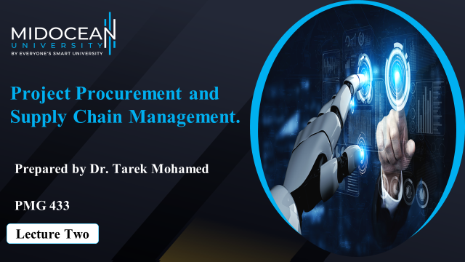

Slide 2


Learning Objectives
1-Discuss the way we manage supply chain and explain the
benefits and impact of supply chain decisions on the success
of a firm.
2-Identify the critical areas of the supply chain.
3-Explain the value drivers in project SCM.
4-Describe the project supply chain process framework.
5-Explain the performance metrics in project supply chain.
www.midocean.ae

Slide 3

Understanding the role of supply chain in project management
Supply chain management is a set of approaches utilized to efficiently and fully integrate the network of all organizations and their related activities in producing/completing and delivering a product, a service, or a project so that system wide costs are minimized while maintaining or exceeding customer-service-level requirements.
This definition implies that a supply chain is composed of a sequence of organizations, beginning with the basic suppliers of raw materials, and extends all the way up to the final customer.
www.midocean.ae

Slide 4
Understanding the role of supply chain in project management
Supply chains are often referred to as value chains, as value is added to the product, service, or project as they progress through the various stages of the chain.
Each organization in the supply chain has two components: an inbound and an outbound component.
The inbound component for an organization may be composed of suppliers of basic raw materials and components, along with transportation links and warehouses, and it ends with the internal operations of the company.
The outbound component begins where the organization delivers its output to its immediate customer.
www.midocean.ae

Slide 5
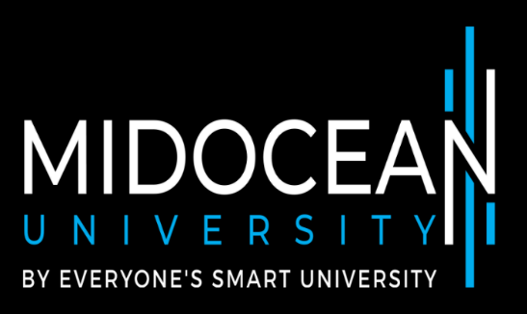
Understanding the role of supply chain in project management
This portion of the supply chain may include wholesalers, retailers, distribution centers, and transportation companies, and it ends with the final consumer in the chain.
The length of each component of the supply chain depends on the nature of the organization.
For a traditional make-to-stock manufacturing company,the outbound or the demand component of the chain is longer than the inbound or supply component.
For a project organization, the inbound component is typically longer than the outbound component.
FIGURE 1-1
Notes:
Notes:
Supply chain involves everybody, from the customer all the way to the last supplier.
Key flows in the supply chain are - information, product, and cash. It is through these flows that a supply chain fills a customer order. The management of these flows is key to the success or failure of a firm. Give Dell & Compaq example, Amazon & Borders example to bring out the fact that all supply chain interaction is through these flows.

Slide 6
SCM Benefits
Companies that effectively manage their supply chain accrue a number of benefits.
Companies that manage their total supply chain from suppliers’ supplier to customers’ customer have achieved enormous payoffs, such as 50 percent reduction in inventories and 40 percent increase in ontime deliveries.
Effective SCM has enabled Campbell Soup to double its inventory turnover rate, Hewlett-Packard reduced its printer supply costs by 75 percent, profits doubled and sales increased by 60 percent for Sport Obermeyer in two years, and National Bicycle achieved an increase in its market share from 5 percent to 29 percent.
www.midocean.ae

Slide 7
SCM Benefits
Companies such as Wal-Mart that have better managed their supply chain have benefited from greater customer loyalty, higher profits, shorter lead times, lower costs, higher productivity, and higher market share. These benefits are not restricted to traditional manufacturing or retail businesses.
Organizations that manage projects can enjoy similar benefits by effectively managing their supply chains.
www.midocean.ae

Slide 8
Critical Areas of SCM
Effective supply chain management requires companies to focus on the following critical areas: customers, suppliers, design and operations, logistics, and inventory.
Customers are the driving force behind supply chain management. Effective supply chain management, first and foremost, requires a thorough understanding of what the customers want.
In a project environment, determining customer requirements and integrating the voice of the customer by working with the customer throughout the project will in all likelihood lead to a satisfied customer and project success.
An important mechanism to achieve such a customer focus in projects is the integration of all project activities and participants into the larger framework of supply chain management.
www.midocean.ae

Slide 9
Critical Areas of SCM
Suppliers constitute the back-end portion of the supply chain and play a key role in adding value to the chain. Their ability to provide quality raw materials and components when they are needed at reasonable cost can lead to shorter cycle times, reduction in inventory related costs, and improvement in end-customer service levels.
The relationship between suppliers and buyers in the supply chain has been adversarial, as each was interested in their own profits and made decisions with no regard to their impact on other partners in the chain.
Supplier partnering is vital for effective supply chain management, and without the involvement, cooperation, and integration of upstream suppliers, value optimization in the total supply chain cannot be a reality
www.midocean.ae

Slide 10
Critical Areas of SCM
For project-based organizations, this issue is even more critical, as the supply or back-end portion of the chain is typically long, and without the total involvement of each and every supplier, value enhancement and project supply chain performance will be less than optimal.
For example, in the case of highly technical projects, it is not a typical to have fifth or even sixth tier suppliers upstream in the project supply chain . Managing the dynamic interrelationships and interactions that exist among these suppliers is considerably more complex and requires the effective integration of these supplier and their project activities into the larger framework of supply chain management.
www.midocean.ae

Slide 11
Critical Areas of SCM
Design and operations play several critical roles in a supply chain.
New product designs often seek new solutions to immensely challenging technical problems. In the face of uncertain customer demand, changes to the existing supply chain may have to be made to
take advantage of these new designs.
They require consideration of trade-offs between higher logistics- or inventory-related costs and shorter manufacturing lead times.
The operations function creates value by converting the raw materials and components to a finished product.
This function is present in every phase of the supply chain and is responsible for ensuring quality, reducing waste, and shortening process lead times.
www.midocean.ae

Slide 12
Critical Areas of SCM
Logistics
Involves the transfer, storage, and handling of materials within a facility and of incoming and outgoing shipments of goods and materials.
By ensuring that the right amounts of material arrive at the right place and at the right time, the logistics function makes a significant contribution to effective supply chain management.
In project management, the logistics function requires a thorough understanding of customer requirements, reduces waste throughout the supply chain in order to reduce costs, and ensures timely completion and delivery of projects.
www.midocean.ae

Slide 13
Critical Areas of SCM
Inventory control is an essential aspect of effective supply chain management for three reasons.
First, inventories represent a substantial portion of the supply chain costs for many companies.
Second, the level of inventories at various points in the supply chain will have a significant impact on customer service levels.
Third, cost trade-off decisions in logistics, such as choosing a mode of transportation, depend on inventory levels and related costs.
In project-based organizations, inventory-related costs can be substantial.
Inventory management can only be achieved through the joint collaboration of all members of the supply chain.
www.midocean.ae

Slide 14
SCM Issues in Project Management
Integrating and managing the total supply chain for a construction project will involve careful balancing of different vested interests and collaboration among all these partners to meet the stringent cost, quality, and delivery criteria set by the customer.
If the project’s goal is focused only at the department or at the individual company level, instead of the total project supply chain, value optimization for the project cannot be achieved.
www.midocean.ae

Slide 15
SCM Issues in Project Management
Effective inventory management is yet another important supply chain issue in projects.
In the airline industry, for example, enormous inventory inefficiencies such as duplication of distribution channels and excessive parts in storage have led to increasing costs for the total supply chain. In addition, a significant portion of every dollar invested in spare parts inventory constitutes holding and material management costs.
Clearly, efficient inventory management throughout the total supply chain for projects in this industry has the potential for significant reduction in project life cycle costs.
www.midocean.ae

Slide 16
SCM Issues in Project Management
Value optimization in projects cannot occur without the joint coordination of activities and communication among the various project participants.
For example, a development project for an aluminum part to be delivered to an airline customer that was originally designed with a certain anodize process specified in the drawing.
When the part designed is ready for production, the supply chain department of the project development group will then typically choose from a list of its favorite suppliers to get the lowest possible price.
www.midocean.ae

Slide 17
SCM Issues in Project Management
Accurate, timely, and quality information on supply-chain-related issues is often not available to project managers and, as a result, causes them to make suboptimal decisions.
Effective project supply chain management requires an infrastructure that can accelerate the velocity of information and will enable all project participants to collaborate throughout the project life cycle.
For example, in a chemical plant construction project, the Global Project and Procurement Network uses the Internet to streamline and accelerate information flow that enables all supply chain participants to collaborate from plant design through operation and maintenance.
www.midocean.ae

Slide 18
Value Drivers in Project Supply Chain Management
Value drivers in a project supply chain are those strategic factors that significantly add or enhance value and provide a distinct competitive advantage to the chain.
The customer is the most important value driver in project supply chain management.
In the context of project supply chains, the project client is the final recipient of the completed project. It is this customer’s definition or perception that determines what constitutes value in a project.
All other upstream supply chain activities in a project are triggered by this concept of customer value.
www.midocean.ae

Slide 19
Value Drivers in Project Supply Chain Management
If the customer values price, then all supply-chain-related activities of the project should focus on efficiency and eliminating waste throughout the total supply chain.
If the customer values completion of the project on time or ahead of schedule, then all of the project supply chain activities should be geared toward achieving this goal.
Thinking in terms of customer value requires project managers to have a clear understanding of customer preferences and needs, profit and revenue growth potential of the customer, and the type of supply chain required to serve the customer, and they must make sure the inevitable trade-offs that need to be made are indeed the correct ones
www.midocean.ae

Slide 20
Value Drivers in Project Supply Chain Management
Value Drivers Definition
Customer The final customer at the end of the project supply chain.
Cost
Total cost incurred at the end of the project supply chain.
Flexibility
The ability of the project supply chain to quickly recognize and respond to changing customer needs.
Time
Refers to on-time delivery or delivery speed of completed projects to the end customer.
Quality
The ability to deliver a completed project that meets or exceeds end customer expectations.
www.midocean.ae

Slide 21

Optimizing Value in Project Supply Chains
Choosing the Right Supply Chain
A fundamental prerequisite for value optimization in projects is the choice of the right supply chain for the project.
Bad supply chain performance is due to the mismatch between the nature of the product and the type of supply chain chosen to produce that product.
In the context of a project environment, this implies that first and foremost, the nature of the project, whether it is primarily functional or primarily innovative, should be clearly delineated.
The next step is to choose the right supply chain for this project that will directly contribute to its core competencies and provide a distinct competitive advantage.
Without having the right supply chain that is best for a particular project, value optimization in projects cannot be achieved.
www.midocean.ae

Slide 22
Optimizing Value in Project Supply Chains
Total Quality Management (TQM)
Quality, as defined by the customer, is the primary value driver in project supply chain management. Therefore, optimizing value in projects requires an unyielding commitment to total quality by all members of the project supply chain. A way to achieve this commitment is to adopt and integrate Total Quality Management (TQM) in project supply chains.
A way to achieve this commitment is to adopt and integrate Total Quality Management (TQM) in project supply chains.
www.midocean.ae

Slide 23
Optimizing Value in Project Supply Chains
‘‘TQM is a holistic approach to continuously meeting customer needs and aims at continual increase in customer satisfaction at continually lower real cost.
Total Quality is a total systems approach (not a separate area or program), and an integral part of high-level strategy.
It works horizontally across functions and departments, involving all employees, top to bottom, and extends backwards and forwards to include the supply chain and customer chain’’.
The integration of the quality management activities of the project supply chain members through TQM is vital to complete a project in such a way that the multiple objectives of the customer in terms cost, quality, time, and safety can be met.
www.midocean.ae

Slide 24
Project Supply Chain Process Framework
PROJECT SUPPLY CHAIN PROCESS FRAMEWORK.
Conversion
Procurement
Delivery
www.midocean.ae

Slide 25
Project Supply Chain Process Framework
Procurement
Involves all activities that are vital in acquiring goods or services that will enable an organization to produce the product or complete a project for its customer. The decision to buy from an outside vendor should be made only after a thorough ‘‘make or buy’’ analysis.
In general,an organization should produce a product or component if it directly contributes to its set of core competencies. Otherwise, the product or components should be purchased from outside suppliers.
www.midocean.ae

Slide 26
Project Supply Chain Process Framework
Procurement
Involves identifying and analyzing user requirements and type of purchase,selecting suppliers, negotiating contracts, acting as liaison between the supplier and the user, and evaluating and forging strategic alliances with suppliers.
For many organizations, materials and components purchased from outside vendors represent a substantial portion of the cost of the end product, and hence effective procurement can significantly enhance the competitive advantage of an organization.
www.midocean.ae

Slide 27
Project Supply Chain Process Framework
Effective procurement strategies such as international sourcing, long-term supplier contracts, partnering with suppliers in project design, and risk and information sharing can maximize these companies’ purchasing power, contribute to their business success, and significantly enhance the value of their supply chain.
‘‘Supplier Kaizen is a method of bringing the suppliers to the same level of operations as the parent company, through training and improvement projects, to ensure superior performance and nurture the trust that is required for strong partnerships’’.
www.midocean.ae

Slide 28
Project Supply Chain Process Framework
Supply Chain Relationships
Value optimization in projects cannot be achieved in the absence of close and trusting relationships among the project participants.
Building trust and integrating the information systems among the supply chain members can lead to the elimination of certain redundant processes and simplification of sourcing, negotiating, and contracting procedures.
Planning efficiency and project performance would improve, as suppliers are in a better position to provide valuable inputs to project planning because of the availability of timely and accurate information
www.midocean.ae

Slide 29
Project Supply Chain Process Framework
Supply Chain Relationships
Through partnering, all members of the supply chain are involved in translating the design concept into reality and ensuring that the appropriate cost criteria are met.
The suppliers, along with other partners can be more innovative; problems can be resolved early, as there are more open channels of communication; and the end result will be a project that is completed on time, of higher quality, at a lower cost, and that gets the clients better value for their money. It is estimated that in the construction industry, supply chain partnering alone would lead to a 10 percent reduction in cost and time, similar increases in productivity and quality, and a 20 percent reduction in defects and accidents.
www.midocean.ae

Slide 30
Project Supply Chain Process Framework
Supplier Development.
Supplier development is yet another strategy that can add value to the procurement phase of the project supply chain.
General Electric Company, as part of their global sourcing initiative, has a program for supplier development that involves providing extensive training by GE personnel to vendors in improving their own operations.
Vendors who have improved their operations to the level of quality and efficiency that GE requires are awarded long-term contracts.
www.midocean.ae

Slide 31
Project Supply Chain Process Framework
Procurement in a project context requires extensive planning and coordination of project activities with suppliers.
Strategies such as supplier Kaizen, partnering based on trust, vendor development, information and risk sharing, long-term strategic alliances with suppliers, and integrating quality management activities of suppliers through TQM, will significantly reduce procurement and inventory costs, shorten lead times, and improve quality of purchased materials, and the value of the total project supply chain will be enhanced.
www.midocean.ae

Slide 32
Project Supply Chain Process Framework
Conversion
The next phase of the project supply chain requires attention for value optimization is the conversion or fabrication phase of the chain.
This is the project venue where the project’s product is actually created, as in the case of new product development,like the creation of a new software package, or building an offshore oil-drilling vessel.
The degree of success, in terms of value, that can be achieved in this area, to a large extent is dictated by the efficiency and effectiveness of the procurement phase of the project supply chain.
www.midocean.ae

Slide 33
Project Supply Chain Process Framework
Delivery
The final phase of the project supply chain process is the delivery of the completed project to the customer. Normally, the transfer of the completed project to the client is relatively straightforward. however, the project delivery process has undergone some significant changes, particularly in the case of clients from foreign countries.
While this increases the risk to the project organization, it also has the potential to enhance customer value.
Clients are becoming increasingly more risk-averse, and the willingness of the project organization to assume additional project risks is certain to add more value and provide a distinct competitive advantage to the total project supply chain.
www.midocean.ae

Slide 34

Integrating the Supply Chain
The obvious key to value optimization in projects is the total integration of the various components of the project supply chain. Several strategies can be implemented to achieve this goal.
First, development of ‘‘work clusters’’ and the application of concurrent engineering principles can lead to project supply chain integration, which in turn can improve value, eliminate inefficiencies, and reduce project costs.
Second, project supply chain integration can be achieved through collaboration and standardization of business processes among the project supply chain partners. Such collaboration, however, requires understanding and managing the differences and interests of all the project supply chain members to create a common vision and work culture.
Third, accelerating information velocity by building an Internet-based supplier network for procurement purposes can further facilitate collaboration and integration in project supply chains
www.midocean.ae

Slide 35
How to add value to the project
Flowchart the project supply chain processes before the project is initiated
Standardize processes
Control process variation
Prequalify suppliers through supplier certification
Audit the project supply chain processes and take corrective and preventive actions
Measure project supply chain performance
www.midocean.ae

Slide 36
Performance Metrics in Project Supply Chain Management
Time
Was the project completed and delivered on time?
What is the potential variability in project completion times?
Was the completed project operationalized on time to the satisfaction of the customer?
Were the purchased materials and manufactured components delivered on time by upstream suppliers?
What is the potential variability in procurement lead times?
www.midocean.ae

Slide 37
Performance Metrics in Project Supply Chain Management
Cost
Was the completed project within budget for each of the project
supply chain member?
What was the total project supply chain cost?
Procurement cost of purchased materials
Manufacturing cost
Inventory-related cost
Transportation cost
Project acceleration costs
Cost of liquidated damages
Other relevant costs: administrative, etc.
www.midocean.ae

Slide 38
Performance Metrics in Project Supply Chain Management
Quality
Did the project meet the technical specifications and does it provide the functionality desired by the customer?
Was the customer satisfied with the service provided during start-up, implementation, and final project transfer?
Were the purchased raw materials and manufactured components defect-free?
Was the completed project’s product reliable and durable during its life cycle?
www.midocean.ae

Slide 39
Performance Metrics in Project Supply Chain Management
Flexibility
Was the customer accorded reasonable freedom within reasonable a time frame to make changes to the project scope, design, or specifications?
Were the upstream suppliers responsive to the reasonable needs of their downstream partners in terms of delivery time and quality issues?
www.midocean.ae

Slide 40
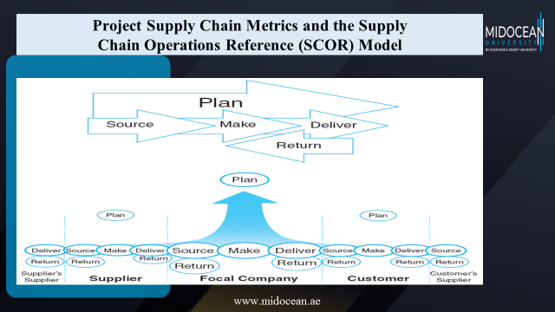

Slide 41
Summary of Learning Objectives
Discussing the way we manage supply chain and explain the benefits and impact of supply chain decisions on the success of a firm.
Understanding the critical areas of the supply chain.
Explaining the value drivers in project SCM.
Identifying the project supply chain process framework.
Explaining the performance metrics in project supply chain.
www.midocean.ae

Slide 42
Essential Reference
The Wiley Guide to Project Technology,
Supply Chain, and Procurement Management by
Peter Morris and Jeffrey K. Pinto.
Chapter Ten.
www.midocean.ae

Slide 43



Thank You

