Slide 1

Prediction of Water Tank Depletion
Prepared By
Name:Waleed Alfaifi ID No.: 243001139
Supervisor Name: Dr. Khalid Eskaf

Slide 2

Problem Statement & Introduction
Current Situation
The sites rely on water tanker trucks due to the absence of a central network, leading to unexpected interruptions that threaten facility sustainability and service quality. Manual refilling also results in resource waste and recurring shortages.
Project Goal
To develop an artificial intelligence model to predict water tank refilling schedules, based on data extracted from the Building Management System (BMS).
Significance
The project contributes to enhancing sustainability, ensuring supply continuity, and minimizing operational challenges.

Slide 3
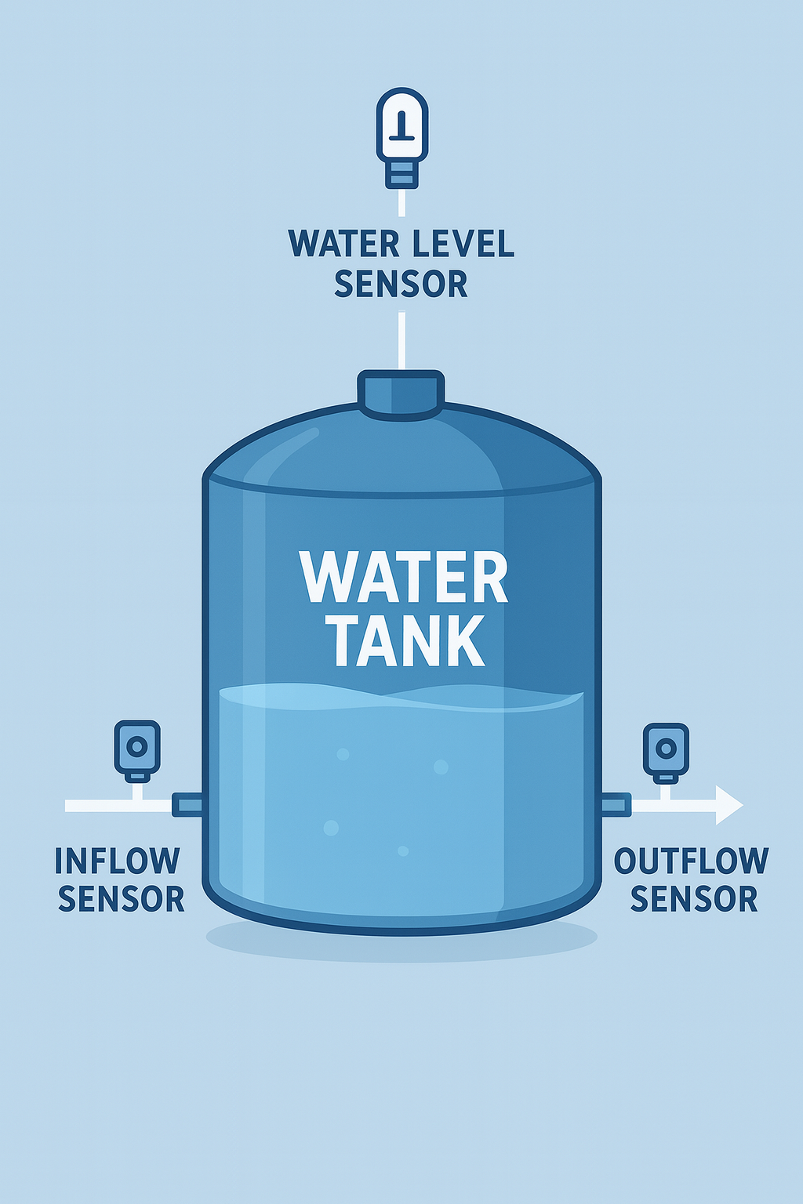
System Block Diagram
Data Sources
Water Level Sensors
Flow Sensors(m³/h)
Data Cleaning
Data cleaning (handling missing and outlier values)
Unit conversion (L/s ➝ m³/h)
Modeling Layer
Linear Regression (Baseline)
Random Forest
Evaluation
XGBoost
Feature Engineering
R² Score
MAE, RMSE
Data Splitting
80%Trainning
20% Testing
Model comparison
Note: All tanks are of the same size :7 m³

Slide 4
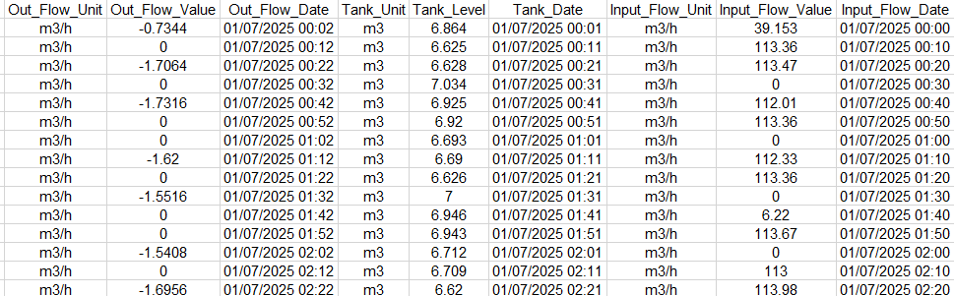
Practical Part: Data and Preprocessing
Dataset Highlights
Visualization
2000+ entries
Example: Input_Flow_Value=39.153 m³/h, Tank_Level=6.864 m³
Cleaning & Features
Remove NaNs, convert dates, standardize Out_Flow.
Features: Flow_Diff, time (hour, day, month).
Plot shows tank level changes over time after cleaning and conversion.
The three models were selected based on their suitability for the dataset and its limited size, as follows:
XGBoost: Best suited for small to medium datasets, offering high accuracy and interpretability.
Random Forest: Capable of handling non-linear patterns and reducing overfitting through bagging.
Linear Regression: Used as a baseline model for comparison, despite its limitations with non-linear relationships.
==

Slide 5




Practical Part: Models and Experiments
Linear Regression
Random Forest
XGBoost
R²~0.03 (poor performance, non-linear data).
Tuned, R²~0.72, MAE~0.0411 (good performance).
Optimized, R²~0.90, MAE~0.0300 (superior accuracy).
Training & Feature Importance
Notebook code demonstrates training; Tank_Level is the highest importance feature.
Video Placeholder: 1-2 minute recording of notebook run (load data, train models, show outputs).

Slide 6
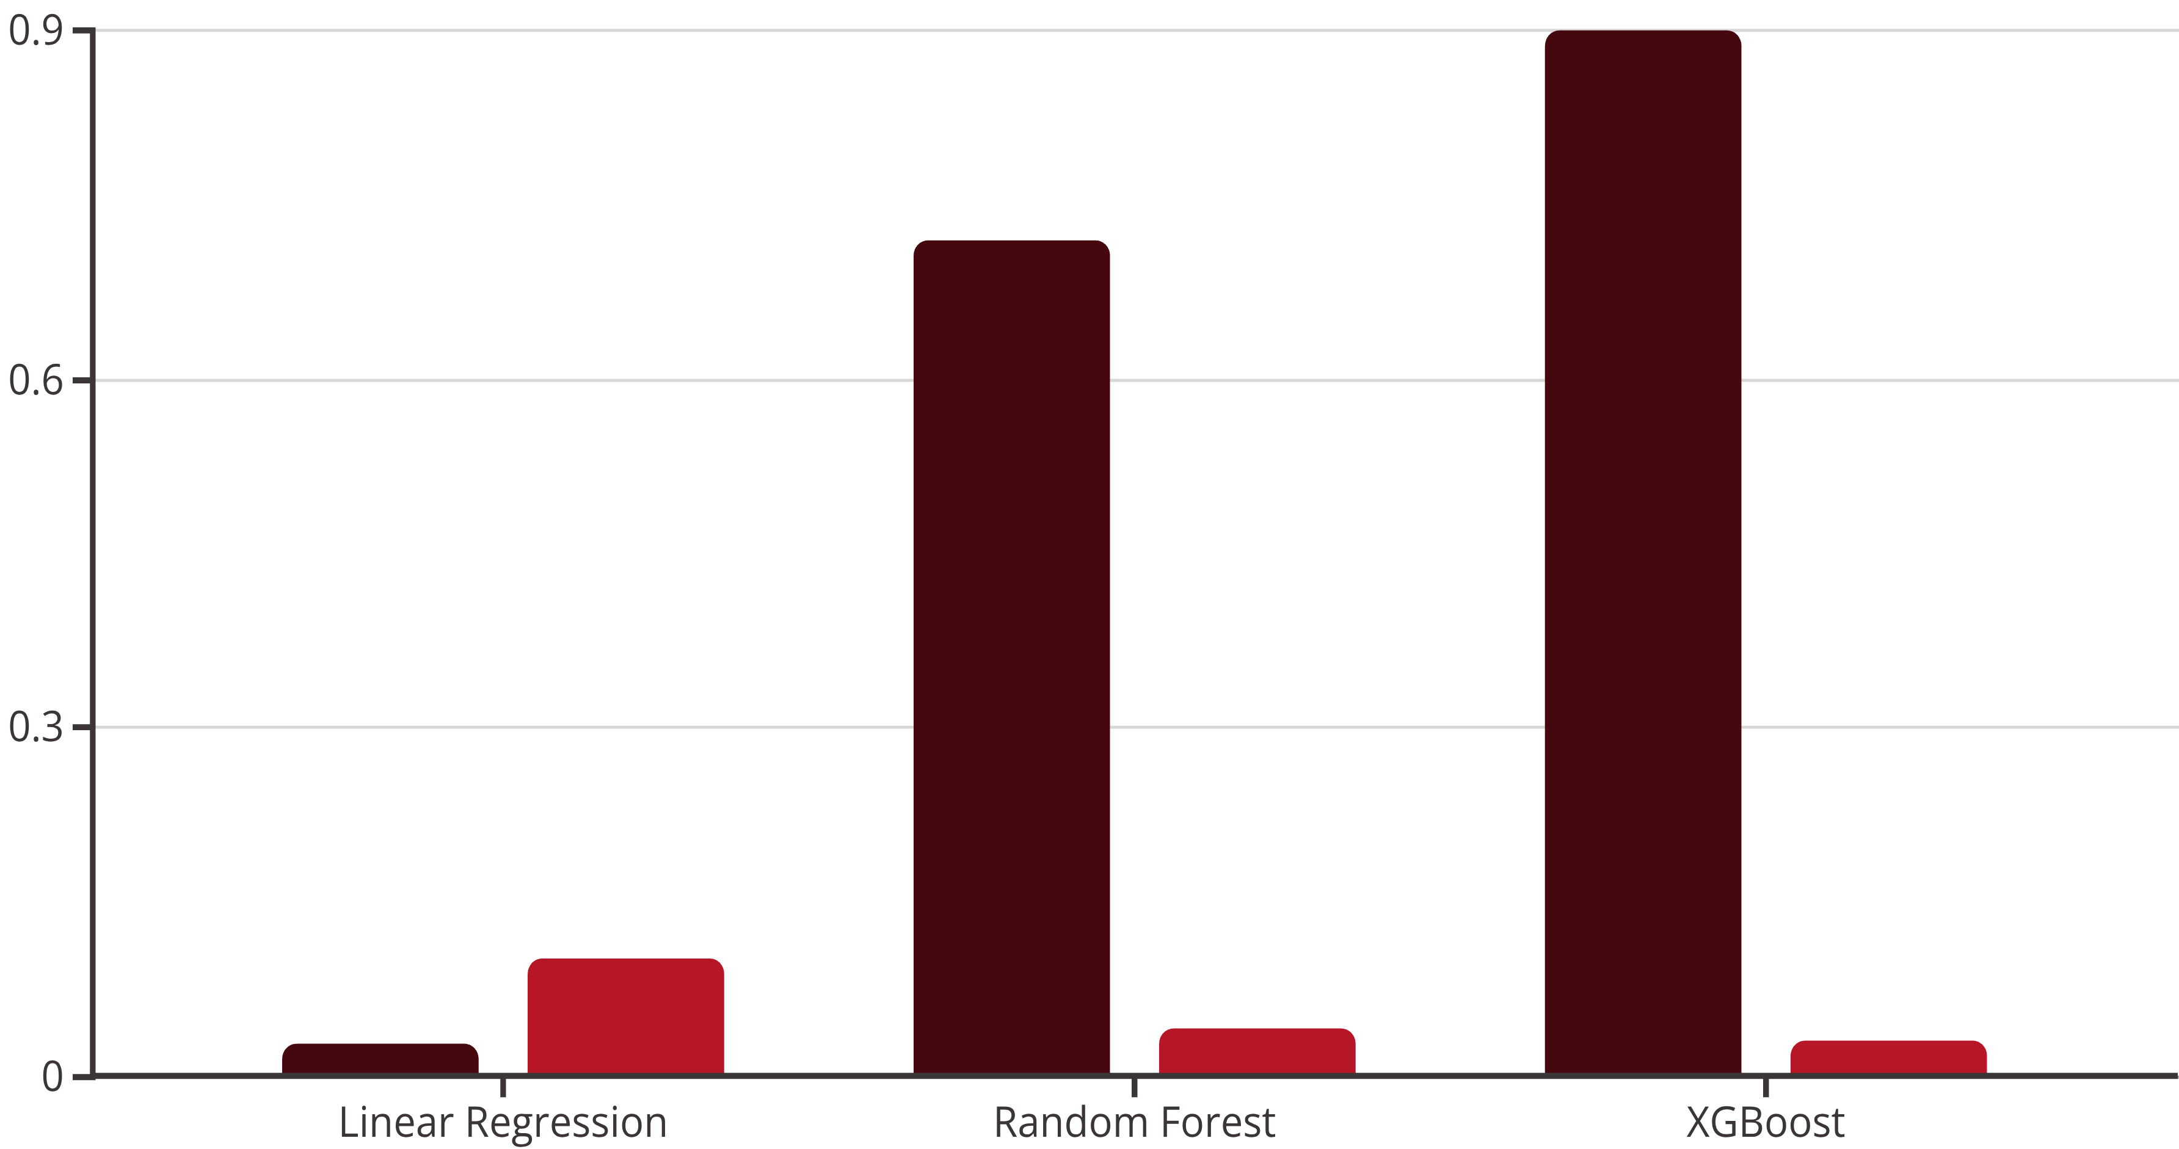
Results and Discussion
R² Score
MAE
XGBoost demonstrates superior performance due to its boosting capabilities and low errors, outperforming other models and literature benchmarks (e.g., Ali et al. 2022 ~80%).

Slide 7

Conclusion and Future Work
Achievements
Future Work
The project demonstrated the efficiency of intelligent models in predicting tank levels, with XGBoost achieving high accuracy (R² ≈ 0.90, MAE = 0.0300). These results confirm the effectiveness of artificial intelligence in enhancing BMS efficiency, reducing waste, and ensuring resource sustainability.
Future directions include testing advanced models such as LSTM, integrating the system with IoT for real-time automation, and expanding the solution across multiple sites and facilities.
Thank You & Questions?

