Slide 1


A Comparative Study of Fake News Detection Using Machine Learning, Deep Learning, and Large Language Models
Prepared By
Name: Rayan Shukri ID No.: 251000636
Name: Sultan Hassan ID No.: 251002896
Subervized by
Wesam Ahmed

Slide 2
Presentation Outline
Introduction
Objective
Contribution
Related work
Proposed framework
Results and Analysis
AGENDA

Slide 3

Introduction
BACKGROUND
What is Fake News?
Fake news = false or misleading content presented as
real news.
Goal: influence opinions or serve political/financial interests.
Social media algorithms amplify and accelerate its spread.
Example: COVID-19 misinformation caused real-world harm.
Role of AI:
Enhances accuracy, scalability, and adaptability.

Slide 4
Objective
Explore and compare three major AI paradigms
Machine Learning (ML)
Deep Learning (DL)
Large Language Models (LLMs)
In terms of their strengths, weaknesses, and effectiveness.
BACKGROUND

Slide 5
KEY RESEARCH CONTRIBUTIONS
1- Implement and evaluate ML, DL, and LLMs for fake news detection.
2- Apply all models on the same datasets and compare with standard metrics.
3- Assess strengths and weaknesses in performance, robustness, and generalization.
4- Present findings to guide future researches and development.
CONTRIBUTIONS

Slide 6
Table 1 .Comparative Analysis of Related Work
Ref | Year | Dataset(s) | Model(s) | Results | Advantages | Limitations
Hansrajh et al.[1] | 2021 | LIAR, ISOT | Ensemble: LR, SVM, LDA, SGD, Ridge | LIAR: F1 = 0.682, Acc = 0.681, ISOT: F1 = 0.984, Acc = 0.985, | ensemble outperformed individual classifiers | lower accuracy on short claims, lack of contextual/social signals)
LITERATURE REVIEW
Ajik et al. [2] | 2023 | FakeNewsNet, ISOT | Optimized CNN + LSTM | Accuracy: ~94.6% (FakeNewsNet), ~96.1% (ISOT) | Hybrid CNN-LSTM captured both local features and sequential dependencies; outperformed baseline DL models | Computationally expensive; requires large labeled datasets for training
Huang et al. [3] | 2025 | Kaggle Fake News dataset (~5,000 articles; balanced real/fake) | Hybrid Transformer + BiGRU + Bayesian Optimization | Transformer+BiGRU: Train 100%, Test 99.67% Transformer+BiGRU+Bayesian: Train 100%, Test 99.73% | - Near-perfect detection accuracy - Bayesian optimization improved robustness (+0.06%) | - Small dataset (risk of overfitting) - No testing on multilingual or multimodal datasets

Slide 7
Fake News Detection Dataset
This dataset, sourced from Kaggle, contains English news articles classified as real or fake. It is widely used as a benchmark dataset for training and evaluating machine learning, deep learning, and transformer-based models in fake news detection research.
METHODOLOGY
Dataset Source:
Key Details:
https://www.kaggle.com/datasets/rahulogoel/isot-fake-news-dataset
Total Articles: ~44,900
Files: True.csv, Fake.csv
Original Columns: title, text, subject, date
Target Label: Created during preprocessing (real / fake)
Format: CSV
Columns Included:
Title: News Headline Text Text: Full News Article Content
Subject: News Category Date: Publication Date
Label: Binary class (real / fake)

Slide 8
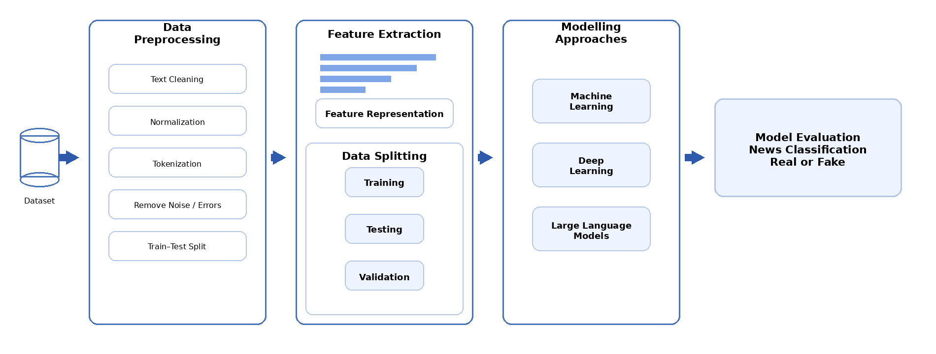



PROPOSED FRAMEWORK ARCHITECTURE
METHODOLOGY

Slide 9
INDIVIDUAL MODEL RESULTS
Rank | Model | Category | Accuracy | Precision | Recall | F1 Score | ROC AUC
1st | BiLSTM | DL | 0.99985 | 1.00000 | 0.99972 | 0.99986 | 1.00000
2nd | DistilBERT | LLM | 0.99915 | 0.99814 | 1.00000 | 0.99907 | ≈1.0000
3rd | BERT | LLM | 0.99898 | 0.99814 | 0.99963 | 0.99888 | 0.99975
4th | CNN-1D | DL | 0.99807 | 0.99886 | 0.99745 | 0.99815 | 0.99996
5th | XGBoost | ML | 0.99760 | 0.99740 | 0.99740 | 0.99740 | 0.99980
6th | Gradient Boosting | ML | 0.99680 | 0.99660 | 0.99630 | 0.99650 | 0.99910
7th | Decision Tree | ML | 0.99590 | 0.99520 | 0.99590 | 0.99550 | 0.99840
8th | Hybrid CNN–LSTM | DL | 0.99436 | 0.99489 | 0.99432 | 0.99461 | 0.99952
9th | Passive Aggressive | ML | 0.99450 | 0.99440 | 0.99370 | 0.99400 | —
10th | Random Forest | ML | 0.98600 | 0.99510 | 0.97430 | 0.98460 | 0.99920
11th | LSTM | DL | 0.98620 | 0.98890 | 0.98470 | 0.98680 | 0.99750
12th | Logistic Regression | ML | 0.98470 | 0.98580 | 0.98060 | 0.98320 | 0.99850
RESULTS & ANALYSIS

Slide 10
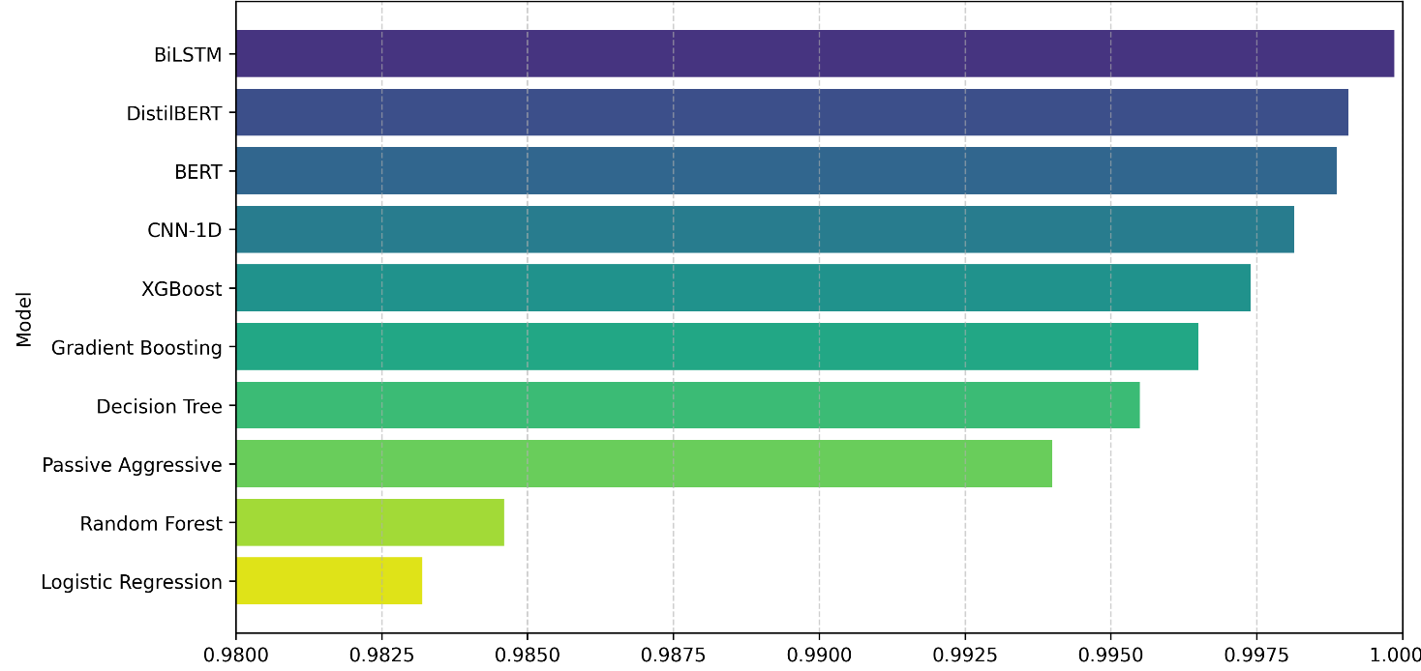
RESULTS AND ANALYSIS
RESULTS & ANALYSIS

Slide 11
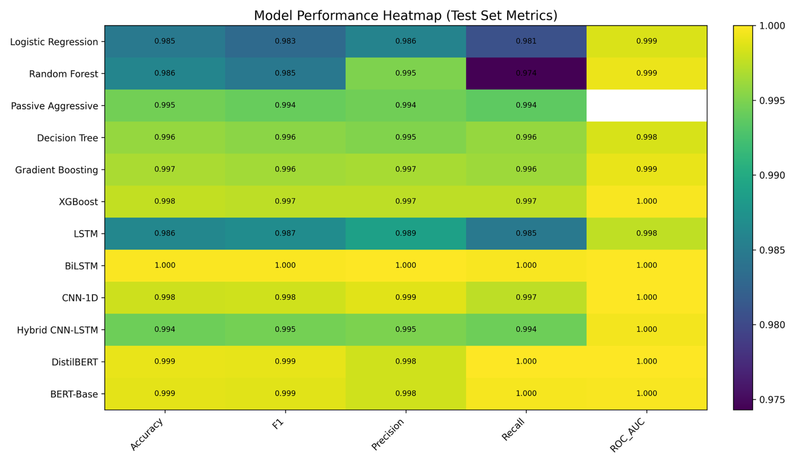
RESULTS AND ANALYSIS
RESULTS & ANALYSIS

Slide 12
References
[1] Hansrajh, A., Adeliyi, T. T., & Wing, J. (2021). Detection of online fake news usingblending ensemble learning. Scientific Programming, 2021, 1–14.
[2] Ajik, E. D., Obuandike, G. N., & Echobu, F. O. (2023). Fake news detection usingoptimized CNN and LSTM techniques. Journal of Information Systems andInformatics, 5(3), 1044–1056.
[3] Huang, T., Xu, Z., Yu, P., Yi, J., & Xu, X. (2025). A hybrid transformer model for fakenews detection: Leveraging Bayesian optimization and bidirectional recurrent unit.arXiv preprint arXiv:2502.09097.
[4] Hakim, K. B. A., & Easwaramoorthy, S. V. (2024). Impact of Fake News on Social MediaTowards Public Users of Different Age Groups. arXiv preprint arXiv:2411.05638.
[5] Surjatmodjo, D., Unde, A. A., Cangara, H., & Sonni, A. F. (2024). Information pandemic: acritical review of disinformation spread on social media and its implications for stateresilience. Social Sciences, 13(8), 418.
[6] Chen, J. A., Chung, W. C., Hung, C. L., & Wu, C. Y. (2025). Identifying Disinformation on theExtended Impacts of COVID-19: Methodological Investigation Using a Fuzzy Ranking Ensemble ofNatural Language Processing Models. Journal of Medical Internet Research, 27, e73601.
[7] Alghamdi, J., Lin, Y., & Luo, S. (2023). Towards COVID-19 fake news detection usingtransformer-based models. Knowledge-Based Systems, 274, 110642.
[8] Allcott, H., & Gentzkow, M. (2017). Social media and fake news in the 2016 election. Journal ofeconomic perspectives, 31(2), 211-236.
REFERENCES

Slide 13
References
[8] Allcott, H., & Gentzkow, M. (2017). Social media and fake news in the 2016 election. Journal ofeconomic perspectives, 31(2), 211-236.
[9] Pulido, C. M., Villarejo-Carballido, B., Redondo-Sama, G., & Gómez, A. (2020). COVID-19 infodemic: More retweets for science-based information on coronavirus than for false information. International sociology, 35(4), 377-392.
[10] Lazer, D. M., Baum, M. A., Benkler, Y., Berinsky, A. J., Greenhill, K. M., Menczer, F., ... & Zittrain, J. L. (2018). The science of fake news. Science, 359(6380), 1094-1096.
[11] ISOT fake news dataset. Kaggle. https://www.kaggle.com/datasets/rahulogoel/isot-fake-news-dataset last accessed on 14/12/2025
REFERENCES

Slide 14
Thank You!

