Slide 1

Lecture 12:
Project Management Career Paths
PMG 605
Project Resources and Time Management
Dr. Eng.
Abdullah Jameel Halawany

Slide 2
Session Outline
Project Management Career Paths
Current Drivers of Project Management
Introduction
Project Management Today: A Socio-Technical Approach
Career Paths
Project Management Areas of Expertise
Professional Training and Certification

Slide 3
Introduction

Slide 4
The Project Manager
Project managers perform the same functions as other managers.
They are plan, schedule, motivate, and control.
What makes them unique is that they manage temporary, nonrepetitive activities, to complete a fixed life project.
Project managers create a project team and organization where none existed before.
They must decide what and how things should be done instead of simply managing set processes.
They must meet the challenges of each phase of the project life cycle, and even oversee the dissolution of their operation when the project is completed.
12–4

Slide 5
The Project Manager
Project managers must work with a diverse troupe of characters to complete projects.
They are typically the direct link to the customer and must manage the tension between customer expectations and what is feasible and reasonable.
Project managers provide direction, coordination, and integration to the project team.
They often must work with a cadre of outsiders—vendors, suppliers, subcontractors.
Project managers are ultimately responsible for performance (frequently with too little authority).
They must ensure that appropriate trade-offs are made among the time, cost, and performance requirements of the project.
12–5

Slide 6
The Project Manager
They must ensure that appropriate trade-offs are made among the time, cost, and performance requirements of the project.
They must orchestrate the completion of the project by inducing the right people, at the right time, to address the right issues and make the right decisions.
Good project managers are always in demand.
Every industry is looking for effective people who can get the right things done on time.
Project Management is a challenging and exciting profession
12–6

Slide 7
The Project Manager
Being Part of a Project Team
Sometimes this work is full-time, but in most cases, people work part-time on one or more projects.
They must learn how to juggle their day-today commitments with additional project responsibilities.
They may join a team with a long history of working together, in which case roles and norms are firmly established.
Alternatively, their team may consist of strangers from different departments and organizations.
As such, they endure the growing pains of a group evolving into a team.
They need to be a positive force in helping the team coalesce into an effective project team.
12–7

Slide 8
The Project Manager
Project members are also expected to use project management tools and concepts.
They develop or are given a project charter or scope statement that defines the objectives and parameters of the project.
They work with others to create a project schedule and budget that will guide project execution.
They need to understand project priorities so they can make independent decisions.
They must know how to monitor and report project progress.
Project members need to know how to avoid the dangers of scope creep, manage the critical path, engage in timely risk management, negotiate, and utilize virtual tools to communicate.
12–8

Slide 9
Snapshot from Practice: Ron Parker
There’s a saying that’s always resonated with me: “If your only tool is a hammer, all your problems look like nails.” Good tools are hard to come by and heavy to carry around. I like my tool bag filled with generalist tools; things like communication skills, leadership, common sense, judgment, reasoning, logic and a strong sense of urgency. I often wonder how much more I could have accomplished had I actually studied project management and had more of that toolset in my bag. With a bag full of strong generalist tools, you can tackle any problem in any business. Project management is clearly one of those skills where the better you are at it, the higher your chances of success in any business environment. Having the tools is only part of the equation though. To be successful, you must also be willing to run at problems/opportunities when everyone else is running away from them.
12–9

Slide 10
Current Drivers of
Project Management

Slide 11
Current Drivers of Project Management
Project management is no longer a special-need management. It is rapidly becoming a standard way of doing business.
The future promises an increase in the importance and the role of projects in contributing to the strategic direction of organizations.
Several reasons why this is the case are:
  Compression of the Product Life Cycle
  Knowledge Explosion
  Triple Bottom Line (Planet, People, Profit)
  Increased Customer Focus
  Small Projects Represent Big Problems
12–11

Slide 12
Current Drivers of Project Management
Compression of the Product Life Cycle
One of the most significant driving forces behind the demand for project management is the shortening of the product life cycle.
Today in high-tech industries the product life cycle is averaging six months to three years. Only 30 years ago, life cycles of 10 to 15 years were common.
In the world of high-tech product development is that a six-month project delay can result in a 33 percent loss in product revenue share.
Speed becomes a competitive advantage.
12–12

Slide 13
Current Drivers of Project Management
Knowledge Explosion
The growth in new knowledge has increased the complexity of projects because projects encompass the latest advances.
For example, building a road 30 years ago was a somewhat simple process. Today, each area has increased in complexity, including materials, specifications, codes, aesthetics, equipment, and required specialists.
Similarly, in today’s digital, electronic age it is becoming hard to find a new product that does not contain at least one microchip.
Product complexity has increased the need to integrate divergent technologies.
12–13

Slide 14
Current Drivers of Project Management
Triple Bottom Line (Planet, People, Profit)
The threat of global warming has brought sustainable business practices to the forefront.
Businesses can no longer simply focus on maximizing profit to the detriment of the environment and society.
Efforts to reduce carbon imprint and utilize renewable resources are realized through effective project management.
The impact of this movement toward sustainability can be seen in changes in the objectives and techniques used to complete projects.
12–14

Slide 15
Current Drivers of Project Management
Increased Customer Focus
Increased competition has placed a premium on customer satisfaction.
Customers no longer simply settle for generic products and services. They want customized products and services that cater to their specific needs.
Account executives and sales representatives are assuming more of a project manager’s role as they work with their organization to satisfy the unique needs and requests of clients.
Project management is critical both to development of customized products and services and to sustaining lucrative relationships with customers.
12–15

Slide 16
Current Drivers of Project Management
Small Projects Represent Big Problems
The velocity of change required to remain competitive, or simply keep up has created an organizational climate in which hundreds of projects are implemented concurrently.
This climate has created a multi-project environment and a plethora of new problems.
Many firms have no idea of the problems involved with inefficient management of small projects. Small projects typically carry the same or more risk as do large projects.
Because so many small projects are going on concurrently and because the perception of the inefficiency impact is small, measuring inefficiency is usually nonexistent.
Unfortunately, many small projects soon add up to large sums of money.
12–16

Slide 17
Digital Transformation – New Driver
Digital Transformation is “the integration of digital technology into all areas of a business, fundamentally changing how you operate and deliver value to customers.”
From a PM perspective, digital transformation isn’t something to be feared. Yes, it will take time, effort, and a bit of disruption.
But it will also empower you as a project manager to better manage team members, more efficiently deliver projects, and better serve your company’s customers and clients.
More efficient and strategic communication among teams and companies
More collaboration within teams and ownership from team members
More focus on results rather than process
More analytics for improved PM processes, outcomes, and ROI (less cost)
12–17

Slide 18
Project Management Today:
A Socio-Technical Approach

Slide 19
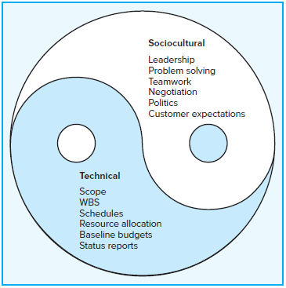
A Socio-Technical Approach
Senior management is often involved in selecting projects but seldom involved in implementing them.
Implementing the project is the challenge.
It is a multidimensional process.
The technical dimension represents the “science” of project management while the sociocultural dimension represents the “art” of managing a project.
12–19

Slide 20
A Socio-Technical Approach
Technical Side
Consists of the formal, disciplined, purely logical parts of the process.
This technical dimension includes planning, scheduling, and controlling projects.
Clear project scope statements are written to link the project and customer and to facilitate planning and control.
The work breakdown structure serves as a database that links all levels in the organization, major deliverables, and all work—right down to the tasks in a work package.
12–20

Slide 21
A Socio-Technical Approach
Sociocultural Side
Involves the much messier, often contradictory and paradoxical world of implementation.
Project managers must shape a project culture that stimulates teamwork and high levels of personal motivation as well as a capacity to quickly identify and resolve problems that threaten project work.
Involves managing the interface between the project and external environment.
12–21

Slide 22
Career Paths

Slide 23
Career Paths
Career avenues vary from industry to industry, organization to organization, and from profession to profession.
What can be said is that advancement occurs incrementally.
You don’t simply graduate and become a project manager.
As in other careers, you have to work your way up to the position.
12–23

Slide 24
Career Paths
In project-based organizations such as construction firms, you may begin by working on several projects as an assistant engineer, then take an assignment as a project analyst. From there you are promoted to principal engineer, advance to assistant project manager, assume the role of project manager over a small project, and then continue to bigger, riskier projects.
In other organizations, project management careers run parallel with functional advancement with many crossovers. You might start a career as a designer, then take an assignment as a project specialist, later work as a project manager, and then return to a functional position as head of a department or as a product manager.
12–24

Slide 25
Career Paths
Other people find that their project management responsibilities expand as they move up the organization’s hierarchy.
For example, a former marketing student began her career as an assistant buyer for a large retail company. She then became area sales manager at a specific store and became involved on a part-time basis in a series of projects, acting as a facilitator of focus groups.
She was promoted to buyer and eventually became a store manager.
In her current position, she coordinates a variety of projects ranging from improving the sales expertise of her salesforce to altering the physical layout of the store.
Although the title of project manager does not appear in her job description, more than 50 percent of her work involves managing projects.
12–25

Slide 26
Project Management
Areas of Expertise

Slide 27
Project Management Areas of Expertise
Application knowledge; standards & regulations
Understanding the Project Environment
Management Knowledge and Skills
Interpersonal Skills
12–27

Slide 28
Application knowledge; standards & regulations
Some projects require specific skills in certain application areas.
They can be defined by: industry group (pharmaceutical, financial, etc), by department (accounting, marketing, legal, etc), by technical (software development, engineering, etc), or management (procurement, research, & development, etc) specialties.
These application areas are usually concerned with disciplines, regulations and the specific needs of the project, the customer, or the industry.
Every industry has standards and regulations. Knowing which ones affect your project before you begin work will not only help the project to unfold smoothly but will also allow for effective risk analysis.
Having some level of experience in the application area you're working in will give you an advantage when it comes to project management.
12–28

Slide 29
Understanding the Project Environment
Project Environment
Physical
Cultural
Social
International
Political
12–29

Slide 30
Understanding the Project Environment
The physical environment; here we think about time zones, think about different countries and how differently your project will be executed whether it is just in your country or whether you have an international project team.
The international and political environment is where you need to understand about different countries cultural influences.
What day and month is 2/8/2021?
  North America it is February 8th
  Much of the rest of the world 2nd August
12–30

Slide 31
Understanding the Project Environment
In terms of the cultural and the social environment. In this region we think of people, demographics and education.
Project managers in multicultural projects must appreciate the culture dimensions and try to learn relevant customs, courtesies, and business protocols before taking responsibility for managing an international project.
12–31

Slide 32
Management Knowledge and Skills
your ability to plan the project, to execute the project properly and of course to control the project and bring it to a successful conclusion with the ability to guide the project team while achieving project objectives and balancing the project constraints.
Managing a project is like running a business: there are risk and rewards, finance and accounting activities, human resource issues, time management, stress management, and a purpose for the project to exist. General management skills are needed in just about every project.
12–32

Slide 33
Interpersonal Skills
Communication
Influence
Leadership
Motivation
Negotiation
Problem Solving
12–33

Slide 34
Professional Training and Certification

Slide 35
Professional Training and Certification
Most project managers have never received formal training in project management.
They mastered the job through on-the-job training, supported by occasional workshops on specific project topics such as project scheduling or negotiating contracts.
It wasn’t until recently that universities started offering courses on project management outside of schools of engineering.
Many professionals find it beneficial to join the Project Management Institute (PMI). Membership entitles you to subscriptions to PMI publications including the academic Project Management Journal and the PM Network, a trade magazine.
12–35

Slide 36
Gaining Visibility
Get actively involved in local community opportunities to manage projects.
Develop contacts by volunteering for task forces and projects that allow access to higher-ups and other departments.
Networking
12–36

Slide 37
Mentors
Mentors are typically superiors who take a special interest in you and your career.
They require loyalty and superior performance.
Take advantage of formal mentoring programs in which experienced project managers are assigned to promising young managers.
Attending conferences, trade fairs, and workshops provides good opportunities to “network” and develop social connections that might precipitate project assignments.
12–37

Slide 38
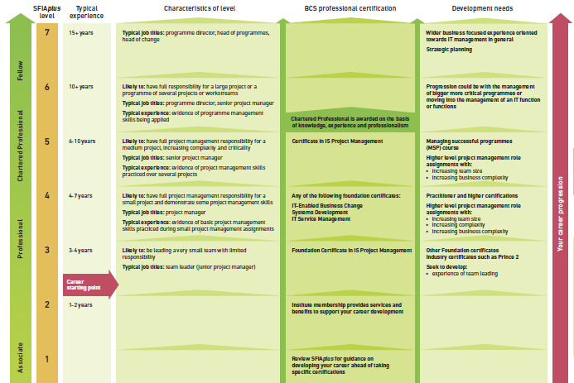
This diagram summarizes the characteristics and development needs that support your career in
IT Project Management
12–38

Slide 39
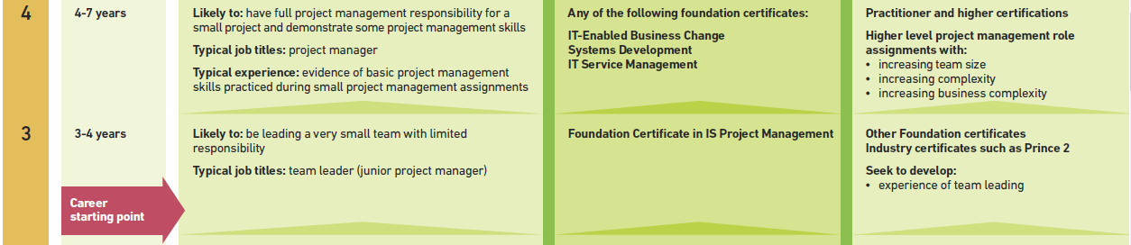
12–39

Slide 40
Summary of Today Session

Slide 41
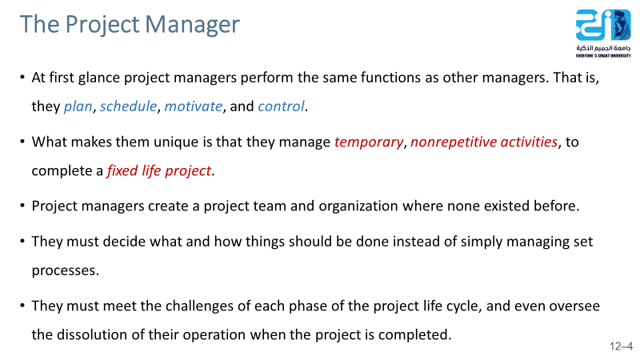
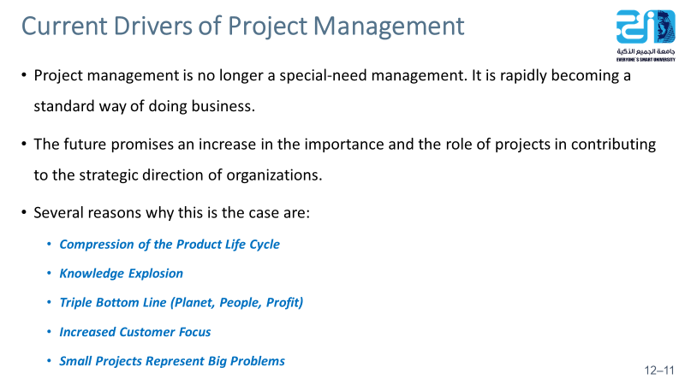
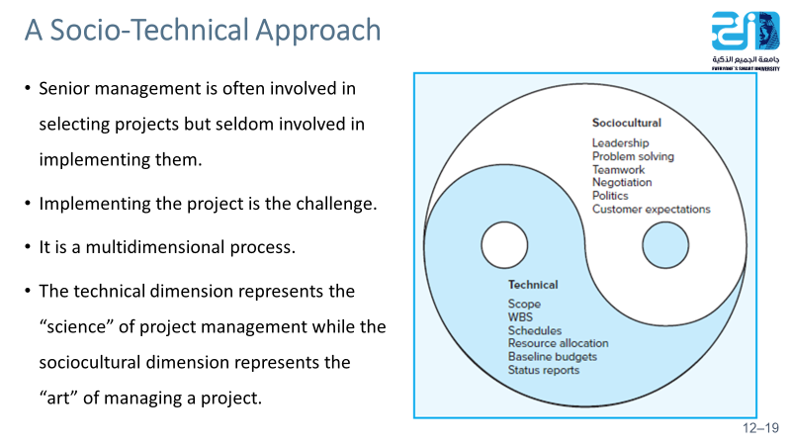
12–41

Slide 42
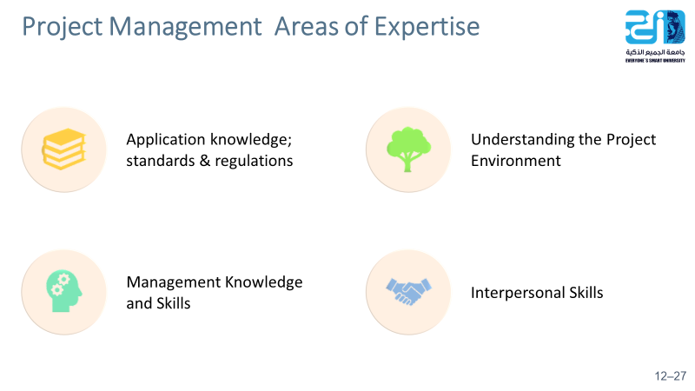
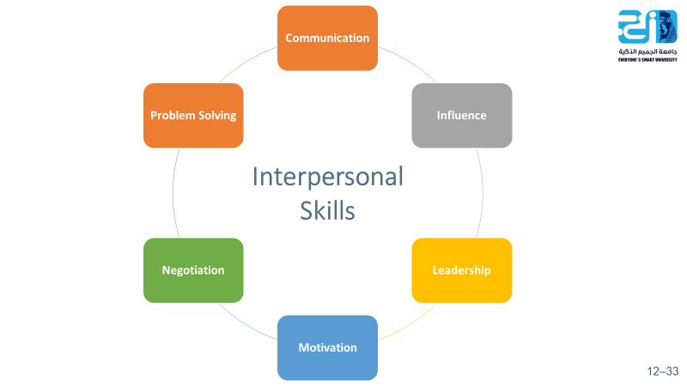
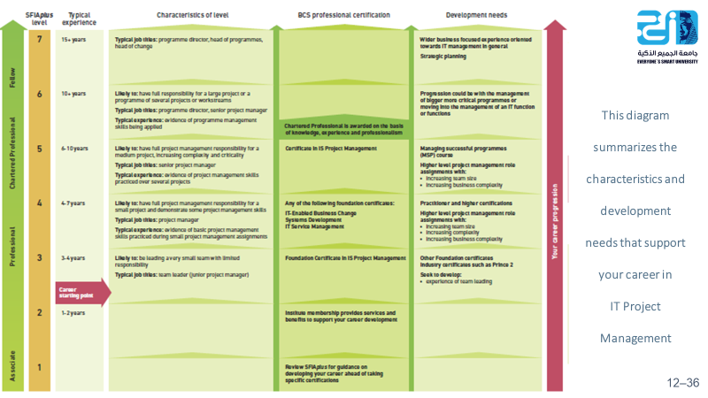
12–42

Slide 43
Resources
Project Management: The Managerial Process Fifth Edition.
By: Erik W. Larson, Oregon State University, Clifford F. Gray, Oregon State University

