Slide 1



Organizing And Managerial Communication
Lecture 7
MGM111
Principle of Management
Prepared by
Dr. Bothaina Mahmoud Fouad

Slide 2

Lec. 7
The main points:
Understanding Managerial Communications
Identify the concept of communication skills
Understand the principles of effective communication

Slide 3
Organizing Your Employees
A job description
is a written statement of what a jobholder does, how the job is done, and why it is done.
It typically portrays job duties, working conditions, and operating responsibilities.

Slide 4

MANAGERIAL COMMUNICATION AND INFORMATION TECHNOLOGY

Slide 5
MANAGERIAL COMMUNICATION AND INFORMATION TECHNOLOGY
Communication skills =
10% words + 30% (tone +tuning) + 60% body language.

Slide 6
What is communication?
In simple words we can say that
“just to convey the message”
  The transfer and understanding of meaning
  Everything that a manager does involves communicating

Slide 7
What is communication?
If we go in more detail we can say that communication is
the process of transmitting (A B) & Receiving
(B A) Messages.

Slide 8
What is communication?
  Interpersonal communication
  occurs between people
  Organizational communication
  all the patterns, networks, and systems of communication in an organization

Slide 9
Communication Skills
the process by which people exchange information or express their thoughts and feelings

Slide 10
Reason of communication
Share our ideas and opinions
Provide feedback to others
Get information from others
Gain power and influence
Develop social relationships
Maintain self-expression and our culture
other ideas you may have thought of
We communicate to:

Slide 11
ORGANIZATIONAL COMMUNICATION
Formal Communication
  Communication that follows the official chain of command or is communication required to do one’s job
  Takes place within prescribed organizational work arrangements
Informal Communication
  Not defined by the organization’s structural hierarchy

Slide 12
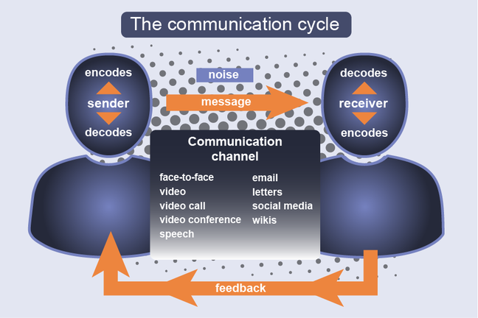
The communication process

Slide 13
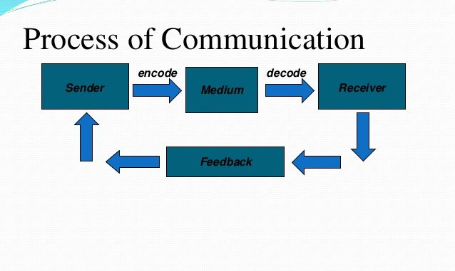
The communication process

Slide 14
PROCESS OF INTERPERSONAL COMMUNICATION
Message - a purpose to be conveyed
Encoding - converting the message in symbolic form
Channel - medium a message travels along
Decoding - retranslating a sender’s message
Noise - disturbances that interfere with the transmission, receipt, or feedback of a message
Feedback is basically the response/reaction of Receiver after receiving the message.

Slide 15
Components of the Communication Process
Message
is basically the basic idea that you want to communicate.
The message may be
  Verbal, means (Written or Spoken)
  Non-Verbal, means( Symbols, Pictures or unspoken).
This is very much important component of communication “ Your message should be or MUST be clear and easy to understand”

Slide 16
Components of the Communication Process
Message, Con’t
The most important element in message is your receiver . You must be well aware about your receiver.
While preparing a message you should keep in mind how your receiver will interpret the message.
You (Sender) should also keep in mind your relationship with the receiver while preparing message.
some times wrong message may create a loss to your organization , to yourself.
or it can create a bad impression for you/your company.

Slide 17
Components of the Communication Process
Sender ( Encoder )
When you sending the message, you are the “Encoder” .
Here the word you mean writer/Speaker decides whether the message should be in written or oral. He/She may choose Words, Symbols, Pictures or Graphics that express the objective in the real sense.

Slide 18
Components of the Communication Process
Medium
is basically channel through which your message reaches to receiver & channel vary from situation to situation.
E.g. some of effective medium it may be: T.V, Radio, Papers
    Or all of the above “keeping in view the Importance of the message.”
    When we talk at Micro /Organizational Level the medium may be writing or non-Verbal

Slide 19
Components of the Communication Process
Receiver (Decoder)
To whom the message is being sent.
In simple words we can say that receiver is your reader (in case of press , letters etc.) or Listener (In case of TV, radio, Speaker Etc.)
Receiver is also known as decoder.

Slide 20
Components of the Communication Process
Feedback
Feedback is basically the response/reaction of Receiver after receiving the message.
Sender always need feedback to check wether the message effectively reached or not…? Or in other words….
Sender need feedback to examine the success or failure of the message.

Slide 21
Methods of Communicating Interpersonally
  A wide variety of communication methods exist
  Choice of a method should reflect:
      the needs of the sender
      the needs of the receiver
      the attributes of the message
      the attributes of the channel

Slide 22
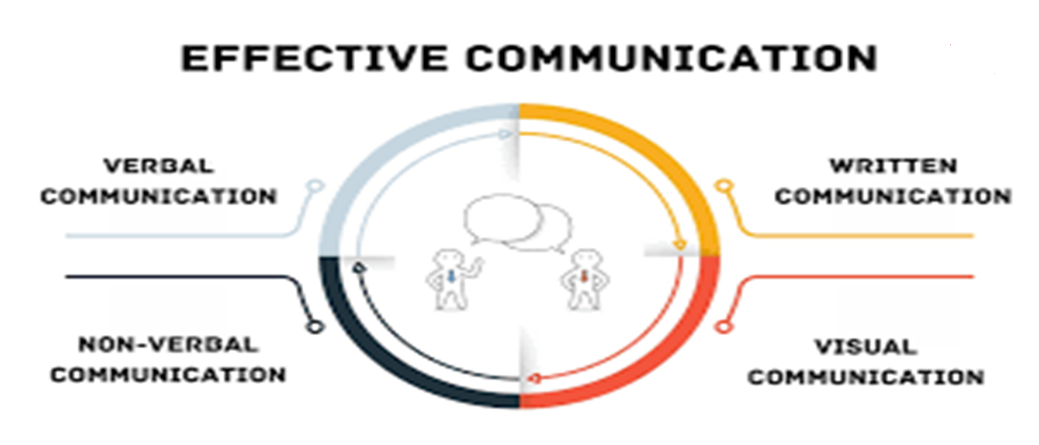
The components of Effective Communication

Slide 23
Verbal Communication
having good communication skills is all about the ability to
Verbal Communication = Speaking + Listening
Non-verbal Communication
Your appearance
Your body language
The tone and the pace of your voice
Eye Contact

Slide 24
Methods of Communicating Interpersonally (continued)
  Nonverbal communication - communication without words
    body language - gestures, facial expressions, and other body movements that convey meaning
    verbal intonation - emphasis given to words or phrases that conveys meaning
    nonverbal component-usually carries the greatest impact

Slide 25
EVALUATING COMMUNICATION METHODS
Feedback - how quickly can the receiver respond to the message?
Complexity capacity - can the method effectively process complex messages?
Breadth potential - how many different messages can be transmitted using this method?
Confidentiality - can communicators be reasonably sure their messages are received only by those intended?
Encoding ease - can sender easily and quickly use this channel?
Decoding ease - can receiver easily and quickly decode messages?

Slide 26
EVALUATING COMMUNICATION METHODS, Con’t
7. Time-space constraint - do senders and receivers need to communicate at the same time and in the same space?
8. Cost - how much does it cost to use this method?
9. Interpersonal warmth - how well does this method convey interpersonal warmth?
10. Formality - does this method have the needed amount of formality?
11. Scan ability - does this method allow the message to be easily browsed or scanned for relevant information?
12. Time of consumption - does sender or receiver exercise the most control over when the message is dealt with?

Slide 27
How to achieve effective Communication
Encourage creative and Critical Thinking
Consider audience’s information needs
Consider Audience's Technical Background
Consider Audience's Cultural Background and Gender
Consider Audience's Knowledge of the Subject

Slide 28
Digital Communication as a tool for workplace
For the past few years, almost all negotiations have been occurring virtually. But even before Covid-19, an increasing number of dealmakers were connecting through digital tools. Video technologies, low-cost teleconferencing, and email have all become efficient ways for teams to prepare together and to negotiate with counterparts.
https://accentonbusiness.net/top-six-communication-skills-negotiation/

Slide 29
Digital Communication as a tool for workplace
Advantages | Disadvantages
time constraints | Limitations with seeing a negotiator’s emotions: There are non-verbal clues that come along with the physical mode of negotiation, such as facial gestures, hand movement, sitting positions, among many others. Virtual communication hardly gives access to all those features.
removes pressure from the negotiator. and allowed him to freely explore ideas, adjust strategy, and provide a more considered approach to their next input to the negotiation. | Technical challenges: there could still be technical challenges such as poor audio recording or limited bandwidth.
Sometimes, negotiating through email or text can also encourage a more sophisticated level of thinking and lead to more objective and rational solutions. | Misinterpretation of text: the other person at the end of the negotiation table might easily read another meaning.

Slide 30
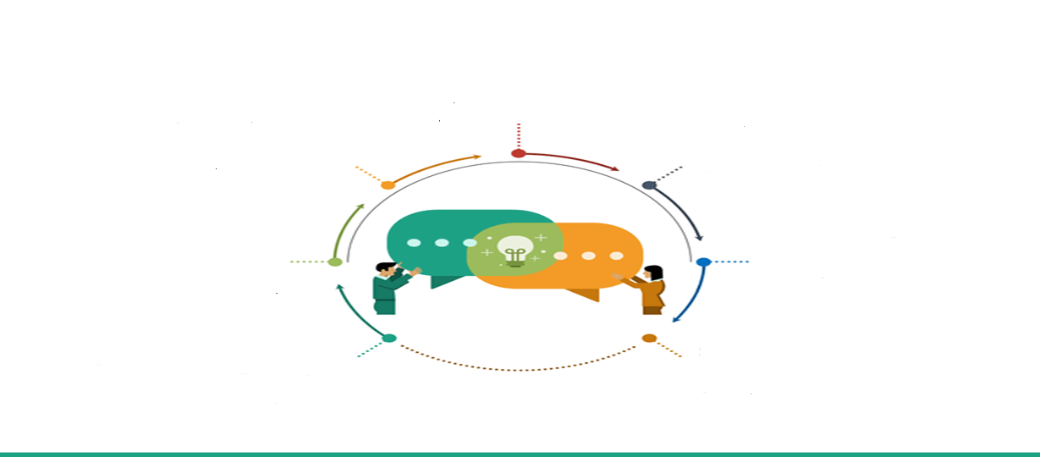
Characteristics of Effective Communication the 7 C’s
Clear
Concrete
Concise
Courtesy
Coherent
Comprehension
Complete
https://www.slideshare.net/effectivecommunication/cs-final-ppt-11938630

Slide 31
the 7 C’s meaning
Clear
main ideas easily identified and understood
Concise
gets to the point without using unneeded words or images
Concrete
includes specific examples or explanations
polite, professional tone
Coherent
information presented in a logical sequence
Courteous
enough information so the audience can understand
Complete
in information, word choice, and grammar
Correct ( Comprehension)

Slide 32
Direction of Communication Flow
Organizational Communication Flows Information can flow in four directions in an organization: downward, upward, horizontally, and diagonally.
The size, nature, and structure of the organization dictate which direction most of the information flows

Slide 33
Direction of Communication Flow
  Downward - flows from a manager to subordinates
    used to inform, direct, coordinate, and evaluate employees
    For example may be an announcement of a new CEO or notice of a merger with a former competitor. Other forms of high-level downward communications include speeches, blogs, podcasts, and videos. The most common types of downward communication are everyday directives of department managers or line managers to employees. These can even be in the form of instruction manuals or company handbooks.

Slide 34
Direction of Communication Flow
  Upward - flows from subordinates to managers
    keeps managers aware of employees’ feelings
    source for ideas on improving operations
    amount of upward communication affected by the culture of the organization
    For example, upward communication occurs when workers report to a supervisor or when team leaders report to a department manager.

Slide 35
Direction of Communication Flow
  Horizontally - involves the exchange of information across departments at the same level in an organization (i.e., peer-to-peer communication). The purpose of most horizontal communication is to request support or coordinate activities.
  An example: if the vice president of sales sends an e-mail to the vice president of manufacturing asking when a product will be available for shipping, this is an example of horizontal communication.

Slide 36
Direction of Communication Flow
  diagonally - cuts across both work areas and organizational levels.
  Other: cross-functional communication between employees at different levels of the organization.
  For example, But if a sales representative e-mails the vice president of marketing, then diagonal communication has occurred.

Slide 37
Direction of Communication Flow
  Diagonal communication is becoming more common in organizations with a flattened, matrix, or product-based structure. Advantages include:
  Building relationships between senior-level and lower-level employees from different parts of the organization.
  Encouraging an informal flow of information in the organization.
  Reducing the chance of a message being distorted by going through additional filters.
  Reducing the workloads of senior-level managers.
  benefits efficiency and speedand e-mail facilitates diagonal communication

Slide 38
Barriers to Effective Interpersonal Communication
  Filtering - the deliberate manipulation of information to make it appear more favorable to the receiver
  Selective Perception - what people see or hear on the basis of their interests, background, experience, and attitudes
  Emotions - interpretation of a message affected by the way the receiver feels
  Information Overload - information available exceeds processing capacity

Slide 39
Barriers to Effective Interpersonal Communication
  Defensiveness - behaviors that result from feeling threatened
  Language - meaning of words differs among people with diverse backgrounds
  National Culture - cultural values affect the way people communicate

Slide 40
Overcoming the Barriers to Effective Interpersonal Communication
  Use Feedback - ask a set of questions about a message to determine whether it was understood as intended
  Simplify Language - tailor the language to the audience for whom the message is intended
  Listen Actively - listen for full meaning
  Constrain Emotions - emotions severely cloud and distort the transference of meaning
  Watch Nonverbal Cues - actions should be aligned with words

Slide 41



Thank You

