Slide 1
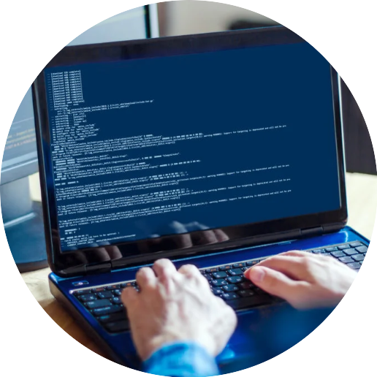


Programming
Foundations in
Python
Prepared by Dr. Hamada I. AbdulWakel
Lecture 1

Slide 2



Introduction to Computer
Programming and Python
Lecture 1
Prepared by
Dr. Hamada I. AbdulWakel
www.midocean.ae

Slide 3
Lecture
LECTURE MAIN POINTS
01
Computer science and information processing relationship.
The meaning of algorithm and its basic features.
The hardware and software collaboration in a computer's architecture.
Reasons of using Python.
Pythons uses.
www.midocean.ae

Slide 4
Lecture
LECTURE MAIN POINTS
01
Cont'd
Installation environment and the required Integrated Development Environment (IDE).
Writing a simple Python program.
Understanding Python code style.
www.midocean.ae

Slide 5
Lecture
COMPUTER SCIENCE
01
Computer Science (CS): the study of computation and information.
  Solving problems is the core of CS.
Problem-solving: the process of transforming the description of a problem into a solution using the problem-solving tools, strategies, and techniques.
www.midocean.ae

Slide 6

Lecture
INFORMATION PROCESSING
01
Data: the raw, unorganized facts that can be in the form of text, graphics, audio, or video.
Information: the processed data with a meaningful form.
Information processing: the process of converting raw data into information.
www.midocean.ae

Slide 7
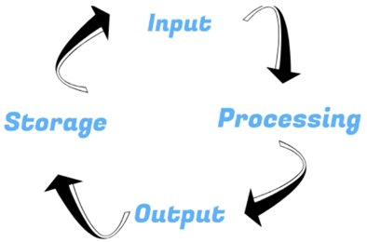
Lecture
INFORMATION PRCESSING CYCLE
01
www.midocean.ae

Slide 8
Lecture
INFORMATION PROCESSING CYCLE
01
Cont'd
Input: the stage where the computer is fed with the data from its user by the use of the input devices.
Processing: after the unorganized facts (data) have been sent (input) into the computer's system, the computer processes and organize them to make them meaningful.
www.midocean.ae

Slide 9
Lecture
INFORMATION PROCESSING CYCLE
01
Cont'd
Output: the step where the computer brings out information in the form understanded to its users and displays it using the output devices.
Storage: the organized data (information) is kept for future use. It can be stored on the internal hard disk or external on storage media.
www.midocean.ae

Slide 10
COMPUTER SCIENCE & INFORMATION PROCESSING RELATIONSHIP
Lecture
01
In order to solve a problem on a computer, you must:
  Know how to represent data describing the problem.
  Determine the steps to transform the information from one representation to another.
www.midocean.ae

Slide 11
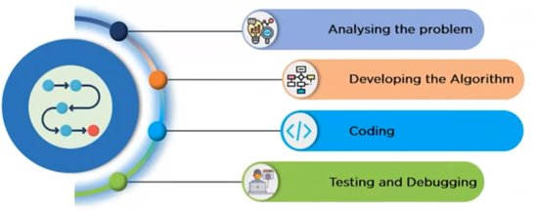
Lecture
PROBLEM-SOLVING STEPS
01
www.midocean.ae

Slide 12
Lecture
PROBLEM-SOLVING STEPS
01
Cont'd
Analyzing the problem (Step 1):
  We can figure out the inputs and outputs to be carried out.
Developing the algorithm (Step 2):
  It is required to decide a solution before writing a program.
www.midocean.ae

Slide 13
Lecture
PROBLEM-SOLVING STEPS
01
Cont'd
Coding (Step 3):
  We must convert the decided algorithm into a code.
Testing and debugging (Step 4):
  The developed code undergoes several rigorous tests.
www.midocean.ae

Slide 14
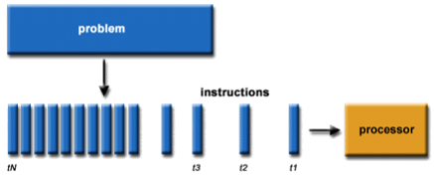
Lecture
ALGORITHM
01
The sequence of steps that describes each of the computational processes.
www.midocean.ae

Slide 15
Lecture
ALGORITHM FEATURES
01
It must consist of a finite number of instructions.
Each algorithm instruction is well defined and not ambiguous.
It should take zero or more input.
It should terminate after a finite time and produce at least one output.
It should be deterministic means giving the same output for the same input case.
www.midocean.ae

Slide 16
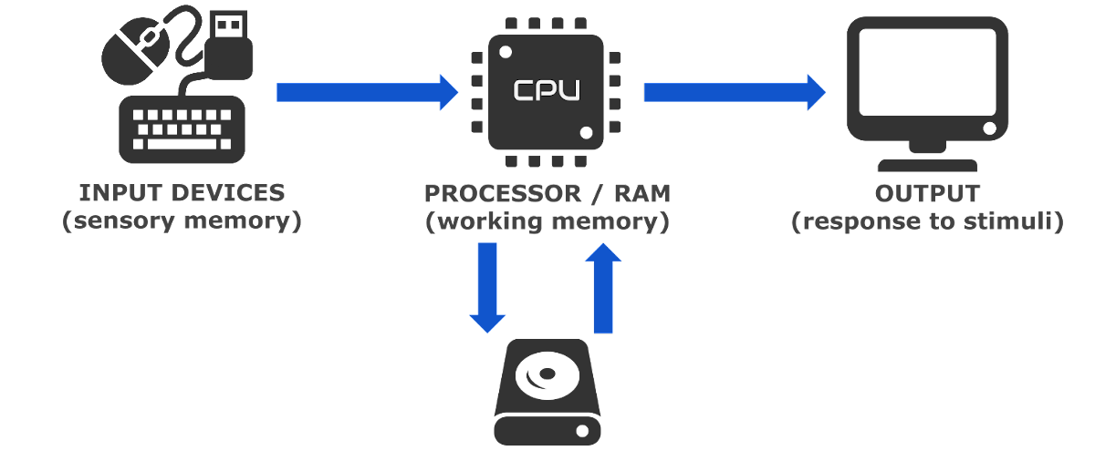
HARDWARE & SOFTWARE
COLLABORATION
Lecture
01
www.midocean.ae

Slide 17
HARDWARE & SOFTWARE
COLLABORATION
Lecture
01
Cont'd
A program (i.e., an algorithm) stored in computer memory must be represented in binary digits, or machine code.
Each loader takes a set of machine language instructions as input and loads them into the appropriate memory locations.
In CPU units performs the required computational, logical, and controlling the loaded instructions.
www.midocean.ae

Slide 18
PROGRAMMING & PROGRAMMING LANGUAGES
Lecture
01
Programming: the design of software using a set of basic instructions.
Programming language: abstract hardware instructions into basic statements, which are much easier to understand and handle.
Using a programming language, one can write complex software, achieving tailored functionalities by combination of basic statements.
www.midocean.ae

Slide 19
Lecture
01
PYTHON POGRAMMING LANGUAGE
Famous and fastest growing language.
Open-source language.
  Mostly open so that anyone can modify them, and they are usually not proprietary.
Multi-purpose language.
  It's a general-purpose language, you can use Python to do and create many different things.
www.midocean.ae

Slide 20
Lecture
01
PYTHON POGRAMMING LANGUAGE
Cont'd
Scripting and interpreted language.
  Compiler: scans the whole program at once and converts it into machine code.
Interpreter: converts the program into machine code one line at a time.
Simple, expressive, and easy to learn language.
  C#: str.Substring(0, 6); JavaScript: str.substr(0, 6); Python: str[0:6]
www.midocean.ae

Slide 21
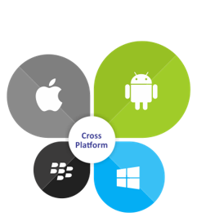
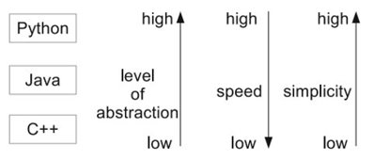
Lecture
01
PYTHON POGRAMMING LANGUAGE
Cont'd
High-level language.
Cross platform language.
www.midocean.ae

Slide 22
Lecture
01
PYTHON USES
Web Development (Django - Flask).
Games (PyGame).
Desktop Apps (PyGUI - Tkinter).
Hacking.
Machine Learning and Data Science.
www.midocean.ae

Slide 23
Lecture
01
PYTHON USES
Cont'd
AI and Robots in Mars.
Automation.
Network Programming and Web Scraping.
Android Games.
www.midocean.ae

Slide 24
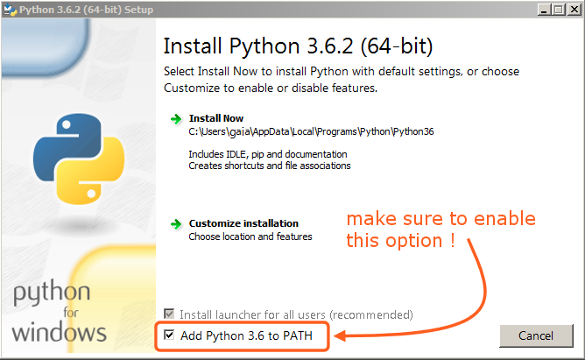
PYTHON INSTALLATION
ENVIRONMENT
Lecture
01
Download Python language.
On Windows.
  Follow the Straightforward steps.
www.midocean.ae

Slide 25
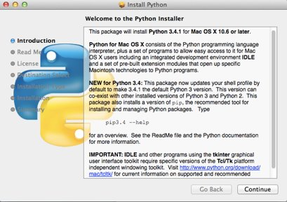
PYTHON INSTALLATION
ENVIRONMENT
Lecture
01
Cont'd
On Mac.
  Follow the Straightforward steps.
www.midocean.ae

Slide 26
PYTHON INSTALLATION
ENVIRONMENT
Lecture
01
Cont'd
On Linux.
  sudo apt install python3 python3-pip build-essential python3-dev
www.midocean.ae

Slide 27
PYTHON INSTALLATION
ENVIRONMENT
Lecture
01
Cont'd
After installation, the executable Python application is the file:
  On Windows:
  C:\Python_version\python.exe
  On Linux and Mac:
    Python is typically pre-installed, and can be found at:
    /usr/bin/python_version
www.midocean.ae

Slide 28


PYTHON INTEGRATED DEVELOPMENT ENVIRONMENT (IDE)
Lecture
01
Pycharm IDE.
  Download.
Visual Studio Code (VScode) IDE.
  Download.
www.midocean.ae

Slide 29
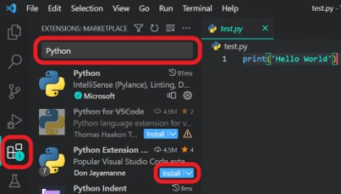
PYTHON INTEGRATED DEVELOPMENT ENVIRONMENT
Lecture
01
Cont'd
In VScode:
  You need to add Python
  extension.
www.midocean.ae

Slide 30
PYTHON INTEGRATED DEVELOPMENT ENVIRONMENT
Lecture
01
Cont'd
Online Editors:
  Online Python.
  Pynative.
  Programiz.
www.midocean.ae

Slide 31
Lecture
01
FIRST PROGRAM IN PYTHON
In order to write Python scripts (codes) in your machine (offline), we must install Python language.
Writing Python scripts using any online editors does not require to install Python language on your machine.
www.midocean.ae

Slide 32
Lecture
01
FIRST PROGRAM IN PYTHON
Cont'd
Follow these steps in writing codes:
  Create a code folder in any location on your machine.
  Create a Python script file.
    Python has .py extension for its script files.
  Open the script file in your IDE.
  Write your code.
  print("Hello World from Python")
www.midocean.ae

Slide 33

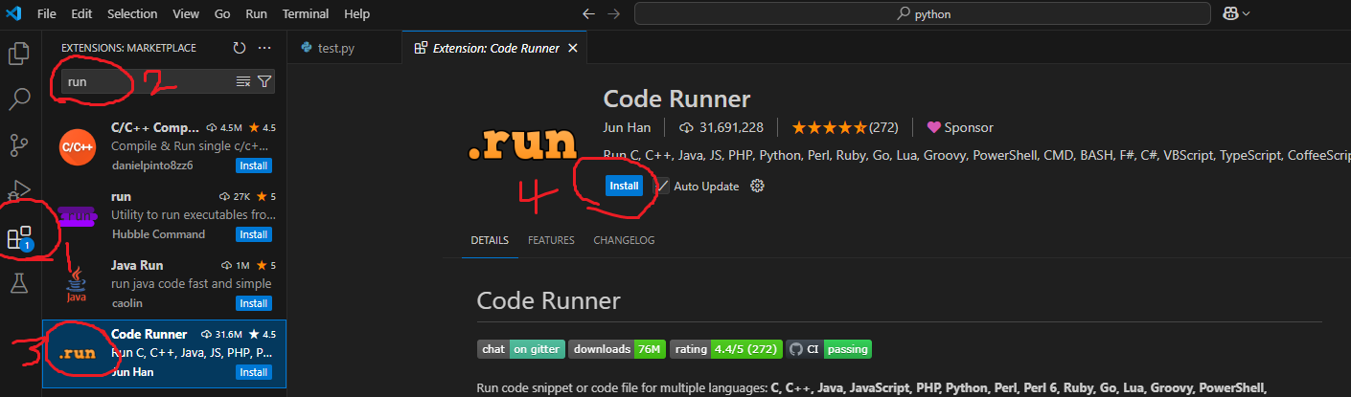
Lecture
01
FIRST PROGRAM IN PYTHON
Cont'd
Follow these steps in writing codes:
  In VScode, press RUN button on top right corner.
  OR, run your code in cmd/terminal.
  python3 first.py
  "/path/to/python3" "/path/to/code file/first.py"
www.midocean.ae

Slide 34
Lecture
01
PYTHON FORMATING STYLE
Indentation: the leading whitespace before any statement in Python.
We can use even if one space for code indentation, the default is four spaces.
A code block: a group of statements that have the same indentation level (have the same number of leading whitespaces).
It used to make the code more readability.
www.midocean.ae

Slide 35
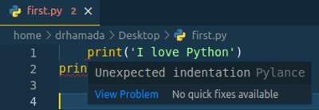
Lecture
01
PYTHON FORMATING STYLE
Cont'd
www.midocean.ae

Slide 36
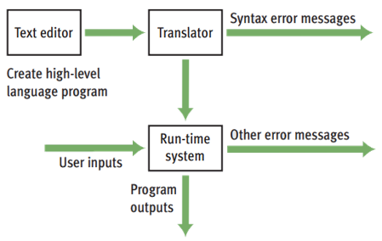
Lecture
01
PROGRAMMING SCENARIO
www.midocean.ae

Slide 37
Lecture
01
PROGRAMMING SCENARIO
Cont'd
A programmer typically starts by writing high-level language statements in a text editor.
The programmer then runs another program called a translator to convert the high-level program code into executable code.
Because it is possible for a programmer to make grammatical mistakes even when writing high-level code, the translator checks for syntax errors before it completes the translation process.
www.midocean.ae

Slide 38
Lecture
01
PROGRAMMING SCENARIO
Cont'd
The programmer then has to revise the program.
If the translation process succeeds without a syntax error, the program can be executed by the run-time system.
The run-time system might execute the program directly on the hardware or run yet another program called an interpreter or virtual machine to execute the program.
www.midocean.ae

Slide 39
Lecture
01
QUESTIONS FOR ONLINE DISCUSSION
Which of the following can be achieved using Python language:
  Mathematical calculations.
  A Windows GUI application.
  Controlling a robotic arm.
  Web crawling.
  A machine-leaning system that can fly a helicopter.
  Simulation of large-scale experiments in physics.
  A game in Android.
  A operating system from scratch.
www.midocean.ae

Slide 40


Thank You

