Slide 1





Lecture 2
Monetary policy & Interest rates
Prepared by Dr. Walaa Mohamed
MGM 237
Introduction to Finance

Slide 2
LEARNING OBJECTIVES
After studying this lecture, you should be able to do the following:
LO 8.1 Understand Monetary policy & its tools.
LO 8.2 Describe how interest rates change in response to shifts in the supply and demand for loanable funds.
LO 8.3 Identify the major components of market interest rates.
LO 8.4 Describe the types of U.S. Treasury marketable & non-marketable securities.
LO 8.5 Deﬁne the term structure of interest rates and describe the three theories used to explain the term structure.
LO 8.6 Describe the various types of inﬂation.
LO 8.7 Describe default risk and default risk premiums.

Slide 3
Understanding Monetary Policy
The primary responsibility of the Fed is to formulate monetary policy, which involves regulating the growth of the supply of money and, therefore, regulating its cost and availability. By exercising its influence on the monetary system of the United States, the Fed performs a unique and important function: promoting economic stability.
Objectives of Monetary Policy
The primary objectives of monetary policies are the management of inflation or unemployment and maintenance of currency exchange rates.
1. Inflation
Monetary policies can target inflation levels. A low level of inflation is considered to be healthy for the
economy. If inflation is high, a contractionary policy can address this issue.

Slide 4
Unemployment
Monetary policies can influence the level of unemployment in the economy. For example, an expansionary monetary policy generally decreases unemployment because the higher money supply stimulates business activities that lead to the expansion of the job market.
Currency exchange rates
Using its fiscal authority, a central bank can regulate the exchange rates between domestic and foreign currencies. For example, the central bank may increase the money supply by issuing more currency. In such a case, the domestic currency becomes cheaper relative to its foreign counterparts.

Slide 5
Tools of Monetary Policy
Central banks use various tools to implement monetary policies. The widely utilized policy tools
include:
1. Interest rate adjustment
A central bank can influence interest rates by changing the discount rate. The discount rate (base rate) is an interest rate charged by a central bank to banks for short-term loans. For example, if a central bank increases the discount rate, the cost of borrowing for the banks increases. Subsequently, the banks will increase the interest rate they charge their customers. Thus, the cost of borrowing in the economy will increase, and the money supply will decrease.

Slide 6
2. Change reserve requirements
Central banks usually set up the minimum amount of reserves that must be held by a commercial bank. By changing the required amount, the central bank can influence the money supply in the economy. If monetary authorities increase the required reserve amount, commercial banks find less money available to lend to their clients, and thus, money supply decreases.
Commercial banks can’t use the reserves to make loans or fund investments into new businesses. Since it
constitutes a lost opportunity for the commercial banks, central banks pay them interest on the reserves.

Slide 7
3. Open market operations
The central bank can either purchase or sell securities issued by the government to affect the money supply. For example, central banks can purchase government bonds. As a result, banks will obtain more money to increase the lending and money supply in the economy.

Slide 8
Types of Monetary Policy
Expansionary vs. Contractionary Monetary Policy
Depending on its objectives, monetary policies can be expansionary or contractionary.
Expansionary Monetary Policy
This is a monetary policy that aims to increase the money supply in the economy by decreasing interest rates (discount rate), purchasing government securities by central banks, and lowering the reserve requirements for banks. An expansionary policy lowers unemployment and stimulates business activities and consumer spending. The overall goal of the expansionary monetary policy is to fuel economic growth. However, it can also possibly lead to higher inflation.

Slide 9
Contractionary Monetary Policy
The goal of a contractionary monetary policy is to decrease the money supply in the economy. It can be achieved by raising interest rates, selling government bonds, and increasing the reserve requirements for banks. The contractionary policy is utilized when the government wants to control inflation levels.

Slide 10
Supply and Demand for Loanable Funds
Loanable funds are the amount of money made available by lenders to borrowers. Lenders are willing to supply funds to borrowers as long as lenders can earn a satisfactory return on their loans (i.e., an amount greater than that which was lent). Borrowers will demand funds from lenders as long as borrowers can invest the funds so as to earn a satisfactory return above the cost of their loans.
Actually, the supply and demand for loanable funds will take place as long as both lenders and borrowers have the expectation of satisfactory returns. Of course, returns received may diﬀer from those expected because of inﬂation, failure to repay loans, and poor investments. Return experiences will, in turn, aﬀect future supply-and-demand relationships for loanable funds.

Slide 11
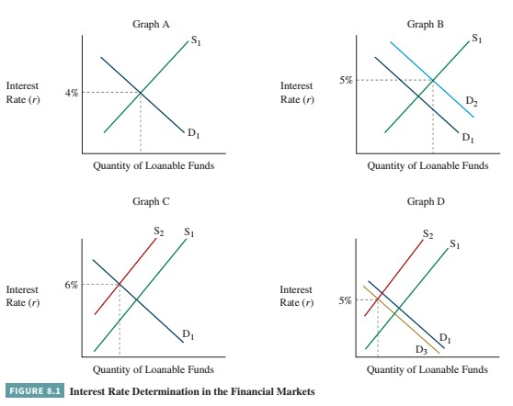

Slide 12
The interest rate is the price of loanable funds in ﬁnancial markets. The price that equates the demand for and supply of loanable funds in the ﬁnancial markets is the equilibrium interest rate. Figure 8.1 depicts how interest rates are determined in the ﬁnancial markets. Graph A shows the interest rate (r) that clears the market by bringing the demand (D₁) by borrowers for funds in equilibrium with the supply (S₁) by lenders of funds. For illustrative purposes, we have chosen a rate of 4 percent as the cost, or price, which makes savings equal to investment (i.e., where the supply and demand curves intersect).

Slide 13
Interest rates may move from an existing equilibrium level to a new equilibrium level as the result of an unanticipated change or “shock” that causes the demand for, or supply of, loanable funds to change or shift. For example, a new increase in the desire to invest in business assets because of an expected expanding economy might cause the demand for loanable funds to increase or shift upward. Graph B depicts a shift in the demand for loanable funds (i.e., from D₁ to D₂) but no change in the supply curve (S₁). Given this demand for a larger quantity of loanable funds, borrowers must pay higher interest rates to get savers to provide a greater supply of loanable funds. An upward movement along the S₁ supply curve occurs until a new equilibrium interest level is reached at, say, 5 percent compared with the previous 4 percent equilibrium interest rate.

Slide 14
Graph C depicts the result of an unanticipated increase in inﬂation, which leads lenders (suppliers) to require a higher rate of interest. Stated diﬀerently, the interest rate observed in the marketplace reﬂects the existing expected inﬂation rate over the life of the debt instrument. When there is an increase in the expected inﬂation rate, lenders will expect to be compensated for this higher inﬂation rate by a higher market interest rate. This is shown by the shift in supply curves from S₁ to S₂, which, for illustrative purposes, shows an increase in the equilibrium interest rate from 4 percent to 6 percent. Given the assumption of no shift or change in the demand curve, the new equilibrium price is reached by borrowers being willing to pay increasingly higher interest rates until the new equilibrium interest rate is reached.

Slide 15
At this point, we have not taken into consideration the fact that borrowers also may adjust or shift their demand for loanable funds because of the likelihood of more-costly loans. Graph D depicts the situation that borrowers may cut back on their demand for loanable funds from D₁ to D₃ as a result of an unanticipated increase in inﬂation. For example, this would occur if borrowers felt that their higher borrowing costs could not be passed on to their customers and, thus, the returns on their investments would be adversely aﬀected by the higher inﬂation rates. Instead of the result of an unanticipated increase in inﬂation shock causing the interest rate to rise to 6 percent (Graph C), the new equilibrium rate where supply equals demand might be only 5 percent. In essence, the upward shift in the supply curve is oﬀset in part by the down- ward shift in the demand curve.

Slide 16
Loanable Funds Theory
The loanable funds theory holds that interest rates are a function of the supply of and demand for loanable funds. This is a ﬂow theory, in that it focuses on the relative supply and demand of loanable funds during a speciﬁed period. How the supply of and demand for loanable funds interact determines both the interest rate and the quantity of funds that ﬂow through the ﬁnancial markets during any period. If the supply of funds increases, holding demand constant, interest rates will tend to fall. Likewise, an increase in the demand for loans will tend to drive up interest rates. This is depicted in Graph B of Figure 8.1.

Slide 17
Sources of Loanable Funds: Current savings and the expansion of deposits by depository institutions represent two basic sources of loanable funds. The Fed, through its open-market operations, also provides a source of loanable funds when it purchases government securities.
The supply of savings comes from all sectors of the economy, and most of it ﬂows through U.S. ﬁnancial institutions. Individuals may save part of their incomes, either as voluntary savings or through contractual savings programs—such as purchasing whole life or endowment insurance policies or repaying installment or mortgage loans.
Governmental units and nonproﬁt institutions sometimes have funds in excess of current expenditures. Corporations may have savings available because they are not paying out all their earnings as dividends. Depreciation allowances that are not being used currently to buy new capital equipment to replace older equipment may also be available for lending.
Pension funds, both governmental and private, provide another source of saving. These funds, which are building up large reserves to meet future commitments, are available for investment.

Slide 18
Some savings are invested as ownership equity in businesses, either directly in single proprietorships or partnerships or by buying stock in corporations. This is, however, only a small part of total savings.
The bulk of the total savings each year is available as loanable funds. Funds may be loaned directly;
for example, when someone lends money to a friend to enable him or her to expand business
operations. However, most savings are loaned through ﬁnancial institutions, one of whose basic functions is the accumulation of savings.

Slide 19
Factors Affecting the Supply of and Demand for Loanable Funds
Many factors can aﬀect the supply of and demand for loanable funds. Following are several important factors.
Volume of Savings The major factor that determines the volume of savings, corporate as well as individual, is the level of national income. When income is high, savings are high; when it is low, savings are low. The pattern of income taxes—both the level of the tax and the tax rates in various income brackets—also inﬂuences savings volume. Furthermore, the tax treatment of savings itself inﬂuences the amount of income saved. For example, the tax deferral on (or postponement of) savings placed in individual retirement accounts (IRAs), increases the volume of savings.
The age of the population has an important eﬀect on the volume of savings. Little saving is done during the formative and education-building stage or during the family creating stage. Therefore, an economy with a large share of young couples with children will have less total savings than one with more people in the older, wealth-building stage.

Slide 20
The volume of savings also depends on the factors that aﬀect indirect savings. The more eﬀectively the life insurance industry promotes the sale of whole life and endowment insurance policies, the larger the volume of savings. The higher the demand for private pension funds, which accumulate contributions during working years to make payments on retirement, the larger the volume of savings. The eﬀect of interest rates on such savings is often just the opposite of the normal eﬀect of price on supply.
As interest rates decrease, more money must be paid for insurance for the same amount of coverage, because a smaller amount of interest will be earned from the reinvestment of premiums and earnings. Inversely, as interest rates rise, less money needs to be put into reserves to get the same objectives. The same is true of the amount of money that must be put into annuities and pension funds.

Slide 21
Expansion of Deposits by Depository Institutions: The amount of short-term credit available depends largely on the lending policies of commercial banks and other depository institutions, and on the policies of the Federal Reserve System. Lenders are inﬂuenced by such factors as present business conditions and future prospects.
Liquidity Attitudes How lenders see the future has a signiﬁcant eﬀect on the supply of loanable funds, both long term and short term. Lenders may feel that the economic outlook is so uncertain that they are reluctant to lend their money. This liquidity preference can be so strong that large amounts of funds lie idle, as they did during the depression in the 1930s. Lenders may also prefer liquidity because they expect either interest rates to go up in the near future or opportunities for direct investment to be more favorable. Thus, liquidity attitudes may result in keeping some funds idle that would normally be available for lending.

Slide 22
Effect of Interest Rates on the Quantity of Loanable Funds Being Demanded:
The demand for loanable funds comes from all sectors of the economy. Business borrows to ﬁnance current operations and to buy plant and equipment. Farmers borrow to meet short- term and long- term needs. Institutions, such as hospitals and schools, borrow primarily to ﬁnance new buildings and equipment. Individuals ﬁnance the purchase of homes with long- term loans, and purchase durable goods or cover emergencies with intermediate- and short- term loans. Governmental units borrow to ﬁnance public buildings, bridge the gap between expenditures and tax receipts, and meet budget deﬁcits. The factors aﬀecting the demand for loanable funds are diﬀerent for each type of borrower. This discussion covers only how interest rates aﬀect the major types of borrowing.

Slide 23
Historically, one of the biggest borrowers has been the federal government, and Congress generally gives little consideration to interest rates in its spending programs. Minor changes in interest rates do not aﬀect short-term business borrowing. However, historical evidence shows that large increases in short-term interest rates do lead to a decrease in the demand for bank loans and other forms of short- term business borrowing.
Changes in long-term interest rates also aﬀect long-term business borrowing. Most corporations put oﬀ
long-term borrowing when rates are up if they expect rates to go down in the near future.
While minor changes in interest rates generally have little eﬀect on consumer borrowing, larger interest rate changes have strongly inﬂuenced consumer borrowing for durable goods and houses in the past. Lower mortgage loan rates, generally, result in greater demand for houses and lower car loan rates often are associated with increases in automobile purchases.

Slide 24
Actions of the Banking System, the Fed, and the Government: While the eﬀect of interest rates on loanable funds varies, both the supply of and the demand for loanable funds are aﬀected by the actions of the banking system, the Fed, and the government. When depository institutions expand credit by increasing the total volume of short-term loans, the supply of loanable funds increases. When credit contracts, the supply of loanable funds decreases.
The actions of the Fed in setting discount rates, buying and selling securities in the open market, and changing reserve requirements also aﬀect the supply of loanable funds. As previously noted, when the Fed purchases government securities the supply of loanable funds increases. When the Fed sells government securities the supply of loanable funds decreases. The selling of government securities by the Fed also can impact the demand for loanable funds since resulting higher interest rates may discourage borrowers.

Slide 25
Government borrowing has become a major inﬂuence on demand for funds and likely will remain so for the foreseeable future. Government surpluses or deﬁcits make funds available in the market or take them out of the market in substantial amounts. Treasury debt management policies also aﬀect the supply-and- demand relationships for short-term and long-term funds. The Treasury, through tax policies and other government programs, can aﬀect the supply of funds. However, the Treasury’s major inﬂuence is on the demand for funds, as it borrows heavily to ﬁnance federal deﬁcits.

Slide 26
International Factors Affecting Interest Rates: Interest rates in the United States are now no longer inﬂuenced only by domestic factors. The willingness of foreign institutions and governments to accumulate and hold U.S. government securities inﬂuences the interest rates the federal government pays in issuing new securities. This international inﬂuence adds to the need to balance the national budget and to reduce the amount of deﬁcit ﬁnancing. As production has shifted to many other countries, investment has also shifted. In short, the Treasury and the Federal Reserve must consider the inﬂuence of international movements of funds on domestic interest rates.

Slide 27
Components of Market Interest Rates
In addition to supply-and-demand relationships, interest rates are determined by a number of speciﬁc factors or components. The market interest rate is the interest rate observed in the marketplace for a debt instrument. A market, or nominal, interest rate contains at least two components—a real rate of interest and an inﬂation premium. The real rate of interest is the interest rate on a risk-free ﬁnancial debt instrument when no inﬂation is expected. It is generally believed that investors must expect a minimum level of return in order to get them to invest in debt instruments instead of holding cash. The inﬂation premium is the additional expected return to compensate for anticipated inﬂation over the life of a debt instrument. In its simplest form, the observed market interest rate (r) can be expressed as,
r = RR + IP
where RR is the real rate of interest and IP is an inﬂation premium. For debt instruments that have no additional risk components, this interest rate is called the risk-free interest rate.

Slide 28
In practice, it is diﬃcult to identify a debt instrument that trades in the market based only on a risk-free interest rate. In the next section we will discuss the possibility of using observed interest rates on U.S. Treasury securities as proxies for the risk-free interest rate. Most debt instruments will also have a default risk premium. Equation 8.1 can be expanded to include expected compensation for this additional risk:
r = RR + IP + DRP
where DRP is the default risk premium.

Slide 29
The default risk premium is the additional expected return to compensate for the possibility that the borrower will not pay interest and/or repay principal when due according to the debt instrument’s contractual arrangements. In essence, “higher returns are expected for taking on more risk.” This is a higher “expected” return because the issuer may default on some of the contractual returns. Of course, the actual “realized” return on a default risky debt investment could be substantially less than the expected return. At the extreme, the debt security investor could lose all of his or her investment.
Two additional premiums are added to equation 8.2 to explain market interest rates for debt instruments with varying maturities and liquidity. This expanded version can be expressed as,
r = RR + IP + DRP + MRP + LP (8.3)
where MRP is the maturity risk premium and LP is the liquidity premium on a debt instrument.

Slide 30
The maturity risk premium is the additional expected return to compensate interest rate risk on debt instruments with longer maturities. Interest rate risk is the risk of changes in the price or value of ﬁxed- rate debt instruments resulting from changes in market interest rates. There is an inverse relationship in the marketplace between debt instrument values or prices and market interest rates. For example, if market interest rates rise from, say, 4 percent to 5 percent because of the expectation of higher inﬂation rates, the values of outstanding debt instruments will decline. Furthermore, the longer the remaining life until maturity, the greater the reductions in a ﬁxed-rate debt instrument’s value to a speciﬁc market interest rate increase.

Slide 31
The liquidity premium is the additional expected return to compensate for debt instruments that cannot be easily converted to cash at prices close to their estimated fair market values. For example, a corporation’s low-quality bond may be traded very infrequently. As a consequence, a bondholder who wishes to sell tomorrow may ﬁnd it diﬃcult to sell except at a very large discount in price. Possibly, this should be called an illiquidity premium since the premium is compensation for a lack of liquidity. However, it is common practice to use the term liquidity premium.

Slide 32
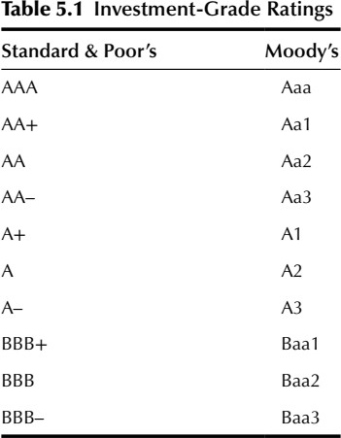
Credit Rating Agencies:
Gradations of credit ratings by Standard & Poor’s and Moody’s from the prime credit level of AAA/Aaa down to the minimum ‘investment grade’ rating of BBB–/ Baa3 (below which most major bondholders will not purchase a bond issue) are as listed in Table 5.1. Most project finance ratings are at the lower end of this range. (Below the investment grade level the ratings continue from BB + /Ba1, etc.)

Slide 33
One way potential default risk is measured is through bond ratings. The highest rating assigned by Moody’s, a major bond-rating agency, is Aaa and indicates the lowest likelihood of default. Investors in these bonds require a small default risk premium over Treasury bonds. Baa-rated bonds have higher default risks but still are considered to be of reasonably high quality. Investment grade bonds have ratings of Baa or higher and meet ﬁnancial institution (banks, pension funds, insurance companies, etc.) investment standards.
Sometimes corporations issue bonds with ratings lower than Baa. These are called high-yield or junk bonds because they have a substantial probability of default. While many institutional investors are restricted to investing in only investment grade (Baa-rated or higher) corporate debt, others are permitted to invest in high-yield, high-risk corporate debt.

Slide 34
Default Risk-Free Securities
U.S. Treasury Debt Instruments
U.S. Treasury debt instruments or securities are typically viewed as being free from default. Even with the large national debt, the U.S. government is not likely to renege on its obligations to pay interest and repay principal at maturity on its debt securities. While the probability of a U.S. government default is not absolutely zero, most analysts view default as being very unlikely. Thus, we view U.S. Treasury securities as being default risk free.
Treasury debt securities that can be traded in the marketplace, the majority of all out- standing U.S. debt, are said to be marketable securities. These securities have virtually no liquidity risk or premium for illiquidity. Short-term government securities do not have a maturity risk premium and, thus, are not exposed to interest rate risk. In contrast, longer-term Treasury securities have a market risk premium due to interest rate risk associated with possible changes in market interest rates. Thus, the closest approximation for the risk-free interest rate would be the interest rate on short-term government securities.

Slide 35
One way of looking at the risk-free rate is to say that this is the minimum rate of interest necessary to get individuals and businesses to save. There must be an incentive to invest or save idle cash holdings. One such incentive is the expectation of some real rate of return above expected inﬂation levels.
There must be an incentive to invest or save idle cash holdings. One such incentive is the expectation of some real rate of return above expected inﬂation levels. For illustrative purposes, let’s assume 1 percent is the current expectation for a real rate of return. Let’s also assume that the market interest rate is currently 3 percent for a one-year Treasury security.

Slide 36
Given these assumptions, we can turn to equation 8.3 to determine the average inﬂation expectations of holders or investors as follows:
3% = RR + IP + DRP + MRP + LP
3% = 1% + IP + 0% + 0% + 0%
IP = 3% – 1% – 0% – 0% – 0% = 2%
The default risk premium (DRP) is estimated to be zero, the market risk premium (MRP) also is estimated to be zero, and there is a zero liquidity premium (LP) on a one-year maturity Treasury security. Thus, investors expect a 2 percent inﬂation premium (IP) rate over the next year; and if they
also want a (RR) of 1 percent, the market interest rate (r) must be 3 percent.
real rate of interest (return)
Since there are no estimated default risk, market risk or liquidity premiums, the interest rate observed in the marketplace for a one-year Treasury security would be our best estimate of a risk-free interest rate.

Slide 37
Marketable Securities
Marketable government securities, as the term implies, are Treasury securities that can be purchased and sold through customary market channels. Large commercial banks and securities dealers maintain markets for these government debt obligations. In addition, nearly all other securities ﬁrms and commercial banks, large or small, will help their customers purchase and sell federal obligations by routing orders to institutions that do maintain markets in them. The investments of institutional investors, and large personal investors in federal obligations, are centered almost exclusively in the marketable issues. Treasury auctions are held for the initial oﬀering of bills, notes, and bonds, as well as for the sale of treasury inﬂation-protected securities and ﬂoating rate notes.

Slide 38
Types of marketable government securities:
Treasury bills are issued with maturities up to one year and, thus, are the shortest maturities of government securities. They are, typically, issued for 91 days, with some issues carrying maturities of 182 days. Treasury bills with a maturity of one year are also issued at auction every four weeks. Issues of Treasury bills are oﬀered each week by the Treasury to refund the part of the total volume of bills that matures.
When the ﬂow of cash revenues into the Treasury is too small to meet expenditure requirements, additional bills are issued. During those periods of the year when revenues exceed expenditures, Treasury bills are allowed to mature without being refunded. Treasury bills, therefore, provide the Treasury with a convenient ﬁnancial mechanism to adjust for the lack of a regular revenue ﬂow into the Treasury. The volume of bills may also be increased or decreased in response to general surpluses or deﬁcits in the federal budget from year to year.

Slide 39
Treasury bills are issued on a discount basis and mature at par. Each week the Treasury bills to be sold are awarded to the highest bidders. Dealers and other investors submit sealed binds. Upon being opened, these bids are arrayed from highest to lowest. Those bidders asking the least discount (oﬀering the highest price) are placed high in the array. The bids are then accepted in the order of their position in the array until all bills are awarded. Bidders seeking a higher discount (oﬀering a lower price) may fail to receive any bills that particular week.
Treasury notes are issued at speciﬁed interest rates for maturities ranging from two to 10 years. The Treasury currently issues 2-year, 3-year, 5-year, 7-year, and 10-year notes. These intermediate-term government securities are also held largely by commercial banks.

Slide 40
Treasury bonds have original maturities ranging from 11 to 30 years, with the current focus being on issuing bonds with 30-year maturities. These bonds bear interest at stated rates. Many issues of these bonds are callable, or paid oﬀ, by the government several years before their maturity. For example, a 30- year bond issued in 2015 may be described as having a maturity of 2040–2045. This issue may be called for redemption at par as early as 2040 but in no event later than 2045.
Treasury bonds, because of at least initial long-term maturities, are subject to maturity or interest rate
risk. Treasury notes with shorter maturities are aﬀected to a lesser extent. For illustrative purposes.

Slide 41
let’s assume that the market interest rate on 30-year Treasury bonds is currently 4 percent and, given their marketability, there is no liquidity premium. Let’s further assume that investors expect the inﬂation rate will average 2 percent over the next 30 years and they expect a real rate of return of 1 percent annually. By applying equation 8.3 we can ﬁnd the maturity risk premium to be,
4% = RR + IP + DRP + MRP + LP
4% = 1% + 2% + 0% + MRP + 0%
MRP = 4% – 1% – 2% – 0% – 0% = 1%

Slide 42
Our interpretation is that the holders, or investors, require a 1 percent maturity risk premium to compensate them for the possibility of volatility in the price of their Treasury bonds over the next 30 years. If market-determined interest rates rise and investors are forced to sell before maturity, the bonds will be sold at a loss.
Furthermore, even if these investors hold their bonds to maturity and redeem them with the government at the original purchase price, the investors would have lost the opportunity of the higher interest rates being paid in the marketplace. This is what is meant by interest rate risk. Of course, if market-determined interest rates decline after the bonds are purchased, bond prices will rise above the original purchase price.

Slide 43
Ownership of Public Debt Securities
The U.S. national debt must be ﬁnanced and reﬁnanced through the issuance of government securities, both marketable and nonmarketable. Nonmarketable government securities are securities that cannot be transferred to other persons or institutions and can be redeemed only by being turned in to the U.S. government. The large size of the national debt, over $18 trillion at the end of ﬁscal year (September) 2015, makes the ﬁnancing process a diﬃcult one. In fact, the United States must rely on the willingness of foreign and international investors to hold a substantial portion of the outstanding, interest-bearing public debt securities issued to ﬁnance the national debt.

Slide 44
Term or Maturity Structureof Interest Rates
The term structure of interest rates indicates the relationship between interest rates or yields and the maturity of comparable quality debt instruments. This relationship is typically depicted through the graphic presentation of a yield curve.
Types of Yield Curves
1. Normal (up-sloped) Yield Curve
A normal or up-sloped yield curve indicates yields on longer-term bonds may continue to rise, responding to periods of economic expansion. A normal yield curve thus starts with low yields for shorter-maturity bonds and then increases for bonds with longer maturity, sloping upwards. This is the most common type of yield curve as longer-maturity bonds usually have a higher yield to maturity than shorter-term bonds. For example, assume a two-year bond offers a yield of 1%, a five-year bond offers a yield of 1.8%, a 10-year bond offers a yield of 2.5%, a 15-year bond offers a yield of 3.0%, and a 20-year bond offers a yield of 3.5%. When these points are connected on a graph, they exhibit a shape of a normal yield curve.

Slide 45
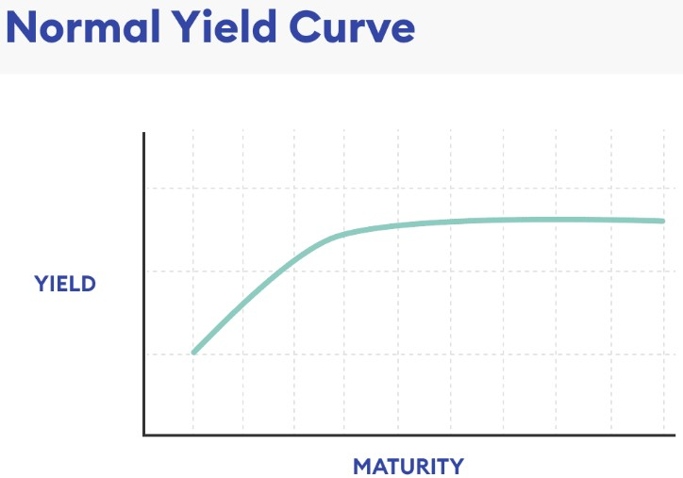

Slide 46
2. Inverted (down-sloped) Yield Curve
An inverted yield curve instead slopes downward and means that short-term interest rates exceed long- term rates. Such a yield curve corresponds to periods of economic recession, where investors expect yields on longer-maturity bonds to become even lower in the future.
Moreover, in an economic downturn, investors seeking safe investments tend to purchase these longer-
dated bonds over short-dated bonds, bidding up the price of longer bonds driving down their yield.

Slide 47
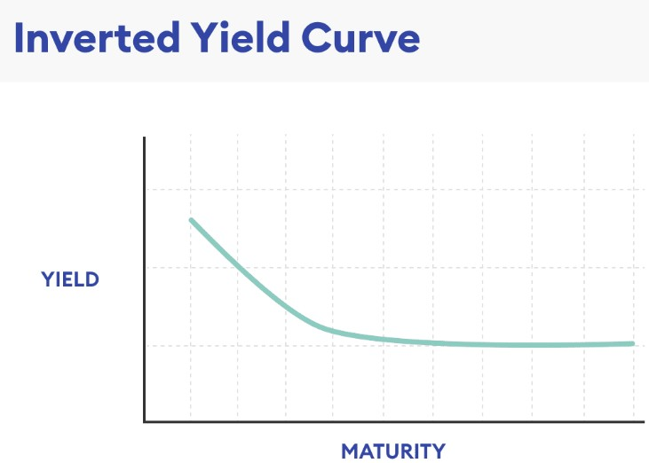

Slide 48
3. Flat Yield Curve
A flat yield curve is defined by similar yields across all maturities. A few intermediate maturities may have slightly higher yields, which causes a slight hump to appear along the flat curve. These humps are usually for the mid-term maturities, six months to two years.
As the word flat suggests, there is little difference in yield to maturity among shorter and longer-term bonds. A two-year bond could offer a yield of 6%, a five-year bond 6.1%, a 10-year bond 6%, and a 20- year bond 6.05%.
Such a flat or humped yield curve implies an uncertain economic situation. It may come at the end of a high economic growth period that is leading to inflation and fears of a slowdown. It might appear at times when the central bank is expected to increase interest rates.
In times of high uncertainty, investors demand similar yields across all maturities.

Slide 49
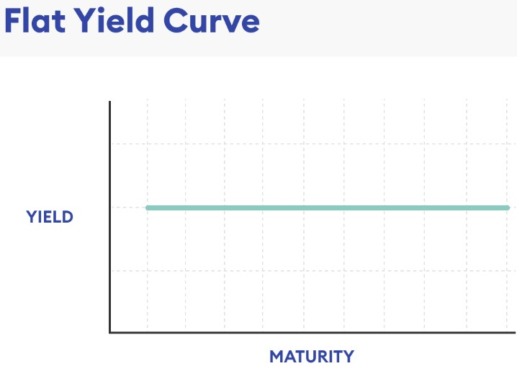

Slide 50
Term Structure Theories
Three theories are commonly used to explain the term structure of interest rates.
The expectations theory contends that the shape of a yield curve reﬂects investor expectations about future inﬂation rates. If the yield curve is ﬂat, expectations are that the current short-term inﬂation rate will remain essentially unchanged over time. When the yield curve is downward sloping, investors expect inﬂation rates to be lower in the future. On the other hand, when the yield curve is upward sloping, investors expect inﬂation rates to be higher in the future.

Slide 51
The liquidity preference theory holds that investors or debt instrument holders prefer to invest short term so that they have greater liquidity and less maturity or interest rate risk. Lenders also prefer to lend short term because of the risk of higher inﬂation rates and greater uncertainty about default risk in the future. Borrowers prefer to borrow long term so that they have more time to repay loans. The net result is a willingness to accept lower interest rates on short-term loans as a trade-oﬀ for greater liquidity and lower interest rate risk.
The market segmentation theory holds that securities of diﬀerent maturities are not perfect substitutes for one another. For example, commercial banks concentrate on holding short-term government securities in an eﬀort to match the short-term maturities of their demand and other deposit liabilities. On the other hand, the nature of insurance company and pension fund liabilities allows these ﬁrms to concentrate holdings in long-term securities. Thus, supply-and-demand factors in each market segment aﬀect the shape of the yield curve. Thus, in some time periods, interest rates on intermediate-term Treasury securities may be higher (or lower) than those for both short-term and long-term Treasuries.

