Slide 1


Supply Chain Risk Management in the Transmission and Amplification of Disruptions
Prepared by
Dr. Badur elgasim
PMG 663
Lecture 7

Slide 2

Chapter
Learning Objectives
07
The Concept of Risk Management
in the Transmission and Amplification of Disruptions
Formulation of the Goals of Risk Management
The Concept of Risk Management in the Transmission and Amplification of Disruptions
Formulation of the Goals of Risk Management
Identification of Potential and Actual Disruptions
Estimation of Disruptions
Evaluation of the Most Appropriate Approach
Application of the Mitigating Strategy

Slide 3
Chapter
07
Introduction
The concept of risk management within the supply chain framework ought to involve indirect effects of disruptions. In other words, not only should it take into consideration the risk sources and their direct consequences, but also look into the indirect disruptions that may be transmitted and amplified in the supply chain structure.

Slide 4
Chapter
07
The transmission of disruptions means that the negative effects of risk are extended to a larger number of participants in a supply chain.
If the negative risk effects are additionally magnified during the transmission, this suggests the occurrence of the amplification of disruptions.
In other words, the subsequent links in a supply chain are exposed to a stronger impact of disruptions in the transmission

Slide 5
Chapter
07
A myriad of examples derived from the practice of supply chain management evidence that risk consequences at the interorganizational level may be very pricey, especially when they take the form of transmission and amplification of disruptions.
For instance, the supply chain of Ericsson lost an estimated $2 billion in 10 min when a fire that happened at its manufacturer of chips left Ericsson with no alternative source of supplies.
On the other hand, the supply chain of Boeing was affected by the loss of $2.6 billion when its two key suppliers failed to deliver critical parts on time.

Slide 6
Chapter
07
The core issue for mitigating the transmission and amplification of disruptions is to establish the appropriate level of integration in supply chains.
The transmission of disruptions is determined by its range, while the amplification is indicated by the strength of disruptions

Slide 7
Chapter
07
Therefore, this phenomenon refers to supply chain integration that may either drive or inhibit the range of transmission and strength of disruptions.
In other words, the supply chain integration demonstrates a trade-off between the pursuit of efficiency/effectiveness and the negative consequences of transmitted and amplified disruptions

Slide 8
The Phenomenon of the Transmission and Amplification of Disruptions in Supply Chains
Chapter
07
.
In general, the transmission of disruptions means that the negative effects of risk are extended to a larger number of participants in a supply chain.
The primary sources of these disruptions are external and internal risk factors.
The external risk factors are located outside the supply chain, while the internal factors remain within the supply chain.

Slide 9
Chapter
07
Therefore, the transmission of disruptions is not limited to one level of a supply chain, and the companies that are only affected indirectly emit these risks to subsequent links of their network.
The problem that risk may arise at the node or link and affect other links and nodes in the structure of a supply chain

Slide 10
Chapter
07
The transmission of negative effects originating from the risk factors requires at least two companies in a supply chain to be involved in a process. One company is affected by a direct impact of these risk factors, whereas the other one is affected by an indirect influence.
The risk factors affect a supplier directly, causing a certain disruption, which is then transmitted to other participants inside the structure of the supply chain.

Slide 11
Chapter
07
In this case, the supplier is the initial link, while the actors at the other levels of the physical flow of products in the supply chain—producer and customer—are exposed to an indirect impact of these risk factors.
Consequently, an indirect impact of risk factors constitutes the transmission of disruptions

Slide 12
Chapter
07
The negative risk effects may spread out to a larger number of participants in a supply chain. The range can be varied, but it generally falls within two types of disruptions located at the extreme positions
of the continuum:
• limited range of disruptions, usually bilateral;
• widespread disruptions, generally holistic.
In the limited range of disruptions, the negative effects of risks are transmitted to a small number of links in a supply chain

Slide 13
Chapter
07
this range consists of only two companies, which indicates the transmission of disruptions from one company to the other .At the other extreme continuum outlining the range of the transmission of negative effects are widespread disruptions.
The transmission of these disruptions affects all actors in a supply chain structure. In general, the effects of risks are positioned between the two poles of limited range and widespread disruptions

Slide 14
Chapter
07
As a result, a certain number of actors participating in a supply chain will be exposed to the negative effects of risk. In terms of the direction of transmission, the propagation of supply chain disruptions may take the form of forward or backward transmission.
The forward transmission denotes that the disruptions caused by
the risk factors in the initial link are then transferred to the other echelons downstream in a supply chain

Slide 15
Chapter
07
The backward transmission is originated when disruptions in the ultimate link of a supply chain are transferred upstream to the initial echelons.
The transmission of negative risk effects often results in the amplification of disruptions. This is consistent with the outcome of the analysis carried out that supply chain risk is likely to affect several organizations through the ‘rippling effect

Slide 16
Chapter
07
The strength of disruptions may be either absorbed or amplified during transmission. In general, the amplification of disruptions means that each affected link in a supply chain can be exposed to stronger effects of risks. In other words, smaller disruptions can snowball into stronger effects setting off the ‘snowball effect’.
It means that subsequent links are exposed to a stronger impact of disruptions in the forward transmission. The transmission and amplification of disruptions may also be manifested in the form of new disruptions, different from the original ones.

Slide 17
The Concept of Risk Management
in the Transmission and Amplification of Disruptions
Chapter
07
Conceptual Framework of the Risk Management Concept
Risk management is the concept used to identify, characterize, quantify, evaluate and mitigate risk and its negative consequences that may produce undesired outcomes .
The framework of risk management in the transmission and amplification of disruptions might be developed on the basis of traditional risk management concepts

Slide 18
Chapter
07
Based on the previous concepts of risk management, the following steps in the process of risk management in the transmission and amplification of disruptions are:
formulation of the goals of risk management, analysis of the environment in terms of disruptions that either currently exist or will emerge in the near future, including:
identification of potential and actual disruptions that may be transmitted to and amplified in other supply chain links, estimation of disruptions, evaluation of the most appropriate approach for each of the identified and estimated disruptions, and finally, application of mitigating strategies congruent with one of the following approaches: passive, reactive or proactive

Slide 19
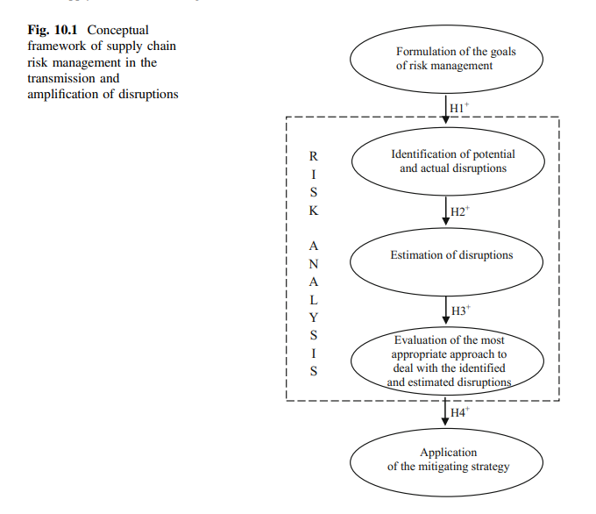
Chapter
07
The conceptual framework of risk management in the transmission and amplification of disruptions is depicted in Fig. 10.1. The concept consists of five constructs and relationships

Slide 20
Chapter
07
Formulation of the Goals of Risk Management
Formulation of the goals is the first step in the process of risk management. As the phenomenon of the transmission and amplification of disruptions is determined by the range of transmission and strength of disruptions, it is inextricably linked to the issue of supply chain integration.
In other words, the supply chain integration may either drive or inhibit the range of transmission and strength of disruptions

Slide 21
Chapter
07
the specific role of the relationship between the efficiency/effectiveness of supply chain management on the one hand, and the extent of transmission and strength of disruptions on the other hand.
the following major factors of supply chain integration that indicate a specific relationship between the supply chain efficiency/effectiveness, and the transmission and amplification of disruptions:
the number of supply chain partners, outsourcing, globalization of supply chains, backup infrastructure and extra capacity/inventory, as well as transparency of the flow of information among the supply chain link

Slide 22
Chapter
07
The first three factors concern the structure of links constituting integrative relationships, whilst the remaining factors refer to the intensity of supply chain integration. For instance, decreasing a number of supply chain partners may lead to single sourcing, whereby one supplier is solely responsible for all supplies of an item.
Several well-documented studies show that the major supply chain disruptions have been caused by a failure at a single source .Even though there are many benefits of reducing the partner base of supply chains, it is also widely recognized that it brings an increased risk

Slide 23
Chapter
07
Outsourcing, as another factor of integration, produces the higher
efficiency/effectiveness of supply chain management; however, it also simultaneously results in the increased supply chain complexity that may be a driver of the transmission and amplification of disruptions.
The globalization is the most important factor increasing the
exposure of supply chains to disruptions.

Slide 24
Chapter
07
The next factor—an increased level of inventory—usually goes hand in hand with the tendency to maintain excessive capacity of technical infrastructure used in the physical flow of products.
This is another way to reduce the increased susceptibility of contemporary supply chains to the transmission and amplification of disruptions.

Slide 25
Chapter
07
Therefore, the fundamental goal of risk management in the transmission and amplification of disruptions is to achieve two tightly-related objectives of the efficient/effective supply chain management and limited transmission and amplification of disruptions.
The first step of risk management should then be followed by the analysis of risk, including identification of potential and actual disruptions, estimation of disruptions and evaluation of the most appropriate approach to deal with the identified and estimated disruptions

Slide 26
Chapter
07
Identification of Potential and Actual Disruptions
The purpose of the identification of disruptions is to determine all disruptions that are likely to be transmitted and amplified in the structures of supply chains .
In practice, one can use several methods for collecting information about the negative risk effects. These include:
experience of managers, use of decision support systems, performance of surveys, “brainstorming” or recourse to the external consultants

Slide 27
Chapter
07
In other words, it is important to identify the specific characteristics of links relevant from the perspective of the transmission and amplification of disruptions.
while it makes sense to consider potential disruptions at the supplier’s suppliers, it is less understandable and may be more costly to read the effects of risk at further stages of a supply chain structure

Slide 28
Chapter
07
the key issue is to determine the scope of diagnosis for the purpose of
outlining how many links are to be involved in the identification process. The problem is that the phenomenon of the transmission and amplification of disruptions may not even be observable in particular situations.
It means that the negative risk effects occurring in a specific link of a supply chain are not necessarily amplified during the transmission. In this case, time and financial expenditures incurred in connection with identification of such disruptions are not justified,because they do not lead to a higher level of efficiency in the entire supply chain

Slide 29
Chapter
07
The issue of the transmission and amplification of disruptions in supply chains is complex and multifaceted, as there are two closely related phenomena involved, namely the range of transmission and the amplification of disruptions.
The most interesting situation concerns the disruptions which were amplified and transmitted to a larger number of firms in a supply chain

Slide 30
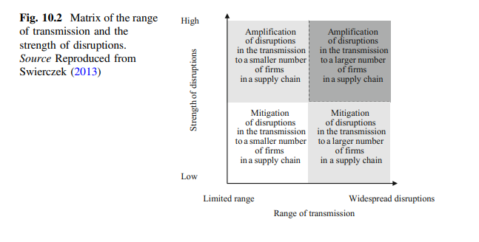
Chapter
07
the relations between the range of transmission and the strength of disruptions are only illustrative—Fig. 10.2.
It is rather uncommon that the effects of risk are transmitted to all companies in a supply chain, having a holistic impact. On the other hand, the disruptions are not only amplified in the transmission, but they may also be mitigated.

Slide 31
Chapter
07
It is also important to identify the risk factors that form the sources of disruptions amplified during the transmission.
The most difficult to identify is the transmission of disruptions caused by the risk factor which directly affects a larger number of companies in a supply chain.
The risk factors such as natural disasters or financial crises often simultaneously and directly affect a larger number of links. The disruptions caused by this group of risk factors are not sequential in nature and they are often interdependent

Slide 32
Chapter
07
The particular risk factor which affects a larger number of companies in a supply chain may be referred to as ‘common risk factor’.
The identification of potential and actual disruptions is a critical step in the risk management process that should then be followed by the estimation of disruptions argues that supply chains have to develop the capability to predict disruptions early, so that they can be duly assessed and mitigated.
Therefore, risk estimation is highly dependent on the quality of risk identification

Slide 33
Chapter
Estimation of Disruptions
07
The estimation of the phenomenon of transmission and amplification of disruptions should be preceded by the identification of risk factors, whose negative effects can be transferred with amplified strength to the subsequent supply chain links.
The managers usually pay special attention to the effects caused by the impact of a specific factor, at the same time underestimating its indirect impact. It may suggest that the strength of disruption caused by the direct impact of an external risk factor is similar to the strength of impact of the same disruption during the transmission

Slide 34
Chapter
07
It is also more difficult to determine the degree of amplification of a disruption caused by a ‘common risk factor’ as a result of transmission from one unit to another, if the same disruption has a direct impact on the other link, causing a higher level of disruptions in this link.
In such a situation, the estimation intended to determine to what degree the disruption transferred from one link caused the amplification of disruption in another link is practically impossible

Slide 35
Chapter
07
The strength of disruption in a particular link depends on the effects caused by the direct impact of the risk factor on this link, as well as on the same disruption transferred during the transmission.
The determination of the degree of the amplification of disruption is additionally hindered by the fact that common risk factor effects can be potentially transferred from several companies at the same
time

Slide 36
Chapter
07
the following activities in the estimation of disruptions:
considering the goals of risk management, determining the probability of failure to achieve these goals, and finally, defining consequences resulting from any failure to achieve the goals of risk management.
In order to estimate the extent of the transmission of disruptions,
asked the respondents to rate the extent to which each of a range of prominent disruptive events affected their own organization, their suppliers and customers.

Slide 37
Chapter
Evaluation of the Most Appropriate Approach
to Deal with the Identified and Estimated Disruptions
07
This approach is more popular if the likelihood of risk and severity of its negative effects are high. The reactive approach tends to ensure the optimal structure and intensity of supply chain integration.
In practice, it pertains to classical means of mitigating the transmission and amplification of disruptions in supply chains, such as establishing an appropriate structure of supply chain network, increasing the transparency in the information flow, maintaining backup infrastructure and excessive capacity/inventory

Slide 38
Chapter
07
The proactive approach denotes ensuring responsiveness and time compression of information and physical flow of products . the proactive approach provides unique capabilities for supply chains operating worldwide.
As demonstrated by the study of the tenets of proactive initiatives enable to mitigate the severity of disruptions. The identification and estimation of the negative risk effects, followed by evaluation of the relevant approach to deal with the disruptions, are necessary to initiate the mitigating activities. The selected mitigating strategy will only work well if all previous steps of risk management are performed carefully and correctly

Slide 39
Chapter
07
Application of the Mitigating Strategy
The application of the mitigating strategy is the last step of risk management in the transmission and amplification of disruptions. The mitigating strategy should follow the appropriate approach that aims to deal with the identified and estimated disruptions. The application of the mitigating strategy consistent with the passive approach denotes that some business opportunities are too risky as compared to the potential benefits
Thus, the supply chain management needs to apply a certain approach that enables to mitigate the negative consequences of the transmission and amplification of disruptions in supply chains

Slide 40
Chapter
07
For instance, supply chains may refuse to sell products to the customers with unhealthy financial standing, abandon the markets whose future perspective is uncertain, or give up the idea to enter the international markets due to high risk and strength of negative effects.
Therefore, employing the mitigating strategy consistent with the passive approach may result in lowering the intensity of integration among geographically-dispersed supply chain partners, or dropping the idea of closer collaboration with other companies in manufacturing and product distribution.

Slide 41
Chapter
07
Among the strategies consistent with the reactive approach, one may enumerate the following: joint efforts to share risk-related information, increased stockpiling and use of buffer stock, maintaining the excess capacity of technical infrastructure and selective outsourcing operations.
These strategies ought to ensure balance between the supply chain efficiency and the negative consequences of the transmission and amplification of disruptions

Slide 42
Chapter
07
Mitigating strategies consistent with the proactive approach include establishing a flexible base of partners, flexible transportation and manufacturing, as well as an agile configuration of the supply chain structure. The cornerstone of the proactive approach is flexible and agile integration in supply chains. For instance, maintaining a flexible base of partners . the example of a supply chain that uses double sourcing for its manufacturing process.
The first manufacturing facility assembles the product in the quantity that meets the base (average) customer demand, while the second one delivers the product if the demand exceeds its base value. Similarly, the strategy of flexible transportation consists in using multi-modal transportation, multi-carrier transportation and multiple routes

Slide 43

Chapter
07
Reference:
Supply Chain RiskManagementAn Emerging DisciplineGregory L. SchlegelRobert J. Trent
Supply Chain Risk Management Advanced Tools, Models, and Developments
By: Yacob Khojasteh -ISBN 978-981-10-4106-8 (eBook)
Chapter 7

Slide 44



Thank You

