Slide 1


Strategic HRM
Prepared by Dr. Sahar Ahmed
Week One
Lecture 1

Slide 2

Self Introduction
EDUCATION
EXPERIENCE
Cairo University
Head of HR Dep.
2010-2015
Ph.D. Business Administration
Major: HRM
Egyptian Nuclear & Radiological Regulatory Authority
2020-2024
2009-2012
AOTIC- AlFuttaim Group
2009-2006
CHUBB Insurance
Cairo University
Dr. Sahar Ahmed
Assistant Professor
2006-2008
Assistant Professor
2012-2020
Master of Business Administration
Major: HRM
- Arab Open University
- British University in Egypt

Slide 3

Course Plan
Week1: Module Outline
Week7 : Ch.9- Training & Development
Core Curriculum
Week2 : Ch.1- An Investment Perspective
of HRM
Week 8 : Ch.10- Performance Management
Week3 : Ch.3- Strategic management
Week 9 : Ch.11- Compensation
Week4 : Ch.4- The evolving Strategic Role of HRM
Week 10 : Ch.13- Separation & Retention
Week5 : Ch.5- Human Resources Planning
Week 11 : Ch.2- Social Responsibility & HRM
Week6 : Ch.8- Human Resources Staffing
Week 12: General Revision
05
www.midocean.ae

Slide 4
Course Content
Weekly Lecture
- Weekly Lecture: Theoretical discussion for each chapter to build student learning (Pdf. + Recorded lecture)
- Weekly Live Meeting: Providing the opportunity for students to apply the material or skills before moving to the next section (Attendance is optional but recommended)
Weekly Quizes (80%)
8 questions for each weekly quiz
1 mark for each question
Exam Type: True/False+MCQ+Verbal Audio
Exam time: 24 minutes
Final Assessment (20%)
End of semster (Week 13)
Exam time: 60 minutes
Exam Type: True/False+MCQ+Verbal Audio
www.midocean.ae

Slide 5
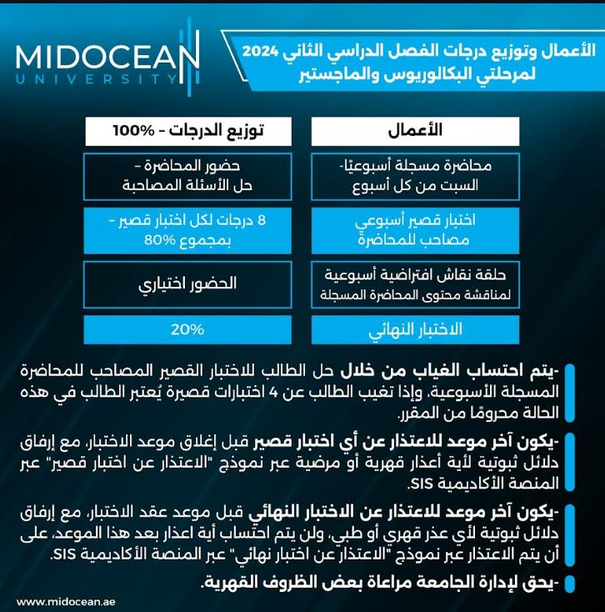


Slide 6
Introduction
In today's business world, the role of Human Resource Management (HRM) is increasingly becoming more strategic rather than administrative.
It's crucial to understand how to adapt or change longstanding HRM responsibilities to those that support the business strategy and enhance the core capabilities of the organization
Effective organizations recognize that employees have value
Much as organization’s physical & capital assets have value
The resource-based view (RBV) argues that a firm's sustained competitive advantage is based on its valuable, rare, inimitable, and non substitutable resources (Barney, 1991)
www.midocean.ae

Slide 7

Week
Sources of Employees Values
Introduction
Technical Knowledge
  -Markets, processes, customers, environment
Ability to Learn and Grow
  -Openness to new ideas
  -Acquisition of knowledge & skills
Decision Making Capabilities
Motivation & Commitment
Teamwork
  -Interpersonal skills, leadership ability
www.midocean.ae

Slide 8
Chapter
01
An Investment Perspective of HRM
This chapter introduces the concept of treating human resource management processes from a strategic point of view. Key Focus:
The Human Element and Strategic HR
Adopting an Investment Perspective
Understanding and Measuring Human Capital
HR Metrics
Factors Influencing Investment Orientation
www.midocean.ae

Slide 9
Chapter
03
Strategic Management
This chapter dives into strategic management and its impact on Human Resources (HR). Key Focus:
Models of Strategies
The Process of Strategic Management
Corporate Strategies
Business Strategies
www.midocean.ae

Slide 10
Chapter
04
The Evolving Strategic Role of HRM
This chapter dives into how the role of HR managers has evolved. Key Focus:
Evolution of HR role: Traditional vs. Strategic
Barriers to Strategic HR
Outcomes of Strategic HR
Model of Strategic Human Resource Management
www.midocean.ae

Slide 11
Chapter
05
Human Resources Planning
This chapter focuses on HR planning from a strategic viewpoint. Key Focus
Objectives of HR planning:
Types of planning:
  Aggregate planning:
  Succession planning:
Mentoring
Importance &Benefits of HR planning:
www.midocean.ae

Slide 12
Chapter
08
Human Resources Staffing
This Chapter emphasizes staffing as a crucial strategic HR function impacting profitability. Key Focus:
Recruitment considerations: temporary vs. permanent employees
Selection decisions and their importance
Testing in the screening process
International assignments
Documenting employment eligibility
New staffing trends
www.midocean.ae

Slide 13
Chapter
09
Training & Development (T&D)
This chapter dives into employee training and development (T&D) programs, highlighting their importance in today's dynamic work environment. Key Focus:
Importance of Training & Development
Planning& Strategizing Training
Organizational Development
Integrating Training with Performance Management System
www.midocean.ae

Slide 14
Chapter
10
Performance Management & Feedback
This chapter focuses on performance management and feedback, emphasizing their importance. Key Focus:
Designing Effective Performance Management
  Who conducts evaluations?
  What aspects are evaluated?
  How are evaluations administered?
  What are the evaluation measures?
  Critical Guidelines for Success
www.midocean.ae

Slide 15
Chapter
11
Compensation
This chapter provides insight into key compensation topics. Equity issues are examined from the individual, internal and external points of view. Key Focus:
Equity
Internal Equity
External Equity
Individual Equity
Executive Compensation
Compensation System
www.midocean.ae

Slide 16
Chapter
13
Employee Separation and Retention Management
This chapter highlights the importance of effectively managing employee separation, both voluntary (resignations) and involuntary (layoffs). Key Focus:
Restructuring and Reductions in Force
Cost of Turnover
Turnover
Retirement
Cost of Turnover
www.midocean.ae

Slide 17
Chapter
02
Social Responsibility & HRM
This chapter dives into challenges faced by Human Resource Management (HRM) in a dynamic environment. Key Focus:
  Workforce Demographic Changes & Diversity
  Ethical and Social Responsibility
  Conclusion
www.midocean.ae

Slide 18
Week
01
References
Main Reference
Mello A .Jeffrey (2011). Strategic Management of Human Resources (3rd ed.) South-Western Cengage Learning.
Additional Resources for extra reading.
Boselie, Paul (2014). Strategic Human Resource Management: A Balanced Approach .McGraw Hill Companies.
Millmor, Mike, Philip Lewis, and others (2007), Strategic Human Resource Management Contemporary issues. Ft Prentice Hall.
www.midocean.ae

Slide 19



Thank You

