Slide 1



The Role of A/B Testing in Digital Marketing in Boosting Online Sales in Saudi Arabia: A field study
Thesis defense
Prepared by
Supervisor
HAMZAH AHMED ALI BIN SHAAIB
Dr. Mohamed Ewies

Slide 2

Content
Background.
Research Model.
Theoretical Framework.
Methodology.
Findings.
Implications.
Limitations and Future Research.

Slide 3
Research Background
Researchers advocate the importance of measuring the effectiveness of online sales in relation to data-driven decision making such as A/B testing (Boegershausen et al., 2025; Esteller-Cucala, Fernandez & Villuendas, 2019; Kohavi & Longbotham, 2017).
Most of the research on A/B testing method in the Saudi context focused on the technical issues and scattered outcomes of the employment of A/B techniques (Alkhalil et al., 2024).

Slide 4
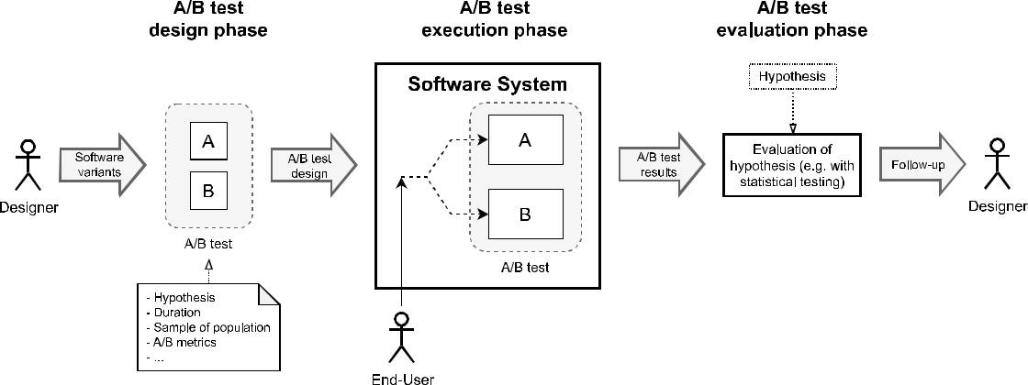
General Process of A/B Testing

Slide 5
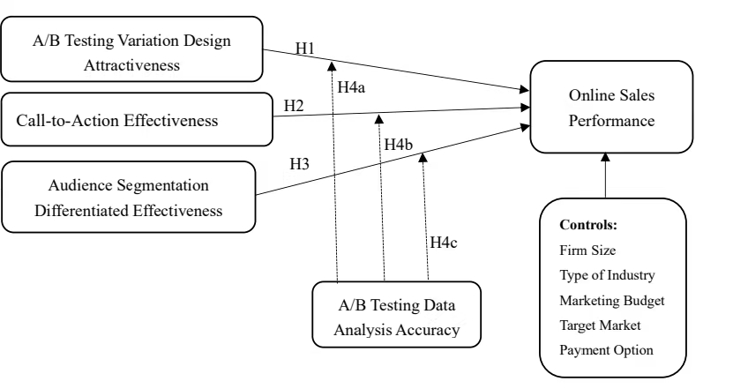
Research Model

Slide 6
Theoretical Framework: Two Theories
Technology-Organization-Environment (TOE): The TOE Framework helps explain this study by showing how A/B testing effectiveness depends on more than just tools. While technology enables testing and analysis, organizational capabilities such as data analysis accuracy and the competitive digital environment in Saudi Arabia together shape how well firms can use A/B testing to improve online sales. | 2. Evidence-Based Management (EBM) EBM is reflected in the study’s focus on data-driven decision-making. Firms achieve better results when they rely on accurate A/B testing data to guide design, messaging, and targeting decisions, reinforcing the idea that strong evidence leads to more effective marketing strategies.

Slide 7
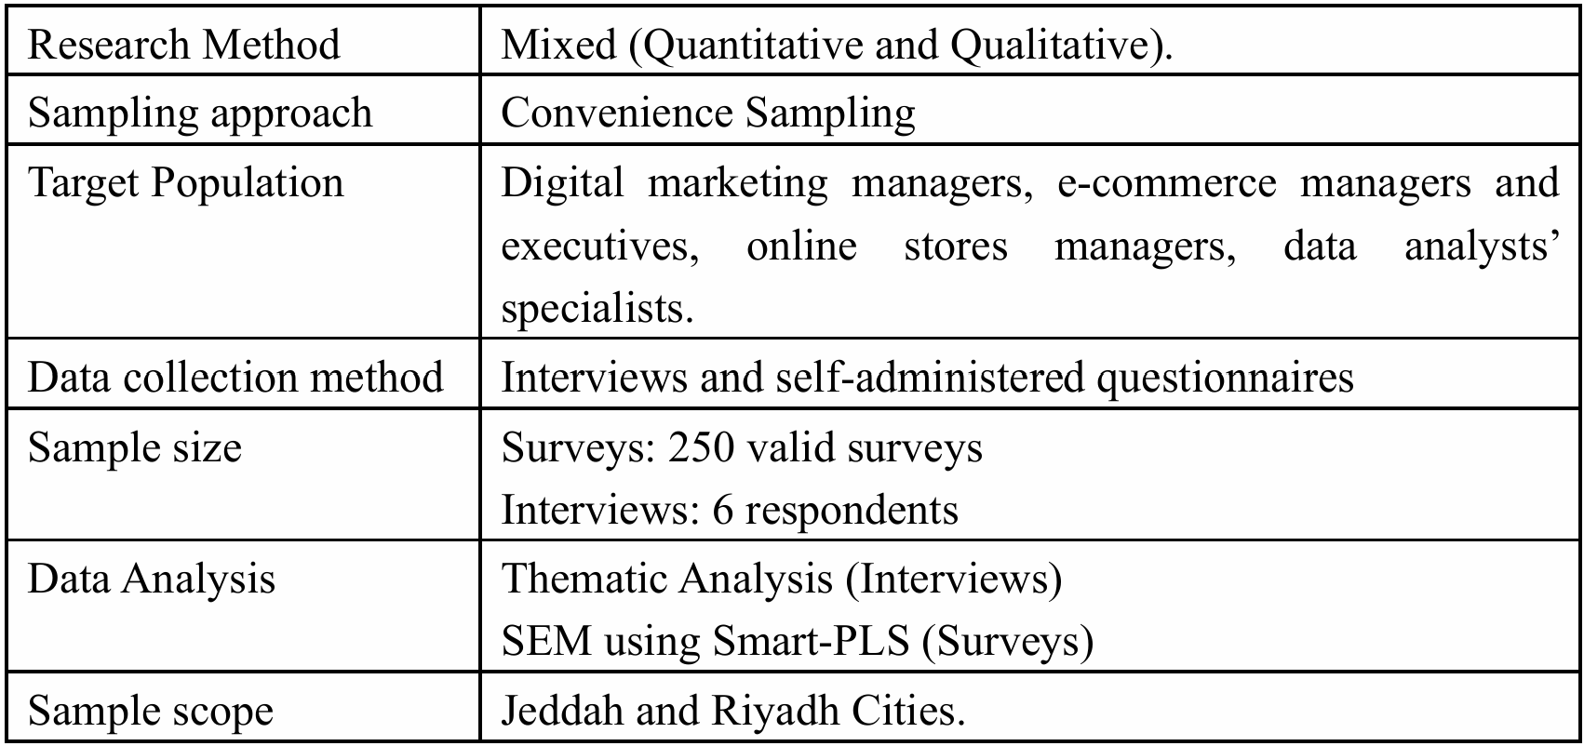
Research Methodology

Slide 8
Variables Measurement- 5 points Likert scale
Construct | No. Items | Sample Item | Source
A/B Testing Variation Design Attractiveness 5 | 5 | The A/B testing variations are more visually appealing and user-friendly than the original. | (Kohavi & Longbotham, 2017).
A/B call-to-action Effectiveness | 4 | The call-to-action (CTA) was clearer and more compelling than the original. | Vafainia et al. (2019).
Audience Segmentation Differentiated Effectiveness | 4 | Demographic segments (e.g., age/gender/location) | Guha et al. (2021)
Online Sales | 5 | Our online sales revenue has increased since implementing A/B digital marketing testing | Mandić et al. (2023)
A/B Data Analysis Accuracy | 4 | The analysis of A/B testing results accurately reflected the differences between the A/B test variations. | Ott and Longnecker (2016).

Slide 9
Research Findings

Slide 10
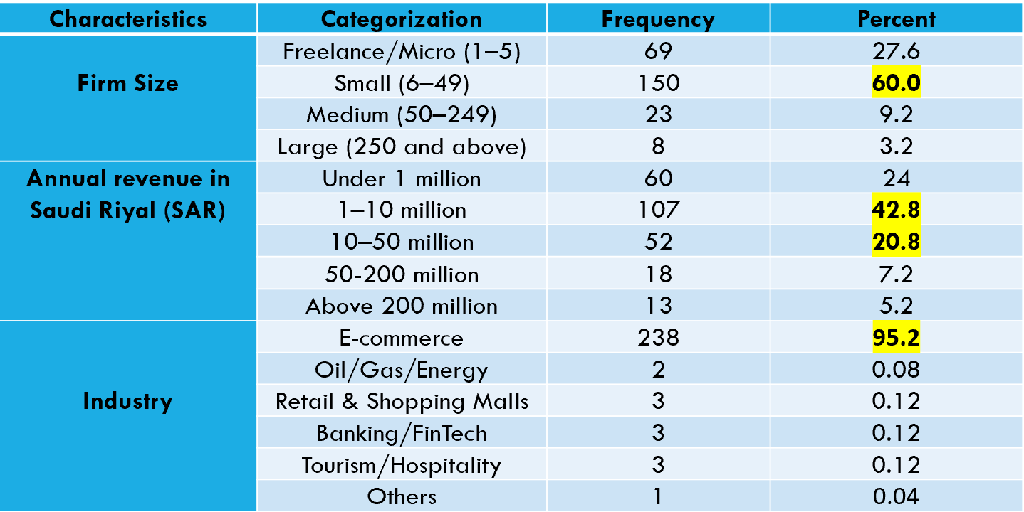
Respondents’ Profile (N=250)

Slide 11
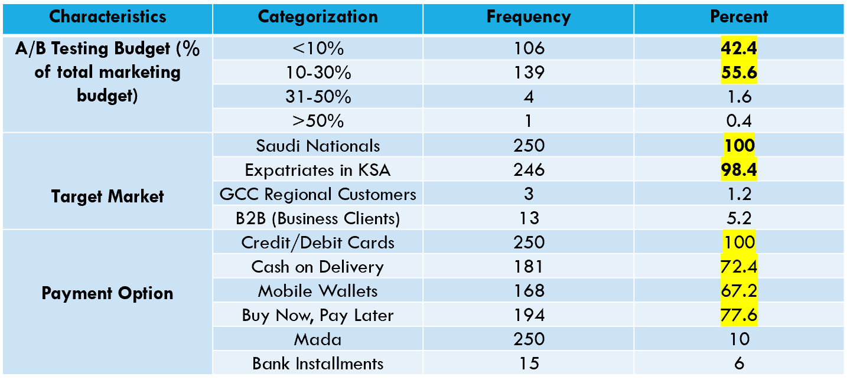
Respondents’ Profile (N=250)

Slide 12
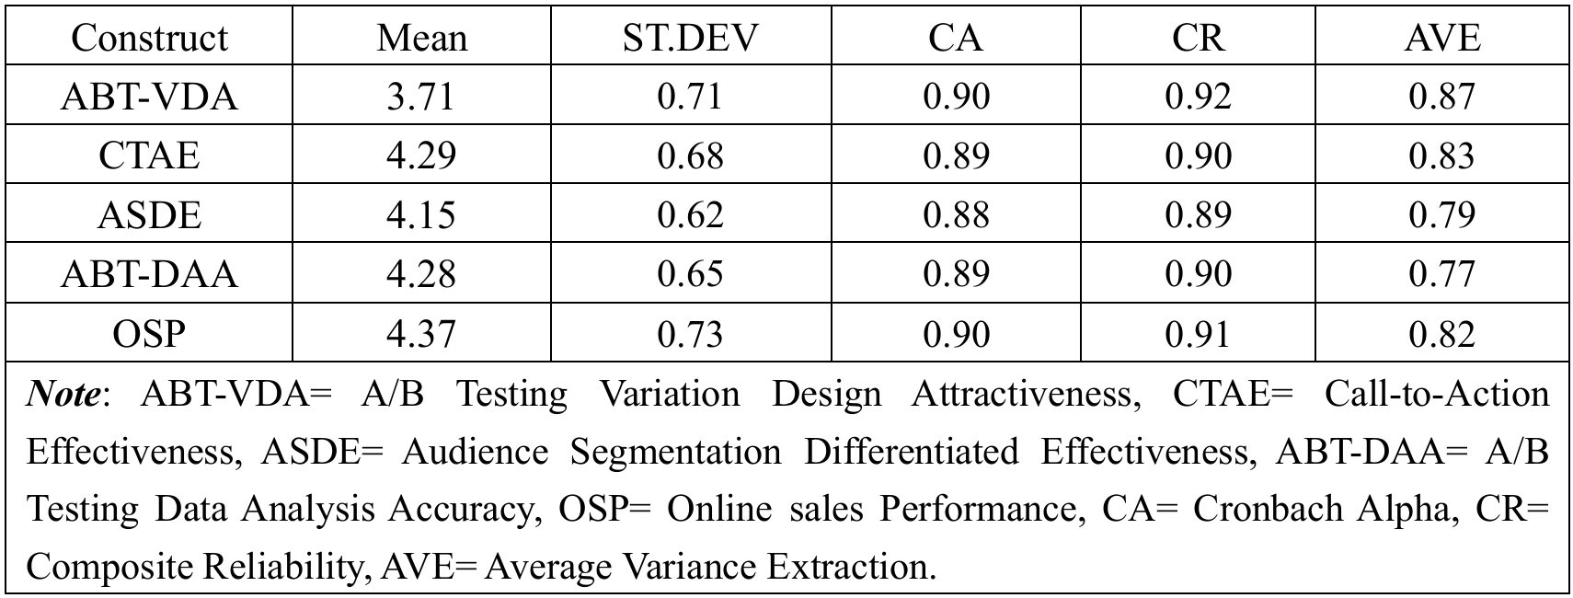
Reliability and Convergent Validity

Slide 13
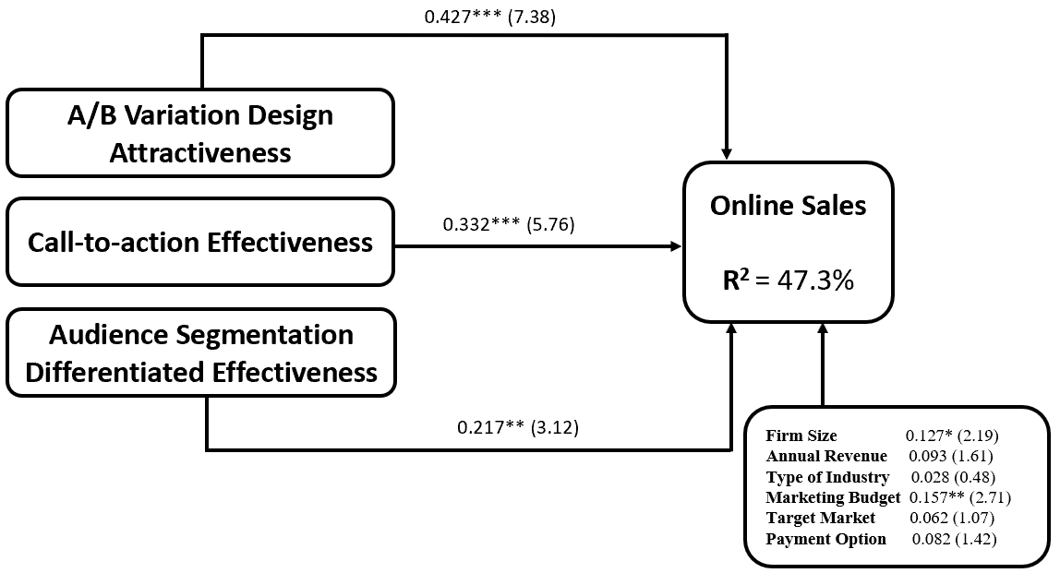
Direct Regression Analysis

Slide 14
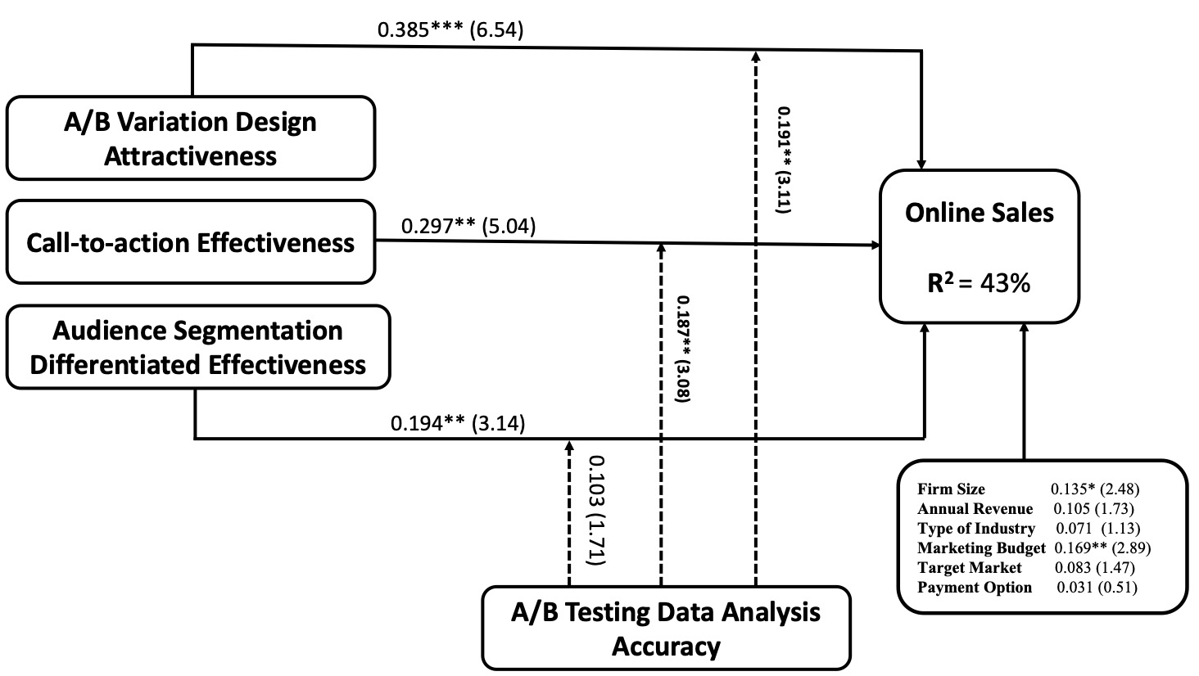
Moderating Regression Analysis

Slide 15
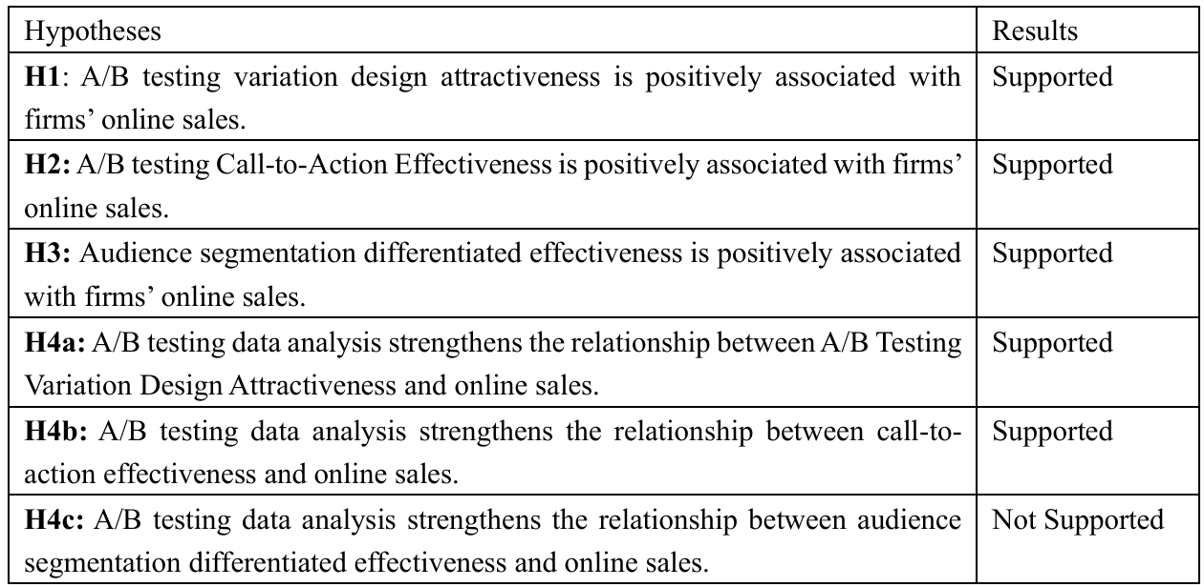
Summary of Hypotheses Testing Results

Slide 16
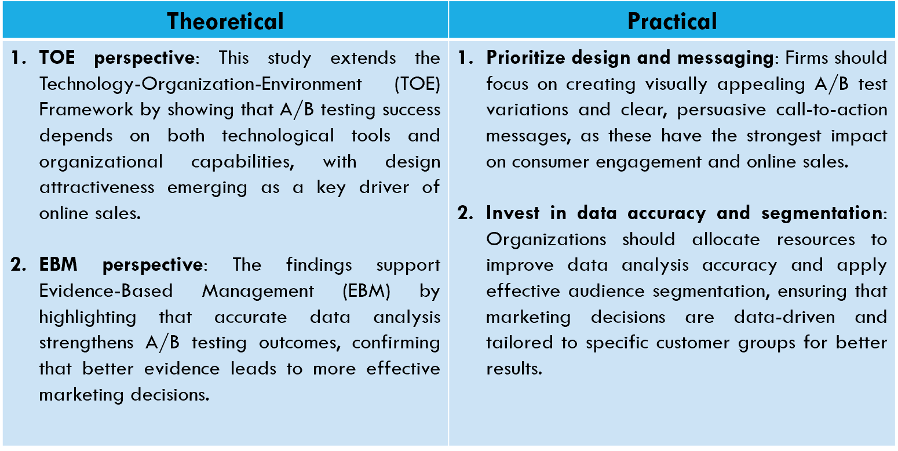
Implications

Slide 17
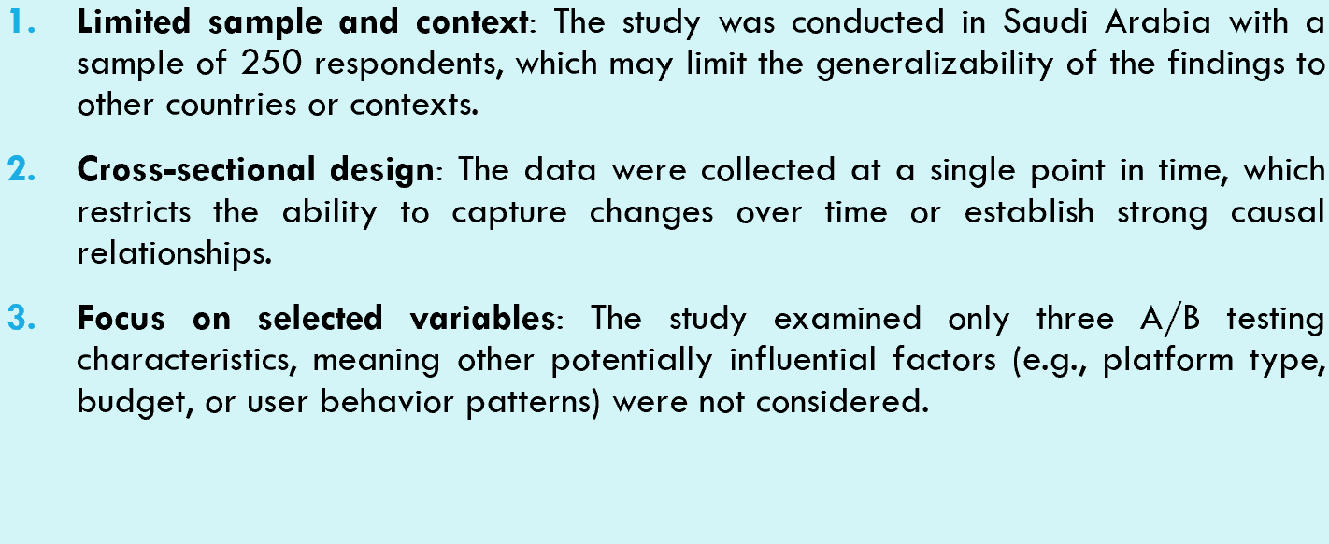
Limitations

Slide 18
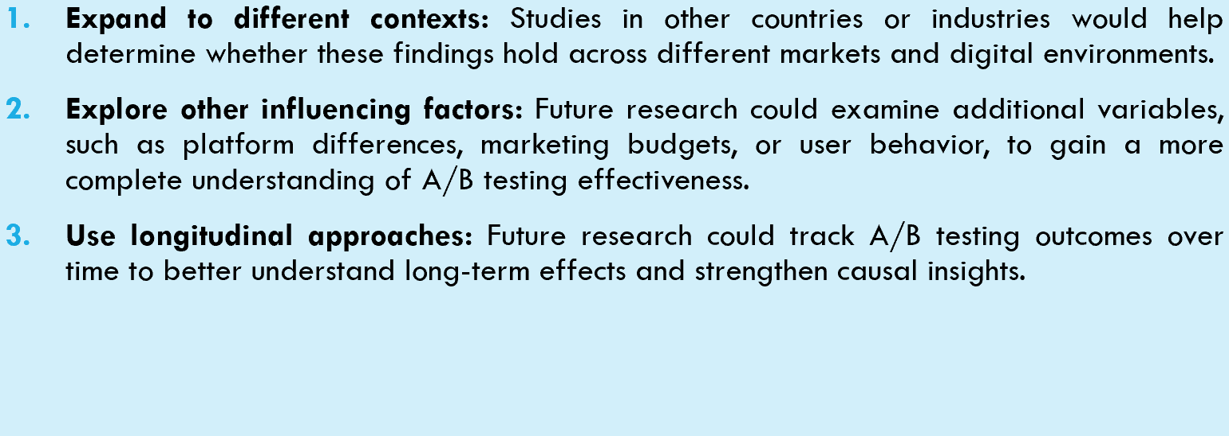
Future Research

Slide 19


Thank you

