Slide 1


Slide 2
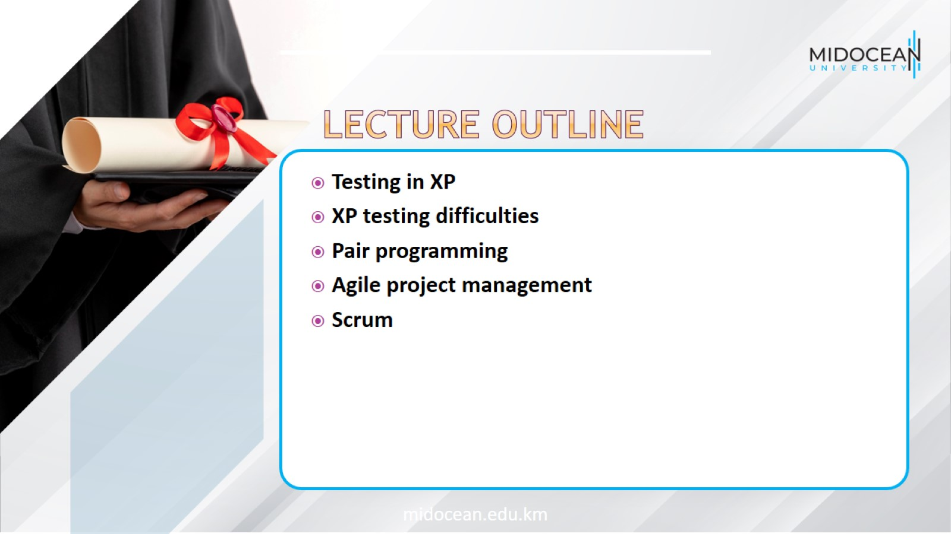

Slide 3

Testing in XP

Slide 4
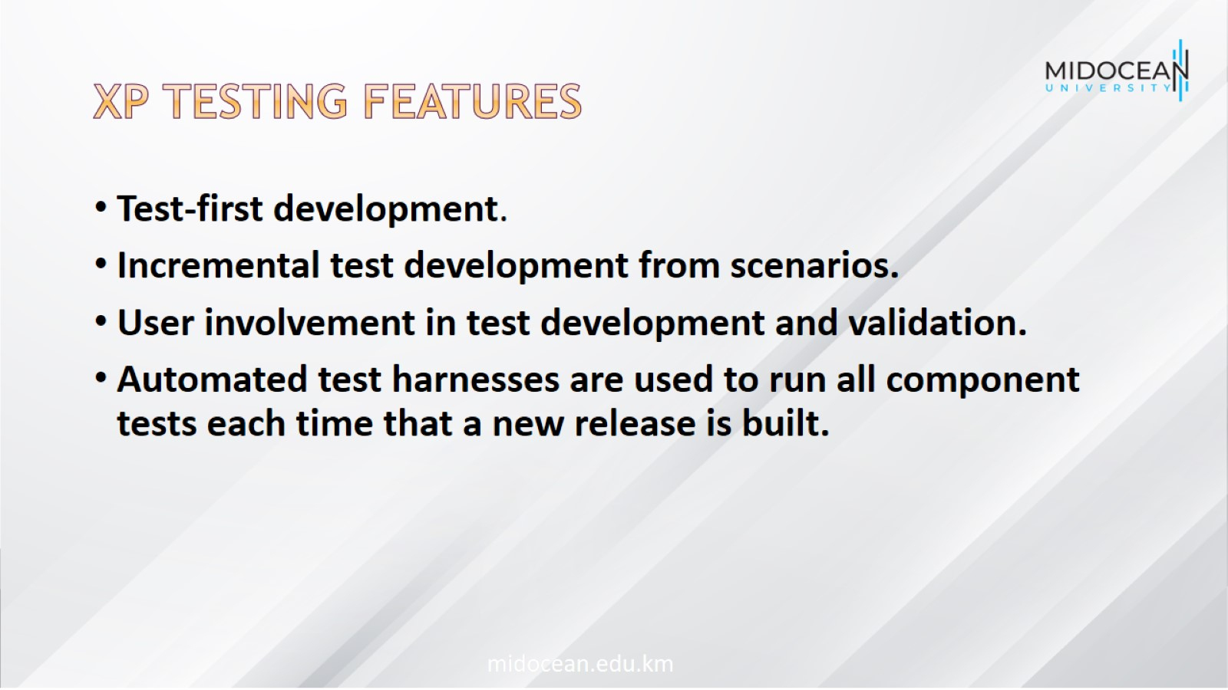
XP testing features

Slide 5
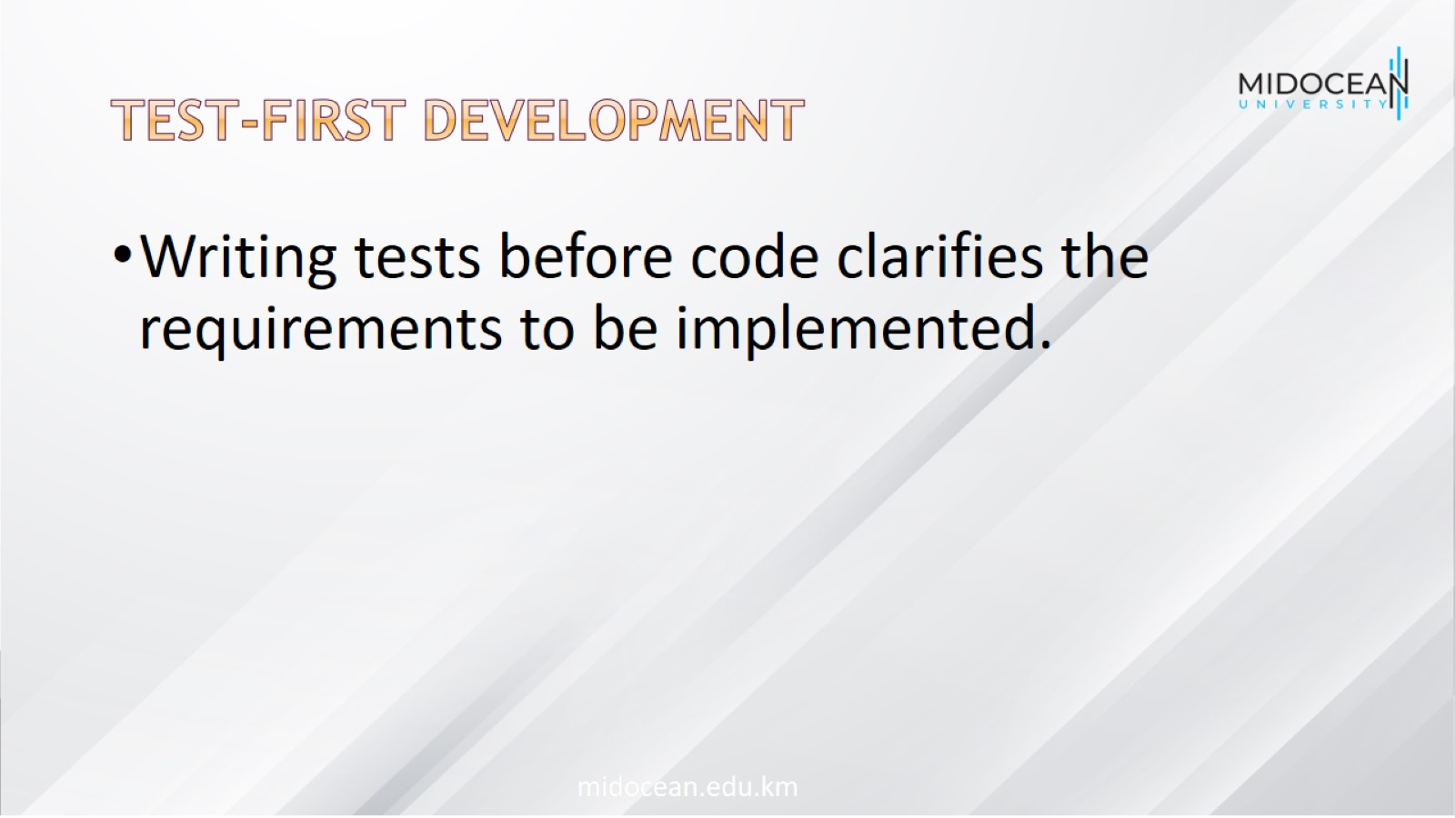
Test-first development

Slide 6
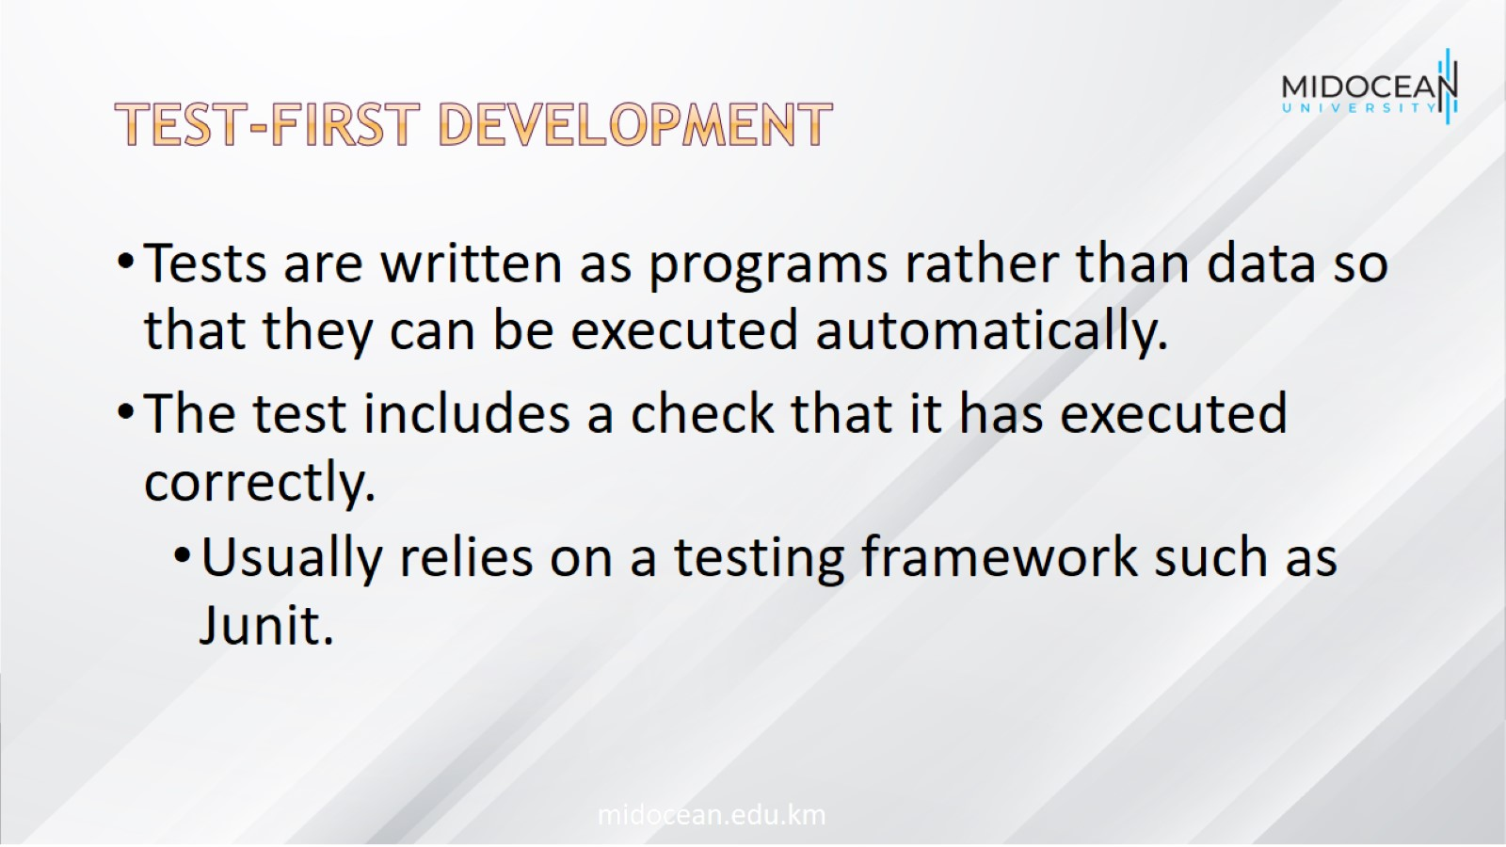
Test-first development

Slide 7
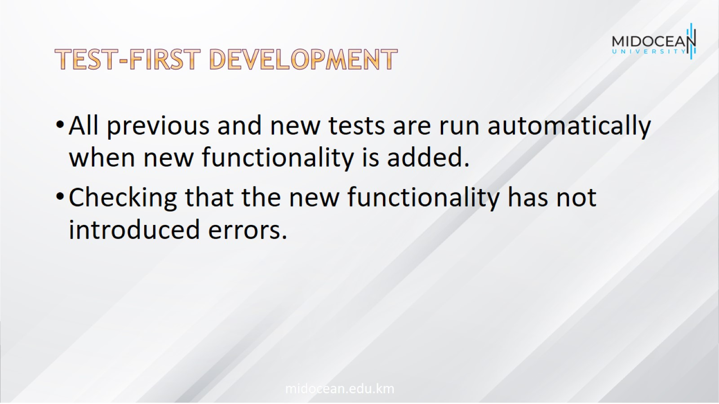
Test-first development

Slide 8
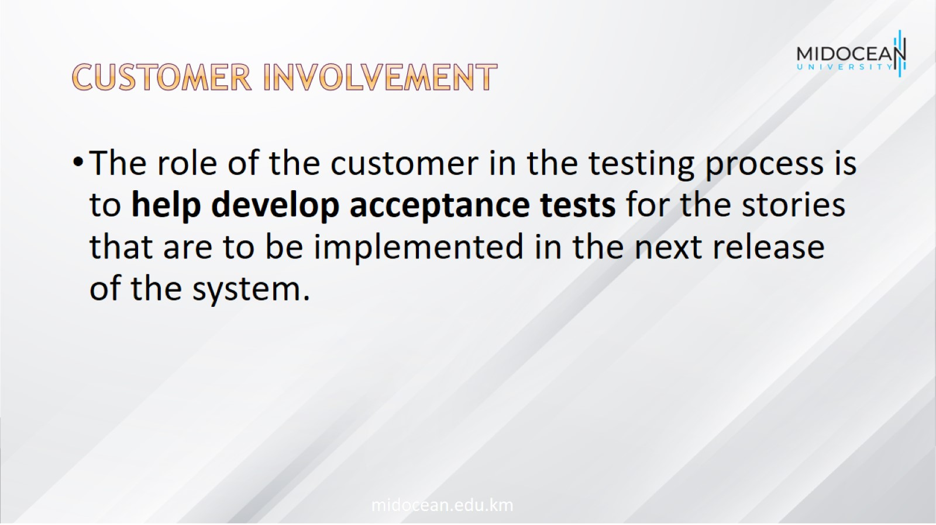
Customer involvement

Slide 9
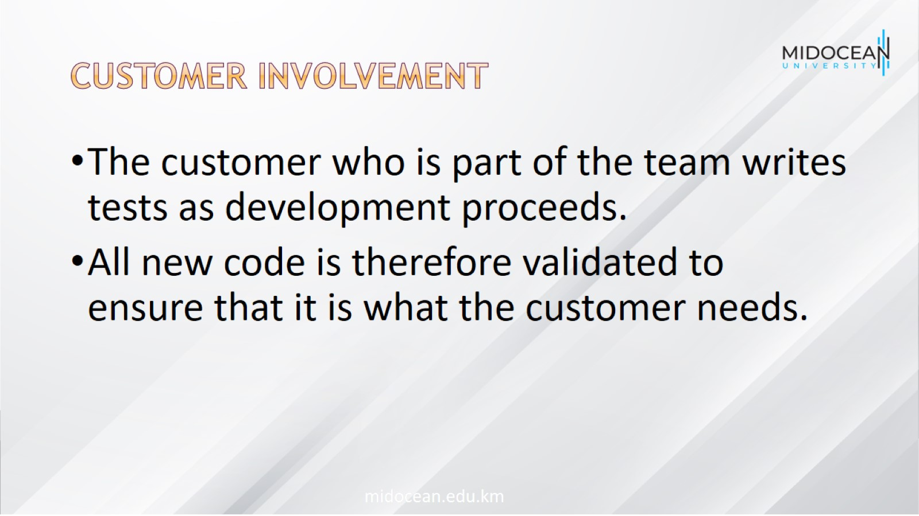
Customer involvement

Slide 10
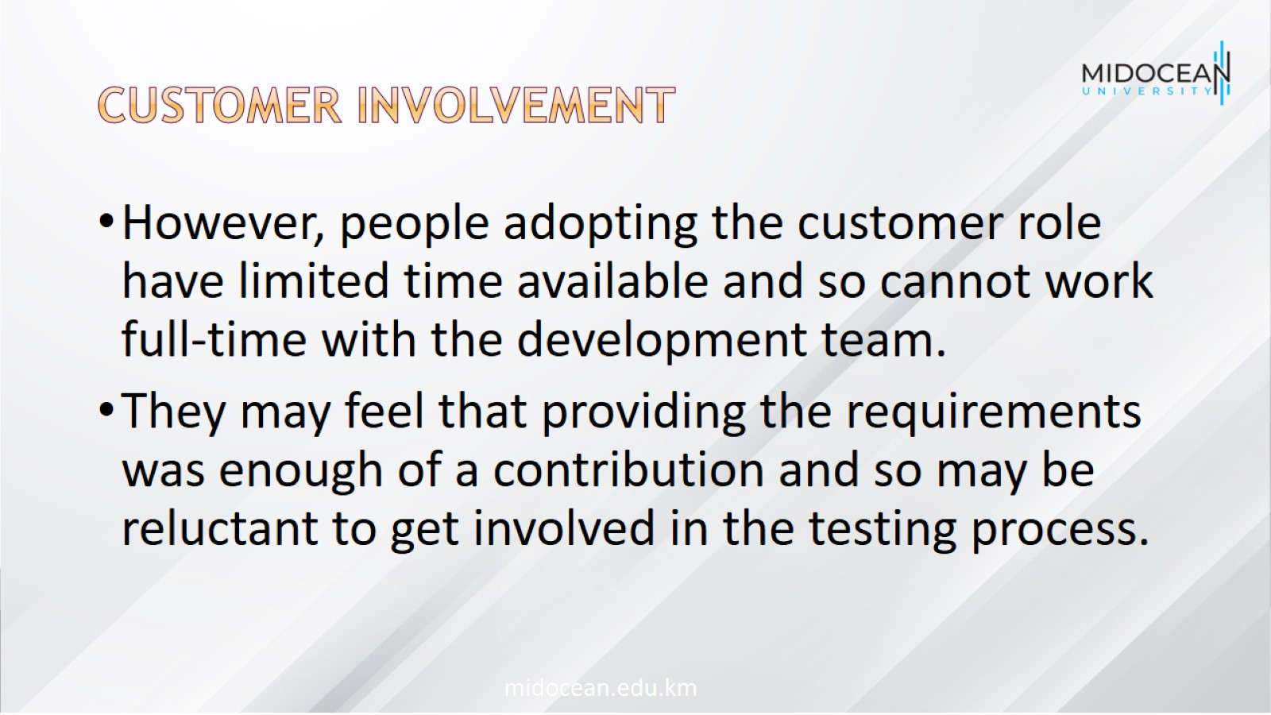
Customer involvement

Slide 11
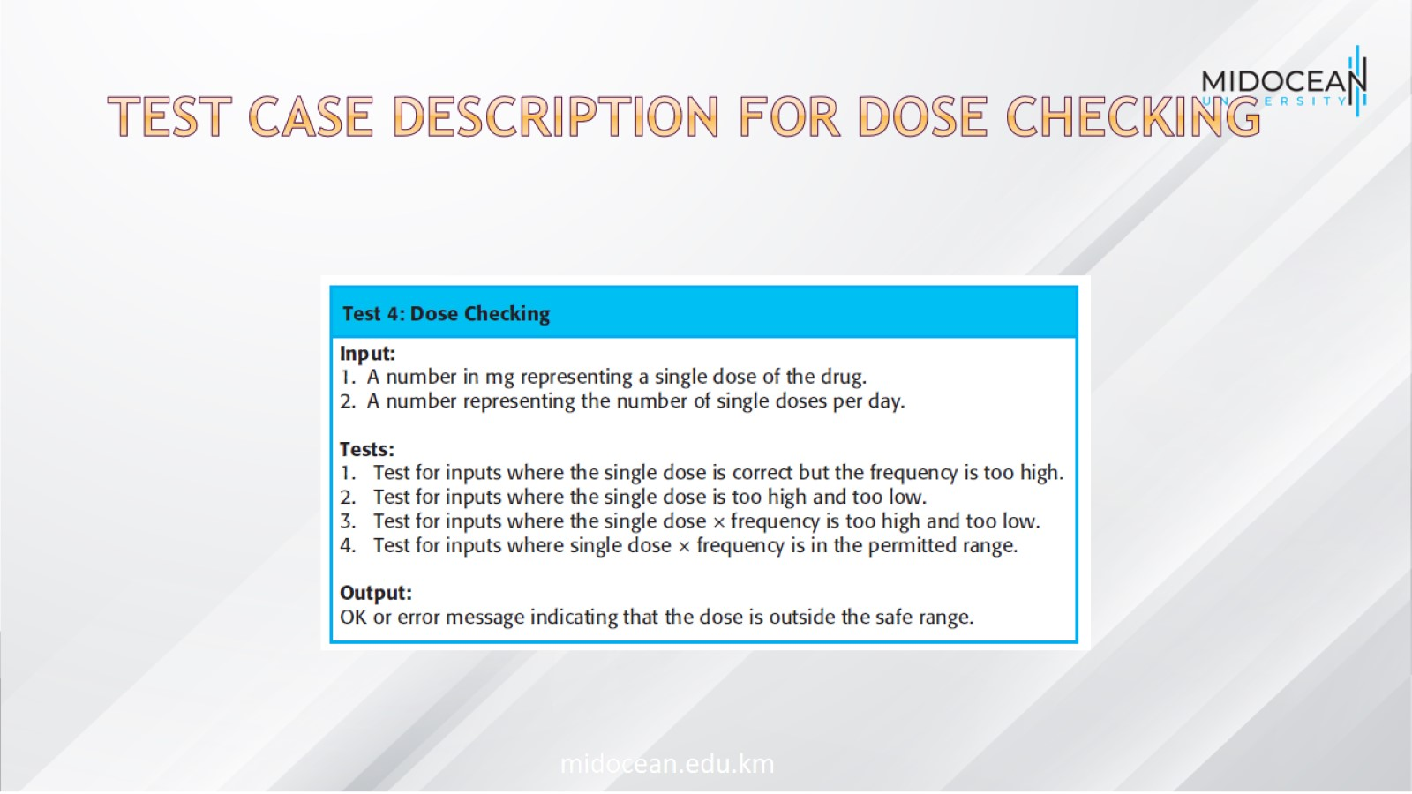
Test case description for dose checking

Slide 12
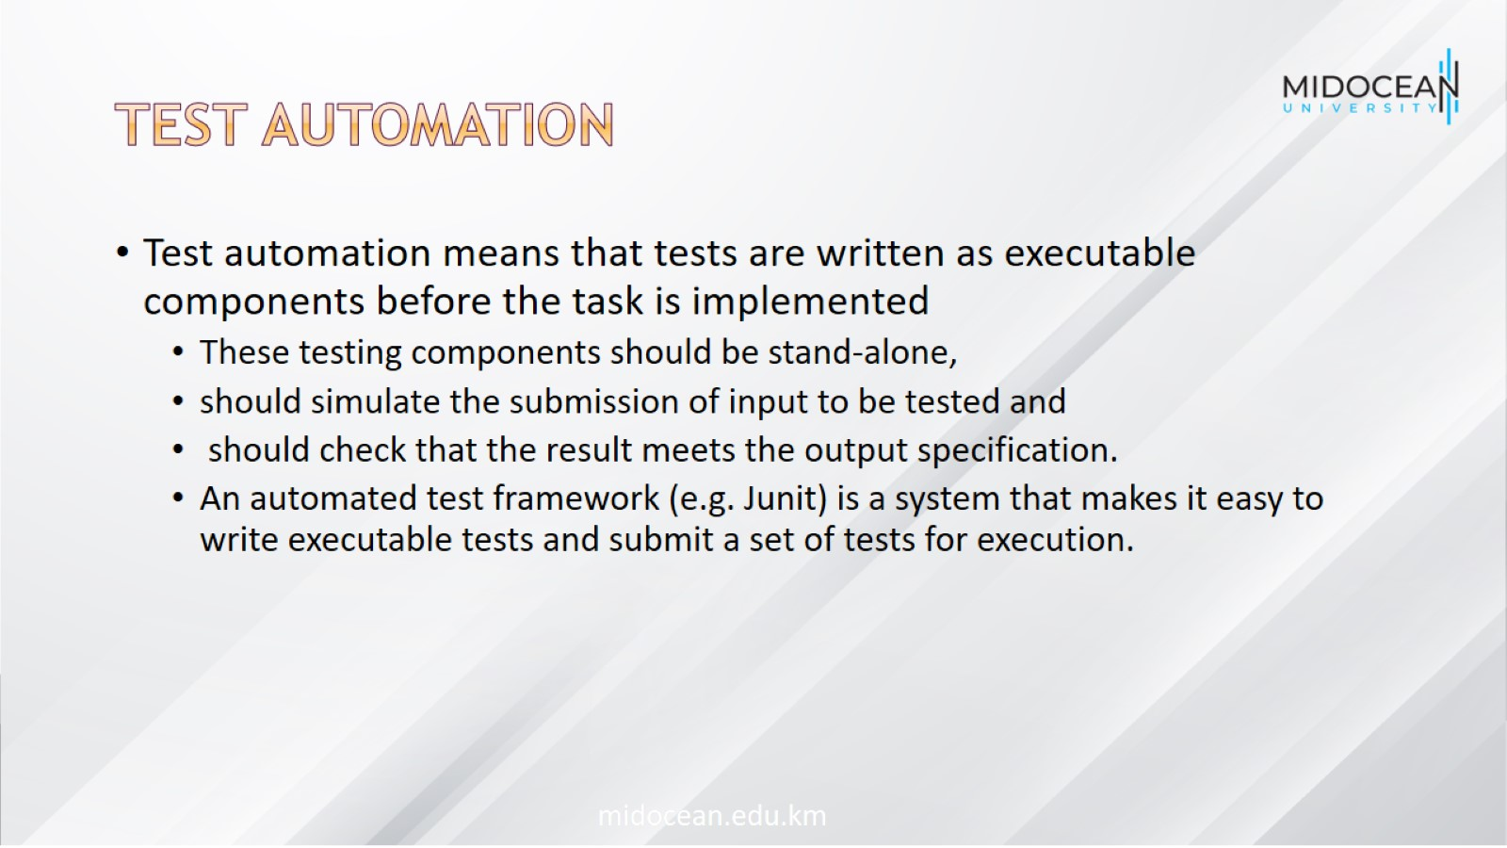
Test automation

Slide 13
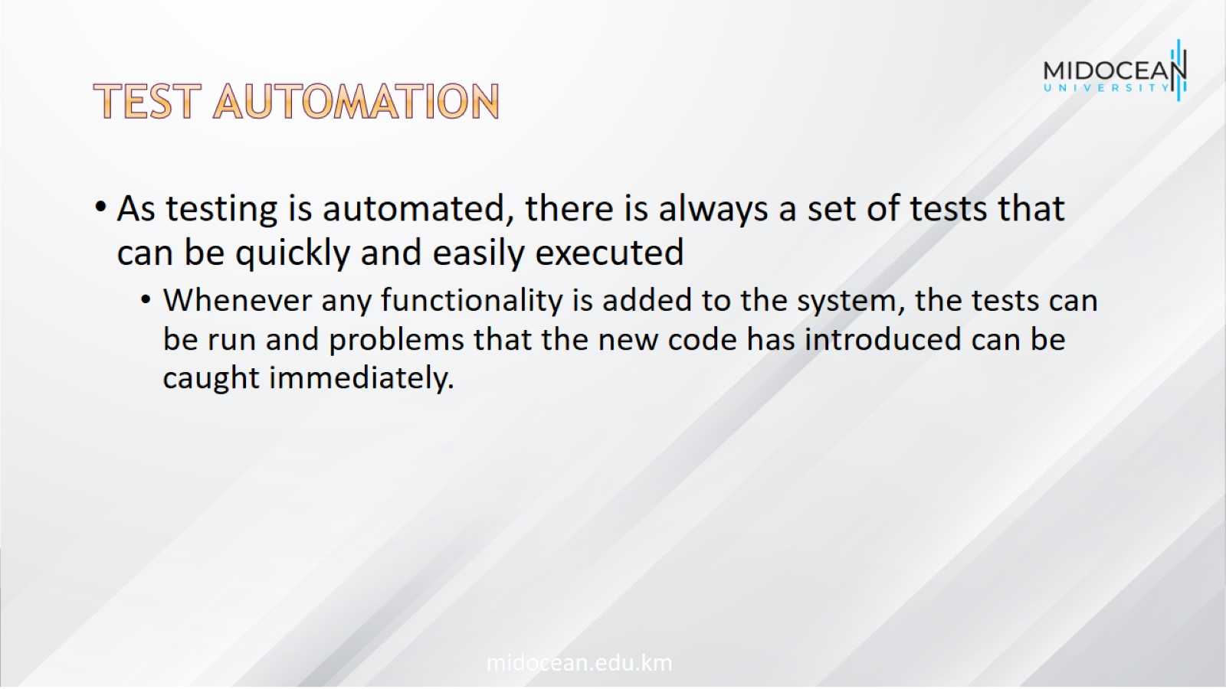
Test automation

Slide 14

XP testing difficulties

Slide 15
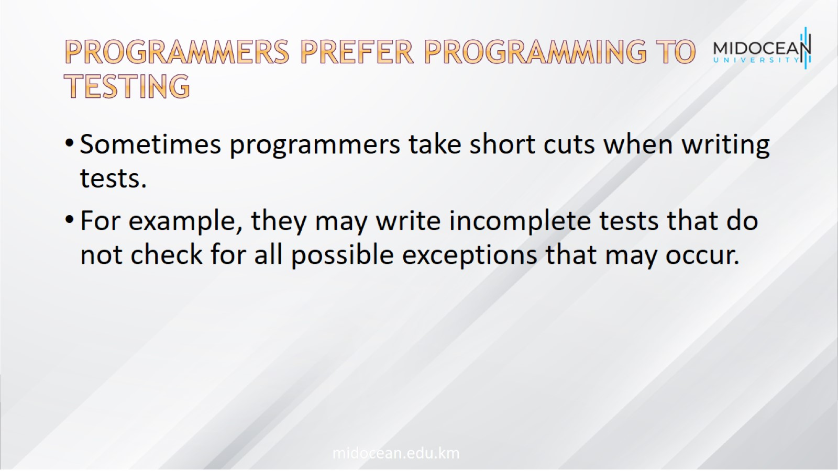
Programmers prefer programming to testing

Slide 16
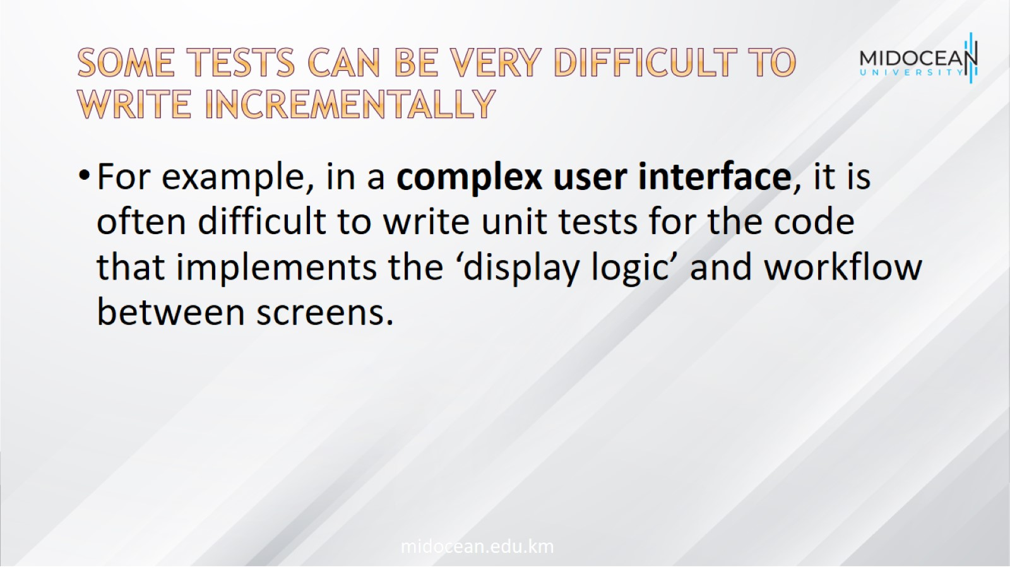
Some tests can be very difficult to write incrementally

Slide 17

It is difficult to judge the completeness of a set of tests

Slide 18

Pair programming

Slide 19
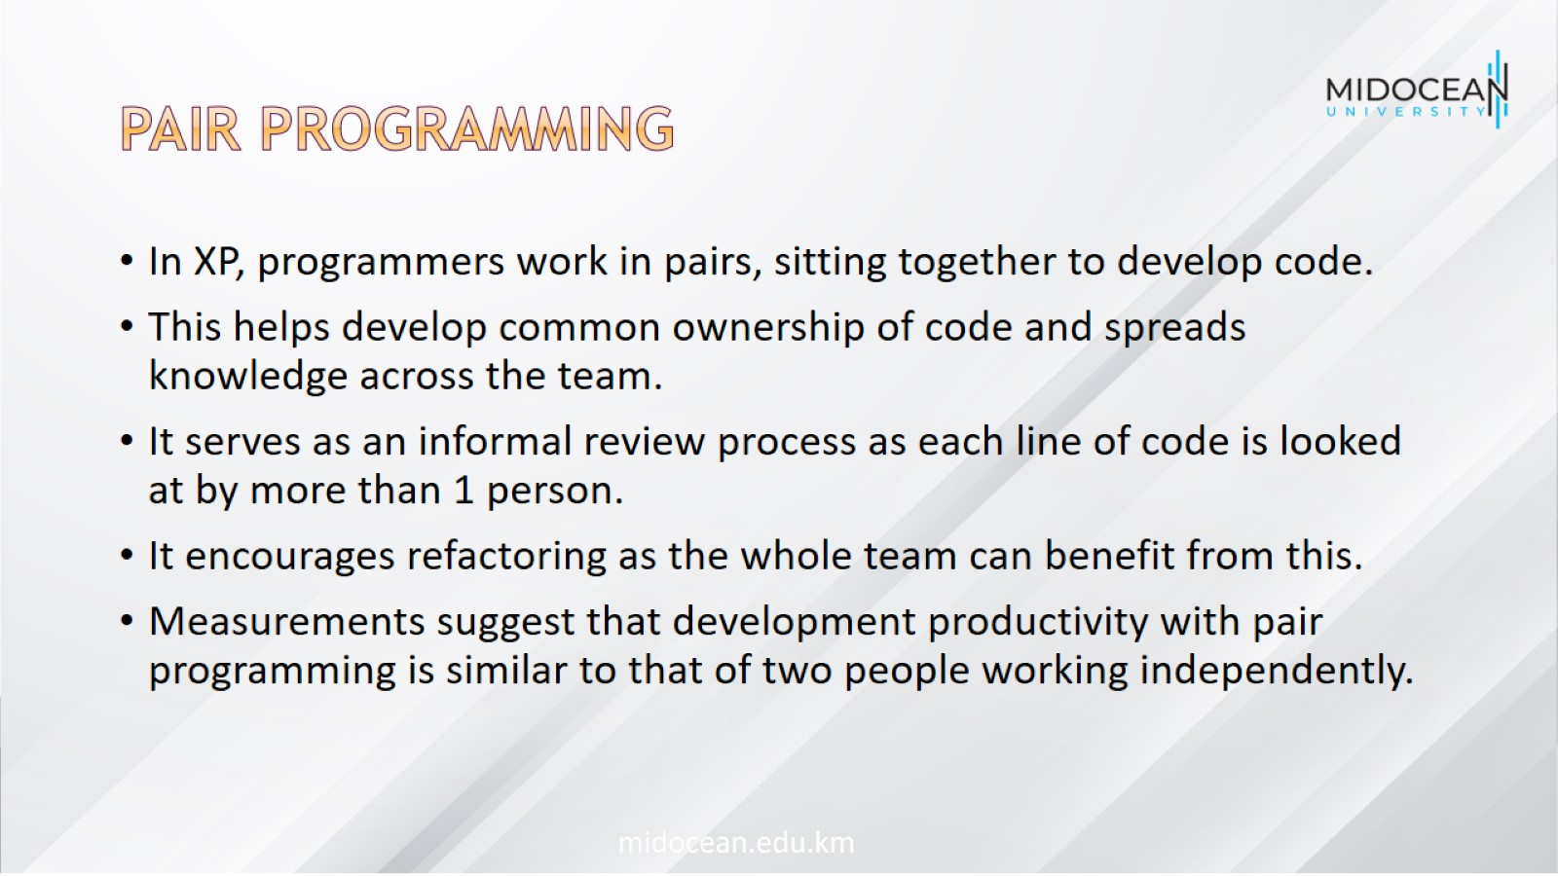
Pair programming

Slide 20
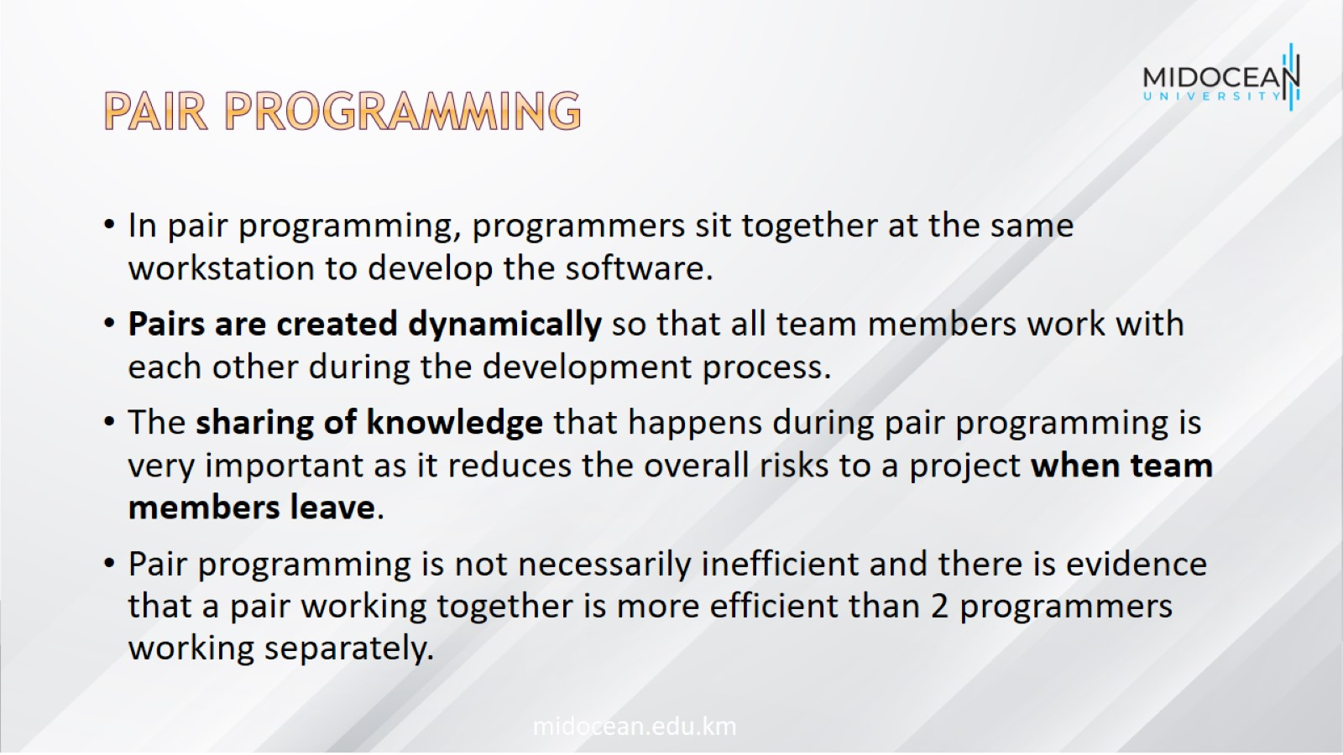
Pair programming

Slide 21
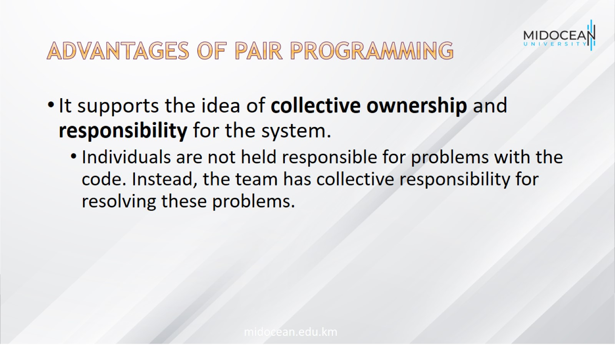
Advantages of pair programming

Slide 22
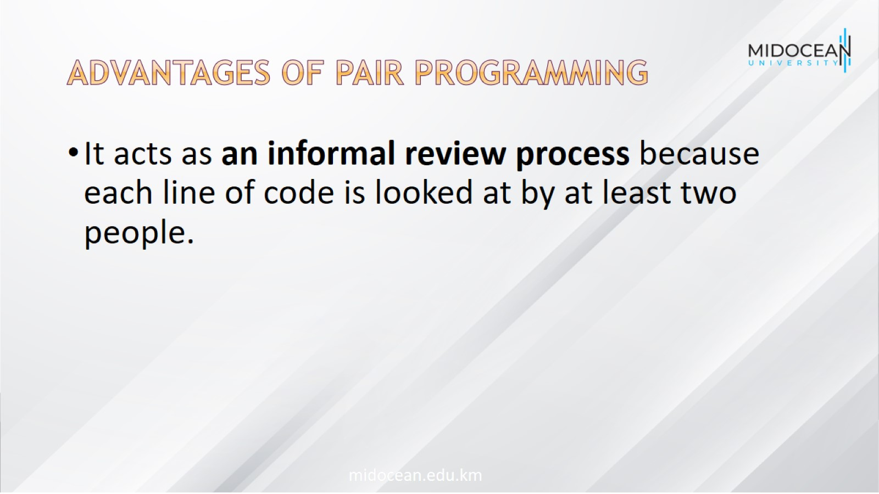
Advantages of pair programming

Slide 23
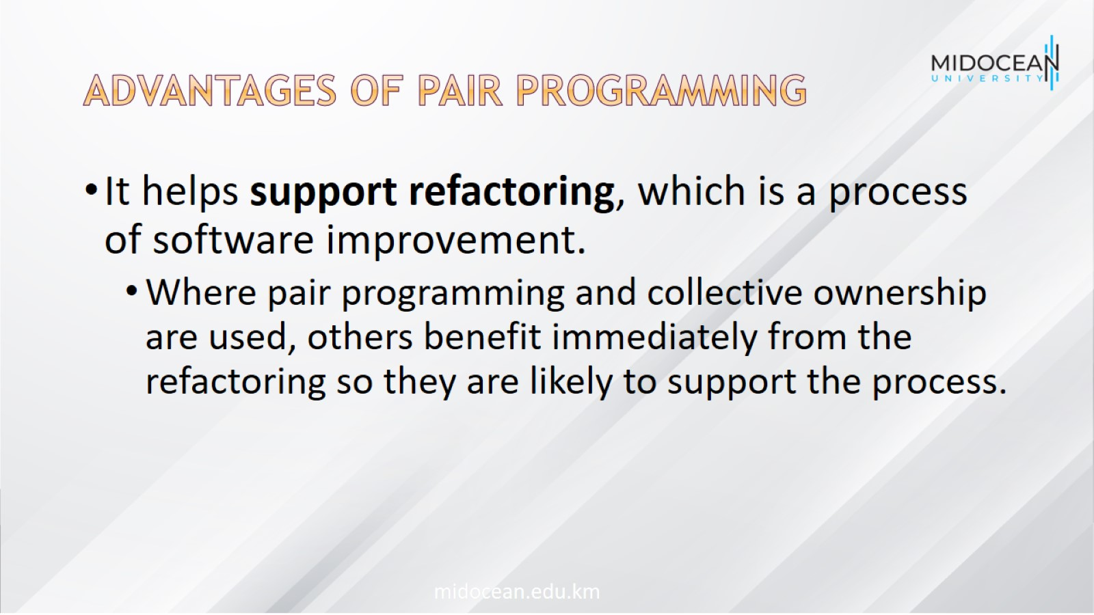
Advantages of pair programming

Slide 24

Agile project management

Slide 25
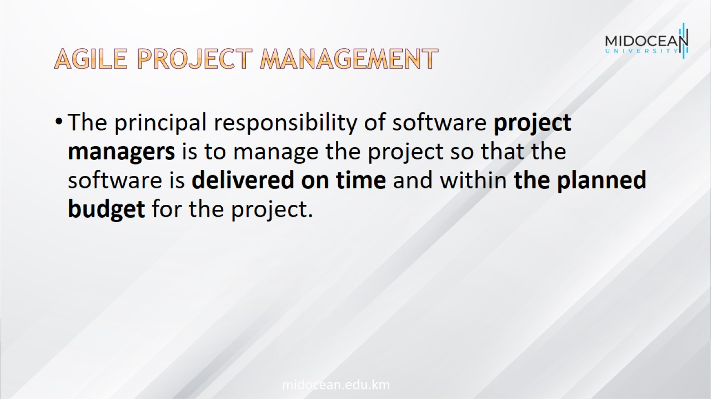
Agile project management

Slide 26
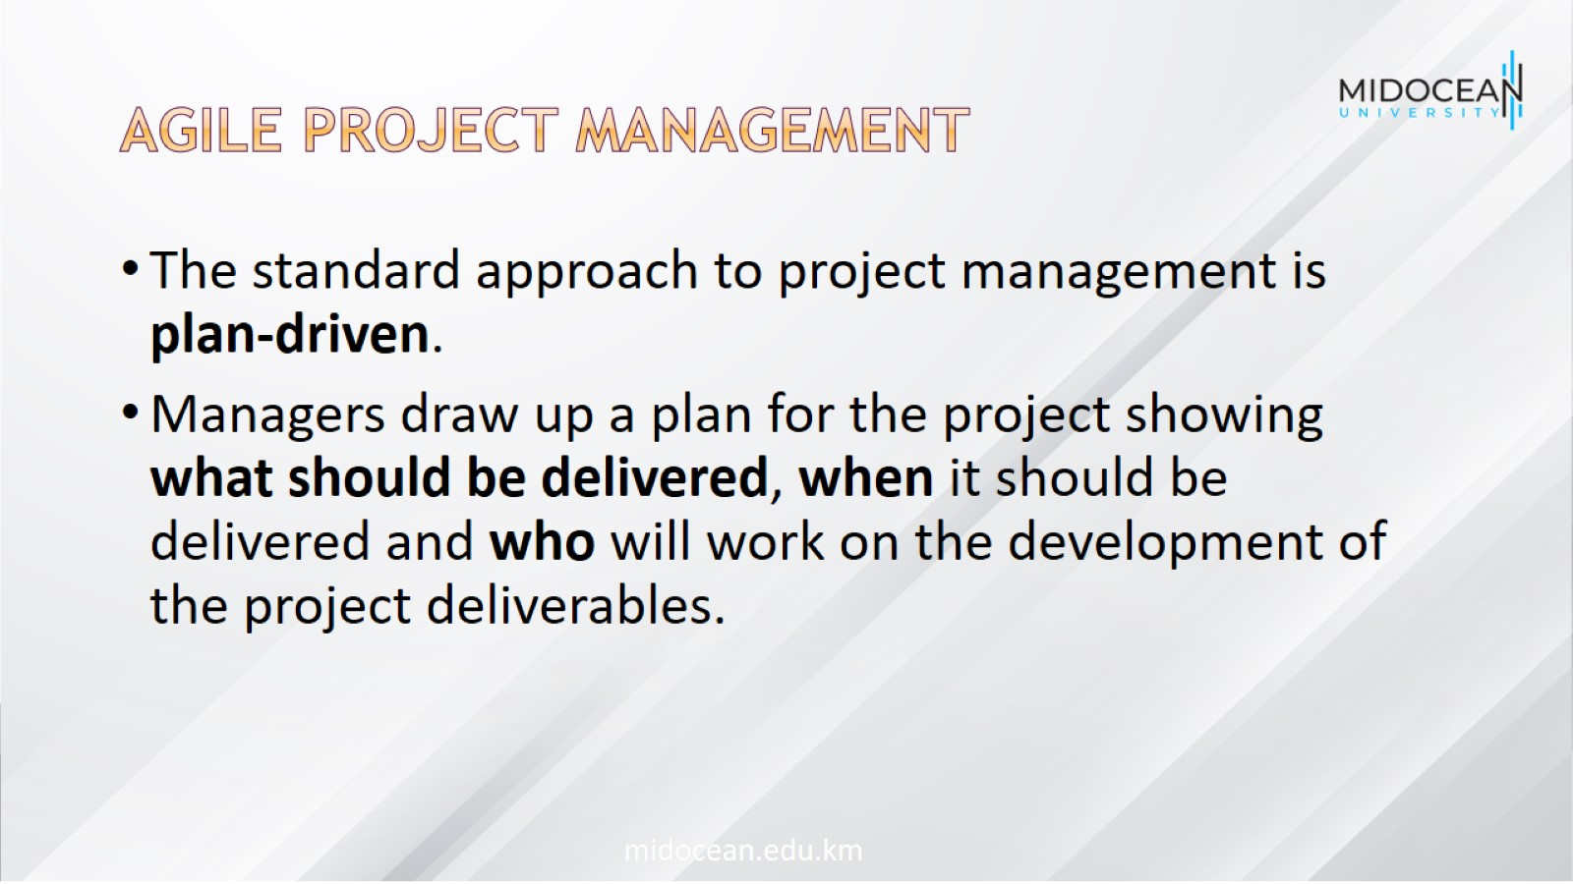
Agile project management

Slide 27
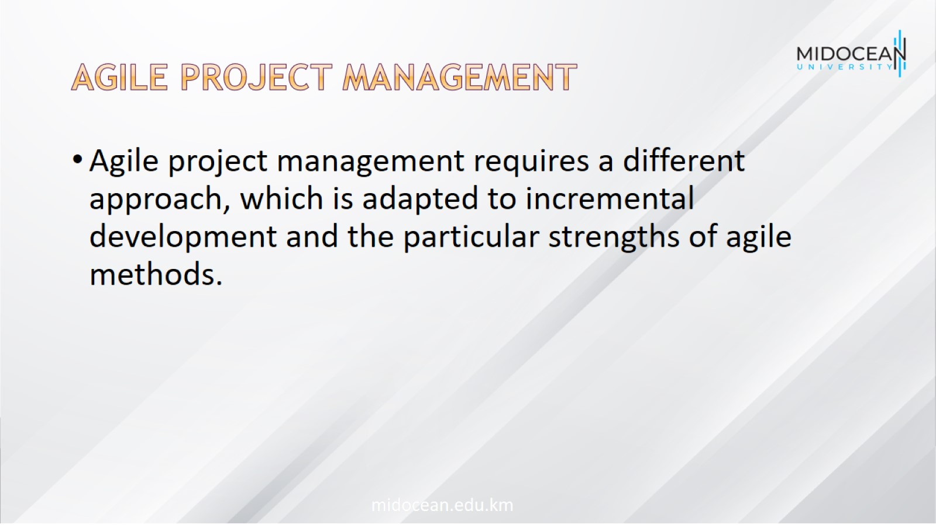
Agile project management

Slide 28
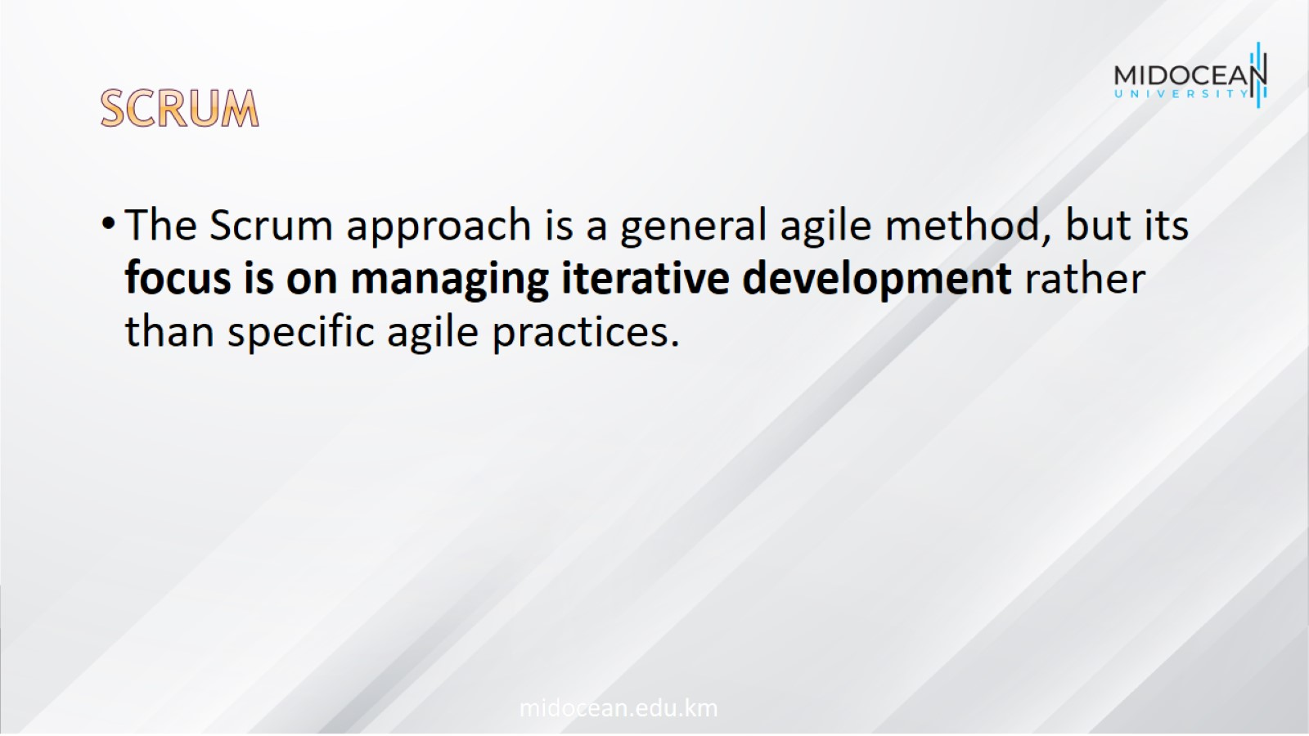
scrum

Slide 29
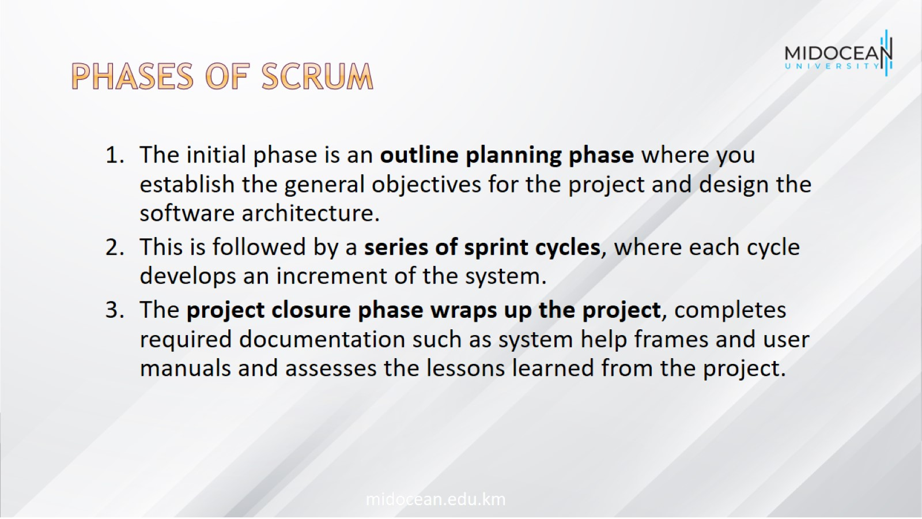
Phases of scrum

Slide 30
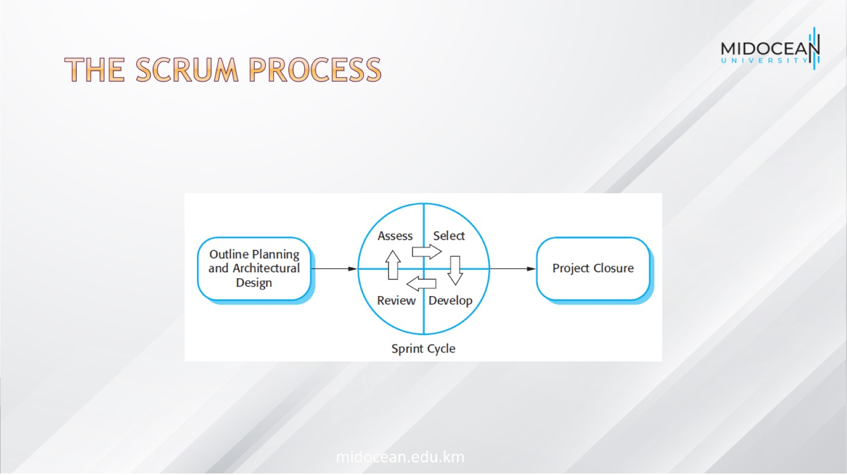
The Scrum process

Slide 31
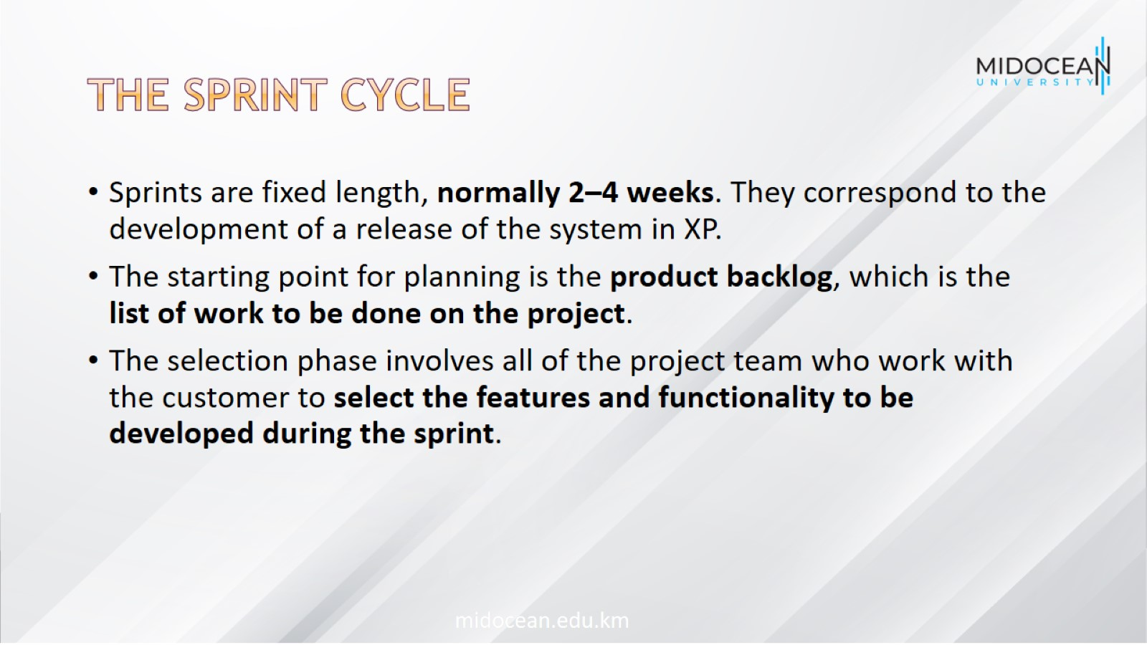
The Sprint cycle

Slide 32
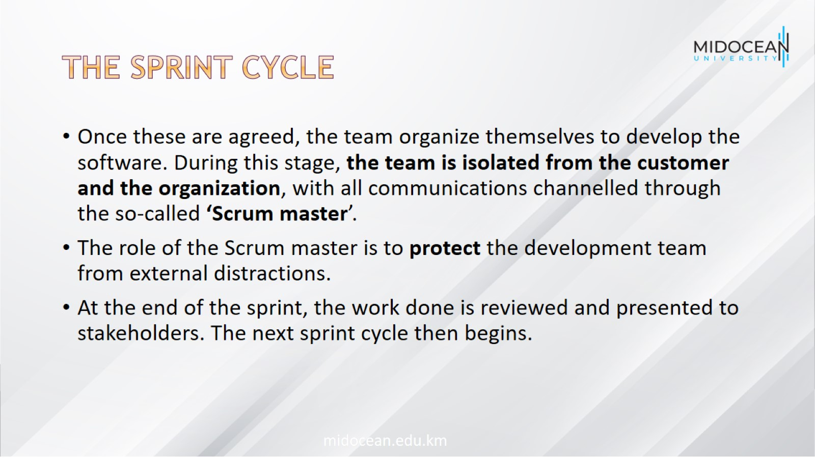
The Sprint cycle

Slide 33
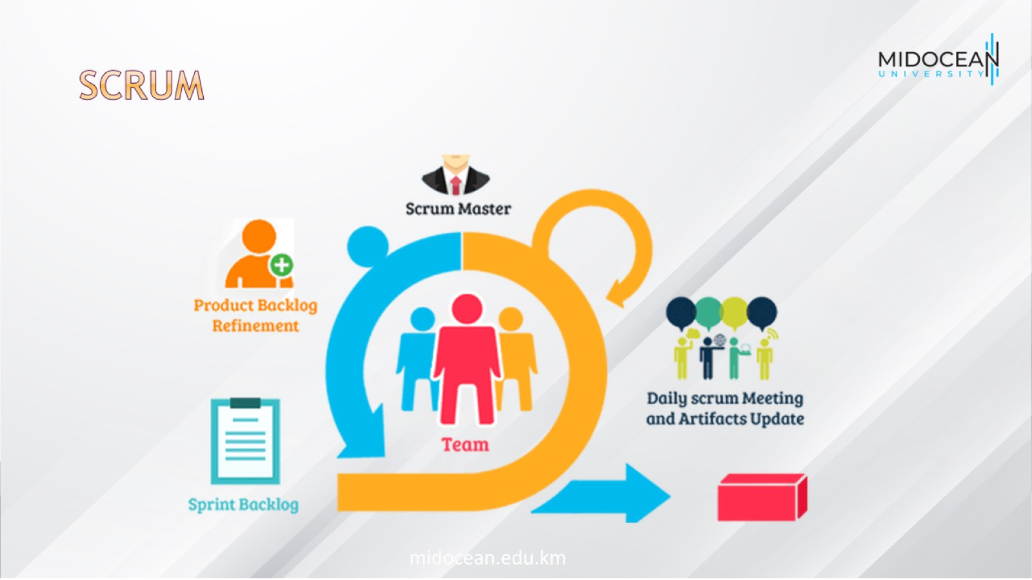
Scrum

Slide 34
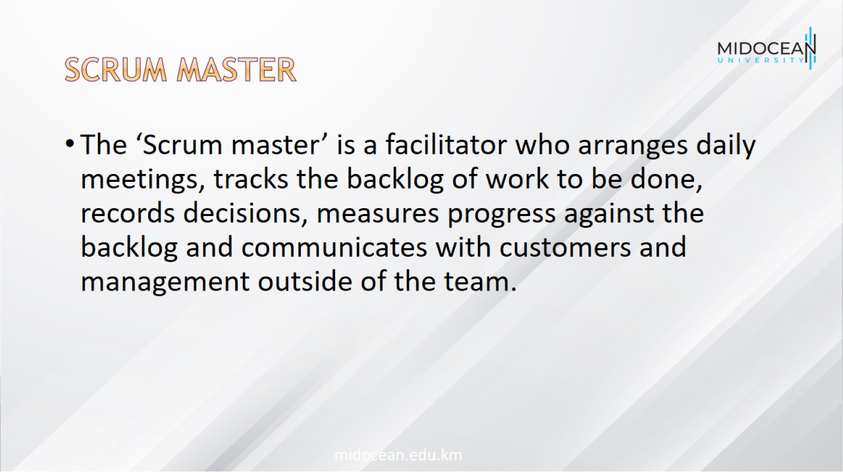
Scrum master

Slide 35
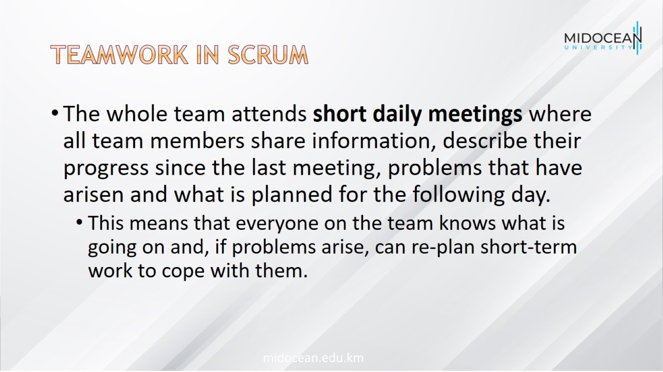
Teamwork in Scrum

Slide 36
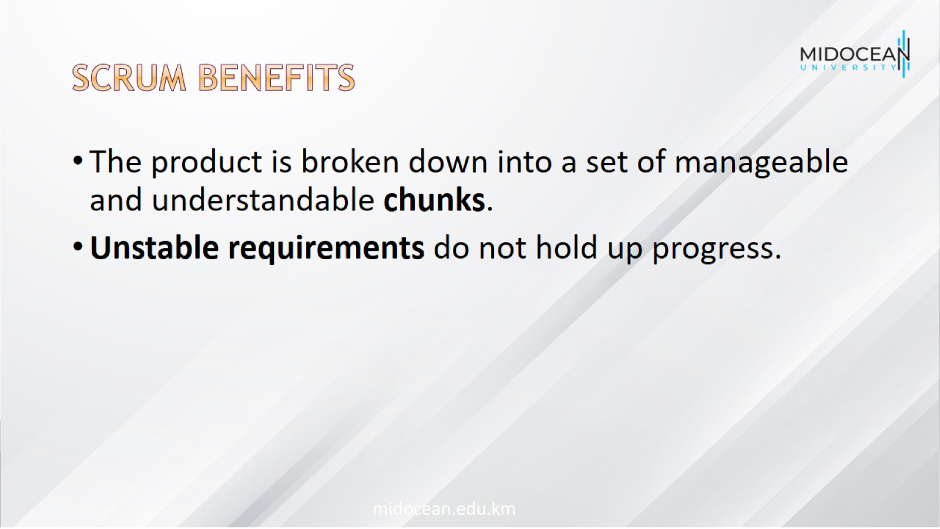
Scrum benefits

Slide 37
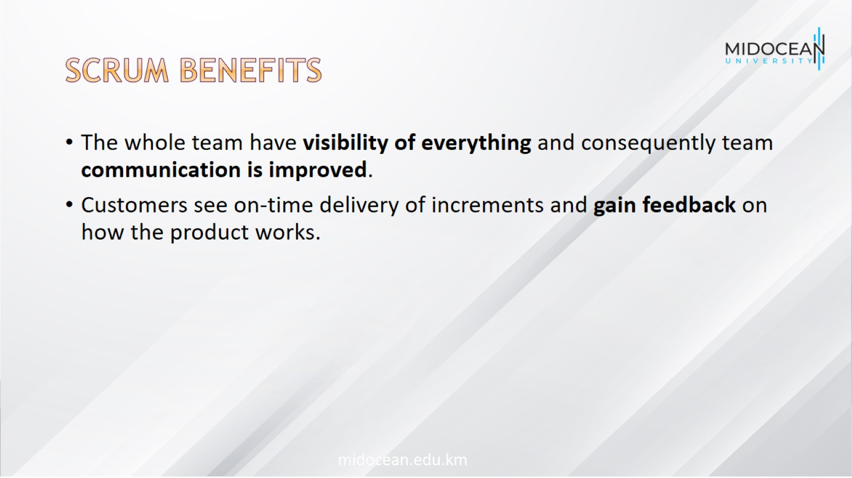
Scrum benefits

Slide 38

Scrum benefits

Slide 39
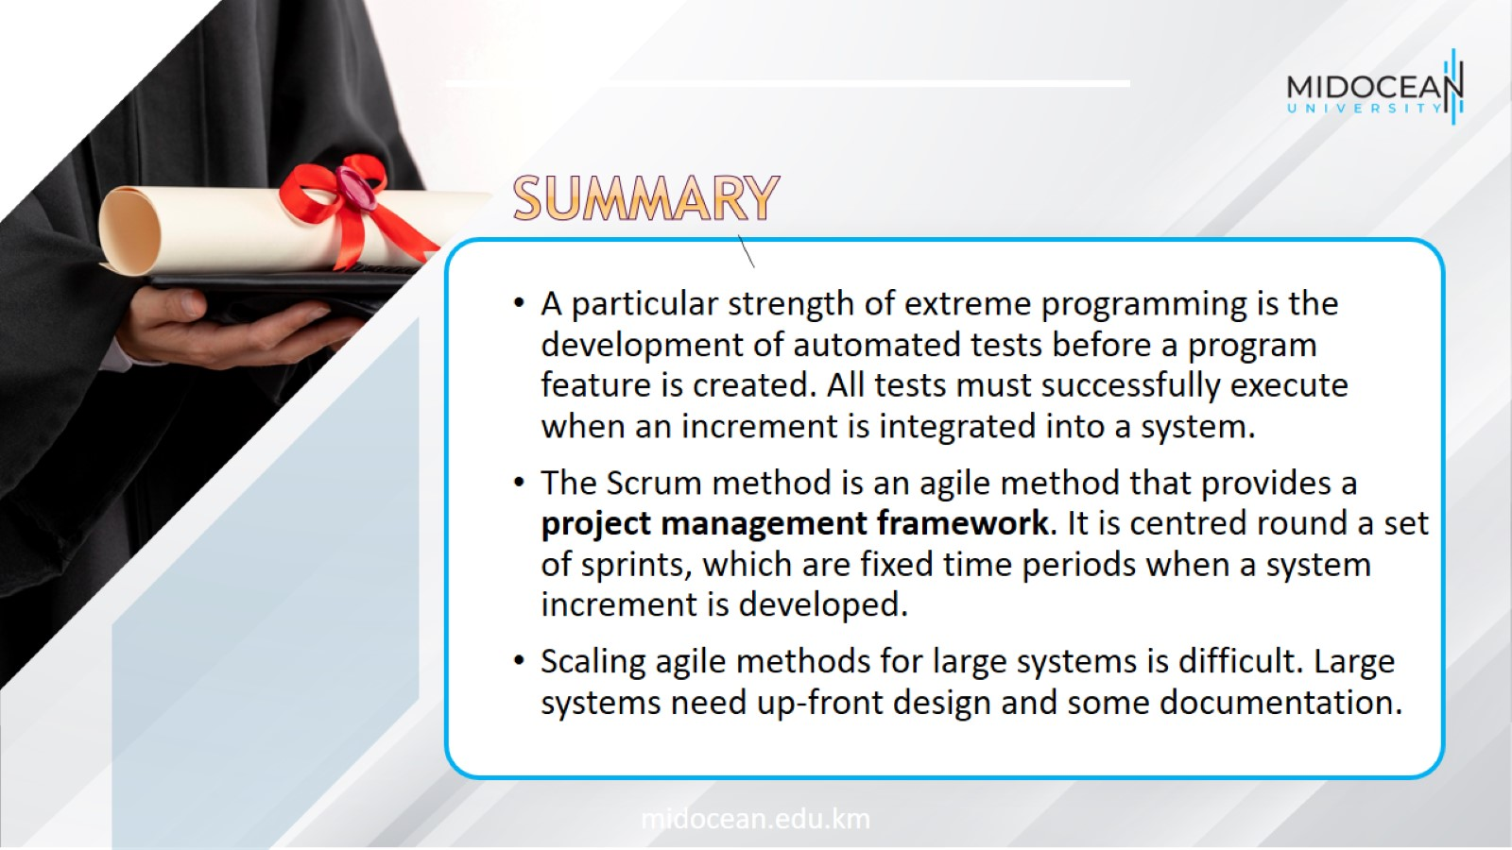

Slide 40


