Slide 1


Introduction to
Healthcare Systems Curricula
Prepared by Dr. Abdulaziz Alsaedi
MHA611
Healthcare Systems
Overview

Slide 2

Outlines:
Healthcare Systems
Why is HC Systems
Why do we study HCS
About HCS curricula
Course objectives
Course focus areas
Learning outcomes
Important dates
Quiz & Final Exam

Slide 3


Dr. Abdulaziz Alsaedi
Education:
Philosophy Degree (Ph.D.) in Evaluation of Health Services Management, Malaysia (2023)
Master Degree in Health Services and Hospital Administration, Saudi Arabia (2013)
Bachelor Degree in Health Services and Hospital Administration, Saudi Arabia (2010)
Work Experience
Prince Mohammed Bin Abdulaziz Hospital, National Guard Health Affairs, Madinah (2013 – Present)
Difference MOH facilities, Madinah, Saudi Arabia (previously)
Voluntary Experience
Chairman of the Strategic and Development Committee, healthcare Quality Association (2023 – Present)
Director of the Saudi Society for Health Administration, Madinah Branch (2021 – 2024)
Deputy Chairman, Strategic and Institutional Excellence, Saudi Society for Health Administration (2022)
Chairman, Training Committee of the Saudi Society for Health Administration, Madinah Branch (2018)
Academic & Research Experience
Local specialized conference on health administration
Publications in Scopus indexed journals
Ongoing research projects on artificial intelligence in healthcare and clinical governance
Consultations
Contributed to various consultation projects with public organizations and NGOs
Courses and Workshops
Provided many courses and workshops on different topics

Slide 4
Healthcare Systems
Healthcare systems encompass the organizations, institutions, resources, and people whose primary purpose is to improve health outcomes. They are complex structures that integrate various components to deliver health services effectively.
According to the World Health Organization (WHO), a health system includes all organizations and actions aimed at promoting, restoring, or maintaining health.
This definition extends beyond hospitals and clinics to include community health initiatives, rehabilitation services, and public health policies that influence health determinants.
Book: healthcare System around the world

Slide 5
Why is the healthcare Systems?
Healthcare is currently undergoing and will continue to undergo significant redesigns and changes that will impact the ways in which patients receive care and how physicians and healthcare professionals “deliver” care.
Understanding how care is delivered and how healthcare professionals work together to deliver that care provides building blocks for physicians and other healthcare professionals to improve all aspects of patient care and healthcare delivery.
Healthcare needs to be provided to expanding and diverse patient populations, including the underserved, patients at the extremes of age, and those with chronic, often environmentally enabled, comorbid conditions.

Slide 6

Why do we study healthcare Systems
Improving Patient Outcomes:
Understanding healthcare systems enables professionals to identify best practices and implement strategies that enhance patient care and safety. By analyzing data and outcomes, students can learn how to create systems that prioritize patient needs and experiences, ultimately leading to better health results. According to the World Health Organization (WHO), a health system includes all organizations and actions aimed at promoting, restoring, or maintaining health.
Book: healthcare System around the world

Slide 7
Why do we study healthcare Systems
Addressing Health Inequalities:
Healthcare systems often reveal disparities in access and quality of care across different populations. Studying these systems allows future health professionals to recognize and address unjustified variations in health outcomes, thereby promoting equity in health services
Contributing to Public Health:
A comprehensive understanding of healthcare systems is crucial for addressing public health challenges. Students learn how to integrate public health policies with clinical practices, which is vital for managing chronic diseases and improving overall community health.
Book: healthcare System around the world

Slide 8
Why do we study healthcare Systems
Development of Transferable Skills:
Studying healthcare systems equips individuals with essential skills such as critical thinking, problem-solving, communication, and teamwork. These skills are highly valued across multiple sectors and enhance employability.
Career Opportunities:
The healthcare sector is one of the fastest-growing industries globally, providing a wide range of career opportunities. Graduates in healthcare studies are in high demand due to the increasing need for healthcare services as populations age and require more support. This field offers not only job security but also diverse paths in various roles such as management, policy-making, and direct patient care.
Book: healthcare System around the world

Slide 9
About the healthcare System curricula
This course covers important concepts about healthcare systems, the importance of these systems in providing high-quality healthcare, and the main components of these systems in more detail.
In addition, the ability to measure the efficiency and performance of these systems and the specific international indicators used to measure their efficiency and effectiveness.
It will also review the different healthcare systems of developed and developing countries and compare them in terms of advantages and challenges.

Slide 10
Objectives of the course
Defining healthcare systems and their objectives.
Identifying the components of healthcare systems and integration between them.
Identifying the vital role of healthcare systems in providing high-quality health services.
Measuring the effectiveness and efficiency of healthcare systems, and what are the used international indicators.
Comparing different healthcare systems for developed and developing countries and benefiting from their advantages and challenges.

Slide 11
Course focused areas:
Concepts of healthcare systems.
Why healthcare systems?
Components of healthcare systems.
Structures and processes of healthcare.
Value in healthcare.
Quality and patient safety.
Leadership in healthcare.
Structural and social determinants of health.
Health laws and ethics.
Health policy and economics.
Measure healthcare systems’ efficiency and effectiveness.
Examples of healthcare systems from developed and developing countries.

Slide 12
Learning Outcomes
Student’s awareness of the concepts of healthcare systems.
Student’s awareness of the importance of developing healthcare systems in enhancing individual and community health.
Student’s awareness of the components of healthcare systems and their effect on individual health.
Student’s awareness of how to measure the efficiency and effectiveness of healthcare systems.
Student’s ability to evaluate the current healthcare system in his/her home country compared with others.

Slide 13
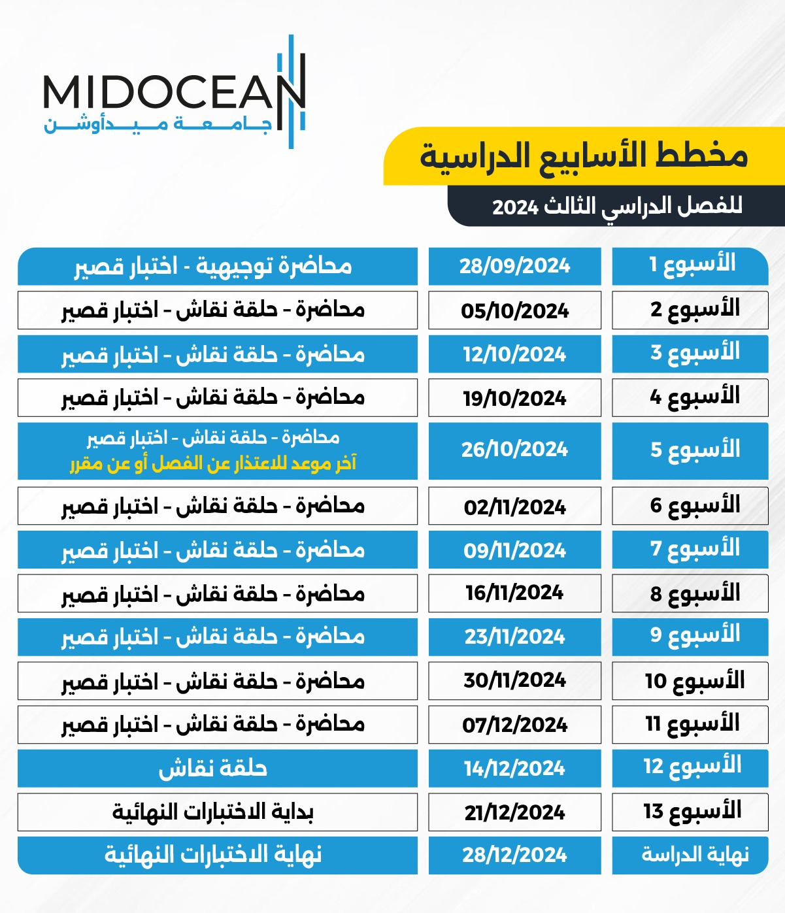
Important Dates
The semester contains 13 weeks.
Each week, you have a recorded lecture to listen to and a related quiz.
Quiz includes Multiple Choices Questions (MCQs) and/or True & False.

Slide 14

Quiz & Final Exam
Weekly virtual discussion meeting (optional).
A Quiz contains 8 questions (8 scores/ all 80%).
Final exam contains 20 questions (20 scores/ 20%).
For personal circumstances to postpone a quiz or the final exam, contact the respective department.

Slide 15
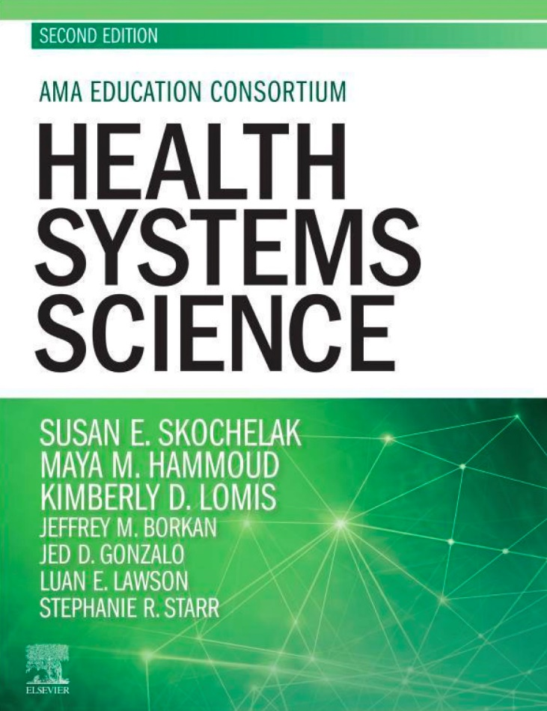

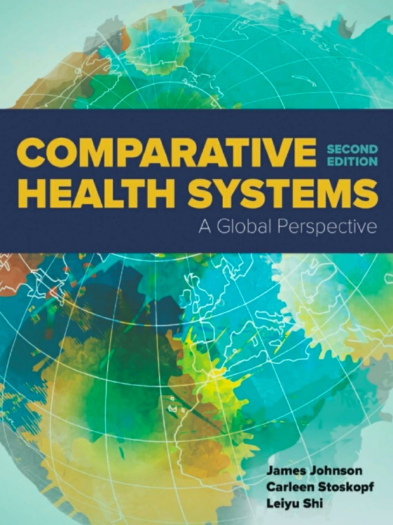
Course Materials
Book: healthcare System around the world

Slide 16



Thank You!

