Slide 1



Ethernet Switching
Lecture 4
CCNA – Introduction to Networks V7.0 (ITN)
Prepared by
Dr. Abdelrhman Ahmed

Slide 2
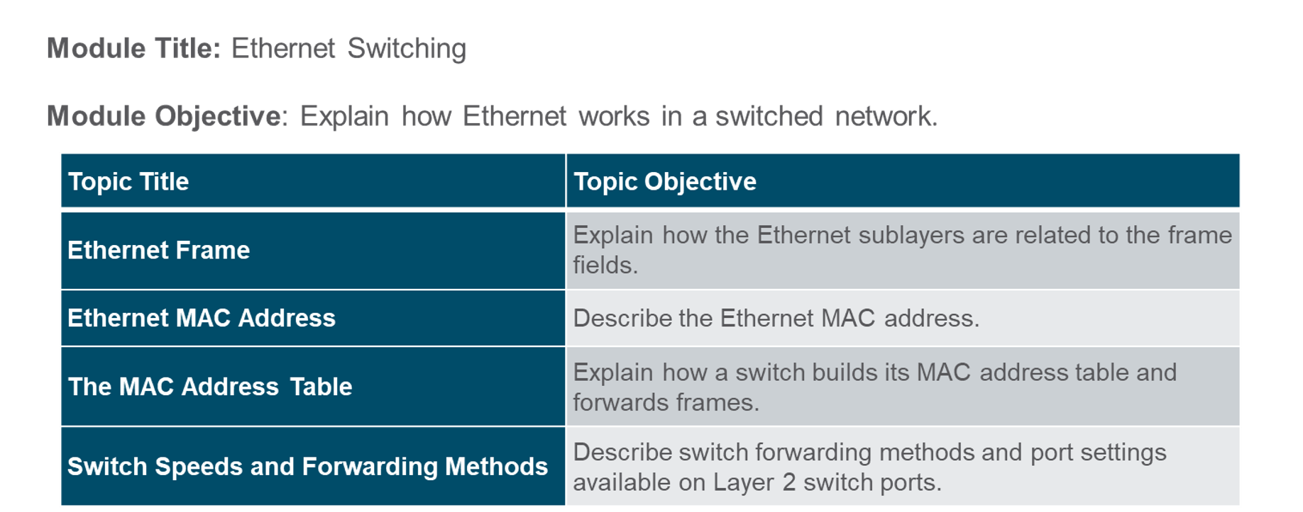
Chapter
Module Objectives
04

Slide 3
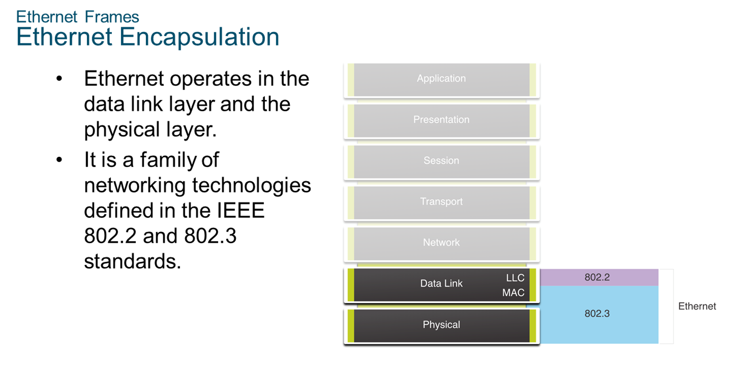
Chapter
Ethernet Frames
04

Slide 4
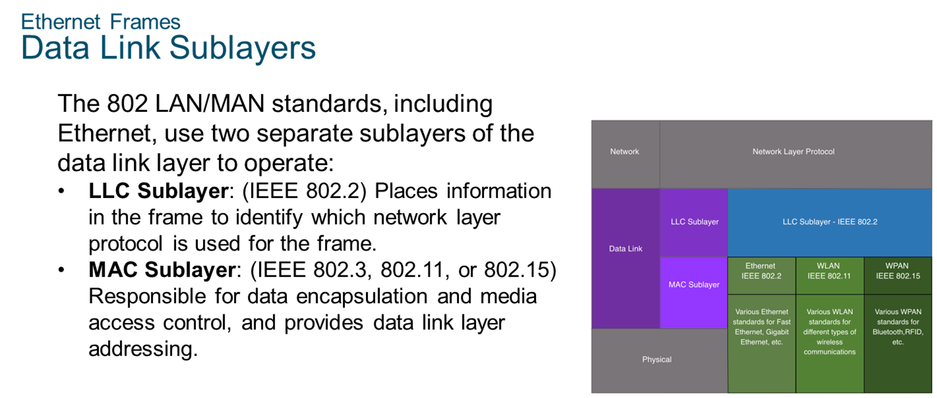
Chapter
Ethernet Frames
04

Slide 5
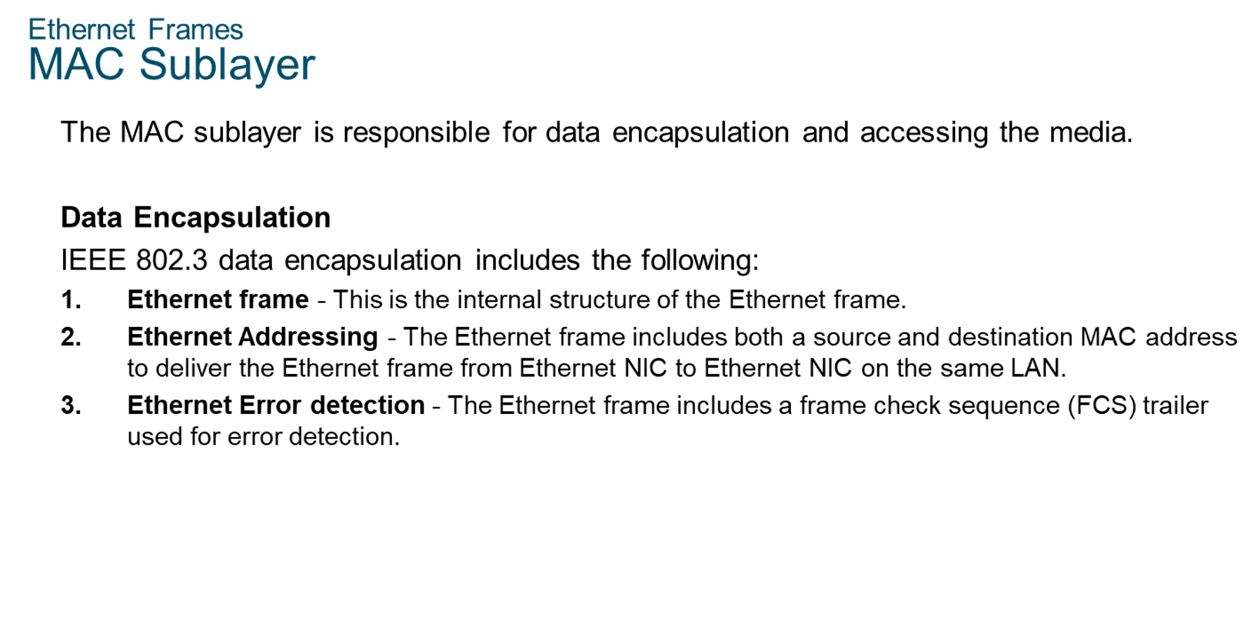
Chapter
Ethernet Frames
04

Slide 6
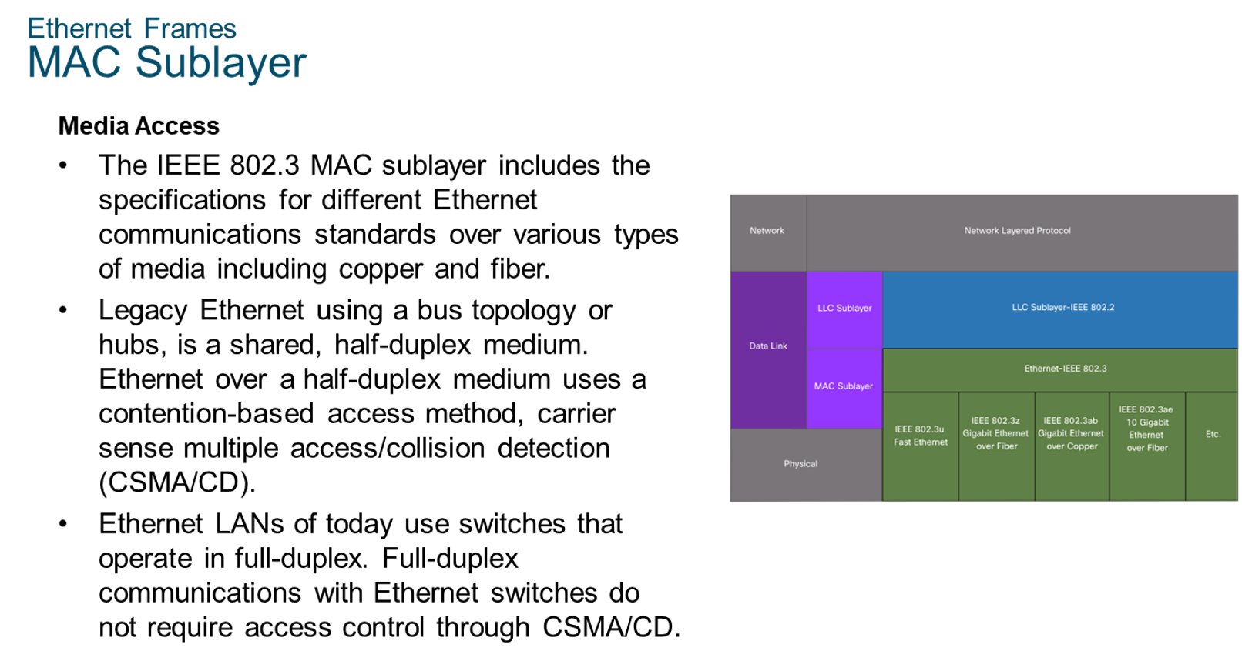
Chapter
Ethernet Frames
04

Slide 7
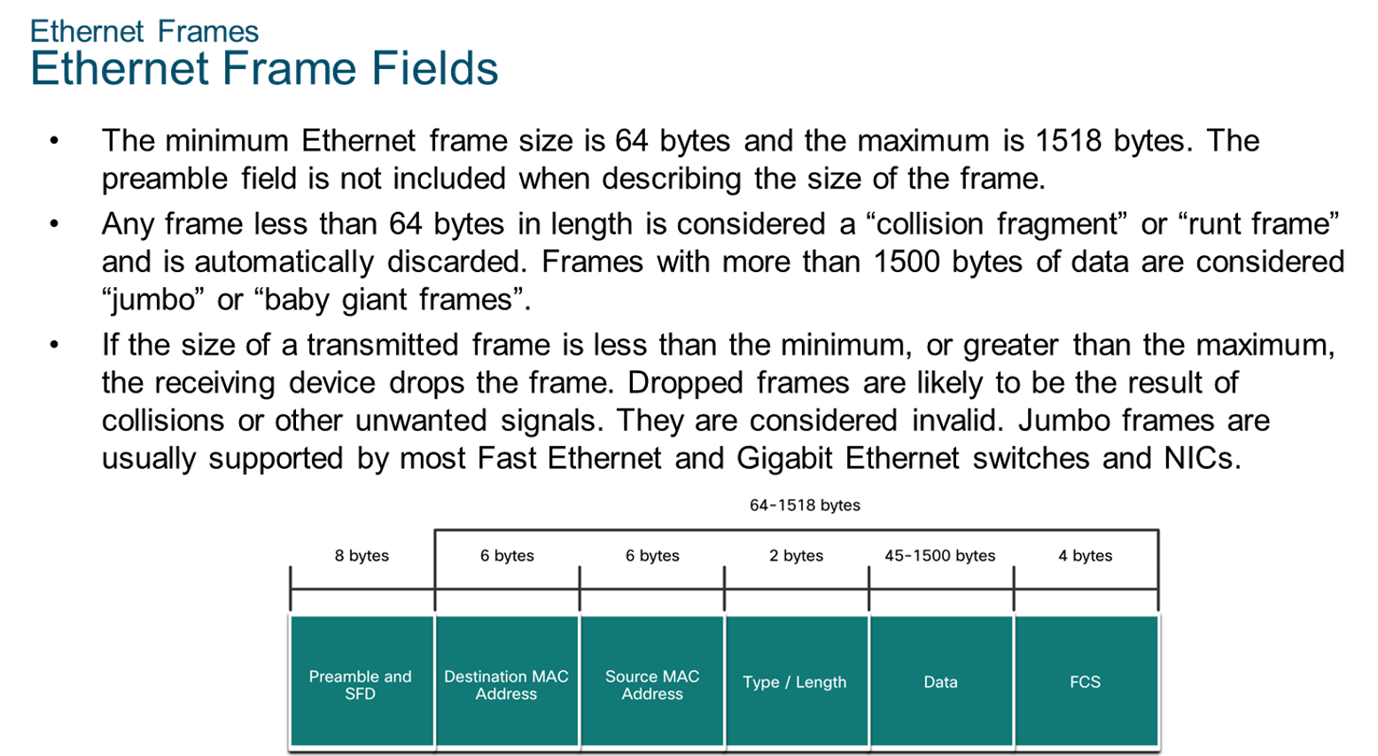
Chapter
Ethernet Frames
04

Slide 8
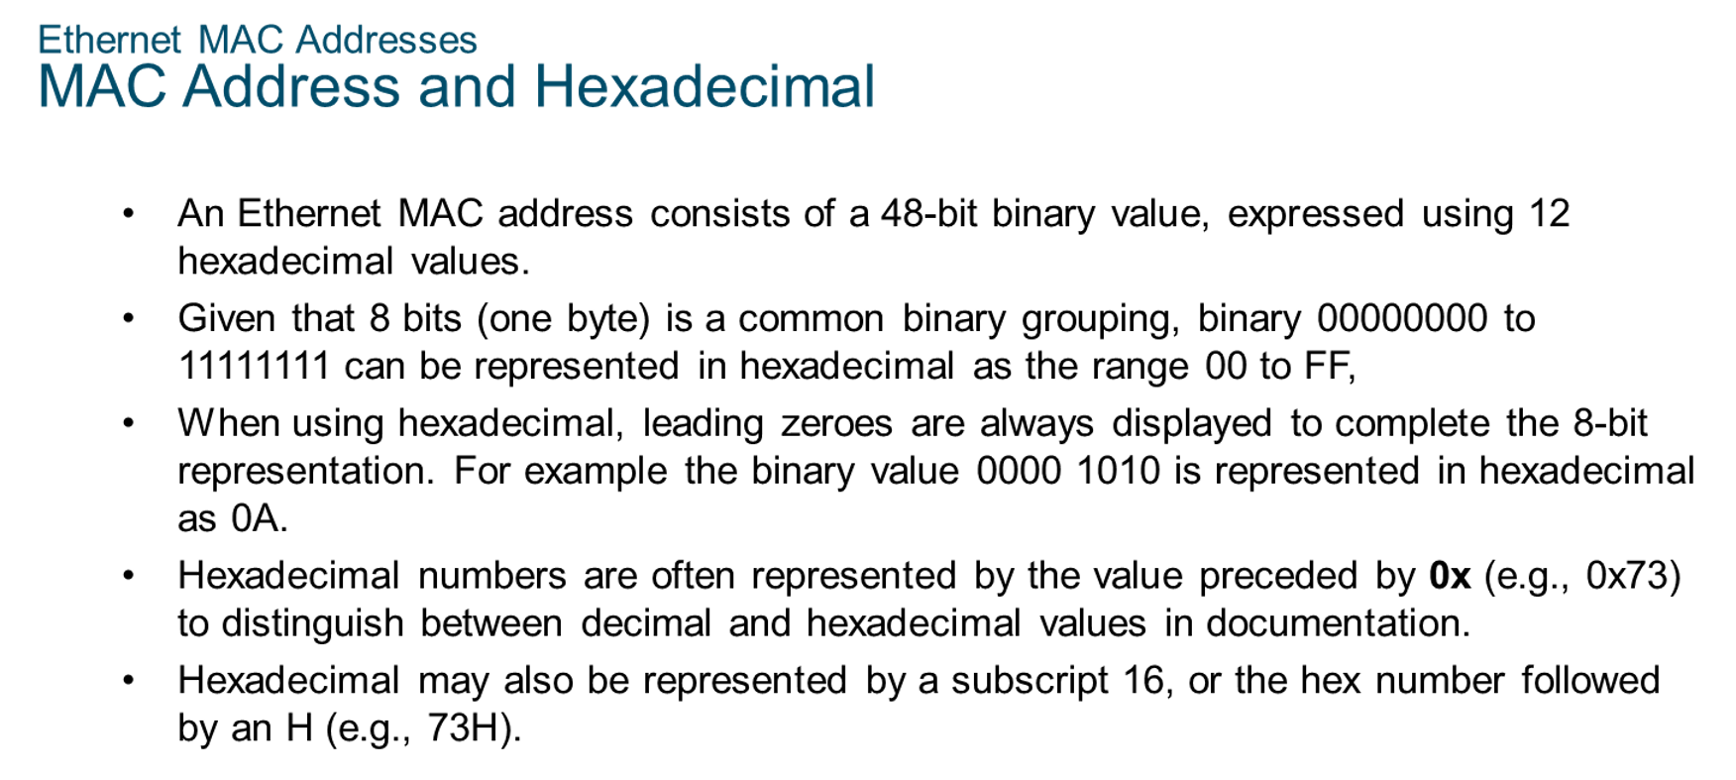
Chapter
Ethernet MAC Addresses
04

Slide 9
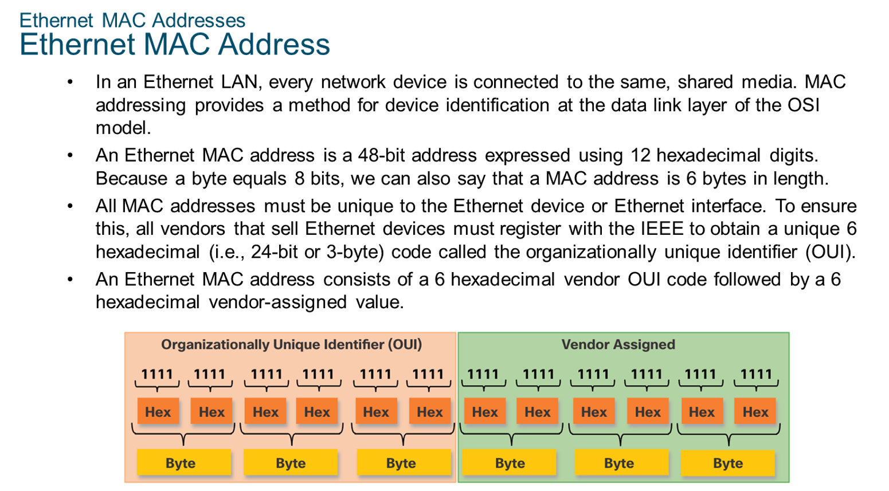
Chapter
Ethernet MAC Addresses
04

Slide 10
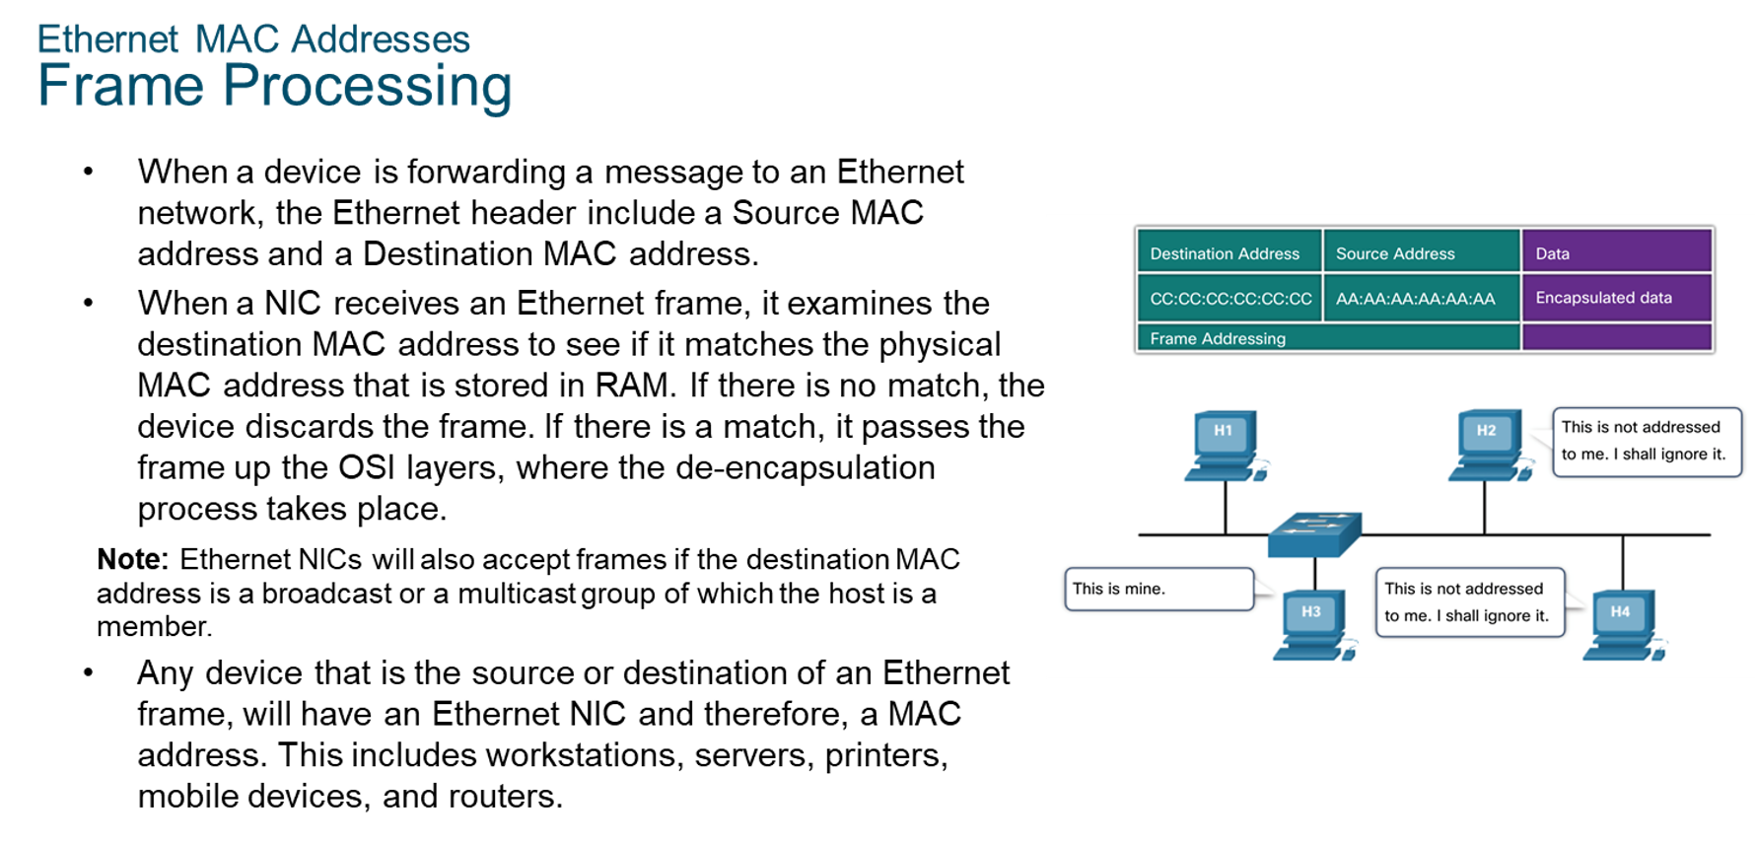
Chapter
Ethernet MAC Addresses
04

Slide 11
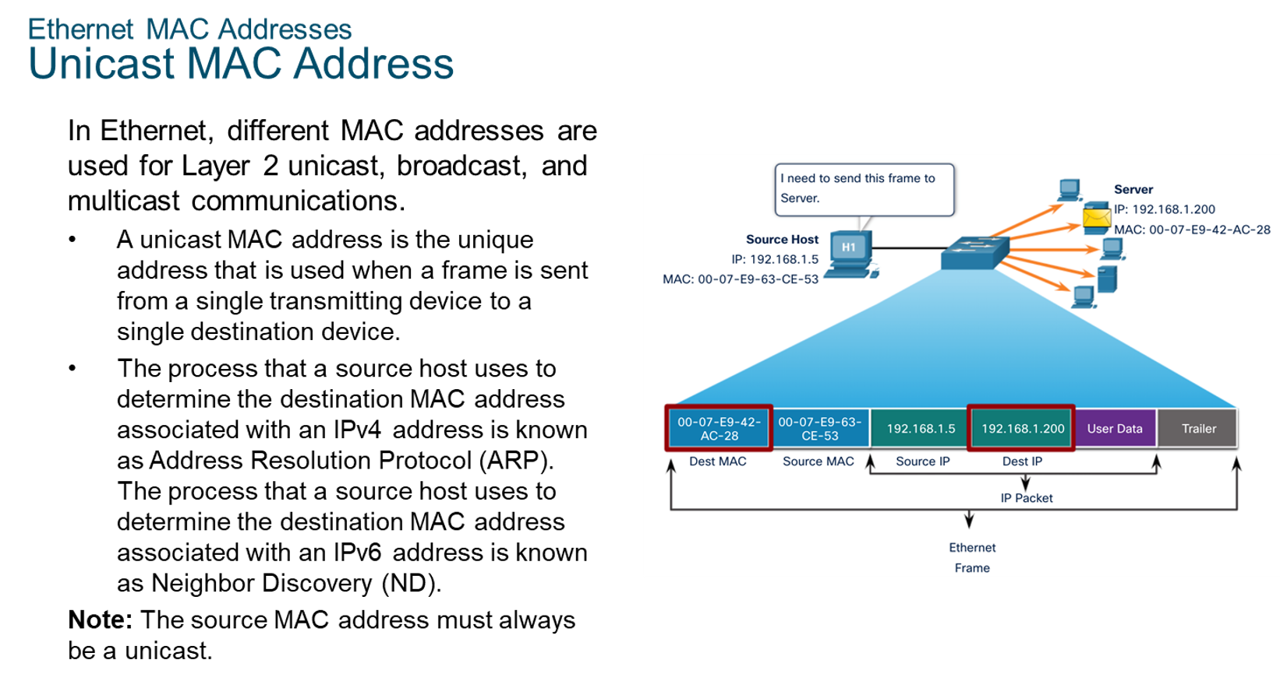
Chapter
04
Ethernet MAC Addresses

Slide 12
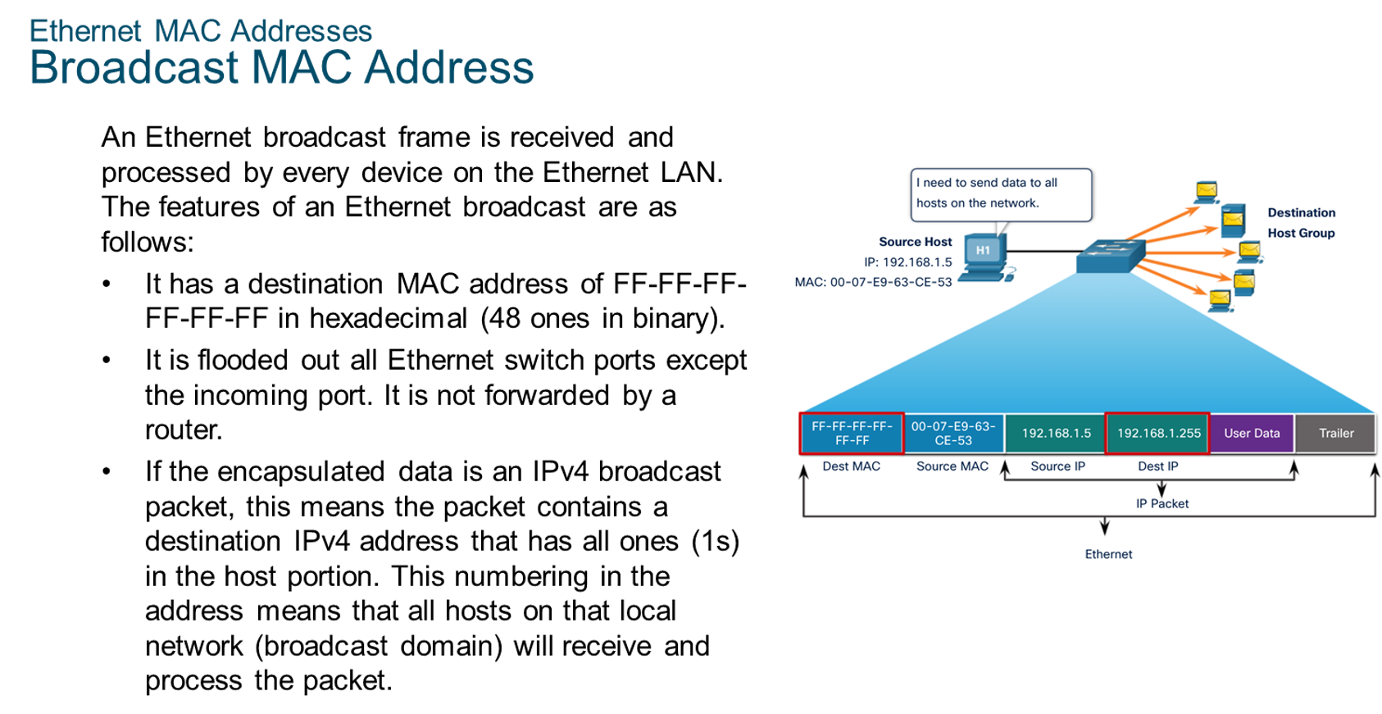
Chapter
Ethernet MAC Addresses
04

Slide 13
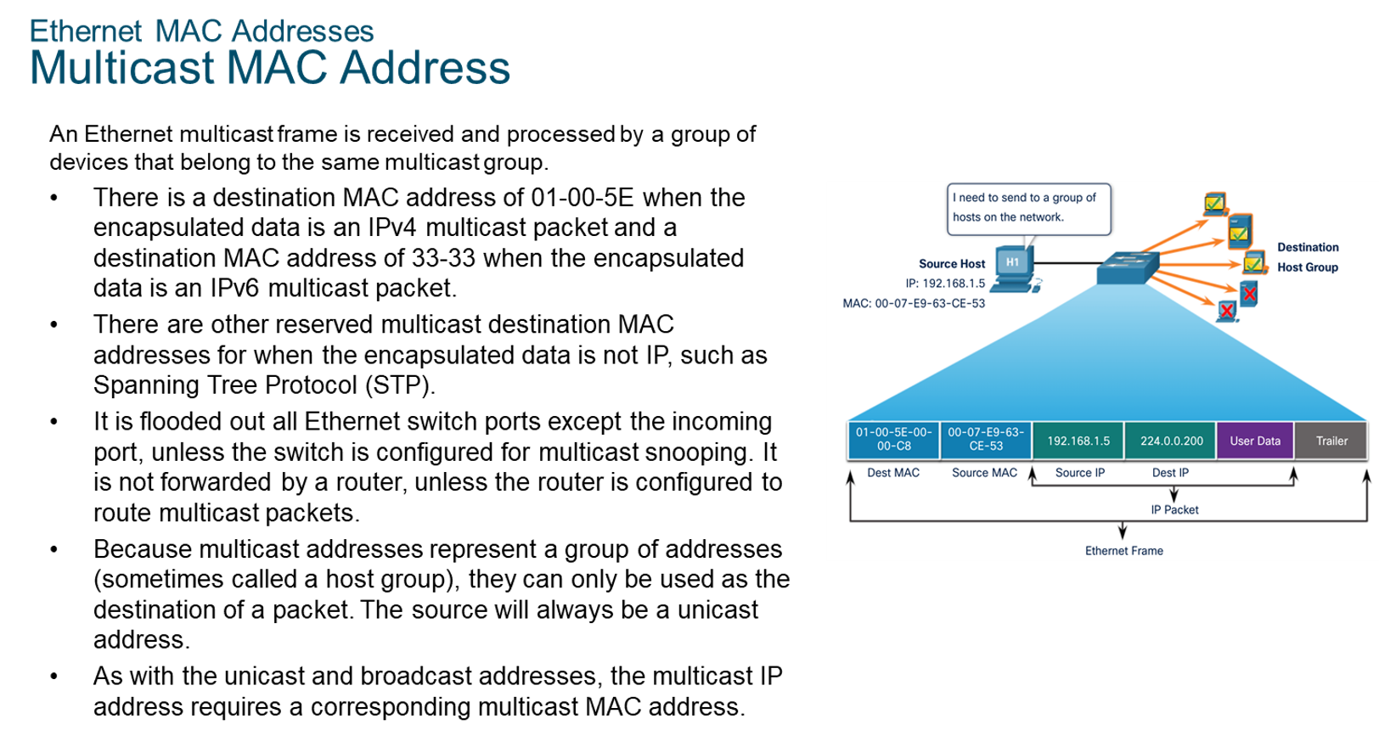
Chapter
Ethernet MAC Addresses
04

Slide 14
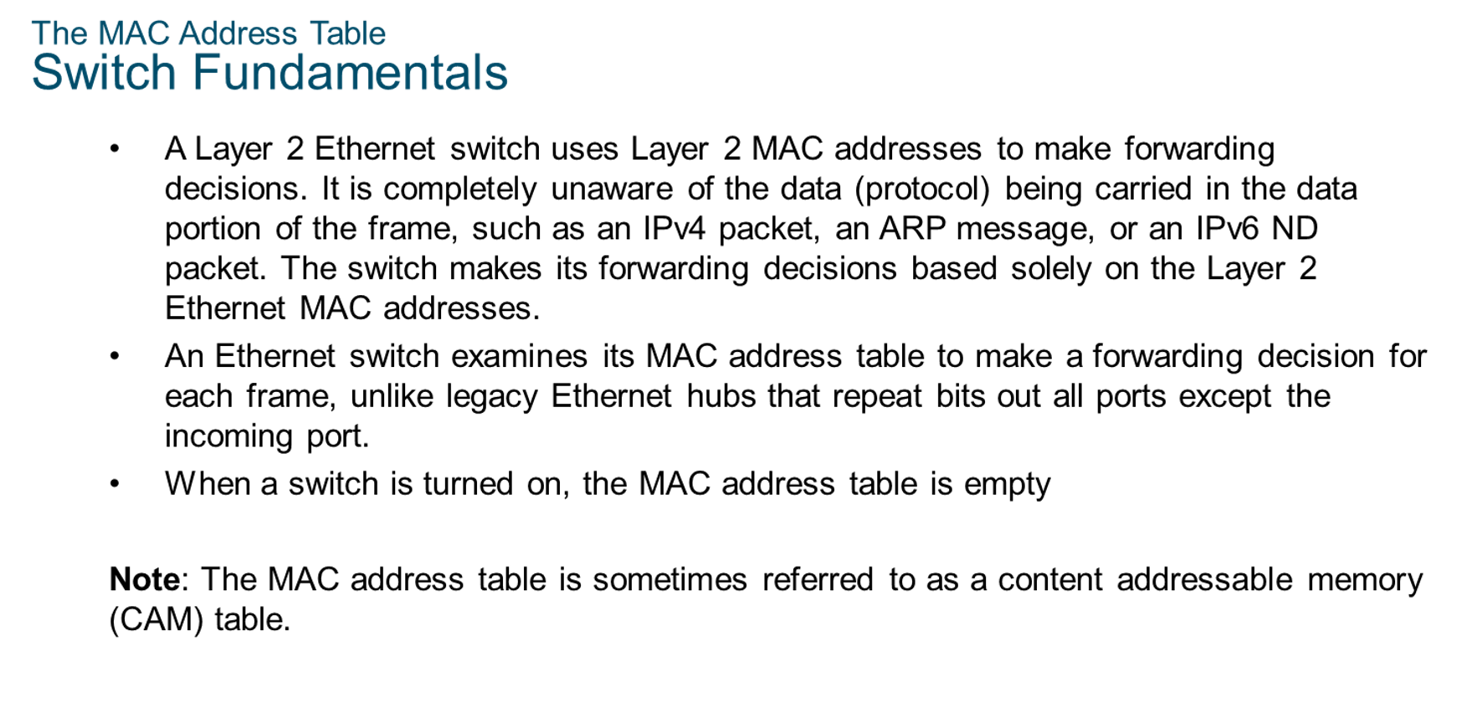
Chapter
The MAC Address Table
04

Slide 15
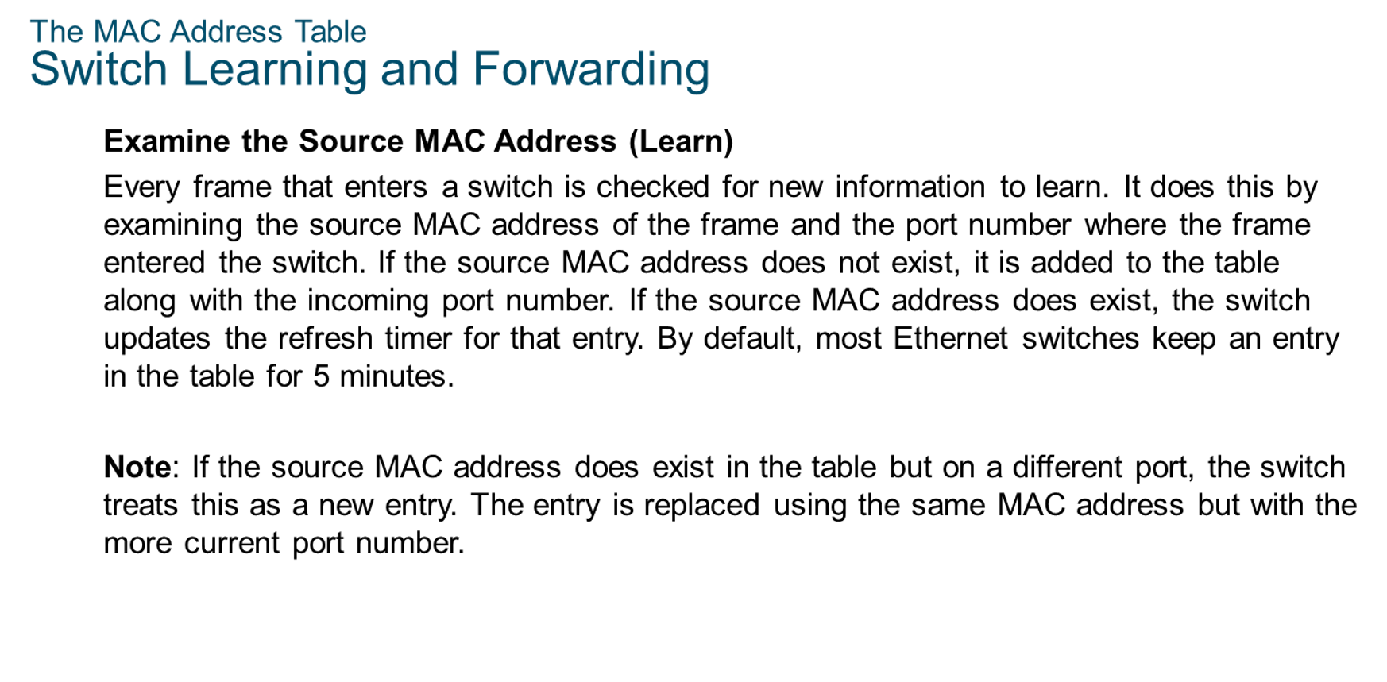
Chapter
The MAC Address Table
04

Slide 16
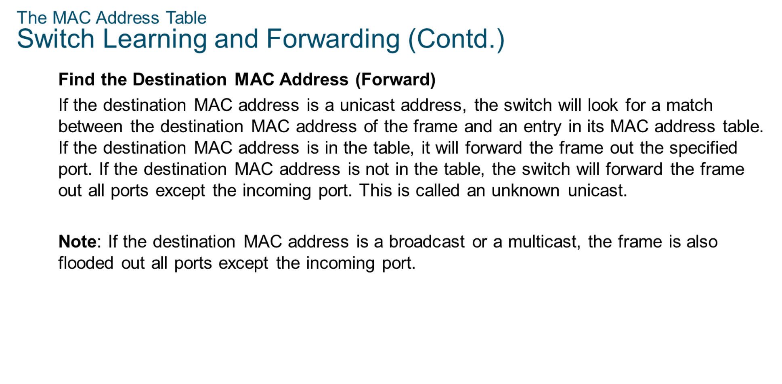
Chapter
The MAC Address Table
04

Slide 17
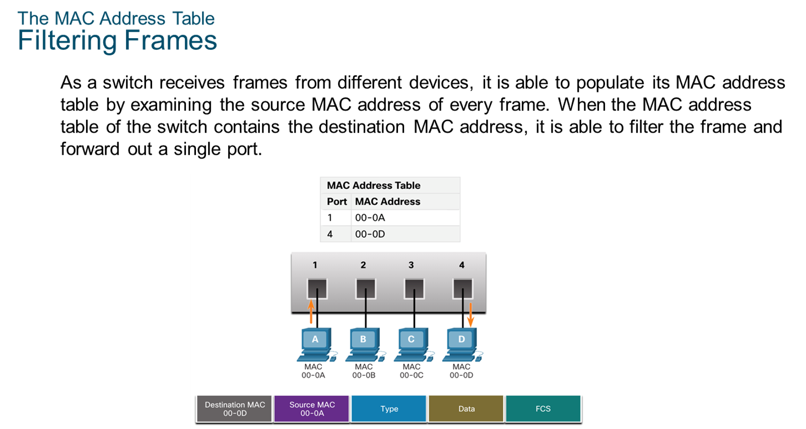
Chapter
The MAC Address Table
04

Slide 18
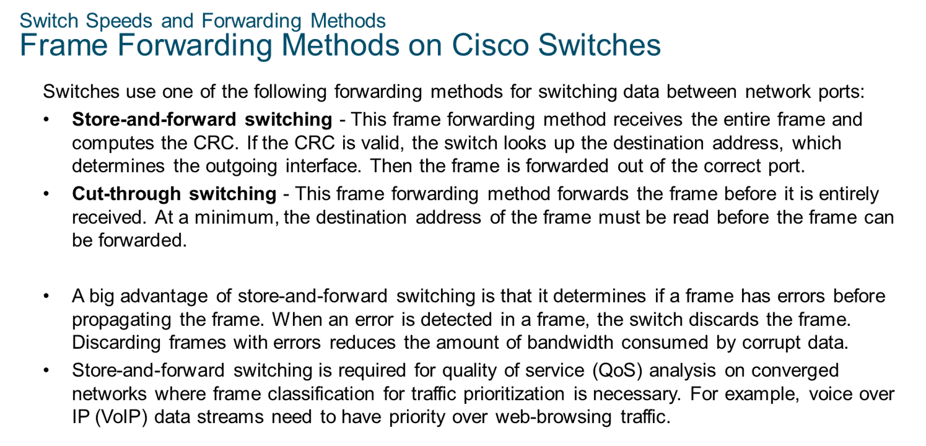
Chapter
Switch Speeds and Forwarding Methods
04

Slide 19
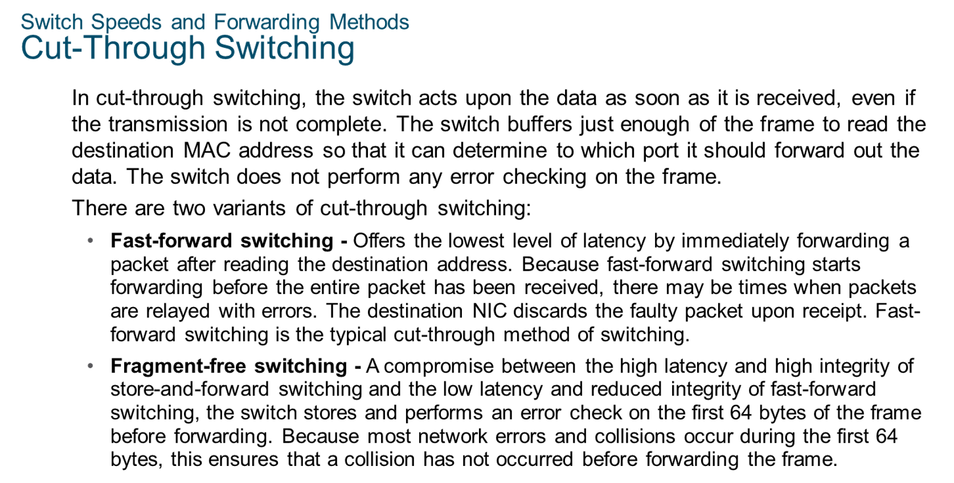
Chapter
Switch Speeds and Forwarding Methods
04

Slide 20
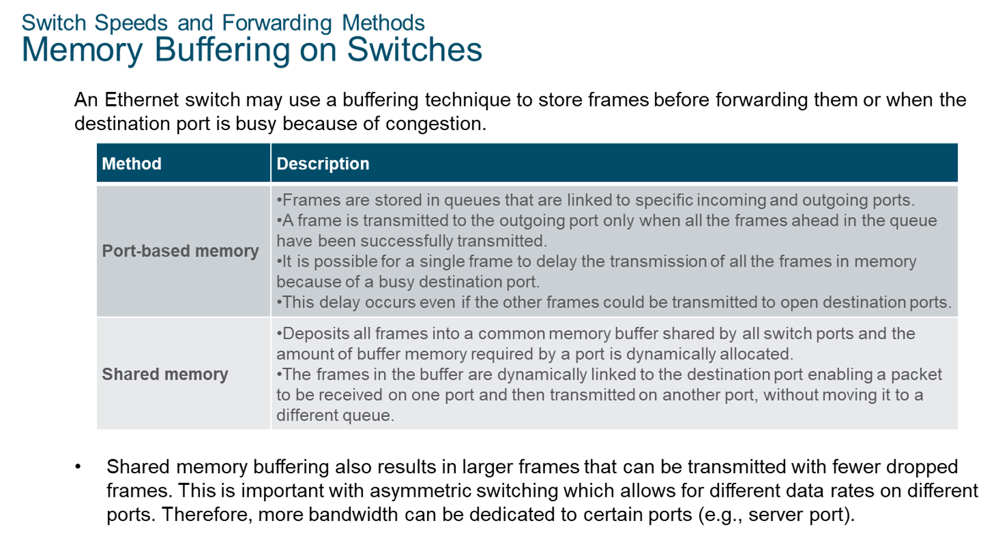
Chapter
Switch Speeds and Forwarding Methods
04

Slide 21
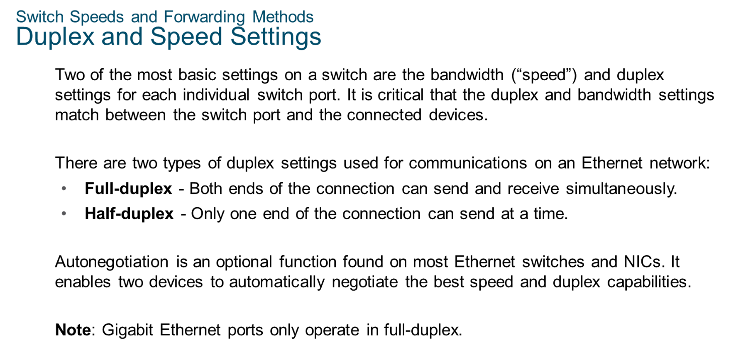
Chapter
Switch Speeds and Forwarding Methods
04

Slide 22
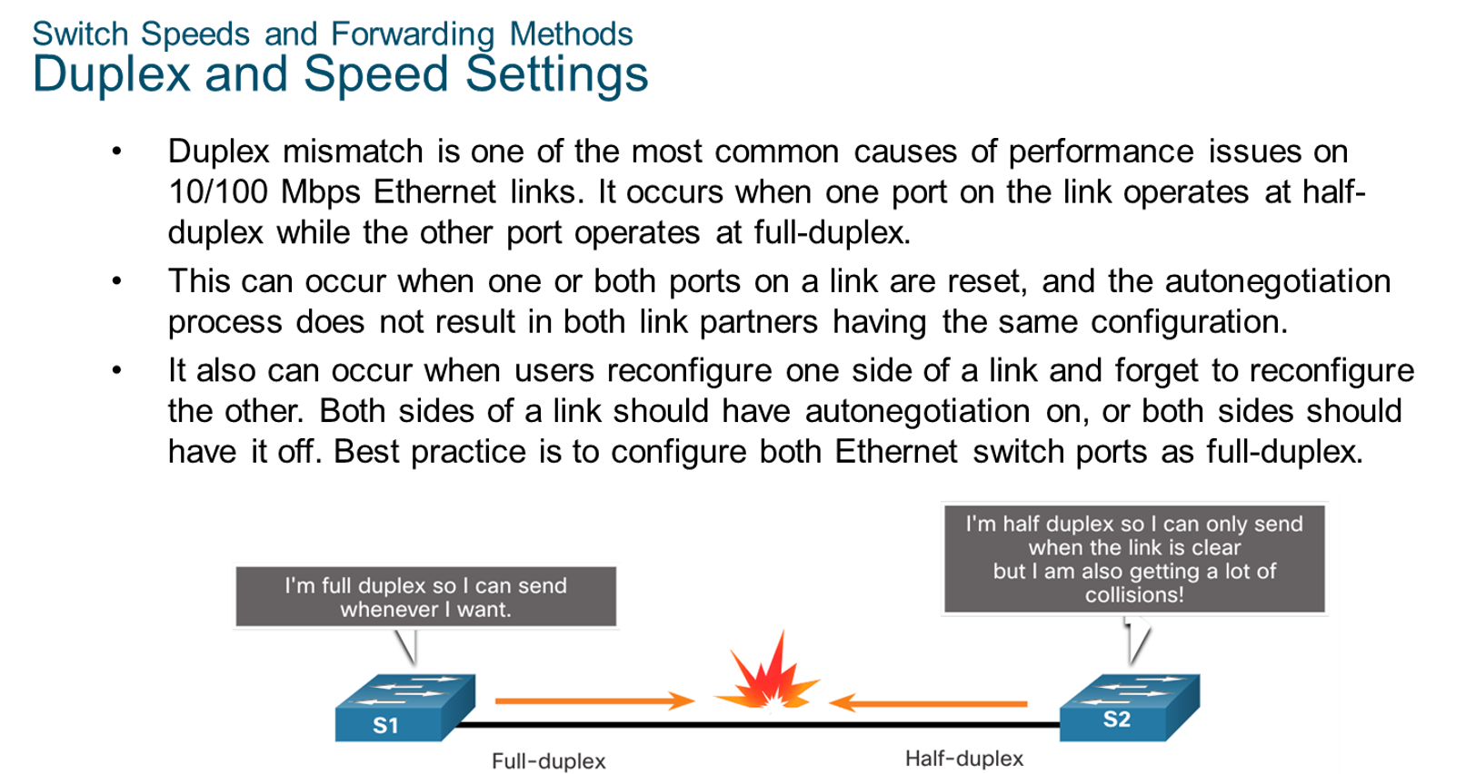
Chapter
Switch Speeds and Forwarding Methods
04

Slide 23
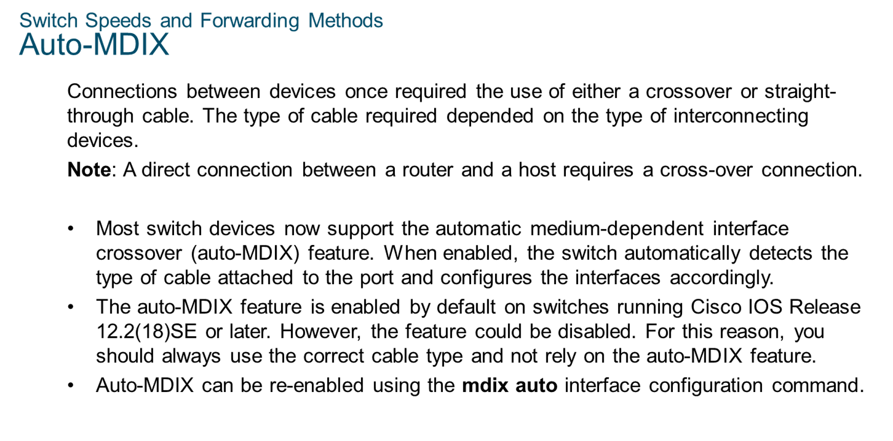
Chapter
Switch Speeds and Forwarding Methods
04

Slide 24



Thank You

