Slide 1


Business law
Prepared by Dr. Fatma Abdalla
MGM412
Business law
Introductory Lecture

Slide 2


introduction
Lecture objectives
Course Description.
The importance of studying business law.
Course Objectives.
Students Evaluation.
Teaching strategy
Course Topics.
References.
Conclusion

Slide 3
introduction
I- Course Description.
This course covers basic principles of law and their application to business problems. Topics include:
nature of legal, ethical and societal environments of business, law of contracts; sales of goods, negotiable instruments, bankruptcy, agency, employer-employee relations; intellectual property, employment law, product liability, transactional international business law including, the legal environment of international business.

Slide 4

II- The importance of studying business law.
.
exercising commerce necessitates:
understanding how to conclude valid contracts.
understanding how to institute commercial companies.
understanding financial instruments.
knowing rights and duties of merchants.
avoiding antitrust acts that may raise the merchant’s liability .
Finally, the most important part for most of you, understanding obligations and rights resulting from employment contract.

Slide 5
introduction
المقدمة
III- Course Objectives.
At the end of the course the student is expected to master the following:
Understanding legal terminology of business law.
Find relevant legal sources to solve business disputes.
Understanding elements required to conclude a legally valid binding contract
Identify intellectual property protections and determine infringement issues.

Slide 6
introduction
المقدمة
III- Course Objectives.
5- Discuss employment laws related to hiring, discrimination, safety, benefits, and termination.
7-Understanding regulations pertaining to consumer protection.
8- Understanding antitrust acts that may raise merchant’s liability.

Slide 7
III- Students Evaluation
This course employs a balance of ongoing and summative assessments to evaluate student learning and comprehension.
The total course grade is calculated out of a maximum of 100 marks.
There will be 10 weekly quizzes administered throughout the semester. Each quiz will cover key concepts from the lecture and assigned readings of that week.

Slide 8
III- Students Evaluation
These weekly quizzes weight is 80% of the final grade.
In addition, Final exam weight is 20% of the final grade.

Slide 9

introduction
V- teaching strategy
Pre-recorded video lectures -A new lecture video will be posted at the start of each week on Saturdays covering key concepts and topics.
2. Live discussion sessions -We will have a one hour weekly discussion session to review the recorded lecture, clarify doubts, and answer your questions. This allows real-time interaction.

Slide 10
introduction
VI- Course Topics.
Topics to be covered in the course:
Source of law and Fundamentals of the legal environment including:
* Difference between civil law and commercial law
* legal Persons subject to the law
* Different types of businesses
* Definition of a merchant and his obligations
* What is a company and types of commercial companies.

Slide 11
introduction
VI- Course Topics.
Topics to be covered in the course:
contract law.
* The requirements of concluding a legally valid contract.
* The electronic signature and its various types and the validity of this signature as evidence.
* The requirements of the company contract and its various formal and substantive conditions.
*Types of commercial companies included in the new Saudi system

Slide 12
introduction
VI- Course Topics.
financial instruments.
* Different types of commercial papers that can be used in different commercial transactions such as checks.

Slide 13
introduction
VI- Course Topics.
antitrust law.
* Or the Anti-Monopoly Act, which aims to prevent powerful economic entities from monopolizing markets through illegal business practices prohibited by law.

Slide 14
introduction
VI- Course Topics.
Employment law.
* discusses the various obligations resulting from the employment contract, whether on the employer or the worker, as well as the penalties that can be imposed on the worker and the cases of termination of this contract.

Slide 15
introduction
VI- Course Topics.
Sales and law.
discusses some important topics about e-commerce and the controls of commercial advertising. We also study the definition of a commercial store and an electronic store, the interfaces for documenting electronic stores, and we also study the types of digital currencies and some of the legal problems associated with them.

Slide 16
introduction
VI- Course Topics.
International business law.
discuss the international rules related to the practice of trade and contained in several international legal sources such as the laws of the European Union and international treaties. To cover some of the previous topics from the international aspect.

Slide 17
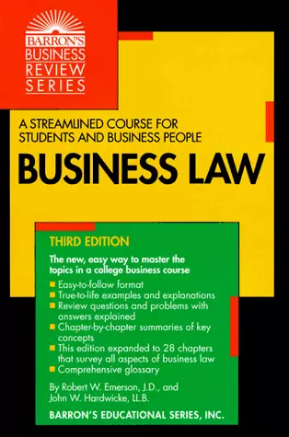
introduction
VII- References
؟
Business Law (Barron's Business Review) by Robert W. Emerson J.D.

Slide 18

VIII- Conclusion
introduction

Slide 19



Thank You

