Slide 1

Digital
Consumer Behavior
Dr. Perihan Salah
MKT713
Master of Digital Marketing
6

Slide 2

Consumer
Learning
Lecture 6
MKT713
Master of Digital Marketing

Slide 3
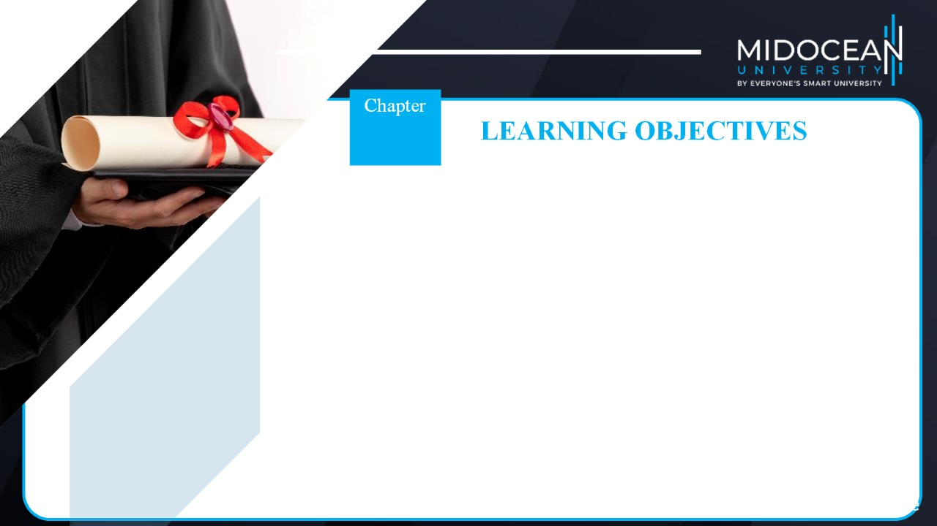
06
To understand the elements of learning in the context of consumer behavior.
To understand behavioral learning, classical conditioning, and the roles of stimulus generalization and discrimination in developing and branding new products.
To understand instrumental conditioning and the objectives and methods of reinforcement.
To understand the role of observational learning in consumer behavior.
To understand the elements of information processing, including receiving, storing, and retrieving consumption-related information.
To understand cognitive learning as a framework for consumer decision-making.
To understand consumer involvement and passive learning, and their impact on purchase decisions and the retention and recall of promotional communications.
To understand how to measure the results of consumer learning.

Slide 4


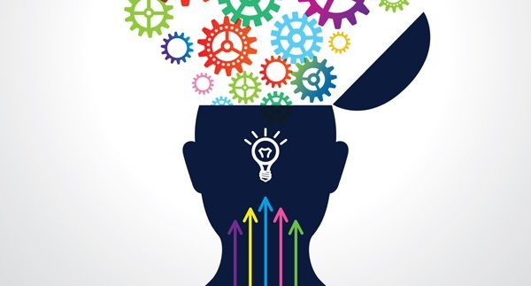
Consumer Learning

Slide 5




Slide 6

Consumer Learning
Learning is applying one’s past knowledge and experience to present circumstances and behavior.
  Students learn more enthusiastically when taught by persons whom they view as knowledgeable.
Second, consumers are more likely to learn from messages that are fun and attract attention
  Just like students who feel motivated and learn more from teachers with good communication skills than from boring teachers.
The third element of learning is repetition
The fourth element is reinforcement, which rewards behavior.

Slide 7


Learning through ads
The ads introducing the two new Galaxy products together – Galaxy Note 3 + Galaxy Gear, are aimed at an audience with a higher standard of living in the Gulf region, with the implicit message that the new competitively priced smartphone, with high-end technology in an attractive shell, is quite the bargain.
Samsung cleverly uses the message “Design Your Life” in the ads to tell its customers that the smartphone along with the one-of-a-kind Gear will help them organize and micro-manage almost every aspect of their lives.

Slide 8
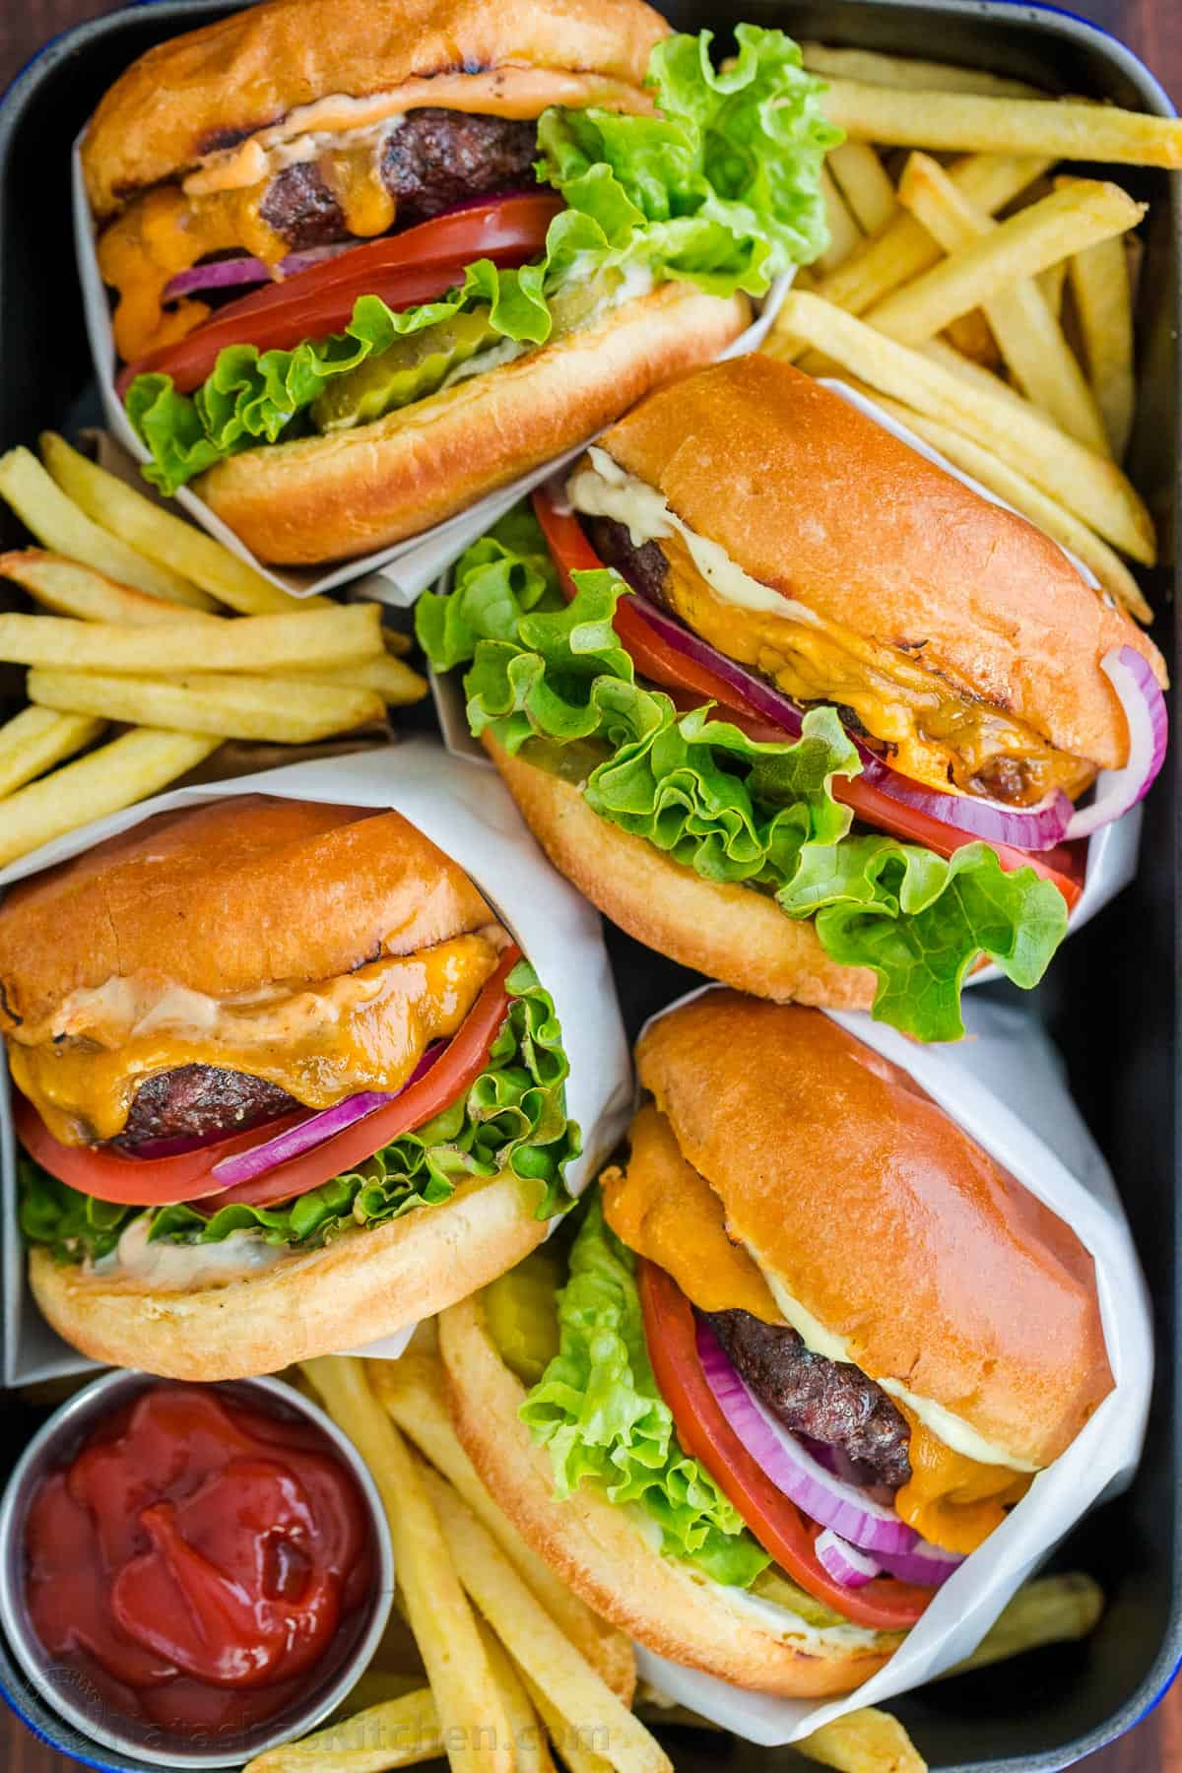
Learning
Intentional vs. incidental learning
Intentional learning is acquired as the result of a search for information,
Incidental learning is acquired by accident or without much effort.
Learning consists of four elements:
Unfilled needs lead to motivation, which spurs learning.
Cues are stimuli that direct motivated behavior.
Response is an individual’s reaction to a drive or cue.
Reinforcement is the reward—the pleasure, enjoyment, and benefits—that the consumer receives after buying and using a product or service.

Slide 9
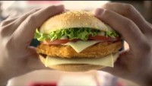
Intentional vs. Incidental learning

Slide 10

Need-cues-motivation-response -Reinforcement

Slide 11
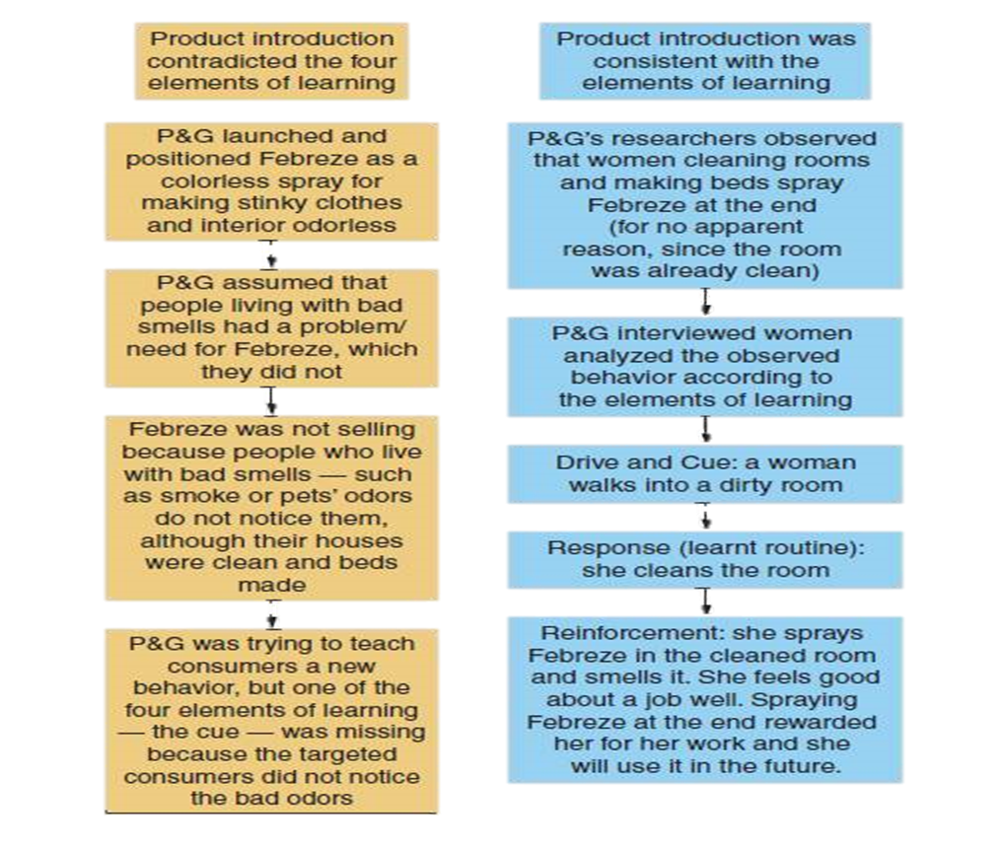
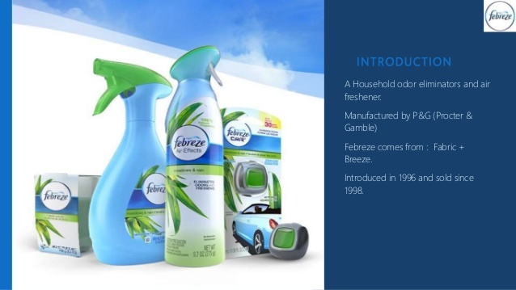
Compare the two introductions of Febreze

Slide 12


Slide 13


Slide 14

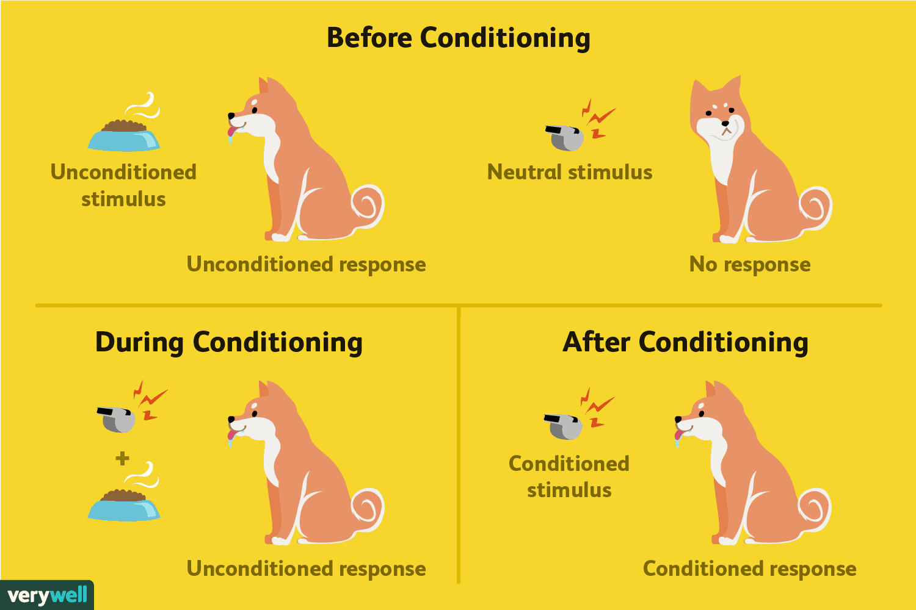
Classical Conditioning
is viewed as a “knee-jerk” (or automatic) response that builds up through repeated exposure and reinforcement.
Unconditioned Stimulus
Conditioned Stimulus
Conditioned Response
becomes associated with a particular event or feeling as a result of repetition
is a response to the conditioned stimulus.
occurs naturally in response to given circumstances
Introduction

Slide 15
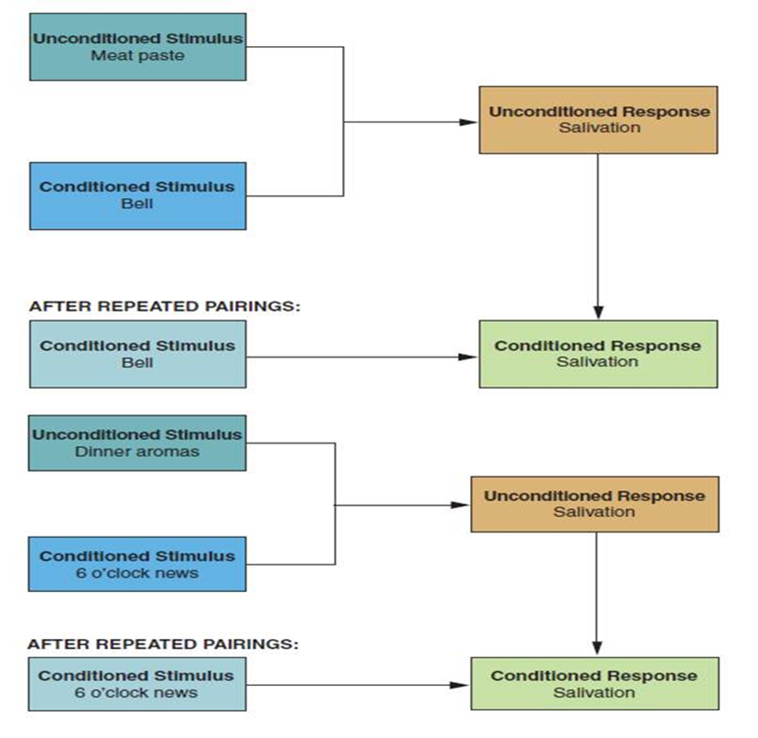
Classical
Conditioning

Slide 16
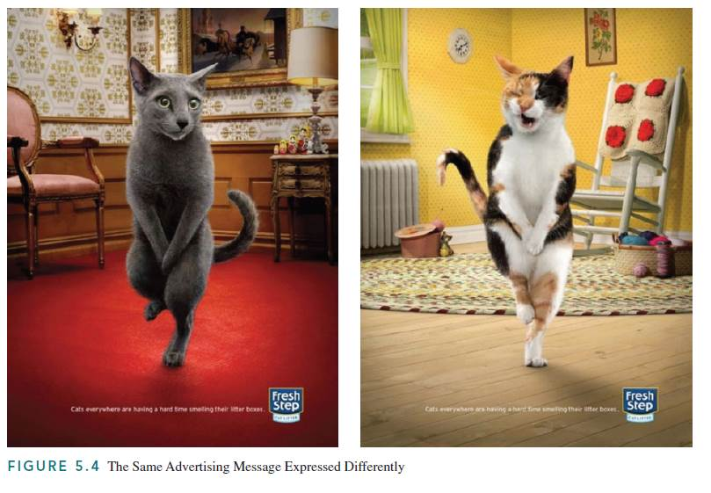
Applications of Classical Conditioning
Associative learning: learning of associations among events that enable consumers to expect and anticipate events.
Need for repetition
Advertising wear-out is the point at which an individual becomes satiated with numerous exposures, and both attention and retention decline.
Three-hit theory. three exposures to an advertisement are needed: one to make consumers aware of the product, a second to show consumers the relevance of the product, and a third to remind them of its benefits.

Slide 17


Slide 18


Slide 19

Situation

Slide 20
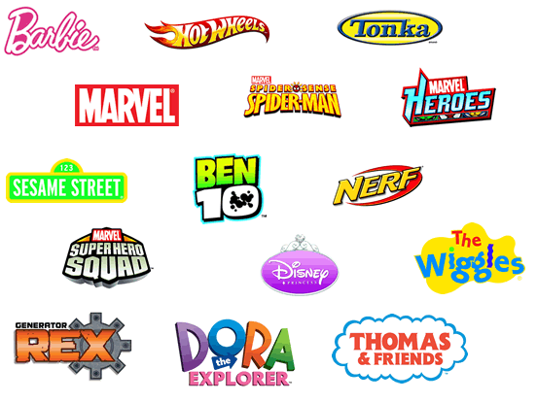
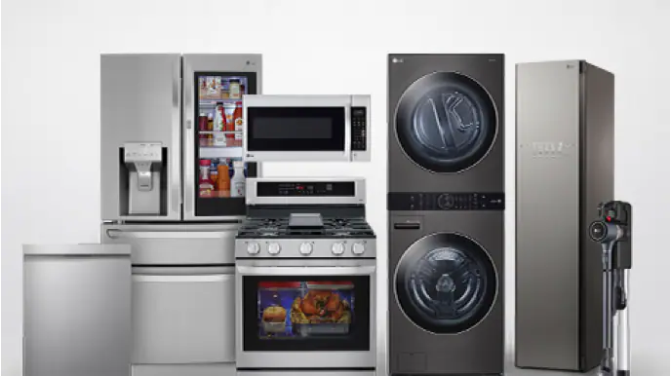

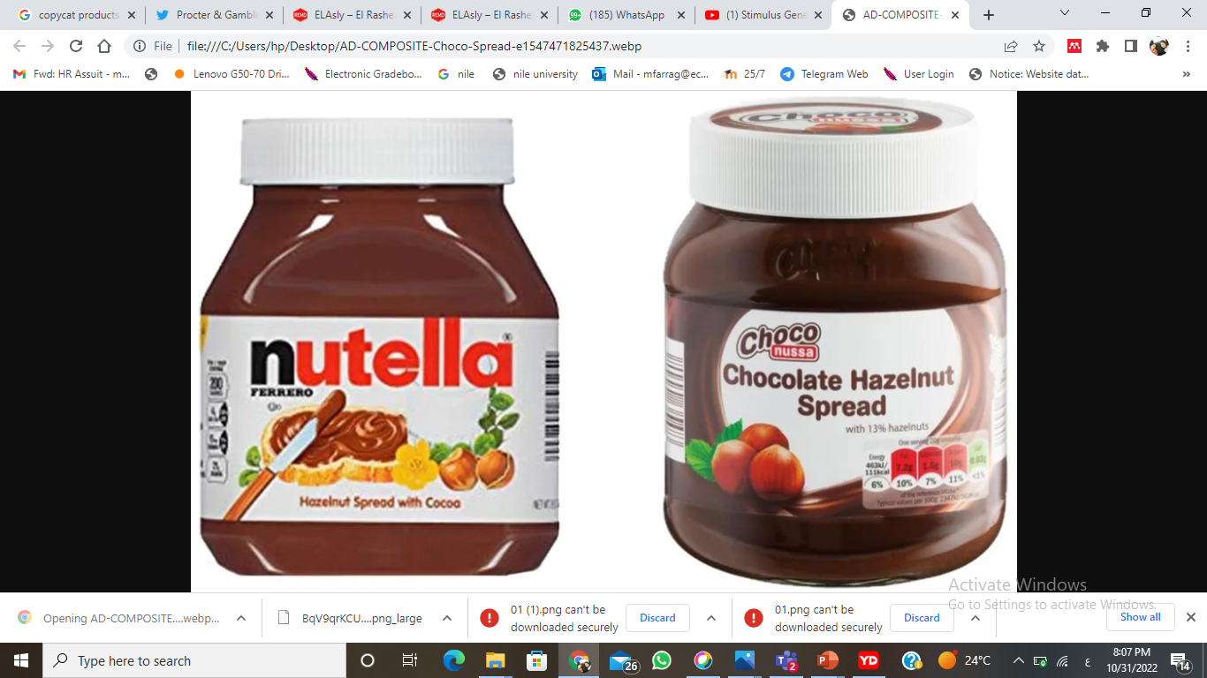
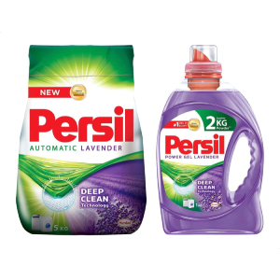

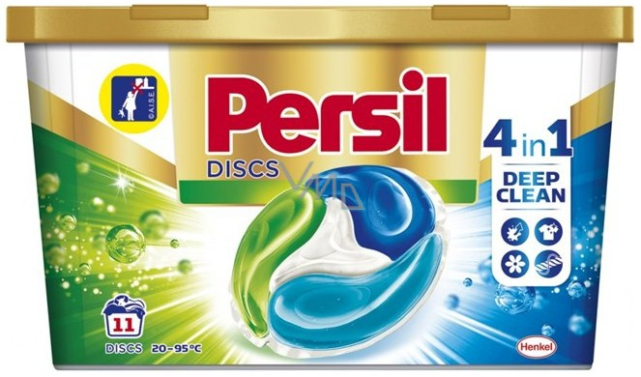
Stimulus Generalization
Product line extensions same brand different products
Product form extensions same product in different forms
Family branding different products ,same brand name
Licensing
Copycat products

Slide 21
Stimulus Generalization
Responding the same way to slightly different stimuli is called stimulus generalization.
Product line extensions are additions of related items to an established brand; these are likely to be adopted because they come under a known and trusted brand name. V8 soups are product line extensions. In learning terms, consumers will apply what they already know about V8 to its new product and probably try the new item.
Offering the same product in a different form but under the same brand is a product form extension.

Slide 22
Stimulus Generalization
Family branding consists of marketing different products under the same brand name. The extension of the V8 line to other products is also a form of family branding.
Licensing is contractually allowing a well-known brand name to be affixed to the products of another manufacturer. The names of designers, manufacturers, celebrities, corporations, and even cartoon characters are attached, for a fee (i.e., “rented out”) to a variety of products, enabling the licensees to achieve instant recognition and implied quality for the licensed products.

Slide 23
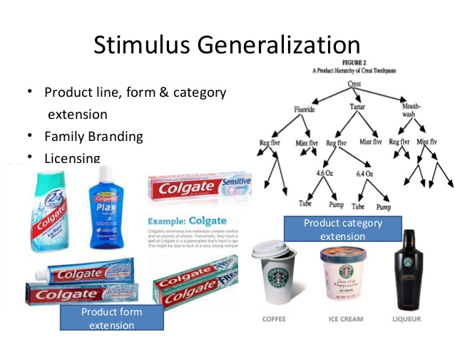
Stimulus Generalization

Slide 24


Stimulus Discrimination
Is the opposite of stimulus generalization.
Its purpose is the selection of a specific stimulus from among similar stimuli.
The core objective of positioning is to “teach” consumers to discriminate among similar products (i.e., similar stimuli) and form a unique image for a brand in their minds.

Slide 25
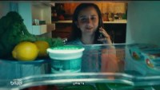
Stimulus Discrimination

Slide 26
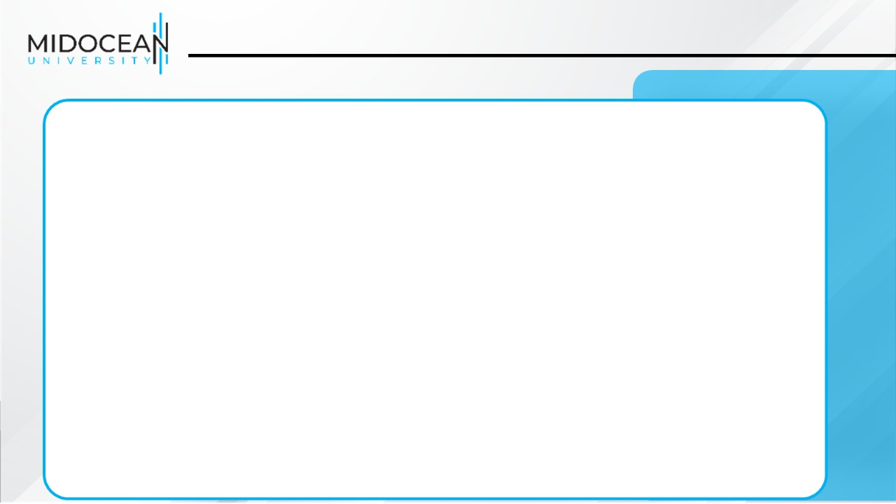
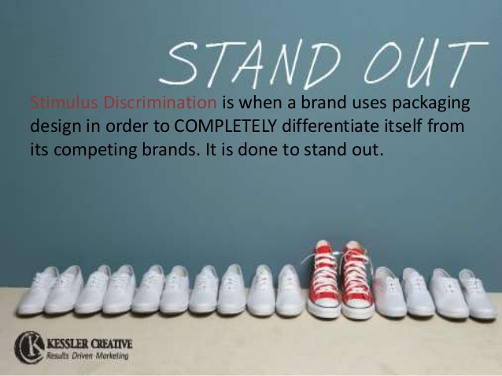

Stimulus Discrimination

Slide 27

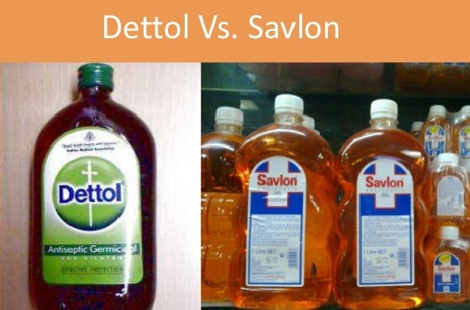
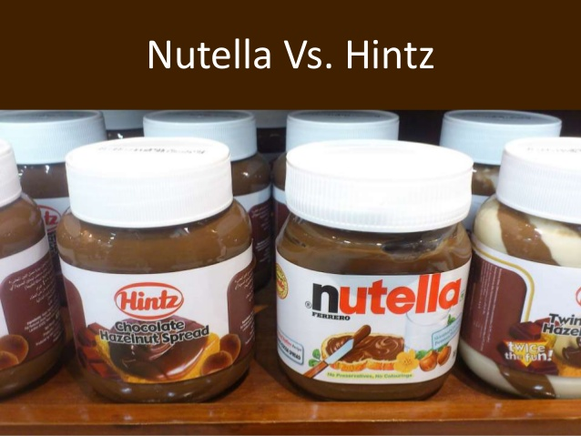
Which concept of behavioral learning
applies to the introduction of this product?

Slide 28
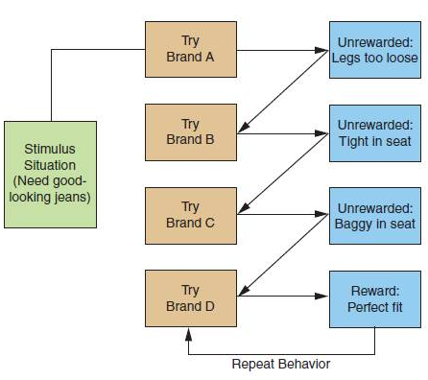
Instrumental Conditioning
The consumer who tries several brands and styles of jeans before finding a style that fits her figure (i.e., reinforcement) has engaged in instrumental
learning.
Presumably, the brand that fits best is the one she will continue to buy.

Slide 29
Instrumental Conditioning
Positive reinforcement rewards a particular behavior and thus strengthens the likelihood of a specific response during the same or similar situation.
Negative reinforcement is the removal of an unpleasant stimulus and it strengthens the likelihood of a given response during the same or similar circumstances.
Punishment is designed to discourage behavior.
Extinction occurs when a learned response is no longer reinforced and the link between the stimulus and the expected reward breaks down.
Forgetting is often related to the passage of time, and thus is often called decay.

Slide 30

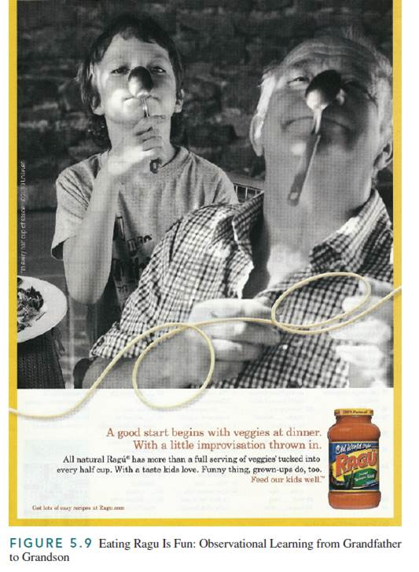

Observational Learning
Children learn much of their social behavior and consumer behavior by observing their older siblings and their parents.
They imitate the behavior of those they see rewarded, expecting to be rewarded similarly if they adopt the same behavior.

Slide 31
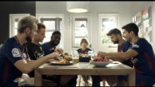
Observational Learning

Slide 32

Observational Learning

Slide 33
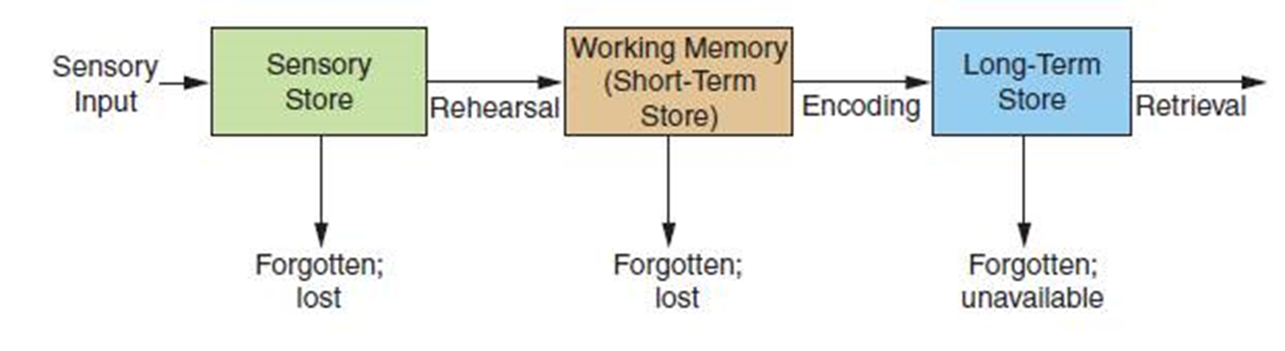
Cognitive Learning
The human mind processes the information it receives.
Consumers process product information by attributes, brands, comparisons between brands, or a combination of these factors.
The number and complexity of the relevant attributes and available alternatives influence the intensity or degree of information processing.
Consumers with higher cognitive abilities acquire more product information and consider more product attributes and alternatives than consumers with lesser ability.
Information processing occurs in stages and in three sequential “storehouses” where information is kept: the sensory, short-term, and long-term stores.

Slide 34


Slide 35
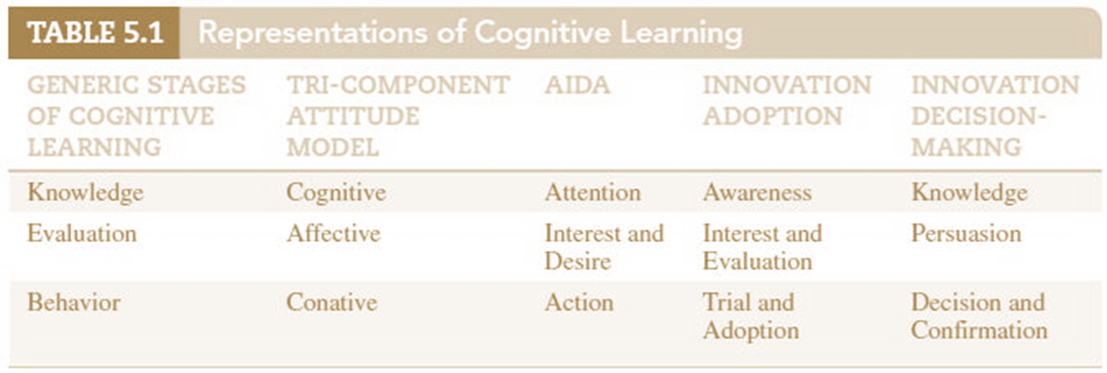
Cognitive Learning

Slide 36
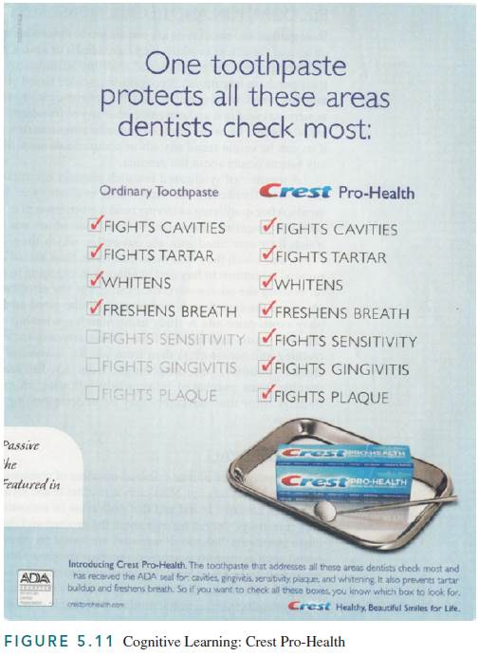
Discussion Question
How would the ad influence the behavior of an individual who was engaged in a cognitive learning process?

Slide 37
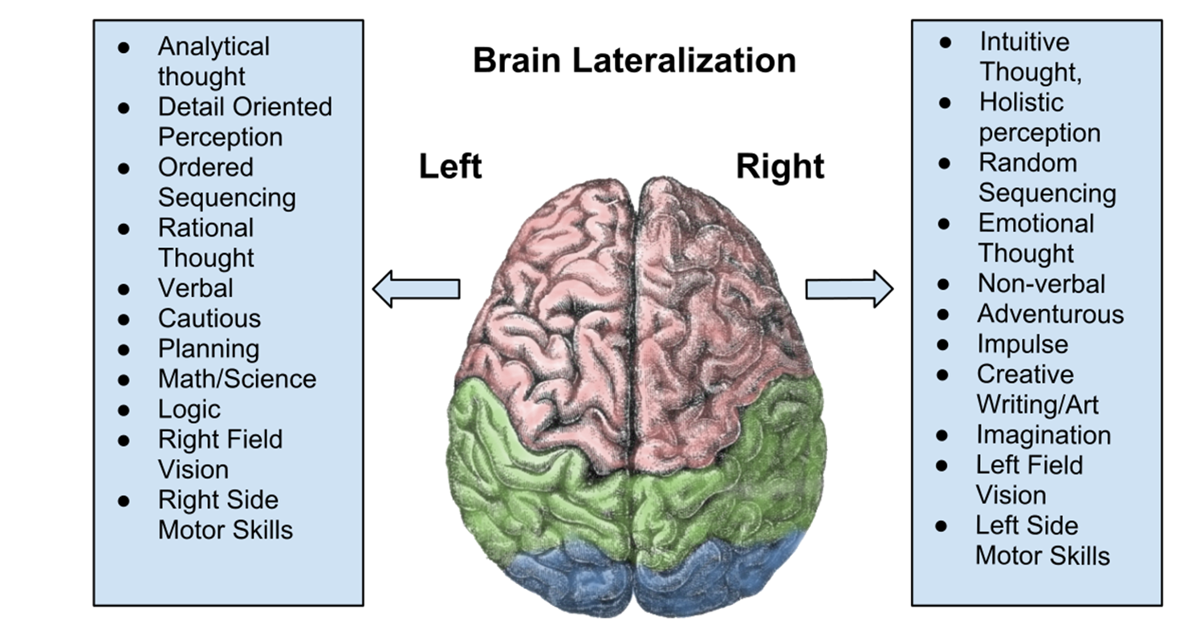
Hemispheric lateralization (split-brain theory)

Slide 38
Hemispheric lateralization (split-brain theory)
Stems from medical research done in the 1960s; its premise is that the human brain is divided into two distinct cerebral hemispheres that operate together, but “specialize” in processing different types of cognitions.
The left hemisphere is the center of human language; it is the linear side of the brain and primarily responsible for reading, speaking, and reasoning. The right hemisphere of the brain is the home of spatial perception and nonverbal concepts; it is nonlinear and the source of imagination and pleasure.
A research suggested that when consumers watch advertising on TV, they “passively” process right brain, pictorial information, but text in print ads were primarily processed using left brain.

Slide 39
Hemispheric lateralization (split-brain theory)
The researcher considered TV a primarily pictorial medium, and TV viewing as a right brain activity, consisting of passive and holistic processing of images viewed on the screen. He also maintained that TV is a low-involvement medium.
Cognitive learning models suggest that behavior follows the cognitive processing of information.
Advocates of passive learning maintain that repeated exposure to TV commercials, which is low-involvement information processing, induces purchases prior to consumers’ information processing and the formation of attitudes.

Slide 40


Slide 41
Brand Loyalty
Depends on
Risk aversion/variety seeking
Brand reputation/ substitute availability
Social influence
There are three types of brand loyalty:
1. Covetous brand loyalty(latent) includes no consistent purchase of a given brand, despite strong attachment to it.
2. Inertia brand loyalty is purchasing the brand because of habit and convenience, but without any emotional attachment to it.
3. Premium brand loyalty means high attachment to the brand and repeat purchase.

Slide 42
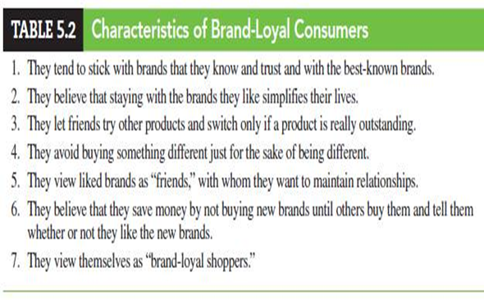

Slide 43
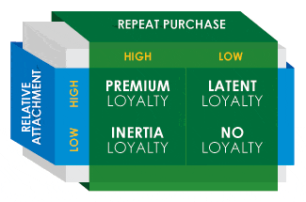

Slide 44


Slide 45
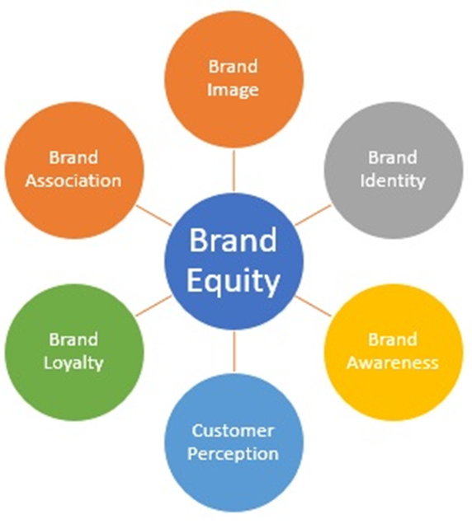
Brand Equity
The intrinsic value of a brand name.
This value stems from the foundations of brand loyalty:
the consumer’s perception of the brand’s superiority,
the social esteem it provides
the customer’s trust and identification with the brand.

Slide 46

06
To understand the elements of learning in the context of consumer behavior.
To understand behavioral learning, classical conditioning, and the roles of stimulus generalization and discrimination in developing and branding new products.
To understand instrumental conditioning and the objectives and methods of reinforcement.
To understand the role of observational learning in consumer behavior.
To understand the elements of information processing, including receiving, storing, and retrieving consumption-related information.
To understand cognitive learning as a framework for consumer decision-making.
6
To understand consumer involvement and passive learning, and their impact on purchase decisions and the retention and recall of promotional communications.
To understand how to measure the results of consumer learning.

Slide 47



