Slide 1



Digital Content Direction
DGM 733
Lecture 10

Slide 2




Lecture 10
Lecture 9 Conclusion:
Remember the last Lecture we talk about:
(Online Community Management)
* What Are Online Communities?
* Online Community Managers.
* Who’s Who in the Online Community?
* Conclusion.
* References.

Slide 3

Online Community Management
and Content Moderation
Lecture 10

Slide 4

Lecture 10
Lecture Outlines:
(Content Moderation)
* Content Moderators.
* Content Producers.
* Responding to Hostility, Misinformation and Disinformation.
* Resources for Community Managers and Content Moderators.
* Conclusion.
* References.

Slide 5

Lecture 10
Digital Content Direction
Content Moderators

Slide 6


The terms ‘online community management’ and ‘content moderation’ are sometimes used interchangeably; in fact, they have subtly Different meanings.
We have provided a definition of the online community manager before, and a snapshot of the tasks they are required to perform. Content moderators have a somewhat more specific role:

Slide 7
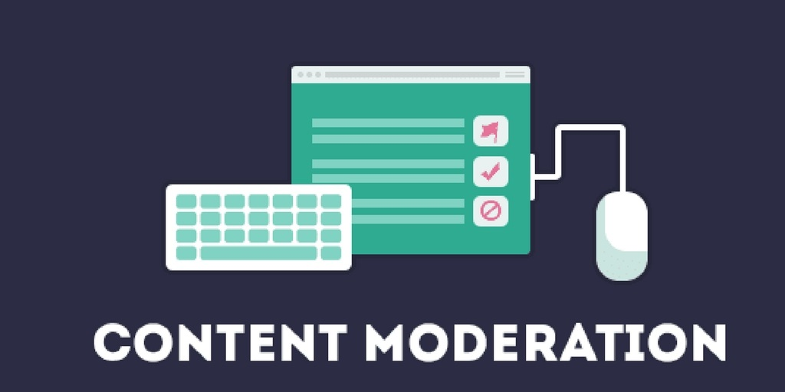
They decide which content can be posted to these spaces and which content must either be deleted or banned outright.
Content moderation can be undertaken by community managers, or by a designated moderator. According to the ACM, content moderation can also be undertaken by:

Slide 8
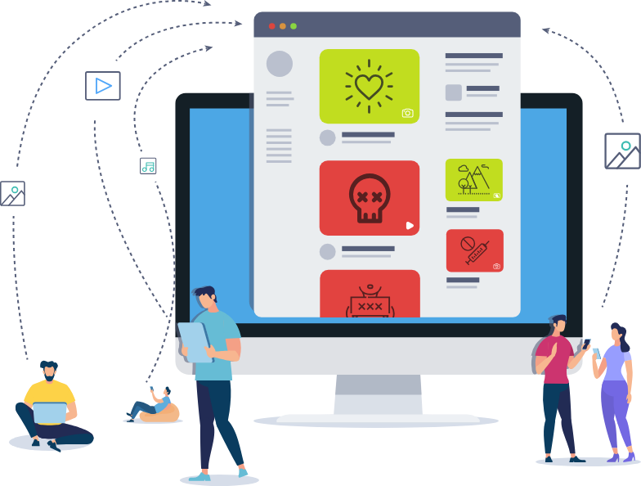
• Social media platform operators (note: this is typically performed by outsourced contractors)
• Community platform operators (often performed as a service extension of platform licensing or purchase)

Slide 9
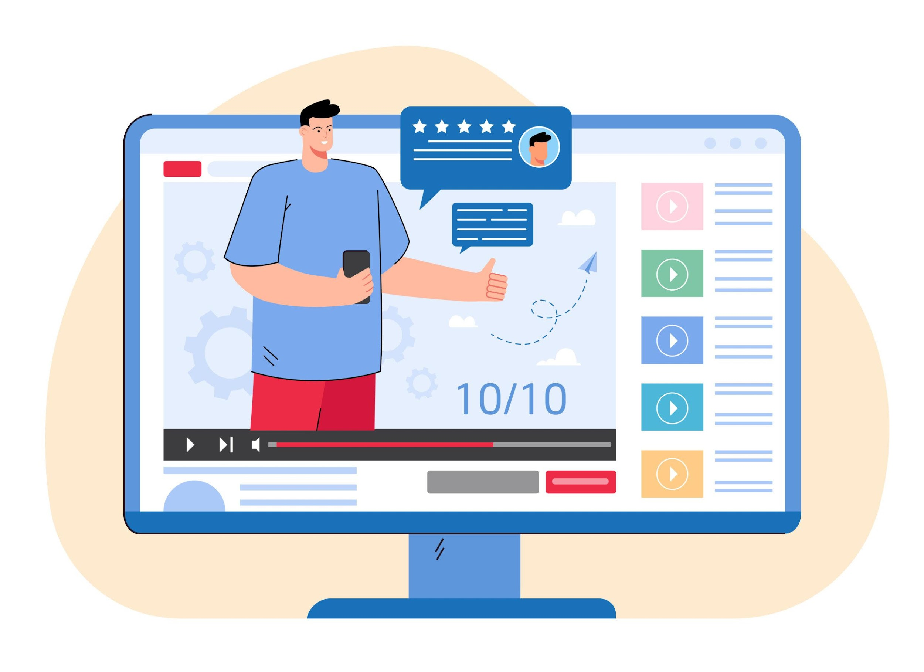
• Organisational representatives who have administrative access and privileges (e.g., media professionals, marketing professionals, customer service agents, product managers)
• Online community members and users.
• Automated machine tools (such as keyword filters programmable by humans).

Slide 10

Moderation can be undertaken prior to material being published (pre-moderation); after published material has been flagged as offensive, or harmful, by community members (reactive moderation); or after publication, when a moderator surveys the material and finds something that goes against community guidelines. Of the three, pre-moderation is potentially the riskiest.

Slide 11
For example, as the ACM point out, with material that is published after review, but that is found to contain offensive or harmful content, ‘it is harder to argue that content was not endorsed by the administrator, community or host organisation’.

Slide 12

Moderation can be undertaken manually, e.g., the moderator scans through posts to ensure that all content adheres to community standards and deletes that which does not.
In recent times, automated software has increasingly been deployed for these purposes. That software includes Perspective API, which has been described as ‘a system for the automated detection of “toxicity’.

Slide 13
Content moderation itself is Not New. ‘What is new’, writes Sarah Roberts, whose book Behind the Screen (2019) examines this line of work, ‘is the industrial-scale organized content moderation activities of professionals who are paid for their evaluative gatekeeping services, and who undertake the work they do on behalf of largescale commercial entities’. The proliferation of platforms has meant a proliferation of online communities to manage and content to moderate.

Slide 14
Lecture 10
Digital Content Direction
Content Producers

Slide 15

So, are online community managers and content moderators content producers?
The answer would seem to be ‘no’, at least at first glance. These media professionals are not (usually) charged with producing vlogs and podcasts; they’re not the ones who produce op eds or promotional material.

Slide 16

A more careful assessment reveals, however, that community managers and content moderators help produce something that is just as important as those artefacts and that is the user’s experience of a particular online community.

Slide 17

Through deciding what content is acceptable for a particular community and what is not, these media professionals play no small role in determining whether somebody will or will not return to—or, more accurately, be permitted to re-enter—the community they oversee.

Slide 18
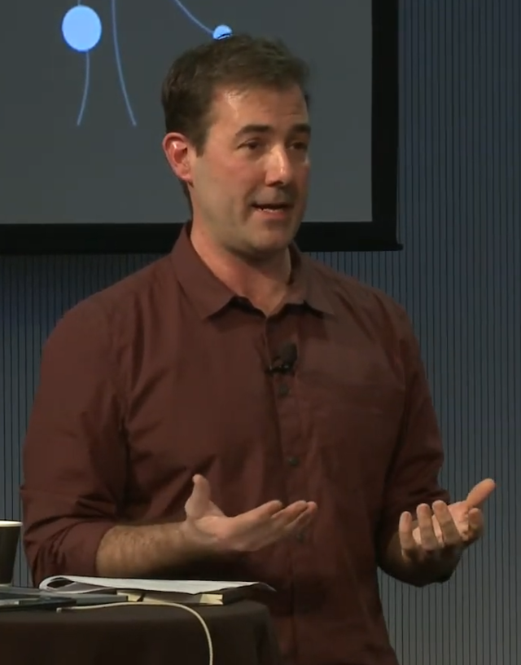
In an incisive 2018 study, the US scholar Tarleton Gillespie writes that content moderation is hugely important from the perspectives of profit and public health:
“Platforms must, in some form or another, moderate: both to protect one user from another, or one group from its antagonists, and to remove the offensive, vile, or illegal as well as to present their best face to new users, to their advertisers and partners, and to the public at large.”

Slide 19

In doing this, content moderators are required to adhere to guidelines enforced by the community manager.
Indeed, as we noted before, community managers are sometimes tasked with content moderation activities.

Slide 20

In the next section, we examine how these media professionals respond to digital hostility.
This encompasses the ‘offensive, vile, or illegal’ content that Gillespie describes above; it also encompasses content that may appear innocuous, but might in fact promote harmful views.

Slide 21
Lecture 10
Digital Content Direction
Responding to Hostility, Misinformation and Disinformation

Slide 22

We use the term digital hostility to describe behaviour that primarily or exclusively seeks to anger, offend or humiliate others.
Digital hostility can take multiple forms, including:

Slide 23
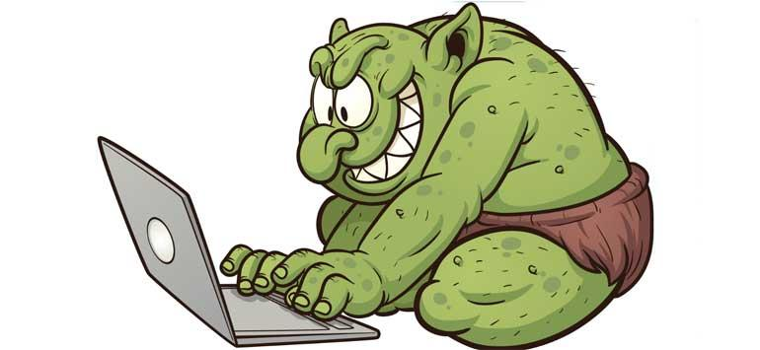

• Trolling: the deliberate posting of content that is designed to generate a heightened (and usually adverse) response from the recipient.
• Doxxing: the unauthorised public sharing of another individual’s personal details (e.g., address, phone number, photographs of loved ones).

Slide 24

• Ad hominem attacks: attacking a person rather than their ideas or actions.
Additionally, there is the abuse that moderators are subject to for just doing their jobs. This abuse can stem from the decisions made by community managers and content moderators in enforcing community standards.

Slide 25
Online communities can also be plagued by misinformation and disinformation.
Misinformation refers to factually inaccurate material. This inaccuracy can be attributed to a number of factors, including poor fact checking; it’s not necessarily intended to harm.
Disinformation refers to factually inaccurate material that is spread with the specific aim of causing unrest, be this political, physical or psychological.

Slide 26
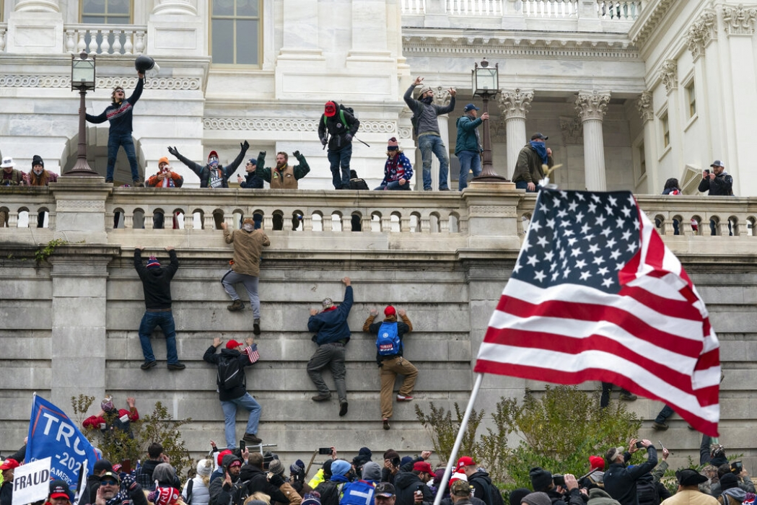
The riots at the Capitol building in Washington in January 2021 is perhaps the best-known example of the unrest that disinformation can cause. Neither misinformation nor disinformation are new, but both have proliferated during the COVID-19 pandemic.

Slide 27

The misinformation and disinformation that we are referring to concerns the novel coronavirus: how the virus is being used by powerful forces to manipulate the broader population, the efficacy (or lack thereof) of vaccines, and whether COVID-19 even exists.

Slide 28

Sometimes, online misinformation and disinformation can take overtly hostile forms. These include YouTube and Instagram videos in which self-styled ‘experts’ (many of whom do not have medical qualifications) decry the novel coronavirus as a government fabrication and vaccines as dangerous, even lethal.

Slide 29
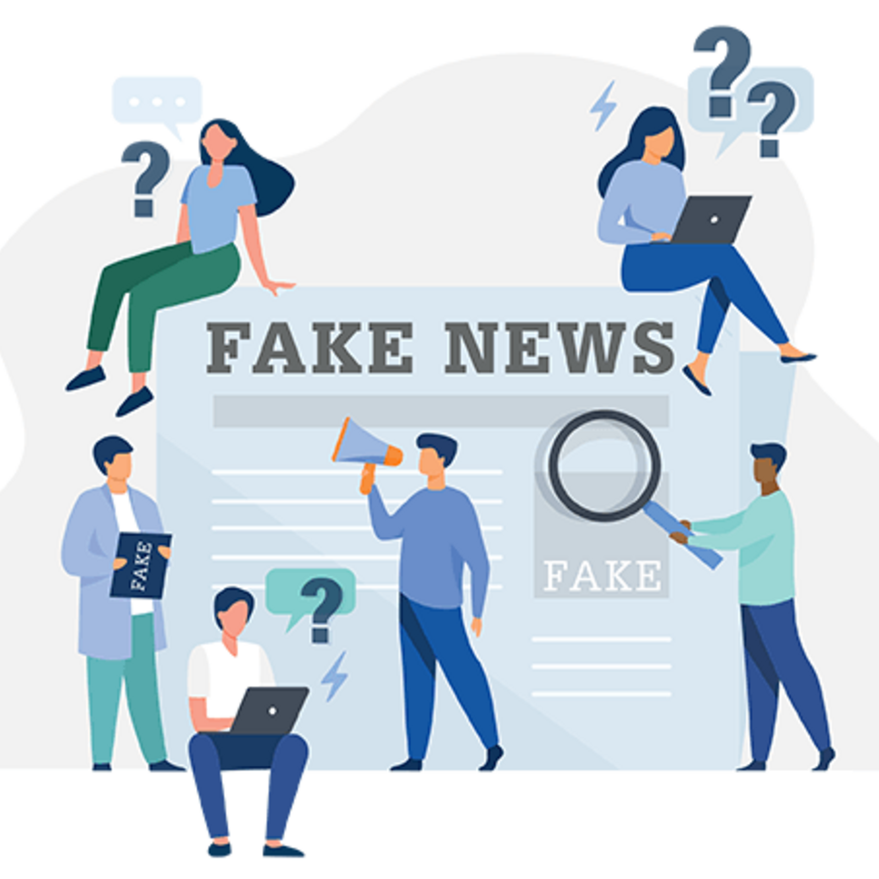
On other occasions, online misinformation and disinformation can appear more inoffensive; it can only be understood by those who are familiar with the codes used by proponents.
We refer here to the ‘dog whistle’ or a ‘phrase that may sound innocuous to some people, but which also communicates something more insidious either to a subset of the audience or outside of the audience’s conscious awareness — a covert appeal to some noxious set of views’.

Slide 30
A key example of the dog whistle is the slogan ‘do your own research’, which has been adopted by exponents of COVID-19 conspiracy theories.
‘Do your own research’ sounds like eminently sensible advice—surely one should become well-versed in the topics they’re discussing—until you consider that ‘research’ can mean relying on the scientifically unproven ideas published by members of the public on platforms such as Telegram or 4Chan, and not rigorous, peer-reviewed research.

Slide 31

To detect inoffensive-seeming content, including dog whistles, community managers and content moderators must possess a considerable deal of media literacy.
They must be able to detect dog whistles and coded, covert endorsements of conspiracy theories and forms of bigotry (racism, anti-Semitism, misogyny, ableism, homophobia, transphobia).

Slide 32
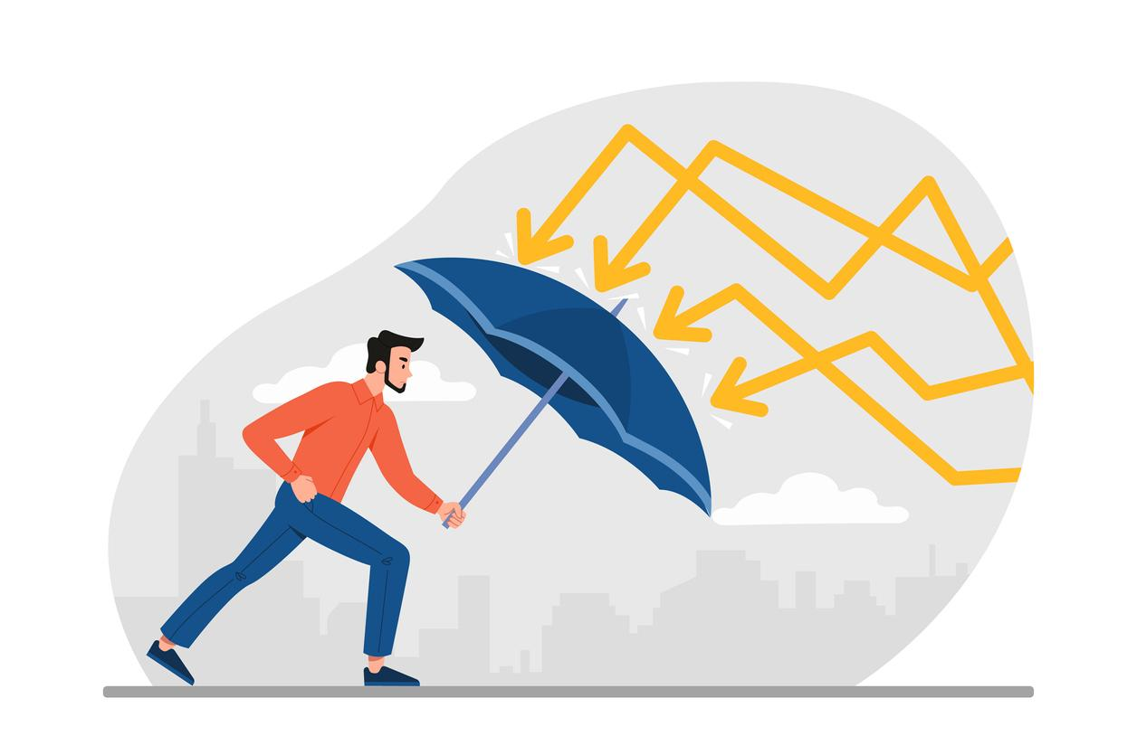
Also, community managers and moderators are required to develop a strong sense of resilience. The term ‘resilience’ refers to the ability to emotionally withstand sometimes profound challenges and difficulties.
Resilience is Not an innate quality, it’s not something that one is born with. Resilience is rather a quality that needs to be cultivated and maintained by the individual. This can be achieved through measures such as the following:

Slide 33

• Access to counselling and psychological services.
• Regular breaks during a work shift to allow the worker to take time away from the challenging content and activity they have been dealing with.

Slide 34
• Support groups in which managers and moderators can discuss the challenges, they have faced in their group, in a non-judgmental environment composed of individuals who have faced and successfully addressed these challenges.
• Reminding oneself that attacks and disinformation say more about their proponents than they do those who are charged with removing them from platforms.

Slide 35

There are no easy answers when it comes to cultivating resilience, but it is important to do so; as one 2019 article points out: ‘Moderators battle depression, addiction, and even post-traumatic stress disorder from the endless parade of horrors they consume’.

Slide 36
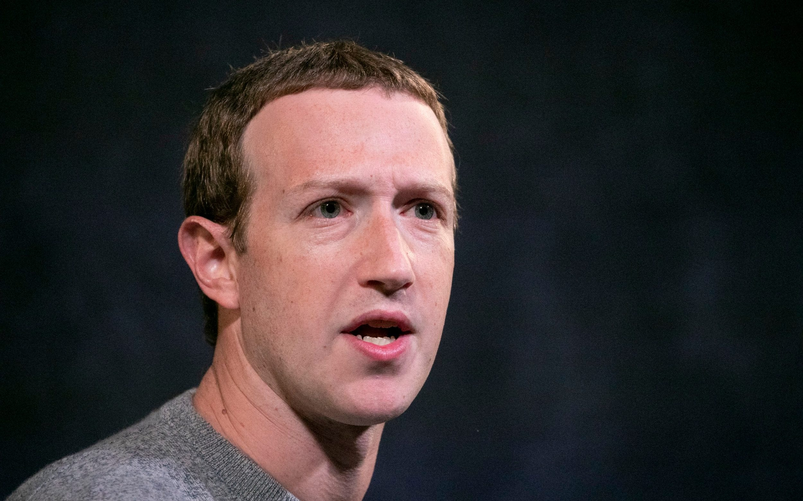
These are workplace injuries, and they have not always been fully appreciated by media outlets. For example, in a recording leaked in 2019, Mark Zuckerberg (chief executive of Facebook) was heard describing reports by moderators of the distress they experienced in doing their jobs as being ‘a little over-dramatic’.

Slide 37
Lecture 10
Digital Content Direction
Resources for Community Managers and Content Moderators

Slide 38

Online community management and content moderation can be challenging professions. Fortunately, there are a number of resources and avenues of support for these professionals.
In Australia, where the authors of this book are based, there are Australian Community Managers (ACM).

Slide 39

ACM is an online community that seeks to ‘grow and enhance community management practice through training, resources, mentoring and meaning-rich connection’ (ACM Website).
They also hold the annual Swarm conference, in which community managers and researchers come together to share knowledge and advice.

Slide 40

There is software devoted to building online communities.
This software includes Higher Logic Online Community, which has been described as a ‘human-focused engagement platform’ (Higher Logic Online Community Reviews undated).

Slide 41

It also includes Mobilise, which purports to provide companies with a new place to engage prospects, partners and customers by providing a private place to build a professional network (Mobilise Reviews undated)

Slide 42
Lecture 10
Lecture Outlines:
(Content Moderation)
* Content Moderators.
* Content Producers.
* Responding to Hostility, Misinformation and Disinformation.
* Resources for Community Managers and Content Moderators.
* Conclusion.
* References.

Slide 43


Lecture 9
Lecture References:
* Jenkins, H., Ford, S., & Green, J. (2013), Spreadable media: Creating value and meaning in a networked culture, New York University Press.
* Jay Daniel Thompson & John Weldon (2022), Content Production for Digital Media: An Introduction, Springer Nature Singapore.

Slide 44


Thank You

Slide 45

Digital Content
Direction
Lecture 9
DGM 733
Prepared by:
Dr. Sherihan Mohamed

