Slide 1

Internet and Information Technology
ITC202
Lecture 7 -Application Software
Dr. Eng. Youssef Ntefeh

Slide 2
Course Topics
History of computing.
Introduction to information technology.
System and application software.
MS Word.
MS Excel.
MS PowerPoint.
Common web services and tools.

Slide 3
Learning Outcomes
Using Technology to Change the World.
Understanding the Computers Parts.
Application Software: Programs That Let You Work.
Introduction to Word, Excel, and PowerPoint.
Using the Internet and Web’s Resources.
Protecting Your Digital Data and Devices.

Slide 4
Learning Objectives
Describe what application software is, the different types of ownership rights, and the difference between installed and Web-based software.
Detail some concepts and commands that many software programs have in common.
Discuss word processing and explain what kinds of documents are created using this type of program.
Explain the purpose of spreadsheet software and the kinds of documents created using this type of program.

Slide 5
Learning Objectives
Identify some of the vocabulary used with database software and discuss the benefits of using this type of program.
Describe what presentation graphics and electronic slide shows are and when they might be used.
List some types of graphics and multimedia software consumers frequently use.
Name other types of application software programs and discuss what functions they perform.

Slide 6
Overview
This lecture covers:
  Characteristics of application software in general.
  A look at the most widely used types of application software, including:
    Word processing.
    Spreadsheet.
    Database.
    Presentation graphics.
    Graphics and multimedia software.
    Other types of application software.

Slide 7
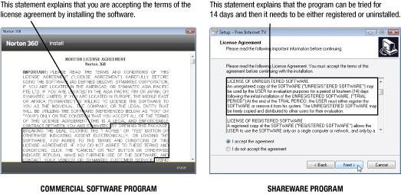
The Basics of Application Software
Software ownership rights: Specify the allowable use of the program.
Software license: Specifies the conditions under which a buyer of the program can use it.

Slide 8
Software Ownership Rights
Commercial software: Copyrighted software that is developed usually by a commercial company, for sale to others.
Shareware: Copyrighted software distributed on the honor system; consumers should either pay for it or uninstall it after the trial period.
Freeware: Copyrighted software programs that are given away by the author for others to use free of charge.
Public domain software: Software that is not copyrighted and ownership rights have been donated to the public domain.
Open source software: Programs with source code made available to the general public.

Slide 9
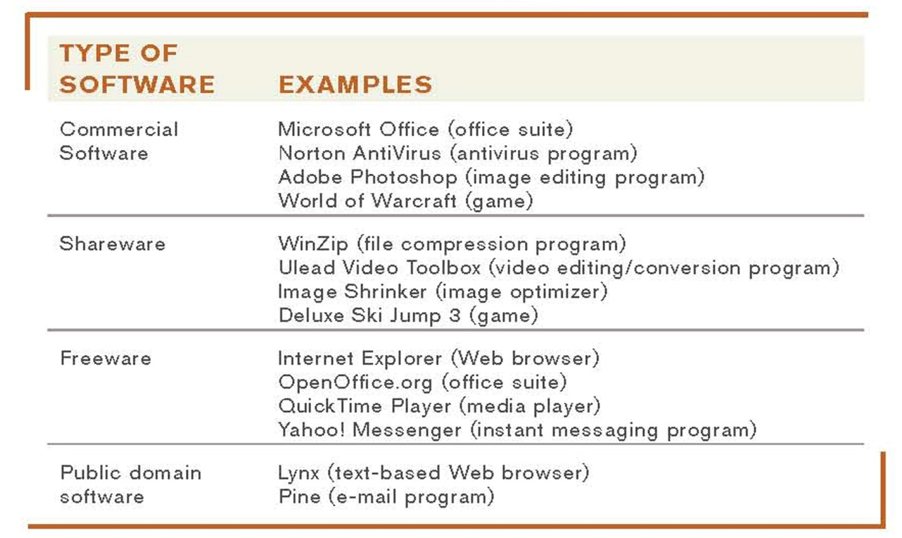
Software Ownership Rights

Slide 10
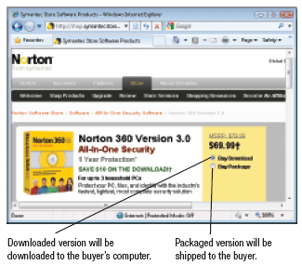
Installed vs. Web-Based Software
Installed software: Must be installed on the computer before it can be run:
  Can be purchased in physical form.
  Can be downloaded from the Internet.

Slide 11
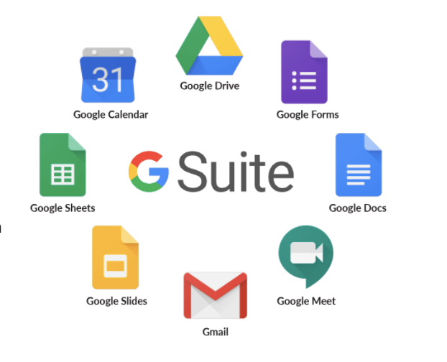
Installed vs. Web-Based Software
Web-based software: Run directly from the Internet.
  Also called Software as a Service (SaaS) and cloudware.
  Includes free software and fee-based software available via an application service provider (ASP).

Slide 12
Software Suites
Software suite: Collection of software programs bundled together and sold as a single software package .
  Office suites are used by most businesses/individuals to produce documents.
    Typically include:
      Word processing software.
      Spreadsheet software.
      Database software.
      Presentation graphics software.
      Additional productivity tools like calendars, messaging programs, or collaboration tools.
  Provides a common interface among programs in the suite.

Slide 13
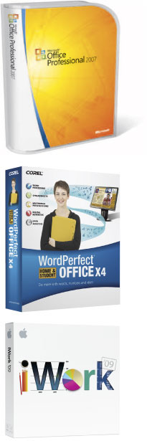
Software Suites
Office suites include:
    Microsoft Office.
    Apple iWork.
    OpenOffice.org (free).
  Most suites available in variety of versions.
Not all suites available for all OS.
Cost lower than buying each program separately.

Slide 14
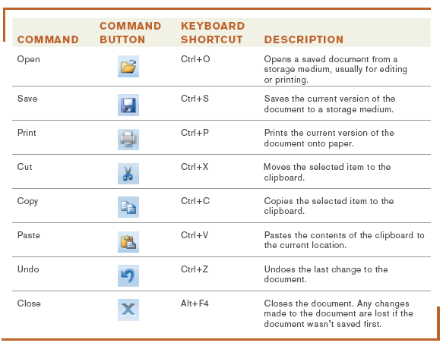
Common Software Commands
Application programs today have a number of concepts and commands in common
  Toolbars.
  Menus.
  Command buttons
  Keyboard shortcuts.
  Ribbon.
  Mini toolbar.

Slide 15
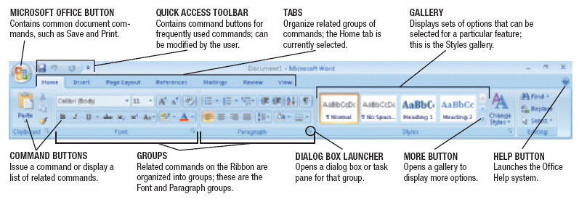
The Ribbon
Used in Microsoft Office 2007 and later.
Commands are organized into groups located on tabs.
Contexual: Commands appear as they are appropriate.

Slide 16
Editing a Document
Editing a document: Changing the content of the document, such as inserting or deleting words.
  Insertion point: Indicates the current location in a document, which is where the changes will be made.
  Typing text will insert it.
  Delete and Backspace key will delete text.
  Text and objects can typically be selected to be moved, copied, deleted, or formatted.

Slide 17
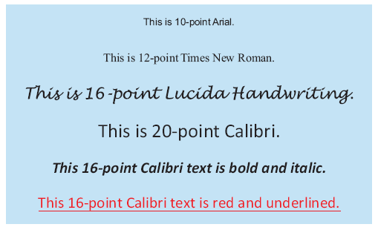
Formatting a Document
Formatting a document: Changing the appearance of the document.
  Changing font face, size, style, or color.
  Changing line spacing or margins.
  Adding page numbers or borders

Slide 18
Word Processing Concepts
Word processing: Using a computer and word processing software to create, edit, save, and print written documents such as letters, contracts, and manuscripts.
Common programs:
  Microsoft Word .
  Corel WordPerfect.
  Apple Pages.

Slide 19
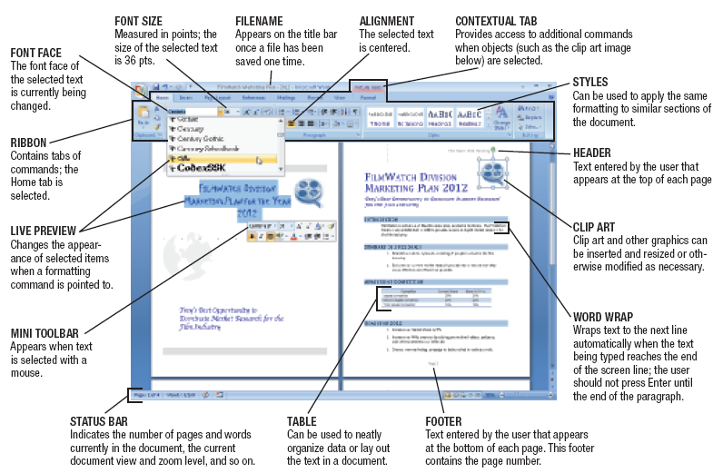
Microsoft Word

Slide 20
Creating a Word Processing Document
Character formatting (font face, size, style, or color).
Paragraph formatting (line spacing, indentation, tabs, alignment, and styles).
Page formatting (margins, paper size, orientation, headers, footers, etc).
Document formatting (footnotes, end notes, table of contents, index, background, theme).

Slide 21
Tables, Graphics, and Templates
Tables: Allow content to be organized in a table consisting of rows and columns.
Graphics or drawing features: Allow images to be inserted into a document (clip art, photographs, drawn images, etc.) and then modified
Templates: Help users create new documents quickly.

Slide 22
Spreadsheet Concepts
Spreadsheet software: Used to create electronic spreadsheets.
Spreadsheets: Documents containing a group of numbers and other data organized into rows and columns.
Worksheet: A single spreadsheet.
Workbook: A collection of worksheets saved in a single file.
Most widely used spreadsheet programs:
  Microsoft Excel.
  Corel Quattro Pro.
  Apple Numbers.

Slide 23
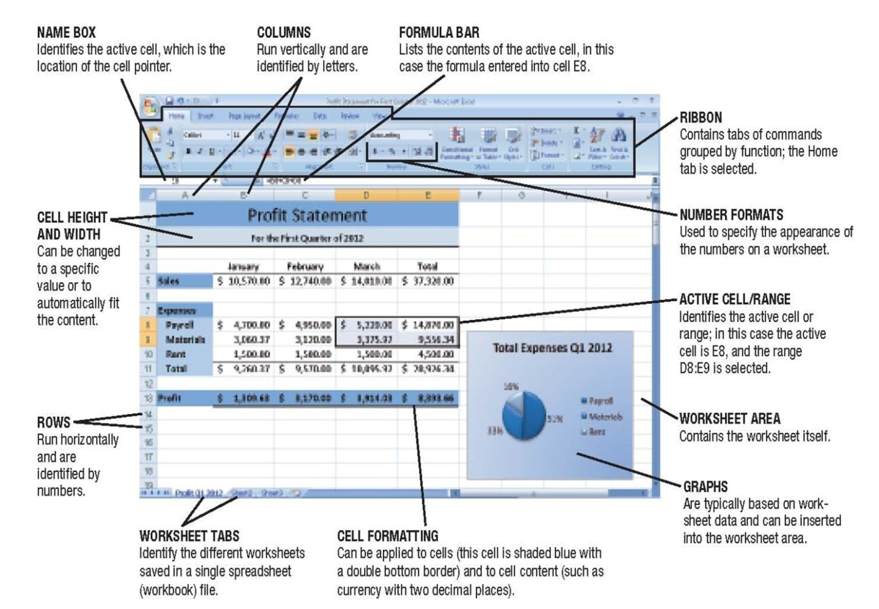
Microsoft Excel

Slide 24
Creating a Spreadsheet
Worksheets are divided into rows and columns.
Cell: The intersection of a row and a column.
  Each cell is identified by a cell address.
  Cell pointer marks current cell.
  Groups of cells are called ranges or blocks; can be selected with mouse or keyboard.
  Data is entered into current cell.

Slide 25
Entering Data into a Spreadsheet Cell
Cells can contain:
  Labels: Text-based entry in a worksheet cell that identifies data on the worksheet.
  Constant values: Numerical entry in a worksheet cell
  Formulas: Performs mathematical operations on the content of other cells.
    Usually reference cell address, not the current data in a cell.
    Use mathematical operators + - / * ^.
    e.g. A1 =B8+C8+D8.
  Functions: Named programmed formula.
    e.g. A1=SUM(B8:D8).

Slide 26
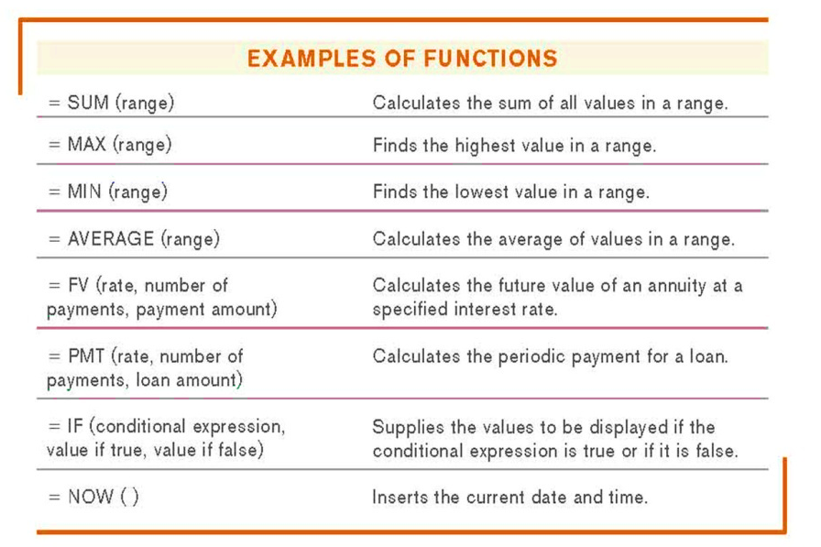
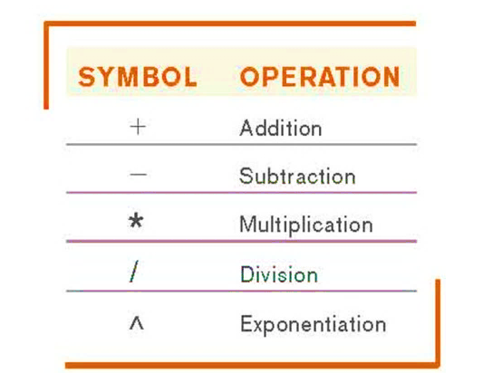
Entering Data into a Spreadsheet Cell

Slide 27
Database Concepts
Database: A collection of related data that is stored in a manner enabling information to be retrieved as needed.
Database management system (DBMS): Software that allows the creation and manipulation of an electronic database.
Most widely used database programs:
  Microsoft Access.
  Oracle Database.
  IBM DB2.

Slide 28
Database Concepts
  Most PC-based databases are relational databases and organized into fields (columns), records (rows), and tables.
  Field (column): A single type of data to be stored in a database.
  Record (row): A collection of related fields.
  Table: collection of related records.
  Database file: Collection of related tables.

Slide 29
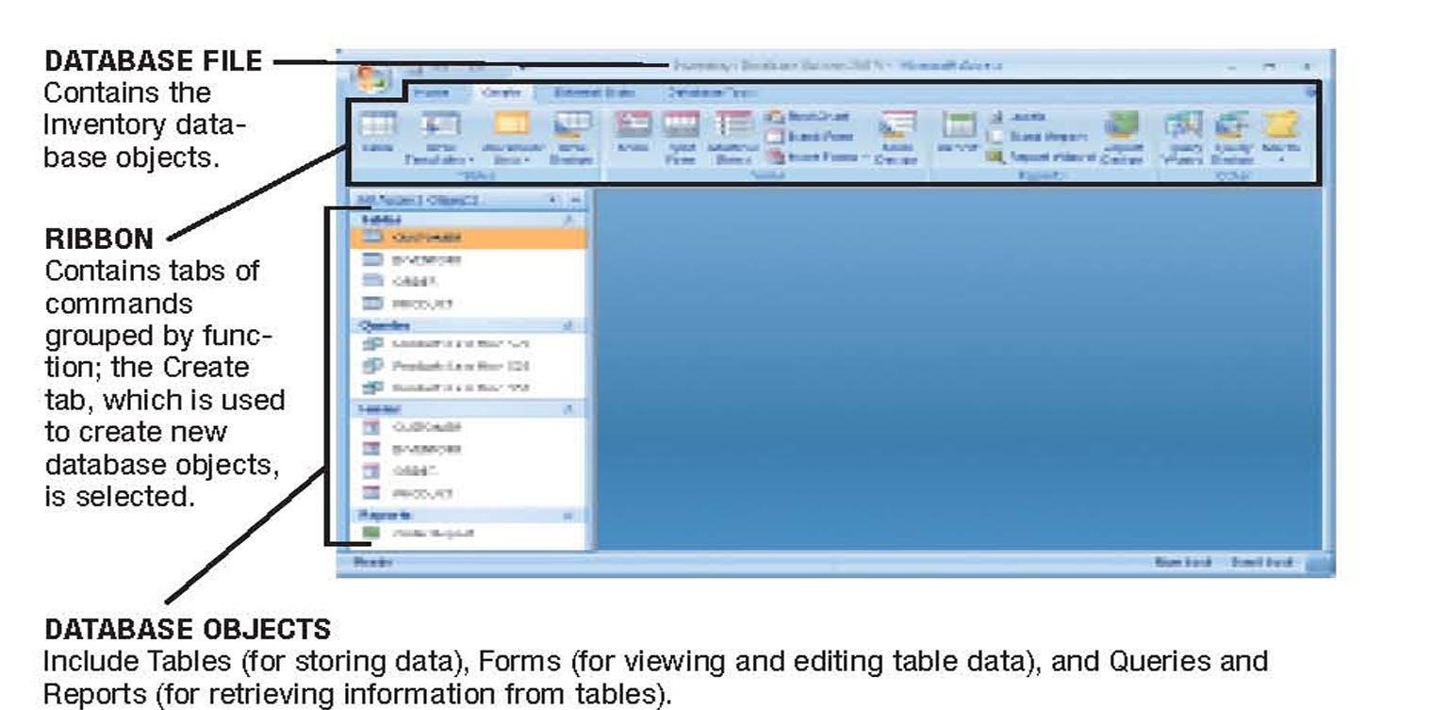
Microsoft Access
Databases contain a variety of objects (such as tables, queries, forms, reports)

Slide 30
Creating a Database
Database file is created first.
Tables can then be created.
Typically, the table structure is specified first .
  Includes a list of fields and their properties, including:
    Field name (unique identifying name).
    Data type (text, number, date, object).
    Field size (maximum number of characters).
    Default value (initial content of the field).

Slide 31
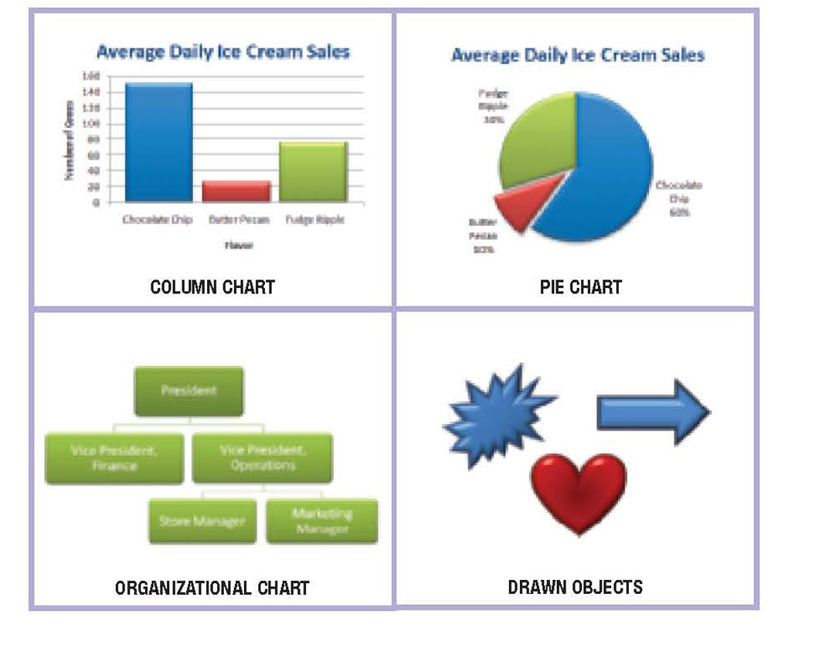
Presentation Graphic Concepts
Presentation graphic: An image designed to visually enhance a presentation.
  Can be used in electronic slide shows, as well as in printed reports.
Slide: A one-page presentation graphic that can be displayed in a group with others to form an electronic slide show.

Slide 32
Presentation Graphic Concepts
Electroniother on a computer monitor or other c slide show: A group of electronic slides that are displayed one after the display device.
Presentation graphics software: Used to create presentation graphics.
Most common presentation graphics programs are:
  Microsoft PowerPoint.
  Corel Presentations.
  Apple Keynote.

Slide 33
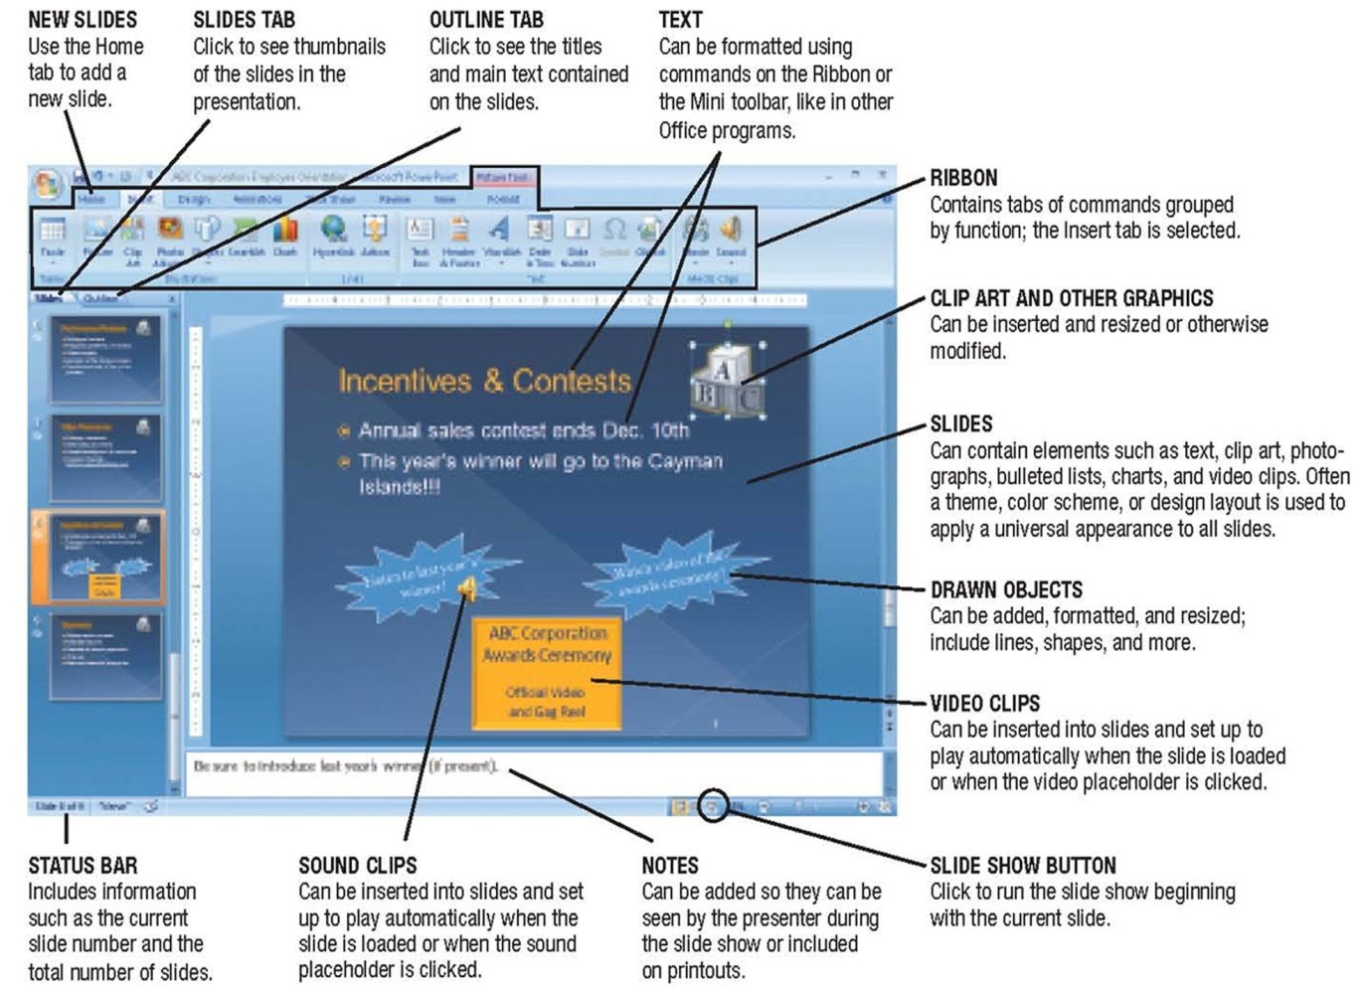
Microsoft PowerPoint

Slide 34
Creating a Presentation
Templates and preformatted slide layouts can often be used.
New slides can be added as needed.
Slides can contain a variety of elements:
  Text.
  Images.
  Charts.
  Audio clips.
  Video clips.
Slides can be formatted as needed.
Multimedia and animation can be added to slides:
  Animation.
  Transitions.

Slide 35
Graphics and Multimedia Concepts
Graphics: Graphical images, such as digital photographs, clip art, scanned drawings, and original images created using a software program.
Multimedia: Typically refers to any application that contains more than one type of media.
  Often used to refer to audio or video content.
Large variety of graphics and multimedia software, such as to:
  Create or modify graphics.
  Edit digital audio or video.
  Play multimedia files.
  Burn CDs and DVDs.

Slide 36
Graphics Software
Graphics software: Used to create or modify images.
  Painting programs: Typically used to create bit-mapped images (Microsoft Paint)
  Drawing programs: Typically create images using mathematical formulas (Adobe Illustrator, CorelDRAW ).
  Image editing or photo editing programs: Designed for touching up or modifying images:
    Correcting brightness/contrast.
    Cropping/eliminating red eye.
    Optimize file size for the Web.
    Adobe Photoshop, Apple iPhoto, etc.

Slide 37
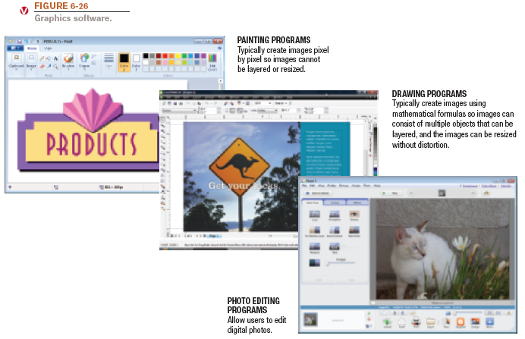
Graphics Software

Slide 38
Audio Editing Software
Audio editing software: Used to create and edit audio files (narrations, podcasts, etc.)
  Capture sound from a microphone.
  Capture sound from a CD using ripping software.
  Edit and apply special effects.
  Windows Sound Recorder, Apple Garage Band, etc.

Slide 39
Video Editing and DVD Authoring Software
Video editing software: Used to modify existing videos.
  Prepare video clips for presentations or Web sites
DVD authoring software: Used to create DVD content.
  Importing videos, creating menus, burning onto a DVD.
DVD burning software: Used to record data on recordable or rewritable DVDs.
  Roxio Creator, Apple iMovie/iDVD, etc.

Slide 40
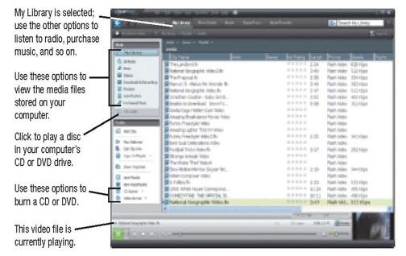
Media Players
Media players: Programs designed to play audio and video files.
  Music CDs, downloaded music, online audio.
  Downloaded and online video.
  RealPlayer, Apple QuickTime, Windows Media
  Player, etc.

Slide 41
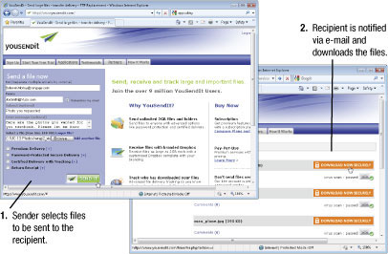
Other Types of Application Software
CAD and other types of design software.
Accounting and personal finance software.
Project management, collaboration, and remote access software.

Slide 42
Review
Software Ownership Rights: Commercial software – Shareware – Freeware - Public domain software - Open source software.
Installed vs. Web-Based Software.
Software Suites.
Common Software Commands.
Editing a Document - Formatting a Document.
Word – Excel – Database – PowerPoint .
Graphics Software.
Audio Editing Software.
Media Players.

Slide 43
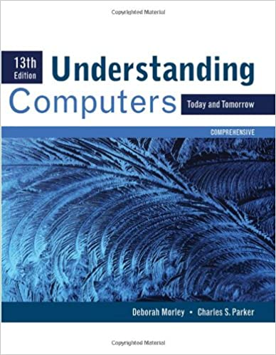
Reference

