Slide 1


Project Business
Analysis
Prepared by Eng. Ahmed Hussein, MBA, PfMP©, PMP©, CMP APMG
PMG 461
Bachelor of Project Management
Lecture 3

Slide 2



Eliciting Requirements from Stakeholders
Lecture 3
PMG 461
Project Business Analysis
Prepared by
Eng. Ahmed Hussein, MBA, PfMP©, PMP©, CMP APMG
www.midocean.ae

Slide 3

Lecture
What we will cover
03
Who are stakeholders, and the role of the business Analyst in Stakeholders Management
Analyzing Stakeholders needs, expectations, and level of interest/influence
Developing Stakeholders Engagement Approach
www.midocean.ae

Slide 4

Who are stakeholders, and the role of the business Analyst in Stakeholders Management
Lecture
03
www.midocean.ae

Slide 5
What is Stakeholder Management?
Stakeholders Management (Engagement) is one of the key knowledge areas within Project Management.
Stakeholder management( engagement) is forming and maintain relationships with stakeholders and influencing them in order to achieve an objective.”
Stakeholder management (engagement) requires two-way communication and incorporation of feedback to:
  Build and sustain appropriate levels of commitment to the objective.
  Identify and mitigate resistance.
www.midocean.ae

Slide 6
Role of the Business Analyst in Stakeholder Management
The Project Manager has the ultimate responsibility for stakeholder management in the project.
The Business Analyst plays a critical role in stakeholder managers as she/he are the ones who spend most of the time with stakeholders.
The Business Analyst contributes to:
  Identifying Stakeholders and their needs
  Analyzing Stakeholders
  Recommending engagement approaches
  Executing some activities in the engagement approach
  Monitoring Stakeholders Engagement throughout the project
www.midocean.ae

Slide 7
Stakeholder Management Process
Develop Stakeholder Management Strategies
Review/Revise Stakeholder’s Management Strategies
Identify Stakeholders
Analyze Stakeholders
Identify Key Stakeholders
Define needs, requirements, concerns and issues, level of commitment, interests, power/influence, resistance
Decide Techniques to involve the stakeholders in requirements, design implementation, and acceptance
Implement the strategies and monitor results, and if needed, adjust your strategies
www.midocean.ae

Slide 8
When is Stakeholders Management done?
Stakeholder Management starts as soon as the objective is agreed and continues until the objective has been achieved.
A stakeholder engagement approach is developed during planning and should include:
Identification, Analysis & how to Monitoring, what we will do to support the project and deal with any issues
Key Messages to stakeholders around business rationale and benefits
Roles and Responsibilities
www.midocean.ae

Slide 9
Key Artifacts in Stakeholder Management
Stakeholder Register
Identification, Analysis and Map
Stakeholder Management Plan
Communication Plan
Stakeholder Engagement Plan
www.midocean.ae

Slide 10
Why is Stakeholders Management Important?
Stakeholders are crucial to achieving your objective(s).
Neglect them and they will actively work against you.
Manage them well and they will actively promote you and your objective(s).
Anonymous
www.midocean.ae

Slide 11
Poorly Managed Stakeholders can have a Negative Impact on the project
Find faults
Be overly controlling
Reassign resources
Start a competing project
Spread negative rumors
Delay approvals
Provide little support
Terminate the project
www.midocean.ae

Slide 12
Who is a Stakeholder?
Lecture
02
A Stakeholder is anyone who has an interest in, or may be affected by, the issue under consideration’.
Or anyone affected by the project or who may be in a position to influence it.
A Stakeholder can be a person, group, or an organization
www.midocean.ae

Slide 13
Stakeholders Classification
Lecture
Customers
Partners
Suppliers
Regulators
Employees
Project Manager
Project Team
Owners
Competitors
Managers
Stakeholders will have a variety of understandings, expectations and levels of commitment
www.midocean.ae

Slide 14
What do Stakeholders provide?
Requirements
Solutions
Risk Identification
Champion the change
Review and accept outputs and deliverables
www.midocean.ae

Slide 15
Identifying Stakeholders
Lecture
02
Start by Asking:
Who are the stakeholders?
What does each stakeholder expect from the objective/project?
What do we expect from each stakeholder for the project?
What are their interests and position for the project?
Who can support us? Who will resist the project?
www.midocean.ae

Slide 16

Tools to Identify Stakeholders
Lecture
02
Brainstorming
Review Charters/Documents
Review Organization Structure
Sponsor and other experts
Similar Past projects
www.midocean.ae

Slide 17
Stakeholder Register
“A document including the identification, assessment, and classification of stakeholders.”
Contains:
  Identification Information: name, organizational position, location, role in project, contact information, …etc.
  Assessment information: major requirements, main expectations, potential influence in project or phase with most interest; and
  Stakeholder classification: Internal/External, supporter/neutral/resistor, etc.
www.midocean.ae

Slide 18
Stakeholder Register
# | Stakeholder Name | Title (or Role) | Contact details | Category (Internal/ External) | Expectations | Requirements | Level of Influence | Level of Interest
1
2
3
4
5
6
7
www.midocean.ae

Slide 19
Lecture
Analyzing Stakeholders
03
www.midocean.ae

Slide 20
Understanding your Stakeholders
Lecture
02
Needs, Requirements, Expectations
Interest? Positive or Negative?
What level of Power or influence do they have on my objective/project?
Motivation?
What do they want?
Who can they influence?
Who influences them?
How to win them?
How will you manage/engage them throughout the project?
www.midocean.ae

Slide 21
Analyzing Stakeholders
Lecture
02
Determine roles, needs, expectations, interests, knowledge, expectations, and influence for all potential stakeholders &
Identify potential impact or support each stakeholder could generate (power-interest)
Assess how key stakeholders are likely to react or respond to various situations.
www.midocean.ae

Slide 22
Stakeholder Power(Influence) vs. Interest Map
Lecture
Those with high decision-making authority
Lacks availability or interest to be actively engaged
Usually difficult to have consistent touch points
Do whatever is needed to keep them satisfied
Ex. Regulators, government authorities,…
02
Business Owners and other executives with high decision-making authority
Easy to identify
Can terminate or support the project
Easy to engage through Setting up consistent communications
Ex. sponsors
High
Keep Satisfied
Actively Engage
Power
They aren’t (and don’t expect to be) significantly involved
They my not be even aware of your project/objective, and are not interested
Know who they are
Monitor them and be aware if they move into other quadrants
ex. Departments not involved in your objective
Monitor
Keep Informed
May be impacted by the objective but have little influence or power
May want more of your time than you can give them
Find efficient ways to communicate and keep them informed (email updates, presentations, campaigns,..)
Ex. End users
Low
High
Interest
www.midocean.ae

Slide 23
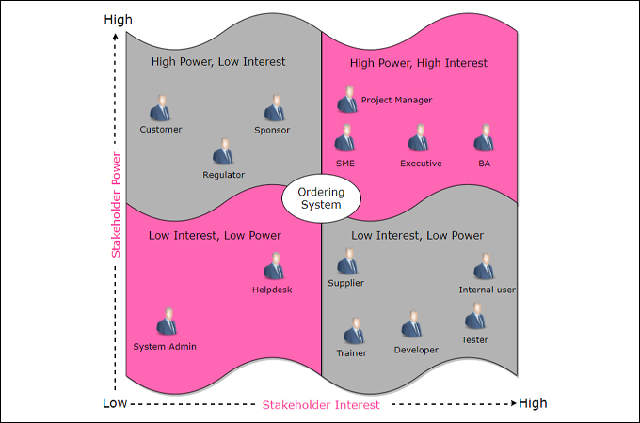
Stakeholder Analysis Example
Lecture
02
High
www.midocean.ae

Slide 24
Lecture
Developing Stakeholders Management Approach
03
www.midocean.ae

Slide 25

Planning Stakeholders Management
Lecture
02
Develop appropriate management strategies for effectively engaging stakeholders during different phases of the
objective/project.
Source: The PMI Guide to Business Analysis. Project Management Institute, Project Management Institute Inc., 2017
www.midocean.ae

Slide 26
10 principles for engaging stakeholders
Communicate
Consult, early and often
Empathize with them
Plan how you will engage them
Relationships are key
Make it simple for them to understand
Consider it part of managing risks
Be willing to compromise
Understand what are your objectives clearly
Take Responsibility for engaging stakeholders
www.midocean.ae

Slide 27
Stakeholder Engagement Strategies
Promotional
Focus on Project Objectives (Asserting our preferences)
Defensive
Assertive
What is the right Strategic Posture with the stakeholder?
Neutral (passive)
Accommodate
Focus on Stakeholders
(Accommodating theirs)
Collaborate
Consult
www.midocean.ae

Slide 28
Stakeholder Engagement Strategies
Ask and Decide:
To what extent do you want to engage with each stakeholder?
Inform
Explain
Consult
Involve
Collaborate
Partner
www.midocean.ae

Slide 29
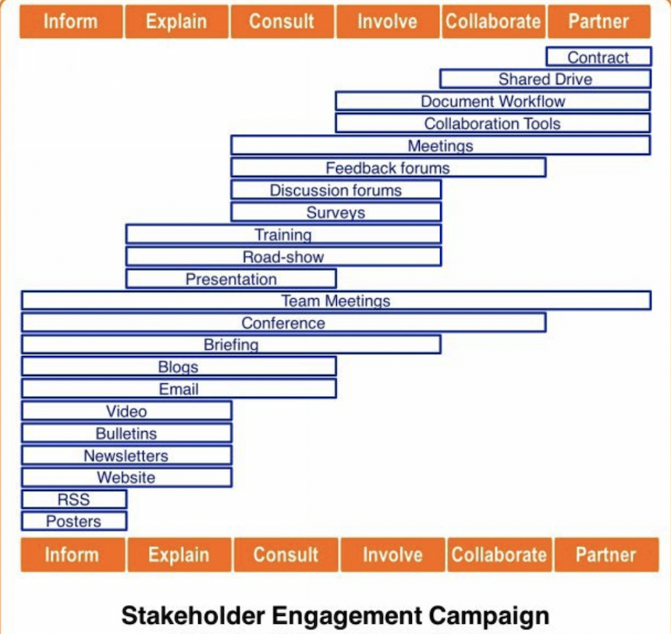
Sample Stakeholders Engagement Channels

Slide 30
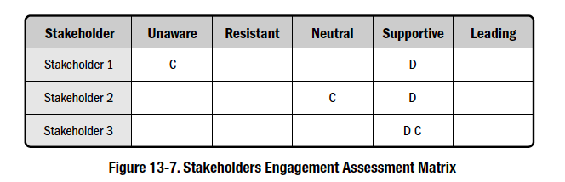
Stakeholders Engagement Matrix
Lecture
02
Defines current and desired engagement level for all stakeholders for successful project completion.
Engagement levels:
  Unaware
  Resistant
  Neutral
  Supportive
  Leading
C = Current engagement level D = Desired engagement level
Source: The PMI Guide to Business Analysis. Project Management Institute, Project Management Institute Inc., 2017
www.midocean.ae

Slide 31
Stakeholder Management Plan
“A plan that defines the strategies required to effectively engage stakeholders in decisions and execution based on the analysis of their needs, interests, and potential impact.”
Provides:
  Desired and Current engagement levels of key stakeholders
  Actions and activities to be performed to move the stakeholders from the current engagement levels to the desired engagement levels (as meetings, emails, workshops, campaigns, etc…)
www.midocean.ae
31

Slide 32
Stakeholder Management Plan
(can be part of the Stakeholder Register)
# | Stakeholder Name | Influence | Interest | Current Engagement | Desired Engagement | Actions
1 |  |  |  | Unaware | Supportive | Meeting, training, campaign, workshop,….
2 |  |  |  | Neutral | Leading
3 |  |  |  | Resisting | Neutral
4
5
6
7
www.midocean.ae

Slide 33
Monitoring Engagement
Take Corrective Action
Assess Engagement
Measure and Report Progress
Implement Engagement Plan
www.midocean.ae

Slide 34




Documents used for Assessment
Minutes of Stakeholder Meetings
Formal/Informal Review
Status Reports
Issues Log, comments, approvals, emails
Presentations/ Trainings and attendees
www.midocean.ae

Slide 35
Look for…
Level of attendance
meetings, training sessions, workshops
Level Absenteeism
for team members
Level of participation
in meetings and workshops
On time delivery
for inputs, feedback, tasks from stakeholders
www.midocean.ae

Slide 36
Stakeholder Engagement Matrix
The Engagement Matrix is a spreadsheet to track engagement and understanding of the project stakeholders.
Paints a picture of the level of commitment, involvement and understanding within the stakeholder group.
It allows us to target activities for individuals if they are not “where we want them to be”
Stakeholder | Objectives / Interests | Desired Engagement | Current Engagement | Differentaial | Action Steps | Responsible
John Doe (Client) | Provides money and resources. Wishes a professional project management. | 3 | 1 | -2
Roger Waters (Project Manager) | Provides his technical Know-How. | 2 | 4 | +2
Jane Brown (Resident) | Will boycott the project and stop if possible. | 4 | 4 | 0
www.midocean.ae

Slide 37
Lecture
Key Points
03
Business Analyst contributes to all activities in stakeholder management
A Stakeholder is anyone who has an interest in, or may be affected by, the project
We develop a stakeholders management plan to engage stakeholders during different project phases
We analyze stakeholders based on level of power/influence and level of interest on the project
Stakeholders engagement is done through communication channels that help build buy-in and commitment.
Stakeholders could be internal/external, individuals, groups, or organizations
www.midocean.ae

Slide 38
You place stakeholders in the appropriate quadrant based on their current realistic situation, and not where you want them to be.
Lecture
02
High
Keep Satisfied
Actively Engage
E
D
B
Power
Monitor
Keep Informed
C
A
Low
High
Interest
www.midocean.ae

Slide 39

For Discussion Panel and Next Lecture:
Reading, Chapter 6. from textbook
“Business Analysis” by James Cadle, Malcolm Eva, Keith Hindle, Debra Paul, 2nd edition
Think of the following scenario:
  You are working on a project to open a new branch for a bank
  Who are the stakeholders?
  What is their level of influence and interest (stakeholder matrix)
  How will you engage them
Lecture
03
For Discussion Panel and Next Lecture
www.midocean.ae

Slide 40



Thank You

